Slide 1
Slide Set 03A:
Creation and Enforcement of the Law
The Executive Branch

Slide 2
Last Time – We Spoke About:
What is the Law?
Part One: Definitions / Types of Law / Priority of Laws
What is a Right:
Part Two: Definitions / Natural Law / The Declaration
Constitutions:
Part Three: Creation/ Federal and State / Govt Structure / Rights
Case Study – Marbury v. Madison:
The Start of Judicial Review

Slide 3
Tonight – We Will Speak About:
The Executive Branch
Part One: Federal and State / Powers / Regs / Executive Orders
The Judicial Branch
Part Two: Federal and State / Powers / Cases
The Legislative Branch
Part Three: Federal and State / Powers / Statutes / Oversight
Class Exercise – How A Bill Becomes A Law
And How to Run for Public Office

Slide 4
The Executive Branch
Generally
Definition / History / Purpose and Duties
The Federal (National) Government
Generally / Powers and Duties / Regulations / Executive Orders
The State Government
Generally / Powers and Duties / Regulations / Executive Orders

Slide 5
Generally

Slide 6
The Executive Branch: Generally
Definition
Black’s Law Dictionary defines the term “Executive” as:
“The branch of government responsible for effecting and enforcing laws (and sometimes said to be the residue of all government after subtracting the judicial and legislative branches).”
Notes:
6

Slide 7
The Executive Branch: Generally
History
The executive branch of government is the oldest of governmental structures, dating back to the earliest of times, with kings, rulers, sultans, potentates, monarchs, warlords and strongmen.
Based upon the history of the deployment of executive power, the Founders granted the following constitutional powers to the executive, that were traditionally reserved for such Kings and Monarchs:
Military Power. The founders saw the importance of a strong military to protect the country and its citizens, but they named the Executive, a civilian, the "commander in chief" of the armed services (U.S. Military in the federal government, National Guard/State Militia in the state government). They were ever mindful of checking and balancing power, and they did not want a military general to seize the government.
Diplomatic Power. In the federal government, the President is given the power to make treaties with foreign nations (with the "advice and consent" of the Senate). The Constitution also provides that the President "shall receive ambassadors and other public ministers," which includes the duty of recognizing new nations, representing the United States to other countries, and performing related ceremonial duties. In the state government, the governor is empowered, upon legislative enactment, to sign interstate compacts.
Appointment Power. The Executive also enjoys the power of appointment. This includes department/agency heads (upon Senate confirmation), management confidential employees in the Executive Branch (but not civil servants), Ambassadors and other public Ministers and Consuls (the President), certain Judges, and many other public officers.
Legislative Power. The Executive is also given the power to veto legislation, which can be overridden by a 2/3 vote of the legislature.
Notes:
7

Slide 8
The Executive Branch: Generally
Purpose and Duties
Accordingly, the purpose and duties of the Executive are as follows:
Head of State: The Executive (the President in the federal government and the Governor in the state government) is the leader of the Executive Branch and is the Head of State of the Government.
Commander-in-Chief: The Executive serves as commander-in-chief of the military (U.S Military in the federal government and National Guard/State Militia in the state government).
Vice President / Lieutenant Governor: Second-in-command to the Executive is the Vice President (in the federal government) or the Lieutenant Governor (in the state government), who takes over as head of the Executive Branch in the event of the death, resignation, removal or disability of the Executive. Such second in command also has the responsibility as President of the Senate (on both the federal and the state level), serving as the presiding officer of that legislative body.
Departments/Agencies: The executive branch also includes the departments and agencies of the government, which administrate, regulate and oversee the day-to-day tasks of enforcing the laws. There are currently 15 executive departments/agencies in the federal government and 19 executive departments/agencies in the state government. Each department/agency is led by a department/agency head, appointed by the Executive, and is granted a specific budget each year to enforce laws and regulate.
Cabinet: The Cabinet is the advisory body consisting of the heads the departments/agencies. Each department/agency head holds the title of Secretary (in the federal government) or Commissioner or Superintendent (in the state government) except the leader of the Department of Justice, who is referred to as the Attorney General, or the Comptroller (in the state government) who is the head of the Department of Audit and Control.
Notes:
8

Slide 9
The Federal Government

Slide 10
The Federal Government
The Executive - Generally

Slide 11
Federal Government – The Executive
Generally
Notes:
11

Slide 12
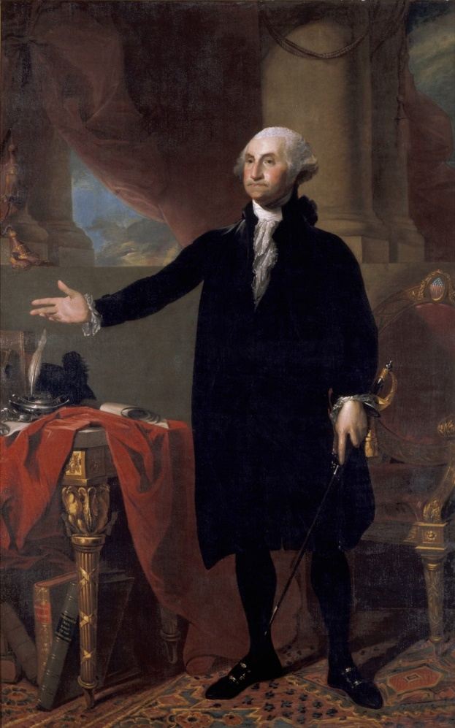
Federal Government – The Executive
Generally
The President of the United States is vested with the power of the Executive under the United States Constitution.
The founders wanted to consolidate Executive Power in a single person, for nimbleness of action and accountability.
Their model for what a President should be was General George Washington, a man of integrity, leadership, accomplishment and talent, who presided over the Constitutional Convention in Philadelphia.
Created as an independent, co-equal branch of the federal (national) government, it has its substantial powers checked by the people (through election) and by the legislative branch (the Congress) and the judicial branch (the Supreme and inferior federal courts).
Designed to represent and administrate the federal government, and the nation at large, the President is charged with providing public protection, securing civil rights, and faithfully enforcing federal laws made by the Congress and by Courts.
Given the veto to check the power of Congress and given the appointment power to check the power of the judiciary.
General George Washington
First President of the United States
Notes:
12

Slide 13
Federal Government – The Executive
Generally
The President of the United States is vested
with the power of the Executive
under the United States Constitution.
Article II of the United States Constitution expressly states the:
manner of election,
the qualifications,
the succession, and
the duties, powers, and responsibilities
of the President of the United States.
The 12th, 20th and 22nd Amendments,
and Title 3 of the United States Code
(a Federal Statute that is proscribed by the Constitution)
also set forth the Powers and Authority of the Executive.
Notes:
13

Slide 14
Federal Government – The Executive
Generally – Presidential Facts
George Washington was the first President of the United States (1789)
There have been 44 subsequent Presidents
The current President of the United States is Donald J. Trump.
Every President, except for Franklin Roosevelt, served a maximum of two terms.
Franklin Roosevelt was elected to four terms (but died in office in his fourth term)
23 presidents (over half) have served only one term.
Eight presidents have died in office: William Henry Harrison (1841); Zachary Taylor (1850); Abraham Lincoln (1865); James Garfield (1881); William McKinley (1901); Warren G. Harding (1923); Franklin D. Roosevelt (1945); John F. Kennedy (1963).
Four of the Eight Presidents who died in office (half) were assassinated: Lincoln, Garfield, McKinnley and Kennedy.
One President Resigned, Richard M. Nixon (1974).
34 Presidents were age 50 or older at the time of their inauguration
No president has ever been an only child.
39 Presidents have held prior public, elected office prior to becoming President.
Only 6 Presidents, Tyler, Grant, Taft, Hoover, Eisenhower and Trump did not hold prior elected office (and 3 were Generals).
32 Presidents had prior service in the United States Military.
Notes:
14

Slide 15
Federal Government – The Executive
Generally – Home States of the President
Where the Presidents Came From:
Of the 45 Presidents:
7 each came from Ohio, and New York,
5 came from Virginia,
4 came from Massachusetts,
3 each came from Tennessee, and Texas,
2 each came from California, Illinois, and Pennsylvania, and
1 each came from Arkansas, Georgia, Indiana, Iowa, Louisiana, Michigan, Missouri, New Hampshire and New Jersey.
32 of the 50 states have never yet produced a president.
Notes:
15

Slide 16
The Federal Government
The Executive Branch

Slide 17
Federal Government – The Executive
Legal Authority
Section One of Article II of the United States Constitution expressly provides that:
“The President of the United States
is vested with the power of the Executive”
Article II, and 12th, 20th and 22nd Amendments, of the United States Constitution expressly set forth the:
manner of election,
the qualifications,
the succession, and
the duties, powers, and responsibilities
of the President of the United States.
Title 3 of the United States Code
(a Federal Statute that is proscribed by the Constitution)
also sets forth the Powers and Authority of the Executive.
Notes:
17

Slide 18
Federal Government – The Executive
Manner of Election – The Electoral College
The United States Constitution expressly sets forth the manner of election for the office of the President of the United States.
The Term of the President is four years, commencing at noon on January 20 following election (Section 1, Article II and the 20th Amendment);
Both the President and Vice President are elected together and for the same term (12th Amendment);
The President is elected by the electoral college (Section 1, Article II and 12th Amendment);
The electoral college consists of electors from every state (Section 1, Article II and 12th Amendment);
The number of electors from each state shall be based upon the number of members of the house of representatives apportioned to each state, plus the two additional electors (one for each United States Senator), under this formula New York gets 29 electoral votes, since it has 27 members of the house of representatives plus 2 Senators. (Section 1, Article II and 12th Amendment);
The District of Columbia also gets 3 electoral votes (the same as it would get if it were a state) so the electoral college has 538 total votes (23rd Amendment);
The electoral college meets in every state (in their state capitol) on the same day in mid-December (after the election has been certified) and casts their ballots (Section 1, Article II and 12th Amendment);
The candidate for whom each elector casts their ballot is determined by state law, but is almost always for the candidate who won the state (as the electors are actually elected on a slate based upon the vote for the the candidate they represent) (Section 1, Article II and 12th Amendment);
Notes:
18

Slide 19
Federal Government – The Executive
Qualifications of the President
Article II of the United States Constitution also establishes the qualifications for the person seeking to serve as the President of the United States. Such qualifications include:
That the President must:
Be a natural born citizen of the United States,
Be at least 35 years of age,
Have been a resident of the United States for at least 14 years; and
Swear a proscribed oath of office stating:
"I do solemnly swear (or affirm) that I will faithfully execute
the Office of President of the United States,
and will to the best of my Ability,
preserve, protect and defend
the Constitution of the United States."
The 22nd Amendment limits the President to two terms in office (which is a lifetime limit, but doesn’t count all succeeded first terms).
Notes:
19

Slide 20
Federal Government – The Executive
Removal and Succession of the President
Article II and the 20th Amendment of the United States Constitution, together with Title 3 of the United States Code, provides for the removal of and the succession as the President of the United States. Such procedures provide:
That the President, Vice President and all civil Officers of the United States, shall be removed from Office on Impeachment for, and Conviction of, Treason, Bribery, or other high Crimes and Misdemeanors (Section 4, Article II);
That upon the death, resignation, removal or disability of the President, the Vice President shall assume the Office of President of the United States (Sec. 1 Article II);
That upon the death, resignation, removal or disability of the Vice President, that the President may appoint a new Vice President who shall assume the Office of Vice President of the United States (20th Amendment);
That If, by reason of death, resignation, removal from office, inability, or failure to qualify, there is neither a President nor Vice President to discharge the powers and duties of the office of President, then the following shall act as President:
(In order of succession) Speaker of the House; President pro tempore of the Senate; Secretary of State, Secretary of the Treasury, Secretary of Defense, Attorney General, Secretary of the Interior, Secretary of Agriculture, Secretary of Commerce, Secretary of Labor, Secretary of Health and Human Services, Secretary of Housing and Urban Development, Secretary of Transportation, Secretary of Energy, Secretary of Education, Secretary of Veterans Affairs, Secretary of Homeland Security. (Section 19 of Title 3 of the United States Code).
Notes:
20

Slide 21
Federal Government – The Executive
Compensation of the President
Section One of Article II of the United States Constitution, and Chapter 2 of Title 3 of the United States Code, establishes the Compensation for service as President of the United States. Such sections provide:
That the President of the United States shall receive compensation for his services in such office, as fixed by Congress (Section One, Article II);
The annual salary of the President is presently $400,000 per year (Section 102 of Title 3 of the United States Code);
The President is further awarded an annual $50,000 expense allowance (Section 102 of Title 3 of the United States Code);
The President is additionally awarded an annual $100,000 nontaxable travel account, (Section 103 of Title 3 of the United States Code);
The President is also provided with a $1,000,000 to enable the President, in his discretion, to meet unanticipated needs for the furtherance of the national interest, security, or defense, including personnel needs and needs for services (Section 108 of Title 3 of the United States Code); and
The President is also entitled also to the use of the furniture and other effects belonging to the United States and kept in the Executive Residence at the White House.
It should be noted that the current President does not accept his salary and donates such to charity.
Notes:
21

Slide 22
Federal Government – The Executive
Powers and Duties
Section Two of Article II of the United States Constitution details the powers and duties of the President of the United States. They are as follows:
That the President shall be the Commander in Chief of the Army and Navy;
That the President may require the opinion of any principal officer of the Executive Departments;
That the President shall have the power to grant reprieves and pardons for offenses against the United States (except for impeachment);
That the President, upon a 2/3 vote of the Senate – advice and consent - shall have the power to make treaties;
That the President, upon a majority vote of the Senate – advice and consent – shall have the power to appoint Ambassadors, Public Ministers and Consuls, Judges of the Supreme Court, and all other officers of the United States;
That the Congress may vest by law (statute) the President with the power to appoint, by his act alone, inferior officers, Courts of Law or Department Heads; and
That the President shall have Power to fill all Vacancies that may happen during the Recess of the Senate, by granting Commissions which shall expire at the End of their next Session (known as recess appointments).
Notes:
22

Slide 23
Federal Government – The Executive
Powers and Duties
Section Three of Article II of the United States Constitution also further details the powers and duties of the President of the United States. They are as follows:
That the President shall give to Congress information of the State of the Union;
That the President may recommend to Congress’ consideration such measures as he shall judge necessary and expedient;
That the President may, on extraordinary occasions, convene both Houses, or either of them, and in case of disagreement between them, with respect to the time of adjournment, he may adjourn them to such time as he shall think proper;
That the President shall receive Ambassadors and other public ministers;
That the President shall take care that the laws be faithfully executed;
That the President shall commission all the officers of the United States; and
That the President may refuse to sign a bill into law (veto), passed by the House of Representatives and the United States Senate, by returning it to the originating house, within 10 days (exclusive of Sundays), together with his objections to be entered in the journal (Section 7, Article I).
Notes:
23

Slide 24
Federal Government – The Executive
Constitutional Provisions
Article II of the United States Constitution creates the office of the President of the United States.
Text of Article II: Article II is broken up into four sections.
Section 1. The specific text of Section One provides:
“The executive Power shall be vested in a President of the United States of America. He shall hold his Office during the Term of four Years, and, together with the Vice President, chosen for the same Term, be elected, as follows
Each State shall appoint, in such Manner as the Legislature thereof may direct, a Number of Electors, equal to the whole Number of Senators and Representatives to which the State may be entitled in the Congress: but no Senator or Representative, or Person holding an Office of Trust or Profit under the United States, shall be appointed an Elector.
The Electors shall meet in their respective States, and vote by Ballot for two Persons, of whom one at least shall not be an Inhabitant of the same State with themselves. And they shall make a List of all the Persons voted for, and of the Number of Votes for each; which List they shall sign and certify, and transmit sealed to the Seat of the Government of the United States, directed to the President of the Senate. The President of the Senate shall, in the Presence of the Senate and House of Representatives, open all the Certificates, and the Votes shall then be counted. The Person having the greatest Number of Votes shall be the President, if such Number be a Majority of the whole Number of Electors appointed; and if there be more than one who have such Majority, and have an equal Number of Votes, then the House of Representatives shall immediately chuse by Ballot one of them for President; and if no Person have a Majority, then from the five highest on the List the said House shall in like Manner chuse the President. But in chusing the President, the Votes shall be taken by States, the Representation from each State having one Vote; A quorum for this Purpose shall consist of a Member or Members from two thirds of the States, and a Majority of all the States shall be necessary to a Choice. In every Case, after the Choice of the President, the Person having the greatest Number of Votes of the Electors shall be the Vice President. But if there should remain two or more who have equal Votes, the Senate shall chuse from them by Ballot the Vice President.
The Congress may determine the Time of chusing the Electors, and the Day on which they shall give their Votes; which Day shall be the same throughout the United States.
No Person except a natural born Citizen, or a Citizen of the United States, at the time of the Adoption of this Constitution, shall be eligible to the Office of President; neither shall any Person be eligible to that Office who shall not have attained to the Age of thirty five Years, and been fourteen Years a Resident within the United States.
In Case of the Removal of the President from Office, or of his Death, Resignation, or Inability to discharge the Powers and Duties of the said Office, the Same shall devolve on the Vice President, and the Congress may by Law provide for the Case of Removal, Death, Resignation or Inability, both of the President and Vice President, declaring what Officer shall then act as President, and such Officer shall act accordingly, until the Disability be removed, or a President shall be elected.
The President shall, at stated Times, receive for his Services, a Compensation, which shall neither be encreased nor diminished during the Period for which he shall have been elected, and he shall not receive within that Period any other Emolument from the United States, or any of them.
Before he enter on the Execution of his Office, he shall take the following Oath or Affirmation:—"I do solemnly swear (or affirm) that I will faithfully execute the Office of President of the United States, and will to the best of my Ability, preserve, protect and defend the Constitution of the United States."
Notes:
24

Slide 25
Federal Government – The Executive
Constitutional Provisions
Article II of the United States Constitution creates the office of the President of the United States.
Text of Article II: Article II is broken up into four sections.
Section 2. The specific text of Section Two provides:
“The President shall be Commander in Chief of the Army and Navy of the United States, and of the Militia of the several States, when called into the actual Service of the United States; he may require the Opinion, in writing, of the principal Officer in each of the executive Departments, upon any Subject relating to the Duties of their respective Offices, and he shall have Power to grant Reprieves and Pardons for Offences against the United States, except in Cases of Impeachment.
He shall have Power, by and with the Advice and Consent of the Senate, to make Treaties, provided two thirds of the Senators present concur; and he shall nominate, and by and with the Advice and Consent of the Senate, shall appoint Ambassadors, other public Ministers and Consuls, Judges of the supreme Court, and all other Officers of the United States, whose Appointments are not herein otherwise provided for, and which shall be established by Law: but the Congress may by Law vest the Appointment of such inferior Officers, as they think proper, in the President alone, in the Courts of Law, or in the Heads of Departments.
The President shall have Power to fill up all Vacancies that may happen during the Recess of the Senate, by granting Commissions which shall expire at the End of their next Session.”
Notes:
25

Slide 26
Federal Government – The Executive
Constitutional Provisions
Article II of the United States Constitution creates the office of the President of the United States.
Text of Article II: Article II is broken up into four sections.
Section 3. The specific text of Section Three provides:
“He shall from time to time give to the Congress information of the state of the union, and recommend to their consideration such measures as he shall judge necessary and expedient; he may, on extraordinary occasions, convene both Houses, or either of them, and in case of disagreement between them, with respect to the time of adjournment, he may adjourn them to such time as he shall think proper; he shall receive ambassadors and other public ministers; he shall take care that the laws be faithfully executed, and shall commission all the officers of the United States.”
Notes:
26

Slide 27
Federal Government – The Executive
Constitutional Provisions
Article II of the United States Constitution creates the office of the President of the United States.
Text of Article II: Article II is broken up into four sections.
Section 4. The specific text of Section Four provides:
“The President, Vice President and all civil Officers of the United States, shall be removed from Office on Impeachment for, and Conviction of, Treason, Bribery, or other high Crimes and Misdemeanors.”
Notes:
27

Slide 28
Federal Government – The Executive
Constitutional Provisions
In addition to Article II, the Twelfth, Twentieth and Twenty-Second Amendments of the United States Constitution also impact the powers and duties of the President of the United States.
Text of the Twelfth Amendment: The specific text of the Twelfth Amendment Provides:
“The Electors shall meet in their respective states and vote by ballot for President and Vice-President, one of whom, at least, shall not be an inhabitant of the same state with themselves; they shall name in their ballots the person voted for as President, and in distinct ballots the person voted for as Vice- President, and they shall make distinct lists of all persons voted for as President, and of all persons voted for as Vice-President, and of the number of votes for each, which lists they shall sign and certify, and transmit sealed to the seat of the government of the United States, directed to the President of the Senate;--The President of the Senate shall, in the presence of the Senate and House of Representatives, open all the certificates and the votes shall then be counted;--The person having the greatest Number of votes for President, shall be the President, if such number be a majority of the whole number of Electors appointed; and if no person have such majority, then from the persons having the highest numbers not exceeding three on the list of those voted for as President, the House of Representatives shall choose immediately, by ballot, the President. But in choosing the President, the votes shall be taken by states, the representation from each state having one vote; a quorum for this purpose shall consist of a member or members from two-thirds of the states, and a majority of all the states shall be necessary to a choice. And if the House of Representatives shall not choose a President whenever the right of choice shall devolve upon them, before the fourth day of March next following, then the Vice- President shall act as President, as in the case of the death or other constitutional disability of the President--The person having the greatest number of votes as Vice-President, shall be the Vice-President, if such number be a majority of the whole number of Electors appointed, and if no person have a majority, then from the two highest numbers on the list, the Senate shall choose the Vice-President; a quorum for the purpose shall consist of two-thirds of the whole number of Senators, and a majority of the whole number shall be necessary to a choice. But no person constitutionally ineligible to the office of President shall be eligible to that of Vice-President of the United States.
Notes:
28

Slide 29
Federal Government – The Executive
Constitutional Provisions
In addition to Article II, the Twelfth, Twentieth and Twenty-Second Amendments of the United States Constitution also impact the powers and duties of the President of the United States.
Text of the Twentieth Amendment: The specific text of the 20th Amendment Provides:
“Section 1. The terms of the President and Vice President shall end at noon on the 20th day of January, and the terms of Senators and Representatives at noon on the 3d day of January, of the years in which such terms would have ended if this article had not been ratified; and the terms of their successors shall then begin.
Section 2. The Congress shall assemble at least once in every year, and such meeting shall begin at noon on the 3d day of January, unless they shall by law appoint a different day.
Section 3. If, at the time fixed for the beginning of the term of the President, the President elect shall have died, the Vice President elect shall become President. If a President shall not have been chosen before the time fixed for the beginning of his term, or if the President elect shall have failed to qualify, then the Vice President elect shall act as President until a President shall have qualified; and the Congress may by law provide for the case wherein neither a President elect nor a Vice President elect shall have qualified, declaring who shall then act as President, or the manner in which one who is to act shall be selected, and such person shall act accordingly until a President or Vice President shall have qualified.
Section 4. The Congress may by law provide for the case of the death of any of the persons from whom the House of Representatives may choose a President whenever the right of choice shall have devolved upon them, and for the case of the death of any of the persons from whom the Senate may choose a Vice President whenever the right of choice shall have devolved upon them.
Section 5. Sections 1 and 2 shall take effect on the 15th day of October following the ratification of this article.
Section 6. This article shall be inoperative unless it shall have been ratified as an amendment to the Constitution by the legislatures of three-fourths of the several States within seven years from the date of its submission”.
Notes:
29

Slide 30
Federal Government – The Executive
Constitutional Provisions
In addition to Article II, the Twelfth, Twentieth and Twenty-Second Amendments of the United States Constitution also impact the powers and duties of the President of the United States.
Text of the Twenty-Second Amendment: The text of the 22nd Amendment provides:
“Section 1. No person shall be elected to the office of the President more than twice, and no person who has held the office of President, or acted as President, for more than two years of a term to which some other person was elected President shall be elected to the office of the President more than once. But this Article shall not apply to any person holding the office of President when this Article was proposed by the Congress, and shall not prevent any person who may be holding the office of President, or acting as President, during the term within which this Article becomes operative from holding the office of President or acting as President during the remainder of such term.
Section 2. This Article shall be inoperative unless it shall have been ratified as an amendment to the Constitution by the legislatures of three-fourths of the several states within seven years from the date of its submission to the states by the Congress.”
Notes:
30

Slide 31
Federal Government – The Executive
Statutory Provisions
In addition to Article II, and the Twelfth, Twentieth and Twenty-Second Amendments of the United States Constitution, Title 3 of the United States Code also outlines the role of the President of the United States, as authorized under the Constitution.
Title 3 of the United States Code: Chapters 1 to 5 of this Federal Statute provide:
Chapter 1: Sections 1-21 Regarding the Electoral College, the Election of the President and Vice President, and the Line of Succession and filling of Vacancies;
Chapter 2. Sections 101-115 Regarding the Office and Compensation of the President;
Chapter 3. Repealed
Chapter 4. Sections 301-303 Regarding the Delegation of Powers of the President;
Chapter 5. Section 401 to 471 Regarding Extension of certain rights and protections to Presidential Offices.
Notes:
31

Slide 32
The Federal Government
The Executive – Departments/Agencies

Slide 33
Federal Government – The Executive
Departments/Agencies and Regulation
Most of the work of the Executive Branch is performed by Departments of the Federal Government and lesser administrative agencies.
Each Department is headed by a Secretary, appointed by the President, and confirmed by the Senate, except the Department of Justice (which is headed by the Attorney General).
There are currently 15 Departments in the federal government.
According to the Federal Register, there are also 440 lesser agencies and commissions.
It is the job of these Federal Departments and Agencies to:
Administer the Government;
Carry out the policy orders of the President,
Implement and manage law, public policy, resources and national security;
Help the President to faithfully execute the laws of the United States; and
Regulate industries or civilian practices that require oversight.
Notes:
33

Slide 34
Federal Government – The Executive
Departments/Agencies and Regulation
Employees of the Federal Executive Branch:
Most of the employees of federal Departments/Agencies are civil servants;
Civil Servants are appointed to their position by qualifications and testing.
Presidential appointees (known as exempt positions) occupy approximately slightly less than 30 percent of the workforce.
The Office of Personnel Management reports that there are presently 4,230,000 employees of the Executive Branch.
1,400,000 of those 4,230,000 employees are military personnel.
Notes:
34

Slide 35
Federal Government – The Executive
Departments/Agencies and Regulation
Today there are hundreds of federal agencies in the Executive Branch that administrate the federal government.
Prior to 1862, there were only 6 Departments of the federal government
Federal Departments and the date of their initial creation, include:
State 1789,
Treasury 1789,
Department of War 1789 (Became a military department (Army) within the Department Defense in 1947) ,
Post Office 1792 (Reorganized as quasi-independent agency in 1971),
Department of the Navy 1798 (Became a military department (Navy) within the Department Defense in 1947)),
Interior 1849,
Agriculture 1862,
Justice 1870 (although Attorney General was established in 1789),
Commerce 1903,
Labor 1913,
Defense 1947 (Merging Army (War), Navy, and Air Force)
Health and Human Services 1953,
Housing and Urban Development 1965,
Transportation 1966,
Energy 1977,
Education 1980,
Veterans Affairs 1989, and
Homeland Security 2002
Notes:
35

Slide 36
Federal Government – The Executive
Departments/Agencies and Regulation
On the federal level the first federal non departmental agency was created in 1863. It was the Office of the Comptroller of the Currency and was established as a civil war measure to regulate national banks.
In 1887, just four years after the civil service law, the ICC (Interstate Commerce Commission), would become the first modern federal agency, paving the way for the expanding power of the federal government.
The early 1900’s saw a more rapid creation of new federal agencies, as the Wilsonian principles of “professionally administered government” began to be put into practice. These agencies included:
The Great Depression and the New Deal brought the creation of dozens of new, federal agencies, with sweeping powers, including the:
1906 | 1913 | 1914
Food and Drug Administration, | Federal Reserve, and | Federal Trade Commission,
1933
Federal Aviation Administration,
Tennessee Valley Authority,
Farm Credit Administration,
Federal Deposit Insurance Corp., and
National Recovery Administration.
1934
Federal Housing Administration,
Federal Communications Commission,
National Labor Relations Board, and
Securities and Exchange Commission .
1935
Farm Security Administration, and ● the Social Security Administration.
Notes:
36

Slide 37
Federal Government – The Executive
Departments/Agencies and Regulation
After the Second World War and with the development of the Great Society programs of the 1960’s, the Federal Government began to expand at an even faster rate, creating huge agencies, with unprecedentedly large budgets and sweeping powers.
From Medicare and Medicaid, to Clean Air and Water, to Employee Safety and Non Discrimination, the federal government created of dozens of large federal agencies, to regulate, adjudicate, investigate and license all areas of American life, and take a much more active administrative role of public affairs.
Administrative Law (the process of Rule Making, Adjudication, Investigation and Enforcement) has been the means by which federal agencies take this active role. The federal agencies created after World War Two, include:
Department of Health and Human Services 1953 (67,000 employees),
Department of Housing and Urban Development 1965 (10,600 employees),
Department of Transportation 1966 (58,600 employees),
Department of Energy 1977 (109,000 employees),
Department of Education 1980 (4,400 employees),
Department of Veterans Affairs 1989 (235,000 employees),
Department of Homeland Security 2002 (208,000 employees*),
Environmental Protection Agency 1970 (17,300 employees),
Equal Employment Opportunity Commission 1965 (2,600 employees), and
Occupational Health and Safety Administration 1971 (2,300 employees).

Slide 38
Federal Government – The Executive
Departments/Agencies and Regulation
Understanding Departments and Agencies
Agencies have widely differing missions, goals and organizations. They all, however, share, some common features:
First, all are created by legislation. This legislation is known as an enabling statute.
These enabling statutes, are duly passed by the Congress and define the department or agency’s mission, organization and jurisdiction.
Second, all departments/agencies are shaped like a pyramid.
Pursuant to this structure, some person or group of persons are at the top; with his, her or their immediate staff below; and then down through the ranks of their subordinates and other employees of the department/agency.
Third, each department/agency shares a unified mission.
The mission of the department/agency is defined by the enabling statute (the legislation that creates the department/agency) and is expressed in the most immediate sense by the person or persons who head the agency.
Lastly, being a part of the Executive Branch, all departments/agencies are eventually accountable to the President of the United States, who is constitutionally the Executive of the United States.
Notes:
38

Slide 39
Federal Government – The Executive
Departments/Agencies and Regulation
What do Departments and Agencies Do?
Due to their multifunctional role, departments and agencies are charged with multiple tasks, including administration of the federal government, providing public protection, securing civil rights, and faithfully enforcing federal laws: They accomplish this by means of Five activities
Regulation:
Often referred to as “rule making”, regulation is the promulgation of rules and regulations and is a legislative like function.
Licensing:
This is where the agency issues licenses for regulated entities to perform regulated conduct and is an executive like function.
Adjudication:
Adjudication is where agencies make administrative determinations as to whether their regulations or statutes under their purview have been violated and is a judicial like function.
Investigation:
Investigation takes place when agencies use their expertise and personnel to examine whether an activity needs to be regulated, or whether a regulation or statute is being followed, and is an executive like function.
Enforcement:
Enforcement occurs when the agency directs a regulated entity to follow laws and regulations under the agency’s jurisdiction, and is an executive like function.
Notes:
39

Slide 40
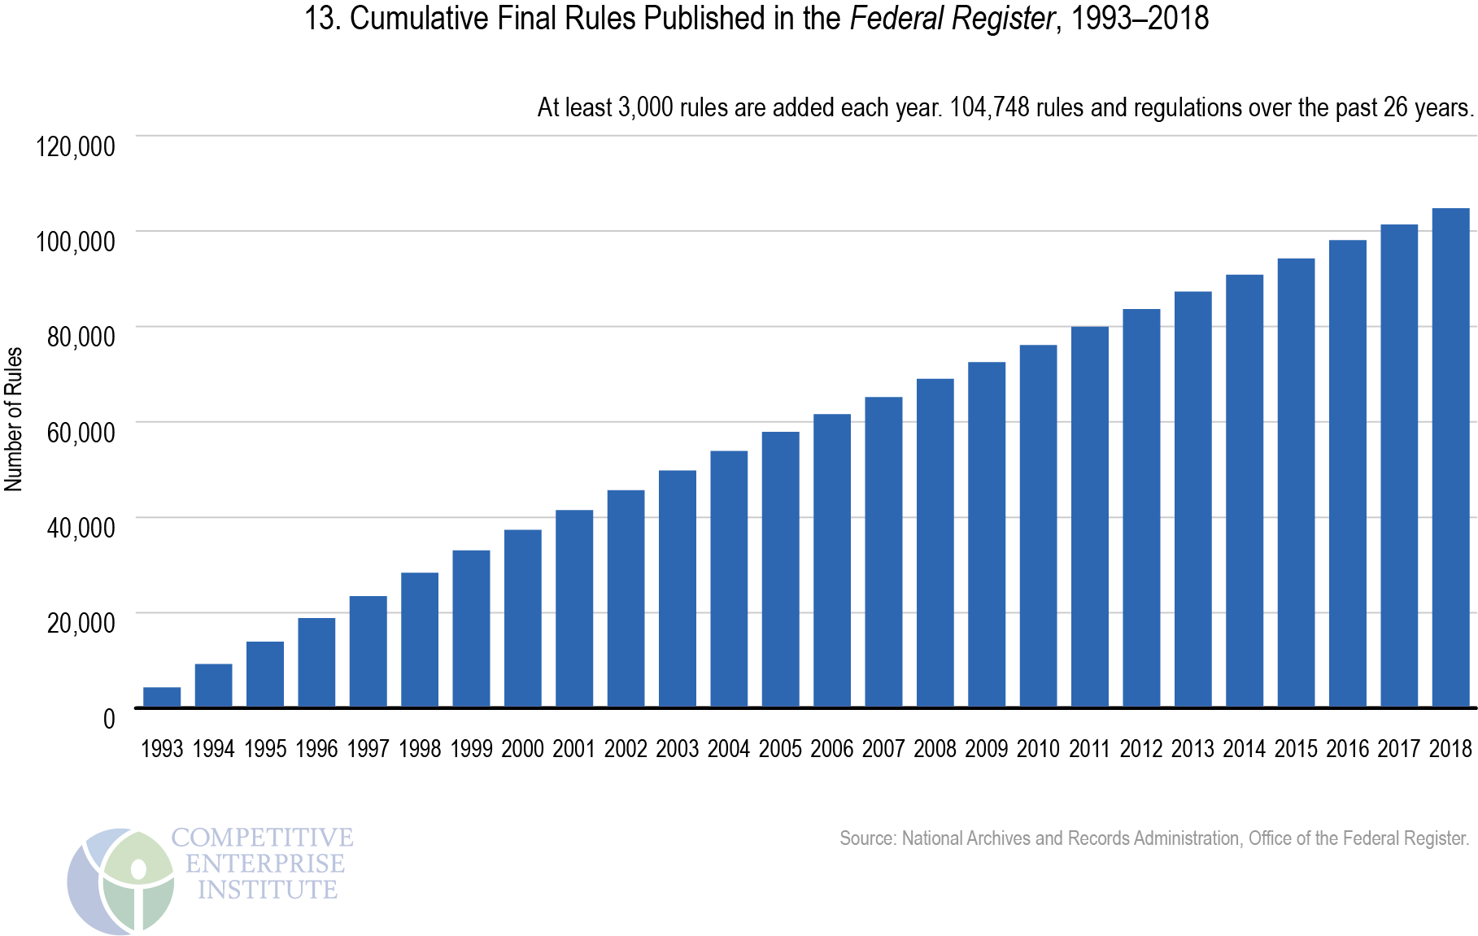
Federal Government – The Executive
Departments/Agencies and Regulation
General Note: The Price of Regulation

Slide 41
Federal Government – The Executive
Departments/Agencies and Regulation
Enforcement
One of any department/agency’s prime responsibilities is enforcement.
Enforcement is an inherent Executive action, whereby the agency seeks to have the regulated entity under its control, and to comply with statutes, rules and regulations under its purview.
It should be noted that an agency's power to compel the enforcement is contained within its enabling act.
Enforcement can be had pursuant to adjudication within the agency, by means of administrative order or fine, or it can be had by means of external action, by means of the agency bringing a court action against the regulated entity.
Both these actions, internal and external enforcement, are done pursuant to the agency’s enabling powers, and both are subject to both jurisdictional requirements and judicial review.

Slide 42
Federal Government – The Executive
Departments/Agencies and Regulation
Enforcement:
Deference and the Case of Chevron USA v. National Defense Counsel
This case involved the Clean Air Act’s requirement of “nonattainment” (dirty air) areas to establish a permit program
The Permit Program sought to regulate “new or modified major stationary sources” of air pollution.
The Environmental Protection Agency promulgated regulations which stated that a plant with multiple sources of pollution are treated as one source of pollution.
This treatment, known as the “Bubble Concept” – placed multiple sources are under one “bubble”, whereby the whole “bubble” is measured (rather than each source).
The National Resources Defense Council (NRDC) challenged EPA’s “Bubble Rule”, claiming that the rule was inconsistent with Clean Air Act.
The Federal Court of Appeals overturned the EPA regulation, and the decision was appealed.
HELD: The United States Supreme Court Reversed, and upheld the regulation as appropriate.
In making the decision, the Court stated that two questions must be asked:
–1. Has the legislative branch directly spoken to the precise question at issue concerning the matter?
–2. If statute is silent or ambiguous on the issue, was the agency’s answer based on permissible construction
of the statute?
Under the case which has come to be know as creating the rule of “Chevron Deference” the Court held that agencies are allowed to fill gaps left by Congress.
Exceptions to this deference are when agency decisions are “arbitrary, capricious or manifestly contrary” to the statute.
The Court in Chevron found that the Legislative delegation may be implicit or explicit – often implicit, and that they will usually defer to administrative interpretations.
Accordingly, the Question is not whether the “bubble concept” is inappropriate, it is if Administrator’s view is appropriate and reasonable.
According to the Court, such is the agency’s choice to make.

Slide 43
The Federal Government
The Executive – Executive Orders

Slide 44
Federal Government – The Executive
Executive Orders
Executive Orders
The President can issue executive orders, which direct executive officers, or which clarify or explain existing laws.
A Quasi-Legislative Action, it is beneath a Regulation, promulgated by a Department/Agency through Rule Making, in the priority of laws.
An Executive Order from a President only lasts during the President’s term of office, and can be overridden by a statute enacted by Congress or struck down by a Federal Court in accordance with judicial review.
They tend to be expedient, temporary actions, and must be consistent with the Constitution, all other statutes, and even other regulations.
Some Presidents issue very few, others issue many: Trump 182, Obama 310, Bush 264 and Clinton 364
Most Executive Orders are issued when there is divided government, meaning Congress and the President are from different political parties, or when there is a national emergency and Congress has not had the opportunity to act.

Slide 45
The State Government

Slide 46
The State Government
The Executive - Generally

Slide 47
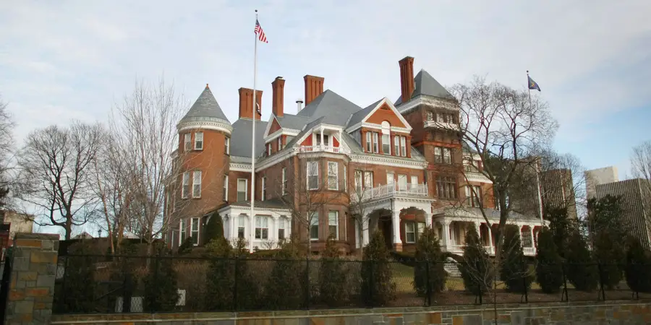
State Government – The Executive
Generally
Notes:
47

Slide 48
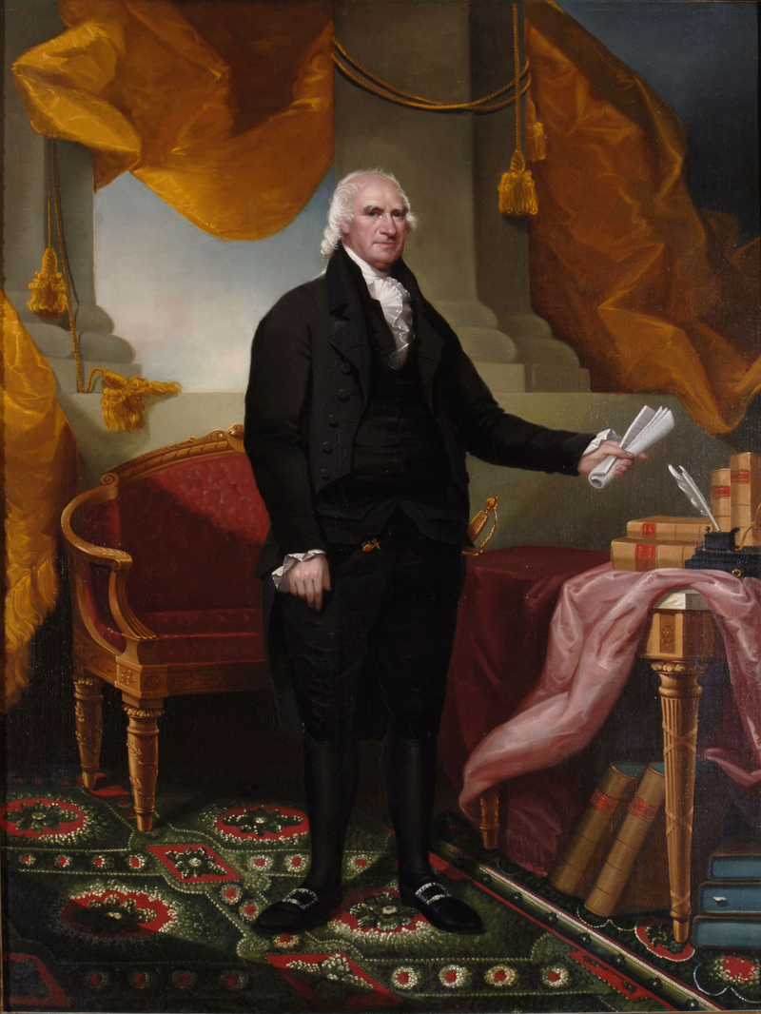
State Government – The Executive
Generally
The Governor is vested with the power of the Executive under the New York State Constitution.
The founders wanted to consolidate Executive Power in a single person, for nimbleness of action and accountability.
Created as an independent, co-equal branch of the state government, it has its substantial powers checked by the people (through a direct election) and by the legislative branch (the State Legislature) and the judicial branch (the Court of Appeals and inferior state courts).
Designed to represent and administrate the state government, and the state at large, the Governor is charged with providing public protection, securing civil rights, and faithfully enforcing state laws made by the State Legislature and by Courts.
Given the veto and the power to assemble the state budget, to check the power of State Legislature, and given the appointment power to check the power of the judiciary.
General George Clinton
First Governor of New York State
Notes:
48

Slide 49
State Government – The Executive
Generally
The Governor of the State of New York is vested
with the power of the Executive
under the New York State Constitution.
Article IV of the New York State Constitution expressly states the:
manner of election,
the qualifications,
the succession, and
the duties, powers, and responsibilities
of the Governor of New York State.
Article V (regarding Officers and Civil Departments) Article VII (regarding State Finances), Article XIII (regarding Public Officers)
and The New York State Executive Law
also set forth the Powers and Authority of the Executive.
Notes:
49

Slide 50
State Government – The Executive
Generally – Gubernatorial Facts
George Clinton was the first Governor of the State of New York (1777).
There have been 55 subsequent Governors
The current Governor of New York State is Andrew M. Cuomo
There is no term limit for the Governor of New York.
Governor Clinton was elected to seven terms (then served as Vice President)
Four Governors have become President (Martin Van Buren, Grover Cleveland, Theodore Roosevelt and Franklin Roosevelt) and Six have become Vice President.
Two New York State Governors were later elevated to become Chief Justice of the United States Supreme Court (John Jay and Charles Evans Hughes).
One Governor died in office: Dewitt Clinton.
Seven Governors have Resigned, six to ascend to another office, George Clinton, Daniel Tompkins, Martin Van Buren, Grover Cleveland, Charles Evans Hughes, Herbert Lehman and Nelson Rockefeller and one is disgrace, Eliot Spitzer.
One Governor was impeached and convicted: William Sulzer
Notes:
50

Slide 51
The State Government
The Executive Branch

Slide 52
State Government – The Executive
Legal Authority
Section One of Article IV of the New York State Constitution expressly provides that:
“The Executive Power shall be in the Governor”
Article IV of the New York State Constitution expressly states the:
manner of election,
the qualifications,
the succession, and
the duties, powers, and responsibilities
of the Governor of New York State.
Article V (regarding Officers/Civil Departments) Article VII (regarding State Finances), Article XIII (regarding Public Officers) also provides for the powers, duties and authority of the Governor of the State of New York.
Lastly, the New York State Executive Law also sets forth
the Powers and Authority of the Executive.
Notes:
52

Slide 53
State Government – The Executive
Term and Manner of Election
The New York State Constitution expressly sets forth the term and manner of election for the office of the Governor of the State of New York.
The Term of the Governor is four years (Section 1, Article IV)
Both the Governor and the Lieutenant Governor are elected together and for the same term (Section 1, Article IV);
The Governor is directly elected by the voters of the State of New York (Section 1, Article IV);
A single ballot of a voter selects both a Governor and a Lieutenant Governor (Section 1, Article IV);
The Governor and the Lieutenant Governor are elected in even number years between presidential elections (Section 1, Article IV);
Notes:
53

Slide 54
State Government – The Executive
Qualifications of the Governor
Article IV of the New York State Constitution also establishes the qualifications for the person seeking to serve as the Governor of the State of New York. Such qualifications include:
That the Governor must:
Be a citizen of the United States,
Be at least 30 years of age,
Have been a resident of New York State for at least the preceding five years; and
Swear a proscribed oath of office stating (pursuant to Sec. 1, Article XIII):
"I do solemnly swear (or affirm)
that I will support the constitution of the United States,
the constitution of the State of New York,
and that I will faithfully discharge the duties of
the Office of Governor of the State of New York,
According to the best of my ability”
There is no term limit for New York State Governor.
Notes:
54

Slide 55
State Government – The Executive
Removal and Succession of the Governor
Article IV of the New York State Constitution, provides for the removal of and the succession of the Governor of the State of New York. Such procedures provide:
That the Governor may be removed from Office on Impeachment and Conviction (Section 5, Article IV);
That the assembly shall have the power of impeachment by a vote of a majority of all the members elected thereto, and the court for the trial of impeachments shall be composed of the president of the senate, the senators, or the major part of them, and the judges of the court of appeals, or the major part of them, and on the trial of an impeachment against the governor or lieutenant-governor, neither the lieutenant governor nor the temporary president of the senate shall act as a member of the court (Section 24, Article VI);
That upon the death, resignation, removal or disability of the Governor, the Lieutenant Governor shall assume the Office of Governor (Section 5 and 6, Article IV);
That upon the death, resignation, removal or disability of the Lieutenant Governor, that the Governor may appoint a new Lieutenant Governor who shall assume the Office of Lieutenant Governor (Article IV as interpreted by the Court of Appeals);
That If, by reason of death, resignation, removal from office, inability, or failure to qualify, there is neither a Governor nor a Lieutenant Governor to discharge the powers and duties of the office of Governor, then temporary president of the senate shall act as governor until the inability shall cease or until a governor shall be elected (Section 6, Article IV).
Notes:
55

Slide 56
State Government – The Executive
Compensation of the Governor
Section Three of Article IV of the New York State Constitution establishes the Compensation for service as Governor of the State of New York. Such section provides:
That the Governor of the State of New York shall receive compensation for his services in such office, as fixed by joint resolution of the Legislature (Section Three, Article IV);
The annual salary of the Governor is presently $225,000 per year (Joint Resolution of the Legislature 2019); and
The Governor is also entitled also to a suitable and furnished executive residence (Section Three, Article IV);
Notes:
56

Slide 57
State Government – The Executive
Powers and Duties
Article IV of the New York State Constitution details the powers and duties of the Governor of the State of New York. They are as follows:
That the Governor shall be the Commander in Chief of the Military and Naval Forces of the State (Section 3, Article IV);
That the Governor shall have the power to grant reprieves, commutations and pardons after convictions, for all offenses except treason and cases of impeachment (Section 4, Article IV);
That the heads of all departments and the members of all boards and commissions, (except the department of law headed by the attorney general, the department of audit and control headed by the state comptroller and the commissioner of education appointed by the state board of regents) excepting temporary commissions for special purposes, shall be appointed by the governor by and with the advice and consent of the senate and may be removed by the governor, in a manner to be prescribed by law (Section 4, Article V);
That the Governor may refuse to sign a bill into law (veto), passed by the Assembly and the State Senate, by returning it to the originating house, within 10 days (exclusive of Sundays), together with his objections to be entered in the journal (Section 7, Article IV).
Notes:
57

Slide 58
State Government – The Executive
Powers and Duties
Article IV of the New York State Constitution also further details the powers and duties of the Governor of the State of New York. They are as follows:
That the Governor shall give to Legislature a message at every session the condition the State of the State (Section 3, Article IV);
That the Governor may recommend to Legislatures’ consideration such measures as he shall judge necessary and expedient (Section 3, Article IV);
That the governor shall expedite all such measures as may be resolved upon by the legislature (Section 3, Article IV); and
That the governor shall take care that the laws are faithfully executed (Section 3, Article IV);
Notes:
58

Slide 59
State Government – The Executive
Constitutional Provisions
Article IV of the New York State Constitution creates the office of the Governor.
Text of Article IV: Article IV is broken up into eight sections.
Section 1-3. The specific text of Sections One through Three provide:
“[Executive power; election and terms of governor and lieutenant-governor]
Section 1. The executive power shall be vested in the governor, who shall hold office for four years; the lieutenant-governor shall be chosen at the same time, and for the same term. The governor and lieutenant-governor shall be chosen at the general election held in the year nineteen hundred thirty-eight, and each fourth year thereafter. They shall be chosen jointly, by the casting by each voter of a single vote applicable to both offices, and the legislature by law shall provide for making such choice in such manner. The respective persons having the highest number of votes cast jointly for them for governor and lieutenant-governor respectively shall be elected.
(Amended by Constitutional Convention of 1938 and approved by vote of the people November 8, 1938; further amended by vote of the people November 3, 1953; November 6, 2001.)
[Qualifications of governor and lieutenant-governor]
2. No person shall be eligible to the office of governor or lieutenant-governor, except a citizen of the United States, of the age of not less than thirty years, and who shall have been five years next preceding the election a resident of this state.
(Amended by vote of the people November 6, 2001.)
[Powers and duties of governor; compensation]
з3. The governor shall be commander-in-chief of the military and naval forces of the state. The governor shall have power to convene the legislature, or the senate only, on extraordinary occasions. At extraordinary sessions convened pursuant to the provisions of this section no subject shall be acted upon, except such as the governor may recommend for consideration. The governor shall communicate by message to the legislature at every session the condition of the state, and recommend such matters to it as he or she shall judge expedient. The governor shall expedite all such measures as may be resolved upon by the legislature, and shall take care that the laws are faithfully executed. The governor shall receive for his or her services an annual salary to be fixed by joint resolution of the senate and assembly, and there shall be provided for his or her use a suitable and furnished executive residence.
(Formerly 4. Renumbered and amended by Constitutional Convention of 1938 and approved by vote of the people November 8, 1938; further amended by vote of the people November 3, 1953; November 5, 1963; November 6, 2001.)”
Notes:
59

Slide 60
State Government – The Executive
Constitutional Provisions
Article IV of the New York State Constitution creates the office of the Governor.
Text of Article IV: Article IV is broken up into eight sections.
Section 4-5. The specific text of Sections Four through Five provide:
“[Reprieves, commutations and pardons; powers and duties of governor relating to grants of]
4. The governor shall have the power to grant reprieves, commutations and pardons after conviction, for all offenses except treason and cases of impeachment, upon such conditions and with such restrictions and limitations, as he or she may think proper, subject to such regulations as may be provided by law relative to the manner of applying for pardons. Upon conviction for treason, the governor shall have power to suspend the execution of the sentence, until the case shall be reported to the legislature at its next meeting, when the legislature shall either pardon, or commute the sentence, direct the execution of the sentence, or grant a further reprieve. The governor shall annually communicate to the legislature each case of reprieve, commutation or pardon granted, stating the name of the convict, the crime of which the convict was convicted, the sentence and its date, and the date of the commutation, pardon or reprieve.
(Formerly 5. Renumbered by Constitutional Convention of 1938 and approved by vote of the people November 8, 1938; further amended by vote of the people November 6, 2001.)
[When lieutenant-governor to act as governor]
5. In case of the removal of the governor from office or of his or her death or resignation, the lieutenant-governor shall become governor for the remainder of the term.
In case the governor-elect shall decline to serve or shall die, the lieutenant-governor-elect shall become governor for the full term.
In case the governor is impeached, is absent from the state or is otherwise unable to discharge the powers and duties of the office of governor, the lieutenant-governor shall act as governor until the inability shall cease or until the term of the governor shall expire.
In case of the failure of the governor-elect to take the oath of office at the commencement of his or her term, the lieutenant-governor-elect shall act as governor until the governor shall take the oath.
(Formerly 6. Renumbered and amended by Constitutional Convention of 1938 and approved by vote of the people November 8, 1938; further amended by vote of the people November 8, 1949; November 5, 1963; November 6, 2001.)”
Notes:
60

Slide 61
State Government – The Executive
Constitutional Provisions
Article IV of the New York State Constitution creates the office of the Governor.
Text of Article IV: Article IV is broken up into eight sections.
Section 6. The specific text of Section Six provides:
“[Duties and compensation of lieutenant-governor; succession to the governorship]
6. The lieutenant-governor shall possess the same qualifications of eligibility for office as the governor. The lieutenant-governor shall be the president of the senate but shall have only a casting vote therein. The lieutenant- governor shall receive for his or her services an annual salary to be fixed by joint resolution of the senate and assembly.
In case of vacancy in the offices of both governor and lieutenant- governor, a governor and lieutenant-governor shall be elected for the remainder of the term at the next general election happening not less than three months after both offices shall have become vacant. No election of a lieutenant-governor shall be had in any event except at the time of electing a governor.
In case of vacancy in the offices of both governor and lieutenant- governor or if both of them shall be impeached, absent from the state or otherwise unable to discharge the powers and duties of the office of governor, the temporary president of the senate shall act as governor until the inability shall cease or until a governor shall be elected.
In case of vacancy in the office of lieutenant-governor alone, or if the lieutenant-governor shall be impeached, absent from the state or otherwise unable to discharge the duties of office, the temporary president of the senate shall perform all the duties of lieutenant- governor during such vacancy or inability.
If, when the duty of acting as governor devolves upon the temporary president of the senate, there be a vacancy in such office or the temporary president of the senate shall be absent from the state or otherwise unable to discharge the duties of governor, the speaker of the assembly shall act as governor during such vacancy or inability.
The legislature may provide for the devolution of the duty of acting as governor in any case not provided for in this article.
(Formerly 7 and 8. Renumbered and amended by Constitutional Convention of 1938 and approved by vote of the people November 8, 1938; further amended by vote of the people November 6, 1945; November 3, 1953; November 5, 1963; November 6, 2001.)
”
Notes:
61

Slide 62
State Government – The Executive
Constitutional Provisions
Article IV of the New York State Constitution creates the office of the Governor.
Text of Article IV: Article IV is broken up into eight sections.
Section 7-8. The specific text of Sections Seven through Eight provide:
“[Action by governor on legislative bills; reconsideration after veto]
7. Every bill which shall have passed the senate and assembly shall, before it becomes a law, be presented to the governor; if the governor approve, he or she shall sign it; but if not, he or she shall return it with his or her objections to the house in which it shall have originated, which shall enter the objections at large on the journal, and proceed to reconsider it. If after such reconsideration, two-thirds of the members elected to that house shall agree to pass the bill, it shall be sent together with the objections, to the other house, by which it shall likewise be reconsidered; and if approved by two-thirds of the members elected to that house, it shall become a law notwithstanding the objections of the governor. In all such cases the votes in both houses shall be determined by yeas and nays, and the names of the members voting shall be entered on the journal of each house respectively. If any bill shall not be returned by the governor within ten days (Sundays excepted) after it shall have been presented to him or her, the same shall be a law in like manner as if he or she had signed it, unless the legislature shall, by their adjournment, prevent its return, in which case it shall not become a law without the approval of the governor. No bill shall become a law after the final adjournment of the legislature, unless approved by the governor within thirty days after such adjournment. If any bill presented to the governor contain several items of appropriation of money, the governor may object to one or more of such items while approving of the other portion of the bill. In such case the governor shall append to the bill, at the time of signing it, a statement of the items to which he or she objects; and the appropriation so objected to shall not take effect. If the legislature be in session, he or she shall transmit to the house in which the bill originated a copy of such statement, and the items objected to shall be separately reconsidered. If on reconsideration one or more of such items be approved by two-thirds of the members elected to each house, the same shall be part of the law, notwithstanding the objections of the governor. All the provisions of this section, in relation to bills not approved by the governor, shall apply in cases in which he or she shall withhold approval from any item or items contained in a bill appropriating money.
(Formerly 9. Renumbered by Constitutional Convention of 1938 and approved by vote of the people November 8, 1938; further amended by vote of the people November 6, 2001.)
[Departmental rules and regulations; filing; publication]
8. No rule or regulation made by any state department, board, bureau, officer, authority or commission, except such as relates to the organization or internal management of a state department, board, bureau, authority or commission shall be effective until it is filed in the office of the department of state. The legislature shall provide for the speedy publication of such rules and regulations by appropriate laws.
(New. Adopted by Constitutional Convention of 1938 and approved by vote of the people November 8, 1938.)
Notes:
62

Slide 63
State Government – The Executive
Constitutional Provisions
Article V of the New York State Constitution establishes provisions regarding the Executive Branch and its Officers and Civil Departments.
Text of Article V: Article V is broken up into seven sections.
Section 1-2. The specific text of Sections One through Two provide:
“[Comptroller and attorney-general; payment of state moneys without audit void]
Section 1. The comptroller and attorney-general shall be chosen at the same general election as the governor and hold office for the same term, and shall possess the qualifications provided in section 2 of article IV. The legislature shall provide for filling vacancies in the office of comptroller and of attorney-general. No election of a comptroller or an attorney-general shall be had except at the time of electing a governor. The comptroller shall be required: (1) To audit all vouchers before payment and all official accounts; (2) to audit the accrual and collection of all revenues and receipts; and (3) to prescribe such methods of accounting as are necessary for the performance of the foregoing duties. The payment of any money of the state, or of any money under its control, or the refund of any money paid to the state, except upon audit by the comptroller, shall be void, and may be restrained upon the suit of any taxpayer with the consent of the supreme court in appellate division on notice to the attorney-general. In such respect the legislature shall define the powers and duties and may also assign to him or her: (1) supervision of the accounts of any political subdivision of the state; and (2) powers and duties pertaining to or connected with the assessment and taxation of real estate, including determination of ratios which the assessed valuation of taxable real property bears to the full valuation thereof, but not including any of those powers and duties reserved to officers of a county, city, town or village by virtue of sections seven and eight of article nine of this constitution. The legislature shall assign to him or her no administrative duties, excepting such as may be incidental to the performance of these functions, any other provision of this constitution to the contrary notwithstanding.
(Amended by Constitutional Convention of 1938 and approved by vote of the people November 8, 1938; further amended by vote of the people November 3, 1953; November 8, 1955; November 6, 2001.)
[Civil departments in the state government]
2. There shall be not more than twenty civil departments in the state government, including those referred to in this constitution. The legislature may by law change the names of the departments referred to in this constitution.
(Amended by Constitutional Convention of 1938 and approved by vote of the people November 8, 1938; further amended by vote of the people November 2, 1943; November 3, 1959; November 7, 1961.)”
Notes:
63

Slide 64
State Government – The Executive
Constitutional Provisions
Article V of the New York State Constitution establishes provisions regarding the Executive Branch and its Officers and Civil Departments.
Text of Article V: Article V is broken up into seven sections.
Section 3-5. The specific text of Sections Three through Five provide:
“[Assignment of functions]
3. Subject to the limitations contained in this constitution, the legislature may from time to time assign by law new powers and functions to departments, officers, boards, commissions or executive offices of the governor, and increase, modify or diminish their powers and functions. Nothing contained in this article shall prevent the legislature from creating temporary commissions for special purposes or executive offices of the governor and from reducing the number of departments as provided for in this article, by consolidation or otherwise.
(Amended by Constitutional Convention of 1938 and approved by vote of the people November 8, 1938; further amended by vote of the people November 7, 1961.)
[Department heads]
4. The head of the department of audit and control shall be the comptroller and of the department of law, the attorney-general. The head of the department of education shall be The Regents of the University of the State of New York, who shall appoint and at pleasure remove a commissioner of education to be the chief administrative officer of the department. The head of the department of agriculture and markets shall be appointed in a manner to be prescribed by law. Except as otherwise provided in this constitution, the heads of all other departments and the members of all boards and commissions, excepting temporary commissions for special purposes, shall be appointed by the governor by and with the advice and consent of the senate and may be removed by the governor, in a manner to be prescribed by law.
(Amended by Constitutional Convention of 1938 and approved by vote of the people November 8, 1938; further amended by vote of the people November 7, 1961.)
[Section 5 which dealt with certain offices abolished was repealed by amendment approved by vote of the people November 6, 1962]”
Notes:
64

Slide 65
State Government – The Executive
Constitutional Provisions
Article V of the New York State Constitution establishes provisions regarding the Executive Branch and its Officers and Civil Departments.
Text of Article V: Article V is broken up into seven sections.
Section 6-7. The specific text of Sections Six through Seven provide:
“[Civil service appointments and promotions; veterans' credits]
6. Appointments and promotions in the civil service of the state and all of the civil divisions thereof, including cities and villages, shall be made according to merit and fitness to be ascertained, as far as practicable, by examination which, as far as practicable, shall be competitive; provided, however, that any member of the armed forces of the United States who served therein in time of war, and who, at the time of such member's appointment or promotion, is a citizen or an alien lawfully admitted for permanent residence in the United States and a resident of this state and is honorably discharged or released under honorable circumstances from such service, shall be entitled to receive five points additional credit in a competitive examination for original appointment and two and one-half points additional credit in an examination for promotion or, if such member was disabled in the actual performance of duty in any war, and his or her disability is certified by the United States department of veterans affairs to be in existence at the time of application for appointment or promotion, he or she shall be entitled to receive ten points additional credit in a competitive examination for original appointment and five points additional credit in an examination for promotion. Such additional credit shall be added to the final earned rating of such member after he or she has qualified in an examination and shall be granted only at the time of establishment of an eligible list. No such member shall receive the additional credit granted by this section after he or she has received one appointment, either original entrance or promotion, from an eligible list on which he or she was allowed the additional credit granted by this section.
(Formerly з6. Repealed and new section approved by vote of the people November 8, 1949; further amended by vote of the people November 3, 1964; November 3, 1987; November 4, 1997; November 6, 2001; November 4, 2008.)
[Membership in retirement systems; benefits not to be diminished nor impaired]
7. After July first, nineteen hundred forty, membership in any pension or retirement system of the state or of a civil division thereof shall be a contractual relationship, the benefits of which shall not be diminished or impaired.
(New. Adopted by Constitutional Convention of 1938 and approved by vote of the people November 8, 1938.)”
Notes:
65

Slide 66
State Government – The Executive
Statutory Provisions
In addition to Article IV and Article VI of the New York State Constitution, the New York State Executive Law also outlines the role of the Governor and the Executive Branch.
NYS Executive Law: Contains 50 Articles (99 with Lettered Titles) concerning the operations and functions of the Executive Branch in New York State. Especially important sections include:
Article 2: Sections 2-12 The Governor
Article 2-B. Sections 20-29K State and Local Natural and Man-Made Disaster Preparedness
Article 3. Sections 30-32 The Executive Department
Article 6. Sections 90 to 160xxxx Department of State
Article 8. Sections 180-183 The Division of the Budget
Articles 9-50. Sections 161 to 1003 Various State Agencies
Notes:
66

Slide 67
The State Government
The Executive – Departments/Agencies

Slide 68
State Government – The Executive
Departments/Agencies and Regulation
Most of the work of the Executive Branch is performed by Departments of the State Government and lesser administrative agencies.
Each Department is headed by a Commissioner, appointed by the Governor, and confirmed by the Senate, except the Department of Law (headed by the Attorney General) and the Department of Audit and Control (headed by the State Comptroller)
There are currently 19 Departments in the state government.
There are also 60 lesser agencies, divisions, offices, boards and commissions, and dozens of state public authorities
It is the job of these State Departments and Agencies to:
Administer the Government;
Carry out the policy orders of the Governor,
Implement and manage law, public policy, resources of the state;
Help the Governor to faithfully execute the laws of the State of New York; and
Regulate industries or civilian practices that require oversight.
Notes:
68

Slide 69
State Government – The Executive
Departments/Agencies and Regulation
Employees of the State Executive Branch:
Most of the employees of State Departments/Agencies are civil servants;
Civil Servants are appointed to their position by qualifications and testing.
Appointees of the Governor (known as exempt positions) occupy approximately slightly less than 20 percent of the workforce.
The Department of Civil Service reports that there are presently 179,700 employees of the Executive Branch in New York State.
There are a combined 623,000 state and local employees in New York State
Notes:
69

Slide 70
State Government – The Executive
Departments/Agencies and Regulation
Today there are over a hundred of state departments, agencies, divisions, offices and public authorities in the Executive Branch that administrate the government.
The Departments in New York State include:
Department of Agriculture and Markets,
Department of Audit and Control – Head: NYS Comptroller – Elected to a 4 year term
Department of Civil Service (Commission),
Department of Corrections and Community Supervision.
Department of Education – Head: Commissioner of Education is Appointed by the State Board of Regents,
Department of the Environmental Conservation,
Department of Family Assistance (Social Services),
Department of Financial Services – Head: Superintendent is Appointed by the Governor,
Department of Health,
Department of Labor,
Department of Law – Head: NYS Attorney General – Elected to a 4 year term
Department of Mental Hygiene,
Department of Motor Vehicles,
Department of Public Service (Commission),
Department of State,
Department of Taxation and Finance,
Department of Transportation, and
The Executive Department – Which is Broken up into the following entities: The Executive Chamber, The Division of the Budget, The Division of Military and Naval Affairs, The Office of General Services, The Division of State Police, The Division of Housing and Community Renewal, The Division of Criminal Justice Services, The Division of Alcoholic Beverage Control (Commission), The Division of Human Rights (Commission), The Division of Veterans’ Services, The Division of Homeland Security and Emergency Services, the Division of
Tax Appeals, and the Office of Information Technology Services.
Notes:
70

Slide 71
State Government – The Executive
Departments/Agencies and Regulation
Understanding Departments and Agencies
Agencies have widely differing missions, goals and organizations. They all, however, share, some common features:
First, all are created by legislation. This legislation is known as an enabling statute.
These enabling statutes, are duly passed by the Legislature and define the department or agency’s mission, organization and jurisdiction.
Second, all departments/agencies are shaped like a pyramid.
Pursuant to this structure, some person or group of persons are at the top; with his, her or their immediate staff below; and then down through the ranks of their subordinates and other employees of the department/agency.
Third, each department/agency shares a unified mission.
The mission of the department/agency is defined by the enabling statute (the legislation that creates the department/agency) and is expressed in the most immediate sense by the person or persons who head the agency.
Lastly, being a part of the Executive Branch, all departments/agencies are eventually accountable to the Governor, who is constitutionally the Executive of New York State.
Notes:
71

Slide 72
State Government – The Executive
Departments/Agencies and Regulation
What do Departments and Agencies Do?
Due to their multifunctional role, departments and agencies are charged with multiple tasks, including administration of the state government, providing public protection, securing civil rights, and faithfully enforcing state laws: They accomplish this by means of Five activities
Regulation:
Often referred to as “rule making”, regulation is the promulgation of rules and regulations and is a legislative like function.
Licensing:
This is where the agency issues licenses for regulated entities to perform regulated conduct and is an executive like function.
Adjudication:
Adjudication is where agencies make administrative determinations as to whether their regulations or statutes under their purview have been violated and is a judicial like function.
Investigation:
Investigation takes place when agencies use their expertise and personnel to examine whether an activity needs to be regulated, or whether a regulation or statute is being followed, and is an executive like function.
Enforcement:
Enforcement occurs when the agency directs a regulated entity to follow laws and regulations under the agency’s jurisdiction, and is an executive like function.
Notes:
72

Slide 73
State Government – The Executive
Departments/Agencies and Regulation
Regulation
One of any department/agency’s prime responsibilities is regulation.
Regulation, often known as “rule making” is where an agency promulgates a regulation that tells the persons and entities under the purview of its enabling act either what to do, how to do something, or what not to do.
Regulations, if properly promulgated, with public comment and an opportunity to be heard, have the effect of law.
Regulations are enforced by the adjudication process within the agency, by means of administrative order or fine, or by bringing a court action against the regulated entity.
Both these actions, internal and external enforcement, are done pursuant to the agency’s enabling powers, and both are subject to both jurisdictional requirements and judicial review.

Slide 74
State Government – The Executive
Departments/Agencies and Regulation
Enforcement
An additional prime responsibility of a department/agency is enforcement.
Enforcement is an inherent Executive action, whereby the agency seeks to have the regulated entity under its control, and to comply with statutes, rules and regulations under its purview.
It should be noted that an agency's power to compel the enforcement is contained within its enabling act.
Enforcement can be had pursuant to adjudication within the agency, by means of administrative order or fine, or it can be had by means of external action, by means of the agency bringing a court action against the regulated entity.
Both these actions, internal and external enforcement, are done pursuant to the agency’s enabling powers, and both are subject to both jurisdictional requirements and judicial review.

Slide 75
The State Government
The Executive – Executive Orders

Slide 76
State Government – The Executive
Executive Orders
Executive Orders
The Governor can issue executive orders, which direct executive officers, or which clarify or explain existing laws.
A Quasi-Legislative Action, it is beneath a Regulation, promulgated by a Department/Agency through Rule Making, in the priority of laws.
An Executive Order from a Governor only lasts during the Governor’s term of office, and can be overridden by a statute enacted by the Legislature or struck down by a State or Federal Court in accordance with judicial review.
They tend to be expedient, temporary actions, and must be consistent with the State Constitution, all other statutes, and even other regulations.
Most Executive Orders are issued when there is divided government, meaning the Legislature and the Governor are from different political parties, or when there is a national emergency and Legislature has not had the opportunity to act.
Some Governors issue very few, others issue many. Governor Cuomo has issued 61 Executive Orders since March on the CoVid crisis alone.

Slide 77
Local Governments
The Executive – Generally

Slide 78
Local Governments – The Executive
Generally
In New York State Local Governments include: Counties, Cities, Towns and Villages.
Counties:
There are 62 Counties in New York State.
The 5 Counties in New York City (New York, Kings – known as Brooklyn, Queens, Bronx and Staten Island) are consolidated into New York City Government.
Counties are governed under the New York State County law, and some Counties also have a Charter, which is like a Constitution.
The Executive of a County is known as the County Executive, who is elected.
Some counties however, have a County Administrator or County Manager, who is appointed by the County Board of Supervisors or County Legislature.
Cities:
There are also 62 Cities in New York State.
They range in size from 8.1 million people (New York City) to 3,071 people (Sherrill).
Cities are governed under the New York State General Cities law, and some cities also have a Charter.
The Executive of a City is known as the Mayor, who is elected.
Towns:
There are 932 Towns in New York State.
They range in size from 759,000 people (Hempstead) to 38 people (Red House).
Towns are governed under the New York State Town law.
The Executive of a Town is known as the Supervisor, who is elected.
Villages:
There are also 551 Villages in New York State.
They range in size from 53,891 people (Hempstead) to 11 people (Dering Harbor).
Villages are governed under the New York State Village law.
The Executive of a Village is known as the Mayor, who is elected.
Notes:
78

Slide 79
Thank you for Coming
For next time – Review Assignments as follows on the Webpage:
Lecture Slides
Selected Readings
Cases and Exercises
We are a hot bench.
Questions?

