Slide 1
Slide Set Eight C:
Third Party Beneficiaries / Assignments

Slide 2
Last Time: What We Spoke About:
Contract Rules and Interpretation
Statute of Frauds
Part One: Definitions / Oral and Written Contracts / Non Compliance
Parole Evidence Rule
Part Two: Definitions / Exclusion / Non Application
Rules of Construction
Part Three: Definitions / Intent / Four Corners / Terms / Conduct
Class Case – Bethlehem Steel v. Turner Construction Company
Contracts Viewed from their Four Corners

Slide 3
Tonight: We Will Speak About:
Third Parties and Assignments
Third Party Beneficiaries
Part One: Definitions/Intentional/Incidental /Modification /Termination /Limitations
Assignments and Delegations
Part Two: Definitions / Notice / Rights / Liabilities / Warranties / Duties
Class Case – Fourth Ocean Putnam Co.
v. Interstate Wrecking Company
The Rights of 3rd Party Beneficiaries in Contract

Slide 4
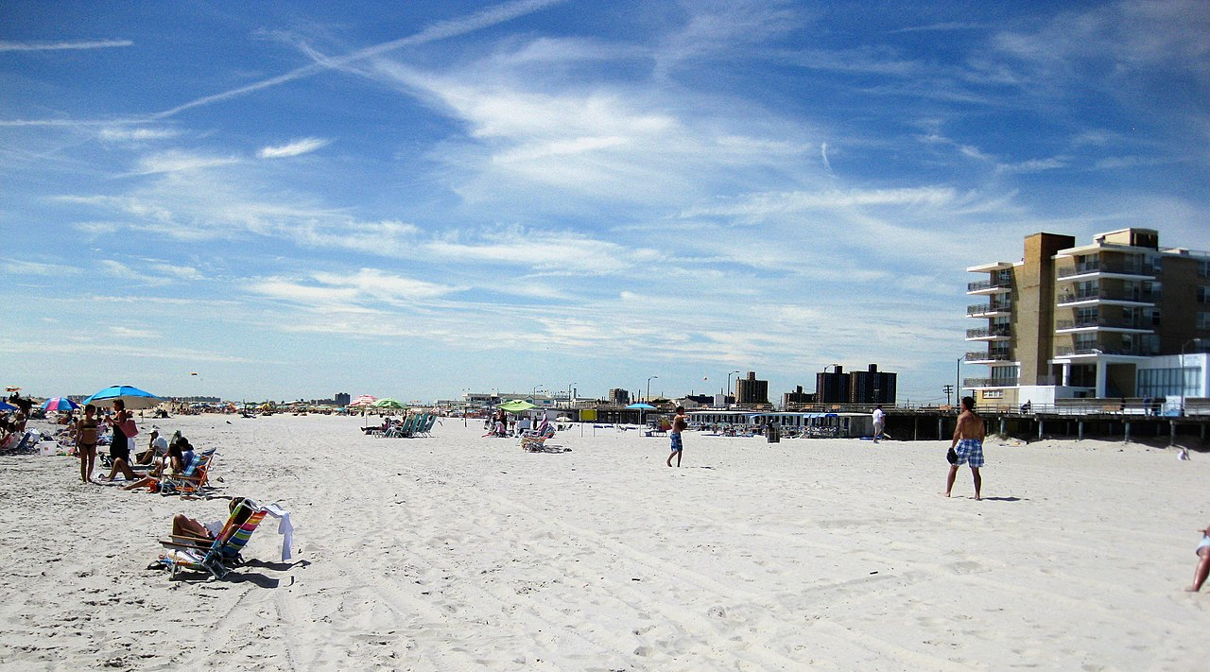
Case Study:
Fourth Ocean Putnam Company v.
Interstate Wrecking Company
Contracts Involving 3rd Party Beneficiaries
The Hotel, the Beach and the Reconstruction

Slide 5
Class 08C - Thank you for Coming
For next time – Review Assignments as follows on the Webpage:
Lecture Slides
Selected Readings
Cases and Exercises
We are a hot bench.
Questions?

