Slide 1
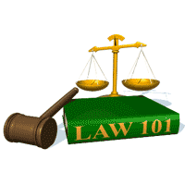
Slide Set Twelve A:
Payment Systems – Negotiable Instruments

Slide 2
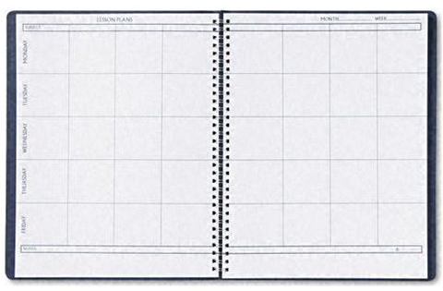
Last Time We Spoke About:
The Law of Torts
General Principles
Part One: Definitions / Torts vs. Crimes / Types of Torts
Negligence and Intentional Torts
Part Two: Definitions / Intentional Torts / Unintentional Torts – Negligence
Liability and Foreseeability
Part Three: Definitions / Liability / Foreseeability / Strict Liability / Defenses
Class Case – MacPherson v. Buick Motor Co.
The Elements of Foreseeability

Slide 3
Tonight We Will Speak About:
Payment Systems - Introduction
Negotiable Instruments – Types/Parties
Part One: Definitions / Types of Negotiable Instruments / Parties
Negotiability
Part Two: Definitions / Requirements of Negotiability / Factors
Language / Statute of Limitations Issues
Transfer/Problems/Warrantees
Part Three: Definitions / Effect of Transfer / Process of Negotiation
Forgery / Unauthorized Documents / Imposters / Lost Instruments Warrantees / Other Parties
Case Study: Manhattan Savings v. NY Natl Exchange
The Elements of Commercial Paper

Slide 4
Negotiable Instruments
General Principles
Definitions

Slide 5
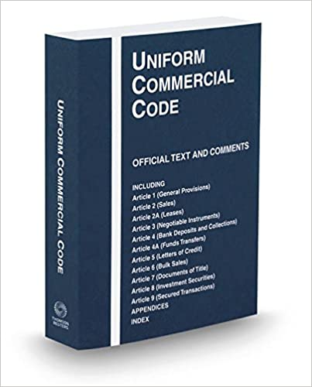
Negotiable Instruments
General Principles - Definitions
Negotiable Instruments:
Defined: Section 3-104(a)(1) and (2) of the UCC
defines a negotiable instrument as:
“an unconditional promise or order
to pay a fixed amount of money, that
Is payable to Bearer or order;
Is payable on demand or at a definite time; and
Does not state any instruction other than the payment of money”
A negotiable instrument is a record
of a signed promise or order to pay
a specified sum of money.

Slide 6
Negotiable Instruments
General Principles - Definitions
The Purpose of Negotiable Instruments
Generally: The overall purpose of negotiable instruments is for convenience and ease of the transfer of money.
They are a way to facilitate financial transactions and payment. To conduct their business, businesses make and accept certain kinds of paper called commercial paper or negotiable instruments to make or obtain payment.
A Money Substitute: Commercial paper is thereby accepted as a substitute for money, or as a means of offering credit.
Negotiable, commercial paper is therefore created or accepted for the purpose of facilitating the transfer of funds and payment in business transactions.

Slide 7
Negotiable Instruments
General Principles
Types of Negotiable Instruments

Slide 8
Negotiable Instruments
General Principles – Types of Negotiable Instruments
Types of Negotiable Instruments:
Generally: There are two categories of negotiable instruments:
Promises to Pay: These include promissory notes and certificates of deposit; and
Orders to Pay: These include drafts and checks.
Specific Negotiable Instruments:
Promissory Notes;
Certificates of Deposit;
Drafts; and
Checks.

Slide 9
Negotiable Instruments
General Principles – Types of Negotiable Instruments
Types of Negotiable Instruments – Promises to Pay:
Promissory Notes Generally: A promissory note is a written promise made and signed by the maker to pay a sum certain in money to the holder of the instrument.
Defined: A promissory note is an unconditional promise in writing made by one person to another, signed by the maker engaging to pay on demand, or at a definite time, a sum
certain in money to order or to bearer. (Parties - maker, payee).
Example of a Promissory Note:
March 31, 2021
Six months after the above date, debtor, John R. Smith hereby promises to pay to the order of Galactic Games, Inc., the sum of three thousand six hundred dollars ($3,600.00), with interest, at the rate of five and nine tenths percent (5.9%).
This note is secured by the Video Arcade game purchased with its funds.
In the event of default, all sums due hereunder may be collected, and debtor further agrees to pay all costs of such collection, including, but not limited to, attorney fees, costs of repossession, and costs of litigation.
John R. Smith
John R. Smith
Video Arcade, Inc.

Slide 10
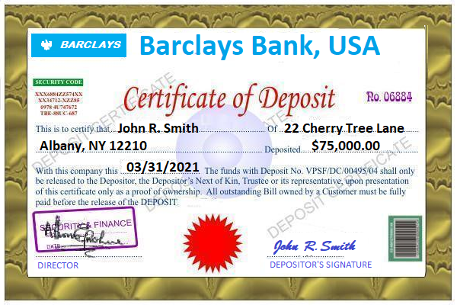
Negotiable Instruments
General Principles – Types of Negotiable Instruments
Types of Negotiable Instruments – Promises to Pay:
Certificates of Deposit Generally: A certificate of deposit is a written promise to pay issued by a bank. Through a CD, a bank acknowledges the customer’s deposit of a specific sum of money, and promises to pay the customer that amount deposited, plus interest, when the certificate is surrendered.
Defined: A Certificate of Deposit is a promise to pay instrument issued by a bank.
Example of a Certificate of Deposit:

Slide 11
Negotiable Instruments
General Principles – Types of Negotiable Instruments
Types of Negotiable Instruments – Orders to Pay:
Drafts Generally: A draft, or bill of exchange, is an order by one party to pay a sum of money to a second party. The party who gives the order is called the drawer, and the party on whom the order to pay is drawn is the drawee. The party to whom payment is to be made is the payee. The drawer may also be named as the payee, as when a seller draws a draft naming a buyer as the drawee. The draft is then used as a means to obtain payment for goods delivered to that buyer. A drawee is not bound to pay a draft simply because the drawer has placed his name on it. However, the drawee may agree to pay the draft by accepting it, which then attaches the drawee’s liability for payment.
Defined: A Draft, or Bill of Exchange, is a written, unconditional order, by one person upon another, signed by the person giving it, and ordering the person to whom it is directed, to pay upon demand, or at a definite time, an amount certain, in money, to order or to bearer. Example of a Draft:
March 31, 2021
To: ELF Games, Inc.
786 Broadway
Albany, NY 12210
One Hundred and Eighty days from the date listed above, PAY TO THE ORDER OF Galactic Games, Inc., THE SUM OF the sum of three thousand seven hundred and eight dollars ($3,708.00).
ACCEPTED BY:
____________________________ John R. Smith
DATE: John R. Smith
_______________________ Video Arcade, Inc.

Slide 12
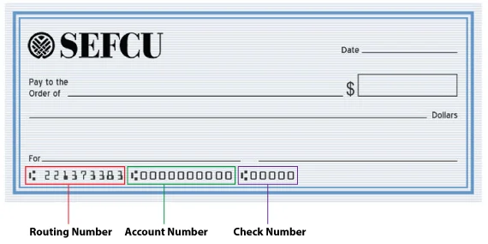
Negotiable Instruments
General Principles – Types of Negotiable Instruments
Types of Negotiable Instruments – Orders to Pay:
Checks Generally: Under U.C.C. §3-104(f), a check is defined as “a draft, other than a documentary draft, payable on demand and drawn on a bank.” A check, therefore, is an order by a depositor (the drawer) on a bank or credit union (the drawee) to pay a sum of money to the order of another party (the payee).
Types of Checks:
An Ordinary Check is drawn by the bank upon a depositor’s account.
A cashier’s check is a draft drawn by a bank on itself.
A teller’s check is a draft drawn by a bank on another bank in which it has an account.
A traveler’s check is a check that is payable on demand, provided it is countersigned by the person whose signature was placed on the check at the time the check was purchased.
Money orders are issued by both banks and nonbanks. A money order drawn by a bank is also a check. Example of an Ordinary Check

Slide 13
Negotiable Instruments
General Principles
Parties to Instruments

Slide 14
Negotiable Instruments
General Principles – Parties
Parties to Negotiable Instruments:
Generally: The Parties to a negotiable instrument are important.
They may be may be:
A natural person,
An artificial person such as a corporation, or
An unincorporated enterprise such as a government agency.
Parties: The Parties to a negotiable instrument are as follows:
For Notes: Notes have two original parties: the maker and the payee.
For Drafts and Checks: Drafts and checks have three original parties: the drawer, the drawee, and the payee.
The names given to the parties to these instruments are important, because the liability of the parties varies depending on the parties’ roles.

Slide 15
Negotiable Instruments
General Principles – Parties
Parties to Negotiable Instruments:
Parties Defined: Parties are defined as follows:
Maker: The maker is the party who writes or creates a promissory note, thereby promising to pay the amount specified in the note.
Drawer: The drawer is the party who writes or creates a draft or check.
Drawee: The drawee is the party to whom the draft is addressed and who is ordered to pay the amount of money specified in the draft. The bank is the drawee on a check, and the credit union is the drawee on a share draft. A drawee on a draft has no responsibility under the draft until it has accepted that instrument.
Payee: The payee is the person named in the instrument to receive payment.
Acceptor: When the drawee of a draft has indicated by writing or record a willingness to pay the amount specified in the draft, the drawee has accepted liability and is called the acceptor.
Secondary Obligor (Accommodation Party): When a party who is not originally named in an instrument allows their name to be added to it for the benefit of another party, in order to add strength to the collectability of the instrument, that party becomes a secondary obligor (formerly called an accommodation party) and assumes a liability role. The UCC now refers to drawer, endorsers, and accommodation parties as “secondary obligors”.

Slide 16
End of Class Twelve A
For next time – Review Assignments as follows on the Webpage:
Lecture Slides
Selected Readings
Cases and Exercises
We are a hot bench.
Questions?

