Slide 1
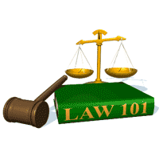
Slide Set 03C:
Creation of the Law
The Legislative Branch

Slide 2
Last Time – We Spoke About:
What is the Law?
Part One: Definitions / Types of Law / Priority of Laws
What is a Right:
Part Two: Definitions / Natural Law / The Declaration
Constitutions:
Part Three: Creation/ Federal and State / Govt Structure / Rights
Case Study – Marbury v. Madison:
The Start of Judicial Review

Slide 3
Tonight – We Will Speak About:
The Executive Branch
Part One: Federal and State / Powers / Regs / Executive Orders
The Judicial Branch
Part Two: Federal and State / Jurisdiction / Powers / The Courts
The Legislative Branch
Part Three: Federal and State / Powers / Statutes / Oversight
Class Exercise – How A Bill Becomes A Law
And How to Run for Public Office

Slide 4
The Legislative Branch
Generally
Definition / History / Purpose and Duties
The Federal (National) Government
Generally / Powers and Duties / Statutes / Oversight
The State Government
Generally / Powers and Duties / Statutes / Oversight

Slide 5
Generally

Slide 6
The Legislative Branch: Generally
Definition
Black’s Law Dictionary defines the term “Legislative Branch” as:
“The branch of government, consisting of a legislature, whose function is responsible for the enacting of laws.”
Notes:
6

Slide 7
The Legislative Branch: Generally
History
The legislative branch of government is also among the oldest of governmental structures, dating back to the Roman times, when a “senate” of the 100 most influential families was created to establish the “twelve tables” which would come to form the basis of codified Roman Law.
Later, in England, the Magna carta would establish the “king’s council” which would evolve into Parliament, an elected legislative body to enact statutes of English Law.
Based upon this history of legislative power, the Founders granted the following constitutional powers to the Congress and State Legislatures.
Enactment of Statutory Laws:
The founders saw the importance of a having independent, representative, elected, government officials, who would enact written laws (statutes) to address the needs of citizens and society.
The legislative branch (Congress on the national level) and (State Legislatures on the state level) are empowered to enact such written laws known as statutes.
Provide Oversight:
The founders also saw the importance of having three, independent, co-equal branches of government, to provide checks and balances upon the others, so as to defuse power, and retain the solvency of the government in the people.
The founders were concerned of abuses of power of all branches of the government. The oversight role of the legislative branch is a critical aspect of preventing and exposing abuses of power, not only in the executive and judicial branches, but also in the legislative branch itself, in a bicameral system.
Notes:
7

Slide 8
The Federal Government

Slide 9
The Federal Government
The Congress - Generally

Slide 10
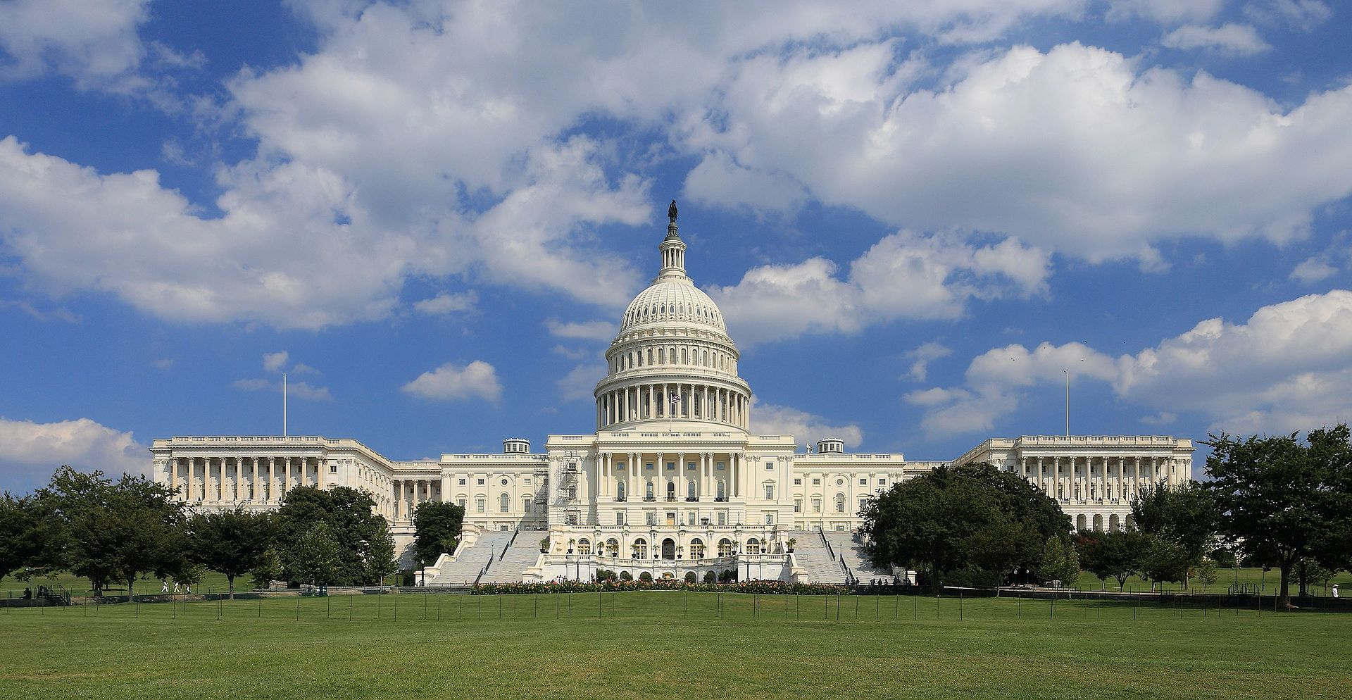
Federal Government – The Congress
Generally
Notes:
10

Slide 11
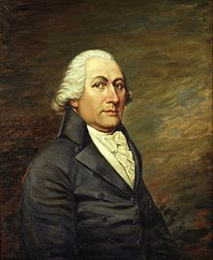
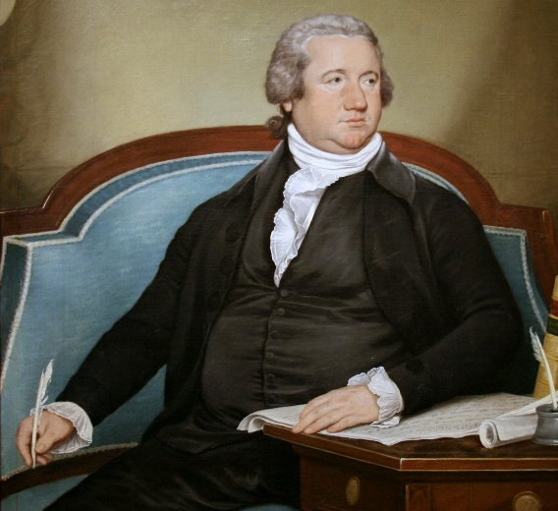
Federal Government – The Congress
Generally
The Legislative Power of United States is vested in a Congress of the United States, which consists of a Senate and House of Representatives, under the United States Constitution.
Created as an independent, co-equal, bicameral branch of the federal (national) government, it has its substantial powers checked by the Executive Branch (through the veto) and by the Judicial Branch (through judicial review).
Designed to enact written statutes involving the issues of federal concern, and provide oversight over all three branches of the federal government, the Congress is charged with enacting laws and taking measures to establish justice, insure domestic tranquility, provide for the common defense, promote the general welfare, and secure the blessings of liberty.
The Article I Congress consists of:
The House of Representatives, and
The United States Senate.
Senator John Langdon
First President Pro Tempore
of the United States Senate
Frederick Muhlenberg
First Speaker of the United States House of Representatives
Notes:
11

Slide 12
Federal Government – The Congress
Generally
The United States Constitution vests the Legislative Power of United States in the Congress, which shall have two bicameral houses, the House of Representatives and the United States Senate.
Article I of the United States Constitution expressly states the:
manner of election,
the qualifications, and
the duties, powers, and responsibilities
of the Congress of the United States.
Title 2 of the United States Code
(a Federal Statute that is proscribed by the Constitution)
also sets forth the Powers and Authority of the Congress.
Notes:
12

Slide 13
The Federal Government
The Legislative Branch

Slide 14
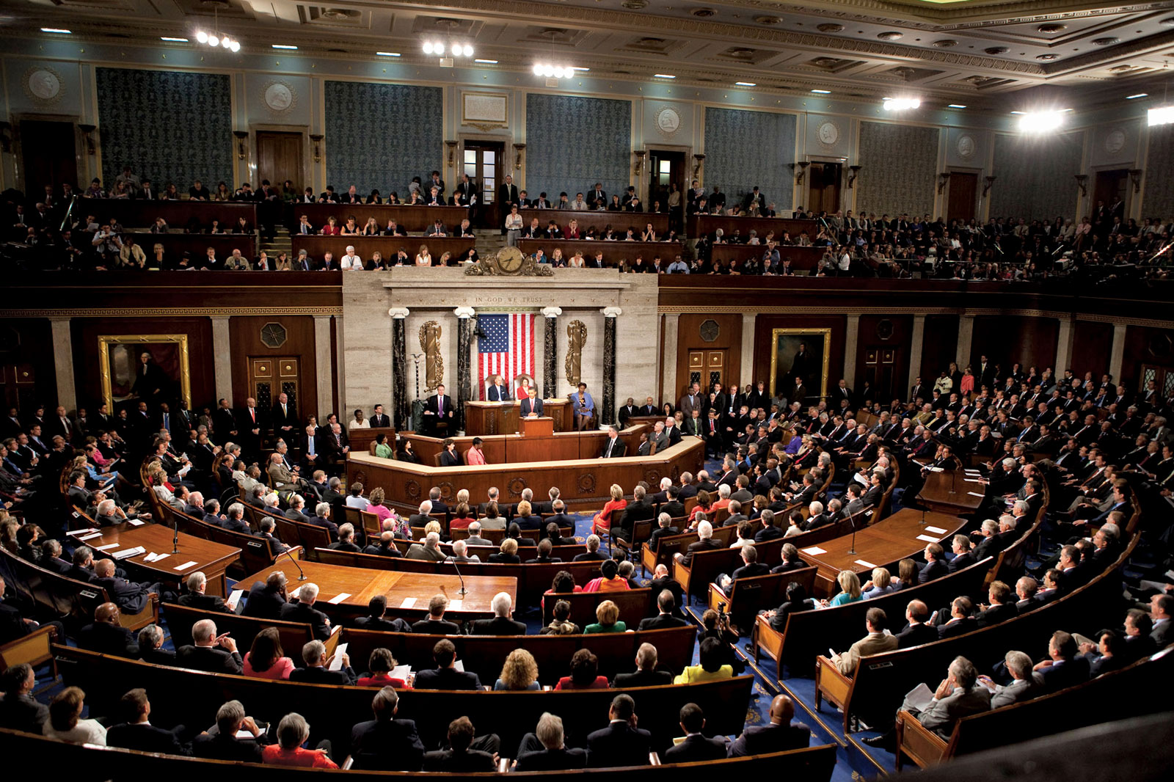
The Federal Government
The House of Representatives

Slide 15
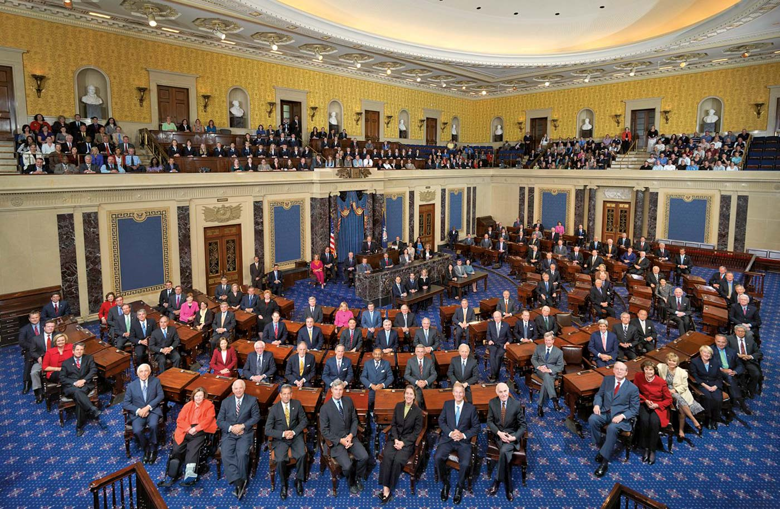
The Federal Government
The United States Senate

Slide 16
Federal Government – The Congress
Legal Authority
Section One of Article I of the United States Constitution expressly provides that:
“All legislative powers herein granted shall be vested in a
Congress of the United States, which shall consist of a
Senate and House of Representatives.”
Article I of the United States Constitution expressly states the:
manner of election,
the qualifications, and
the duties, powers, and responsibilities
of the Congress of the United States.
Title 2 of the United States Code
(a Federal Statute that is proscribed by the Constitution)
also sets forth the Powers and Authority of the Congress.
It should also be noted that each House of Congress adopts by resolution its own Rules, which have the effect of law.
Notes:
16

Slide 17
Federal Government – The Congress
Manner of Selection – House of Representatives
Section Two of Article II of the United States Constitution, and Title 2 of the United States Code, details manner of selection of Members of the United States House of Representatives.
More Specifically, Section Two of Article II of the United States Constitution specifies:
“The House of Representatives shall be composed of members chosen every
second year by the people of the several states, and the electors in each state
shall have the qualifications requisite for electors of the most numerous branch
of the state legislature. … Representatives and direct taxes shall be apportioned
among the several states which may be included within this union, according to
their respective numbers …”
Chapter 1 of Title 2 of the United States Code further describes the process for the apportionment (the number of representatives per state), the manner of elections, and the total number of total seats elected to the United States House of Representatives. In accordance with Article I and these Sections of Title 2:
The House of Representatives shall consist of a total of 435 members (Section 2a of Title 2 of the United States Code);
Each State Shall be entitled to the number of apportioned representatives, based upon the decennial census, with no state afforded less than one member; (Section 2a of Title 2 of the United States Code).
With 435 members, a bill or resolution needs 218 votes to pass the House of Representatives
Notes:
17

Slide 18
Federal Government – The Congress
Manner of Selection – United States Senate
Section Three of Article II of the United States Constitution, which provided that United States Senators would be chosen by their state Legislatures was changed in 1913 by the ratification of the 17th Amendment.
The 17th Amendment to the United States Constitution now specifically provides:
“The Senate of the United States shall be composed of two Senators from each State, elected by the people thereof, for six years; and each Senator shall have one vote. The electors in each State shall have the qualifications requisite for electors of the most numerous branch of the State legislatures.
When vacancies happen in the representation of any State in the Senate, the executive authority of such State shall issue writs of election to fill such vacancies: Provided, That the legislature of any State may empower the executive thereof to make temporary appointments until the people fill the vacancies by election as the legislature may direct.”
Accordingly, whereas the Senate, under the original construct of the Constitution represented the States, giving them a check against the Federal Government, today it represents the people of each state, modifying that originally intended constitutional balance.
As every state is awarded two Senators, and there are presently 50 states in the Union, the United States Senate consists of a total of 100 members (17th Amendment).
With 100 Senators, a bill or resolution needs 51 votes to pass the United States Senate.
Notes:
18

Slide 19
Federal Government – The Congress
Qualifications of Congress
Section 2 of Article I of the United States Constitution sets forth the specific qualifications for a person seeking to serve in the House of Representatives of the United States Congress. Such qualifications are as follows:
“No person shall be a Representative who shall not have attained to
the age of twenty five years, and been seven years a citizen of the
United States, and who shall not, when elected, be an inhabitant of
that state in which he shall be chosen.”
Section 3 of Article I of the United States Constitution sets forth the specific qualifications for a person seeking to serve in the United States Senate of the United States Congress. Such qualifications are as follows:
“No person shall be a Senator who shall not have attained to
the age of thirty years, and been nine years a citizen of the
United States and who shall not, when elected, be an inhabitant
of that state for which he shall be chosen.”
Notes:
19

Slide 20
Federal Government – The Congress
Compensation, Privileges and Immunities
Section 6 of Article I of the United States Constitution, provides for the compensation, privileges and immunities of the members of Congress of the United States. With respect to compensation, such Section 6 provides:
The Senators and Representatives shall receive a compensation for their services, to be ascertained by law, and paid out of the treasury of the United States.
Pursuant to federal statutes:
The compensation for most Senators and Members of the House of Representatives, is $174,000. The exceptions are the Speaker of the House with a salary of $223,500 and the President pro tempore of the Senate, and the Majority and Minority Leaders in both the House and Senate with a salary of $193,400. These levels have remained unchanged since 2009.
Permissible “outside earned income” for Senators and Members of the House Representatives and Senators is limited to 15% of the annual rate of basic pay for level, with such amount currently at $28,440. Certain types of outside income, however, such as honoraria, are completely prohibited.
With respect to privileges and immunities, Section 6 of Article I provides:
That members of congress shall in all cases, except treason, felony and breach of the peace, be privileged from arrest during their attendance at the session of their respective Houses, and in going to and returning from the same; and for any speech or debate in either House, they shall not be questioned in any other place.
Notes:
20

Slide 21
Federal Government – The Congress
Powers, Duties and Responsibilities
Article I of the United States Constitution provides following the powers, duties and responsibilities for the Congress of the United States. They are as follows:
House Officers: The House of Representatives shall choose their speaker and other officers. The Vice President of the United States shall be President of the Senate, but shall have no vote, unless they be equally divided. The Senate shall also choose their other officers, and also a President pro tempore, in the absence of the Vice President, or when he shall exercise the office of President of the United States;
House Rules: Each House:
Shall be the judge of the elections, returns and qualifications of its own members;
Shall provide that a majority of each shall constitute a quorum to do business; but a smaller number may adjourn from day to day, and may be authorized to compel the attendance of absent members.
May determine the rules of its proceedings, punish its members for disorderly behavior, and, with the concurrence of two thirds, expel a member.
Shall keep a journal of its proceedings, and from time to time publish the same, excepting such parts as may in their judgment require secrecy; and the yeas and nays of the members of either House on any question shall, at the desire of one fifth of those present, be entered on the journal.
Notes:
21

Slide 22
Federal Government – The Congress
Powers, Duties and Responsibilities
Article I of the United States Constitution provides following the powers, duties and responsibilities for the Congress of the United States. They are as follows:
Time of Meeting: The Congress shall assemble at least once in every year, and such meeting shall be on the first Monday in December, unless they shall by law appoint a different day.
Adjournment: Neither House, during the session of Congress, shall, without the consent of the other, adjourn for more than three days, nor to any other place than that in which the two Houses shall be sitting.
Impeachments: The House of Representatives shall have the sole power of impeachment. The Senate shall have the sole power to try all impeachments. When sitting for that purpose, they shall be on oath or affirmation. when the President of the United States is tried, the Chief Justice shall preside: And no person shall be convicted without the concurrence of two thirds of the members present. Judgment in cases of impeachment shall not extend further than to removal from office, and disqualification to hold and enjoy any office of honor, trust or profit under the United States: but the party convicted shall nevertheless be liable and subject to indictment, trial, judgment and punishment, according to law.
Notes:
22

Slide 23
Federal Government – The Congress
Powers, Duties and Responsibilities
Article I of the United States Constitution provides following the powers, duties and responsibilities for the Congress of the United States. They are as follows:
Legislative Powers and Duties:
Revenue Bills: All bills for raising revenue shall originate in the House of Representatives; but the Senate may propose or concur with amendments as on other Bills.
Signature or Veto by the President: Every bill which shall have passed the House of Representatives and the Senate, shall, before it become a law, be presented to the President of the United States;
If he approve he shall sign it, but if not he shall return it, with his objections to that House in which it shall have originated, who shall enter the objections at large on their journal, and proceed to reconsider it;
If after such reconsideration two thirds of that House shall agree to pass the bill, it shall be sent, together with the objections, to the other House, by which it shall likewise be reconsidered, and if approved by two thirds of that House, it shall become a law;
But in all such cases the votes of both Houses shall be determined by yeas and nays, and the names of the persons voting for and against the bill shall be entered on the journal of each House respectively;
If any bill shall not be returned by the President within ten days (Sundays excepted) after it shall have been presented to him, the same shall be a law, in like manner as if he had signed it, unless the Congress by their adjournment prevent its return, in which case it shall not be a law.
Every order, resolution, or vote to which the concurrence of the Senate and House of Representatives may be necessary (except on a question of adjournment) shall be presented to the President of the United States; and before the same shall take effect, shall be approved by him, or being disapproved by him, shall be repassed by two thirds of the Senate and House of Representatives, according to the rules and limitations prescribed in the case of a bill.
Notes:
23

Slide 24
Federal Government – The Congress
Powers, Duties and Responsibilities
Article I of the United States Constitution provides following the powers, duties and responsibilities for the Congress of the United States. They are as follows:
Further Powers and Duties:
Defense and Foreign Powers:
To regulate commerce with foreign nations, and among the several states, and with the Indian tribes;
To define and punish piracies and felonies committed on the high seas, and offenses against the law of nations;
To declare war, grant letters of marque and reprisal, and make rules concerning captures on land and water;
To raise and support armies, but no appropriation of money to that use shall be for a longer term than two years;
To provide and maintain a navy;
To make rules for the government and regulation of the land and naval forces;
To provide for calling forth the militia to execute the laws of the union, suppress insurrections and repel invasions; and
To provide for organizing, arming, and disciplining, the militia, and for governing such part of them as may be employed in the service of the United States, reserving to the states respectively, the appointment of the officers, and the authority of training the militia according to the discipline prescribed by Congress
Notes:
24

Slide 25
Federal Government – The Congress
Powers, Duties and Responsibilities
Article I of the United States Constitution provides following the powers, duties and responsibilities for the Congress of the United States. They are as follows:
Further Powers and Duties:
Fiscal Powers:
The Congress shall have power to lay and collect taxes, duties, imposts and excises, to pay the debts and provide for the common defense and general welfare of the United States; but all duties, imposts and excises shall be uniform throughout the United States;
To borrow money on the credit of the United States;
To coin money, regulate the value thereof, and of foreign coin, and fix the standard of weights and measures; and
To provide for the punishment of counterfeiting the securities and current coin of the United States.
Domestic Powers:
To establish a uniform rule of naturalization, and uniform laws on the subject of bankruptcies throughout the United States;
To establish post offices and post roads;
To promote the progress of science and useful arts, by securing for limited times to authors and inventors the exclusive right to their respective writings and discoveries; and
To constitute tribunals inferior to the Supreme Court.
Notes:
25

Slide 26
Federal Government – The Congress
Prohibitions on Congress
Section 9 of Article I of the United States Constitution establishes prohibition on the Congress of the United States. They are as follows:
Prohibitions:
The privilege of the writ of habeas corpus shall not be suspended, unless when in cases of rebellion or invasion the public safety may require it;
No bill of attainder or ex post facto Law shall be passed;
No capitation, or other direct, tax shall be laid, unless in proportion to the census or enumeration herein before directed to be taken;
No tax or duty shall be laid on articles exported from any state;
No preference shall be given by any regulation of commerce or revenue to the ports of one state over those of another: nor shall vessels bound to, or from, one state, be obliged to enter, clear or pay duties in another;
No money shall be drawn from the treasury, but in consequence of appropriations made by law; and a regular statement and account of receipts and expenditures of all public money shall be published from time to time; and
No title of nobility shall be granted by the United States: and no person holding any office of profit or trust under them, shall, without the consent of the Congress, accept of any present, emolument, office, or title, of any kind whatever, from any king, prince, or foreign state.
Notes:
26

Slide 27
Federal Government – The Congress
Powers, Duties and Responsibilities
Article I of the United States Constitution provides following the powers, duties and responsibilities for the Congress of the United States. They are as follows:
Further Powers and Duties:
District of Columbia:
To exercise exclusive legislation in all cases whatsoever, over such District (not exceeding ten miles square) as may, by cession of particular states, and the acceptance of Congress, become the seat of the government of the United States, and
To exercise like authority over all places purchased by the consent of the legislature of the state in which the same shall be, for the erection of forts, magazines, arsenals, dockyards, and other needful buildings.
General Powers and Duties:
To make all laws which shall be necessary and proper for carrying into execution the foregoing powers, and
All other powers vested by this Constitution in the government of the United States, or in any department of officer thereof.
Notes:
27

Slide 28
Federal Government – The Congress
Constitutional Provisions
Article I of the United States Constitution creates the Legislative Branch of the Congress.
Text of Article I: Article I is broken up into ten sections, and Sections 1 and 2 state as follows:
“Section 1.
All legislative powers herein granted shall be vested in a Congress of the United States, which shall consist of a Senate and House of Representatives.
Section 2.
The House of Representatives shall be composed of members chosen every second year by the people of the several states, and the electors in each state shall have the qualifications requisite for electors of the most numerous branch of the state legislature.
No person shall be a Representative who shall not have attained to the age of twenty five years, and been seven years a citizen of the
United States, and who shall not, when elected, be an inhabitant of that state in which he shall be chosen.
Representatives and direct taxes shall be apportioned among the several states which may be included within this union, according to their respective numbers, which shall be determined by adding to the whole number of free persons, including those bound to service for a term of years, and excluding Indians not taxed, three fifths of all other Persons. The actual Enumeration shall be made within three years after the first meeting of the Congress of the United States, and within every subsequent term of ten years, in such manner as they shall by law direct. The number of Representatives shall not exceed one for every thirty thousand, but each state shall have at least one Representative; and until such enumeration shall be made, the state of New Hampshire shall be entitled to chuse three, Massachusetts eight, Rhode Island and Providence Plantations one, Connecticut five, New York six, New Jersey four, Pennsylvania eight, Delaware one, Maryland six, Virginia ten, North Carolina five, South Carolina five, and Georgia three.
When vacancies happen in the Representation from any state, the executive authority thereof shall issue writs of election to fill such vacancies.
The House of Representatives shall choose their speaker and other officers; and shall have the sole power of impeachment.
Notes:
28

Slide 29
Federal Government – The Congress
Constitutional Provisions
Article I of the United States Constitution creates the Legislative Branch of the Congress.
Text of Article I: Article I is broken up into ten sections, and Sections 3 and 4 state as follows:
“Section 3.
The Senate of the United States shall be composed of two Senators from each state, chosen by the legislature thereof, for six years; and each Senator shall have one vote.
Immediately after they shall be assembled in consequence of the first election, they shall be divided as equally as may be into three classes. The seats of the Senators of the first class shall be vacated at the expiration of the second year, of the second class at the expiration of the fourth year, and the third class at the expiration of the sixth year, so that one third may be chosen every second year; and if vacancies happen by resignation, or otherwise, during the recess of the legislature of any state, the executive thereof may make temporary appointments until the next meeting of the legislature, which shall then fill such vacancies.
No person shall be a Senator who shall not have attained to the age of thirty years, and been nine years a citizen of the United States and who shall not, when elected, be an inhabitant of that state for which he shall be chosen.
The Vice President of the United States shall be President of the Senate, but shall have no vote, unless they be equally divided.
The Senate shall choose their other officers, and also a President pro tempore, in the absence of the Vice President, or when he shall exercise the office of President of the United States.
The Senate shall have the sole power to try all impeachments. When sitting for that purpose, they shall be on oath or affirmation. When the President of the United States is tried, the Chief Justice shall preside: And no person shall be convicted without the concurrence of two thirds of the members present.
Judgment in cases of impeachment shall not extend further than to removal from office, and disqualification to hold and enjoy any office of honor, trust or profit under the United States: but the party convicted shall nevertheless be liable and subject to indictment, trial, judgment and punishment, according to law.
Section 4.
The times, places and manner of holding elections for Senators and Representatives, shall be prescribed in each state by the legislature thereof; but the Congress may at any time by law make or alter such regulations, except as to the places of choosing Senators.
The Congress shall assemble at least once in every year, and such meeting shall be on the first Monday in December, unless they shall by law appoint a different day.”
Notes:
29

Slide 30
Federal Government – The Congress
Constitutional Provisions
Article I of the United States Constitution creates the Legislative Branch of the Congress.
Text of Article I: Article I is broken up into ten sections, and Sections 5 and 6 state as follows:
“Section 5.
Each House shall be the judge of the elections, returns and qualifications of its own members, and a majority of each shall constitute a quorum to do business; but a smaller number may adjourn from day to day, and may be authorized to compel the attendance of absent members, in such manner, and under such penalties as each House may provide.
Each House may determine the rules of its proceedings, punish its members for disorderly behavior, and, with the concurrence of two thirds, expel a member.
Each House shall keep a journal of its proceedings, and from time to time publish the same, excepting such parts as may in their judgment require secrecy; and the yeas and nays of the members of either House on any question shall, at the desire of one fifth of those present, be entered on the journal.
Neither House, during the session of Congress, shall, without the consent of the other, adjourn for more than three days, nor to any other place than that in which the two Houses shall be sitting.
Section 6.
The Senators and Representatives shall receive a compensation for their services, to be ascertained by law, and paid out of the treasury of the United States. They shall in all cases, except treason, felony and breach of the peace, be privileged from arrest during their attendance at the session of their respective Houses, and in going to and returning from the same; and for any speech or debate in either House, they shall not be questioned in any other place.
No Senator or Representative shall, during the time for which he was elected, be appointed to any civil office under the authority of the United States, which shall have been created, or the emoluments whereof shall have been increased during such time: and no person holding any office under the United States, shall be a member of either House during his continuance in office.”
Notes:
30

Slide 31
Federal Government – The Congress
Constitutional Provisions
Article I of the United States Constitution creates the Legislative Branch of the Congress.
Text of Article I: Article I is broken up into ten sections, and Section 7 states as follows:
“Section 7.
All bills for raising revenue shall originate in the House of Representatives; but the Senate may propose or concur with amendments as on other Bills.
Every bill which shall have passed the House of Representatives and the Senate, shall, before it become a law, be presented to the President of the United States; if he approve he shall sign it, but if not he shall return it, with his objections to that House in which it shall have originated, who shall enter the objections at large on their journal, and proceed to reconsider it. If after such reconsideration two thirds of that House shall agree to pass the bill, it shall be sent, together with the objections, to the other House, by which it shall likewise be reconsidered, and if approved by two thirds of that House, it shall become a law. But in all such cases the votes of both Houses shall be determined by yeas and nays, and the names of the persons voting for and against the bill shall be entered on the journal of each House respectively. If any bill shall not be returned by the President within ten days (Sundays excepted) after it shall have been presented to him, the same shall be a law, in like manner as if he had signed it, unless the Congress by their adjournment prevent its return, in which case it shall not be a law.
Every order, resolution, or vote to which the concurrence of the Senate and House of Representatives may be necessary (except on a question of adjournment) shall be presented to the President of the United States; and before the same shall take effect, shall be approved by him, or being disapproved by him, shall be repassed by two thirds of the Senate and House of Representatives, according to the rules and limitations prescribed in the case of a bill.”
Notes:
31

Slide 32
Federal Government – The Congress
Constitutional Provisions
Article I of the United States Constitution creates the Legislative Branch of the Congress.
Text of Article I: Article I is broken up into ten sections, and Section 8 states as follows:
“Section 8.
The Congress shall have power to lay and collect taxes, duties, imposts and excises, to pay the debts and provide for the common defense and general welfare of the United States; but all duties, imposts and excises shall be uniform throughout the United States;
To borrow money on the credit of the United States;
To regulate commerce with foreign nations, and among the several states, and with the Indian tribes;
To establish a uniform rule of naturalization, and uniform laws on the subject of bankruptcies throughout the United States;
To coin money, regulate the value thereof, and of foreign coin, and fix the standard of weights and measures;
To provide for the punishment of counterfeiting the securities and current coin of the United States;
To establish post offices and post roads;
To promote the progress of science and useful arts, by securing for limited times to authors and inventors the exclusive right to their respective writings and discoveries;
To constitute tribunals inferior to the Supreme Court;
To define and punish piracies and felonies committed on the high seas, and offenses against the law of nations;
To declare war, grant letters of marque and reprisal, and make rules concerning captures on land and water;
To raise and support armies, but no appropriation of money to that use shall be for a longer term than two years;
To provide and maintain a navy;
To make rules for the government and regulation of the land and naval forces;
To provide for calling forth the militia to execute the laws of the union, suppress insurrections and repel invasions;
To provide for organizing, arming, and disciplining, the militia, and for governing such part of them as may be employed in the service of the United States, reserving to the states respectively, the appointment of the officers, and the authority of training the militia according to the discipline prescribed by Congress;
To exercise exclusive legislation in all cases whatsoever, over such District (not exceeding ten miles square) as may, by cession of particular states, and the acceptance of Congress, become the seat of the government of the United States, and to exercise like authority over all places purchased by the consent of the legislature of the state in which the same shall be, for the erection of forts, magazines, arsenals, dockyards, and other needful buildings;--And
To make all laws which shall be necessary and proper for carrying into execution the foregoing powers, and all other powers vested by this Constitution in the government of the United States, or in any department or officer thereof.
Notes:
32

Slide 33
Federal Government – The Congress
Constitutional Provisions
Article I of the United States Constitution creates the Legislative Branch of the Congress.
Text of Article I: Article I is broken up into ten sections, and Sections 9 and 10 state as follows:
“Section 9.
The migration or importation of such persons as any of the states now existing shall think proper to admit, shall not be prohibited by the Congress prior to the year one thousand eight hundred and eight, but a tax or duty may be imposed on such importation, not exceeding ten dollars for each person.
The privilege of the writ of habeas corpus shall not be suspended, unless when in cases of rebellion or invasion the public safety may require it.
No bill of attainder or ex post facto Law shall be passed.
No capitation, or other direct, tax shall be laid, unless in proportion to the census or enumeration herein before directed to be taken.
No tax or duty shall be laid on articles exported from any state.
No preference shall be given by any regulation of commerce or revenue to the ports of one state over those of another: nor shall vessels bound to, or from, one state, be obliged to enter, clear or pay duties in another.
No money shall be drawn from the treasury, but in consequence of appropriations made by law; and a regular statement and account of receipts and expenditures of all public money shall be published from time to time.
No title of nobility shall be granted by the United States: and no person holding any office of profit or trust under them, shall, without the consent of the Congress, accept of any present, emolument, office, or title, of any kind whatever, from any king, prince, or foreign state.
Section 10.
No state shall enter into any treaty, alliance, or confederation; grant letters of marque and reprisal; coin money; emit bills of credit; make anything but gold and silver coin a tender in payment of debts; pass any bill of attainder, ex post facto law, or law impairing the obligation of contracts, or grant any title of nobility.
No state shall, without the consent of the Congress, lay any imposts or duties on imports or exports, except what may be absolutely necessary for executing it's inspection laws: and the net produce of all duties and imposts, laid by any state on imports or exports, shall be for the use of the treasury of the United States; and all such laws shall be subject to the revision and control of the Congress.
No state shall, without the consent of Congress, lay any duty of tonnage, keep troops, or ships of war in time of peace, enter into any agreement or compact with another state, or with a foreign power, or engage in war, unless actually invaded, or in such imminent danger as will not admit of delay.”
Notes:
33

Slide 34
Federal Government – The Judiciary
Statutory Provisions
In addition to Article I, Title 2 of the United States Code also outlines the role of the Congress of the United States, as authorized under the Constitution.
Title 2 of the United States Code: Chapters 1 to 15 of this Federal Statute include:
Chapter 1. Election of Senators and Representatives (Sections 1-9)
Chapter 2. Organization of Congress (Sections 21-30b)
Chapter 3. Compensation and Allowances of Members (Sections 31-59h)
Chapter 4. Officers and Employees of Senate and House of Representatives (Sections 60-130l)
Chapter 5. Library of Congress (Sections 131-185)
Chapter 6. Congressional and Committee Procedure; Investigations (Sections 190-199)
Chapter 7. Contested Elections [Repealed] (Sections 201-226)
Chapter 8. Federal Corrupt Practices [Repealed] (Sections 241-256)
Chapter 8A. Regulation of Lobbying [Repealed] (Sections 261- 270)
Chapter 9. Office of Legislative Counsel (Sections 271-282e)
Chapter 9A. Office of Law Revision Counsel (Sections 285-285g)
Chapter 9B. Legislative Classification Office [Repealed] (Sections 286-286g)
Chapter 9C. Office of Parliamentarian of House of Representatives (Section 287-287d)
Chapter 9D. Office of Senate Legal Counsel (Sections 288-288n)
Chapter 10. Classification of Employees of House of Representatives (Sections 291-303)
Chapter 10A. Payroll Administration in House of Representatives (Sections 331-336)
Chapter 11. Citizens' Commission on Public Service and Compensation (Sections 351-364)
Chapter 12. Contested Elections (Sections 381-396)
Chapter 13. Joint Committee on Congressional Operations [Repealed] (Sections 411-417)
Chapter 14. Federal Election Campaigns (Sections 431-457)
Chapter 15. Office of Technology Assessment (Sections 471-481)
Notes:
34

Slide 35
Federal Government – The Judiciary
Statutory Provisions
In addition to Article I, Title 2 of the United States Code also outlines the role of the Congress of the United States, as authorized under the Constitution.
Title 2 of the United States Code: Chapters 16 to 25 of this Federal Statute include:
Chapter 16. Congressional Mailing Standards (Sections 501-506)
Chapter 17. Congressional Budget Office (Sections 601-613)
Chapter 17A. Congressional Budget and Fiscal Operations (Section 621-661f)
Chapter 17B. Impoundment Control (Sections 681-688)
Chapter 18. Legislative Personnel Financial Disclosure Requirements (Sections 701-709)
Chapter 19. Congressional Award Program (Sections 801-808)
Chapter 19A. John Heinz Competitive Excellence Award (Section 831)
Chapter 20. Emergency Powers To Eliminate Budget Deficits (Sections 900-922)
Chapter 20A. Statutory Pay-as-You-Go (Sections 931-939)
Chapter 21. Civic Achievement Award - Honor of Speaker of House [Repealed] (Section 1001-1004)
Chapter 22. John C. Stennis Center for Public Service Training Development (Sections 1101-1110)
Chapter 22A. Open World Leadership Center (Section 1151)
Chapter 22B. Hunger Fellowship Program (Section 1161)
Chapter 23. Government Employee Rights (Sections 1201-1224)
Chapter 24. Congressional Accountability (Sections 1301-1438)
Chapter 25. Unfunded Mandates Reform (Sections 1501-1556)
Notes:
35

Slide 36
Federal Government – The Judiciary
Statutory Provisions
In addition to Article I, Title 2 of the United States Code also outlines the role of the Congress of the United States, as authorized under the Constitution.
Title 2 of the United States Code: Chapters 26 to 65 of this Federal Statute include:
Chapter 26. Disclosure of Lobbying Activities (Sections 1601-1614)
Chapter 27. Sound Recording Preservation by the Library of Congress (Sections 1701-1743)
Chapter 28. Architect of the Capitol (Sections 1801-1881d)
Chapter 29. Capitol Police (Sections 1901-1982)
Chapter 30. Operation and Maintenance of Capitol Complex (Sections 2001-2186)
Chapter 31. Capitol Visitor Center (Sections 2201-2273)
Chapter 41. Congressional Officers and Administration (Sections 4101-4132)
Chapter 43. Congressional Committees (Sections 4301-4338)
Chapter 45. Congressional Pay and Benefits (Sections 4501-4595)
Chapter 47. Congressional Ethics (Sections 4701-4728)
Chapter 49. Congressional Pages (Section 4901-4917)
Chapter 51. House of Representatives Leadership (Section 5101-5162)
Chapter 53. House of Representatives Members (Sections 5301-5352)
Chapter 55. House of Representatives Officers and Administration (Sections 5501-5352)
Chapter 61. Senate Leadership (Sections 6101-6160)
Chapter 63. Senate Members (Sections 6301-6320)
Chapter 65. Senate Officers and Administration (Sections 6501-6654)
Notes:
36

Slide 37
Federal Government – The Congress
Enactment of Laws - Statutes
The Congress Legislates by Enacting Statutes:
The Legislative Process:
The first step in the legislative process is the introduction of a bill to Congress.
Anyone can write it, but only members of Congress can introduce legislation.
Some important bills are traditionally introduced at the request of the President, such as the annual federal budget.
Amendments and Committee Review:
During the legislative process, however, the initial bill can undergo drastic changes.
The bill’s sponsor controls the legislation and can always amend it.
After being introduced, a bill is referred to the appropriate committee for review.
There are 17 Senate committees, with 70 subcommittees and there are 23 House committees, with 104 subcommittees.
The committees are not set in stone, but change in number and form with each new Congress as required for the efficient consideration of legislation.
Each committee oversees a specific policy area, and the subcommittees take on more specialized policy areas.
A bill is first considered in a subcommittee, where it may be accepted, amended, or rejected entirely. If the members of the subcommittee agree to move a bill forward, it is reported to the full committee, where the process is repeated again.
Throughout this stage of the process, the committees and subcommittees call hearings to investigate the merits and flaws of the bill. They invite experts, advocates, and opponents to appear before the committee and provide testimony, and can compel people to appear using subpoena power if necessary.
Notes:
37

Slide 38
Federal Government – The Congress
Enactment of Laws - Statutes
The Congress Legislates by Enacting Statutes:
Committee Report:
If the full committee votes to approve the bill, it is reported to the floor of the House or Senate.
Debate and Passage of Bills:
Upon report of the bill from committee, the majority party leadership decides when and if to place the bill on the calendar for consideration by the entire house.
If a bill is particularly pressing, it may be considered right away. Others may wait for months or never be scheduled at all.
When the bill comes up for consideration, the House has a very structured debate process.
Each member who wishes to speak only has a few minutes, and the number and kind of amendments are usually very limited.
Senate Debates and Consideration
In the Senate, debate on most bills is unlimited.
Senators may speak to issues other than the bill under consideration during their speeches, and any amendment can be introduced.
Senators can use this to filibuster bills under consideration, a procedure by which a Senator delays a vote on a bill — and by extension its passage — by refusing to stand down.
A supermajority of 60 Senators can break a filibuster by invoking cloture, or the cession of debate on the bill, and forcing a vote.
Once debate is over, the votes of a simple majority are all that is necessary to pass a bill.
In the Senate a bill needs 51 votes to pass, in the House of Representatives is needs 218 votes to pass.
Notes:
38

Slide 39
Federal Government – The Congress
Enactment of Laws - Statutes
The Congress Legislates by Enacting Statutes:
Enactment into Law (Becoming a Statute):
A bill must pass both houses of Congress before it goes to the President for consideration.
Though the Constitution requires that the two bills have the exact same wording, this rarely happens in practice.
To bring the bills into alignment, a Conference Committee is convened, consisting of members from both chambers. The members of the committee produce a conference report, intended as the final version of the bill.
Each chamber then votes again to approve the conference report.
Depending on where the bill originated, the final text is then enrolled by either the Clerk of the House or the Secretary of the Senate, and presented to the Speaker of the House and the President of the Senate for their signatures. The bill is then sent to the President.
When receiving a bill from Congress, the President has several options. If the President agrees substantially with the bill, he or she may sign it into law, and the bill is then printed in the Statutes at Large.
If the President believes the law to be bad policy, he may veto it and send it back to Congress. Congress may override the veto with a two-thirds vote of each chamber, at which point the bill becomes law and is printed.
There are two other options that the President may exercise.
If Congress is in session and the President takes no action within 10 days, the bill becomes law.
If Congress adjourns before 10 days are up and the President takes no action, then the bill dies and Congress may not vote to override.
This is called a pocket veto, and if Congress still wants to pass the legislation, they must begin the entire process from the beginning again.
Notes:
39

Slide 40
Federal Government – The Congress
Oversight of Other Branches or Issues
The Investigation Power of Congress:
One of the most important powers of Congress is oversight.
Performed Through Committee:
The oversight process is done through Congressional Committees, using the Committee’s investigation powers to examine the other branches of government or issues of concern.
Congressional Committees in both houses have the power of investigation, with substantial professional staff to assist members in collecting information, data and testimony.
Subpoena Power:
Indeed, such Congressional Committees have subpoena power, so they can even compel persons and entities to testify and to produce documents, data and other information.
Subject Matter Unlimited:
Congressional Committees have broad investigation powers and can even stray in such investigations from the subject matter jurisdiction of the Committee if such investigation will lead to evidence being uncovered that is within the Committee’s jurisdiction.
Ultimately the Purpose of the Investigation is to Produce Legislation:
The reason Congressional Committees have such broad and powerful investigation powers is to allow the Committee to collect information that would be valuable in drafting legislation.
But this investigation role may never actually led to the introduction of any legislation, such as when a Committee is exercising its oversight role in examining an executive agency under its subject matter jurisdiction.
A substantial amount of the annual congressional budget and staff resources in both houses of congress is expended in conducting investigations and oversight.
Notes:
40

Slide 41
The State Government

Slide 42
The State Government
The Legislature - Generally

Slide 43
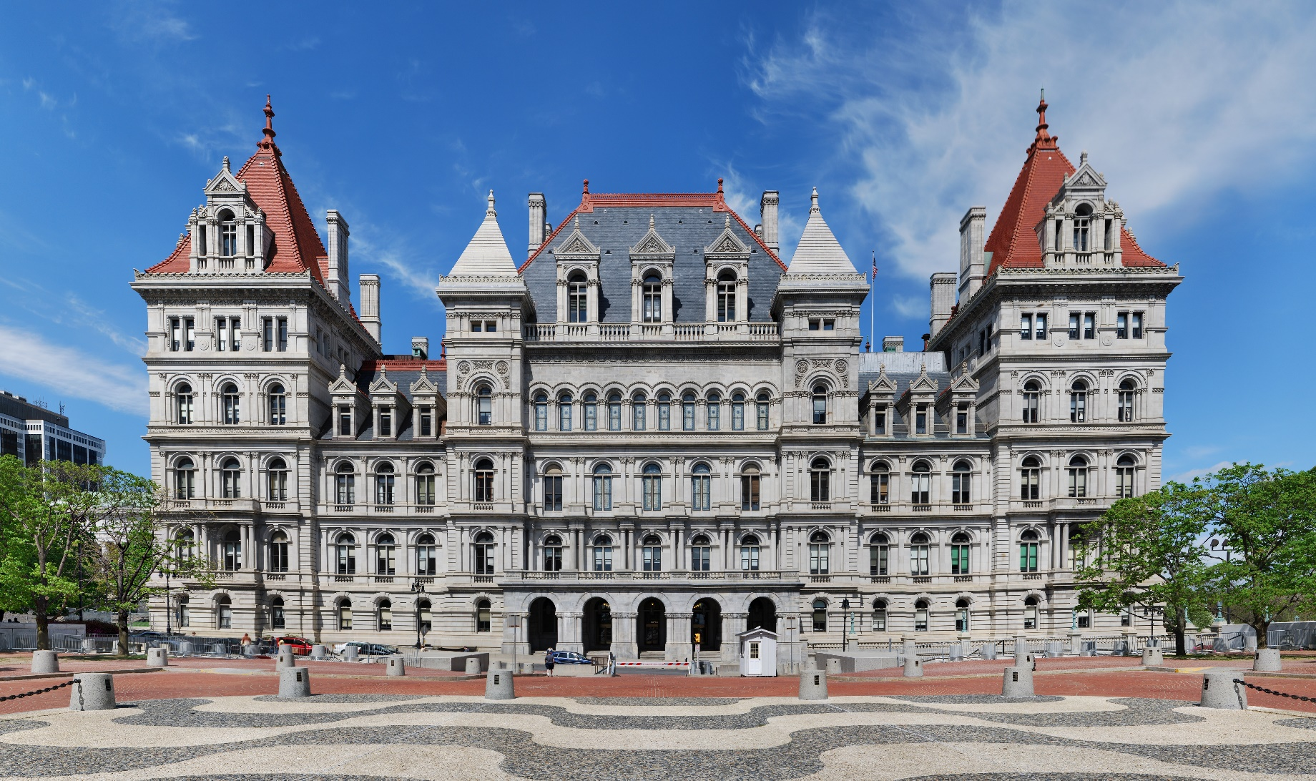
State Government – The Legislature
Generally
Notes:
43

Slide 44
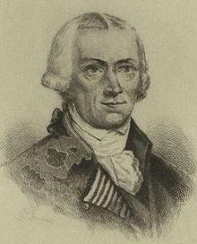
State Government – The Legislature
Generally
The Legislative Power of New York State is vested in a State Legislature, which consists of a Senate and an Assembly, under the New York State Constitution.
Created as an independent, co-equal, bicameral branch of the state government, it has its substantial powers checked by the Executive Branch (through the veto) and by the Judicial Branch (through judicial review).
Designed to enact written statutes involving the issues of state concern, and provide oversight over all three branches of the state government, the Senate and Assembly are charged with enacting laws and taking measures to secure the blessings of liberty.
The Article III State Legislature consists of:
The New York State Assembly, and
The New York State Senate.
Senator Pierre Van Cortlandt
First President
of the New York State Senate
Walter Livingston
First Speaker of the
New York State Assembly
Notes:
44

Slide 45
State Government – The Legislature
Generally
The New York State Constitution vests the Legislative Power of New York State in the Legislature, which shall have two bicameral houses, the Assembly and the Senate.
Article III of the New York State Constitution expressly states the:
manner of election,
the qualifications, and
the duties, powers, and responsibilities
of the Legislature of the State of New York.
The New York State Legislative Law and the NYS State Law
(New York State Statutes that are authorized by the Constitution)
also set forth the Powers and Authority of the State Legislature.
Notes:
45

Slide 46
The State Government
The Legislative Branch

Slide 47
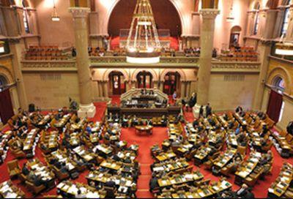
The State Government
The New York State Assembly

Slide 48
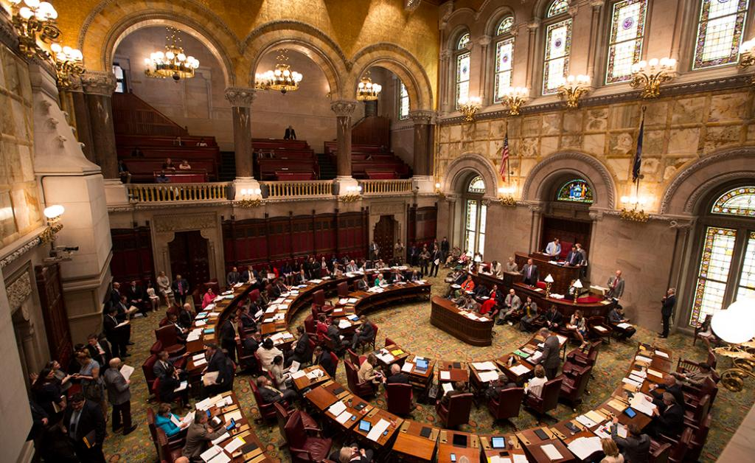
The State Government
The New York State Senate

Slide 49
State Government – The Legislature
Legal Authority
Section One of Article III of the New York State Constitution expressly provides that:
“The legislative power of this state shall be vested
in the senate and assembly.”
Article III of the New York State Constitution expressly states the:
manner of election,
the qualifications, and
the duties, powers, and responsibilities
of the Legislature of the State of New York.
The New York State Legislative Law and the NYS State Law
(New York State Statutes that are authorized by the Constitution)
also set forth the Powers and Authority of the State Legislature.
It should also be noted that each house of the Legislature adopts by resolution, its own Rules, which have the effect of law.
Notes:
49

Slide 50
State Government – The Legislature
Manner of Selection – New York State Senate
Section Two of Article III of the United States Constitution, and Section 123 of the New York State State Law, details manner of selection of and Number of Members of the New York State Senate.
Such Senators are directly elected from equally apportioned districts for a term of two years. And according to Section 8 of Article II:
“the elections of senators and members of assembly, shall be held on the Tuesday
succeeding the first Monday of November, unless otherwise directed by the legislature.”
More Specifically, Section Two of Article III of the New York Constitution specifies:
“The senate shall consist of fifty members, except as hereinafter provided. The senators elected in the year one thousand eight hundred and ninety-five shall hold their offices for three years, and their successors shall be chosen for two years.”
Section 123 of the New York State State Law additionally provides:
“The senate shall consist of sixty-three members chosen from the districts described within and apportioned among the counties on the basis of the number of inhabitants of the state based on the Federal Census”
The average size of State Senate districts in New York is 307,356 inhabitants.
Pursuant to Section 2 of Article III of the New York State Constitution, State Legislative elections, for both the Senate and the Assembly, must take place in every even numbered year.
With 63 members, a bill or resolution needs 32 votes to pass the New York State Senate
Notes:
50

Slide 51
State Government – The Legislature
Manner of Selection – New York State Assembly
Section Two of Article III of the United States Constitution, and Section 123 of the New York State State Law, details manner of selection of and Number of Members of the New York State Assembly.
Such Members of Assembly are directly elected from equally apportioned districts for a term of two years. And according to Section 8 of Article II:
“the elections of senators and members of assembly, shall be held on the Tuesday
succeeding the first Monday of November, unless otherwise directed by the legislature.”
More Specifically, Section Two of Article III of the New York Constitution specifies:
“The assembly shall consist of one hundred and fifty members. The assembly members elected in the year one thousand nine hundred and thirty-eight, and their successors, shall be chosen for two years.”
Section 120 of the New York State State Law additionally provides:
“The assembly shall consist of one hundred fifty members chosen from the districts described within and apportioned among the counties on the basis of the number of inhabitants of the state based on the Federal Census ”
The average size of State Assembly districts in New York is 129,089 inhabitants.
Pursuant to Section 2 of Article III of the New York State Constitution, State Legislative elections, for both the Senate and the Assembly, must take place in every even numbered year.
With 150 members, a bill or resolution needs 76 votes to pass the New York State Assembly
Notes:
51

Slide 52
State Government – The Legislature
Qualifications of Legislators
Section 7 of Article III of the New York State Constitution sets forth the specific qualifications for a person seeking to serve in the New York State Legislature. The qualifications for the Senate and the Assembly are the same. Such qualifications are as follows:
“No person shall serve as a member of the legislature unless:
He or she is a citizen of the United States; and
He or she has been a resident of the state of New York for five years, and,
Except as hereinafter otherwise prescribed, he or she has been a resident of the assembly or senate district for the twelve months immediately preceding his or her election (if elected a legislator at the first election next ensuing after a readjustment or alteration of the senate or assembly districts becomes effective, a person, to be eligible to serve as such, must have been a resident of the county in which the legislative district is contained for the twelve months immediately preceding his or her election).
No member of the legislature shall, during the time for which he or she was elected, receive any civil appointment from the governor, the governor and the senate, the legislature or from any city government, to an office which shall have been created, or the emoluments whereof shall have been increased during such time.
If a member of the legislature be elected to congress, or appointed to any office, civil or military, under the government of the United States, the state of New York, or under any city government except as a member of the national guard or naval militia of the state, or of the reserve forces of the United States, his or her acceptance thereof shall vacate his or her seat in the legislature, providing, however, that a member of the legislature may be appointed commissioner of deeds or to any office in which he or she shall receive no compensation.
Notes:
52

Slide 53
State Government – The Legislature
Compensation
Section 6 of Article III of the New York State Constitution, provides for the compensation of the members of State Legislature. With respect to compensation, such Section 6 provides:
Basic Compensation: Each member of the legislature shall receive for his or her services a like annual salary, to be fixed by law (Presently $110,000 per year in accordance with the report of the 2018 state legislative compensation commission).
Travelling Expenses: Each member of the legislature shall also be reimbursed for his or her actual traveling expenses in going to and returning from the place in which the legislature meets, not more than once each week while the legislature is in session.
Stipends: Any member, while serving as an officer of his or her house or in any other special capacity therein or directly connected therewith not hereinbefore in this section specified, may also be paid and receive, in addition, any allowance which may be fixed by law for the particular and additional services appertaining to or entailed by such office or special capacity. (Presently limited to only certain legislative leaders in accordance with the report of the 2018 state legislative compensation commission).
Cant be Changed During Their Term: Neither the salary of any member nor any other allowance so fixed may be increased or diminished during, and with respect to, the term for which he or she shall have been elected, nor shall he or she be paid or receive any other extra compensation.
Pursuant to state statutes:
The compensation for most Senators and Members of the Assembly, is $110,000.
The exceptions are: (Assembly) the Speaker, the Majority Leader, the Speaker Pro Tempore, the Chair of the Ways and Means Committee, Chair of the Codes Committee, the Minority Leader, the Minority Leader Pro Tempore, the Ranking Member of the Ways and Means Committee and the Ranking Member of the Codes Committee; and (Senate) the Temporary President, Deputy Majority Leader, the Chair of the Finance Committee, the Minority Leader, Deputy Minority Leader, and Ranking Member on the Senate Finance Committee, who all receive an extra stipend for additional services.
Notes:
53

Slide 54
State Government – The Legislature
Powers, Duties and Responsibilities
Article III of the New York State Constitution provides following the powers, duties and responsibilities for the Legislature of the State of New York. They are as follows:
Powers of Each House:
A majority of each house shall constitute a quorum to do business.
Each house shall determine the rules of its own proceedings,
Each house shall be the judge of the elections, returns and qualifications of its own members;
Each house shall choose its own officers; and the senate shall choose a temporary president and the assembly shall choose a speaker.
Journals; open sessions; adjournments:
Each house of the legislature shall keep a journal of its proceedings, and publish the same, except such parts as may require secrecy.
The doors of each house shall be kept open, except when the public welfare shall require secrecy.
Neither house shall, without the consent of the other, adjourn for more than two days.
Members not to be questioned for speeches:
For any speech or debate in either house of the legislature, the members shall not be questioned in any other place.
Notes:
54

Slide 55
State Government – The Legislature
Powers, Duties and Responsibilities
Article III of the New York State Constitution provides following the powers, duties and responsibilities for the Legislature of the State of New York. They are as follows:
Bills may originate in either house; may be amended by the other:
Any bill may originate in either house of the legislature; and
All bills passed by one house may be amended by the other
Enacting clause of bills; no law to be enacted except by bill:
The enacting clause of all bills shall be "The People of the State of New York, represented in Senate and Assembly, do enact as follows“; and
No law shall be enacted except by bill;
Manner of passing bills; message of necessity for immediate vote:
No bill shall be passed, or become a law, unless it shall have been printed and upon the desks of the members, in its final form, at least three calendar legislative days prior to its final passage, unless the governor, or the acting governor, shall have given the house seeking to pass the bill a message of necessity;
A message of necessity must certify, by the governor’s hand and the seal of the state, the facts which in his or her opinion necessitate an immediate vote thereon, in which case the must nevertheless be upon the desks of the members in final form, not necessarily printed, before its final passage;
No bill shall be passed or become a law, except by the assent of a majority of the members elected to each branch of the legislature; and upon the last reading of a bill, no amendment thereof shall be allowed, and the question upon its final passage shall be taken immediately thereafter, and the ayes and nays entered on the journal.
Notes:
55

Slide 56
State Government – The Legislature
Powers, Duties and Responsibilities
Article III of the New York State Constitution provides following the powers, duties and responsibilities for the Legislature of the State of New York. They are as follows:
Private or local bills to embrace only one subject, expressed in title:
No private or local bill, which may be passed by the legislature, shall embrace more than one subject, and that shall be expressed in the title
Existing law not to be made applicable by reference:
No act shall be passed which shall provide that any existing law, or any part thereof, shall be made or deemed a part of said act, or which shall enact that any existing law, or part thereof, shall be applicable, except by inserting it in such act (This forbids incorporation by reference).
Cases in which private or local bills shall not be passed:
The legislature shall not pass a private or local bill in any of the following cases:
Changing the names of persons;
Laying out, opening, altering, working or discontinuing roads, highways or alleys, or for draining swamps or other low lands;
Locating or changing county seats;
Providing for changes of venue in civil or criminal cases;
Incorporating villages;
Providing for election of members of boards of supervisors;
Selecting, drawing, summoning or empaneling grand or petit jurors;
Regulating the rate of interest on money;
The opening and conducting of elections or designating places of voting;
Creating, increasing or decreasing fees, percentages or allowances of public officers, during the term for which said officers are elected or appointed;
Granting to any corporation, association or individual the right to lay down railroad tracks.;
Granting to any private corporation, association or individual any exclusive privilege, immunity or franchise whatever;
Granting to any person, association, firm or corporation, an exemption from taxation on real or personal property; or
Providing for the building of bridges, except over the waters forming a part of the boundaries of the state, by other than a municipal or other public corporation or a public agency of the state.
* The above three requirements do not apply to any bill recommended by a public agency.
Notes:
56

Slide 57
State Government – The Legislature
Powers, Duties and Responsibilities
Article III of the New York State Constitution provides following the powers, duties and responsibilities for the Legislature of the State of New York. They are as follows:
Extraordinary sessions of the legislature; power to convene on legislative initiative:
The members of the legislature shall be empowered, upon the presentation to the temporary president of the senate and the speaker of the assembly of a petition signed by two-thirds of the members elected to each house of the legislature, to convene the legislature on extraordinary occasions to act upon the subjects enumerated in such petition.
Two-thirds bills:
The assent of two-thirds of the members elected to each branch of the legislature shall be requisite to every bill appropriating the public moneys or property for local or private purposes.
Tax laws to state tax and object distinctly; definition of income for income tax purposes by reference to federal laws authorized:
Every law which imposes, continues or revives a tax shall distinctly state the tax and the object to which it is to be applied, and it shall not be sufficient to refer to any other law to fix such tax or object.
Notwithstanding the foregoing or any other provision of this constitution, the legislature, in any law imposing a tax or taxes on, in respect to or measured by income, may define the income on, in respect to or by which such tax or taxes are imposed or measured, by reference to any provision of the laws of the United States as the same may be or become effective at any time or from time to time, and may prescribe exceptions or modifications to any such provision.
Notes:
57

Slide 58
State Government – The Legislature
Powers, Duties and Responsibilities
Article III of the New York State Constitution provides following the powers, duties and responsibilities for the Legislature of the State of New York. They are as follows:
When yeas and nays necessary; three-fifths to constitute quorum:
On the final passage, in either house of the legislature, of any act which imposes, continues or revives a tax, or creates a debt or charge, or makes, continues or revives any appropriation of public or trust money or property, or releases, discharges or commutes any claim or demand of the state, the question shall be taken by yeas and nays, which shall be duly entered upon the journals, and three-fifths of all the members elected to either house shall, in all such cases, be necessary to constitute a quorum therein
Emergency governmental operations; legislature to provide for:
Notwithstanding any other provision of this constitution, the legislature, in order to insure continuity of state and local governmental operations in periods of emergency caused by enemy attack or by disasters (natural or otherwise), shall have the power and the immediate duty:
(1) to provide for prompt and temporary succession to the powers and duties of public offices, of whatever nature and whether filled by election or appointment, the incumbents of which may become unavailable for carrying on the powers and duties of such offices, and
(2) to adopt such other measures as may be necessary and proper for insuring the continuity of governmental operations; and
Nothing in this article shall be construed to limit in any way the power of the state to deal with emergencies arising from any cause.
Notes:
58

Slide 59
State Government – The Legislature
Constitutional Provisions
Article III of the New York States Constitution creates the Legislative Branch of the New York State Legislature (Senate and Assembly).
Text of Article III: Article III is broken up into twenty-five sections, and Sections 1 to 3 state as follows:
“ARTICLE III - Legislature
[Legislative power]
Section 1. The legislative power of this state shall be vested in the senate and assembly.
[Number and terms of senators and assemblymen]
2. The senate shall consist of fifty members,* except as hereinafter provided. The senators elected in the year one thousand eight hundred and ninety-five shall hold their offices for three years, and their successors shall be chosen for two years. The assembly shall consist of one hundred and fifty members. The assembly members elected in the year one thousand nine hundred and thirty-eight, and their successors, shall be chosen for two years. (Amended by vote of the people November 2, 1937; November 6, 2001.)
[Senate districts]
3. The senate districts described in section three of article three of this constitution as adopted by the people on November sixth, eighteen hundred ninety-four are hereby continued for all of the purposes of future reapportionments of senate districts pursuant to section four of this article. (Formerly Section 3. Repealed and replaced by new Section 3 amended by vote of the people November 6, 1962.)”
Notes:
59

Slide 60
State Government – The Legislature
Constitutional Provisions
Article III of the New York States Constitution creates the Legislative Branch of the New York State Legislature (Senate and Assembly).
Text of Article III: Article III is broken up into twenty-five sections, and Section 4 states as follows:
“ARTICLE III - Legislature
[Readjustments and reapportionments; when federal census to control]
4. Except as herein otherwise provided, the federal census taken in the year nineteen hundred thirty and each federal census taken decennially thereafter shall be controlling as to the number of inhabitants in the state or any part thereof for the purposes of the apportionment of members of assembly and readjustment or alteration of senate and assembly districts next occurring, in so far as such census and the tabulation thereof purport to give the information necessary therefor. The legislature, by law, shall provide for the making and tabulation by state authorities of an enumeration of the inhabitants of the entire state to be used for such purposes, instead of a federal census, if the taking of a federal census in any tenth year from the year nineteen hundred thirty be omitted or if the federal census fails to show the number of aliens or Indians not taxed. If a federal census, though giving the requisite information as to the state at large, fails to give the information as to any civil or territorial divisions which is required to be known for such purposes, the legislature, by law, shall provide for such an enumeration of the inhabitants of such parts of the state only as may be necessary, which shall supersede in part the federal census and be used in connection therewith for such purposes. The legislature, by law, may provide in its discretion for an enumeration by state authorities of the inhabitants of the state, to be used for such purposes, in place of a federal census, when the return of a decennial federal census is delayed so that it is not available at the beginning of the regular session of the legislature in the second year after the year nineteen hundred thirty or after any tenth year therefrom, or if an apportionment of members of assembly and readjustment or alteration of senate districts is not made at or before such a session.
Notes:
60

Slide 61
State Government – The Legislature
Constitutional Provisions
Article III of the New York States Constitution creates the Legislative Branch of the New York State Legislature (Senate and Assembly).
Text of Article III: Article III is broken up into twenty-five sections, and Section 4 states as follows:
“ARTICLE III - Legislature
[Readjustments and reapportionments; when federal census to control] - Continued
4. At the regular session in the year nineteen hundred thirty-two, and at the first regular session after the year nineteen hundred forty and after each tenth year therefrom the senate districts shall be readjusted or altered, but if, in any decade, counting from and including that which begins with the year nineteen hundred thirty-one, such a readjustment or alteration is not made at the time above prescribed, it shall be made at a subsequent session occurring not later than the sixth year of such decade, meaning not later than nineteen hundred thirty-six, nineteen hundred forty-six, nineteen hundred fifty-six, and so on; provided, however, that if such districts shall have been readjusted or altered by law in either of the years nineteen hundred thirty or nineteen hundred thirty-one, they shall remain unaltered until the first regular session after the year nineteen hundred forty. Such districts shall be so readjusted or altered that each senate district shall contain as nearly as may be an equal number of inhabitants, excluding aliens, and be in as compact form as practicable, and shall remain unaltered until the first year of the next decade as above defined, and shall at all times consist of contiguous territory, and no county shall be divided in the formation of a senate district except to make two or more senate districts wholly in such county. No town, except a town having more than a full ratio of apportionment, and no block in a city inclosed by streets or public ways, shall be divided in the formation of senate districts; nor shall any district contain a greater excess in population over an adjoining district in the same county, than the population of a town or block therein adjoining such district. Counties, towns or blocks which, from their location, may be included in either of two districts, shall be so placed as to make said districts most nearly equal in number of inhabitants, excluding aliens.
Notes:
61

Slide 62
State Government – The Legislature
Constitutional Provisions
Article III of the New York States Constitution creates the Legislative Branch of the New York State Legislature (Senate and Assembly).
Text of Article III: Article III is broken up into twenty-five sections, and Section 4 states as follows:
“ARTICLE III - Legislature
[Readjustments and reapportionments; when federal census to control] - Continued
4. No county shall have four or more senators unless it shall have a full ratio for each senator. No county shall have more than one-third of all the senators; and no two counties or the territory thereof as now organized, which are adjoining counties, or which are separated only by public waters, shall have more than one-half of all the senators.
The ratio for apportioning senators shall always be obtained by dividing the number of inhabitants, excluding aliens, by fifty, and the senate shall always be composed of fifty members, except that if any county having three or more senators at the time of any apportionment shall be entitled on such ratio to an additional senator or senators, such additional senator or senators shall be given to such county in addition to the fifty senators, and the whole number of senators shall be increased to that extent.
The senate districts, including the present ones, as existing immediately before the enactment of a law readjusting or altering the senate districts, shall continue to be the senate districts of the state until the expirations of the terms of the senators then in office, except for the purpose of an election of senators for full terms beginning at such expirations, and for the formation of assembly districts. (Amended by vote of the people November 6, 1945.)
Notes:
62

Slide 63
State Government – The Legislature
Constitutional Provisions
Article III of the New York States Constitution creates the Legislative Branch of the New York State Legislature (Senate and Assembly).
Text of Article III: Article III is broken up into twenty-five sections, and Section 5 states as follows:
“ARTICLE III - Legislature
[Apportionment of assemblymen; creation of assembly districts]
5. The members of the assembly shall be chosen by single districts and shall be apportioned by the legislature at each regular session at which the senate districts are readjusted or altered, and by the same law, among the several counties of the state, as nearly as may be according to the number of their respective inhabitants, excluding aliens. Every county heretofore established and separately organized, except the county of Hamilton, shall always be entitled to one member of assembly, and no county shall hereafter be erected unless its population shall entitle it to a member. The county of Hamilton shall elect with the county of Fulton, until the population of the county of Hamilton shall, according to the ratio, entitle it to a member. But the legislature may abolish the said county of Hamilton and annex the territory thereof to some other county or counties.
The quotient obtained by dividing the whole number of inhabitants of the state, excluding aliens, by the number of members of assembly, shall be the ratio for apportionment, which shall be made as follows: One member of assembly shall be apportioned to every county, including Fulton and Hamilton as one county, containing less than the ratio and one-half over. Two members shall be apportioned to every other county. The remaining members of assembly shall be apportioned to the counties having more than two ratios according to the number of inhabitants, excluding aliens. Members apportioned on remainders shall be apportioned to the counties having the highest remainders in the order thereof respectively. No county shall have more members of assembly than a county having a greater number of inhabitants, excluding aliens.
Notes:
63

Slide 64
State Government – The Legislature
Constitutional Provisions
Article III of the New York States Constitution creates the Legislative Branch of the New York State Legislature (Senate and Assembly).
Text of Article III: Article III is broken up into twenty-five sections, and Section 5 states as follows:
“ARTICLE III - Legislature
[Apportionment of assemblymen; creation of assembly districts] - Continued
5. The assembly districts, including the present ones, as existing immediately before the enactment of a law making an apportionment of members of assembly among the counties, shall continue to be the assembly districts of the state until the expiration of the terms of members then in office, except for the purpose of an election of members of assembly for full terms beginning at such expirations.
In any county entitled to more than one member, the board of supervisors, and in any city embracing an entire county and having no board of supervisors, the common council, or if there be none, the body exercising the powers of a common council, shall assemble at such times as the legislature making an apportionment shall prescribe, and divide such counties into assembly districts as nearly equal in number of inhabitants, excluding aliens, as may be, of convenient and contiguous territory in as compact form as practicable, each of which shall be wholly within a senate district formed under the same apportionment, equal to the number of members of assembly to which such county shall be entitled, and shall cause to be filed in the office of the secretary of state and of the clerk of such county, a description of such districts, specifying the number of each district and of the inhabitants thereof, excluding aliens, according to the census or enumeration used as the population basis for the formation of such districts; and such apportionment and districts shall remain unaltered until after the next reapportionment of members of assembly, except that the board of supervisors of any county containing a town having more than a ratio of apportionment and one-half over may alter the assembly districts in a senate district containing such town at any time on or before March first, nineteen hundred forty-six. In counties having more than one senate district, the same number of assembly districts shall be put in each senate district, unless the assembly districts cannot be evenly divided among the senate districts of any county, in which case one more assembly district shall be put in the senate district in such county having the largest, or one less assembly district shall be put in the senate district in such county having the smallest number of inhabitants, excluding aliens, as the case may require. No town, except a town having more than a ratio of apportionment and one-half over, and no block in a city inclosed by streets or public ways, shall be divided in the formation of assembly districts, nor shall any districts contain a greater excess in population over an adjoining district in the same senate district, than the population of a town or block therein adjoining such assembly district. Towns or blocks which, from their location may be included in either of two districts, shall be so placed as to make said districts most nearly equal in number of inhabitants, excluding aliens. Nothing in this section shall prevent the division, at any time, of counties and towns and the erection of new towns by the legislature.
An apportionment by the legislature, or other body, shall be subject to review by the supreme court, at the suit of any citizen, under such reasonable regulations as the legislature may prescribe; and any court before which a cause may be pending involving an apportionment, shall give precedence thereto over all other causes and proceedings, and if said court be not in session it shall convene promptly for the disposition of the same. (Amended by vote of the people November 6, 1945.)
Notes:
64

Slide 65
State Government – The Legislature
Constitutional Provisions
Article III of the New York States Constitution creates the Legislative Branch of the New York State Legislature (Senate and Assembly).
Text of Article III: Article III is broken up into twenty-five sections, and Sections 5-a and 6 state as follows:
“ARTICLE III - Legislature
[Definition of inhabitants]
5-a. For the purpose of apportioning senate and assembly districts pursuant to the foregoing provisions of this article, the term "inhabitants, excluding aliens" shall mean the whole number of persons. (New. Added by vote of the people November 4, 1969.)
[Compensation, allowances and traveling expenses of members]
6. Each member of the legislature shall receive for his or her services a like annual salary, to be fixed by law. He or she shall also be reimbursed for his or her actual traveling expenses in going to and returning from the place in which the legislature meets, not more than once each week while the legislature is in session. Senators, when the senate alone is convened in extraordinary session, or when serving as members of the court for the trial of impeachments, and such members of the assembly, not exceeding nine in number, as shall be appointed managers of an impeachment, shall receive an additional per diem allowance, to be fixed by law. Any member, while serving as an officer of his or her house or in any other special capacity therein or directly connected therewith not hereinbefore in this section specified, may also be paid and receive, in addition, any allowance which may be fixed by law for the particular and additional services appertaining to or entailed by such office or special capacity. Neither the salary of any member nor any other allowance so fixed may be increased or diminished during, and with respect to, the term for which he or she shall have been elected, nor shall he or she be paid or receive any other extra compensation. The provisions of this section and laws enacted in compliance therewith shall govern and be exclusively controlling, according to their terms. Members shall continue to receive such salary and additional allowance as heretofore fixed and provided in this section, until changed by law pursuant to this section. (Amended by Constitutional Convention of 1938 and approved by vote of the people November 8, 1938; further amended by vote of the people November 4, 1947; November 3, 1964; November 6, 2001.)
Notes:
65

Slide 66
State Government – The Legislature
Constitutional Provisions
Article III of the New York States Constitution creates the Legislative Branch of the New York State Legislature (Senate and Assembly).
Text of Article III: Article III is broken up into twenty-five sections, and Sections 7 and 8 state as follows:
“ARTICLE III - Legislature
[Qualifications of members; prohibitions on certain civil appointments; acceptance to vacate seat]
7. No person shall serve as a member of the legislature unless he or she is a citizen of the United States and has been a resident of the state of New York for five years, and, except as hereinafter otherwise prescribed, of the assembly or senate district for the twelve months immediately preceding his or her election; if elected a senator or member of assembly at the first election next ensuing after a readjustment or alteration of the senate or assembly districts becomes effective, a person, to be eligible to serve as such, must have been a resident of the county in which the senate or assembly district is contained for the twelve months immediately preceding his or her election. No member of the legislature shall, during the time for which he or she was elected, receive any civil appointment from the governor, the governor and the senate, the legislature or from any city government, to an office which shall have been created, or the emoluments whereof shall have been increased during such time. If a member of the legislature be elected to congress, or appointed to any office, civil or military, under the government of the United States, the state of New York, or under any city government except as a member of the national guard or naval militia of the state, or of the reserve forces of the United States, his or her acceptance thereof shall vacate his or her seat in the legislature, providing, however, that a member of the legislature may be appointed commissioner of deeds or to any office in which he or she shall receive no compensation. (New. Derived in part from former зз7 and 8. Adopted by Constitutional Convention of 1938 and approved by vote of the people November 8, 1938; amended by vote of the people November 2, 1943.)
[Time of elections of members]
8. The elections of senators and members of assembly, pursuant to the provisions of this constitution, shall be held on the Tuesday succeeding the first Monday of November, unless otherwise directed by the legislature. (Formerly з9. Renumbered by Constitutional Convention of 1938 and approved by vote of the people November 8, 1938.)
Notes:
66

Slide 67
State Government – The Legislature
Constitutional Provisions
Article III of the New York States Constitution creates the Legislative Branch of the New York State Legislature (Senate and Assembly).
Text of Article III: Article III is broken up into twenty-five sections, and Sections 9 to 13 state as follows:
“ARTICLE III - Legislature
[Powers of each house]
9. A majority of each house shall constitute a quorum to do business. Each house shall determine the rules of its own proceedings, and be the judge of the elections, returns and qualifications of its own members; shall choose its own officers; and the senate shall choose a temporary president and the assembly shall choose a speaker. (Formerly з10. Renumbered by Constitutional Convention of 1938 and approved by vote of the people November 8, 1938. Amended by vote of the people November 5, 1963.)
[Journals; open sessions; adjournments]
10. Each house of the legislature shall keep a journal of its proceedings, and publish the same, except such parts as may require secrecy. The doors of each house shall be kept open, except when the public welfare shall require secrecy. Neither house shall, without the consent of the other, adjourn for more than two days. (Formerly з11. Renumbered and amended by Constitutional Convention of 1938 and approved by vote of the people November 8, 1938.)
[Members not to be questioned for speeches]
11. For any speech or debate in either house of the legislature, the members shall not be questioned in any other place. (Formerly з12. Renumbered by Constitutional Convention of 1938 and approved by vote of the people November 8, 1938.)
[Bills may originate in either house; may be amended by the other]
12. Any bill may originate in either house of the legislature, and all bills passed by one house may be amended by the other. (Formerly з13. Renumbered by Constitutional Convention of 1938 and approved by vote of the people November 8, 1938.)
[Enacting clause of bills; no law to be enacted except by bill]
13. The enacting clause of all bills shall be "The People of the State of New York, represented in Senate and Assembly, do enact as follows," and no law shall be enacted except by bill. (Formerly з14. Renumbered by Constitutional Convention of 1938 and approved by vote of the people November 8, 1938.)
Notes:
67

Slide 68
State Government – The Legislature
Constitutional Provisions
Article III of the New York States Constitution creates the Legislative Branch of the New York State Legislature (Senate and Assembly).
Text of Article III: Article III is broken up into twenty-five sections, and Sections 14 to 16 state as follows:
“ARTICLE III - Legislature
[Manner of passing bills; message of necessity for immediate vote]
14. No bill shall be passed or become a law unless it shall have been printed and upon the desks of the members, in its final form, at least three calendar legislative days prior to its final passage, unless the governor, or the acting governor, shall have certified, under his or her hand and the seal of the state, the facts which in his or her opinion necessitate an immediate vote thereon, in which case it must nevertheless be upon the desks of the members in final form, not necessarily printed, before its final passage; nor shall any bill be passed or become a law, except by the assent of a majority of the members elected to each branch of the legislature; and upon the last reading of a bill, no amendment thereof shall be allowed, and the question upon its final passage shall be taken immediately thereafter, and the ayes and nays entered on the journal. (Formerly з15. Renumbered and amended by Constitutional Convention of 1938 and approved by vote of the people November 8, 1938; further amended by vote of the people November 6, 2001.)
[Private or local bills to embrace only one subject, expressed in title]
15. No private or local bill, which may be passed by the legislature, shall embrace more than one subject, and that shall be expressed in the title. (Formerly з16. Renumbered by Constitutional Convention of 1938 and approved by vote of the people November 8, 1938.)
[Existing law not to be made applicable by reference]
16. No act shall be passed which shall provide that any existing law, or any part thereof, shall be made or deemed a part of said act, or which shall enact that any existing law, or part thereof, shall be applicable, except by inserting it in such act. (Formerly з17. Renumbered by Constitutional Convention of 1938 and approved by vote of the people November 8, 1938.)
Notes:
68

Slide 69
State Government – The Legislature
Constitutional Provisions
Article III of the New York States Constitution creates the Legislative Branch of the New York State Legislature (Senate and Assembly).
Text of Article III: Article III is broken up into twenty-five sections, and Section 17 states as follows:
“ARTICLE III - Legislature
[Cases in which private or local bills shall not be passed]
17. The legislature shall not pass a private or local bill in any of the following cases:
Changing the names of persons.
Laying out, opening, altering, working or discontinuing roads, highways or alleys, or for draining swamps or other low lands. Locating or changing county seats.
Providing for changes of venue in civil or criminal cases.
Incorporating villages.
Providing for election of members of boards of supervisors.
Selecting, drawing, summoning or empaneling grand or petit jurors.
Regulating the rate of interest on money.
The opening and conducting of elections or designating places of voting.
Creating, increasing or decreasing fees, percentages or allowances of public officers, during the term for which said officers are elected or appointed.
Granting to any corporation, association or individual the right to lay down railroad tracks.
Granting to any private corporation, association or individual any exclusive privilege, immunity or franchise whatever.
Granting to any person, association, firm or corporation, an exemption from taxation on real or personal property.
Providing for the building of bridges, except over the waters forming a part of the boundaries of the state, by other than a municipal or other public corporation or a public agency of the state. (Formerly з18. Renumbered and amended by Constitutional Convention of 1938 and approved by vote of the people November 8, 1938; further amended by vote of the people November 3, 1964.)
Notes:
69

Slide 70
State Government – The Legislature
Constitutional Provisions
Article III of the New York States Constitution creates the Legislative Branch of the New York State Legislature (Senate and Assembly).
Text of Article III: Article III is broken up into twenty-five sections, and Sections 18 to 20 state as follows:
“ARTICLE III - Legislature
[Extraordinary sessions of the legislature; power to convene on legislative initiative]
18. The members of the legislature shall be empowered, upon the presentation to the temporary president of the senate and the speaker of the assembly of a petition signed by two-thirds of the members elected to each house of the legislature, to convene the legislature on extraordinary occasions to act upon the subjects enumerated in such petition. (New. Added by vote of the people November 4, 1975.)
[Private claims not to be audited by legislature; claims barred by lapse of time]
19. The legislature shall neither audit nor allow any private claim or account against the state, but may appropriate money to pay such claims as shall have been audited and allowed according to law.
No claim against the state shall be audited, allowed or paid which, as between citizens of the state, would be barred by lapse of time. But if the claimant shall be under legal disability, the claim may be presented within two years after such disability is removed. (Derived in part from former з6 of Art. 7. Amended by Constitutional Convention of 1938 and approved by vote of the people November 8, 1938; further amended by vote of the people November 3, 1964.)
[Two-thirds bills]
20. The assent of two-thirds of the members elected to each branch of the legislature shall be requisite to every bill appropriating the public moneys or property for local or private purposes.
Notes:
70

Slide 71
State Government – The Legislature
Constitutional Provisions
Article III of the New York States Constitution creates the Legislative Branch of the New York State Legislature (Senate and Assembly).
Text of Article III: Article III is broken up into twenty-five sections, and Sections 21 to 23 state as follows:
“ARTICLE III - Legislature
[Certain sections not to apply to bills recommended by certain commissioners or public agencies]
21. Sections 15, 16 and 17 of this article shall not apply to any bill, or the amendments to any bill, which shall be recommended to the legislature by commissioners or any public agency appointed or directed pursuant to law to prepare revisions, consolidations or compilations of statutes. But a bill amending an existing law shall not be excepted from the provisions of sections 15, 16 and 17 of this article unless such amending bill shall itself be recommended to the legislature by such commissioners or public agency. (Formerly з23. Renumbered and amended by Constitutional Convention of 1938 and approved by vote of the people November 8, 1938.)
[Tax laws to state tax and object distinctly; definition of income for income tax purposes by reference to federal laws authorized]
22. Every law which imposes, continues or revives a tax shall distinctly state the tax and the object to which it is to be applied, and it shall not be sufficient to refer to any other law to fix such tax or object.
Notwithstanding the foregoing or any other provision of this constitution, the legislature, in any law imposing a tax or taxes on, in respect to or measured by income, may define the income on, in respect to or by which such tax or taxes are imposed or measured, by reference to any provision of the laws of the United States as the same may be or become effective at any time or from time to time, and may prescribe exceptions or modifications to any such provision. (Formerly з24. Renumbered by Constitutional Convention of 1938 and approved by vote of the people November 8, 1938; amended by vote of the people November 3, 1959.)
[When yeas and nays necessary; three-fifths to constitute quorum]
23. On the final passage, in either house of the legislature, of any act which imposes, continues or revives a tax, or creates a debt or charge, or makes, continues or revives any appropriation of public or trust money or property, or releases, discharges or commutes any claim or demand of the state, the question shall be taken by yeas and nays, which shall be duly entered upon the journals, and three-fifths of all the members elected to either house shall, in all such cases, be necessary to constitute a quorum therein. (Formerly з25. Renumbered by Constitutional Convention of 1938 and approved by vote of the people November 8, 1938.)
Notes:
71

Slide 72
State Government – The Legislature
Constitutional Provisions
Article III of the New York States Constitution creates the Legislative Branch of the New York State Legislature (Senate and Assembly).
Text of Article III: Article III is broken up into twenty-five sections, and Sections 24 to 25 state as follows:
“ARTICLE III - Legislature
[Prison labor; contract system abolished]
24. The legislature shall, by law, provide for the occupation and employment of prisoners sentenced to the several state prisons, penitentiaries, jails and reformatories in the state; and no person in any such prison, penitentiary, jail or reformatory, shall be required or allowed to work, while under sentence thereto, at any trade, industry or occupation, wherein or whereby his or her work, or the product or profit of his or her work, shall be farmed out, contracted, given or sold to any person, firm, association or corporation, provided that the legislature may provide by law that such prisoners may voluntarily perform work for nonprofit organizations. As used in this section, the term "nonprofit organization" means an organization operated exclusively for religious, charitable, or educational purposes, no part of the net earnings of which inures to the benefit of any private shareholder or individual.
This section shall not be construed to prevent the legislature from providing that convicts may work for, and that the products of their labor may be disposed of to, the state or any political division thereof, or for or to any public institution owned or managed and controlled by the state, or any political division thereof. (Formerly з29. Renumbered and amended by Constitutional Convention of 1938 and approved by vote of the people November 8, 1938; further amended by vote of the people November 3, 2009.)
[Emergency governmental operations; legislature to provide for]
25. Notwithstanding any other provision of this constitution, the legislature, in order to insure continuity of state and local governmental operations in periods of emergency caused by enemy attack or by disasters (natural or otherwise), shall have the power and the immediate duty (1) to provide for prompt and temporary succession to the powers and duties of public offices, of whatever nature and whether filled by election or appointment, the incumbents of which may become unavailable for carrying on the powers and duties of such offices, and (2) to adopt such other measures as may be necessary and proper for insuring the continuity of governmental operations.
Nothing in this article shall be construed to limit in any way the power of the state to deal with emergencies arising from any cause. (New. Added by vote of the people November 5, 1963.)
Notes:
72

Slide 73
State Government – The Legislature
Statutory Provisions
In addition to Article III, The New York State Legislative Law also outlines the role of the New York State Legislature, as authorized under the State Constitution.
NYS Legislative Law: Articles 1 to 7 of this State Statute include:
Article 1. Short Title (Section 1)
Article 1-A. The Lobbying Act (Sections 1A – 1V)
Article 2. Members, Officers and Employees of the Legislature (Sections 2 - 33)
Article 2-A Procedure for Convening Extraordinary Sessions of the Legislature by
Petition (Sections 34 - 39)
Article 3. The Enactment and Publication of Laws (Sections 40 - 54-A)
Article 3-A. Requests from Local Governments for Enactments (Sections 55 - 56)
Article 4. Legislative Committees; Testimony in Proceedings (Sections 60 - 67)
Article 4-A. Law Revision Commission (Sections 70 - 72)
Article 5. Legislative Ethics (Section 80)
Article 5-A. Legislative Commissions (Section 82 - 83-M)
Article 5-B. Legislative Review of Administrative Regulations (Sections 86 - 88)
Article 6. Internal Control Responsibilities of the Legislature (Sections 89 - 92)
Article 6-A. Redistricting of Congressional and Legislative Districts (Sections 93 - 94)
Article 7. Laws Repealed; When To Take Effect (Section 100 - 101)
Notes:
73

Slide 74
State Government – The Legislature
Statutory Provisions
In addition to Article III, The New York State State Law also outlines the role of the Legislature of the State of New York, as authorized under the State Constitution.
NYS State Law: Article 8 of this State Statute include:
ARTICLE 8
Assembly and Senate Districts Of The State
Title I. Assembly districts (Sections 120-122)
Title II. Senate districts (Sections 123-125)
Title III Miscellaneous (Sections 126-128)
Notes:
74

Slide 75
State Government – The Legislature
Enactment of Laws - Statutes
The Legislature Legislates by Enacting Statutes:
Generally
The job of the Senate and Assembly is to work with each other and the Governor to enact, amend or repeal statutes which make up the body of laws within which we live.
This involves drafting, discussing and approving bills and resolutions.
These next few slides will show the process in a simplified progression from "Idea" to "Law."
At any step in the process, participation by a citizen or group of citizens is as easy as making a call, writing a letter, or signing a petition being sent to your Senator, your Member of Assembly, any other legislator, or the Governor.
The Idea
This is the starting point in the process, and the first point at which the citizen has a chance to have a say in the writing or rewriting of law.
Subjects of legislation are as varied as the range of human activities. Someone once said that legislation deals with birth and death, and everything in between.
Ideas for legislation come from many sources. A Senator or Member of Assembly may have an idea.
One of their constituents may point out a need. A State official may propose a change. An organization may espouse a cause that requires a change in the law. There is no monopoly on ideas for legislation.
Often, one person's idea on how to solve a problem has resulted in good legislation to help solve the problems of many people.
Notes:
75

Slide 76
State Government – The Legislature
Enactment of Laws - Statutes
The Legislature Legislates by Enacting Statutes:
Bill Drafting
Once an idea for a new law has been settled on, it must be put into bill form before it can be considered by the Senate. The actual drafting of legislation requires a specialized type of legal training and is usually done by the staff of the Legislative Bill Drafting Commission.
Sometimes, however, an interest group may have its own attorneys draft a bill, and lawyers working in various state agencies and the executive branch often submit their ideas for legislation in bill form.
Introduction
No law may be enacted in New York State unless it has been adopted by the Legislature in bill format.
To be adopted, it must first be introduced. With a single exception, bills can be introduced only by legislators or by standing committees on Rules in Senate and Assembly. That exception is the Executive Budget, when bills pertaining to the budget are submitted directly by the Governor.
On introduction in the Senate or the Assembly, a bill goes to the Introduction and Revision Office, where it is examined and corrected for ministerial errors, given a number, referred to the appropriate standing committee, entered into the Revision’s computer, deemed to have had its first and second readings and printed.
(Incidentally, "first reading", "second reading" and "third reading" are terms which linger in the legislative vocabulary from the days when each bill was read aloud in full in public session three times before final action could be taken.)
Notes:
76

Slide 77
State Government – The Legislature
Enactment of Laws - Statutes
The Legislature Legislates by Enacting Statutes:
Committee Action
Just as we engage specialists for specialized problems such as legal or medical advice, so does the Senate and Assembly engage specialists to study legislation.
These specialists are members in the Senate and the Assembly of Standing Committees in their respective house who evaluate bills and decide whether to "report" them (send them) to the Senate or Assembly floor for a final decision by the full membership.
A committee agenda is issued each week listing the bills and issues each Senate and Assembly committee will handle the following week.
Committees often hold public hearings on bills to gather the widest possible range of opinion.
The committee stage is the second point at which the citizen's contribution is important.
For an expression of opinion on a proposed bill can be sent directly to the committee chairman, or it can be sent to your local Senator or Member of Assembly for relay to the committee members.
The committee system acts as a funnel through which the large number of bills introduced each session must pass before they can be considered. The system also acts as a sieve to sift out undesirable or unworkable ideas.
After consideration, the committee may vote to report the bill to the full Senate or Assembly for consideration, amend the bill, or reject it. It takes a majority vote of all the committee members to report a bill.
Notes:
77

Slide 78
State Government – The Legislature
Enactment of Laws - Statutes
The Legislature Legislates by Enacting Statutes:
Amendments
Once a bill has been introduced, reported out by a committee and is on the calendar for consideration by the full Senate or Assembly, it can still be amended.
The sponsor of the bill, for example, can submit the changes to the Bill Drafting Commission, which will make such changes and reprint the bill as amended.
The bill, once in its amended form, retains its original number, but amended versions are denoted by a letter suffix A, B, C, D, ect., designating each time the bill is changed by amendment.
Once the bill is reported to the floor, any Senator or Member of Assembly may amend it in their respective house, by offering amendments to it on the floor, and obtaining a majority of votes to amend in the full house (32 in the Senate and 76 in the Assembly). Such floor amendments can be offered by any legislator, even if they are not one of the bill's sponsors.
This floor amendment process allows all members access to a bill's language, opening it to the suggestions and opinions of members who may like the essential ideas of the bill, but disagree with the sponsor on one or more of the legislation's details.
Floor amendments are procedurally made by means of motions before the house, and are offered in open session. When made, all members of the house can ask questions and discuss the merits of the proposed amendments.
Success on such motions are admittedly rare, and nearly all amendments are proposed and accomplished by the bill’s sponsor.
Notes:
78

Slide 79
State Government – The Legislature
Enactment of Laws - Statutes
The Legislature Legislates by Enacting Statutes:
The Calendar
The Daily Calendar is the agenda for Senate and Assembly sessions and contains those measures which have come through the committee process.
Bills take their place in order as they are reported from committee, and at this point are referred to by their Calendar Number. This process allows additional time for public reaction for or against a bill.
Each bill must be on the Senators' or Member of Assembly’s desks for three days before it can be voted on, unless the Governor authorizes a Message of Necessity to waive this aging requirement for a certain bill.
When bills reach the Order of Third Reading, meaning they have been on the legislators’ desks for three days, they become ready for a final vote of the house.
If the sponsor of a bill realizes at this point that his bill may not have enough support for passage, or has a defect which may require an amendment, he may ask that it be laid aside, returned to committee for further study, or "starred" (placed on inactive status).
By communicating your views on a particular issue to your Senator or Member of Assembly, you have another opportunity at this point to participate in the lawmaking process.
When the bill is ready for passage by the entire house, it is placed on that house’s Active List for the day’s bills to be taken up for debate and vote.
Notes:
79

Slide 80
State Government – The Legislature
Enactment of Laws - Statutes
The Legislature Legislates by Enacting Statutes:
Passing a Bill
An Active list is prepared each day the Senate and the Assembly is in session for each house.
The Active list is the list of bills on the third reading calendar that the Senate will consider that day for a vote.
The Active list is prepared by the Office of Majority Counsel, upon consultation with Senate Leadership.
When the bill comes up for consideration on the Order of Third Reading, it is subject to debate, discussion or explanation.
After the bill is called up for consideration, its title is read into the journal by the clerk, and debate, discussion or explanation can take place.
When such debate, discussion and/or explanation is concluded, and the bill is called for a vote, the aye and no votes are taken and recorded.
As the Senate has 63 members, in order for a bill to pass, it must receive at least 32 aye votes from the Senators (a majority of its members elected to the house).
As the Assembly has 150 members, in order for a bill to pass, it must receive at least 76 aye votes for the Members of Assembly (a majority of its members elected to the house).
If such a majority of the members of the house approves, the bill is then sent by that House’s Desk to the other house of the legislature (so from the Senate to the Assembly for instance).
In the other house, constituents and interested groups again have a chance to influence the bill as it moves through a process basically the same as that did in first house that passed the bill.
In the second house it is also referred to a committee for discussion, and if reported there, it can then go to the full membership of the second house for a vote.
If the bill is passed in the second house without amendment, it gets returned to the first house, who will then send it to the Governor. Such a bill must be sent to the Governor before the 31st of December.
If it is amended by the second house, it is returned to the first house for its reconsideration (with the new amendments).
Notes:
80

Slide 81
State Government – The Legislature
Enactment of Laws - Statutes
The Legislature Legislates by Enacting Statutes:
Conference Committees
Sometimes the Senate and Assembly pass similar bills, but cannot easily reconcile the differences between them in a reasonable time frame. Pursuant to the New York State Constitution, a bill must be passed in identical form by both houses to become law.
Accordingly, in cases where there is minor differences in the two houses’ bills, a procedural device called a conference committee can be used to iron out the differences.
The Senate Majority Leader and Assembly Speaker each appoint five members from their respective houses to serve on this committee. After agreement is reached, a bill is printed and processed like any other bill.
The Governor
As aforementioned, once an identical bill is passed by both houses, it can be sent to the Governor for his approval. The house that passed the bill first, is the house that transmits it to the Governor. They can send it to him anytime after the bill has passed both houses, but such bill must be sent before December 31st of the year in which it passed.
While the Legislature is in session, the Governor has 10 days (not counting Sundays) to sign or veto bills passed by both houses.
Signed bills become law; vetoed bills do not.
Unlike the federal government, however, the Governor's failure to sign or veto a bill within the 10-day period means that it becomes law automatically.
Vetoed bills are returned to the house that first passed them, together with a statement of the reason for their disapproval. A vetoed bill can become law if two-thirds of the members of each house vote to override the Governor's veto.
If a bill is sent to the Governor when the Legislature is out of session, the rules are a bit different. At such times, the Governor has 30 days in which to make a decision, and failure to act ("pocket veto") has the same effect as a veto.
Public comment is an important part of the legislative process. Constituents often affect the shape of a bill as well as its eventual success or failure. Remember, your input can play a crucial role..
Notes:
81

Slide 82
State Government – The Legislature
Oversight of Other Branches or Issues
The Investigation Power of The State Legislature:
One of the most important powers of the State Legislature is oversight.
Performed Through Committee:
The oversight process is done through Senate and Assembly Standing Committees, using the Committee’s investigation powers to examine the other branches of government or issues of concern.
Senate and Assembly Standing Committees both have the power of investigation, with substantial professional staff to assist members in collecting information, data and testimony.
Subpoena Power:
Indeed, such standing Committees have subpoena power, pursuant to the state legislative law, so they can even compel persons and entities to testify and to produce documents, data and other information.
Subject Matter Unlimited:
Senate and Assembly Standing Committees have broad investigation powers and can even stray in such investigations from the subject matter jurisdiction of the Committee if such investigation will lead to evidence being uncovered that is within the Committee’s jurisdiction.
Ultimately the Purpose of the Investigation is to Produce Legislation:
The reason Senate and Assembly Standing Committees have such broad and powerful investigation powers is to allow the Committee to collect information that would be valuable in drafting legislation.
But this investigation role may never actually led to the introduction of any legislation, such as when a Committee is exercising its oversight role in examining an executive agency under its subject matter jurisdiction.
A substantial amount of the annual legislative budget and staff resources in both houses of the legislature is expended in conducting investigations, oversight and review of legislation.
Notes:
82

Slide 83
Local Governments
The Legislative Branch – Generally

Slide 84
Local Governments – The Legislative
Generally
In New York State Local Governments include: Counties, Cities, Towns and Villages.
Counties:
There are 62 Counties in New York State.
The 5 Counties in New York City (New York, Kings – known as Brooklyn, Queens, Bronx and Staten Island) are consolidated into New York City Government.
Counties are governed under the New York State County law, and some Counties also have a Charter, which is like a Constitution.
The Legislative Branch of a County is known as the County Legislature, or the County Board of Supervisors, and is elected.
Cities:
There are also 62 Cities in New York State.
They range in size from 8.1 million people (New York City) to 3,071 people (Sherrill).
Cities are governed under the New York State General Cities law, and some cities also have a Charter.
The Legislative Branch of a City is known as the City Council, and is elected.
Towns:
There are 932 Towns in New York State.
They range in size from 759,000 people (Hempstead) to 38 people (Red House).
Towns are governed under the New York State Town law.
The Legislative Branch of a Town is known as the Town Council, and is elected.
Villages:
There are also 551 Villages in New York State.
They range in size from 53,891 people (Hempstead) to 11 people (Dering Harbor).
Villages are governed under the New York State Village law.
The Legislative Branch of a Village is known as the Board of Trustees, and is elected.
These entities can pass local laws and ordinances in accordance with their governing statute and the municipal home rule law.
Notes:
84

Slide 85
Thank you for Coming
For next time – Review Assignments as follows on the Webpage:
Lecture Slides
Selected Readings
Cases and Exercises
We are a hot bench.
Questions?

