Slide 1
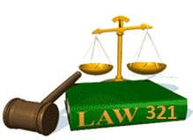
Slide Set Four A:
The Law of Business Organizations

Slide 2
Last Time – We Spoke About:
The Executive Branch
Part One: Federal and State / Powers / Regs / Executive Orders
The Judicial Branch
Part Two: Federal and State / Jurisdiction / Powers / The Courts
The Legislative Branch
Part Three: Federal and State / Powers / Statutes / Oversight
Class Exercise – How A Bill Becomes A Law
And How to Run for Public Office

Slide 3
Tonight – We Will Speak About:
The Law of Business Organizations
Part One: Principles of Business Organization
The Nature of Business Organizations
The Nature of Agency
Part Two: Definitions /Elements of Agency /Examples of Agency Contracts Between Agents and Principals
The Purpose of Agency / Creating the Agency Relationship
Termination of Agencies and Duties and Liabilities
Agency and Employment
Part Three: Definitions / Employment Law / Collective Bargaining
Equal Opportunity / Civil and Human Rights
Class Case – Maurillo v. Park Slope U-Haul
Recognition of Contractual Elements

Slide 4
The Law of Business Organizations
Principles of Business Organization
The Nature of Business Organizations

Slide 5
An Adventure in the Law
To start our Adventure we need to think about
what we are going to cover this semester:
The course syllabus serves as our road map.
We will talk about
Business Organizations
Agency;
Sole Proprietorships;
Partnerships;
Corporations;
Public Authorities;
Limited Liability Companies;
Freedom.

Slide 6
The Law of Business Organizations
Principles of Business Organization
1. Business Organizations are creatures of law;
2. Agents stand in the shoes of their Principals;
3. Sole proprietorships are the easiest and most prominent form of ownership, with 3/4 of all businesses operating in that form;
4. In a Partnership, your partner can be more important than your spouse;
5. Business Corporations are artificial persons under the law, with rights of a person. They are formed for one purpose: to conduct a business for profit. Profit is not a dirty word. It is one of the greatest human motivators, providing jobs, opportunities and innovation;
6. Limited Liability Companies are the child of Partnerships and Corporations;
7. Public Authorities are Corporations designed to do the work of Government;
8. Freedom is the most powerful form of human existence. True freedom is linked to the worth of the individual, and their ability to pursue property and happiness.

Slide 7
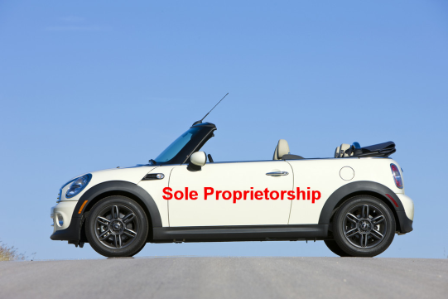
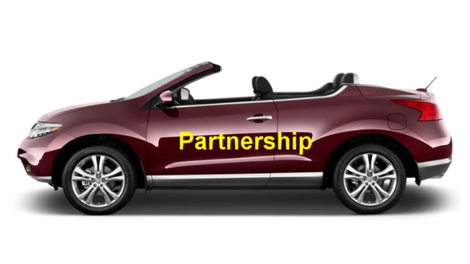
The Law of Business Organizations
The Nature of Business Organizations
This is a class on the Law of Business Organizations
One can not have a true understanding the Law of Business and the Organizations which are its vehicle to accomplish its goals, unless they have a true understanding of the Law.
Moreover, to truly understand the Law of Business, we need to understand these Organizations as the vehicle which delivers the needs of Commerce.
That requires us to have an understanding of the Law which governs the rules of the road upon which we drive that vehicle.
That is why our last three classes were an overview of the Law.

Slide 8
Thank you for your Attention
For next time – Review Assignments as follows on the Webpage:
Lectures, Slides and Cases
Selected Readings
Weekly Information Sheets
We are a hot bench.
Questions?

