Slide 1

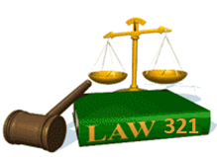
Slide Set Four B:
The Law of Agency

Slide 2

Last Time – We Spoke About:
The Executive Branch
Part One: Federal and State / Powers / Regs / Executive Orders
The Judicial Branch
Part Two: Federal and State / Jurisdiction / Powers / The Courts
The Legislative Branch
Part Three: Federal and State / Powers / Statutes / Oversight
Class Exercise – How A Bill Becomes A Law
And How to Run for Public Office

Slide 3
Tonight – We Will Speak About:
The Law of Business Organizations
Part One: Principles of Business Organization
The Nature of Business Organizations
The Nature of Agency
Part Two: Definitions /Elements of Agency /Examples of Agency Contracts Between Agents and Principals
  The Purpose of Agency / Creating the Agency Relationship
  Termination of Agencies and Duties and Liabilities
Agency and Employment
Part Three: Definitions / Employment Law / Collective Bargaining
Equal Opportunity / Civil and Human Rights
Class Case – Maurillo v. Park Slope U-Haul
Recognition of Contractual Elements

Slide 4
The Nature of Agency
Definitions and Elements of Agency
Examples of Agency
  Contracts Between Agents and principals
  The Purpose of Agency
  Creating the Agency Relationship
  Termination of Agencies
  Duties and Liabilities

Slide 5
The Nature of Agency
The Wonderful World of Agency
And Now:
The Wonderful World of Agency
Principle One:
Agents stand in the shoes of their Principals.

Slide 6
The Nature of Agency
Definition
Black’s Law Dictionary, the Gold Standard of Legal Definitions, defines the “Agency” as:
“A fiduciary relationship created by express or implied contract, or by law, in which one party (the agent) may act on behalf of another party (the principal), and bind that other party by words or actions.”
Notes:
6

Slide 7
The Nature of Agency
The Elements of the Agency Relationship
The elements of an “Agency Relationship” include:
A fiduciary relationship;
Created by:
Express conduct;
Implied contract, or
Law;
3. In which one party (the agent);
4. May act on behalf of another party (the principal);
5. By their legally valid authority; and
6. Bind that other party by words or actions.
Notes:
7

Slide 8

The Nature of Agency
Examples of Agents
Real Estate

Slide 9

The Nature of Agency
Examples of Agents
Insurance

Slide 10

The Nature of Agency
Examples of Agents
Sports

Slide 11

The Nature of Agency
Examples of Agents
Theatrical

Slide 12
The Nature of Agency
The Contractual Agreement
All Agencies Arise From Contract: The Fundamental Nature of the Agency Relationship, is that it arises out of contract.
It is through this contract where the agent agrees to stand in the shoes of the principal.
Basis of the Contractual Relationship: More Specifically, the Contract liability in agency refers to the legal relationship whereby one party (called an agent) is legally authorized to represent the other party (called a principal) in business dealings with third parties.
  Scope of Appointments: A principal may appoint an agent to do any act EXCEPT an act which by its nature, by public policy, or by contract, requires personal performance by the principal.

Slide 13
The Nature of Agency
The Contractual Agreement
When an Agency Relationship Arises: An agency relationship exists when the parties agree to an express or implied agreement (a contract), whereby one person, the agent, is authorized to make agreements, with third persons, on behalf of, and subject to the control of, the other person - the principal.
The agent stands in the shoes of their principal.
Classification of Agents: Under a contract of Agency, Agents can be classified within three categories:
Special Agents: A special agent is authorized by the principal to handle a specific business transaction.
General Agents: A general agent is authorized by the principal to transact all business affairs of the principal at a certain place.
Universal Agents: A universal agent is authorized by the principal to perform all acts that can be legally delegated to a representative.

Slide 14
The Nature of Agency
The Purpose of Agency
  Binding the Principal: The effect of a proper exercise of authority by an agent, is to bind the principal and third person to a contract.
The agent stands in the shoes of their principal.
  Non Liability of Agents: The agent, not being a party to the contract, is not liable, in any respect, under the contract.
Agent
Principal
deals with third person
and makes contracts on
behalf of principal
Third
Person
Parties to
the contract(s)

Slide 15
The Nature of Agency
Creation of the Agency Relationship
Elements of the Creation an Agency Relationship: Certain elements must exist to create an agency relationship.
Capacity: There must exist the capacity to enter into the agency agreement.
Formalities: Many of the formalities of a contractual relationship must be present.
Consent of the parties must exist;
Consideration need not exist (can have voluntary agencies); and
No Written Contract Required (unless covered by statute of frauds)
  Modes of Creation: There must a contractual relationship established:
a. By Act of the Parties
Actual Authority;
Apparent Authority;
Inherent Authority; and
Ratification
b. By Operation of Law
Estoppel; or
Statute

Slide 16
The Nature of Agency
Creation of the Agency Relationship - Capacity
Capacity: A threshold (condition precedent) to the creation of an agency relationship is that the respective parties must have CAPACITY.
Defined: Capacity has been defined as:
“The power to create or enter into a legal relationship under the same circumstances in which a normal person would have the power to create or enter into such relationship”, and
“The satisfaction of a legal qualification, such as legal age or soundness of mind, that determines one’s ability to enter into a binding contract.”

Slide 17
The Nature of Agency
Creation of the Agency Relationship - Capacity
Capacity: A threshold (condition precedent) to the creation of an agency relationship is that the respective parties must have CAPACITY.
Principals and Agents: The degree of capacity required for a principal differs from that required for an agent.
Principal Must Have Contractual Capacity: Generally, one who has contractual capacity may be a principal and enter into a contract through an agent.
Minors: As a general rule, a minor cannot bind himself absolutely in contract; therefore, his appointment of an agent as well as the agent's actions are voidable and can be disaffirmed.
Incompetents: An incompetent's appointment of an agent as well as the agent's actions may be disaffirmed by the incompetent or his committee or personal representative.
Unincorporated Organizations: Unincorporated not-for-profit organizations such as churches and clubs CANNOT be principals. (However, members of such organizations may be held jointly liable as principals if they have authorized or assented to the act giving rise to the litigation.)
Agents Generally Need Not Have Contractual Capacity: As a general rule, any person may be an agent, even if they have no contractual capacity. But there are limitations to this rule.
Minors: Minors may validly be appointed as agents.
Incompetents: Individuals incompetent to enter into a valid contract on their own behalf may still act as another's agent.
Exceptions: Courts nonetheless, have held that a minimal age and mental capacity is usually required.
Disqualification of Agents: A person, however, can be disqualified from being an agent.
Representation of Both Parties: An agent cannot represent both parties unless both parties are fully advised of the facts and agree to the dual representation.
Self-Dealing: The agent may not secretly act for her own account.
Not Licensed: If the law requires the agent to have a license, he cannot act as an agent without one (such as certain brokers, real estate agents, or insurance agents). In practice, this means that the unlicensed agent cannot recover commissions for their work.

Slide 18
The Nature of Agency
Creation of the Agency Relationship - Formalities
Formalities: To establish an agency relationship, certain formalities must be established. These include:
Consent: As the relationship is a contract, consent must be manifested by both the principal and the agent to create an agency relationship.
No Consideration Required: Unlike a standard contract, however, consideration is not necessary for the creation of an agency relationship.
Writing – No Written Contract Required: Generally, the agency agreement can be oral and need not be in writing, but there are exceptions.
General Rule-No Writing Required: Another exception to this contractual relationship is that normally, the existence of the agency DOES NOT have to be evidenced by a writing. This is true even where the Statute of Frauds requires the agreement that the agent is entering on behalf of the principal to be in writing.
Conveyance of Real Estate: An exception to this exception, however is where a party relying on a written contract of sale of an interest in realty greater than one year must show that the agent's authority to sign was in writing or that the principal has ratified the signing. [See N.Y.S. General Obligations Law §5-703, §5-1111]

Slide 19
The Nature of Agency
Creation of the Agency Relationship – Modes of Creation
By Act of the Parties: There are four ways in which the parties may create an agency relationship. They are as follows:
1. Actual Authority: The principal may, by direct communication to the agent, orally or in writing, actually appoint and authorize the agent to act on the principal's behalf.
2. Apparent Authority: The principal may, by communication to the third party, orally or in writing, indirectly authorize the agent to act on the principal’s behalf.
3. Inherent Authority: The principal, by actually authorizing the agent to act, may be liable for acts performed by the agent, even if such acts are in violation of the principal's orders.
4. Ratification: An agency relationship may be created by the principal's later, subsequent affirmation (ratification) of the actions of one who purported to be acting on behalf of the principal. Basically, a ratification affirms a previously unauthorized act.

Slide 20
The Nature of Agency
Creation of the Agency Relationship – Modes of Creation
By Operation of Law: There are two ways in which the law may create an agency relationship. They are as follows:
1. Estoppel: In certain instances, the law may impose an agency relationship under the doctrine known as estoppel. Under these circumstances the principal is legally estopped from denying the existence of the agency under a theory of equitable relief.
Note: There is little difference recognized in law between estoppel and apparent authority as they both depend on a third person's reliance on a communication from the principal. The former is merely an equitable remedy to prevent unjust enrichment, while the latter gives rise to a contract with its accompanying rights and obligations.
2. Statute: In other instances an agency may be created by statute. Such statutes are usually, however, designed to accomplish or address a limited purpose.
Example: Certain statutes will designate the Secretary of State as an agent for the limited purpose of receiving service of process. [See N.Y.S. Vehicle and Traffic Law §2531]

Slide 21
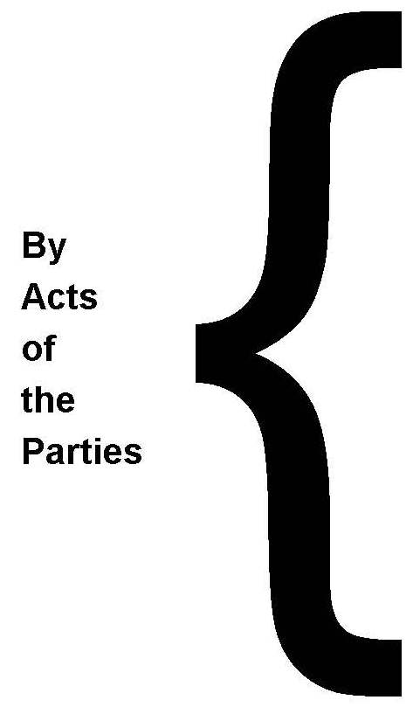
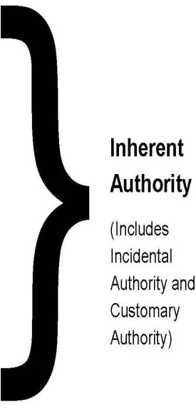
The Nature of Agency
Creation of the Agency Relationship – Modes of Creation
Express authorization — appointed to act for or on behalf of another
AGENCY BY
APPOINTMENT
Actual Authority (Such as Power of Attorney)
Conduct of principal as to agent and third person consistent with the existence of an agency relationship
AGENCY BY
CONDUCT
Apparent Authority
AGENCY BY
RATIFICATION
With knowledge of an agent’s act, the principal accepts or retains the benefit of the act, or brings an action to enforce legal rights based on the act, or defends the action, or fails to repudiate the act.
AGENCY BY
OPERATION OF LAW
Statutes or Courts create or find an agency when none would otherwise exist.

Slide 22
The Nature of Agency
Creation of the Agency Relationship – Types of Authority
Actual Authority
No Authority
Apparent
Authority
Express
Authority
Express Authority: Principal tells agent to perform a certain act
Buy new office furniture and sell specified used furniture
Incidental Authority: An act reasonably necessary to perform the act expressly authorized by the principal
Buy furniture on credit when funds are
not made available to pay for items.
Incidental
Authority
Customary
Authority
Customary Authority: An act that, according to the custom of similar businesses in the community, usually
accompanies the act performed under
express authority.
Issue receipts for used furniture sold
Apparent Authority: Principal leads third party to believe that the agent has authority to serve as an agent.
Principal was present when third party
purchased furniture from agent and did
not stop the unauthorized transaction.

Slide 23
The Nature of Agency
Creation of the Agency Relationship – Actual Authority
Actual Authority – Defined: Black’s Law Dictionary defines actual authority to mean:
“Such authority as a principal directly and intentionally confers on the agent, or intentionally or by want of ordinary care allows the agent to believe himself to possess.”
Actual Authority - The Three Part Test: In determining whether a prospective agent has actual authority, it must be determined:
1. Whether the requisite formalities, if any, have been complied with;
2. What type of actual authority (express or implied) is present; and
3. Whether the authority has been terminated.
Types of Actual Authority: Actual or real authority is that authority the agent reasonably thinks they possess. It does not depend upon knowledge of, or reliance by, the third party. There are two basic types of real authority:
Express Authority: That authority contained within the "four comers" of the agency agreement. It is the authority contained in the communication, whether written or oral, from the principal to the agent. Generally, the grant is, but need not be, in writing.
Implied Authority (Includes Incidental and Customary): Implied actual authority is authority that the agent (not the third party) reasonably believes they have as a result of the actions of the principal.

Slide 24
The Nature of Agency
Creation of the Agency Relationship – Actual Authority
Termination of Actual Authority: Once having determined that the requisite formalities exist, and that there express or implied actual authority has been afforded, Such authority may be terminated. This Termination may occur by:
1) Lapse of Time
a) Specified Time
b) Time Not Specified
2) Happening of Event
3) Breach of Agent's Fiduciary Duty
4) Change of Circumstances
a) Destruction of the subject matter of the authority;
b) A drastic change in business conditions;
c) A change in relevant laws; and
d) Insolvency of the agent or principal, if relevant.
5) Unilateral Act of Principal or Agent
6) Operation of Law
a) Death
b) Incapacity of Principal
c) Dissolution of Corporation or Partnership

Slide 25
The Nature of Agency
Creation of the Agency Relationship – Actual Authority
Termination of Actual Authority: Once having determined that the requisite formalities exist, and that there express or implied actual authority has been afforded, Such authority may be terminated. This Termination may occur by:
1) Lapse of Time
a) Specified Time: If the agency relationship is to last for a set period of time, the agent's authority will terminate upon expiration of this period.
b) Time Not Specified: If there is no set period of time specified in the agreement between the principal and agent, the courts will imply termination within a reasonable time period.
2) Happening of Event
a) Identified Event: The agency agreement may specify that it is to last until a specified event happens. When that event takes place, authority will be terminated.
b) Note: Zamira is hired to work on public relations for the space exploration program until an astronaut has successfully been landed on Mars. With the first landing of an astronaut on Mars, the agency relationship terminates.
3) By Breach of Agent's Fiduciary Duty
A breach of a fiduciary duty by the agent terminates the agent’s authority.

Slide 26
The Nature of Agency
Creation of the Agency Relationship – Actual Authority
Termination of Actual Authority: Once having determined that the requisite formalities exist, and that there express or implied actual authority has been afforded, Such authority may be terminated. This Termination may occur by:
4) Change of Circumstances: A change of circumstances that should cause an agent to realize the principal would not want the agent to exercise her authority terminates her authority. A change of circumstances sufficient to bring about termination would include the following:
a) Destruction of the subject matter of the authority;
b) A drastic change in business conditions;
c) A change in relevant laws; and/or
d) Insolvency of the agent or principal, if relevant.
5) By Unilateral Act of Principal or Agent
Generally: Either the principal or the agent can unilaterally terminate the agency relationship.
Note: Communication of a declaration that the agency is at an end is sufficient. It is important to note that the power to unilaterally terminate the relationship exists even though the party who exercises that power may be in breach of the agency contract when they do so (i.e., the parties have the power, but may have to face the legal and financial consequences of such a termination). Accordingly, the breaching party could therefore be liable for damages.

Slide 27
The Nature of Agency
Creation of the Agency Relationship – Actual Authority
Termination of Actual Authority: Termination may occur by:
5) Operation of Law: An agency relationship may be terminated by operation of law without regard to the parties wishes.
a) Death:
(1) In General: The death of either the principal or the agent terminates the agency relationship at the time of death, with or without knowledge of the surviving party.
(a) Power of Attorney: A power of attorney (i.e., a written instrument authorizing an agent to perform specific acts), not involving a principal in the military service, terminates upon the death of either party
(2) Exceptions:
(a) Bank Transactions: The Uniform Commercial Code ("U.C.C.") provides that a bank may pay or collect the commercial paper of a customer until it receives notice of death and has a reasonable opportunity to act on it. Even with knowledge of the customer's death, a bank may for 10 days after the date of death, pay or collect commercial paper drawn on or prior to the date of death. [See U.C.C. §4-405]
(b) Military Employees: The death of a principal who is a member of the armed forces does not terminate a written power of attorney if the attorney-in-fact does not have actual knowledge or notice of the principal's death and acts pursuant to the power in good faith. [N.Y.S. General Obligations Law §3-501]
b) Incapacity of Principal
(1) Adjudicated: If the principal is formally adjudicated an incompetent, the prior authority possessed by his agent is immediately terminated and any transaction by the agent with third parties is void.
(a) U.C.C. Exception: U.C.C. section 4-405 provides that a bank may continue to honor transactions for a customer's account until it learns of the adjudication of incapacity and has a reasonable time to act.
(2) No Adjudication:
(a) Knowledge: If an agent enters into a transaction with a third party and the third party has knowledge of the principal's incapacity at the time of the transaction, the transaction is void.
(b) No Knowledge: If an agent enters into a transaction with a third party and the third party has no knowledge of the principal's incapacity other than death at the time of the transaction, the agreement is valid.
(c) Statute - Power of Attorney: N.Y.S. General. Obligations Law § 5-1505 authorizes a principal to provide in a written power of attorney (called durable) that the power shall not be affected by the subsequent incompetence or disability of the principal. If this authorization is given, all acts done by the attorney-in-fact during the subsequent disability or incompetence of the principal would have the same effect as if the principal were competent and not disabled. If a committee s appointed for the principal, then the attorney is accountable to the committee rather than to the principal. The committee may revoke, suspend, or terminate the power to the same extent as the principal were competent.
c) Dissolution of Corporation or Partnership: Generally, the dissolution of a corporation or partnership terminates any agency relationship.

Slide 28
The Nature of Agency
Creation of the Agency Relationship – Actual Authority
Irrevocable Agencies: There are two types of agencies that may not be unilaterally terminated by the principal:
1. Subject Matter: These irrevocable agencies occur where the agent has an interest in the subject matter of the agency,
2. Security: These irrevocable agencies occur where the agent has a power given for security.
a) Agency Coupled with an Interest: This is where an agent has an "interest" when they have been given immediately exercisable rights in the property.
Note: Dawn owes Edgar $20,000. Dawn gives Edgar a written power of attorney authorizing Edgar to sell her farm Black Rock, and to remit to Dawn any money received in excess of $20,000. Edgar accepts this as a discharge of Dawn’s debt. Dawn cannot revoke Edgar's power to sell Black Rock.
b) Power Given as Security: A power given as security is normally exercisable by the agent only upon a subsequent default by the principal. These transactions normally involve a loan to the principal with the principal posting collateral and giving the agent authority to sell in the event of a default.
Note: Powers given as security involve a principal-agent relationship where the agent is really acting for their own benefit. Therefore, even though agency is involved, the agent has their own interest in the subject matter of the agency power.
c) Agency Status: Strictly speaking, the above are not agencies at all because the first is technically an assignment for purposes of securing a loan, and in the second the agent is not acting under the control of the principal or for the principal, but as the principal where default occurs. In addition, unlike other agency relationships, these do not terminate by operation of law.

Slide 29
The Nature of Agency
Creation of the Agency Relationship – Apparent Authority
Apparent Authority – Defined: Black’s Law Dictionary defines apparent authority to mean:
“Such authority as the principal knowingly permits the agent to assume, or which he holds the agent out as possessing; including such authority as the agent appears to have and such authority as a reasonably prudent man, using diligence and discretion, in view of the principal's conduct, would naturally suppose the agent to possess.”
Effect of Apparent Authority: Generally speaking, a person is not responsible for the act of another who assumes to represent him, unless he has made the other his representative and conferred upon her the powers that she purports to possess.
Mere Assertion of Agency is Not Sufficient: The mere assertion by an agent of her powers is not sufficient to bind the principal because an agent cannot "bootstrap" her own authority. A third party must ascertain at his peril the authority of the agent. There is no presumption of agency.

Slide 30
The Nature of Agency
Creation of the Agency Relationship – Apparent Authority
Apparent Authority – Meaning: Sometimes referred to as “ostensible authority”, apparent authority relates to the actions of the principal in representing to others that the agent is in fact his agent.
Basic Theory: Where the principal "holds out" another as possessing certain authority, thereby inducing others reasonably to believe that such authority exists, the agent has apparent authority to act, even though as between the agent and the principal such authority has not been directly granted.
Note: Apparent authority differs from actual authority in that apparent authority arises out of the reasonable beliefs of third parties, whereas actual authority arises out of reasonable beliefs of agents.
1. "Holding Out" by Principal
a) Affirmative Action: The "holding out" may be by word or conduct on the part of the principal.
Note: Pat tells Tom that Anne is Pat's agent and has the power to contract for Pat. In fact, Anne has no actual authority to contract for Pat. If Anne contracts with Tom on Pat's behalf, then Pat will be bound under the doctrine of apparent authority.
b) Inaction: The "holding out" may also be by inaction on the part of the principal. Accordingly, when it comes to agency, there must be some duty to act, (i.e., to disclose) or apparent authority will attach.
Note: Anne, in Pat's presence, tells Tom that she is Pat's agent when in fact she is not. Under these circumstances, Pat has a duty to correct A's representation; if he does not, Anne will have apparent authority to act on Pat's behalf.
2. Reasonable Reliance by Third Party: In addition to the requirement that some "holding out" must be traceable to the principal, the third party must reasonably rely on the "holding out."
3. Negligence on Part of Principal: Where the principal's negligence was the proximate cause of the acts of an unauthorized person, the principal may be estopped from disclaiming liability to third parties.
Note: Alex, president and treasurer of Yelraf Motors Corp., leaves the corporation checks and the corporation signature stamp on his desk, in plain view, overnight. While cleaning up that night, without authorization, the janitor executes several of the corporation checks and cashes them early the next morning. Alex, having negligently allowed this to occur, is liable on the checks cashed by the janitor. [See U.C.C. §3-406]

Slide 31
The Nature of Agency
Creation of the Agency Relationship – Inherent Authority
Inherent Authority – Defined: Inherent authority or inherent agency power, is an equitable doctrine, and results in the principal being bound by the agent's acts in certain situations even when the agent has no actual or apparent authority.
Basic Rationale: The principal will sometimes be held liable on inherent authority grounds due to balancing interests. Courts normally tend to want to protect innocent third persons as opposed to a principal, who in fact gave some actual authority to the agent. In effect, the principal that turned the agent loose on the world, should have some responsibility for their misdeeds.
Examples:
1. Respondeat Superior: The principal is held liable for the torts of an employee committed within the scope of employment even though there is no actual or apparent authority.
2. Conduct Similar to that Authorized: Where a general agent exceeds their actual authority but the act performed is similar to the act authorized, the principal will be held liable.
3. Improper Disposition of Goods-Apparent Ownership: One recurring problem is the improper disposition of goods by a person to whom they have been entrusted.
a) General Rule-Mere Possession Insufficient: Generally, the fact that the agent has possession of the principal's goods does not entitle the agent to sell them or transfer good title.
b) Indicia of Ownership: Where the principal transfers possession of property to the agent and gives the agent some document of title or other indicia of ownership, the agent has the power to transfer good title even though the
transfer is unauthorized.
c) Dealer in the Goods: Under the U.C.C., where a dealer in goods of the type sold improperly sells the principal's goods to a third party in the ordinary course of business, the third party takes good title. [See U.C.C. §2-403]

Slide 32
The Nature of Agency
Creation of the Agency Relationship – Ratification
Ratification – Defined: Black’s Law Dictionary defines "ratification" as the confirmation of an unauthorized act or contract after it has been made.
Generally: There are situations where an individual Prospective Agent will purport to act on behalf of a Prospective Principal without any type of authority. In such a situation, may still be bound by such Prospective Agent’s act if such Prospective Principal subsequently ratifies such Prospective Agent's act.
1. Effect of Ratification
a. The Principal is Bound: When the Principal ratifies an unauthorized transaction, they become bound on the contract.
b. The Agent is Relieved of Liability for Breach: Generally, when a prospective agent acts without authority he breaches his implied warranty of authority to the Principal and thus is himself liable on the contract. When ratification occurs however, the agent’s is relieved of this liability and it is taken up by the principal.
c. Contract Given Retroactive Effect: If ratified, a transaction will generally be treated as if it had been entered into with authority, but in some instances, the contact will only be effective upon the ratification and not the agreement of the agent.
2. What Constitutes Ratification
a. Prerequisites
1) The Prospective Principal Must Know Material Facts: There can be ratification only where the Prospective Principal has or reasonably should have knowledge of the material facts at the time of the alleged affirmance.
2) The Prospective Principal Must Accept Entire Transaction: Ratification must be of the entire transaction. The Prospective Principal may not merely ratify a portion of the transaction (unless, of course, the transaction[s] is severable).
3) The Prospective Principal Must Have Capacity: The Prospective Principal must be competent and of legal age in order to ratify.
4) No Consideration Needed: Ratification is a unilateral act of the Prospective Principal and requires no consideration.
b. Methods of Ratifying
1) Express Affirmance: A transaction may be expressly affirmed by the Prospective Principal.
2) Implied Affirmance: Conduct on the part of the Prospective Principal that would be consistent with approval of the heretofore unauthorized act may be taken as a ratification.
Acceptance of Benefits: If the Prospective Principal accepts the benefits of the transaction when it is still possible to decline, he will be deemed to have ratified.
Silence: If a Prospective Principal is silent where he would otherwise have a duty to disaffirm the transaction, his silence will act as a ratification.
Lawsuit: If a Prospective Principal brings a lawsuit involving the transaction, it will be construed as a ratification.

Slide 33
The Nature of Agency
Creation of the Agency Relationship – Ratification
Ratification: There are situations where an individual Prospective Agent will purport to act on behalf of a Prospective Principal without any type of authority. In such a situation, may still be bound by such Prospective Agent’s act if such Prospective Principal subsequently ratifies such Prospective Agent's act.
3. What May Be Ratified
a. General Rule: Anything a Prospective Principal could have legally done can be ratified. Accordingly, as long as a Prospective Agent’s act could have legally been performed or authorized by a Prospective Principal at the time a Prospective Agent acted, then the Prospective Principal may ratify.
Note: On June 1, Prospective Agent, without any authorization, contracts on Prospective Principal's behalf to establish an off-track betting parlor. On July1, the legislature legalizes off-track betting. Prospective Principal may not ratify after July1 because Prospective Agent’ s original act was illegal.
b. Exceptions:
Performance Illegal: If contract performance would be illegal at the time of the ratification, it may not be ratified.
Note: Assume same off-track betting example as above, except that offtrack betting was legal on June 1 and
outlawed on July 1. Accordingly, the Prospective Principal may not ratify after July 1.
Withdrawal by Third Party: If, prior to ratification, the third party indicates that she will not be bound by the contract, the Prospective Principal may not ratify.
Material Change of Circumstances: Where there has been a material change of circumstances so that it would not be equitable to hold the third party to the contract, there can be no ratification.
Note: Prospective Agent sells Prospective Principal’s house to Ken. Before ratification, the house is destroyed
by fire. Prospective Principal may not ratify.
4. Who May Ratify
a. General Rule: The general rule is that a Prospective Principal alone can ratify. A Prospective Principal may not elect to treat the contract as their own.
b. No Ratification by Undisclosed Principal: Because the act must be entered into by Prospective Agent Alex on behalf of Prospective Principal Pam, an undisclosed principal cannot ratify because the third party never relied upon her existence. (Compare with ratification in tort situations, however. There it is not necessary that the third party have knowledge of Pam as long as Alex intended to act on his behalf.)

Slide 34
The Nature of Agency
The Termination of the Agency Relationship
Termination of Agencies:
Who Can Terminate: An agency relationship can be terminated by either the principal or the agent, or both.
Means of Termination: An agency relationship can be terminated by means of:
Performance (the agency contract is fulfilled and completed);
Breach (one or both parties refuse to perform the agency contract);
Recission (the parties are returned to the status quo ante); or
Automatically.
Automatic Termination: An agency is automatically terminated upon:
The death of the principal or agent;
Insanity of the principal or agent;
Bankruptcy of the principal or agent;
Impossibility of performance; or
War.
Effect of Termination: The terminating party may be liable for damages to the other party, if the termination is by breach and the other party sues for a violation of the agency contract.
Notice:
Required Notice: When the law requires the giving of notice in order to end the power of the agent to bind the principal, individual notice must be given or mailed to all persons who had prior dealings with the agent.
General Notice: Notice to the general public can be given by publishing the announcement in a newspaper of general circulation in the affected geographic area.
When the Agency is Revoked: An Agency is revoked when agent receives notification of the termination, whereupon the Agent loses the right to bind the principal.
Notice to Third Persons: Termination of the agency is effective without giving notice to third persons, but the Agent may still have apparent authority, so it is a good idea to notify such third persons as well.

Slide 35
The Nature of Agency
The Agency Relationship – Duties of Agents and Principals
Duty Defined: Black’s Law Dictionary defines “DUTY” as:
1. A person’s action which is exactly conformable to the laws which require the person to obey them; or
2. A legal or moral obligation; or
3. Conduct or service which is obligatory; or
4. A mandatory obligation to perform.
A Simple definition of “Duty” is:
“A legally recognized obligation requiring
certain conduct by one person to another.”
The Concept of Duty” in Agency: As the nature of agency is a contractual relationship, it is based upon contractually defined duties between the principal and the agent.

Slide 36
The Nature of Agency
The Agency Relationship – Duties of Agents and Principals
General Rules: With respect to duties in agency, there are some general rules. Accordingly, when an agency relationship exists:
The agent owes the principal the duties of:
Being loyal,
Obeying all lawful instructions,
Exercising reasonable care,
Accounting for all property or money belonging to the principal, and
Informing the principal of all facts relating to the agency that are relevant to the principal’s interests.
The principal owes the agent the duties of:
Compensating the agent as agreed;
Indemnifying and protecting the agent against claims, liabilities, and expenses incurred in discharging the duties assigned by the principal;
Acting in accordance with the express and implied terms of any contract between the principal and the agent;
Good faith and fair dealing, due to the fiduciary nature of their relationship, however, a principal can be relieved of contractual obligations by an agent’s prior breach of contract; and
Indemnifying the agent for payments made during the course of the agency, when the agent acts within the scope of their actual authority irrespective of whether the expenditure was expressly authorized or merely necessary in promoting the principal’s business

Slide 37
The Nature of Agency
The Agency Relationship – Duties of Agents and Principals
Duties of Agent to Principal: The agent has whatever duties are expressly stated in their contract with their principal. Additionally, in the absence of anything contrary in the agreement, the agent has three major duties implied by law: loyalty, obedience, and care.
Duty of Loyalty: The fiduciary duty of an agent to his principal is one of undivided loyalty. If an agent has interests adverse to the interests of his principal (e.g., self-dealing or obtaining secret profits),
then such agent will be seen as in breach this duty by failing to disclose.
Duty of Obedience:
General Rule: An agent must obey all reasonable directions of his principal. While the principal may well be liable for the agent's acts in violation of directions (apparent or inherent authority), the agent will be liable to the principal for any loss that the principal suffers.
What Constitutes Reasonable Directions: Reasonableness depends on custom, the nature of the work, and contractual understanding.
Example: A janitor would be expected to follow minute instructions regarding his daily work effort while an attorney would not normally be expected to follow his client's directions as to how to draft a complaint.
Duty of Reasonable Care:
Compensated Agent: An agent owes a duty to his principal to carry out his agency with reasonable care, in light of local community standards and taking into account any special skills of the agent.
Gratuitous Agent: The modem trend is to hold a gratuitous or uncompensated agent to the degree of care customary in the community for one undertaking similar tasks without compensation. In most situations, this results in no difference between the standard for paid and unpaid agents.
Duty to Notify: An agent has a duty to notify his principal of all matters that come to the agent's knowledge affecting the subject of the agency. The effect of this rule is that notice of all such matters coming to the attention of the agent is imputed to the principal.
Example: Notice will not be imputed under certain circumstances, e.g., where the agent acts in their own interest and adversely to the principal, or where the agent and the third party attempt to commit a fraud on the principal.

Slide 38
The Nature of Agency
The Agency Relationship – Duties of Agents and Principals
Remedies of the Principal: The principal has a variety of remedies against the agent for breach of duty.
Action for Damages: An agent may be liable either for breach of contract or in tort.
Breach of Contract-Compensated Agents: A compensated agent may be held liable for damages suffered by the principal as a result of breach of contract. All of the remedies and methods of calculating damages that apply in normal breach of contract situations apply to a breach of contract for a compensated agent as well.
Tort-All Agents: An agent, whether compensated or gratuitous, may be held liable for damages resulting from their misuse of the principal's property, whether intentional or negligent, or because of misperfomance, or failure to perform.
Action for Secret Profits: Where an agent breaches her fiduciary duty and secretly profits, the principal may recover the actual profits or property held by the agent.
Example: Alan the Agent is employed full-time by Paula the Principal to purchase timberland for Paula in a designated area. Alan purchases some land in the designated area for himself with his own money. The law will find that Alan holds the land as constructive trustee for Paula and must convey it to Paula at cost.
Example: Alan the Agent is employed as a clerk in Paula the Principal's retail store. All goods are marked with a fixed price. Alan sells a $20 radio to a customer for $25. Alan must give Paula the additional $5 even though Paula has suffered no injury.

Slide 39
The Nature of Agency
The Agency Relationship – Duties of Agents and Principals
Duties of Principal to Agent:
Duties Imposed by Operation of Law:
Compensation: The principal owes the agent a duty to compensate her reasonably for their services unless, of course, the agent has agreed to act gratuitously. It should be noted that a principal has no duty to compensate a subagent, even if the agent was authorized to hire subagents, unless the principal agrees otherwise.
Reimbursement: The principal owes the agent (and any authorized subagent) a duty to indemnify them for all expenses or losses reasonably incurred in discharging any authorized duties, including any legal liability incurred by the agent in acting for her principal, unless the loss was due solely to the agent's fault.
Duties Imposed by Contract: The principal also has a duty to comply with the terms of any contract between him and the agent. Such a contract can, however, vary the terms of the common law duties.
Duty to Cooperate: As a general rule, the principal should cooperate with his agent to help her carry out agency functions. Thus, the principal must provide the agent with the requisite opportunities and not unreasonably interfere with the agent's performance. Accordingly, the scope of the duty is measured by what is reasonably contemplated by the parties.
Example: If Patty Principal hires Arthur Agent for $500 a month to sell widgets, Patty has no obligation to provide Arthur with widgets to sell. If Arthur is to be paid by commission however (or Arthur’s compensation is otherwise based on the results of her work), it is reasonable for Arthur to assume that Patty will provide him with an opportunity to work, and so must provide Arthur with widgets.
Example: If Patty Principal hires Arthur Agent to sell his empty factory building on commission, Patty cannot then lease the building to a third party.

Slide 40
The Nature of Agency
The Agency Relationship – Duties of Agents and Principals
Remedies of the Agent: The agent has a variety of remedies against the principal for breach of duty.
Breach of Contract: A compensated agent has the usual remedies for breach of contract. An agent does however have a duty to mitigate (lessen) their damages
Example: Anna the Agent executes an employment contract with Phillip the Principal. Under the 10-year written contract Anna will be provided with a salary of $40,000 per year. Phillip fires Anna after two years without cause. Anna cannot spend the next eight years in Acapulco on vacation and collect her
money. She must actively seek other employment (in an attempt to mitigate her damages).
Agent's Lien: An agent has a possessory lien (i.e., a claim against the principal's property held by the agent) for any money due to the agent, unless the contract provides otherwise.
Example: Alma the Agent purchases coins for Pherb the Principal with her own funds. Pherb does not reimburse Alma for the cost of the coins. If Alma still has possession of the coins, she has a lien upon them until Pherb pays her for the same.

Slide 41
The Nature of Agency
The Agency Relationship – Liabilities of Agents and Principals
Generally: Having established that there is a valid contract entered into by an agent for their principal, the next step is to determine who the parties to the contract are, and what their rights and liabilities are under the contract.
Third Party vs. Principal: The general rule is that if the agent had authority, the principal is liable to the third party.
Third Party vs. Agent: Whether an agent can be held liable on a contract depends on whether the principal was disclosed, partially disclosed, or undisclosed.
Disclosed Principal Situation (Defined): A disclosed principal is one whose existence and identity are known to the third party.
Disclosed Principal Liable: A disclosed principal is always liable on a contract entered into by an authorized agent.
Agent Generally Not Liable: A third party generally has no action against an agent in a disclosed principal situation because the contract is with the principal. There are, however, certain well-recognized exceptions to this rule:
1) Intent of Parties: Where the intent of the parties is that the agent shall be a party to the contract, they will be held liable.
2) Agent's Implied Warranty of Authority: When an agent enters into a contract purportedly on behalf of a disclosed principal, the agent makes an implied warranty of authority (i.e., a warranty that they have the authority that they purport to have). Thus, although the agent generally is not liable in contract when they contract for a disclosed principal, they may nevertheless be held liable to the third party for breach of their implied warranty if they acted without authority.
Partially Disclosed and Undisclosed Principal Situations (Defined): A partially disclosed principal is one whose existence, but not identity, is known to the third party. An undisclosed principal is one whose existence and identity are unknown to the third party.
Note: If the third party should have reasonably known that the person with whom they were dealing was acting for a principal, then they would be deemed to have known of the principal's existence.
Both Agent and Principal Liable: Both the agent and the principal are liable on a contract entered into by an authorized agent on behalf of a partially disclosed or undisclosed principal.
No Election to Hold Principal or Agent Required: The third party, upon learning the identity of the principal (and in the undisclosed principal situations also learning of his existence), may hold the principal and agent liable. A judgment against either one is not a bar to suit against the other except to the extent the judgment has been satisfied. [See U.C.C. §3-401]

Slide 42
The Nature of Agency
The Agency Relationship – Liabilities of Agents and Principals
Generally: Having established that there is a valid contract entered into by an agent for their principal, the next step is to determine who the parties to the contract are, and what their rights and liabilities are under the contract.
Third Party vs. Principal: The general rule is that if the agent had authority, the principal is liable to the third party.
Third Party vs. Agent: Whether an agent can be held liable on a contract depends on whether the principal was disclosed, partially disclosed, or undisclosed.
Right to Hold Third Party Liable on Contract:
Disclosed Principal Situation: Principal May Enforce Contract: In a disclosed principal situation, only the principal, not the agent, may enforce the contract and hold the third party liable.
Partially Disclosed and Undisclosed Principal Situation - Principal or Agent May Enforce Contract: In partially disclosed and undisclosed principal situations, either the principal or agent may enforce the contract and hold the third party liable. However, if the agent enforces the contract, the principal is entitled to all of the rights and benefits thereunder.
- Situations Where Principal May Not Enforce Contract: Where there is a partially disclosed or undisclosed principle, there are two situations where the principal may not enforce the contract. These include the following:
a) Fraudulent Concealment of Principal's Identity: Where an intentional misrepresentation of the principle’s identity is made to the third party, neither the agent nor the principal may enforce the contract.
b) Increase of Burden to Third Party: Where performance by the principal would impose an undue burden on the third party (by virtue of the fact that it is the principal and not the agent to whom performance must be made), the contract may not be specifically enforced and the third party will have a right to rescission

Slide 43
The Nature of Agency
The Agency Relationship – Liabilities of Agents and Principals
Generally: Having established that there is a valid contract entered into by an agent for their principal, the next step is to determine who the parties to the contract are, and what their rights and liabilities are under the contract.
Liability of Agent to Third Person:
Within the Scope of the Agent’s Authority – No Agent Liability: An agent who makes a contract with a third person within the scope of their authority, has no personal liability on the contract (as the liability is with the principal).
Warrantee of Agent: A person purporting to act as an agent for a principal, warrants by implication that there is an existing principal with legal capacity, and that the principal has authorized the agent to act. If such is not the case, the agent is solely responsible to the third party.
Not Within the Scope of the Agent’s Authority – Complete Agent Liability: If the person acting as an agent is not authorized, or not an agent, person holding themselves out as the agent is then liable for any loss caused to the third person.
Liability of Principal to Third Person:
Signature by Agents on Contracts: An agent takes on the assumption of liability for the contract, if such is signed by an agent, in the agent’s own name.
Contracts Signed by Agents Denoting the Agency: Upon the execution of the contract, if the agent wishes to avoid personal liability, they must sign the principal’s name and then put “by” or “per” agent’s name.
Agent’s Statements: A principal is bound by an agents statements when the agent makes such statements while acting within the scope of actual or apparent authority.
Agent’s Knowledge: A principal is legally imputed (deemed bound) by an agent’s knowledge gained while acting within the scope of actual or apparent authority. This is done to promote communication between agents and principles with respect to the transactions of the agency, and to protect third parties.

Slide 44
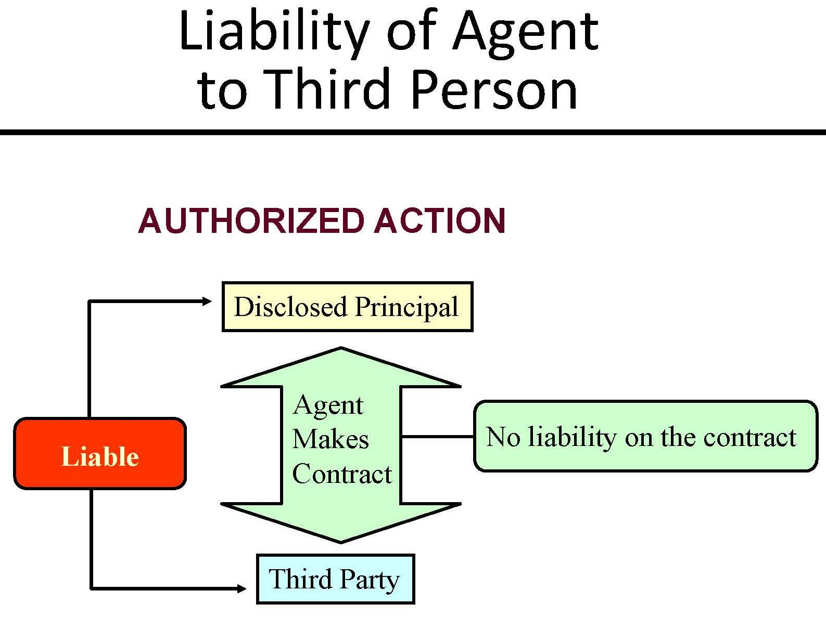
The Nature of Agency
The Agency Relationship – Liabilities of Agents and Principals

Slide 45
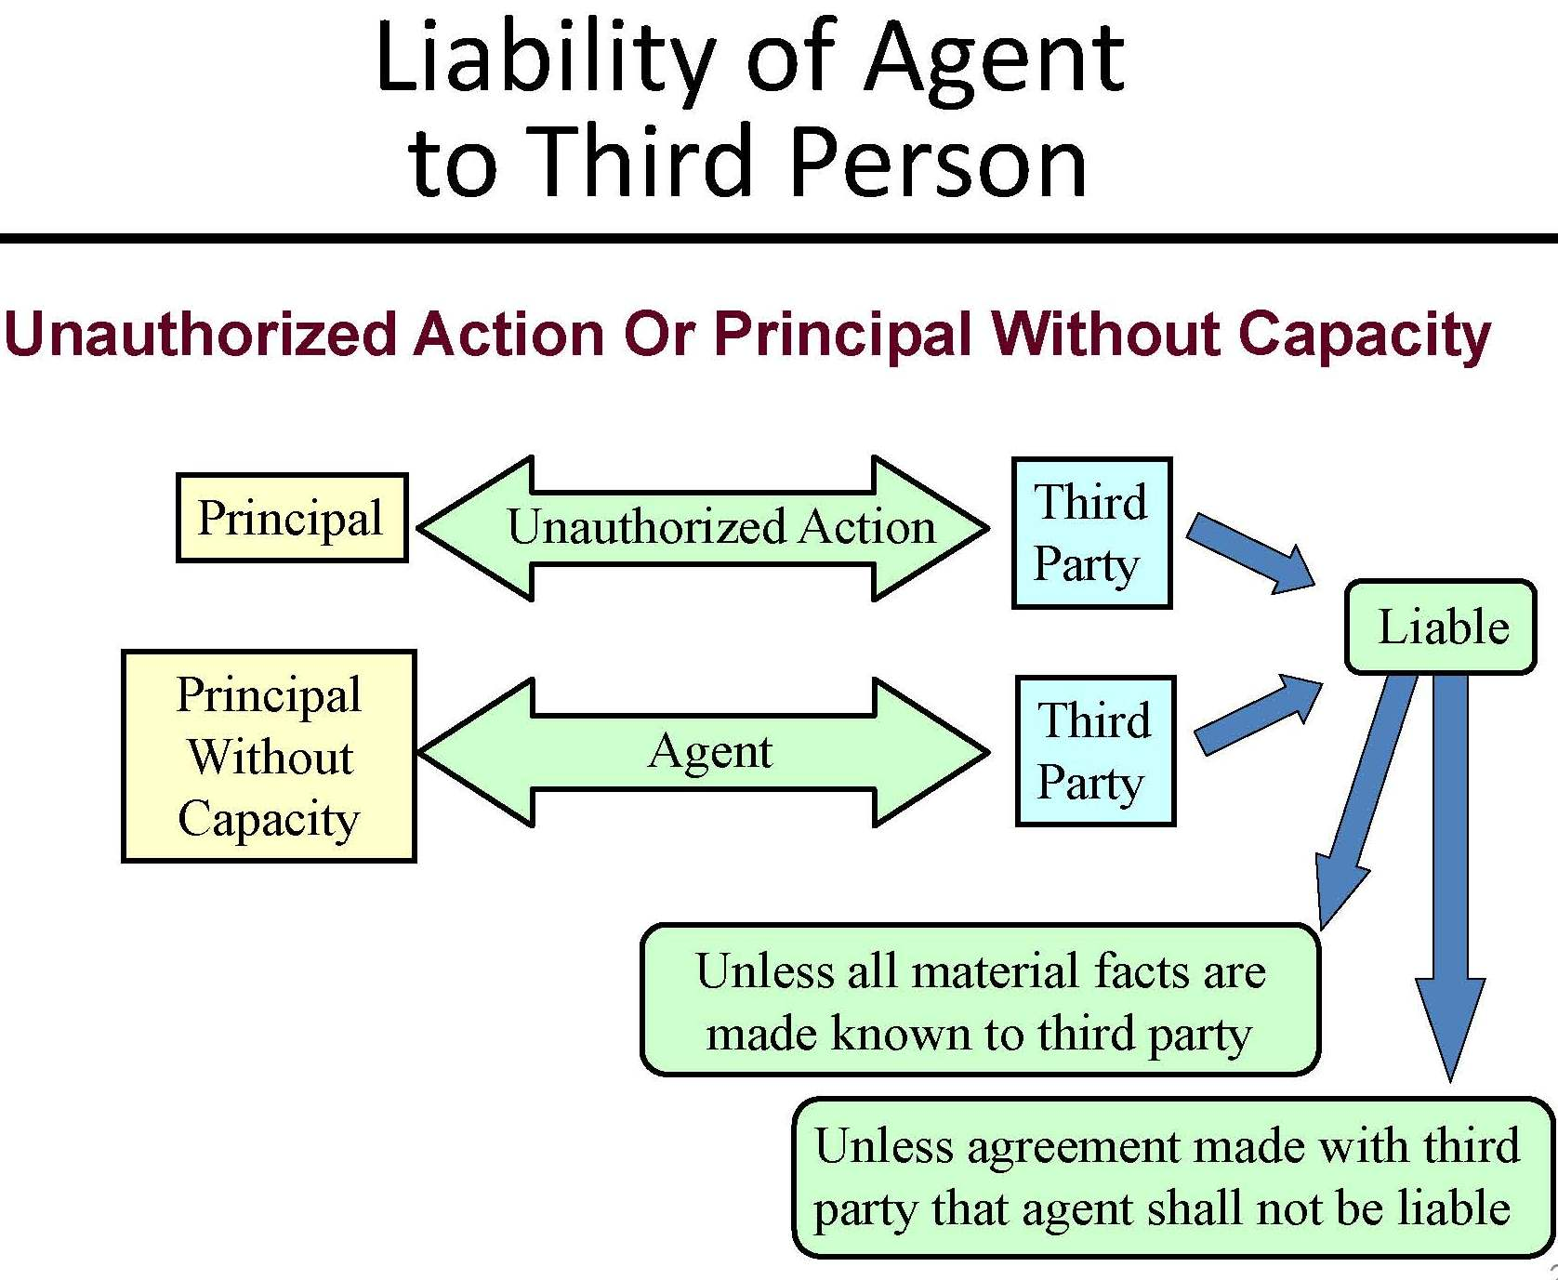
The Nature of Agency
The Agency Relationship – Liabilities of Agents and Principals

Slide 46
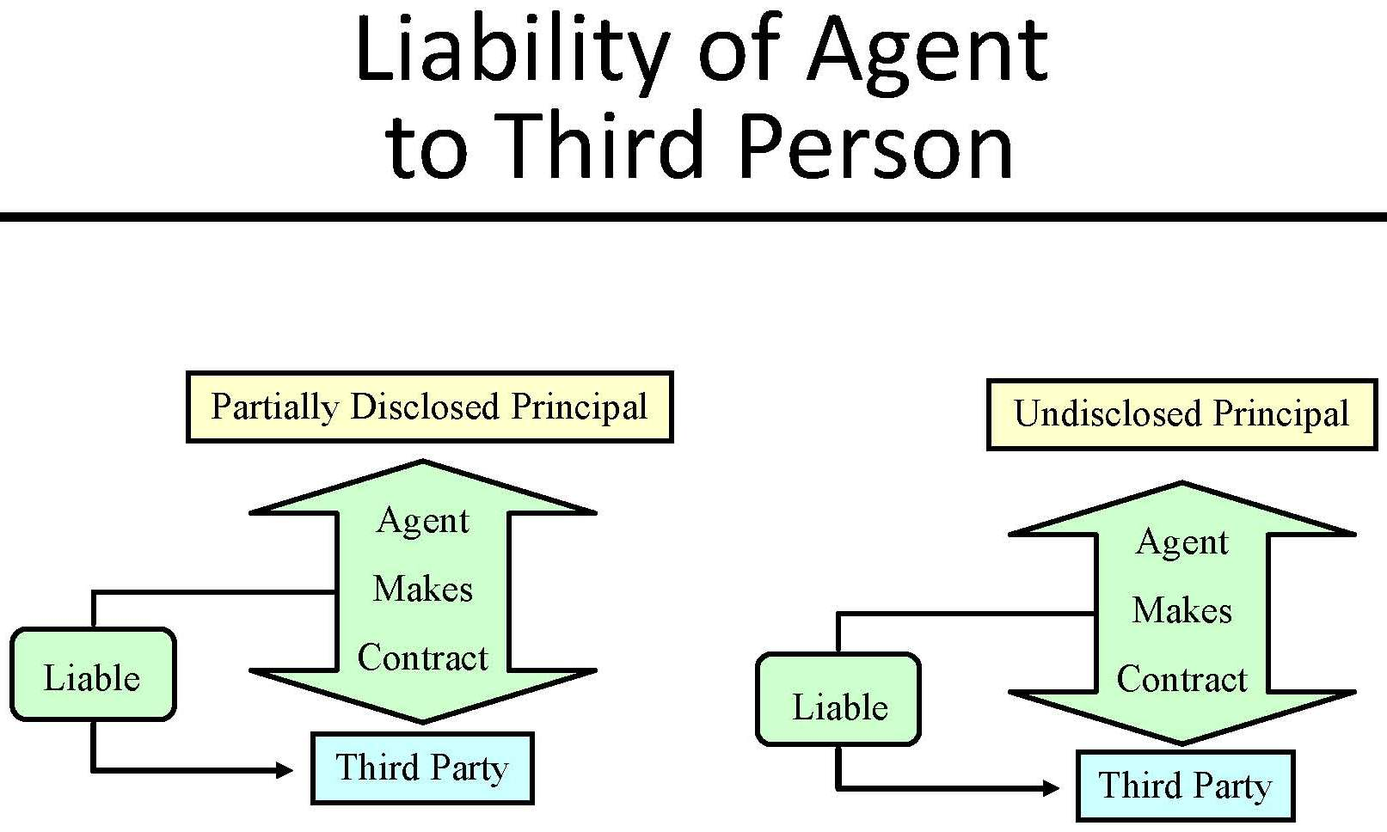
The Nature of Agency
The Agency Relationship – Liabilities of Agents and Principals

Slide 47
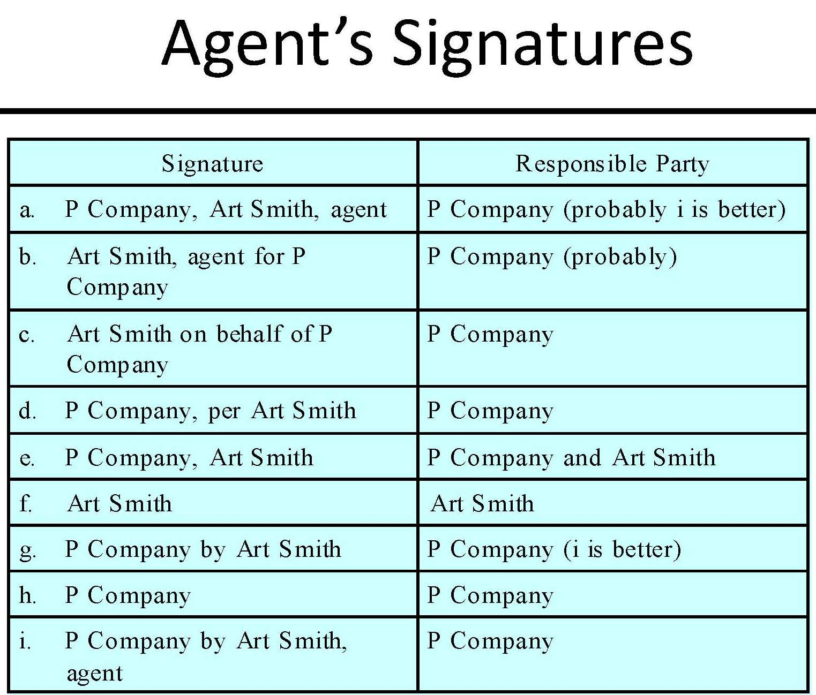
The Nature of Agency
The Agency Relationship – Liabilities of Agents and Principals

Slide 48
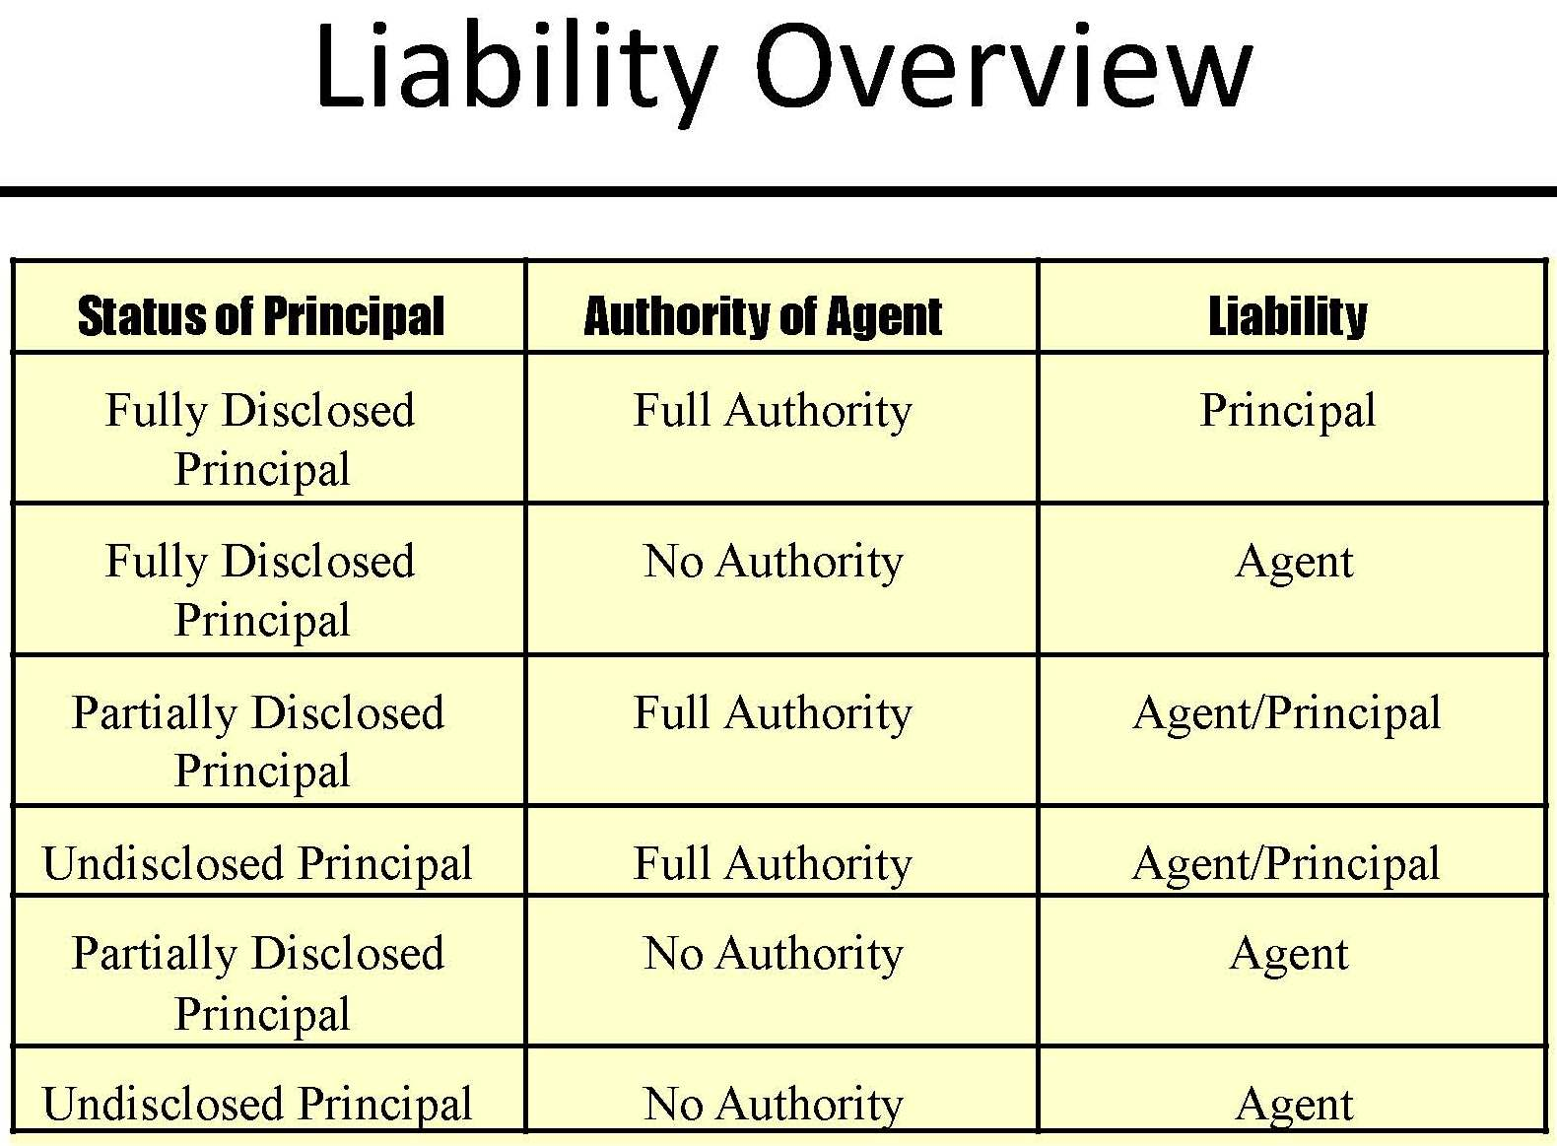
The Nature of Agency
The Agency Relationship – Liabilities of Agents and Principals

Slide 49
Thank you for Coming
For next time – Review Assignments as follows on the Webpage:
  Lectures, Slides and Cases
  Selected Readings
  Weekly Information Sheets
We are a hot bench.
Questions?

