Slide 1


Slide Set Four C:
The Law of Employment

Slide 2

Last Time – We Spoke About:
The Executive Branch
Part One: Federal and State / Powers / Regs / Executive Orders
The Judicial Branch
Part Two: Federal and State / Jurisdiction / Powers / The Courts
The Legislative Branch
Part Three: Federal and State / Powers / Statutes / Oversight
Class Exercise – How A Bill Becomes A Law
And How to Run for Public Office

Slide 3
Tonight – We Will Speak About:
The Law of Business Organizations
Part One: Principles of Business Organization
The Nature of Business Organizations
The Nature of Agency
Part Two: Definitions /Elements of Agency /Examples of Agency Contracts Between Agents and Principals
  The Purpose of Agency / Creating the Agency Relationship
  Termination of Agencies and Duties and Liabilities
The Law of Employment
Part Three: Definitions / Employment Law / Collective Bargaining
Equal Opportunity / Civil and Human Rights
Class Case – Maurillo v. Park Slope U-Haul
Recognition of Contractual Elements

Slide 4

The Wonderful World
of
Employment Law

Slide 5
The Nature of Employment
The Employment Relationship – Definitions
What is Employment:
Employment Defined: Black’s Law Dictionary defines “Employment” as:
1. Act of employing or state of being employed; or
2. That which engages or occupies; or
3. That which consumes time or attention; or
4. An occupation, profession, trade, post or business.
Simple definition of “Employment” is:
“An act to engage or hire one’s service,
in return for payment for such service.”
Labor Law Definition: A relationship where someone is “permitted or suffered to work”

Slide 6
The Nature of Employment
The Employment Relationship – Independent Contractors
Employment and Independent Contractors:
Definitional Standards:
Independent Contractor: A clear example of an independent contractor is one who has a calling of his own, is hired to do a particular job, is paid a given amount for that job, and who follows his own discretion in carrying out the job. The entity hiring the independent contractor has no right to control the manner and method in which an independent contractor performs the job.
Employee: A clear example of an employee, is one who works full-time for their employer, is compensated on a time basis, and is subject to the supervision of the employer in the details of the work. An employer has the right to control the manner and method in which an employee performs the job.
Determination of Right to Control:
Decerning Whether the Work Relationship is an Employee or Independent Contractor: There are many cases where it is not clear whether the relationship is one of employee or independent contractor. The single overriding factor in determining whether a person is an employee is whether the hiring entity has the right to control the manner and method by which the individual performs his tasks.

Slide 7
The Nature of Employment
The Employment Relationship – Employment at Will
Employment at Will v. Employment Contract
Employment at Will Concept:
New York State Law: New York State is an Employment at Will state.
Definition: This means that an employer can pay the employee what they wish (so long as it is above minimum wage), provide what benefits (if any) that they wish, and dismiss (fire) an employee for any reason, or for no reason whatsoever. as long as such reason is not an illegal reason (such as a violation of the Federal Civil Rights law or New York State Human Rights law).
Employment Contract:
Exception in the Law: An exception to the employment of will doctrine is when the employee and employer have an employment contract. In such instance the contract terms will govern the parameters of the employment. A collectively bargained employee is determined to have an employment contract as negotiated and approved by the employer and the employee’s representative (union).
When it is unclear if there is an Employment Contract:
Question Over Whether Employment Contract Exists: Under certain circumstances whether an employment contact exists can be unclear. Under such circumstances, courts have imposed other documents (such as an employee handbook or manual) to constitute an employment contract.

Slide 8
The Nature of Employment
The Employment Relationship – Employment Regulation
Employment Regulation:
Equal Opportunity:
Federal Civil Rights Law: The Federal Civil Rights Law Prohibit Employment Discrimination on the basis of race, color, religion, sex, or national origin, age, gender, disability and pregnancy. Such discrimination can be contested by means of a civil action under 42 U.S.C. Section 1983.
State Human Rights Law: Section 290 of the NYS Executive Law also provides that the “opportunity to obtain employment without discrimination because of age, race, creed, color, national origin, sexual orientation, military status, sex, marital status, or disability, is hereby recognized as and declared to be a civil right.” Such rights can be enforced through both civil and governmental actions.
Collective Bargaining:
National Labor Relations Act: The National Labor Relations Act (Wagner Act – 29 U.S.C Section 151 et seq.) that provides that private sector employees have a right to collectively bargain.
State Labor Relations Act: New York has a nearly identical law to the NLRA (contained within Articles 4, 5, 6 and 20 of the State Labor Law)
Taylor Law: This New York Law – Article 14 of the State Civil Service Law - grants public sector employees the right to collectively bargain.
Heath and Safety Laws:
Workplace Protection: Both Federal and State Governments have health and safety laws (Such as OSHA and Labor Laws) which regulate workplace conditions, minimum wages, and hours of employment.

Slide 9
The Nature of Employment
The Employment Relationship – Foundational Elements
Foundational Elements in Employment Law:
The Employment Relationship: The legal basis of the between employee and employer is created by the agreement of the parties and is determined by one of three foundational elements:
Employment At Will: This relationship exists when there is no written employment contract, and permits either or both parties to end the relationship at any time for any reason or no reason at all (so long as it is not a legally prohibited reason) without consequence.
Individual Employment Contract: This relationship exists when there is an individually written employment contract. In this circumstance both parties must follow the provisions of the contract with respect to work hours, performance and production, compensation and end of the relationship. Failure to do so will give rise to a breach of contract claim for the aggrieved party.
Collectively Bargained Employment Contract: This relationship exists when a representative (such as a union) of a collectively bargained group of employees, negotiates an employment contract that covers all the employees in the group (often called the collective bargaining unit). In this often highly structured contract, all terms and conditions of the employment relationship will be set forth, together with procedures to determine violations and variations, and the consequences thereof.
Employment Protection Laws
Protection Beyond Agreement: Although great flexibility is afforded to the parties in the conduct of the employment relationship there are certain legal protections afforded pursuant to both Federal and State Law, beyond the employment at will or contract standards, for health and safety reports and whistleblowers.

Slide 10
The Nature of Employment
The Employment Relationship – Foundational Elements
Additional Issues in Employment:
Labor Relations Laws:
The Right to Collectively Bargain: Both New York State and the Federal Government have recognized the fundamental right of workers to join a Union and Collectively Bargain for terms and conditions of employment.
Fair Labor Standards Act: This Federal Law regulates minimum wages, overtime hours and child labor. Articles 4, 5 and 6 of the New York State’s Labor Law also contains similar provisions.
National Labor Relations Act: As aforementioned, this Federal Law recognizes the rights of employees to form a union and to collectively bargain with an employer for terms and conditions of employment as embodied in an employment contract (often called a collective bargaining agreement). This law further recognizes the rights of employees to refrain from organizing and to decline union membership. Article 20 of the New York Labor Law (the State Labor Relations Act) embodies similar legal principles in state law.
National Labor Relations Board: The National Labor Relations Act establishes the National Labor Relations Board (NLRB). The NLRB is the administrative body which regulates and enforces the National Labor Relations Act, and as such, oversees union elections, organizing activities, and redress for violations of the NLRA.
Union Certification: Once a collective bargaining unit is organized and certified, employers have a legal duty to collectively bargain and recognize the union as the employees’ representative.
Right to Work Laws: The NLRA also recognizes state right to work laws which allow workers to choose not to collectively bargain.

Slide 11
The Nature of Employment
The Employment Relationship – Foundational Elements
Additional Issues in Employment:
Pension Plans:
ERISA – Employees Retirement Income Security Act: This Federal Law protects employees and their pensions by requiring:
High Standards of those persons or entities administering the funds;
Reasonable vesting of benefits;
Adequate capitalization of funds; and
Insurance to guarantee payments of earned benefits of beneficiaries (retirees).
Unemployment Benefits:
Nature of Benefits: Unemployment benefits are paid to persons for a limited period of time if they are out of work through no fault of their own. Persons receiving benefits must be:
available for job placement;
in a job with similar duties and comparable rate of pay to the job they lost.
Other Benefits:
Workers Compensation: Workers Compensation Insurance provides a scheduled loss benefit to persons injured in the course of their employment. As a consequence of this benefit:
Workers are prohibited from suing their employer for negligence.
The Federal Employers Liability Act, a Federal Law enacted prior to workers compensation, however, that does permit certain employees (railroads and stevedores) to sue and recover from their employer in federal court for injuries sustained in the workplace if they prove negligence in the slightest degree.
Family Medical Leave: This is paid leave for maternity, paternity and adoption.
Social Security: This provides economic benefits for retirement, disability and death.

Slide 12
The Nature of Employment
The Employment Relationship – Foundational Elements
Additional Issues in Employment:
Employee Privacy:
General Issues Concerning Employee Privacy: Federal and state statutes and constitutions, and case law determined thereunder, as well as employment contracts are the source of public and private sector employees’ privacy rights.
Specific Issues:
Employers have the legal right to monitor employee’s phone calls, internet traffic and email, (including authority under exceptions to the Federal Electronic Communications Privacy Act of 1986) but some state statutes do limit ease dropping on private, personal conversations;
Employers often notify employees of their policies on searching lockers, desks and offices, thereby reducing their expectation of privacy and legal recourse for violation;
Drug and alcohol testing is also generally permissible by an employer if it is based upon reasonable suspicion or for a safety-sensitive position; and
Privacy rights are legally viewed as a term and condition of employment and will therefore often be a subject of a collective bargaining agreement.
Employment Immigration Issues:
Nature of Issues: American Citizenship can be a condition of employment:
Immigration laws prohibit the employment of illegal aliens who have entered the United States by unlawful means; and
Employers are liable for not performing sufficient background checks to determine required immigration status, including not following verification procedures or compliance with special hiring programs.

Slide 13
The Nature of Employment
The Employment Relationship – Foundational Elements
Additional Issues in Employment:
Employment Discrimination:
Issues Concerning Employment Discrimination:
Federal Civil Rights Law:
Title VII of the Federal Civil Rights Act of 1964 (42 U.S.C. 2000, et seq.) forbids discrimination on the basis of race, color, religion, sex, or national origin on the basis of race, color, religion, sex, national origin, age, gender, disability or pregnancy.
The Federal Equal Opportunity Commission Administers the Act.
A discrimination claim in violation of the Act can be contested by means of a civil action under 42 U.S.C. Section 1983.
State Human Rights Law:
Section 290 of the NYS Executive Law provides that the “opportunity to obtain employment without discrimination because of age, race, creed, color, national origin, sexual orientation, military status, sex, marital status, or disability, is hereby recognized as and declared to be a civil right.”
Such rights can be enforced through both civil and governmental actions, administratively through the New York State Division of Human Rights, or by means of a civil action in state court.
Sexual Harassment:
Employers can be held vicariously liable for supervisors’ actions
Quid Pro Quo Cases
Hostile Work Environment
Non Supervisors

Slide 14
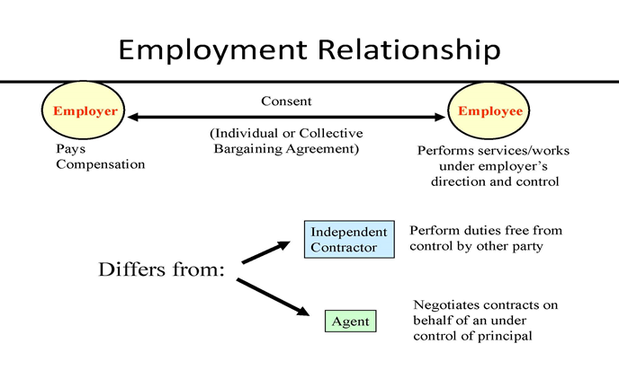
The Nature of Employment
The Employment Relationship

Slide 15
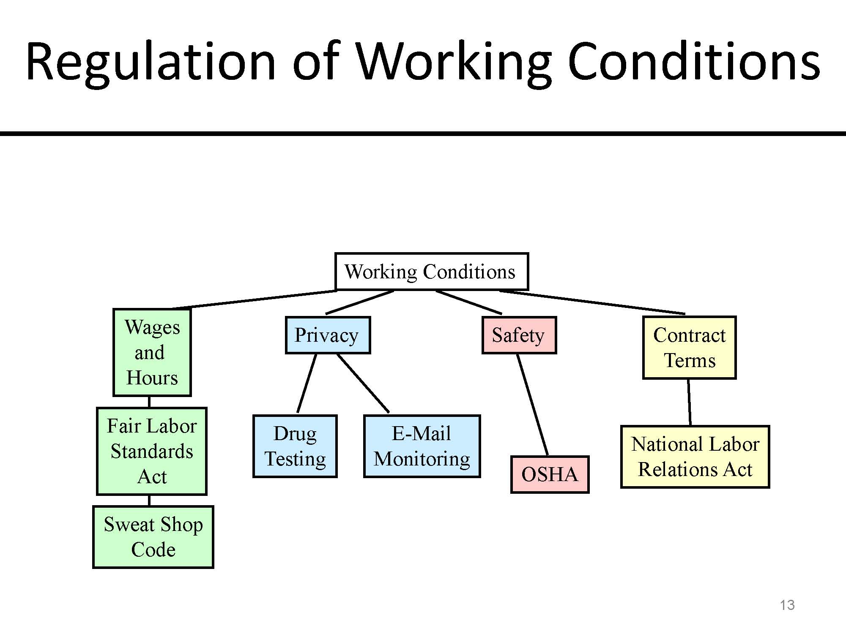
The Nature of Employment
The Employment Relationship – Workplace Regulation

Slide 16
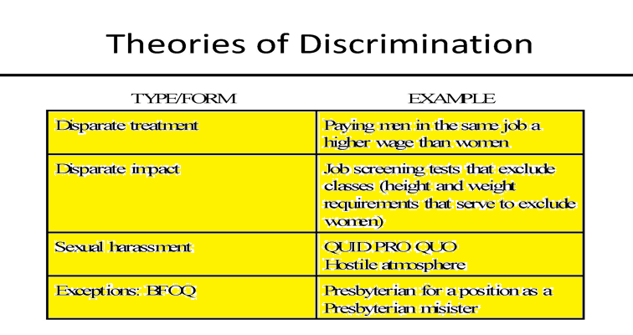
The Nature of Employment
The Employment Relationship – Theories of Discrimination

Slide 17
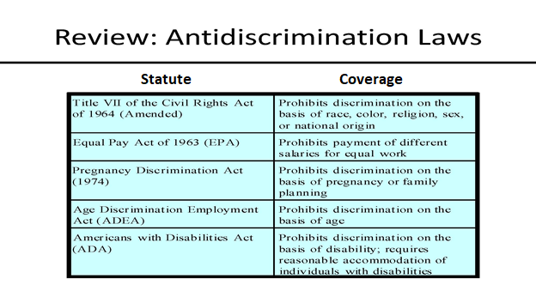
The Nature of Employment
The Employment Relationship – Antidiscrimination Laws

Slide 18

The Nature of Agency and Employment
The Agency and Employment Relationship – Case Study
The Case of the U-Haul Fall
Michael Maurillo et al. v. Park Slope U-Haul et al.

Slide 19
Thank you for Coming
For next time – Review Assignments as follows on the Webpage:
  Lectures, Slides and Cases
  Selected Readings
  Weekly Information Sheets
We are a hot bench.
Questions?

