Slide 1
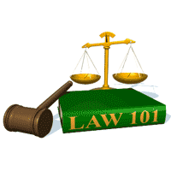
Slide Set 05A:
Introduction to Business Organizations
Sole Proprietorships

Slide 2
Last Time We Spoke About:
The Law of Business Organizations
Part One: Principles of Business Organization
The Nature of Business Organizations
The Nature of Agency
Part Two: Definitions /Elements of Agency /Examples of Agency Contracts Between Agents and Principals
The Purpose of Agency / Creating the Agency Relationship
Termination of Agencies and Duties and Liabilities
Agency and Employment
Part Three: Definitions / Employment Law / Collective Bargaining
Equal Opportunity / Civil and Human Rights
Class Case – Maurillo v. Park Slope U-Haul
Recognition of Contractual Elements

Slide 3
Tonight – We Will Speak About:
The Forms of Business Organizations
Part One: The Different Types of Business Organizations
Sole Proprietorships / Definitions / Formation / Operations
Advantages / Disadvantages / Doing Business As / Termination
Partnerships
Part Two: Nature of Partnerships / Definitions / Formation
Partnership Property / Relations Between Partners
Relations Between Partners and Third Parties
Dissolution / Termination of Partnerships
Franchises
Part Three: Definitions / Characteristics / Examples
Class Case – Congel v. Malfitano
Applying the Law of Partnerships

Slide 4
Forms of Business Organizations
The Different Types of Business Organizations
Types of Business Organizations
- Individual (Sole) Proprietorships
- Partnerships
- Corporations
Business Corporations,
Professional Corporations,
Public Benefit Corporations, and
- Limited Liability Companies
L.L.C.’s
- Organizations
Joint Ventures,
Unincorporated Associations,
Co-operatives, and
Franchises

Slide 5
Forms of Business Organizations
The Different Types of Business Organizations
Forms of Business Organizations
The four principal forms of business organizations are:
– Sole Proprietorships,
– Partnerships,
– Corporations, and
– LLC’s
The selection of the form of organization is determined by:
– Nature of the business,
– Tax considerations,
– Financial risk involved,
– Importance of limited liability, and
– The extent of management control desired.
Newly created forms of business
- The LLC
Allows for tax treatment as a partnership with some limited liability.
A great form of business organization for small businesses

Slide 6
Forms of Business Organizations
The Different Types of Business Organizations
Forms of Business Organizations:
An Unincorporated Association is:
an organization, club or group is a group of individuals
who enter into an agreement as volunteers
to form a body or organization
to accomplish a purpose.
Liability and Rights of an Unincorporated Association:
Everyone has a right under the federal constitution of free association, to associate and work with whom they choose.
As a result, any group of persons may, of course, may form or work as an association but in such case, the persons making a transaction in the name of the association all take responsibility for it
Cooperatives:
These Organizations exist when:
two or more persons or enterprises,
such as farmers,
cooperate to achieve a common objective,
such as the distribution of farm products.

Slide 7
The Nature of Sole Proprietorships
Definition
Meaning
Formation
Operations
Advantages
Disadvantages
Doing Business As
Termination / Dissolution

Slide 8
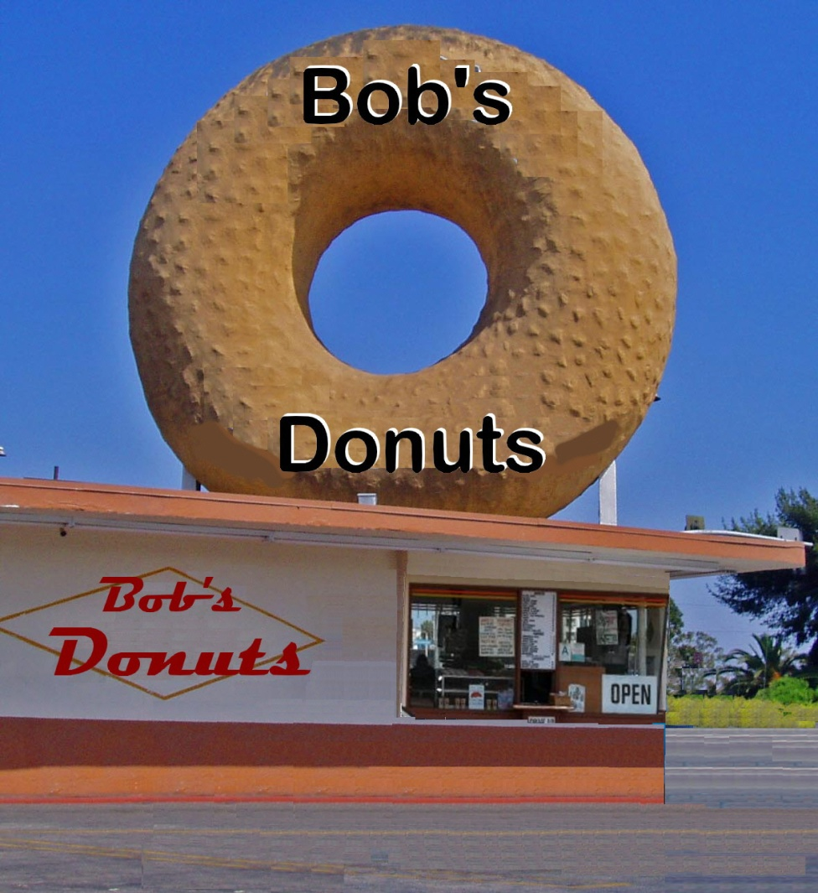
Forms of Business Organizations
So You Want to Start A Business
What type of Business
Organization do you
choose?
Tonight, we will discuss
the first possibility:
Sole Proprietorships

Slide 9
Forms of Business Organizations
Sole Proprietorship - Definition
Anderson’s Business Law, defines a “Sole Proprietorship” as:
“A form of business ownership in which one individual owns the business. The owner may be the sole worker of the business or employ as many others as needed to run the concern. Sole proprietorships are commonly used in retail stores, service businesses, and agriculture.”
Notes:
9

Slide 10
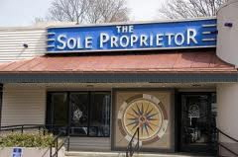
Forms of Business Organizations
Sole Proprietorship - Meaning
Sole Proprietorships:
Third Principle of Business Organization:
“Sole proprietorships are the easiest and most prominent form of
ownership, with 3/4 of all businesses operating in that form”
What is a Sole Proprietorship?
A sole proprietorship is a business established, owned, and controlled by a single person.
Sole proprietorships come in all shapes and
sizes.
The owner of a sole proprietorship
realizes all the profits and assumes all
responsibility for all losses.
The sole proprietorship is the most
prominent of the four forms of ownership.

Slide 11
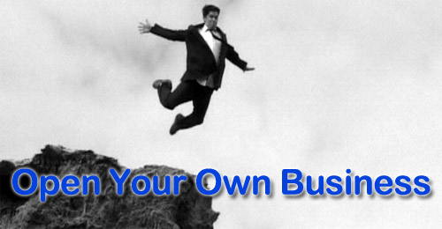
Forms of Business Organizations
Sole Proprietorship - Formation
Formation of a Sole Proprietorship:
Of the four forms of ownership, the sole proprietorship is by far the easiest to form.
The government exercises very little control over the establishment of new sole proprietorships.
Start-up can be immediate and simple.
You may need to obtain licenses or permits for your particular type of business. (DBA’s)

Slide 12
Forms of Business Organizations
Sole Proprietorship - Operation
Operation of a Sole Proprietorship:
Sole proprietors make all the decisions regarding the operation of the business.
The assets of sole proprietors are not considered legally separate from the assets of the business.
Owners of sole proprietorships report business income and expenses on their personal income tax returns.

Slide 13
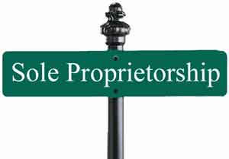
Forms of Business Organizations
Sole Proprietorship - Advantages
Advantages of a Sole Proprietorship:
Sole proprietorships are simple to start.
No formal action is required.
A sole proprietorship may be started immediately.
The owner has total control of all aspects of the business.
The business is nimble and easily adaptable to changes
The owner receives all the profits.
The business itself pays no income tax; the owner pays income tax as an individual on his or her individual return.

Slide 14
Forms of Business Organizations
Sole Proprietorship - Disadvantages
Disadvantages of a Sole Proprietorship:
No Liability Protection.
The owner is solely liable for all financial losses (and damages).
The owner has total control of all aspects of the business (including management).
The owner is solely responsible for all capital expenses.
The business itself pays no income tax; the owner pays income tax as an individual on his or her individual return.

Slide 15
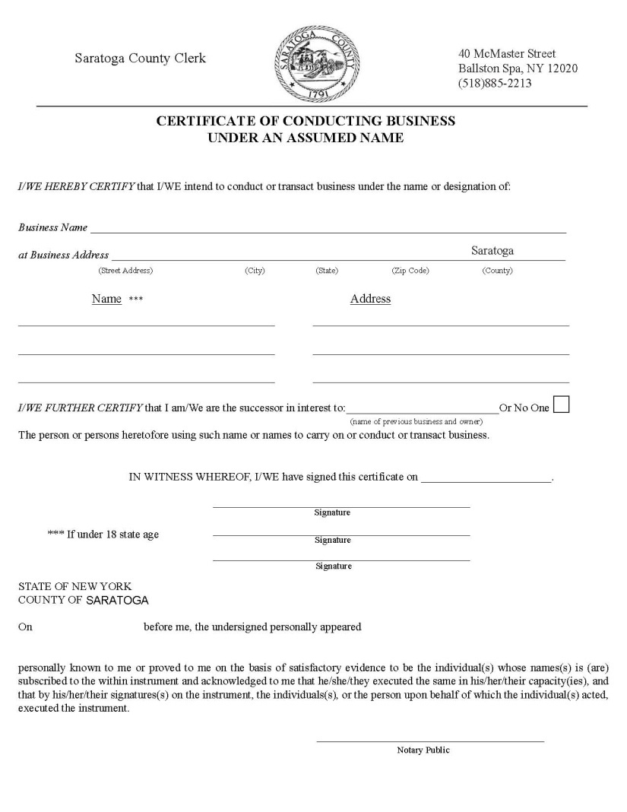
Forms of Business Organizations
Sole Proprietorship – DBA – Doing Business As
A DBA Certificate:
A “Doing Business As” (DBA) is a
certificate filed with a local government
(the office of the County Clerk in New
York State) that designates that a sole
proprietorship is being operated within
that community under a specific name.
The local government will require the
business owner file a form to provide
their name, type of business operated,
and address on the DBA application.
A DBA certificate is filed in every county
where the business operates
There is often a small filing fee for a
DBA (in Saratoga County for instance
it is $25 with a $5 certified copy fee).

Slide 16
Forms of Business Organizations
Sole Proprietorship – Termination / Dissolution
Dissolution of a Sole Proprietorship:
Of the four forms of ownership, the sole proprietorship is by far the easiest to dissolve.
The government exercises very little control over the termination or dissolution of sole proprietorships.
As all the business property is deemed that of the owning sole proprietor, dissolution and termination can be immediate and simple.
Additionally, any contracts or legal obligations
are also those of the owner, so no distributions
or liability sharing is necessary or required.

Slide 17
Thank you for Your Attention
For next time – Review Assignments as follows on the Webpage:
Lectures, Slides and Cases
Selected Readings
Weekly Information Sheets
We are a hot bench.
Questions?

