Slide 1
Slide Set 05C:
Introduction to Business Organizations
Franchises

Slide 2
Last Time We Spoke About:
The Law of Business Organizations
Part One: Principles of Business Organization
The Nature of Business Organizations
The Nature of Agency
Part Two: Definitions /Elements of Agency /Examples of Agency Contracts Between Agents and Principals
The Purpose of Agency / Creating the Agency Relationship
Termination of Agencies and Duties and Liabilities
Agency and Employment
Part Three: Definitions / Employment Law / Collective Bargaining
Equal Opportunity / Civil and Human Rights
Class Case – Maurillo v. Park Slope U-Haul
Recognition of Contractual Elements

Slide 3
Tonight – We Will Speak About:
The Forms of Business Organizations
Part One: The Different Types of Business Organizations
Sole Proprietorships / Definitions / Formation / Operations
Advantages / Disadvantages / Doing Business As / Termination
Partnerships
Part Two: Nature of Partnerships / Definitions / Formation
Partnership Property / Relations Between Partners
Relations Between Partners and Third Parties
Dissolution / Termination of Partnerships
Franchises
Part Three: Definitions / Characteristics / Examples
Class Case – Congel v. Malfitano
Applying the Law of Partnerships

Slide 4
The Nature of Franchises
Definitions
Formation
Operations
Advantages
Disadvantages
Doing Business As
Termination / Dissolution

Slide 5
Forms of Business Organizations
Franchise - Definition
Anderson’s Business Law, defines a “Franchise” as:
“A method of doing business, not a form of business organization. A franchise can be operated as a sole proprietorship, a partnership, a limited liability company, or a corporation. The franchise agreement is a contract that sets forth the rights and obligations of the parties. Contract law governs questions that arise under the franchise agreement.”
The Federal Trade Commission (FTC) defines a franchise under federal law, to be a commercial business arrangement that satisfies three definitional elements, where the franchisor must:
Promise to provide a trademark or other commercial symbol;
Promise to exercise significant control or provide significant assistance in the operation of the business; and
Require a minimum payment of at least $540 during the first six months of operations.”
Notes:
5

Slide 6
Forms of Business Organizations
Franchise - Meaning
What is a Franchise:
A Franchise is:
a contractual agreement,
whereby the owner of a trademark, trade name, or copyright,
licenses others to use the trademark or copyright to sell goods or services,
in a uniform, consistent manner, or
with a similar process or product line.
Liability of Franchises
A franchisor is not liable to third persons dealing with its franchisees.
Liability of the franchisor may, however, be imposed on the ground of the apparent authority of the franchisee or the contract control by the franchisor.
Liability of the franchisor may also arise in cases of product liability.

Slide 7
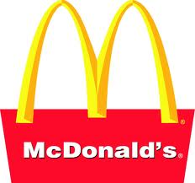
Forms of Business Organizations
Famous Franchises
Famous Franchises:
• Some Famous Franchises include:
Fast Food Restaurants, such as McDonalds,
Wendy’s, KFC, and Subway, ect
Car Dealerships such as Ford, Chevrolet,
Toyota, Volkswagen, and Dodge, ect
Hotels, such as Hampton Inn, Comfort Inn,
Hilton, Fairfield Inn and Motel 6, ect
Gasoline Dealers, such as Mobil, Speedway
SUNOCO, Gulf, and Chevron, ect
Fitness Centers, such as Planet Fitness,
Gold’s Gym, and Curves, ect

Slide 8
Forms of Business Organizations
Franchises – Special Issues
Special Issues:
• Special Issues for Franchises:
Special Protections under Federal and State Laws.
Automobile Dealer’s Day in Court Act.
Petroleum Marketing Practices Act.
Zone Pricing Acts for Gasoline
These statutes provide covered franchisees with protection from bad-faith terminations and unfair trade practices
Disclosure Issues, and
Vicarious Liability Claims Against Franchisors.

Slide 9
Forms of Business Organizations
Franchises – General Principles
Franchises – General Principles:
Franchises are licensing agreements under intellectual property laws that allow businesses to operate in a standardized, uniform manner.
These businesses are individually and privately owned, but conform to the uniform standards due to the franchise agreement.
Such agreements allows for standardization of products and processes so as to build brand uniformity and satisfy customer expectation.
Famous franchises include businesses such as Subway, McDonalds, and Exxon-Mobil Gas Stations
Franchises do not include big companies like GE, Walmart, Microsoft or wholly owned private companies like Price Chopper, Koch Industries and Dell Computers.

Slide 10
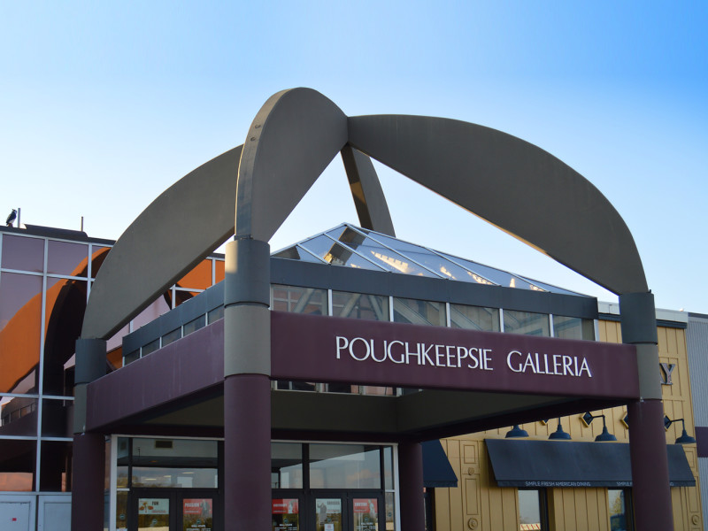
The Nature of Partnerships
The Legal Relationship Between Partners – Case Study
The Case of the Poughkeepsie Shopping Mall
Robert Congel v. Marc Malfitano

Slide 11
Thank you for Your Attention
For next time – Review Assignments as follows on the Webpage:
Lectures, Slides and Cases
Selected Readings
Weekly Information Sheets
We are a hot bench.
Questions?

