Slide 1
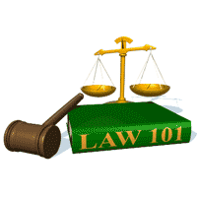
Slide Set Six C:
Elements of a Corporation

Slide 2
Last Time We Spoke About:
The Forms of Business Organizations
Part One: The Different Types of Business Organizations
Sole Proprietorships / Definitions / Formation / Operations
Advantages / Disadvantages / Doing Business As / Termination
Partnerships
Part Two: Nature of Partnerships / Definitions / Formation
Partnership Property / Relations Between Partners
Relations Between Partners and Third Parties
Dissolution / Termination of Partnerships
Franchises
Part Three: Definitions / Characteristics / Examples
Class Case – Congel v. Malfitano
Applying the Law of Partnerships

Slide 3
Tonight – We Will Speak About:
The Nature of a Corporation
Part One: Origins of the Corporation / Definitions / Artificial Person
The Types of Corporations
Part Two: 1. Business Corporations
2. Professional Corporations
3. Public Purpose Corporations
4. Not for Profit Corporations
Elements of a Corporation
Part Three: Principal Characteristics / Comparisons / Powers
Class Case – Dartmouth College v. Woodward
Recognition of Corporate Personhood

Slide 4
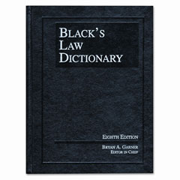
Elements of a Corporation
Definitions
Corporation Defined
Black’s Law Dictionary defines a
Corporation as:
“An artificial person or legal entity
created by or under the authority
of the laws of the state or nation,
which has an existence distinct from that
of its associated individuals,
and has a duration that is either perpetual
or for a limited term of years,
and which acts as a unit
in matters relating to the common purpose of the association
and within the scope of the powers conferred upon it by law.”

Slide 5
The Elements of a Corporation
Principal Characteristics
WHAT IS A ''CORPORATION''
A corporation is a legal entity (an artificial person) created in accordance with statutes.
The corporation is a creature of law, a legal construct.
No one has ever seen one.
The corporation’s existence and attributes arise from state-enabling statutes, which give business participants significant freedom to choose their own customized relationships.
The corporate entity is separate and distinct from the legal personalities of those who own and manage the corporation.
In New York, as elsewhere, corporate law is mostly statutory, and most of the statutory law relating to general business corporations (i.e., corporations for profit) is contained in the New York Business Corporation Law ("BCL").

Slide 6
The Elements of a Corporation
Principal Characteristics
Principal Characteristics of a Corporation:
All corporations share certain defining characteristics. These include:
Limited Liability
Entity Powers (Corporate Personhood)
Centralized Management
Continuity of Existence
Free Transferability of Interests
Statutory Sources of Authority
Constitutional Status

Slide 7
The Elements of a Corporation
Principal Characteristics
PRINCIPAL CHARACTERISTICS OF CORPORATIONS
Limited Liability
Because a corporation is a separate legal entity, its debts and obligations are treated as being distinctly its own.
Its shareholders and managers are ordinarily not liable for corporate indebtedness, and are instead, only financially responsible for the amount contributed to purchase their shares.
Arising from the sovereign immunity of the King, granted to these entities under regal charter, Limited Liability has long been a magnet for capital investment, and have made the corporate form of business organization as one of the most attractive and effective in the world.
One exception is the liability of the 10 largest shareholders of non-publicly traded corporations for the wages of corporate employees. [BCL §630]

Slide 8
The Elements of a Corporation
Principal Characteristics
PRINCIPAL CHARACTERISTICS OF CORPORATIONS
Entity Powers (Corporate Personhood)
Since the time of their establishment under Roman Law, Corporations have been held to be, and have been viewed as, an Artificial Person Under the Law.
This Corporate “Personhood” means that the corporation is viewed as a separate entity, distinct from its shareholder owners, and managing board of directors and officers.
As a result, a corporation can contract in its own name, sue or be sued, own or convey property, and be held criminally liable for crimes that it commits. (BCL §202).
Additionally, under nearly all state’s general incorporation statutes, unless the articles of incorporation expressly limits the corporation’s powers, it will be deemed to have the power to engage in any lawful business activity.

Slide 9
The Elements of a Corporation
Principal Characteristics
PRINCIPAL CHARACTERISTICS OF CORPORATIONS
Centralized Management
Corporations follow the principle of centralized management.
Centralized Management is a form of republican (representative) governance, whereby the shareholders (the owners of the company) participate in the management of the corporation only by electing the board of directors as their representatives to make the policy decisions of governance.
The board of directors supervises and manages the corporation’s affairs, and directs the day-to-day control of the company, to execute the board’s policy directives, through the corporation’s officers, who are appointees of the board.
As a result, shareholders have only extremely limited power to make management decisions (except insofar as they may elect and remove directors). Under such system there is thereby centralized management.

Slide 10
The Elements of a Corporation
Principal Characteristics
PRINCIPAL CHARACTERISTICS OF CORPORATIONS
Continuity of Existence
As mentioned previously, one of the reasons Roman Law established corporations was because their society wanted businesses to last longer than a human lifetime.
Accordingly, the law of corporations provides even still today, that unless the duration of a corporation is specifically limited in the certificate of incorporation, a corporation's duration is "perpetual“ (continues forever unless and until it is dissolved, merged. or consolidated in accordance with the BCL).
Additionally, the death, withdrawal, bankruptcy, or incapacity of any of its shareholders or directors or officers has no effect on the corporation's existence. [BCL §202(a)(l)].

Slide 11
The Elements of a Corporation
Principal Characteristics
PRINCIPAL CHARACTERISTICS OF CORPORATIONS
Free Transferability of Interests
The interest of the corporation's owners is divided into shares, and these shares may be freely transferred.
This means, that any share owned by a share holder, may be freely transferred from that shareholder to another qualified person (in order to own stock in a corporation a shareholder must be not less than 21 years of age, and if the corporation is a closed corporation, satisfy the close corporations qualifications for ownership – such as be a family member, employee, ect.). Non closed corporations have no restrictions other than age.
As a result, within the above qualifications, another person may be fully substituted in the place of the transferor, as the holder of ownership interests (shares) in the corporation.
When such transfer takes place, notice of such transfer of stock must be given to the secretary of the corporation, so that the new stockholder can be registered for voting purposes.

Slide 12
The Elements of a Corporation
Principal Characteristics
PRINCIPAL CHARACTERISTICS OF CORPORATIONS
Statutory Sources of Authority
A corporation is a creature of statute.
The corporation, its shareholders, directors, officers and agents, have only such authority to act, as conferred to it by, and/or pursuant to, statute (in New York for a business corporation, such would be the NYS Business Corporation Law).
Case law does have some effect on the operations of a corporation, but such is mostly an interpretation of its statutory source of authority.
A corporation’s statutory source of authority will often specify that such a corporation may make its own rules, so long as such don’t conflict with the statute. These internal rules of the corporation exist in its certificate of incorporation, or in its bylaws.

Slide 13
The Elements of a Corporation
Principal Characteristics
PRINCIPAL CHARACTERISTICS OF CORPORATIONS
Constitutional Status
A corporation is an “artificial person" under the law.
Accordingly, it is a “person” entitled to due process and equal protection of the law under the Fifth and Fourteenth Amendments.
It has also been held to have similar civil rights afforded to people, such as protections under the First Amendment.
But Courts have also held that corporations are not a "citizen" referred to by the Privileges and Immunities Clause of Article IV or the Fourteenth Amendment (meaning states can discriminate against out of state corporations), and that it holds no right against self incrimination under the Fifth Amendment.

Slide 14
The Elements of a Corporation
Comparison From Other Forms of Business
1. Comparison with Partnership
A partnership is not a separate entity distinct from its owners, the partners. Each partner is jointly and severally liable for the debts of the partnership. (NYPL §26). Each partner has a voice in management unless the partners all agree to the contrary. The existence of the partnership cannot be perpetual, and the ownership interests are not freely transferable. Its statutory authority in New York is the Partnership Law.
2. Comparison with Limited Liability Company (LLC)
A limited liability company in many ways is similar to a cross between a partnership and a corporation. Its owners, known as members, do enjoy limited liability, but it is not centrally managed as the members, like partners, provide the management of the company. Formed by means of an articles of organization, and managed in accordance with an operating agreement signed by all members, the LLC is a much less powerful, more streamlined, and more affordable to operate a small business with limited liability. Its statutory authority in New York is the Limited Liability Company Law.
3. Comparison with Sole Proprietorships
Sole proprietorships have no statutory requirements for formation, ownership or operation. There is no limited liability, and financial protections must be procured by means of the purchase of insurance. The owner is the sole manager, and all profits and all losses inure to their benefit or detriment.

Slide 15
The Elements of a Corporation
Powers of the Corporation
The Business Corporation Law sets forth broad statutory powers that may be exercised by a domestic corporation (whether or not such powers are specifically identified in the certificate of incorporation). [BCL §202]
This broad grant of powers may, however, be qualified in specific cases, either by the certificate, other statutes, or rules of law (case law or regulations). For instance, the power "to make contracts" does not include contracts tainted by illegality.
These statutory powers may be exercised by a corporation only in furtherance of its corporate purposes. The more important of these statutory powers include the power to:
Transfer Property: This includes the power to transfer or mortgage all or any part of the corporation’s assets. [BCL §202 (a)(5)];
Lend Money: A corporation has the power to lend money, invest its funds. and to take collateral therefor in connection with a business operation other than banking. Unless it is a banking corporation, it has no banking powers. [BCL §202 (a)(8)];
Buy and Sell Securities: A corporation has the power to acquire, hold, vote, and dispose of bonds, shares. and other securities of any other issuer (regardless of the issuer’s business). [BCL §202 (a)(6)];
Contract and Borrow: A corporation has the power to make contracts, to borrow money, to issue notes, bonds and other obligations, and to give mortgages of its property as security. [BCL §202 (a)(7)];
Compensate Employees: A corporation has the power to fix compensation of employees. officers. and directors, and to pay pensions and establish retirement, incentive. and benefit plans and trusts for its employees, officers, and/or directors (including pension, profit sharing, share purchase. options, and bonus plans). [BCL §202 (a)(10) and (13)]; and
Participate in Other Ventures: A corporation also has the power to be a (i) promoter, (ii) partner, (iii) associate, or (iv) manager of other business enterprises or ventures. Also a New York corporation may also act as an incorporator of foreign corporations if permitted by the jurisdiction of incorporation. [BCL §202 (a) (15)]

Slide 16
The Elements of a Corporation
Powers of the Corporation
The Business Corporation Law further authorizes additional power, including:
Major Residuary Power: In addition to other specified powers, corporations may further exercise all powers that are necessary and convenient to effect any or all purposes for which the corporation is formed. [BCL §202(16)].
Contributions: The Business Corporation Law further authorizes corporations to make the following contributions:
Charitable Contributions: A corporation may make donations, irrespective of corporate benefit, for the public welfare or for charitable, educational, scientific, civic or similar purposes, subject to a certificate of incorporation provision limiting this power. [BCL §202 (a)(12)];
Political Contributions: A corporation has the power to political contributions subject to campaign finance limits under federal and State Election Law. Federal law prohibits direct contributions to candidates from corporations (although indirect expenditures can be made (See Citizens United v. FEC). New York State Election Law (section 14-116) limits corporate contributions to a total of $5000 for any calendar year, and any officer, director, shareholder, attorney or agent who intentionally participates in a violation of this section is guilty of a misdemeanor;
Guarantees: The Business Corporation Law additionally authorizes corporations to give guarantees in furtherance of corporate purposes [BCL §202 (a)(7)], and also give a guarantee not in furtherance of corporate business when authorized by a vote of two-thirds of the shares entitled to vote [BCL §908];
Practice of Law: An ordinary business corporation may not engage in the practice of law.
Note: A professional corporation consisting of attorneys can engage in the practice of law [BCL – Article 15], as well as
a court approved charitable organization helping indigents pursue civil remedies [N.Y. Jud. Law §495].
Indemnification of Directors and Officers: The Business Corporation Law also authorizes corporations to indemnify directors and officers, but the extent: to which a corporation may (and must) indemnify its directors and officers for litigation related expenses is strictly controlled by law.
Acquisition of Its Own Shares: The Business Corporation Law further authorizes corporations to acquire, hold and dispose of (but not vote) its own shares, subject to certain limitations.

Slide 17
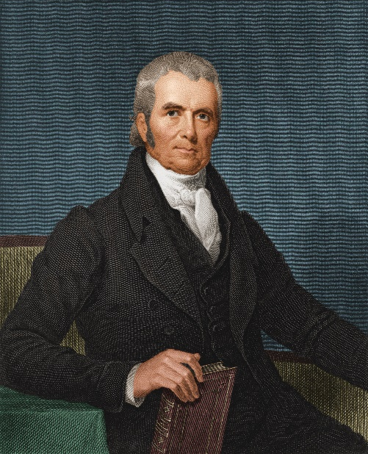
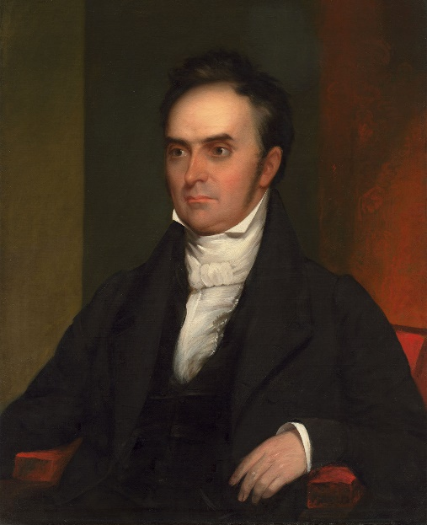
Case Study:
Dartmouth College v. Woodward
The case that announced
Corporate Personhood
John Marshall Dartmouth College Daniel Webster

Slide 18
End of Class Six C
For next time – Review Assignments as follows on the Webpage:
Lecture Slides
Selected Readings
Cases and Exercises
We are a hot bench.
Questions?

