Slide 1
Slide Set 10A:
Corporate Governance – Boards of Directors

Slide 2
Last Time We Spoke About:
Securities Regulation
State Regulation
Part One: Generally / Jurisdiction / Blue Sky Laws / The Martin Act
Federal Regulation
Part Two: Generally / Jurisdiction / Federal Regulatory Statutes
Industry Self Regulation
Part Three: Generally / Definitions / Effectiveness
Class Case – SEC v. W.J. Howey Company
The Scope of Federal Regulation

Slide 3
Tonight We Will Speak About:
Corporate Governance
Board Members
Part One: Definitions / Roles / Obligations and Duties / Liabilities
Chairman / Board Members / Committees
Officers, Employees and Agents
Part Two: Generally / Officer Roles / Obligations / Duties
Employees / Agents
Corporate Personhood
Part Three: Generally / Running the Corporation / Fiduciary Responsibilities
Enforcement of Board Policies / Employment Management
Shareholder Derivative Lawsuits / Separate Personhood Interests
Political Independence
Class Case – Citizen United v. FEC
The Constitutional Rights of Corporations

Slide 4
Part One:
Corporate Governance
Generally – Organizing the Corporation

Slide 5
Corporate Governance
Generally – Organizing the Corporation
The Final Steps in Organizing the Corporation:
Steps of Corporate Organization: Once the certificate of incorporation have been filed, there are some additional steps that must be followed to complete proper organization of the newly formed corporation. They include:
Initial Organizational Meeting
Issuance of Shares
Election of Directors (if not named in the certificate of incorporation)
Creation and Adoption of Corporate Bylaws
Appointment of Corporate Officers
Approval of Shareholders Agreements
Ratification of Promoter Contracts
Banking Resolution and Fiscal Year Provisions

Slide 6
Corporate Governance
Generally – Organizing the Corporation
Organizational Meeting Generally:
The organizational meeting, or initial meeting, is the first official business of the newly formed corporation. The purpose of this meeting is to bring together the various members of the corporation, elect directors, appoint officers, adopt by-laws, and take care of the other clerical work that must be done to officially launch the corporation.
Election of Directors:
Shareholders of the corporation, who have shares entitling them to vote, decide who they would like to elect to the corporation’s board of directors. These directors will set the policies for the corporation and handle many other important decisions, including the payment of taxes, franchise fees, and changes in corporate procedures.
Appointment of Officers:
One of the first tasks the board of directors must accomplish is to appoint officers that will lead the corporation on a day to day basis. These officers include: Chief Executive Officer, President, Vice President(s), Chief Financial Officer, Treasurer and Secretary.

Slide 7
Corporate Governance
Generally – Organizing the Corporation
Creation and Adoption of Corporate Bylaws:
Whereas the Articles of Incorporation are similar to a Corporation’s Constitution, the Corporation will also adopt Bylaws, which are similar to statutes. These Bylaws contain guidelines for how the business will be run and should make provisions for the following:
•The Date and Location of the annual shareholder meeting
•The Number of Directors (if not specified in the certificate of incorporation)
•The authority, duties, and titles of corporate officers
The Bylaws must be consistent with the certificate of incorporation, and many courts have defined Bylaws as the essential contract between shareholders and the corporation.
Shareholder Agreements and Banking Resolutions:
One of the first acts of the board of directors will also be the approval of shareholder agreements. Such approval will be made pursuant to any guidance that exists in the Certificate of Incorporation.
Another of the first acts of the Board of Directors will be the approval of Banking Resolutions. Banking resolutions authorize the creation and maintenance of corporate bank accounts.
These resolutions will further limit who has access to corporate accounts, who is permitted to sign corporate checks, who is allowed to oversee the accounts, and how account reports will be made to the shareholders.

Slide 8
Part Two:
Corporate Governance
Boards of Directors – Definition and Role

Slide 9
Corporate Governance
Boards of Directors – Definition and Role
Corporation Board of Directors:
Defined: Blacks law dictionary defined Board of Directors to mean:
“The governing body of a corporation, elected by the shareholders to establish corporate policy, appoint executive officers, and make major business and financial decisions.”
Role: The role of the Board of Directors of a Corporation is as follows:
Meet Regularly to Govern the Corporation: The Members of a Corporation’s Board of Directors are the elected representatives of the shareholders, that meet regularly to govern the corporation.
Provide Oversight for, and Make Policy of, the Corporation: The Members of a Corporation’s Board of Directors provide general oversight and make policy of the corporation (similar to that of political system’s republican, representative government) so as to serve as the governance power of the corporation. All policy decisions are thus under the dominion and control of the board of directors. These decisions include such things as:
Hiring Officers;
Development and Approval of Strategic Plans;
Approving Policy Initiatives and Directives of the Corporation;
Approving SEC Filings and Annual Reports;
Acting on Mergers, Acquisitions and Dissolutions;
Approving Annual Budgets and Ensuring the Availability of Financial Resources; and
Establishing Compensation and Benefits for Officers and Employees.
Size of the Board of Directors: The number of Directors is fixed in the certificate of incorporation or when it is silent, the corporate Bylaws.
Chair of the Board: Typically, the Board of Directors chooses one of its members to be the Chair of the Board, by majority vote. The Chair is the person responsible for presiding over the meetings of the Board. Such person provides leadership of the Board, often speaks for its actions, appoints the committees of the board, and exercises the additional duties and powers as provided in the Certificate of Incorporation, the Bylaws or by vote of the board.

Slide 10
Corporate Governance
Boards of Directors – Role
Corporation Board of Directors:
Role (Continued): The role of the Board of Directors of a Corporation is as follows:
Board Meetings: The board of directors conduct its meetings according to the rules and procedures contained in the corporation’s governing documents (the certificate of incorporation or the bylaws). The agenda for the meeting is generally prepared by the Chair of the Board (most often with assistance of the secretary of the corporation), but many of the procedures (including the items that must be considered on an agenda) may be contained in the corporate bylaws. These procedures include things like quorums, order (and types) of meeting business, and board voting and attendance procedures (including electronic and proxy appearance and voting).
Committees: A corporation’s board of directors are often tasked to serve as members of committees of the board. Committees can be standing committees, used on a regular and continuing basis by the board and set forth in the certificate of incorporation or the corporate bylaws, or they can be ad hoc committees, created on a singular basis by vote of the board. The larger the board of directors, often the more committees the board will have. Each committee will have a chair and members, usually all appointed by the chair of the entire board of directors. Examples of standing committees include:
The Executive Committee: Usually chaired by the chair of the entire board, which is generally delegated to meet and take action for the corporation between full meetings of the entire board of directors;
Audit Committee: This committee is tasked with selecting the outside auditor of the corporation, meets with the auditor to receive the audit report and management letter, reports to the full board of directors on the annual audit and the management letter, and often is charged with auditing the expenses of the board and the chief executive officer;
The Governance Committee: This committee is charged with the care and feeding of the board itself, and its responsibilities generally include board recruitment, orientation, board and director self-assessment, continuing education, and board management;
Finance Committee: Sometimes called a Budget Committee or a Budget and Finance Committee, this committee oversees staff’s preparation of the corporation’s annual budget and the performance of the corporation in meeting its budgeted revenues and expenses;
Membership Committee: This committee is most often tasked with developing criteria for membership, credentialing members, overseeing elections, or developing and delivering programs for members; and
Program or Personnel Committee: This committee also sometimes known as the planning committee, often considers programs and development plans of the corporation, personnel issues and policies, and future corporate goals and policies.

Slide 11
Part Three:
Corporate Governance
Boards of Directors – Elections

Slide 12
Corporate Governance
Boards of Directors – Elections
Corporation Board of Directors:
Elections: Shareholders have the power to elect directors at the initial shareholders’ meeting and then at every annual meeting thereafter. Control over the composition of the board is at the heart of the shareholders’ governance role.
Procedures: Director elections occur pursuant to procedures outlined in either the certificate of incorporation, or the bylaws, or both, complying with procedural guidelines including notice, quorum and ballot requirements. Most election procedures allow for proxy voting.
Time of Election: The initial election is held at the organizational meeting, and then at the annual meeting of the corporation.
Nominations: Generally, the directors which run for election, are nominated either by the board of directors as a whole, or a nominating committee, or by the shareholders themselves.
Means of Voting: Depending upon the procedures in the Certificate of Incorporation and/or the Bylaws, the means of elections can be by either straight voting or cumulative voting.
Straight Voting: In straight voting, each share may be voted for as many candidates as there are slots on the board, but no share may be voted more than once for any given candidate. Directors are thereby elected by a plurality (not necessarily majority) of the votes cast, with each share casting only one vote per candidate running.
Cumulative Voting: To ensure board representation for larger minority shareholders, some corporations allow cumulative voting. In cumulative voting, minority shareholders can accumulate all of their votes, and allocate them among a few or even one candidate. This increases the chances of board representation for minority shareholders. It should be noted, however, that cumulative voting, however, only applies to electing directors, not to any other type of shareholder vote.
Election Inspectors: To determine the shares represented at a meeting, count votes, determine the validity of proxies, and resolve voting disputes, corporations authorize the corporation to appoint inspectors to inspect proxies and votes. Very often the corporation’s accounting firm is chosen as election inspector. They are generally given broad latitude under standards deferential to the inspector’s good faith judgment.

Slide 13
Part Four:
Corporate Governance
Boards of Directors – Obligations and Duties

Slide 14
Corporate Governance
Boards of Directors – Obligations and Duties
Corporation Board of Directors:
Obligations and Duties: A Corporation’s Board of Directors have the following obligations and duties:
Establish Ongoing Goals, Missions and Policies of the Corporation;
Hire and Oversee the Corporate Officers;
Delegate Duties to Officers, so as to Advance Corporate Policy and Goals;
Perform Corporate Planning and Strategy Development for Corporate Advancement;
Provide General Management of the Corporate Business, Policy, and Resources;
Determine and Monitor the Organization's Products, Services and Programs;
Enhance the Corporation's Public Image (so as to improve share value);
Assess the Performance of the Corporation and the Board Itself;
Avoid Conflicts of Interests and Keep Their Fiduciary Duty to Shareholders;
Provide Continuity of the Corporation; and
Account to Shareholders for the operation and Conduct of Corporate Business.

Slide 15
Part Five:
Corporate Governance
Boards of Directors – Responsibilities to Shareholders

Slide 16
Corporate Governance
Boards of Directors – Responsibilities to Shareholders
Corporation Board of Directors:
Board of Directors’ Responsibilities to Shareholders:
Fiduciary Duty: The primary responsibilities of board directors to shareholders relate to their fiduciary duties, including the duty of care, duty of loyalty and duty of obedience. These duties require board directors to place the best interests of the company ahead of their own. They must make decisions for the company and act in a manner that an ordinary, prudent person would. The duty of obedience requires boards to ensure that the company remains in compliance with all laws and regulations.
Quality Board Members Who Make Quality Decisions: Another responsibility that board directors have to shareholders is to compose and maintain a diverse, independent and highly competent board. Sound decision-making only comes from a wide variety of perspectives. Shareholders are entitled to know that the board overseeing the company’s operations is well-qualified and up to the task.
Transparent Communication: Boards are required to take minutes of their meetings to detail the issues that they’re working on. Shareholders may request copies of board meeting minutes if they’re looking for assurance that the board is actively fulfilling their duties of oversight and strategic planning. This doesn’t mean that shareholders have any say in directing the issues the board chooses to tackle or the way they prioritize issues.
Oversee a Financially Sound Corporation: Shareholders look for assurance that companies are financially strong currently and will continue to grow and prosper. The board of directors has an explicit responsibility to form a short-term plan of one to two years to ensure sustainability. In addition, shareholders are interested in long-term growth for continued security and prosperity.
Assure that Corporation Operates Consistently With Policy Goals: Board directors also have a responsibility to oversee all departments and aspects of the corporation. The responsibility includes making sure operations are running efficiently, company operations are in alignment with the organization’s purpose, there are no incidences of fraud, they communicate the corporate culture throughout the organization, and they conduct oversight over all departments and operations of the company.

Slide 17
Part Six:
Corporate Governance
Boards of Directors – Liability of Directors

Slide 18
Corporate Governance
Boards of Directors – Liability of Directors
Corporation Board of Directors:
Liability: Directors have a unique relationship to the corporation, arising from their broad authority to manage and supervise the corporation’s business and affairs, subject to the rights of shareholders. The liability and responsibility of Directors includes:
Fiduciary Duty: Corporate directors are said to owe fiduciary duties to the corporation itself as a separate and distinct artificial person under the law, and not to the particular shareholders who elected them. These fiduciary rules thus proceed from a theory of maximizing corporate financial well-being by focusing on shareholder wealth maximization.
Corporate Social Responsibility: Over the past decade, many companies have begun to assert that their responsibilities extend beyond the legal duties toward shareholders and others with whom the company does business, and have voluntarily taken responsibility for their impact on customers, workers, communities, and other stakeholders, as well as the environment. This attitude, however, can directly conflict with the true fiduciary duties of Directors to the Corporation itself and its shareholder owners.
Duties of Care and Loyalty: According to traditional fiduciary analysis, corporate Directors owe two duties to the corporation: care and loyalty. Each duty describes standards for judicial review of corporate decision-making and fiduciary activities.
Duty of Care: The duty of care addresses the attentiveness and prudence of Directors in performing their decision-making and oversight functions. The famous “business judgment rule” presumes that directors carry out their functions in good faith, after sufficient investigation, and for acceptable reasons. Unless this presumption is overcome, courts abstain from second guessing well-meaning business decisions even when they are flops. This is a risk that shareholders take when they make a corporate investment. Thus, to encourage directors to take business risks without fear of personal liability, corporate law protects well-meaning Directors, through exculpation provisions in the corporation’s articles and Bylaws, as well as through directors’ and officers’ insurance.
Duty of Loyalty: The duty of loyalty addresses fiduciaries’ conflicts of interest. This duty requires fiduciaries to put the corporation’s interests ahead of their own. This means that fiduciaries cannot serve two masters. Corporate fiduciaries breach their duty of loyalty when they divert corporate assets, business opportunities, or proprietary information for personal gain. Accordingly, courts will not interfere with the board’s judgment in the absence of unusual conduct such as fraud, and a Director has a duty of loyalty, and is disqualified from taking part in corporate action, when they have a conflict of interest.

Slide 19
Part Seven:
Corporate Governance
Boards of Directors – Management of Corporation

Slide 20
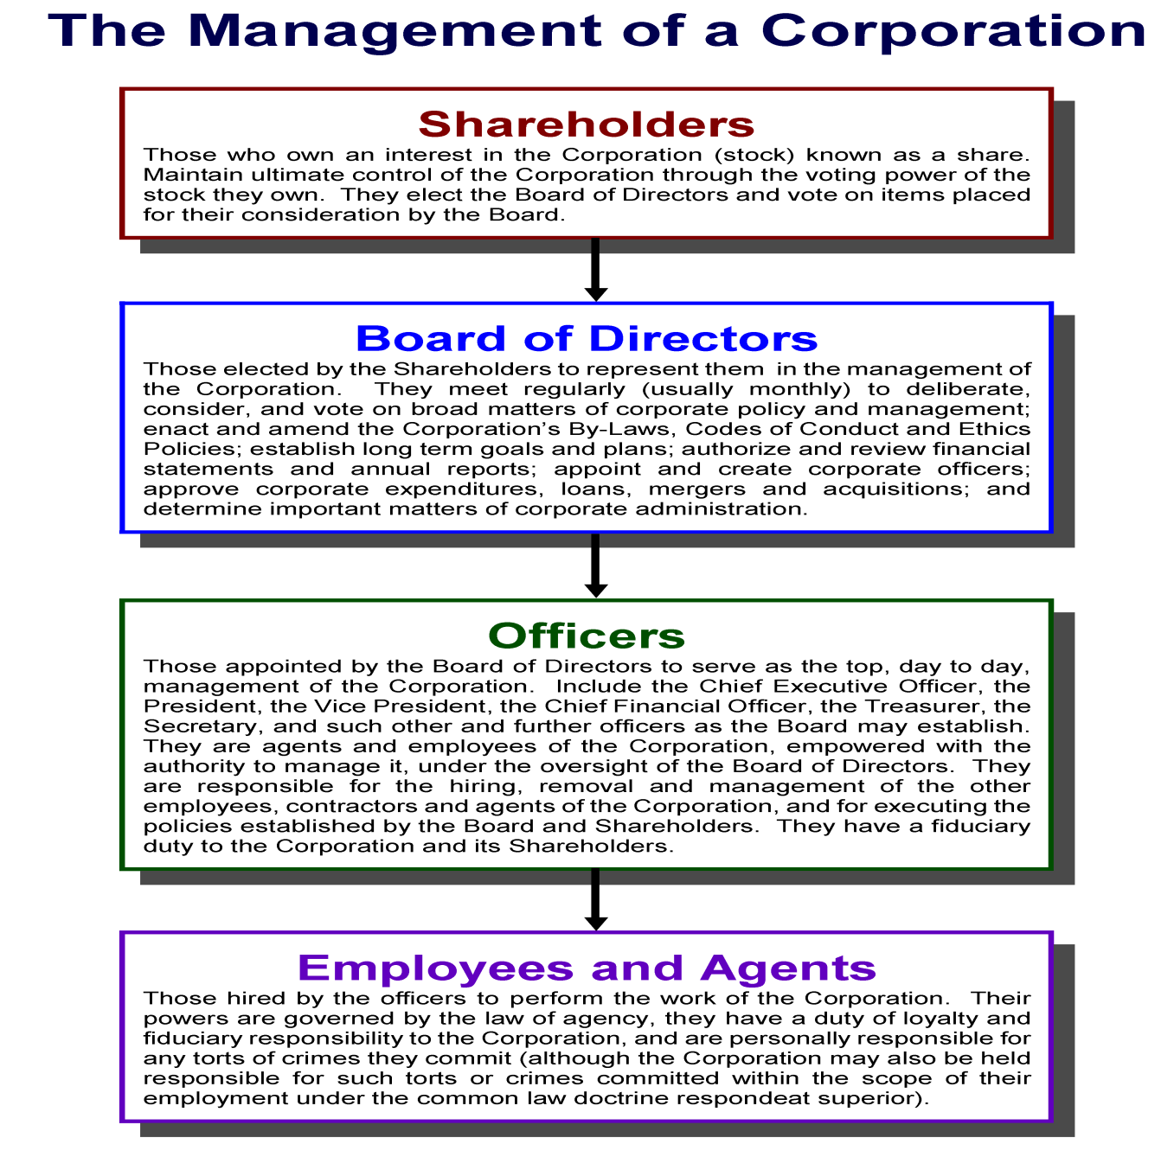

Slide 21
Part Eight:
Corporate Governance
Chair of the Board of Directors – Powers

Slide 22
Corporate Governance
Chair of Board of Directors – Powers
Chair of the Board of Directors:
Chair of the Board: The Board of a Corporation is led by a Chair.
Chosen by the Members: Typically, the Board of Directors chooses, by majority vote, one of its members, to be the Chair of the Board.
Presides Over Meetings of the Board: The Chair is the person responsible for presiding over the meetings of the Board.
Board Meetings Conducted Pursuant to Adopted Procedures: The board of directors conduct its meetings according to the rules and procedures contained in the corporation’s governing documents (the certificate of incorporation or the bylaws). These procedures include things like quorums, order (and types) of meeting business, and board voting and attendance procedures (including electronic and proxy appearance and voting).
Board Meeting Agenda Established by the Chair: The agenda for the meeting is generally prepared by the Chair of the Board (most often with assistance of the secretary of the corporation), but many of the procedures (including the items that must be considered on an agenda) may be contained in the corporate bylaws
Often Acts as Board’s Spokesperson: The Chair provides leadership of the Board, and often speaks for its actions.
Responsible for Appointing Board’s Committees and Committee Chairs: The Chair appoints the committees of the board as well as the committee chairs. The standing committees so appointed, typically include the executive committee, the audit committee, the governance committee, the finance committee, the membership committee and the program or personnel committee.
Generally Serves As Chair of the Executive Committee: The Chair of the Board usually also chairs the Executive Committee, which is generally delegated to meet and take action for the corporation between full meetings of the entire board of directors;
Additional Powers of the Chair: The Chair will also exercise such additional duties and powers as provided in the Certificate of Incorporation, the Bylaws or by vote of the board.

Slide 23
Part Nine:
Corporate Governance
The Board of Directors – What Do they Do?

Slide 24
Corporate Governance
Boards of Directors – What Do Boards Do?
Corporation Board of Directors:
Generally – What Boards Do: At the most general level, all boards can be said to share a single, overarching responsibility - To build an effective organization. Everything else is derivative. Essentially, all boards serve ten principal functions:
1. Ensure that the corporation operates effectively, responsibly and in accordance with its certificate, by creating and approving resolutions, by majority vote, at board meetings;
2. Consider, create, discuss, review, and approve strategic directions;
3. Monitor performance;
4. Act on specific policy recommendations and mobilize support for decisions taken;
5. Select, direct, encourage, advise, evaluate, compensate, and, if need be, replace the CEO;
6. Provide a buffer for the CEO—in the vernacular, “take some of the heat”;
7. Ensure that the necessary resources, both human and financial, will be available to pursue the corporation’s strategies and achieve its objectives; and
8. Nominate suitable candidates for election to the board, and establish and carry out an effective system of governance at the board level.

Slide 25
Corporate Governance
Boards of Directors – What Do They Do
Corporation Board of Directors:
Obligations and Duties: A Corporation’s Board of Directors have the following obligations and duties:
Establish Ongoing Goals, Missions and Policies of the Corporation;
Hire and Oversee the Corporate Officers;
Delegate Duties to Officers, so as to Advance Corporate Policy and Goals;
Perform Corporate Planning and Strategy Development for Corporate Advancement;
Provide General Management of the Corporate Business, Policy, and Resources;
Determine and Monitor the Organization's Products, Services and Programs;
Enhance the Corporation's Public Image (so as to improve share value);
Assess the Performance of the Corporation and the Board Itself;
Avoid Conflicts of Interests and Keep Their Fiduciary Duty to Shareholders;
Provide Continuity of the Corporation;
Account to Shareholders for the operation and Conduct of Corporate Business;
Approving Policy Initiatives and Directives of the Corporation;
Approving SEC Filings and Annual Reports;
Acting on Mergers, Acquisitions and Dissolutions;
Approving Annual Budgets and Ensuring the Availability of Financial Resources; and
Establishing Compensation and Benefits for Officers and Employees.

Slide 26
Part Ten:
Corporate Governance
Boards of Directors – Powers

Slide 27
Corporate Governance
Boards of Directors – Defined Role
Corporation Board of Directors:
Defined Powers and Role: Pursuant to Article 7 of the Business Corporation Law, establishes the powers and role of a Corporations Board of Directors as follows:
Operates By Means of Resolutions: The principal power of a corporation’s board of directors is to operate as the Corporation’s governing body, by considering, debating and enacting resolutions, at board meetings, to establish the policies and directive of the Corporation.
Meets Regularly to Govern the Corporation: The Members of a corporation’s board of directors are the elected representatives of the shareholders, and as such, they meet regularly to govern the corporation by means of the passing of resolutions.
Provide Oversight for, and Make Policy of, the Corporation: The members of a corporation’s board of directors provide general oversight and make policy of the corporation (similar to that of political system’s republican, representative government) so as to serve as the governance power of the corporation. All policy decisions are thus under the dominion and control of the board of directors, and are effectuated by means of a majority vote on resolutions.
Board Meetings: The board of directors conduct its meetings according to the rules and procedures contained in the corporation’s governing documents (the certificate of incorporation or the bylaws). The agenda for the meeting is generally prepared by the Chair of the Board (most often with assistance of the secretary of the corporation), but many of the procedures (including the items that must be considered on an agenda) may be contained in the corporate bylaws. These procedures include things like quorums, order (and types) of meeting business, and board voting and attendance procedures (including electronic and proxy appearance and voting).
Vote of the Board: Resolutions of the board of directors are enacted by a majority vote. The Chair of the Board is the person responsible for presiding over the meetings of the board of directors, and announces the votes of the board and the passage of resolutions. Each board member is entitled to cast one vote.

Slide 28
Part Eleven:
Corporate Governance
Boards of Directors – Committees

Slide 29
Corporate Governance
Boards of Directors – Role
Corporation Board of Directors:
Committees: The members of the board of directors are often asked to serve on committees.
Standing Committees and Ad Hoc Committees: Committees can be standing committees, used on a regular and continuing basis by the board and set forth in the certificate of incorporation or the corporate bylaws, or they can be ad hoc committees, created on a singular basis by vote of the board.
Chairs and Members: Each committee will have a chair and members, usually all appointed by the chair of the entire board of directors. Committee chairs and members usually have an expertise in the subject matter of the committee.
Purpose of the Committee: The purpose of the Committees is to advise the full board of directors, and make recommendations on issues within the Committee’s oversight. Committees will issue and vote on reports and recommendations, prior to advising and reporting to the full board.
Standing committees often include:
The Executive Committee: Usually chaired by the chair of the entire board, which is generally delegated to meet and take action for the corporation between full meetings of the entire board of directors;
Audit Committee: This committee is tasked with selecting the outside auditor of the corporation, meets with the auditor to receive the audit report and management letter, reports to the full board of directors on the annual audit and the management letter, and often is charged with auditing the expenses of the board and the chief executive officer;
The Governance Committee: This committee is charged with the care and feeding of the board itself, and its responsibilities generally include board recruitment, orientation, board and director self-assessment, continuing education, and board management;
Finance Committee: Sometimes called a Budget Committee or a Budget and Finance Committee, this committee oversees staff’s preparation of the corporation’s annual budget and the performance of the corporation in meeting its budgeted revenues and expenses;
Membership Committee: This committee is most often tasked with developing criteria for membership, credentialing members, overseeing elections, or developing and delivering programs for members; and
Program or Personnel Committee: This committee also sometimes known as the planning committee, often considers programs and development plans of the corporation, personnel issues and policies, and future corporate goals and policies.

Slide 30
End of Class Ten A
For next time – Review Assignments as follows on the Webpage:
Lecture Slides
Selected Readings
Cases and Exercises
We are a hot bench.
Questions?

