Slide 1
Slide Set Ten B:
Corporate Governance – Officers / Employees

Slide 2
Last Time We Spoke About:
Securities Regulation
State Regulation
Part One: Generally / Jurisdiction / Blue Sky Laws / The Martin Act
Federal Regulation
Part Two: Generally / Jurisdiction / Federal Regulatory Statutes
Industry Self Regulation
Part Three: Generally / Definitions / Effectiveness
Class Case – SEC v. W.J. Howey Company
The Scope of Federal Regulation

Slide 3
Tonight We Will Speak About:
Corporate Governance
Board Members
Part One: Definitions / Roles / Obligations and Duties / Liabilities
Chairman / Board Members / Committees
Officers, Employees and Agents
Part Two: Generally / Officer Roles / Obligations / Duties
Employees / Agents
Corporate Personhood
Part Three: Generally / Running the Corporation / Fiduciary Responsibilities
Enforcement of Board Policies / Employment Management
Shareholder Derivative Lawsuits / Separate Personhood Interests
Political Independence
Class Case – Citizen United v. FEC
The Constitutional Rights of Corporations

Slide 4
Part One:
Corporate Governance
Corporate Officers - Definitions

Slide 5
Corporate Governance
Corporate Officers - Definitions
Definitions:
Officer Defined: Black’s law dictionary defines the term officer as:
“A person who holds an office of trust, authority or command, and when an officer of a corporation, a person who is the company’s chief executive officer, president, Vice President, chief financial officer, treasurer or secretary.
Business Corporation Law: Section 715 of the New York State Business Corporation Law further provides that:
The board of directors may appoint the officers of the corporation, who hold office for the term for which they are appointed, and who shall have such authority and perform such duties in the management of the corporation as may be provided in the by-laws or, to the extent not so provided, by the board of directors; and
Such officers shall perform their duties in good faith and with that degree of care which an ordinarily prudent person in a like position would use under similar circumstances, and in performing such duties, an officer shall be entitled to rely on information, opinions, reports or statements, including financial statements and other financial data, and a person who so performs their duties shall have no liability by reason of being or having been an officer of the corporation.

Slide 6
Part Two:
Corporate Governance
Corporate Officers - Generally

Slide 7
Corporate Governance
Corporate Officers - Generally
Generally
Officers are the persons who actually perform the day to day management and operation of the corporation, under the oversight of the Board of Directors.
Officers of a corporation, are selected and removed by the board of directors.
Officers are agents of the corporation with specific, actual authority, and with powers governed by the law of agency.
Their relations with the corporation are fiduciary in nature, and they are liable for any secret profits and for diverting corporate opportunities to their own advantage.
Officers, as agents of the corporation, are personally responsible for any torts or crimes they commit even if they act on behalf of the corporation.
Officers may be liable for taking advantage of a corporate opportunity.
When determining liability, the question is asked – Was there a breach of a fiduciary duty?

Slide 8
Corporate Governance
Corporate Officers - Generally
Who are the Officers of a Corporation:
Officers of a corporation include:
Chief Executive Officer;
President;
Vice – President;
Chief Financial Officer;
Treasurer; and
Secretary.
Officers vs. Agents
Officers are employees of the corporation who have general duties.
An Agent, on the other hand is a broad term encompassing any individual
who works, even temporarily, for another’s interest.
As a result, all officers are agents, but not all agents are officers.

Slide 9
Part Three:
Corporate Governance
Corporate Officers – Roles and Duties

Slide 10
Corporate Governance
Corporate Officers – Roles and Duties
What corporate officers do:
Chief Executive Officer – The highest ranking officer in the corporation – responsible as the corporation’s lead agent, and performs the following duties:
Decides whom to hire and fire as agent or employee;
Responsible for the day to day management of the business;
Oversees the other employees (and to limited extent other officers as they are appointed and overseen by directors);
Signs contracts on behalf of the corporation;
Negotiates on behalf of the corporation (pursuant to the parameters set by the board of directors); and
Delegates his authority to other officers or employees (as allowed by the board of directors).
Responsible under the Sarbanes Oxley Act for the signing and verification of corporate reports (such as annual reports)

Slide 11
Corporate Governance
Corporate Officers – Roles and Duties
What corporate officers do:
President – If no separate Chief Executive Officer, the president is the highest ranking officer in the corporation – and is responsible as the corporation’s lead agent, and performs the duties as set forth previously for the CEO, or as assigned by the corporate bylaws or the Board of Directors.
Vice President - Corporate vice-presidents generally have very little to do with the day-to-day function of a corporation. Usually, they are only authorized to take action in specific situations, such as when the corporate president is unavailable. Sometimes they are the head of a division the corporation or set in charge of a function (such as Head of Light Bulb Manufacturing Division or Consumer Affairs/Relations)

Slide 12
Corporate Governance
Corporate Officers – Roles and Duties
What corporate officers do:
Chief Financial Officer – The Chief Financial Officer or CFO is the officer responsible for the finances, and accounting of the finances, of the corporation. Together with the Chief Executive Officer, the CFO must also verify the accuracy of reports under the Sarbanes Oxley Act.
Treasurer – If the corporation does not have a separate, Chief Financial Officer, the treasurer serves as the officer responsible for the finances, and accounting of the finances, of the corporation. The treasurer is the officer responsible for maintaining records of the corporation’s finances and ensuring that all corporate checking accounts, revenues, and accounts receivable are accurate and up-to-date.

Slide 13
Corporate Governance
Corporate Officers – Roles and Duties
What corporate officers do:
Secretary – The Secretary is the officer responsible for the maintaining nonmonetary records for the corporation. The corporate secretary is responsible for sending out/transmitting all notices and documents from the corporation.
They are the officer that keeps the corporate seal, and who keep all records of the shareholder and directors’ meetings.
The secretary must also ensures that proper documentation is filed with the state secretary of state’s office, or any other required corporate filing.

Slide 14
Part Four:
Corporate Governance
Corporate Officers – Liabilities

Slide 15
Corporate Governance
Corporate Officers – Liabilities
Generally:
Generally, directors and officers are not liable for corporate obligations or debts.
A corporation is civilly liable to a third party if one of its agents causes injury.
Because a corporation is an artificial person, it can be both civilly and criminally liable for actions carried out on its behalf.
Directors are personally liable for breaches of their duties and any economic injuries to the corporation that result from their negligence.
Shareholders who seek losses for business deals that never materialized must prove that the failure to consummate the deal rests squarely with the negligent officer before the court will entertain any action for indemnification for possible lost profits.
The core responsibility of directors (under the Business Judgment Rule) is to weigh risk against reward. This is an art, not a science.

Slide 16
Corporate Governance
Corporate Officers – Liabilities
The Business Judgment Rule:
The business judgment rule is a case law-derived concept in corporations law whereby the "directors of a corporation . . . are clothed with [the] presumption, which the law accords to them, of being [motivated] in their conduct by a bona fide regard for the interests of the corporation whose affairs the stockholders have committed to their charge" (See Gimbel v. Signal Cos., 316 A.2d 599, 608 (Del. Ch. 1974)
To challenge the actions of a corporation's board of directors, or its officers, a plaintiff assumes "the burden of providing evidence that the directors, or the officers, in reaching their challenged decision, breached any one of the triads of their fiduciary duty good faith, loyalty, or due care".
Failing to do so, a plaintiff "is not entitled to any remedy unless the transaction constitutes waste . . . [that is,] the exchange was so one-sided that no business person of ordinary, sound judgment could conclude that the corporation has received adequate consideration".
The Business Judgment Rule has at its core, a responsibility of directors and officers to weigh risk against reward. This is an art, not a science.

Slide 17
Corporate Governance
Corporate Officers – Liabilities
The Business Judgment Rule Continued:
The business judgment rule protects corporate officers and directors from being sued when their business judgments turn out to be incorrect.
The business judgment rule not only insulates officers and directors from lawsuits from shareholders, but it also keeps courts out of the business of monitoring business decisions.
When corporate officers or directors exceed their authority, the business judgment rule no longer protects them.
Such acts, which exceed authority, are deemed to be ultra vires (a Latin phrase meaning “beyond the powers” – meaning the board of directors has exceeded or gone beyond their legal authority).
Only shareholders or others who have a direct interest in the corporation can raise a claim of ultra vires.

Slide 18
Corporate Governance
Corporate Officers – Liabilities
Liability of Officers:
Officers, as agents generally of the corporation, are personally responsible for any torts or crimes they commit, even if they act on behalf of the corporation. If they act on behalf of the corporation, then the corporation may be liable as well.
Officers may also be liable for taking advantage of a corporate opportunity.
An officer is also disqualified from taking part in corporate action when the officer has a conflict of interest.
Pursuant to the Sarbanes Oxley Act, all direct and indirect loans to officers are prohibited.
In determining liability, the threshold question is: was there a breach of fiduciary duty?

Slide 19
Corporate Governance
Corporate Officers – Liabilities
Liability to Third Parties:
Generally:
Shareholders enjoy limited liability.
Generally, directors and officers are not liable for corporate obligations or debts.
A corporation is civilly liable to a third party if one of its agents causes injury.
Liability of Management to Third Persons:
Generally not liable for economic consequences if decision made in good faith.
Generally not liable to third parties for poor decisions (but there may be a shareholder derivative suit).
Criminal Liability:
Criminal Liability is pursuant to the Responsible Corporate Officer Doctrine: Control and Knowledge of the Violations.

Slide 20
Part Five:
Corporate Governance
Corporate Employees - Definitions

Slide 21
Corporate Governance
Corporate Employees – Definitions
Definitions:
Employment Defined: Black’s Law Dictionary defines “Employment” as:
1. Act of employing or state of being employed; or
2. That which engages or occupies; or
3. That which consumes time or attention; or
4. An occupation, profession, trade, post or business.
A Simple definition of “Employment” is:
“An act to engage or hire one’s service, in return for payment for such service.”
The Labor Law’s Definition of “Employment” is:
A relationship where someone is “permitted or suffered to work”
Corporation Employees: Has been held to include all individuals who are employees of Corporation, including unionized (collectively bargained), non-unionized (non collectively bargained), part-time, full-time employees, or individuals engaged on contract to provide employment services or sales to Corporation.

Slide 22
Part Six:
Corporate Governance
Corporate Employees - Generally

Slide 23
Corporate Governance
Corporate Employees - Generally
Generally
Employees are the persons who actually perform the day to day work of the corporation, under the oversight of the Corporate Officers.
Employees of a corporation, are selected and removed by the Corporate Officers.
Employees of the corporation are vested with specific, actual authority, and with powers governed by the law of agency.
Employees, like Officers, are personally responsible for any torts or crimes they commit even if they act on behalf of the corporation.
Employees, like Officers, may be liable for taking advantage of a corporate opportunity.
The primary difference between an employee and an officer of the corporation is that employee is an individual who merely provides professional or manual work to a corporation while an officer has a position of authority in the corporation’s hierarchical organization.

Slide 24
Corporate Governance
Corporate Officers - Generally
Employees of a Corporation – Who they are and what they do:
Employees of the corporation are agents hired and paid by the corporation, to perform its functions, as directed by the corporation’s officers.
Their employer is the corporation itself.
The corporation is generally liable for their actions.
Employees are hired, and may be discharged, by the corporation’s officers.
Employees vs. Agents
Employees of the corporation have a permanent status, and are paid regular
wages or salaries by the corporation for their work and duties.
Agents, on the other hand, is a broad term encompassing any individual
who works, even temporarily, for another’s interest.
As a result, all employees are agents, but not all agents are employees.

Slide 25
Part Seven:
Corporate Governance
Corporate Employees – Roles, Duties and Liabilities

Slide 26
Corporate Governance
Corporate Employees – Roles, Duties and Liabilities
What Corporate Employees do:
Corporate Employees – Although Corporate Employees are employees of the corporation, they are hired by the corporate officers, and perform the roles and duties assigned to them by the corporate officers.
Only Provide Delegated Management Role: They play no role in the management or decision making of the corporation, other than to manage other employees or to make decisions delegated to them by the corporate officer to whom the employee reports.
Agency Principles Govern: The authority, rights, and liabilities of an agent or employee of a corporation are governed by the same rules as those applicable when the principal or employer is a natural person. As a result, the authority of corporate employees is also governed by general agency principles.
No Shielded Protection: The fact that a person is acting on behalf of a corporation does not serve as a shield from the liability that would be imposed for acts done on behalf of a natural person.
Indemnification: While performing what they believe to be their duty, employees, like directors and officers, may commit acts for which they are later sued or criminally prosecuted. Corporations are empowered to indemnify these persons if they acted in good faith and in a manner reasonably believed to be in, or not opposed to, the interests of the corporation and had no reason to believe that their conduct was ultra vires or unlawful.

Slide 27
Part Eight:
Corporate Governance
Corporate Agents

Slide 28
Corporate Governance
Corporate Agents – Definitions, Duties and Liabilities
What Corporate Agents do:
Corporate Agents – As an artificial person under the law, corporations must act through agents. The conduct of agents is governed by the law of agency.
Agency Defined: Black's Law Dictionary defines the term “Agency” as follows:
“A fiduciary relationship created by express or implied contract or by law, in which one party (the agent) may act on behalf of another party (the principal) and bind that other party by words or actions.”
Agency Principles Govern: The authority, rights, and liabilities of an agent of a corporation are governed by the same rules as those applicable when the principal or employer is a natural person. As a result, the authority of corporate agents is also governed by general agency principles.
Temporary Role: Unlike an employee, who holds a permanent status by means of regular paid salary or wages by the corporation, an agent relationship tends to be more of a task related relationship, whereby payment and authority exist only for the performance of the task assigned.
Indemnification: While performing what they believe to be their duty, agents, may also commit acts for which they are later sued or criminally prosecuted. Corporations are empowered to indemnify these persons if they acted in good faith and in a manner reasonably believed to be in, or not opposed to, the interests of the corporation and had no reason to believe that their conduct was ultra vires or unlawful.

Slide 29
Part Nine:
Corporate Governance
Corporate Officers – Management of Corporation

Slide 30
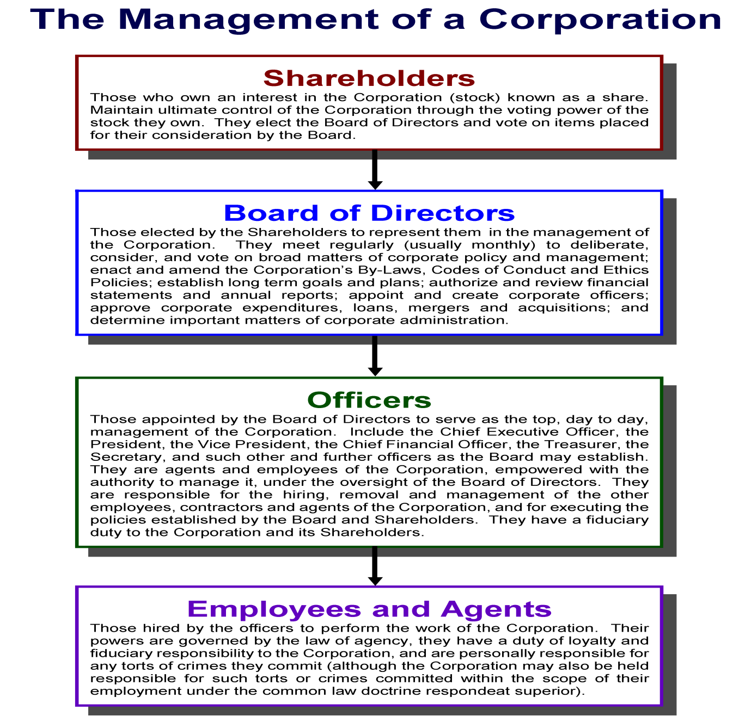

Slide 31
End of Class Ten B
For next time – Review Assignments as follows on the Webpage:
Lecture Slides
Selected Readings
Cases and Exercises
We are a hot bench.
Questions?

