Slide 1
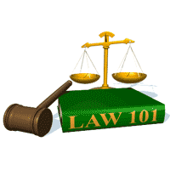
Slide Set Ten C:
Corporate Governance

Slide 2
Last Time We Spoke About:
Corporate Governance – Boards of Directors
Board Members
Part One: Definitions / Roles / Obligations and Duties / Liabilities
Board Member Powers
Part Two: Generally / Chairman / Board Members / Committees
Corporate Personhood
Part Three: Generally / Fiduciary Responsibilities / Personhood Interests
Class Case – Citizen United v. FEC
The Constitutional Rights of Corporations

Slide 3
Tonight We Will Speak About:
Corporate Governance – Officers and Employees
Corporate Officers
Part One: Definitions / Roles / Obligations and Duties / Liabilities
Employees and Agents
Part Two: Employees and Agents
Corporate Governance
Part Three: Running the Corporation / Policies / Management / Shareholder Lawsuits
Class Case – In Re Caremark International
Directors Duty of Oversight Care

Slide 4
Part One:
Corporate Governance
Corporate Governance – Running the Corporation

Slide 5
Corporate Governance
Corporate Governance – Running the Corporation
Running the Corporation:
Board of Directors: The New York Business Corporation Law, as well as the articles of incorporation and the by laws of the corporation, provide broad powers to the board of directors to manage and run the corporation. They are the policy making entity for the corporation and hire the corporate officers who provide the day to day management of corporate affairs.
Meetings of the Boards of Directors: The Board of Directors operates by means of meetings of the board. Agendas for such meetings are prepared by the Chair of the Board. Business of the board, and policy decisions made by the board, is accomplished by resolutions adopted by the board at their meetings.
Size of the Board of Directors: The size of the board of directors is established in the articles of incorporation or the by-laws. Such size is a balancing test between the need for broad talent and diverse opinions and the need to have a manageable size so as to not make meetings unwieldy. Corporate Governance Expert Ira Milstein, has declared that seven persons is the perfect balance for board size. But due to regulatory requirements, corporate committee needs, and modern board duties, most boards are far larger than seven, so as to accommodate and more fairly such workloads and duties.
Officers: The board of directors appoints officers and other agents to act for the company, to do the day to day work of the corporation, in accordance with board directives and policies. To accomplish the work of the corporation, the board grants broad powers to its officers to do the work they are assigned. The Chief Executive Officer, is the primary corporate manager, and pursuant to board policy and directive, is the person responsible for carrying out the day to day responsibilities of the company, and assuring that the purposes and goals of the corporation are achieved.

Slide 6
Part Two:
Corporate Governance
Corporate Governance – Board Polices and Employee Management

Slide 7
Corporate Governance
Corporate Governance – Board Polices and Employee Management
Enforcement of Board Policies:
Board Policies: The Corporate Officers are the persons most generally responsible for the implementation and enforcement of policies adopted by the Corporation’s Board of Directors. As the day to day managers of the Corporation, the Officers are responsible for the board policies under their area of responsibility, and are overseen and held accountable by the board of directors for their performance
Execution of Board Action: If the Board of Directors decides to expand into a new product line or area, or discontinue a previously authorized corporate activity or mission, it is the officers of the corporation that must act to make this decision a reality, including the purchase or sale of materials and expansion or reduction of employees incumbent with such a directive. Officers are generally given broad discretion as to how to accomplish these board directives and policies.
Employee Management:
Oversight of Corporate Employees: The Corporate Officers are the persons responsible for the oversight and management of all the corporate employees. The officers hire, fire and manage the corporation’s employees so as to carry out the corporation’s purposes and accomplish the directive and policies of the board of directors.
Employee Administration: Corporate Officers, especially the Chief Executive Officer, provide employee administration, including tasking employees, defining employee roles, establishing and administering employee salaries, wages and benefits, granting employee raises, levying employee discipline, determining workforce strength, directing employee missions, and examining and reporting on employee productivity.

Slide 8
Part Three:
Corporate Governance
Corporate Governance – Shareholder Derivative Lawsuits

Slide 9
Corporate Governance
Corporate Governance – Shareholder Derivative Lawsuits
Shareholder Derivative Law Suits:
Defined: A shareholder derivative suit is a lawsuit brought by a shareholder on behalf of a corporation against a third party. Often, the third party is an insider of the corporation, such as an executive officer or director. Shareholder derivative suits are unique because under traditional corporate law, management is responsible for bringing and defending the corporation against suit. Shareholder derivative suits permit a shareholder to initiate a suit when management has failed to do so. It should be noted, that if the shareholder wins the action, it is the corporation, and not the shareholder who is awarded the recovery.
Reasons for Derivative Law Suits: Derivative shareholder lawsuits are frequently brought to redress the following types of wrongdoing by the Board of Directors and/or Officers of a company:
Breach of fiduciary duty
Fraud or other unlawful activity
Self-dealing or greed by insiders
Conflict of interest
Waste of corporate assets
Accounting wrongdoing
Inflated, false, or misleading financial statements
inflated executive compensation
Management or board decisions that expose the company to harm, violate consumer protection or other laws.

Slide 10
Part Four:
Corporate Governance
Corporate Governance – Management of Corporation

Slide 11
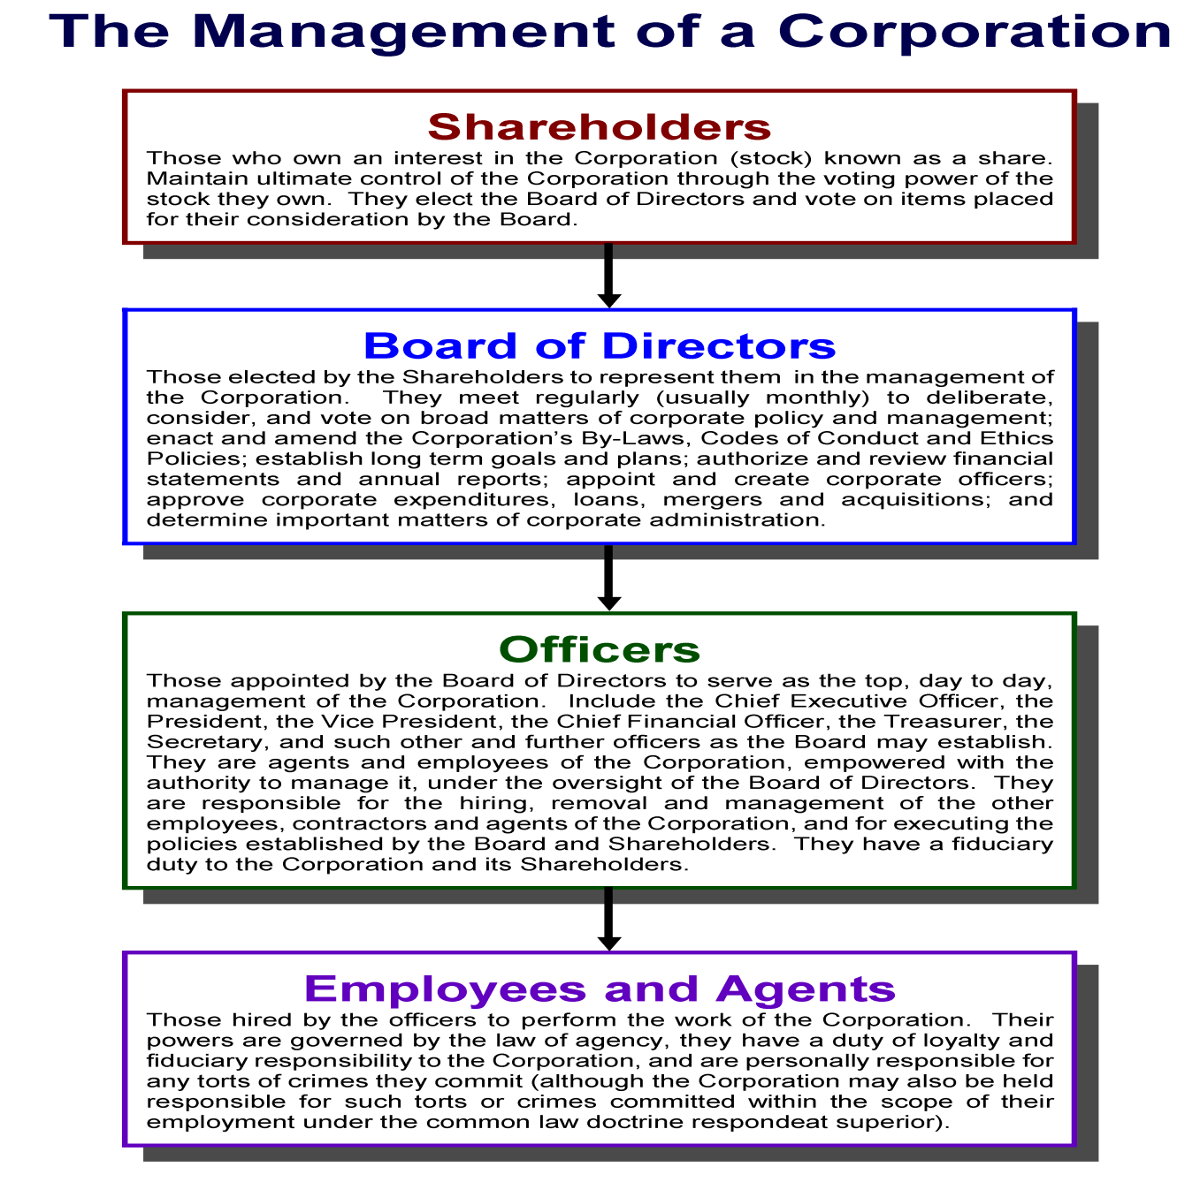

Slide 12
Part Five:
Corporate Governance
Generally – Corporate Personhood

Slide 13
Corporate Governance
Generally – Corporate Personhood
An Artificial Person Under the Law:
Corporate Personhood: As declared since the famous case of Dartmouth College v. Woodward, is the legal principle that a corporation is an Artificial Person under the law, with many of the same rights and privileges as a natural person.
Corporations Have Their Own Separate Legal Status: Pursuant to the concept of corporate personhood, corporations are deemed as legally separate from their associated human beings (shareholders, directors, officers and employees), and have their own constitutionally protected rights.
Rights of the Corporation: As separate legal persons, corporations have a right to enter into contracts with other parties, to sue or be sued in court in the same way as natural persons, and enjoy most constitutional rights traditionally associated with natural persons. The constitutional rights they DO NOT have include:
Corporations cannot vote in political elections;
Corporations are not citizens under the Fourteenth Amendment;
Corporations lack Fifth Amendment self-incrimination rights;
Corporations are not given Privileges and Immunities under Article IV;
Corporations are not afforded Due Process Clause Liberty Rights; and
Corporations obviously due not have the human rights to serve on juries, run for political office, marry, procreate, or travel.

Slide 14
Part Six:
Corporate Governance
Corporate Personhood – Fiduciary Responsibilities

Slide 15
Corporate Governance
Corporate Personhood – Fiduciary Responsibilities
Corporate Personhood:
Fiduciary Duties and the Corporation:
Fiduciary Duty: The members of a corporation’s board directors hold fiduciary duties to the corporation itself, as an artificial person under the law. These duties require board directors to place the best interests of the company ahead of their own. Directors must make decisions for the company and act in a manner that an ordinary, prudent person would. These fiduciary rules thus proceed from a theory of maximizing corporate financial well-being by focusing on shareholder wealth maximization.
Oversee a Financially Sound Corporation: Part of this fiduciary duty to the corporation is to assure that it is financially strong and will continue to grow and prosper. The board of directors has an explicit responsibility to form a short-term plan of one to two years to ensure sustainability of the corporation. In addition, the directors must also plan for long-term growth to promote continued security and prosperity.
Assure that the Corporation Operates Consistently With Policy Goals: Members of a corporation’s board of directors also have a responsibility to oversee all departments and aspects of the corporation. This responsibility includes making sure operations are running efficiently, company operations are in alignment with the organization’s purpose, that there are no incidences of fraud, that adequate communication takes place throughout the corporation, and that sufficient oversight is provided over all departments and operations of the company.
Duties of Care and Loyalty: According to traditional fiduciary analysis, corporate Directors owe two duties to the corporation: care and loyalty. Each duty describes standards for judicial review of corporate decision-making and fiduciary activities.
Duty of Care: The duty of care addresses the attentiveness and prudence of Directors in performing their decision-making and oversight functions. The famous “business judgment rule” presumes that directors carry out their functions in good faith, after sufficient investigation, and for acceptable reasons. Unless this presumption is overcome, courts abstain from second guessing well-meaning business decisions even when they are flops. This is a risk that shareholders take when they make a corporate investment. Thus, to encourage directors to take business risks without fear of personal liability, corporate law protects well-meaning Directors, through exculpation provisions in the corporation’s articles and Bylaws, as well as through directors’ and officers’ insurance.
Duty of Loyalty: The duty of loyalty addresses fiduciaries’ conflicts of interest. This duty requires fiduciaries to put the corporation’s interests ahead of their own. This means that fiduciaries cannot serve two masters. Corporate fiduciaries breach their duty of loyalty when they divert corporate assets, business opportunities, or proprietary information for personal gain. Accordingly, courts will not interfere with the board’s judgment in the absence of unusual conduct such as fraud, and a Director has a duty of loyalty, and is disqualified from taking part in corporate action, when they have a conflict of interest.

Slide 16
Part Seven:
Corporate Governance
Corporate Personhood – Separate Personhood Interests

Slide 17
Corporate Governance
Corporate Personhood – Separate Personhood Interests
An Artificial Person under the Law
Corporate Personhood: Since the time of their establishment under Roman Law, Corporations have been held to be, and have been viewed as, an Artificial Person Under the Law. This Corporate “Personhood” means that the corporation is viewed as a separate entity, distinct from its shareholder owners, and managing board of directors and officers.
Powers of a Corporation: Because of its status as an artificial person under the law, corporations have many, distinct entity powers. This means a corporation can contract in its own name, sue or be sued, own or convey property, and be held criminally liable for crimes that it commits. (BCL §202).
Certificate of Incorporation: Unless the certificate of incorporation expressly limits the corporation’s powers, it will be deemed to have the power to engage in any lawful business activity.
Meaning of Corporate Rights: Corporate personhood refers to the ability of corporations to be recognized by law as an artificial person under the law, with certain constitutionally protected rights. One of these critical rights is the power to act as a person under the law, thereby enter into contractual agreements and to bring and defend litigation in its own name in a court of law. Corporate personhood is also linked to the concept of limited liability, as its is the corporation that enters into contracts and take on debt and risk, not the individuals who work for the corporation or the shareholders who own its stock.

Slide 18
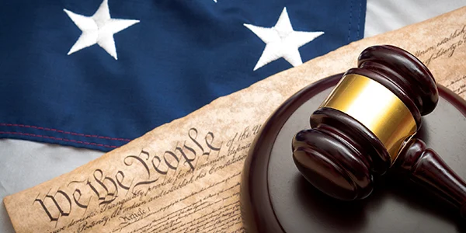
Case Study:
Citizens United v. FEC
The Constitutional Rights of Corporations
The case that fought for freedom of speech

Slide 19
End of Class Ten C
For next time – Review Assignments as follows on the Webpage:
Lecture Slides
Selected Readings
Cases and Exercises
We are a hot bench.
Questions?

