Slide 1
Pandemics and Reactions
An Overview and Analysis

Slide 2
Pandemics and Reactions
What We Will Talk About:
Part One: What is a Pandemic?
Pandemic Defined
Why are Pandemics Scary?
What Causes Pandemics: Diseases, Transmission and Virulence
Defense Against Pandemics – Immunity
Forces to Fight Pandemics
Part Two: Pandemics in History
Pioneers in Medicine
Past Pandemics
Part Three: How to Address a Pandemic
Prevention
Response
Recovery
Entities Responsible for Addressing A Pandemic
Part Four: The Coronavirus Pandemic of 2019-20
Facts About the Coronavirus
Ground Zero Wuhan China
Coronavirus 2019-20 Pandemic Statistics
Coronavirus 2019-20 Pandemic Federal Action Team
Coronavirus 2019-20 Pandemic State Action Team
Coronavirus 2019-20 Pandemic Action Timeline
Coronavirus 2019-20 Pandemic Final Thoughts

Slide 3
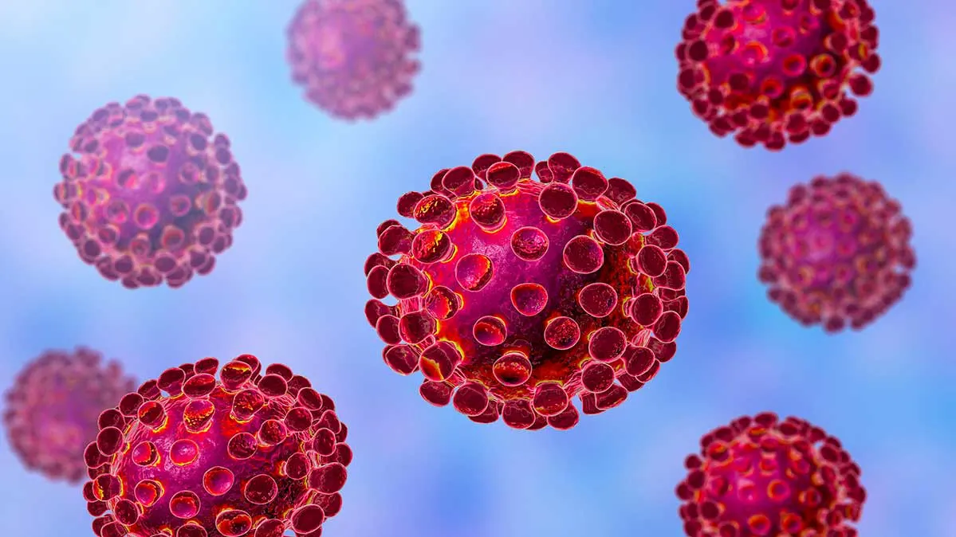
Part One - What is a Pandemic

Slide 4
Pandemic Defined
An Epidemic is the active spread of an infectious disease across a large geographic area, among a high proportion of the population, and has been characterized as “out of control”.
A Pandemic on the other hand, is the active spread of an epidemic, nationally or globally.
A disease is not a pandemic or epidemic merely because it kills or afflicts, a great number of people, or occurs in wide variety of places. It must be infectious and communicable as well.
Accordingly, cancer or diabetes are not a pandemic diseases, whereas AIDS, Influenza and Corona Viruses are.

Slide 5
Why are Pandemics Scary?
Pandemics are scary for multiple reasons.
Invisible – First, pandemics are caused by microscopic pathogens that human beings cannot see. An unseen threat is particularly scary.
Dangerous – Second, pandemics cause physical sickness, permanent disability and/or death. A threat that can make us sick, harm us forever, or kill us is again, particularly scary.
Dynamic – Third, pandemics are caused by complex, mutating, biological organisms that are hard to understand. A threat that frequently changes and is difficult to comprehend is very scary.
Helpless - Fourth, pandemics, until they are studied, and sometimes even afterward, are very difficult to treat, cure or prevent. When no effective treatment, cure or prevention exists, people feel helpless. A threat against which people are helpless, is again, particularly scary.

Slide 6
What Causes Pandemics?
A Pandemic, is caused by:
A Disease which is:
Communicable and
Virulent

Slide 7
What Causes Pandemics - Diseases
What Is A Disease?
A human Disease, is a particular abnormal condition, that negatively affects the structure or function of all or part of a human being’s body, and which is not caused by any immediate external injury.
Diseases are medical conditions that are associated with specific symptoms.
Diseases involved with pandemics are caused by a specific Pathogen. A Pathogen is anything that can cause a disease, and types of Pathogens include:
● Viruses; ● Bacteria; ● Prions;
● Fungi; ● Algae; and ● Parasites.

Slide 8
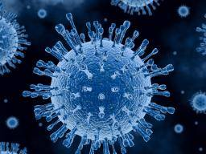
What Causes Pandemics - Diseases
Pathogens - Viruses
Viruses are submicroscopic infectious agents.
They are organisms typically 100 times smaller than bacteria.
Viruses are not plants, animals, or bacteria, and are not living
organisms in the strict sense of the word, because without a
host cell, they cannot carry out their life-sustaining functions
or reproduce.
They contain RNA or DNA, but they do require a host cell to replicate.
Found everywhere on earth, they are the most numerous type of biological entity.
They are classified into seven groups:
dsDNA viruses (e.g. Adenoviruses, Herpesviruses, Poxviruses);
ssDNA viruses (e.g. Parvoviruses);
dsRNA viruses (e.g. Reoviruses);
(+)ssRNA viruses (e.g. Coronaviruses, Picornaviruses, Togaviruses);
(−)ssRNA viruses (e.g. Orthomyxoviruses, Rhabdoviruses);
ssRNA-RT viruses (e.g. Retroviruses); and
dsDNA-RT viruses (e.g. Hepadnaviruses)

Slide 9
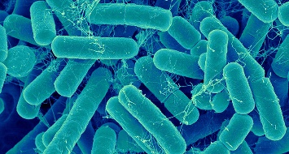
What Causes Pandemics - Diseases
Pathogens - Bacteria
Bacteria are microscopic infectious agents.
They are organisms typically 100 times larger than viruses, but are still so small they can not begin to be seen by the naked eye (typically a few micrometers – one millionth of a meter - in size).
Bacteria are Prokaryotes, which are cellular organisms that have no membrane bound organelles. (An organelle is a specialized subunit, within a cell, that has a specific function, and within bacteria, are spatially distinct functional units without a surrounding lipid bilayer).
The vast majority of bacteria are harmless or even beneficial to humans, however, certain pathogenic bacteria, can result in infectious diseases, by causing cellular damage to their host..
A type of biological cell, bacteria were among the first life forms to appear on Earth, and like viruses, are found everywhere on the planet.
Pathogenic bacteria are a major cause of human death and disease, and can cause infections such as tetanus, typhoid fever, diphtheria, syphilis, cholera, foodborne illness, leprosy and tuberculosis.
Bacterial infections may be treated with antibiotics, which are classified as bacteriocidal if they kill bacteria, or bacteriostatic if they just prevent bacterial growth.
Disinfectants, such as bleach, are also used to kill bacteria, or other pathogens, on surfaces, to prevent contamination and further reduce the risk of infection.

Slide 10
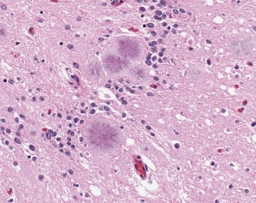
What Causes Pandemics – Diseases
Pathogens - Prions
Prions are misfolded proteins that can transfer their
misfolded state to normally folded proteins of the same type.
They do not contain any DNA or RNA and cannot replicate other
than to convert normal proteins to the misfolded state.
All known prion diseases affect the structure of the brain, or other neural tissue, are progressive and degenerative, have no known effective treatment, and are always fatal.
The most well known prion based disease is Creutzfeldt–Jakob disease (better known as mad cow disease).
Transmission of prions is believed to be caused by ingestion.
They are size of a single protein, and are 1/10th the size of a virus.
The word “prion”, coined in 1982 is derived from “protein” and “infection”, and is short for "proteinaceous infectious particle", in reference to its ability to self-propagate and transmit its conformation to other proteins.
Sadly, very little is known about prions or the diseases the cause, but research is ongoing.

Slide 11
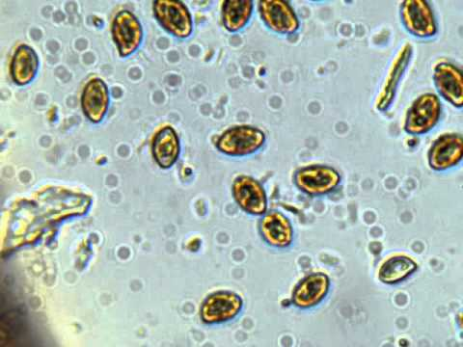
What Causes Pandemics - Diseases
Pathogens - Fungi
Fungi are eukaryotic, microscopic, spore based, organisms that
can function as pathogens. (Eukaryotes are organisms
whose cells have a nucleus enclosed within membranes)
Approximately 300 known fungi are pathogenic to humans.
Fungi spores are approximately the same size as a virus.
Fungi include yeasts and molds, as well as the more familiar mushrooms.
Abundant worldwide, most fungi are inconspicuous because of the small size of their structures, and their cryptic lifestyles in soil or on dead matter.
Certain fungi can cause serious diseases in humans, several of which may be fatal if untreated. These include aspergillosis, candidiasis, coccidioidomycosis, cryptococcosis, histoplasmosis, mycetomas, and paracoccidioidomycosis.
Persons with immuno-deficiencies are particularly susceptible to disease by fungi such as Aspergillus, Candida, Cryptoccocus, Histoplasma, and Pneumocystis.
Other fungi can attack eyes, nails, hair, and especially skin (the so-called dermatophytic and keratinophilic fungi) and can cause local infections such as ringworm or athlete's foot. Fungi can also cause allergies and other reactions.

Slide 12
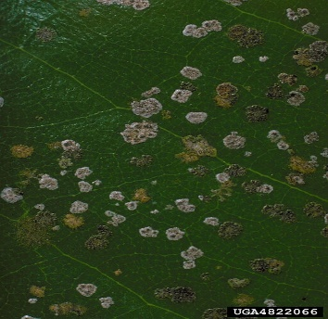
What Causes Pandemics - Diseases
Pathogens - Algae
Algae are single-celled microscopic plants.
Algae too are Eukaryotes, meaning organisms whose cells
have a nucleus enclosed within membranes.
They are generally non-pathogenic, but pathogenic varieties do exist.
They are 7 times the size of viruses.
Examples of algae acting as a pathogens are well known, causing such diseases as protothecosis and prototheca, which are parasitic conditions, causing infection, inflammation and cellular damage.
Algae can also become pathogenic as a part of harmful algal bloom (HAB), which is an algal bloom that causes negative impacts to other organisms via production of natural toxins, cellular damage, or by other means.
HABs are also often associated with large-scale marine mortality events, frequently causing shellfish poisonings, which can effect humans by ingestion.

Slide 13
What Causes Pandemics - Diseases
Pathogens - Parasites
Human parasites are organisms, that lives inside a human being,
and which depends upon that human host for its survival.
Without the human host the parasite cannot grow, live or multiply.
Parasites vary widely, with 70 percent not being visible to the human eye (such as the malarial parasite), but other parasites (such as some rapidly growing worms) can reach over 30 meters in length.
Human parasites include:
microscopic protozoa (more than 12 types);
worms (more than 8 types); and flukes
(more than 5 types).
Human parasites can infect humans and can cause parasitic diseases.
They are divided into:
endoparasites (which cause infection inside the body); and
ectoparasites (which cause infection superficially within the skin).

Slide 14
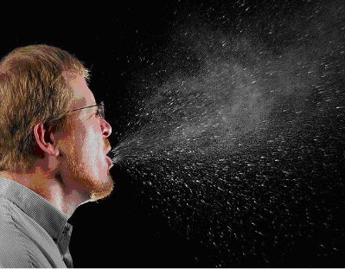
What Causes Pandemics - Transmission
Communicable Diseases – Means of Transmission
A pandemic requires that the disease which causes it
must be communicable.
This means that the subject disease must be able to be
transmitted to people.
The means of this transmission is the way the disease is transmitted
to a human being, as well as the manner in which another human
can catch it.
There are multiple means of transmission for pathogens, and they include:
● Airborne ● Droplet ● Foodborne ● Infectious ● Lifestyle ● Non-communicable

Slide 15
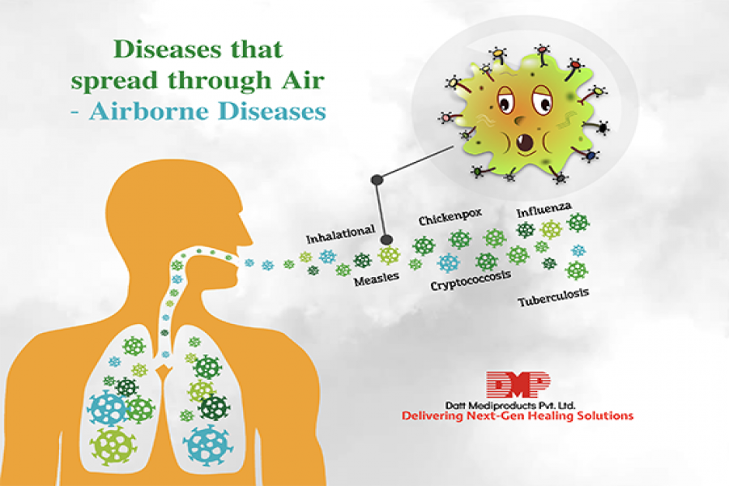
What Causes Pandemics - Transmission
Communicable Diseases – Means of Transmission
● Airborne:
An airborne disease
is any disease
that is caused
by pathogens
and is transmitted
through the air.

Slide 16
What Causes Pandemics - Transmission
Communicable Diseases – Means of Transmission
● Droplet:
Droplet transmission occurs
when pathogens travel
on relatively large respiratory
droplets that people sneeze,
cough, drip, or exhale.
These droplets travel short distances before
settling, usually less than 3 feet, and are loaded
with infectious particles.
They can be spread directly if people are close,
but more often, these droplets land on surfaces,
where they often remain infectious for hours or days.

Slide 17
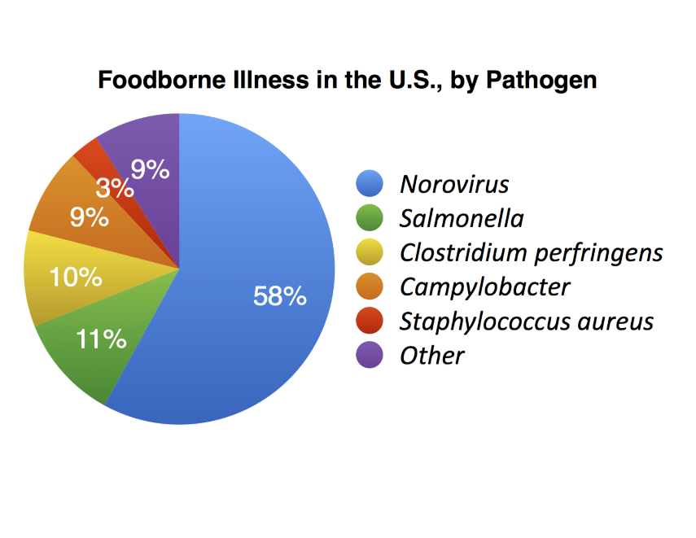
What Causes Pandemics - Transmission
Communicable Diseases – Means of Transmission
● Foodborne:
A foodborne illness
or food poisoning
is any disease
resulting from
the consumption
of food contaminated
with pathogenic bacteria, toxins, viruses,
prions or parasites.
In such cases the means of transmission
is ingestion

Slide 18
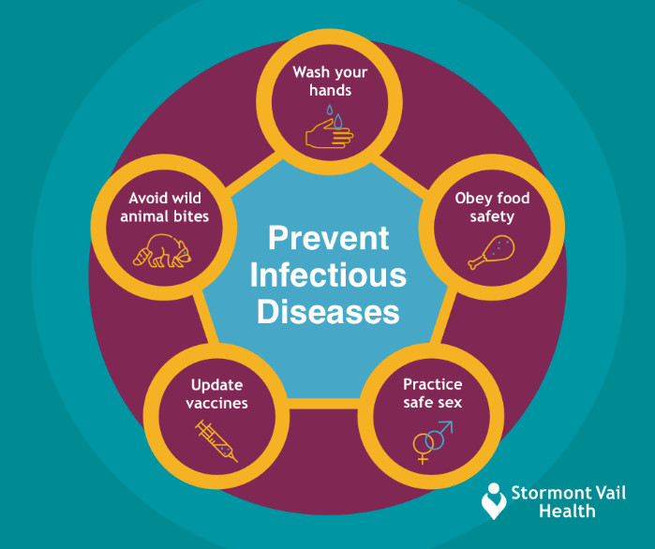
What Causes Pandemics - Transmission
Communicable Diseases – Means of Transmission
● Infectious:
An infectious disease,
also known as
a transmissible disease
or a communicable disease,
results from the infection,
presence and growth
of pathogenic, biological agents
in an individual host organism, and that can be transmitted from one person to another.
Such transmission occurs when the pathogen invades the human’s body, by means of physical contact with a person’s skin, mouth, nose, eyes, blood or other bodily canals or fluid exchange.

Slide 19
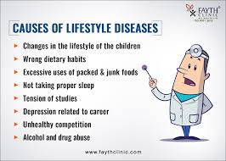
What Causes Pandemics - Transmission
Non Communicable Diseases:
Certain diseases are behavioral, and are not communicable. These diseases cannot cause a pandemic.
● Lifestyle:
A disease that is
non-transmissible,
with risk factors that
include behavioral choices,
such as a sedentary lifestyle,
substance abuse, smoking
or a diet high in unhealthful
foods.

Slide 20
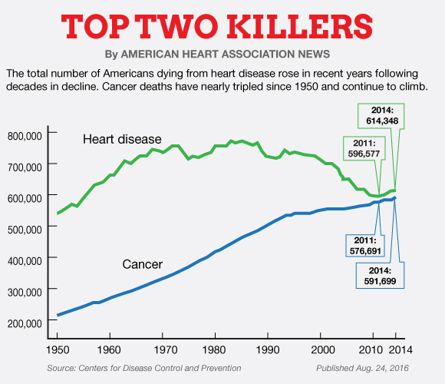
What Causes Pandemics - Transmission
Non Communicable Diseases:
Certain diseases cannot be transmitted, and are not communicable. These diseases cannot cause a pandemic.
● Non-communicable:
These diseases are a
medical condition or
disease that is
non-transmissible.
These diseases cannot be transmitted directly
from one person to another.
Heart disease and cancer are examples of
non-communicable diseases.

Slide 21
What Causes Pandemics - Transmission
Communicable Diseases: Ease of Transmission
A pandemic also requires that the disease which causes it, must be EASY to transmit and contract.
If a disease is not easily transmitted by an infected person, or not easily contracted by an uninfected person, it is unlikely to be widely spread.
Ease of transmission: How easily the disease is spread, from one person to another, depends on several factors.

Slide 22
What Causes Pandemics - Transmission
Communicable Diseases – Ease of Transmission
How easily the disease is spread, from one person to another, depends on:
● Means of Transmission:
Does the means of transmission
of the pathogen
afford easy transmissibility
(such as airborne or droplet transmission)
and can such a spread
occur simply by casual contact,
or through exposure to environments?

Slide 23
What Causes Pandemics - Transmission
Communicable Diseases – Ease of Transmission
How easily the disease is spread, from one person to another, depends on:
● Resiliency of the Pathogen:
How resilient the pathogen is
(i.e., can it survive on many kinds
of surfaces in the open air
for long periods of time,
or does it need moisture
or some special environment
to survive and spread)?

Slide 24
What Causes Pandemics - Transmission
Communicable Diseases – Ease of Transmission
How easily the disease is spread, from one person to another, depends on:
● Infectiousness of the Pathogen:
How infectious is the pathogen
(in how likely is any exposure
to the pathogen in an uninfected
person to cause an infection),
and how much of the pathogen
does it take to cause the infection
of another person?

Slide 25
What Causes Pandemics - Transmission
Communicable Diseases – Ease of Transmission
How easily the disease is spread, from one person to another, depends on:
● Control/Prevention of Transmission:
How abundant is the transmission
(how often can it occur) and
how difficult is it to prevent
the means of transmission?

Slide 26
What Causes Pandemics - Transmission
Communicable Diseases – Ease of Transmission
How easily the disease is spread, from one person to another, depends on:
● Virulence of the Disease:
Can the disease be present
in people without making them
so sick that they do not
have the opportunity
to transmit it to others?

Slide 27
What Causes Pandemics - Transmission
Communicable Diseases – Ease of Transmission
How easily the disease is spread, from one person to another, depends on:
● Incubation period:
How long does it take
for an infected person
to develop symptoms, and
how long does the infected person
remain contagious?

Slide 28
What Causes Pandemics - Transmission
Communicable Diseases – Ease of Transmission
How easily the disease is spread, from one person to another, depends on:
● Discoverability:
How easy is the disease
to diagnosis, treat, and prevent?

Slide 29
What Causes Pandemics - Virulence
Virulence
A pandemic requires that the disease which causes it must also be virulent.
● Virulence:
Relates to the level or degree
of harm that the subject disease
can cause to a human being
who contracts it.

Slide 30
What Causes Pandemics - Virulence
Virulence
A pandemic requires that the disease which causes it must also be virulent.
● Virulence and Pandemics:
Virulence is the prime factor of whether
a disease will rise to the level of a pandemic.
For if the disease which is spreading globally,
does not cause significant levels of death, or
serious disability, to human beings,
(such as the common cold or seasonal flu),
it is much more likely that the disease,
will merely be categorized as an annoyance,
rather than a serious, global health emergency.

Slide 31
What Causes Pandemics - Virulence
Virulence
A pandemic requires that the disease which causes it must also be virulent.
● Virulence and Infectiousness:
Virulence is also a factor related to both the lethality of the
disease (the likelihood that the disease will cause death or
serious, permanent injury to the person), as well as the
infectiousness of the disease (the ease of the disease’s
transmission and the likelihood that any single person can
catch such disease from exposure to any other person).
Because highly virulent diseases tend to kill or seriously
disable persons infected, they also often have a reduced
chance of transmissibility (since infected people die or
become disabled before they can transmit the disease).
This issue, however, is impacted by the length of time that
exists, before a person infected with the disease, becomes
symptomatic (as such a person can transmit the disease to
others before they succumb to the effects of its virulence).

Slide 32
Defense Against Pandemics - Immunity
The Immune System
The best defense against a pandemic is human beings themselves.
For when a disease attacks a human being, what ultimately allows that person to survive, is their immune system.
All treatments, vaccines and remedies that we develop to fight disease, have one thing in common, they buy time for our own immune system to kill the pathogen that invades us.

Slide 33
Defense Against Pandemics - Immunity
The Immune System – What is it?
What is the Immune System?
Our immune system is an intricate collection of specialized cells, tissues, and molecules, that work together to protect us from infectious diseases.
When our immune system is working well, we stay healthy, and when it’s not, we may become susceptible to deadly infections.
In this section we will discuss the components of the immune system, and how they work together to protect us.
Additionally, we will discuss what we can do to boost our immune systems to fight disease.

Slide 34
Defense Against Pandemics - Immunity
The Immune System - Components
● Components of the Immune System
There are four structural components of the immune system.
These include:
The Thymus;
Bone Marrow;
The Spleen; and
The Lymphatic System.
These components work together to keep us healthy and fend off pathogens that can cause disease.
To function properly, our immune system must detect these pathogens, and distinguish them from the organism's own healthy tissue.
As pathogens can rapidly evolve, adapt and mutate to avoid detection and neutralization by the immune system, it in turn, has developed multiple defense mechanisms, to recognize and neutralize diseases that have invaded a person’s body.

Slide 35
Defense Against Pandemics - Immunity
The Immune System – The Innate System
There are two divisions of the immune system we use to fight disease. They are the Innate System and the Adaptive System
The Innate System:
Human Beings have certain built-in, or innate, immune features that helps protect us from disease.
First, there are physical barriers to invasion from pathogens, including the skin, mucous membranes, tears, saliva, and stomach acid, which do not target specific germs, but are rather, all purpose defenses, to prevent infection from causing us harm.
Second, there are also internal innate immune responses, including:
White blood cells called neutrophils, produced in the bone marrow, and positioned along the circulatory system, and in the blood, to act as a reservoir of infection fighting cells.
Inflammation, which is a response to the entry of a pathogen that causes increased blood flow to the invaded area, bringing killer white blood cells to attack the disease.
Fever, raises the body temperature of the invaded person, to deploy the weapon of heat against the pathogen, which impairs them from replicating.

Slide 36
Defense Against Pandemics - Immunity
The Immune System – Adaptive System
There are two divisions of the immune system we use to fight disease. They are the Innate System and the Adaptive System
The Adaptive System:
Human Beings also have an adaptive immune system, composed of highly specialized cells that can adapt to, and learn from, prior encounters with a specific pathogen.
It remembers that you had a specific pathogen in the past, and will protect you from it again, thereby providing you “immunity.
The Adaptive Immune System works through the cell-mediated system and the antibody-mediated humoral system:
The Cell Mediated System uses cells to attack infection. These include Lymphocytes, which are B and T cells, which mount very specific antigen response and bind only one particular molecular structure, to impair or kill it, or to activate other cells to do so.
The Antibody Mediated System works through plasma cells, performing several functions, including neutralizing bacterial toxins, binding to viruses to prevent entry into cells, and opsonization, in which a coating of antibodies increases the effectiveness of neutrophils trying to engulf the pathogen. There are four main types of antibodies: immunoglobulins M, A, E, and G.

Slide 37
Defense Against Pandemics - Immunity
The Immune System – How to Boost It
How to Boost the Immune System?
It is difficult to boost the immune system precisely because it is a system made up of many different types of cells, and science is not exactly sure what kinds of cells, and/or how many of each, would make up a perfect system.
Presently, medical science looks for ways to best improve a person’s overall immune response, and make them healthy, thereby advising things like a healthy diet and exercise.
But when fighting a specific disease, there are some additional things that can be done to boost the immune system, including:
Vaccination: Boosts a person’s adaptive immune system, by introducing a weakened version of a pathogen into a person’s body, so that the immune system can easily kill it and recognize it again in the future.
Antibiotics and Antivirals: Medications that help the immune system attack and kill a pathogen, thereby providing it with an opportunity to defeat the disease, and allow the person to return to good overall health.
Symptom Treatments: Medications or procedures that help a person deal with the negative symptoms of a pathogenic infection, and thereby prevent an overwhelming of the immune system, so as to give it sufficient time to kill, neutralize or address the disease.

Slide 38
Forces to Fight Pandemics
Modern Medicine
The principle force to help our own immune systems fight a pandemic is modern medicine.
Born from the scientific method of the 18th century, modern medicine helps us by developing cures, treatments and strategies to fight diseases.
It does this by research, experimentation, modeling and communication.

Slide 39
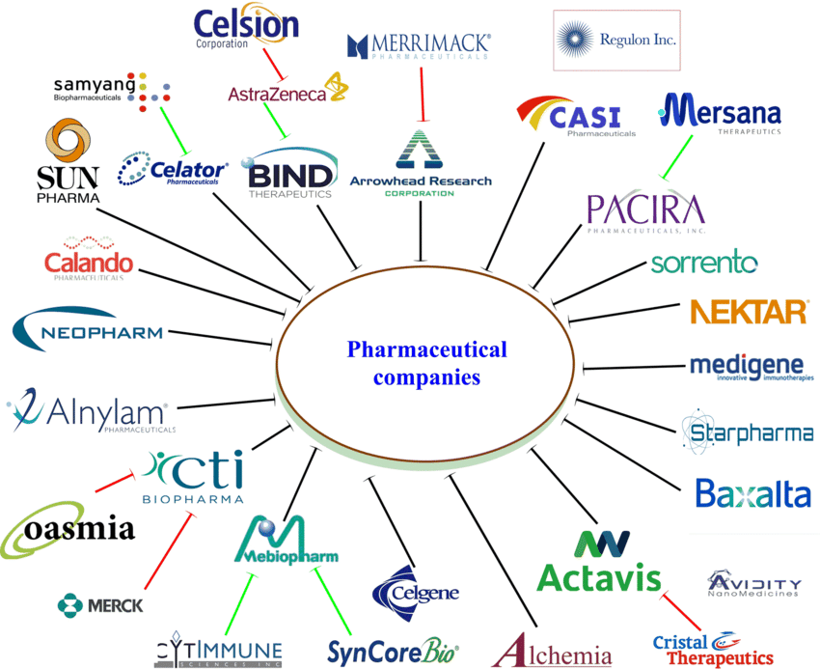
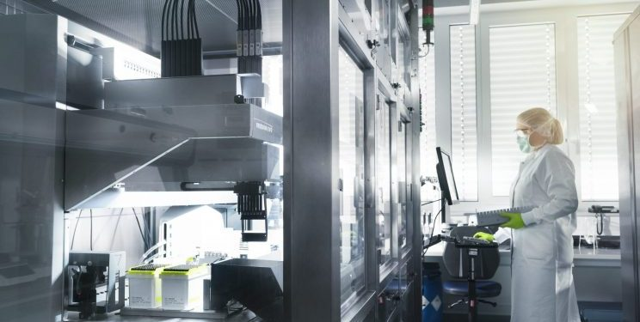
Forces to Fight Pandemics
Pharmaceutical Companies
One of the primary entities modern medicine uses to fight diseases is pharmaceutical companies.
These private sector companies use the power of profit to develop new treatments, medications (drugs) and vaccines to fight disease.
By pouring Billions of dollars annually into scientific research, clinical trials and testing, these companies produce countless treatments, medications and vaccines each year.
Located all across the globe, but principally in the United States, these companies lead the way against the fight against pandemics.

Slide 40
Forces to Fight Pandemics
Federal Research and Development Labs
Another critical entity that modern medicine uses to fight diseases is Federal Research and Development Laboratories.
Operated and funded by the federal government, these entities include:
USAMRID – The US Army Medical Research Institute of Infectious Disease;
Fort Detrick, Maryland
CDC – Center for Disease Control and Prevention;
Atlanta, Georgia
NIH - National Institutes of Health;
Bethesda, Maryland
NIAID - National Institute of Allergy and Infectious Diseases;
Bethesda, Maryland and Hamilton, Montana
FDA - Food and Drug Administration; and
Silver Spring, Maryland
HRSA - Health Resources and Service Administration.
Bethesda, Maryland

Slide 41
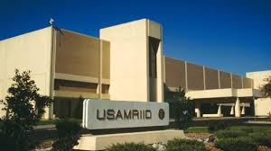
Forces to Fight Pandemics
Federal Research and Development Labs
Another critical entity that modern medicine uses to fight diseases is Federal Research and Development Laboratories.
Operated and funded by the federal government, these entities include:
USAMRID – The US Army Medical Research Institute of Infectious Disease;
Fort Detrick, Maryland

Slide 42
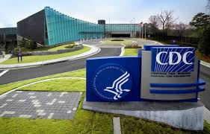
Forces to Fight Pandemics
Federal Research and Development Labs
Another critical entity that modern medicine uses to fight diseases is Federal Research and Development Laboratories.
Operated and funded by the federal government, these entities include:
CDC – Center for Disease Control and Prevention;
Atlanta, Georgia

Slide 43
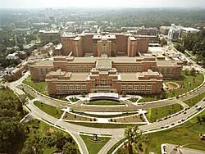
Forces to Fight Pandemics
Federal Research and Development Labs
Another critical entity that modern medicine uses to fight diseases is Federal Research and Development Laboratories.
Operated and funded by the federal government, these entities include:
NIH - National Institutes of Health;
Bethesda, Maryland

Slide 44
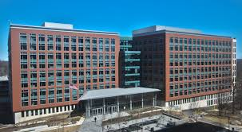
Forces to Fight Pandemics
Federal Research and Development Labs
Another critical entity that modern medicine uses to fight diseases is Federal Research and Development Laboratories.
Operated and funded by the federal government, these entities include:
NIAID - National Institute of Allergy and Infectious Diseases;
Bethesda, Maryland and Hamilton, Montana

Slide 45
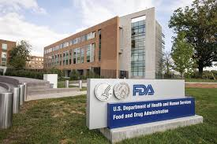
Forces to Fight Pandemics
Federal Research and Development Labs
Another critical entity that modern medicine uses to fight diseases is Federal Research and Development Laboratories.
Operated and funded by the federal government, these entities include:
FDA - Food and Drug Administration; and
Silver Spring, Maryland

Slide 46
Forces to Fight Pandemics
Federal Research and Development Labs
Another critical entity that modern medicine uses to fight diseases is Federal Research and Development Laboratories.
Operated and funded by the federal government, these entities include:
HRSA - Health Resources and Service Administration.
Bethesda, Maryland

