Slide 1
Slide Set Four C:
Rights in Property

Slide 2
Last Time – We Spoke About:
The Executive Branch
Part One: Federal and State / Powers / Regs / Executive Orders
The Judicial Branch
Part Two: Federal and State / Jurisdiction / Powers / The Courts
The Legislative Branch
Part Three: Federal and State / Powers / Statutes / Oversight
Class Exercise – How A Bill Becomes A Law
And How to Run for Public Office

Slide 3
Tonight – We Will Speak About:
The Rights in Property
Part One: Founders View / Importance / Why We Recognize Rights
The Four Postulates
Part Two: 1. Property is a Collection of Rights
2. Property and Law are Intertwined
3. Property Rights are Inherent to Our Humanity
4. Rights Include: Exclude, Possess, Use and Transfer
Types of Property
Part Three: Real / Personal / Intellectual
Class Case – Dred Scott v. Sandford
People Should Not Be Viewed as Property

Slide 4
The Meaning of Property
Rights in Property – Types of Property
To Understand Property:
We Must Understand the four postulates:
1. Property needs to be seen as a collection of “Rights” not a collection of “Things”;
2. Property Rights are those recognized by Law and the Law evolved from Property Rights;
3. Our Foundations of Law recognized that we are endowed with Property Rights; and
4. Property Rights can be summarized by E-PUT
The RIGHT to EXCLUDE
The RIGHT to POSSESS
The RIGHT to USE; and
The Right to TRANSFER.

Slide 5
The Meaning of Property
Rights in Property – Types of Property
Its All About Rights
So it has become apparent – if you want to understand Property you need to understand Rights.
So lets begin our understanding into the true meaning of property law, by performing a review of the Types of Property in which these Rights vest.
Notes:
5

Slide 6
The Meaning of Property
Rights in Property – Types of Property
Its All About Rights
Property as “Rights” - Types of Property
What types of Property can “Rights” be exercised over:
Real (Rights in Land);
Real Estate – Ownership/Leaseholds/Easements/Life Estates
Personal (Rights in Objects); and/or
Chattels – Tangible, visible “things”
Intellectual (Rights in Ideas)
Patents – Idea for Product or Process
Trademarks – Logo, Identification or Distinction
Copyrights – Written or Performed Works

Slide 7
The Meaning of Property
Rights in Property – Types of Property
Its All About Rights
Property as a “Right” - Types of Property
Real (Rights in Land)
Real property consists of Rights in:
1. Land;
2. Anything attached to land (Buildings, buildings, signs, fences, or trees);
3. The land surface, subsurface (including minerals and groundwater), and the airspace above the surface.
Historically, Property Law was almost exclusively concerned with Real Property.

Slide 8
The Meaning of Property
Rights in Property – Types of Property
Its All About Rights
Property as a “Right” - Types of Property
Personal (Rights in Things)
Personal Property consists of Rights:
Items of tangible, visible personal property, including:
Chattels: Cars, clothing, jewelry, livestock, airplanes, coins, rings, and books
Virtually all of the personal property in feudal England fell into this category.
Today, property rights can exist in almost any tangible, visible “thing.”
Almost every moveable thing around you now is a chattel, with property rights vested with someone.
Prominent exceptions to this general observation:
Human kidneys, fingers, ova, sperm, blood cells, and other body parts may well be characterized as “tangible, visible things,” but many courts and legislatures have proven reluctant to extend property rights to them.
Similarly, the law also deems deer, foxes, whales, and other wild animals, in their natural habitats, as unowned.

Slide 9
The Meaning of Property
Rights in Property – Types of Property
Its All About Rights
Property as a “Right” - Types of Property
Intellectual (Rights in Ideas)
Intellectual Property Rights exist in:
Patents – (Property rights in conceptual products, designs and processes)
Trademarks – (Property rights in Logos, Identifications or Distinctions); and
Copyrights – (Property rights in writings, art or performances).
Property rights have been deemed to be vested in these types of ideas.
This type of property, known as intellectual property, provide for rights in items that are not tangible, nor visible, but which can have great worth, and which have been produced with great labor.

Slide 10
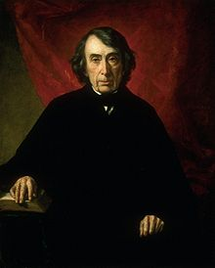
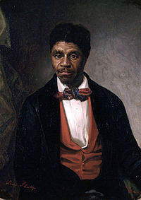
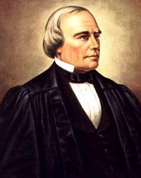
Case Study:
Dred Scott v. Sanford
The case that caused a
Civil War
Roger Tauney Dred Scott Benjamin Robbins Curtis

Slide 11
End of Class Four C
Please don’t forget to hand in your bio form
For next time – Review Assignments as follows on the Webpage:
Lecture Slides
Selected Readings
Cases and Exercises
We are a hot bench.
Questions?

