Slide 1
Slide Set Six B:
Liens and Security Interests

Slide 2
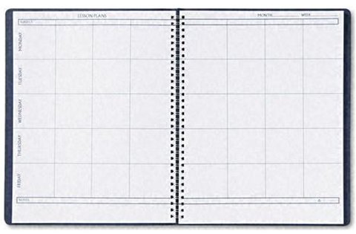
Last Time We Spoke About:
Personal Property
Part One: Meaning of Personal Property / EPUT Right Enforcement
Wild Animals
Part Two: Possession / Capture / Return / Regulation
Acquisition of Property Rights
Part Three: Means of Acquisition:
- Occupancy / Possession
- Purchase by Sale
- Adverse Possession
- Accession / Confusion
- Judgement
- Found Property – Lost / Mislaid / Abandoned
- Gift
Class Case – Pierson v. Post
Mere Pursuit is NOT Possession

Slide 3
Tonight – We Will Speak About:
Gifts
Part One: Definitions / Gifts Inter Vivos / Gifts Causa Mortis / Others
Liens and Security Interests
Part Two: Definitions / General and Special Liens / Particular Issues
Bailments
Part Three: Definitions / Elements / Duties / Benefits
Class Case – Gruen v. Gruen
Conditional Delivery of Gifts

Slide 4
Personal Property
Liens
Definitions

Slide 5
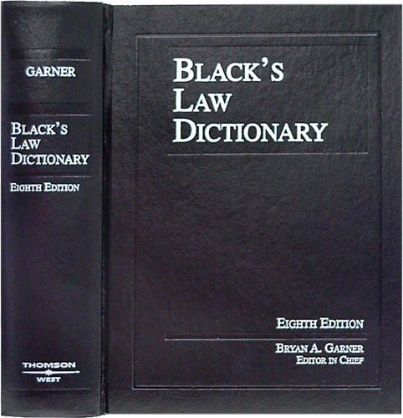
Personal Property
Liens - Definition
Liens
So just what is a Lien?
Well lets go to Blacks Law Dictionary,
and remember we need to think of
property as a collection of “Rights”
and not a collection of “Things”;
Blacks defines a “LIEN” as:
A charge or security or encumbrance upon property
A claim or charge on property for payment of some debt, obligation or duty
A right to retain property for payment of debt or demand
A simple definition of Lien is:
“The Right to encumber certain property for security on a debt”

Slide 6
Personal Property
Liens - Definition
Liens
A lien is a security device to enforce payment
Types of Liens:
A. Common Law Lien:
A Common Law Lien is a common law, customary right to possess or retain personal property which has been improved or enhanced in value by the person who claims the lien until the person claiming the property pays in full all charges attaching to the property for such improvement. Every lien requires that:
1. A debt has arisen from services performed on the thing;
2. Title to the thing is in the debtor; and
3. Possession of the thing is in the creditor.
B. Statutory Lien
A Statutory Lien is an express right to enforce a lien pursuant to statute.

Slide 7
Personal Property
Liens
General Liens / Special Liens

Slide 8
Personal Property
Liens – General Liens / Special Liens
Liens
Classes of Liens
A. General Lien
A general lien is the right to retain ALL OF THE PROPERTY of another person as security for a general balance due from such other person. Certain creditors and universal agents can have a general lien.
B. Special Lien
A special lien is the right to retain SPECIFIC PROPERTY of another to secure some particular claim or charge which has attached to the property retained. A common or private carrier, a warehouser or ordinary bailee, a trustee, attorney, arbitrator, and a general or special agent may have a special lien.

Slide 9
Personal Property
Liens – General Liens / Special Liens
Liens
Consequence of Classification
The question as to whether a lien is general or special becomes important only when the lien holder releases a portion of the chattels held as security. Where a doubt exists as to whether the lien holder has a general or special lien, the law presumes the lien to be special rather than general.
General Lien
If the lienholder has a general lien and releases part of the chattels, he releases no portion of the lien and he may hold the unreleased portion until the entire lien charge is paid.
Special Lien
If the lien is a special lien and the lienholder releases a portion of the chattels held, he thereby waives the lien to the extent of the chattels released.

Slide 10
Personal Property
Liens
Particular Issues

Slide 11
Personal Property
Liens – Particular Issues
Liens
Lien Given By One Not The Owner
A lien is a proprietary interest, a qualified ownership, and, in general, can only be created by the owner or someone authorized by the owner.
Example:
A person in possession of a truck with the owner’s permission cannot create a lien for repairs. The fact that the repairs are for the benefit of the owner is immaterial.

Slide 12
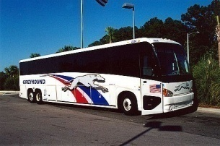
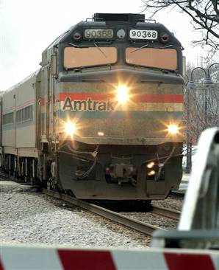
Personal Property
Liens – Particular Issues
Liens
2. Innkeepers and Common Carriers
The lien of an innkeeper and a common carrier is recognized at common law on the theory that common carriers and innkeepers, being compelled by law to indiscriminately accept all persons who present themselves, must be protected and secured in their just charges for the services rendered.
a. Innkeepers:
This lien is peculiar in nature. It attaches to any property brought into the inn by the guest. It is not essential that the guest should, in all cases, be the owner of such property. The property may be that of a third person, or even stolen goods. If the innkeeper has no knowledge that such property is not rightfully in the possession of the guest, such lien will attach generally to all such property to the extent of a reasonable charge for the services rendered.
b. Common Carriers:
Although a common carrier is generally required, like an innkeeper, to accept all goods delivered, it has no lien on the goods which it receives from persons other than the owner. The reason for this rule is that the carrier may demand transportation charges in advance, or in the alternative, proof from the shipper that he is acting with the authority of the owner (i.e. as his agent).

Slide 13
Personal Property
Liens – Particular Issues
Liens
3. Warehouser
At common law a warehouser was not recognized
to have a lien on bailed chattel.
Such a lien is NOW RECOGNIZED pursuant to statute
under the New York Uniform Commercial Code (Section 7-209).
It should be noted, however, that despite this statutory lien,
the courts have held that a garagekeeper (a subclass
of warehouser as opposed to a mechanic) does not have a
right under our state’s constitution to conduct a satisfaction
of this lien through an ex parte sale.
4. Statutory Liens
New York’s Lein Law expressly recognizes a number of liens to enforce payment for goods or services performed.
These include liens for:
1. Mechanics, 2. Hospitals,
3. Artisians, 4. Animal caretakers – including vets,
5. Stone carvers, 6. Shipkeepers, and
7. Virtually all creditors.

Slide 14
Personal Property
Liens – Particular Issues
Liens
Waiver of Liens
1. Contract
A lien can be waived either by provision or fulfillment of a contract (such as payment).
2. Substitution of Other Security
Where a lienor (the person placing the lien) accepts security for payment, the security eliminates the lien.
3. Demand for Unlawful Charges
Where the lienor includes within his valid lien, amounts in excess of his lawful charges, he is deemed to state that a tender of the lawful amount will not be accepted, and as such the lien is deemed waived, with the lienor’s remedies being those under the law for default.
4. Reservation or Temporary Use
The lien is NOT deemed waived if the lienholder temporarily surrenders the goods to the bailor, if such lienor reserves their lien or permits bailor to have temporary use.
5. Satisfaction
A lien can be satisfied upon the sale of the item by the lienor or payment by the lienee (the person against who the lien is levied).

Slide 15
End of Class Six B
For next time – Review Assignments as follows on the Webpage:
Lecture Slides
Selected Readings
Cases and Exercises
We are a hot bench.
Questions?

