Slide 1
Slide Set Seven A:
Intellectual Property - Copyrights

Slide 2
Last Time We Spoke About:
Gifts
Part One: Definitions / Gifts Inter Vivos / Gifts Causa Mortis / Others
Liens and Security Interests
Part Two: Definitions / General and Special Liens / Particular Issues
Bailments
Part Three: Definitions / Elements / Duties / Benefits
Class Case – Gruen v. Gruen
Conditional Delivery of Gifts

Slide 3
Tonight We Will Speak About:
Copyrights
Part One: Definitions / Elements / Rights / Duration / Enforcement
Patents
Part Two: Definitions / Elements / Rights / Duration / Enforcement
Trademarks
Part Three: Definitions / Elements / Rights / Duration / Enforcement
Class Case – A&M Records v. Napster
Peer to Peer Infringement

Slide 4
Intellectual Property
Generally

Slide 5
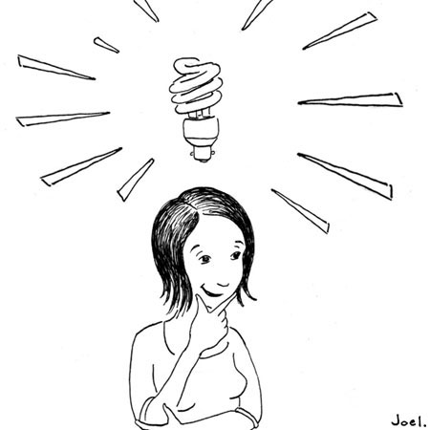
Intellectual Property
Generally
Intellectual Property
Not all property is tangible
This is why we need to think of property in terms of “rights” not “things”.
This concept becomes especially important for
intellectual property.

Slide 6
Intellectual Property
Generally
Intellectual Property
Rights in Ideas:
Although common law was reluctant to invest property rights in an “idea”, modern society and law have evolved property rights to include certain unique intellectual designs, processes or works.
Federal Law Governs:
Although most property law is state law, virtually all intellectual property law is based upon federal statutes.

Slide 7
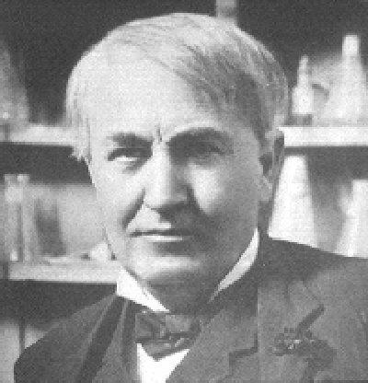
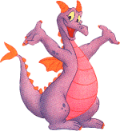
Intellectual Property
Generally
Intellectual Property
It all starts with an idea!

Slide 8
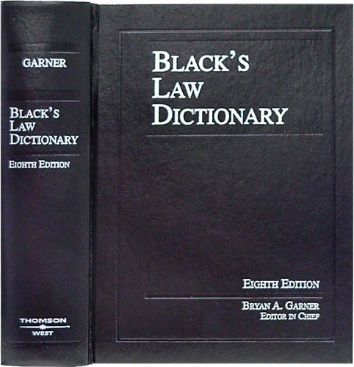
Intellectual Property
Generally
Intellectual Property
Defined: Any product of human intellect
that is intangible but has value
in the marketplace.
It is called “intellectual” property
because it is the product
of human imagination, creativity,
and inventiveness.

Slide 9
Intellectual Property
Generally
Intellectual Property
Why It is Important:
Traditionally, businesses have thought of their physical assets,
such as land, buildings, and equipment as the most important.
Increasingly, however, a company’s intellectual assets
are the most important.
Protecting intellectual property, promotes creativity,
invention and provides incentive and rewards
for hard work.

Slide 10
Intellectual Property
Generally
Intellectual Property
Three Types of Intellectual Property:
Copyrights – Written or Performed Works
Patents – Ideas for Products or Processes
Trademarks – Logos, Identifications or Distinctions

Slide 11
Intellectual Property
Copyrights
Enforceable Rights in Writings, Art or Expression
Definitions

Slide 12
Intellectual Property
Copyrights - Defined
Intellectual Property
Copyrights – Rights in Writings, Art or Expression
Copyrights have been Defined as:
“Original works of authorship
fixed in any tangible medium of expression”.
A circled letter C is the symbol designating a copyright.
In the United States, the Berne Convention Implementation Act of 1988, effective March 1, 1989, removed the requirement for the copyright symbol from U.S. copyright law.
Its presence or absence, however, is still legally significant, on works published before that date, and it continues to affect remedies available to a copyright holder whose work is infringed.

Slide 13
Intellectual Property
Copyrights
Enforceable Rights in Writings, Art or Expression
Elements

Slide 14
Intellectual Property
Copyrights - Elements
Intellectual Property
Copyrights – Rights in Writings, Art or Expression
Key Elements
1. Originality (Uniqueness)
2. Work of Authorship
● Literary,
● Music,
● Dramatic,
● Graphic or Architectural, or
● Movies or Audio Production
*Software is viewed as literary
3. Fixation (Any physical rendering)

Slide 15
Intellectual Property
Copyrights
Enforceable Rights in Writings, Art or Expression
Rights

Slide 16
Intellectual Property
Copyrights - Rights
Intellectual Property
Copyrights – Rights in Writings, Art or Expression
Collection of Rights: Including the right to:
Prevent Reproduction
Create derivative works
Distribute Copies
Perform, display or transmit the Work Publicly
Duration of Rights:
If work was created after 1978: Life of the author plus 70 years (No renewal);
If work was created before 1978: 28 years plus a renewal for 47 years (75 years);
Work for Hire Exception: 95 years from publication or 120 from creation, whichever is less.

Slide 17
Intellectual Property
Copyrights - Rights
Intellectual Property
Copyrights – Rights in Writings, Art or Expression
To prove Infringement – A Plaintiff Must:
1. Hold a valid copyright
2. The defendant copied the work; and
3. The copy was improper appropriation
(The two works are substantially similar)
Defenses:
Agreement or Fair Use – Protecting the Copyright and protecting the minimal use and free speech rights of the user.
Remedies:
Injunction, Impoundment and Destruction, and Damages

Slide 18
Intellectual Property
Copyrights
Enforceable Rights in Writings, Art or Expression
How a Copyright is Obtained

Slide 19
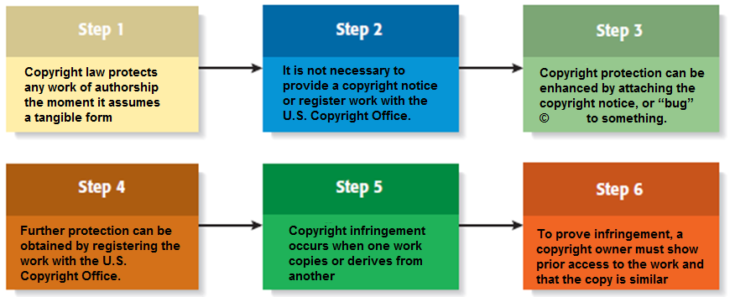
Intellectual Property
Copyrights – The Process of Obtainment
Intellectual Property
Copyrights – Rights in Writings, Art or Expression
The Process of Obtaining a Copyright

Slide 20
End of Class Seven A
For next time – Review Assignments as follows on the Webpage:
Lecture Slides
Selected Readings
Cases and Exercises
We are a hot bench.
Questions?

