Slide 1
Slide Set Seven B:
Intellectual Property - Patents

Slide 2
Last Time We Spoke About:
Gifts
Part One: Definitions / Gifts Inter Vivos / Gifts Causa Mortis / Others
Liens and Security Interests
Part Two: Definitions / General and Special Liens / Particular Issues
Bailments
Part Three: Definitions / Elements / Duties / Benefits
Class Case – Gruen v. Gruen
Conditional Delivery of Gifts

Slide 3
Tonight We Will Speak About:
Copyrights
Part One: Definitions / Elements / Rights / Duration / Enforcement
Patents
Part Two: Definitions / Elements / Rights / Duration / Enforcement
Trademarks
Part Three: Definitions / Elements / Rights / Duration / Enforcement
Class Case – A&M Records v. Napster
Peer to Peer Infringement

Slide 4
Intellectual Property
Generally

Slide 5
Intellectual Property
Generally
Intellectual Property
Not all property is tangible
This is why we need to think of property in terms of “rights” not “things”.
This concept becomes especially important for
intellectual property.

Slide 6
Intellectual Property
Generally
Intellectual Property
Rights in Ideas:
Although common law was reluctant to invest property rights in an “idea”, modern society and law have evolved property rights to include certain unique intellectual designs, processes or works.
Federal Law Governs:
Although most property law is state law, virtually all intellectual property law is based upon federal statutes.

Slide 7
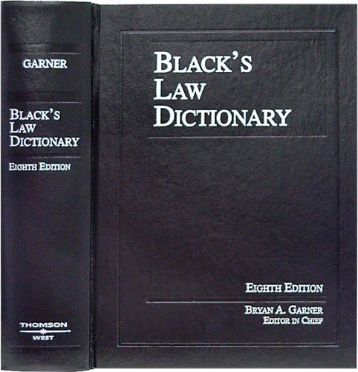
Intellectual Property
Generally
Intellectual Property
Defined: Any product of human intellect
that is intangible but has value
in the marketplace.
It is called “intellectual” property
because it is the product
of human imagination, creativity,
and inventiveness.

Slide 8
Intellectual Property
Generally
Intellectual Property
Why It is Important:
Traditionally, businesses have thought of their physical assets,
such as land, buildings, and equipment as the most important.
Increasingly, however, a company’s intellectual assets
are the most important.
Protecting intellectual property, promotes creativity,
invention and provides incentive and rewards
for hard work.

Slide 9
Intellectual Property
Generally
Intellectual Property
Three Types of Intellectual Property:
Copyrights – Written or Performed Works
Patents – Ideas for Products or Processes
Trademarks – Logos, Identifications or Distinctions

Slide 10
Intellectual Property
Patents
Enforceable Rights in any new or useful process, machine, manufacture, composition of matter, or improvement.
Definitions

Slide 11
Intellectual Property
Patents - Defined
Intellectual Property
Patents – Enforceable Rights in any new or useful process, machine, manufacture, composition of matter, or improvement.
Patents have been Defined as:
“The governmental grant of a right, privilege or authority.
Also the right to exclude others from making, using, marketing, selling, offering for sale, or importing an invention for a specified period, granted by the federal government to the inventor if the device is novel, useful and nonobvious”.

Slide 12
Intellectual Property
Patents
Enforceable Rights in any new or useful process, machine, manufacture, composition of matter, or improvement.
Elements

Slide 13
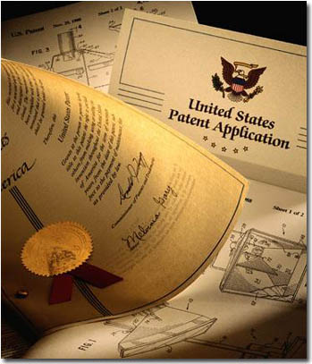
Intellectual Property
Patents - Elements
Intellectual Property
Patents – Enforceable Rights in any new or useful process, machine, manufacture, composition of matter, or improvement.
Patents are the intellectual property rights vested in anyone who invents or discovers any new or useful process, machine, manufacture, or any composition of matter, or any new or useful improvement thereof.”
Four Key Elements
1. Patentable subject matter
2. Utility
3. Novelty; and
4. Non-obviousness

Slide 14
Intellectual Property
Patents - Elements
1. Patentable Subject Matter
● Process:
An act, or a series of acts or steps (such as a
mode of treatment of certain materials) to
produce a given result.
● Machine:
A concrete thing, consisting of parts, or of
certain devices and combination of devices.
● Manufacture
An article produced from raw or prepared materials by giving to these
materials new forms, qualities, properties, or combinations, whether by
hand labor or by machinery.
● Composition of matter
All compositions of two or more substances and all composite articles,
whether they be the results of chemical union, or of mechanical mixture, or
whether they be gases, fluids, powders or solids.

Slide 15
Intellectual Property
Patents - Elements
2. Utility
The Invention must be useful
and provide actual benefit
3. Novelty
The Invention must new, novel
and unique.
4. Non-obviousness
The Invention must not be obvious
to a person of ordinary skill in the
subject area.

Slide 16
Intellectual Property
Patents
Enforceable Rights in any new or useful process, machine, manufacture, composition of matter, or improvement.
Rights

Slide 17
Intellectual Property
Patents - Elements
Collection of Rights
- The Right to prevent others from
making, using or selling the invention.
- A patent is federal right with no rights
directly transferable outside the US.
- Must file the patent in every nation
in which they wish to protect.
2. Duration of Rights
- 20 years from the date the patent is filed
- Nonrenewable and require a maintenance fee to the PTO.

Slide 18
Intellectual Property
Patents
Enforceable Rights in any new or useful process, machine, manufacture, composition of matter, or improvement.
How a Patent is Obtained

Slide 19
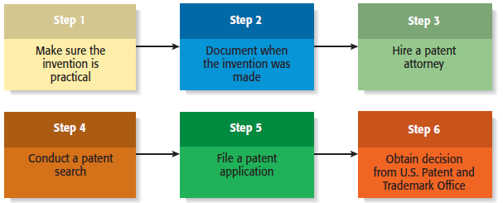
Intellectual Property
Patents – The Process of Obtainment
Intellectual Property
Patents – Enforceable Rights in any new or useful process, machine, manufacture, composition of matter, or improvement.

Slide 20
End of Class Seven B
For next time – Review Assignments as follows on the Webpage:
Lecture Slides
Selected Readings
Cases and Exercises
We are a hot bench.
Questions?

