Slide 1
Slide Set Seven C:
Intellectual Property - Trademarks

Slide 2
Last Time We Spoke About:
Gifts
Part One: Definitions / Gifts Inter Vivos / Gifts Causa Mortis / Others
Liens and Security Interests
Part Two: Definitions / General and Special Liens / Particular Issues
Bailments
Part Three: Definitions / Elements / Duties / Benefits
Class Case – Gruen v. Gruen
Conditional Delivery of Gifts

Slide 3
Tonight We Will Speak About:
Copyrights
Part One: Definitions / Elements / Rights / Duration / Enforcement
Patents
Part Two: Definitions / Elements / Rights / Duration / Enforcement
Trademarks
Part Three: Definitions / Elements / Rights / Duration / Enforcement
Class Case – A&M Records v. Napster
Peer to Peer Infringement

Slide 4
Intellectual Property
Generally

Slide 5
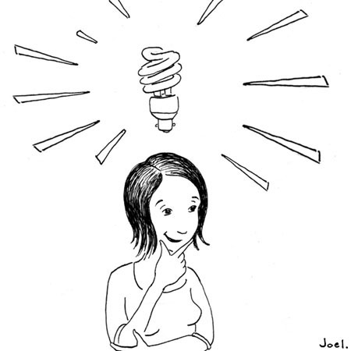
Intellectual Property
Generally
Intellectual Property
Not all property is tangible
This is why we need to think of property in terms of “rights” not “things”.
This concept becomes especially important for
intellectual property.

Slide 6
Intellectual Property
Generally
Intellectual Property
Rights in Ideas:
Although common law was reluctant to invest property rights in an “idea”, modern society and law have evolved property rights to include certain unique intellectual designs, processes or works.
Federal Law Governs:
Although most property law is state law, virtually all intellectual property law is based upon federal statutes.

Slide 7
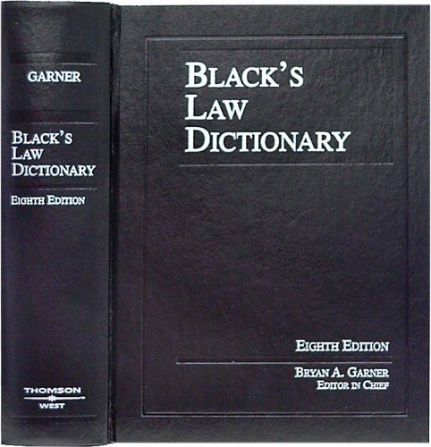
Intellectual Property
Generally
Intellectual Property
Defined: Any product of human intellect
that is intangible but has value
in the marketplace.
It is called “intellectual” property
because it is the product
of human imagination, creativity,
and inventiveness.

Slide 8
Intellectual Property
Generally
Intellectual Property
Why It is Important:
Traditionally, businesses have thought of their physical assets,
such as land, buildings, and equipment as the most important.
Increasingly, however, a company’s intellectual assets
are the most important.
Protecting intellectual property, promotes creativity,
invention and provides incentive and rewards
for hard work.

Slide 9
Intellectual Property
Generally
Intellectual Property
Three Types of Intellectual Property:
Copyrights – Written or Performed Works
Patents – Ideas for Products or Processes
Trademarks – Logos, Identifications or Distinctions

Slide 10
Intellectual Property
Trademarks
Enforceable Rights in any word, name, symbol or devise.
Definitions

Slide 11
Intellectual Property
Trademarks - Defined
Intellectual Property
Trademarks – Rights in words, names, symbols or devises.
Trademarks have been Defined as:
Any “word, name, symbol or devise used by a person to identify and distinguish their goods from those sold by others”
A circled letter R is the symbol designating a registered trademark.
In the United States, the registered trademark symbol was originally introduced in the trademark act of 1945.
This symbol provides notice that the preceding word or symbol is a trademark or service mark that has been registered with a national trademark office. A trademark is a symbol, word, or words legally registered or established by use as representing a company or product.

Slide 12
Intellectual Property
Trademarks
Enforceable Rights in any word, name, symbol or devise.
Elements

Slide 13
Intellectual Property
Trademarks - Elements
Intellectual Property
Trademarks – Rights in words, names, symbols or devises.
A trademark is any “word, name, symbol or devise used by a person to identify and distinguish their goods from those sold by others”
Key Elements
Distinctiveness
Non-functionality
First use in trade

Slide 14
Intellectual Property
Trademarks
Enforceable Rights in any word, name, symbol or devise.
Rights

Slide 15
Intellectual Property
Trademarks - Rights
Intellectual Property
Trademarks – Rights in words, names, symbols or devises.
Collection of Rights: Including the right to:
Prevent Unauthorized use of the word, name, symbol or device trademarked.
Prevent Dilution of the Trademarked Item
Use and maintenance of, exclusive rights over, the trademarked item in relation to products or services
Duration of Rights:
Good For Ten Years With Infinite Renewals

Slide 16
Intellectual Property
Trademarks - Rights
Intellectual Property
Trademarks – Rights in words, names, symbols or devises.
MULTIFACTED TRADEMARK PROTECTION
Name is trademarked
Symbol is trademarked
Slogan is trademarked

Slide 17
Intellectual Property
Trademark
Enforceable Rights in any word, name, symbol or devise.
How a Trademark is Obtained

Slide 18
Intellectual Property
Trademarks – Process of Obtaining
Intellectual Property
The Process of Obtaining a Trademark

Slide 19
Intellectual Property
Generally
General Important Issues

Slide 20
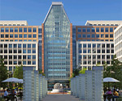
Intellectual Property
Generally
Registration and Recording
Where, When and How
● US Patent and Trademark Office
Washington DC
● Practice before it and the Federal
Courts requires admission to a
separate bar
● Can clerk at the office and
don’t have to even be a lawyer.

Slide 21
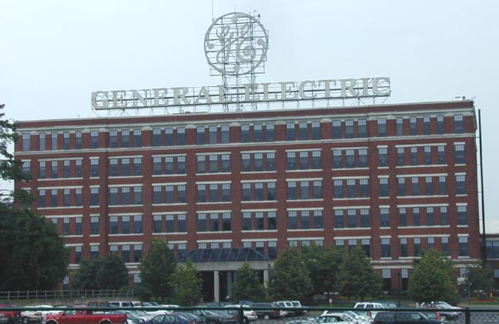
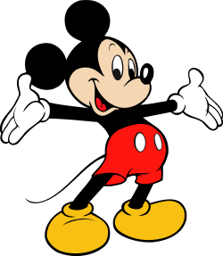
Intellectual Property
Generally
Modern Trends
The World of Intellectual Property
Concerns over China – Reverse Engineering
Especially big issues with items uniquely
Intellectual – music, software, processes
Big players
General Electric
Disney
Motion Picture Companies

Slide 22
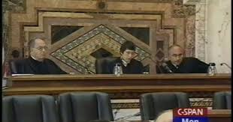
An Adventure into the Case Law Intellectual Property
The Case of A&M Records v. Napster
A Peer to Peer Sharing System Against Music Content

Slide 23
End of Class Seven C
For next time – Review Assignments as follows on the Webpage:
Lecture Slides
Selected Readings
Cases and Exercises
We are a hot bench.
Questions?

