Slide 1
Slide Set Eight C:
Criminal Law – Common Law Felonies

Slide 2
Last Time We Spoke About:
Copyrights
Part One: Definitions / Elements / Rights / Duration / Enforcement
Patents
Part Two: Definitions / Elements / Rights / Duration / Enforcement
Trademarks
Part Three: Definitions / Elements / Rights / Duration / Enforcement
Class Case – A&M Records v. Napster
Peer to Peer Infringement

Slide 3
Tonight We Will Speak About:
Structure and Purpose of Criminal Law
Part One: Definitions / Substantive - Procedural / Purpose / Crimes / Torts
Theories of Criminal Punishment
Part Two: Punishment Theories / Sentencing / Classification
Common Law Felonies
Part Three: Common Law Felonies / Current Day Criminal Statutes
Class Case – Regina v. Dudley and Stephens
Necessity and Mens Rea

Slide 4
Criminal Law
Common Law Felonies

Slide 5
The Criminal Law Common Law Felonies Common Law: As previously mentioned the current criminal law evolved from common law. Felonies and Misdemeanors were classifications under common law of the seriousness of a crime At common law, a felony carried with it the possible penalty of death. They were the most serious of crimes. Misdemeanors, conversely, were less serious offenses, which could result in short term imprisonment. Today’s Criminal Statutes: Most criminal law resides in the states and is derived from common law offenses. These offenses have been codified under such statutes as the New York State Penal Law. Although there are some Federal Criminal Offenses, codified under the United States Code, most relate federal issues, such as crimes against federal officials, terrorism, bank robbery, federal tax evasion, wire fraud, mail fraud, piracy, counterfeiting, drug trafficking or treason.

Slide 6
Criminal Law Common Law Felonies Remember - Mr & Mrs Lamb Murder Rape Manslaughter Robbery Sodomy Larceny Arson Mayhem Burglary

Slide 7
Criminal Law
Common Law Felonies
Current Day Criminal Statutes

Slide 8
Murder A person is guilty of murder when: 1. With intent to cause the death of another person, he causes the death of such person or of a third person; 2. Under circumstances evincing a depraved indifference to human life, he recklessly engages in conduct which creates a grave risk of death to another person, and thereby causes the death of another person; or 3. Acting either alone or with one or more other persons, he commits or attempts to a felony, and, in the course of and in furtherance of such crime or of immediate flight therefrom, he, or another participant, if there be any, causes the death of a person other than one of the participants.

Slide 9
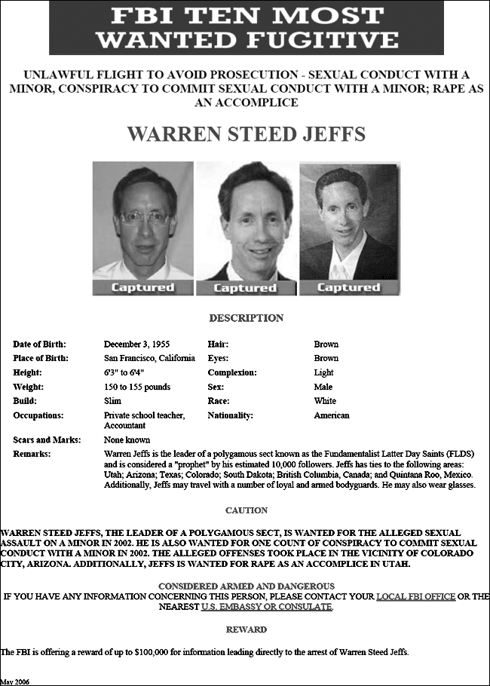
Rape A person is guilty of rape when: He or she engages in sexual intercourse with another person: 1. By forcible compulsion; or 2. Who is incapable of consent by reason of being physically helpless; or 3. Who is less than eleven years old; or 4. Who is less than thirteen years old and the actor is eighteen years old or more.

Slide 10
Manslaughter A person is guilty of manslaughter when: 1. With intent to cause serious physical injury to another person, he causes the death of such person or of a third person; or 2. With intent to cause the death of another person, he causes the death of such person or of a third person under circumstances which do not constitute murder because he acts under the influence of extreme emotional disturbance.

Slide 11
Robbery Robbery is forcible stealing. A person forcibly steals property and commits robbery when: In the course of committing a larceny, he uses or threatens the immediate use of physical force upon another person for the purpose of: 1. Preventing or overcoming resistance to the taking of the property or to the retention thereof immediately after the taking; or 2. Compelling the owner of such property or another person to deliver up the property or to engage in other conduct which aids in the commission of the larceny.

Slide 12
Sodomy (No long referred to in New York’s Penal Law) Under common law, a person was guilty of Sodomy when: He or she engages in deviate sexual intercourse with another person: 1. By forcible compulsion; or 2. Who is incapable of consent by reason of being physically helpless; or 3. Who is less than eleven years old; or 4. Who is less than thirteen years old and the actor is eighteen years old or more.

Slide 13
Larceny A person steals property and commits larceny when: With intent to deprive another of property, or to appropriate the same to himself or to a third person, he wrongfully takes, obtains or withholds such property from an owner thereof. Larceny includes a wrongful taking, obtaining or withholding of another's property, committed in any of the following ways: (a) By conduct known as larceny by trespassory taking, larceny by trick, embezzlement, or by obtaining property by false pretenses; or (b) By acquiring lost property, when during such acquisition he exercises control over property of another which he knows to have been lost or mislaid, or to have been delivered under a mistake as to the identity of the recipient or the nature or amount of the property, without taking reasonable measures to return such property to the owner; or (c) By committing the crime of issuing a bad check; or (d) By false promise, when, pursuant to a scheme to defraud, he obtains property of another by means of a representation, express or implied, that he or a third person will in the future engage in particular conduct, and when he or the third person does not intend to do so; or (e) By extortion, when he compels or induces another person to deliver such property to himself or to a third person by means of instilling in him a fear that, if the property is not so delivered, the actor or another will: (i) Cause physical injury to some person in the future; or (ii) Cause damage to property; or (iii) Engage in other conduct constituting a crime; or ((iv) Accuse some person of a crime or cause criminal charges to be instituted against him; or (v) Expose a secret or publicize an asserted fact, whether true or false, tending to subject some person to hatred, contempt or ridicule; or (vi) Cause a strike, boycott or other collective labor group action injurious to some person's business; except that such a threat shall not be deemed extortion when the property is demanded or received for the benefit of the group in whose interest the actor purports to act; or (vii) Testify or provide information or withhold testimony or information with respect to another's legal claim or defense; or (viii) Use or abuse his position as a public servant by performing some act within or related to his official duties, or by failing or refusing to perform an official duty, in such manner as to affect some person adversely; or (ix) Perform any other act which would not in itself materially benefit the actor but which is calculated to harm another person materially with respect to his health, safety, business, calling, career, financial condition, reputation or personal relationships.

Slide 14
Arson A person is guilty of arson when: He intentionally damages a building or motor vehicle by causing an explosion or a fire; 1. When: A. Such explosion or fire is caused by an incendiary device propelled, thrown or placed inside or near such building or motor vehicle; or B. Such explosion or fire is caused by an explosive; or C. Such explosion or fire either: (i) causes serious physical injury to another person other than a participant, or (ii) the explosion or fire was caused with the expectation or receipt of financial advantage or pecuniary profit by the actor; and 2. When another person who is not a participant in the crime is present in such building or motor vehicle at the time; and 3. When the defendant knows that fact or the circumstances are such as to render the presence of such person therein a reasonable possibility.

Slide 15
Mayhem (Merged under Crime of First Degree Assault in Present Day NY Law) At Common Law, Mayhem was defined as: “The intentional disfigurement of any part of the male body useful in time of war.”

Slide 16
Burglary A person is guilty of burglary when: 1. He knowingly enters or remains unlawfully in a dwelling with intent to commit a crime therein, and 2. In effecting entry or while in the dwelling or in immediate flight therefrom, he or another participant in the crime: A. Is armed with explosives or a deadly weapon; or B. Causes physical injury to any person who is not a participant in the crime; or C. Uses or threatens the immediate use of a dangerous instrument; or D. Displays what appears to be a pistol, revolver, rifle, shotgun, machine gun or other firearm.

Slide 17
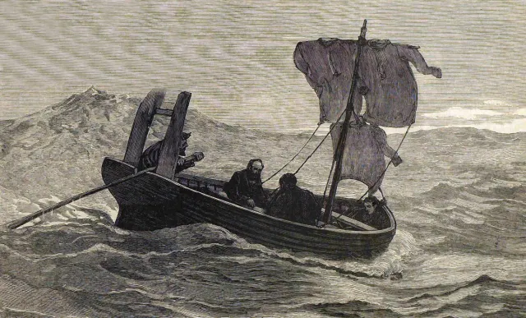
An Adventure into the Case Law Criminal Law
The Case of Regina v. Dudley and Stephens
The Question of Necessity as a Defense

Slide 18
End of Class Eight C
For next time – Review Assignments as follows on the Webpage:
Lecture Slides
Selected Readings
Cases and Exercises
We are a hot bench.
Questions?

