Slide 1
Slide Set Nine A:
Real Property Introduction

Slide 2
Last Time We Spoke About:
Structure and Purpose of Criminal Law
Part One: Definitions / Substantive - Procedural / Purpose / Crimes / Torts
Theories of Criminal Punishment
Part Two: Punishment Theories / Sentencing / Classification
Common Law Felonies
Part Three: Common Law Felonies / Current Day Criminal Statutes
Class Case – Regina v. Dudley and Stephens
Necessity and Mens Rea

Slide 3
Tonight We Will Speak About:
An Introduction to Real Property
Real Property - Introduction
Part One: Definitions / Importance / Nature / Livery of Seisen
Shared Interests in Land
Part Two: Tenants in the Entirety / Joint Tenants / Tenants in Common
Real Property Taxes
Part Three: Valuation of Property / Regressiveness / Entities Supported
Class Case - Hellerstein v. Assessor
Challenges to Assessing Practices

Slide 4
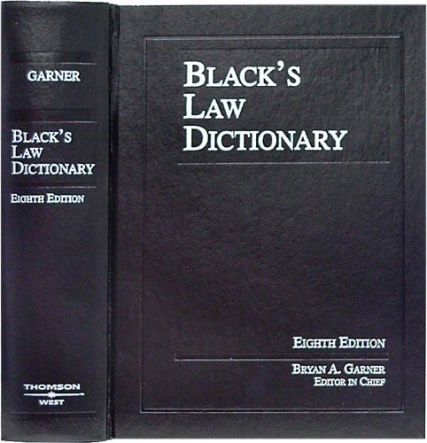
Real Property - Definitions
Blacks law Dictionary Defines Real Property as
“Land and generally whatever is erected
or growing upon or affixed to land.”
Also
“Rights issuing out of, annexed to,
and exercisable within or about land”
Also
“Immovable Property or rights arising
from Immovable property”
But a simple definition is:
“Property Rights involving Land, its fixtures, structures or production”

Slide 5
Real Property
The Importance of Real Property
Real Property has historically meant:
1. Wealth,
2. Power, and
3. Life
Real Property needs to be thought of in terms of:
1. Possession, and
2. Time
Critical concepts include (as expressed in the Deed):
1. Titled Ownership, and
2. Limitations on Titled Ownership
The value of Real Property has led to complex legal rules

Slide 6
Real Property
The Importance of Real Property –
Why is Real Property Important?
Real Property has always represented:
Wealth;
Power; and
Life
Why Wealth, Power and Life?
➢ Special - Distinct - Unique and - Valuable (Limited Finite Resource).
➢ Sovereignty (governmental power) and its relationships depended on land
➊ Real Property granted “Freeman” status after Magna Carta,
➋ Right to Vote was linked to Ownership of Real Property
➌ Landlord – Tenant Relationship: The Owner had Power (Fuedalism).
➢ Was (and still is today) the source of:
➊ Food (where crops and animals are raised),
➋ Clothing (where material for cloth is harvested), and
➌ Housing (where buildings for shelter are constructed and maintained).
➢ Has always provided the owner with wealth, status, sustenance, and
➢ Social, political, and economic power.

Slide 7
Real Property
The Importance of Real Property –
What does the law recognize as far as rights in land?
Rights in Land, commonly known as real property, consists of:
interests in land; and
anything attached to land (e.g., buildings, fixtures, signs, fences, or trees).
Just what are interests in land (really another term for rights)
Interests in land can include:
ownership interests,
leaseholds,
easements,
life estates, and
future interests.
Interests further include:
rights in the land surface,
the subsurface (including minerals and groundwater), and
the airspace above the surface.

Slide 8
Real Property
The Importance of Real Property –
The law’s recognition of rights in land – The Rest of the Story
It All Comes Down to Value and Control
Control over land has always provided the basis for political sovereignty.
Accordingly, disputes concerning real property were historically resolved in the king's courts.
Indeed, disputes over real property
traditionally made up the bulk of all litigation.

Slide 9
Real Property
The Importance of Real Property –
The law’s recognition of rights in land – The Rest of the Story
It All Comes Down to Value and Control
Even today, a person’s real estate holdings
typically make up their most important
and most valuable asset.
As a result, even today, rights in land remain
the single most important resource for human existence.
As our population increases and environmental
concerns continue, disputes about property rights,
due to our finite land supply, will continue to make
interest in real property one of the most important
legal rights.

Slide 10
Real Property
The Importance of Real Property –
The law’s recognition of rights in land – The Rest of the Story
What Does it Mean to Have “Rights in Land”
The concept of Real Property is one of the oldest
concepts existing in the law.
As we have seen, however, the legal recognition of
property in ancient times, was not what we understand
today as the legal standing of individual ownership,
nor the acknowledgment of individual property rights.
These concepts, which have developed into what we
classify as “rights in land” came later, and are a much
more recent development of mature legal systems.

Slide 11
Real Property
The Importance of Real Property –
The law’s recognition of rights in land – The Rest of the Story
What Does it Mean to Have “Rights in Land”
Ancient Law saw property and people as associations,
as merely a factor of being in proximity to the land or
object.
Indeed, Roman law had no actual word for what we call
“ownership”.
The word “ownership” does not appear in English
Common law decisions until 1583.

Slide 12
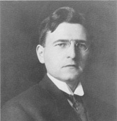
Real Property
The Importance of Real Property –
The law’s recognition of rights in land – The Rest of the Story
What Does it Mean to Have “Rights in Land”
Nonetheless, Property has been a fundamental concept of the earliest legal systems.
People have been concerned with property, and its uses, and their law has recognized its importance and value, since man came down from the trees.
Accordingly, in the earliest societies, their concept of property, can best be understood, through the perspective of a Hohfeldian analysis.
Wesley Newcomb Hohfeld (1879 -1918)
A Professor of Jurisprudence (the philosophy of the law).
During his life he published several influential law journal articles
regarding the philosophy of property.
His famous book, the Fundamental Legal Conceptions of Property
was derived from two articles in the Yale Law Journal (1913) and (1917),
and set forth his famous property analysis whereby property
is seen as an object in connection with a complex web of social relations,
with these relations establishing a limiting and defined relationship
between the person and the object.

Slide 13
Real Property
The Importance of Real Property –
The law’s recognition of rights in land – The Rest of the Story
What Does it Mean to Have “Rights in Land”
It is in this interrelationship between law and property, that it can be seen
that one of the reasons law was developed in the first place,
was to protect property rights and resolve property disputes.
It is to this understanding that Bentham speaks when he says,
“Property and law are born together, and die together. Before laws were made, there was no property;
take away laws, and property ceases.”
This concept applies across the legal spectrum of all property:
Personal, Real and Intellectual

Slide 14
Real Property
Interests in Land
Like all property, interests in land are a collection of rights.
Interests in Land are the vehicles for the exercise of these rights.
To understand “Interests in Land”, they need to be seen through the prism of:
Possession
Time
Two Major Questions
Possession – Does the interest allow possession of the realty?
Time – What time will the interest in the property be executed?

Slide 15
The Nature of Interests in Real Property

Slide 16
Real Property
Interests in Land
So just what is an “Interest in Land” ?
Interests in Land relate to your Collection of Rights
with respect to the Real Property in question
Real Property has always been held as:
- Special,
- Distinct,
- Unique, and
- Valuable in the law.
The law has thus long recognized that Rights in Real Property
are to be viewed as Extensive and Severable,
and as such, can also be significantly limited through
its Transference, from the original owner.

Slide 17
Real Property
Interests in Land
So just what is an “Interest in Land” ?
So if Interests in Land relate to your Collection of Rights
with respect to the Real Property in question, what are they:
EPUT – with an Added T
Accordingly, These Rights, and their Limitations,
of an Interest in Land, include:
Exclusion
Possession
Use; and
Transfer; as well as
Time

Slide 18
Real Property
Interests in Land
So just what is an “Interest in Land” ?
As Interests in Land relate to your Collection of Rights
how do we know the extent of these rights (the interest)?
To determine the rights and limitations conveyed,
under this Collection of Rights, it is necessary
to think in terms of:
1. Titled “Fee” Ownership, and
2. Limitations on Titled “Fee” Ownership
The inherent value of Real Property has led to complex legal rules to provide these rights and limitations and their conveyance.
The effect of these complex legal rules can be seen in the Deed
which is the instrument that conveys the extent of titled ownership

Slide 19
Real Property
Interests in Land – Language in the Deed
What is FEE??
The concept of Fee had its origins in Feudalism.
It is a designation of the extent of one’s rights in real property.
Under Common Law, the King had “radical title” or “allodium”
over all English lands.
This meant that he was the ultimate "owner" of all Real Property.
As the ultimate “owner” of all English lands,
the King, could grant to a subject,
an “estate in land”, which was as sub-ownership interest,
what would be “owned and possessed” by the citizen granted the estate.
This estate so granted was known as a “Fee”. The fee simple estate, also called "estate in fee simple" or "fee-simple title" and was often referred to as a “freehold”.

Slide 20
Real Property
Interests in Land – Language in the Deed
What is FEE??
In the early period after the Norman conquest,
the holder of an estate in fee simple could not sell it,
but instead could only grant a subordinate fee simple estate
to a third party in the same parcel of land,
a process known as “subinfeudation”.
The Statute of Quia Emptores,
adopted in 1290, abolished subinfeudation.
This Statute, another consequence and offshoot of the freedoms
inspired by the Magna Carta,
allowed the sale of fee simple estates,
from which modern land transactions are derived.

Slide 21
Real Property
Interests in Land – Language in the Deed
What is FEE??
As Deeds became the vehicle to transfer Real Property, the term “Fee” became the primary identifier of the rights in land conveyed. A transfer will all possible rights was deemed
According to William Blackstone, the great common law commentator, land held in fee simple:
is the estate in land held by the owners and their heirs absolutely;
is an estate in land without any end or limit;
can be conveyed by its owner to whomsoever they please;
can be mortgaged or put up as security; and
can be reduced to any other type of lesser estate.

Slide 22
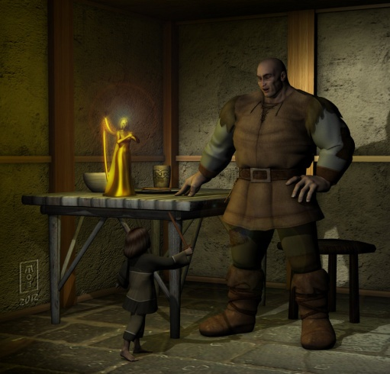
Real Property
Interests in Land – Language in the Deed
What is FEE??
The term Fee Is represented in Jack and the Beanstalk
when the Giant expresses the “Castle Doctrine” saying:
Fee Fi Fo Fum…
I smell the blood of an Englishman …
Be he alive, or be he dead …
I’ll grind his bones to make my bread …
Fee – Fee Estate – Meaning this is my home,
Fi – An ancient phrase to express disapproval,
Fo – A colloquialism used to express disgust of an opponent, and
Fum – Fume, meaning anger

Slide 23
Real Property
Interests in Land
As we have seen, like all other property, interests in land,
are determined through a collection of rights.
- Exclusion
- Possession
- Use; and
- Transfer; as well as
- Time
The rights maintained and transferred in an Interest in Land
need to be seen through the qualifier of:
- Possession
- Time
Two Major Questions – Must be asked to determine the Interest
Possession – Does the interest allow possession of the realty?
Time – What time will the interest in the property be executed?
The Deed to the property will often answer these two major questions.

Slide 24
Real Property
Interests in Land
Words of Purchase vs. Words of Limitation
To determine what rights exist in an Interest in Land,
we examine the Deed to the Property.
The Deed will most often define the two factors which tell the story:
Words of purchase:
Words that describe who takes the real property
by means of grant, gift, inheritance or bequest.
Words of limitation:
Words that describe type and duration
of the estate taken by the transferee.

Slide 25
Real Property
Interests in Land
Assessing the Words of the Deed is:
A Two Step Dance: Possession and Time
Step One: Form of Possession
Possessory Interests in Land (Either presently or in the future)
Non - Possessory Interests in Land (Either presently or in the future)
Step Two: When the Interest Vests
Present interests (When the RIGHT to possess is NOW)
Future interests (When the RIGHT to possess is in the future)

Slide 26
Real Property
Interests in Land
Possessory Interests in Land (Either presently or in the future)
1. Fee Simple Absolute
2. Defeasible Estates
- Fee Simple Determinable with Possibility of Reverter
- Fee Simple Subject to a Condition Precedent
- Fee Simple Subject to an Executory Interest
3. Fee Tail
4. Life Estate
Non possessory interests in land: (An Interest with a right that can be executed but is not presently possessed)
1. Easements
2. Profits,
3. Covenants, and
4. Servitudes

Slide 27
Livery of Seisen

Slide 28
End of Class Nine A
For next time – Review Assignments as follows on the Webpage:
Lecture Slides
Selected Readings
Cases and Exercises
We are a hot bench.
Questions?

