Slide 1
Slide Set Nine C:
Real Property Taxes

Slide 2
Last Time We Spoke About:
Structure and Purpose of Criminal Law
Part One: Definitions / Substantive - Procedural / Purpose / Crimes / Torts
Theories of Criminal Punishment
Part Two: Punishment Theories / Sentencing / Classification
Common Law Felonies
Part Three: Common Law Felonies / Current Day Criminal Statutes
Class Case – Regina v. Dudley and Stephens
Necessity and Mens Rea

Slide 3
Tonight We Will Speak About:
An Introduction to Real Property
Real Property - Introduction
Part One: Definitions / Importance / Nature / Livery of Seisen
Shared Interests in Land
Part Two: Tenants in the Entirety / Joint Tenants / Tenants in Common
Real Property Taxes
Part Three: Valuation of Property / Regressiveness / Entities Supported
Class Case - Hellerstein v. Assessor
Challenges to Assessing Practices

Slide 4
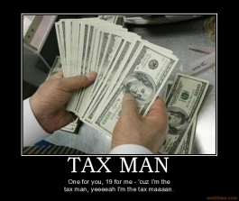
Real Property Taxes
The Tax Man Cometh

Slide 5
Real Property Taxes
- Real Property Taxes and Estate (Death) Taxes
are the only two type of taxes
that tax you on what you own or have,
not on what you earn or acquire.
- Very Repressive and Regressive,
especially on the poor and elderly.
- Imposed by and used to finance:
Local governments, Special districts and Schools.
- Very stable source of government revenue.
- Many movements to shift funding from Real Property Tax
(STAR Program and the Tax Cap).

Slide 6
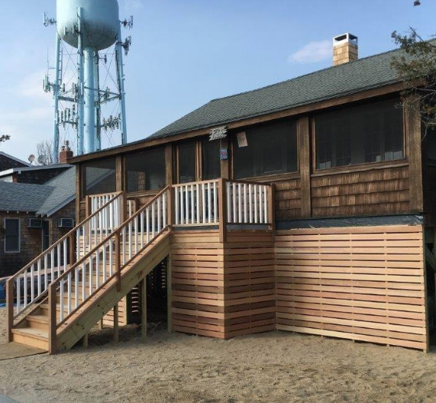
Case – Hellerstein v. Assessor
- A Challenge to Assessing Practices

Slide 7
End of Class Nine C
For next time – Review Assignments as follows on the Webpage:
Lecture Slides
Selected Readings
Cases and Exercises
We are a hot bench.
Questions?

