Slide 1
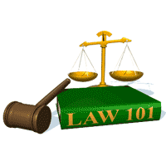
Slide Set 10 C:
Title Limitation Rules

Slide 2
Last Time We Spoke About:
An Introduction to Real Property
Real Property - Introduction
Part One: Definitions / Importance / Nature / Livery of Seisen
Shared Interests in Land
Part Two: Tenants in the Entirety / Joint Tenants / Tenants in Common
Real Property Taxes
Part Three: Valuation of Property / Regressiveness / Entities Supported
Class Case - Hellerstein v. Assessor
Challenges to Assessing Practices

Slide 3
Tonight We Will Speak About:
Real Property - Rights in Land
Real Property – Estates in Land
Part One: Definitions / Possession and Time / Types of Estates / Possessory v. Non Possessory
Future Interests
Part Two: Reversions / Possibility of Reverter / Right of Re-entry
Title Limitation Rules
Part Three: Rule in Shelley’s Case / Doctrine of Worthier Title / Rule Against Perpetuities / Rule Against Restraints on Alienation
Class Case – Crown v. Susannah North Martin
The Salem Witch Trials and Property Forfeiture

Slide 4
Title Limitation Rules

Slide 5
Title Limitation Rules
Rule in Shelley’s Case
Doctrine of Worthier Title
Rule Against Perpetuities
Rule Against Restraints on Alienation
These Rules All Seek
to Promote Marketable Title
and Ensure that Real Property
is NOT Controlled for any significant time
from Beyond the Grave

Slide 6
RULE IN SHELLY’S CASE
Wolfe v. Shelley, 1 Co. Rep. 93b, 76 Eng. Rep. 206 (C.P.), generally known as Shelley's Case
In 1581 England, in an attempt to avoid inheritance taxes, land transactions were being structured:
To A for life, with a remainder to A’s heirs
Seeing through this legal fiction, the court held that since A could control the disposition of his estate (i.e. who would be his heirs), that any such transfer was really, and should be deemed to be:
Now: To A in Fee Simple Absolute.

Slide 7
The Rule in Shelley’s Case
As a Result:
If a life estate is created in A and a remainder is created in A’s heirs, the remainder is deemed to have been created in A rather than A’s heirs.
Now with the Rule in Shelley’s Case, A would have a life estate and the next vested estate, and they would merge to give A a fee simple absolute in the property.
Reasons for the rule?
- Promote marketable title
- End a legal fiction tax dodge

Slide 8
Doctrine of Worthier Title
(Similar to Rule in Shelley’s Case, but with different parties)
Again in Common Law England, in an attempt to avoid inheritance taxes, land transactions were being structured:
To A for life, with a remainder to O’s heirs
Seeing through this legal fiction, the courts held that since O could control the disposition of his estate (i.e. who would be his heirs), that any such transfer was really, and should be deemed to be:
Now: To A for Life, with a Reversion to O.

Slide 9
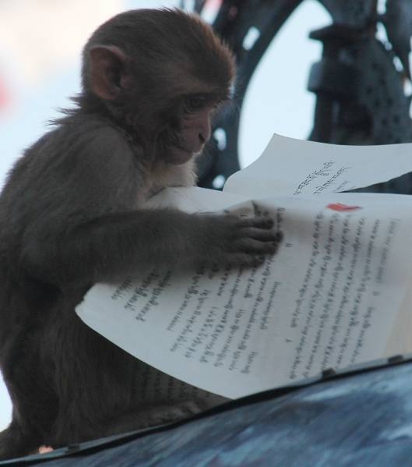
Rule Against Perpetuities
The Rule Against Perpetuities
is one of the most complicated
Rules in the Law.
Basically, common law disfavors and prevents property from being held perpetually in trust.

Slide 10
The Rule Against Perpetuities
Statement of the Rule:
Any agreement
with respect to the transfer of property
(reversions, remainder, ect.) is VOID
which does not end
twenty-one (21) years after
a life in being at the time of the transfer
(i.e. one generation from lives presently in being - twenty-one years.)

Slide 11
Rule Against Perpetuities
Another way to describe this is:
"No property interest
shall be deemed valid
unless it vests, if at all,
not later than 21 years
after some life in being
at the time of the creation of the interest.“
An interest is "vested" when we know for sure
that someone will receive, or fail to receive, the interest.

Slide 12
The Rule Against Perpetuities
Explained:
This 21 years (which represents a generation) is an arbitrary time period merely intended as a breaker for the entanglement to estates and their title, so as to return such estates back to the preferred title of fee simple absolute.

Slide 13
The Rule Against Perpetuities
Pursuant to this Rule “lives in being” include:
The holder of the interest;
The person creating the interest;
Any person who can affect a condition precedent attached to the interest; and
Any person who can affect the identify of the holder
It should be noted that unborn babies, if born alive, are considered “lives in being”

Slide 14
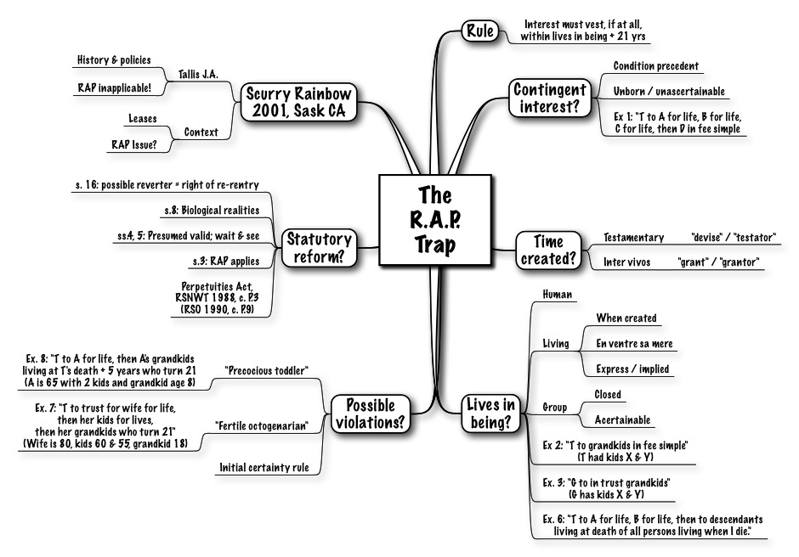
The Rule Against Perpetuities

Slide 15
Rule Against Restraints on Alienation
This Rule was established and recognized under Common Law. It stated that:
“Any restriction on the transferability
of a legal (as distinguished from an equitable)
interest in property
is, and shall be deemed as, void.”
A “Restraint on Alienation" means an express restriction on the future transferability of the real property.
Like the Rule Against Perpetuities, this is a Rule
of public policy, that is designed to encourage
the marketability of title, and prevent real property
from being tied up and taken out of commerce.

Slide 16
Rule Against Restraints on Alienation
There are three types of restraints on alienation:
1. Disabling restraints, which prohibit any future transfer;
2. Forfeiture restraints, under which an attempted transfer results in a forfeiture of the interest; and
3. Promissory restraints, under which an attempted transfer breaches a covenant.

Slide 17
Rule Against Restraints on Alienation
Types of Restraints
ALL Disabling Restraints on Legal Interests Are VOID
- Disabling restraints are seen as particularly offensive because:
(i) Unlike the other types of restraints, transfers are totally prohibited;
(ii) they enable a person to deny the validity of his own conveyance, and
(iii) they exempt the property from the person's creditors even while he is
enjoying the property.
ALL Absolute Restraints on Fee Simple Are VOID
- Absolute restraints of whatever type on fee simple estates are void.
- The grantee may ignore the restraint and freely transfer the property.

Slide 18
Rule Against Restraints on Alienation
Exceptions to the Rule:
Partial Restraints on Fees Simple
- Although absolute restraints on fee simple estates
are held to be VOID, a restraint for a limited time and
for a reasonable purpose is likely to be upheld.
Example and Explanation:
A owns and resides in a house. He conveys a one-half interest in the house to his brother, B, including in the deed, a covenant that "during their joint lifetimes, each party promises not to convey his interest to any other person without the consent of the other party."
This promissory restraint is limited to the joint lifetimes of the parties
and is a reasonable way to ensure that neither party will be faced
with the prospect of having to reside with a stranger.
This restraint would probably be upheld.

Slide 19
Rule Against Restraints on Alienation
Exceptions to the Rule Continued:
Forfeiture and Promissory Restraints on Life Estates
Forfeiture and promissory restraints on life estates are VALID.
A life estate is inalienable as a practical matter
because few would be willing to pay full value
for an estate of uncertain duration.
As a result, little is lost by giving effect to the transferor's intention to restrict the estate's transferability. (However, Disabling restraints on legal life estates are void.)

Slide 20
Rule Against Restraints on Alienation
Exceptions to the Rule Continued:
Forfeiture Restraint on Transferability
of a Future Interest
A forfeiture restraint on the transferability of a future interest, during the period when the interest is still a future interest,
is deemed to be VALID.

Slide 21
Rule Against Restraints on Alienation
Exceptions to the Rule Continued:
Reasonable Restrictions in Commercial Transactions
The courts tend to uphold restrictions on transferability
that arise in the context of a commercial transaction
on the theory that the restriction appears in an agreement
entered into by the parties, it is a product of their bargaining,
and presumably serves a useful purpose
in facilitating the parties' objectives.
Thus, restrictions on transferability that are part of a
bargained for agreement, as distinguished from
a donative transaction, are deemed valid.

Slide 22
Rule Against Restraints on Alienation
Exceptions to the Rule Continued:
Right of First Refusal
The right to have the first opportunity
to purchase Real Estate when it becomes available,
or the right to meet any other offer,
is valid if reasonable.
( i.e by specifying fair market value or other reasonable price).

Slide 23
Rule Against Restraints on Alienation
Exceptions to the Rule Continued:
Restrictions on Transferability of Leaseholds
A provision in a lease prohibiting the lessee's assignment
or subletting of their leasehold interest
without the consent of the landlord
is given effect in all jurisdictions.
Spendthrift Clauses Are Valid
The rule applicable to restrictions on alienation
involving equitable interests (i.e. those held in trust)
is the exact opposite of legal interests.
As a result, Spendthrift clauses, which are true disabling restraints, are deemed VALID.

Slide 24
Title Limitation Rules
Rule in Shelley’s Case
Doctrine of Worthier Title
Rule Against Perpetuities
Rule Against Restraints on Alienation
These Rules All Seek
to Promote Marketable Title
and Ensure that Real Property
is NOT Controlled for any significant time
from Beyond the Grave

Slide 25
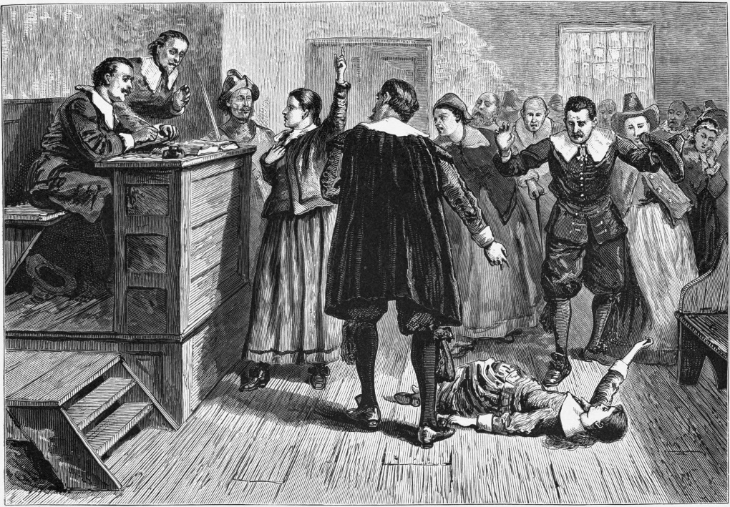
Case Study: Crown v. Susannah North Martin
A case involving the Salem Witch Trials
“Remember, it’s all about the property”

Slide 26
End of Class Nine C
For next time – Review Assignments as follows on the Webpage:
Lecture Slides
Selected Readings
Cases and Exercises
We are a hot bench.
Questions?

