Slide 1
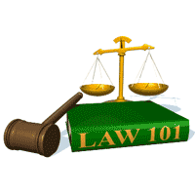
Slide Set 11 C:
Adverse Possession

Slide 2
Last Time We Spoke About:
Real Property - Rights in Land
Real Property – Estates in Land
Part One: Definitions / Possession and Time / Types of Estates / Possessory v. Non Possessory
Future Interests
Part Two: Reversions / Possibility of Reverter / Right of Re-entry
Title Limitation Rules
Part Three: Rule in Shelley’s Case / Doctrine of Worthier Title / Rule Against Perpetuities / Rule Against Restraints on Alienation
Class Case – Crown v. Susannah North Martin
The Salem Witch Trials and Property Forfeiture

Slide 3
Tonight We Will Speak About:
Real Property - Rights in Land
Non Possessory Interests
Part One: Definitions / Easements / Profits / Covenants / Servitudes
Fixtures
Part Two: Definitions / General Principles / Challenging Items
Adverse Possession
Part Three: Definitions / COACHEN
Class Case: Red Hill Outing Club v. Hammond
Tentativeness of Property Restraints

Slide 4
Adverse Position

Slide 5
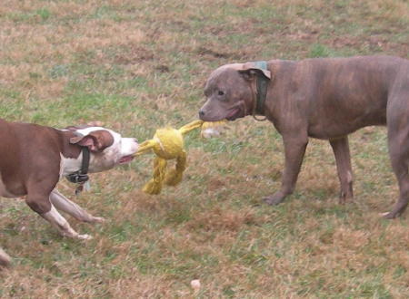
Adverse Possession

Slide 6
Adverse Possession
Generally:
STATUTE OF LIMITATIONS:
At the core of Adverse Possession is a statute of limitations
Statutes of Limitation bar law suits (the bringing of legal actions) after some period of time after the cause of action accrues.
Why a have Statutes of Limitations? - Stale claims - Memory of witnesses - Plaintiff lacks seriousness - Judicial administration
Under New York State Law (Section 212 (a) of the CPLR) the statute of limitations for an action to recover real property is 10 years (this is the time period for adverse possession).

Slide 7
Adverse Possession
Generally:
Basic Issues:
In context of actions to recover possession of real property
the cause of action accrues at the time wrongdoer enters and takes
possession of the property.
A cause of action for wrongful possession
differs from cause of action for trespass.
In trespass, there is a wrongful entry, not wrongful possession.
Underlying Policies: Why the Law Recognizes It
To reward productivity with the land
To avoid continuing, unresolved, title disputes
To penalize true owners for sitting on their rights and not protecting their land

Slide 8
Adverse Possession
Specific Requirements: C-O-A-C-H-E-N:
C-O-A-C-H-E-N

Slide 9
Adverse Possession
Specific Requirements: C-O-A-C-H-E-N:
C-O-A-C-H-E-N
Continuous
Open
Actual
Claim of Right
Hostile
Exclusive
Notorious

Slide 10
Adverse Possession
Specific Requirements: C-O-A-C-H-E-N:
1. Continuous:
Continuous for Adverse Possession purposes has been defined as:
“The uninterrupted possession of the land”.
But the possessor needn’t be present at all times
The term Continuous has further been described as:
“The kind and frequency of the acts of occupancy, necessary to constitute continuing possession, are dependent on the nature and condition of the premises as well as the uses to which it is adapted.”
Seasonal possession can constitute continuous possession

Slide 11
Adverse Possession
Specific Requirements: C-O-A-C-H-E-N:
2. Open:
An act to adversely possess a parcel is deemed as Open:
“if it is conducted in a manner
which would put a person of ordinary prudence
on notice of the [adverse] claim”.

Slide 12
Adverse Possession
Specific Requirements: C-O-A-C-H-E-N:
3. Actual:
Actual has been defined as:
“The use of the land as a reasonable owner would use the land -- not necessarily its highest and best use”
The Adverse Possession is viewed in terms
of the ACTUAL state of the land
Simply because a parcel may be susceptible to uses
other than those to which the claimant chose to put it
does not necessarily lead to the conclusion
that the claimant failed to act toward the parcel
as an average owner would have

Slide 13
Adverse Possession
Specific Requirements: C-O-A-C-H-E-N:
4. Claim of Right:
Claim of Right for Adverse Possession has been defined as:
“A claim of land to hold it for oneself.”
Different from Color of Title - which is any fact that would support a party’s title to a parcel of land.
With a Claim of Right:
The party “claims” the land, and
then takes possession under such action.
It can be viewed as Action v. Argument.

Slide 14
Adverse Possession
Specific Requirements: C-O-A-C-H-E-N:
5. Hostile:
Hostile for the purpose of Adverse Possession has been defined as:
“When an adverse possessor acts as if he intends
to claim the land and treat it as his own.”
Hostile is a legal concept, not an emotional one.
- This is not the same as acting with ill-will.
- Rather, an adverse possessor acts with hostility, merely
when they act as if they own the property
and maintain all the rights incumbent with such ownership.

Slide 15
Adverse Possession
Specific Requirements: C-O-A-C-H-E-N:
6. Exclusive:
Exclusive for Adverse Possession purposes has been defined as:
“The Exclusive, unshared use of the land”.
This Exclusive requirement means that the adverse possession is:
“For the sole use and enjoyment of the possessor alone,
and that such possession and use is not shared with the true owner.”

Slide 16
Adverse Possession
Specific Requirements: C-O-A-C-H-E-N:
7. Notorious:
Notorious for Adverse Possession purposes has been defined as:
“That the possession by the adverse party
is well and widely known in a public manner
forming a part of common knowledge
in the community.
Whereas the “OPEN” requirement necessitates that the true owner of the property would be on notice of the adverse possession, the “NOTORIOUS” requirement necessitates that the Community would be on notice of the actions constituting the Adverse Possession.

Slide 17
Adverse Possession
What does it mean? - Restrictions
This is a way for land to be acquired without formal conveyance
It is not with out risk or restrictions
Action can be maintained by true land owner for ejectment with damages.
New law passed last year in New York State:
(Chapter 269 of the laws of 2008) – Amending Section 501 of the Real Property Actions and Proceedings Law, to bar bad faith adverse possession claims by requiring an adverse possessor to have a reasonable basis for believing that the property belongs to the possessor.
Specifically, this law would also:
(1) Remove the traditional requirement that property be cultivated or improved, and instead requires acts sufficient to put a reasonably diligent owner on notice;
(2) Provide that lawn mowing and de minimus non-structural encroachments would be deemed permissive; and
(3) updates some archaic statutory language.

Slide 18
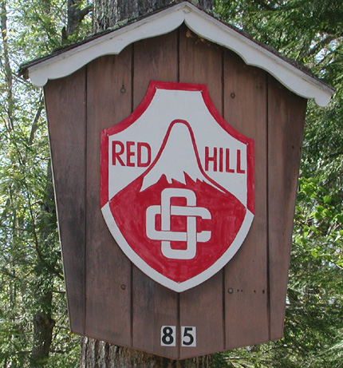
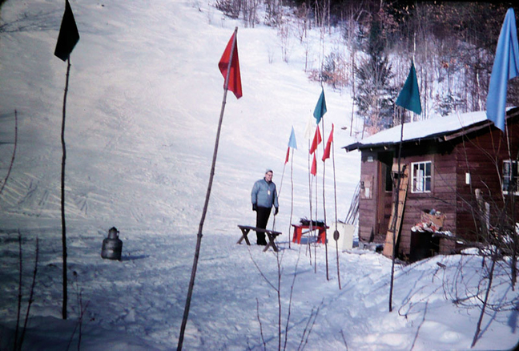
Class Case:
The Case of the Ski-slope
The Club and the Rope Tow

Slide 19
End of Class Eleven C
For next time – Review Assignments as follows on the Webpage:
Lecture Slides
Selected Readings
Cases and Exercises
We are a hot bench.
Questions?

