Slide 1
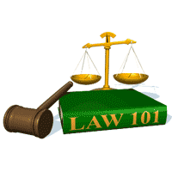
Slide Set 14 A:
Role Models

Slide 2
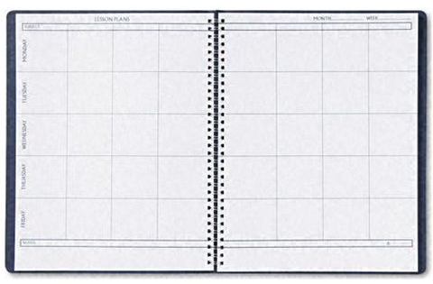
Last Time We Spoke About:
Real Property - Rights in Land
Title Security
Part One: The Value of Title Searches
Interference With Property Rights
Part Two: Nuisance, Trespass and Ejectment
Land Use
Part Three: Definitions / Zoning / Planning / Eminent Domain and Takings
Class Case: Kelo v. City of New London
Economic Development v. Property Rights

Slide 3
Tonight We Will Speak About:
Real Property - Rights in Land
Role Models
Part One: The Value of Inspiration
The Law of Landlords and Tenancies
Part Two: Definitions
Leasehold Interests
Leases
Tenants Duties and Remedies
Landlords Duties and Remedies

Slide 4
Role Models
The Value of Inspiration

Slide 5
Role Models
We all need people to look up to, admire
What makes a hero, a role model?

Slide 6
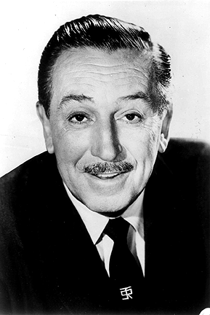
Imagination
Walt Disney

Slide 7
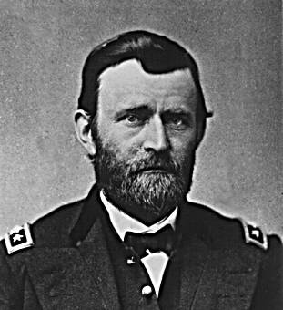
Determination
U.S. Grant

Slide 8
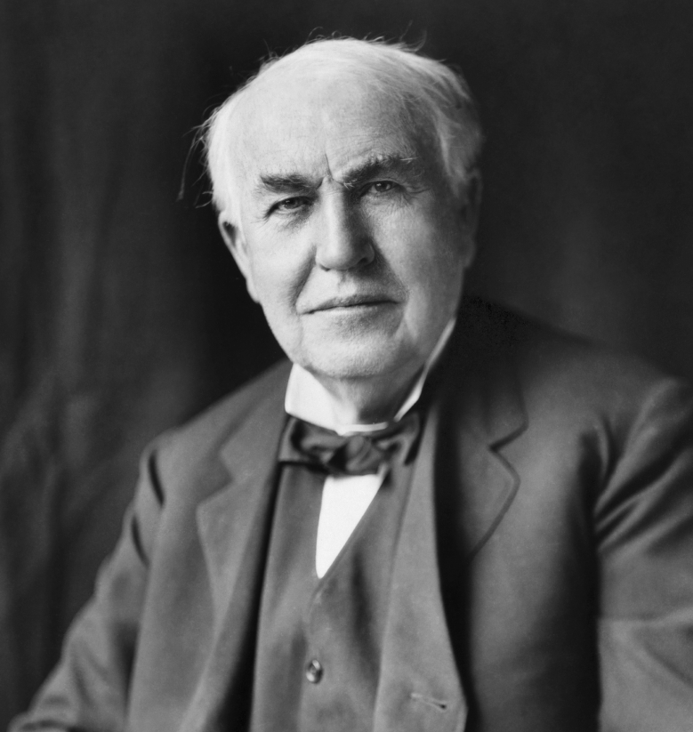
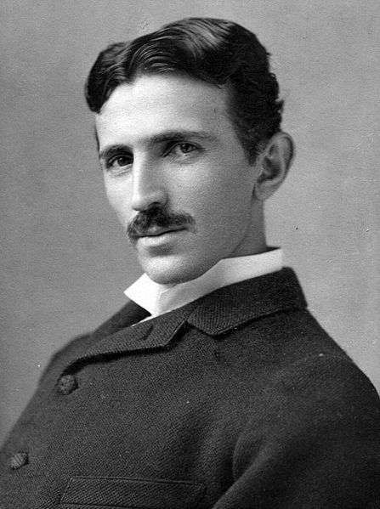
Hard Work and Vision
Thomas Edison Nicolas Tesla

Slide 9
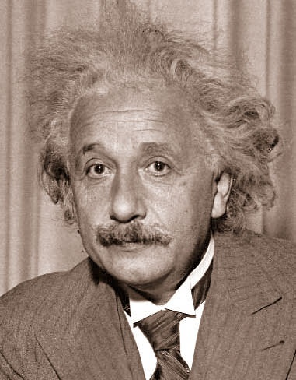
Creativity
Albert Einstein

Slide 10
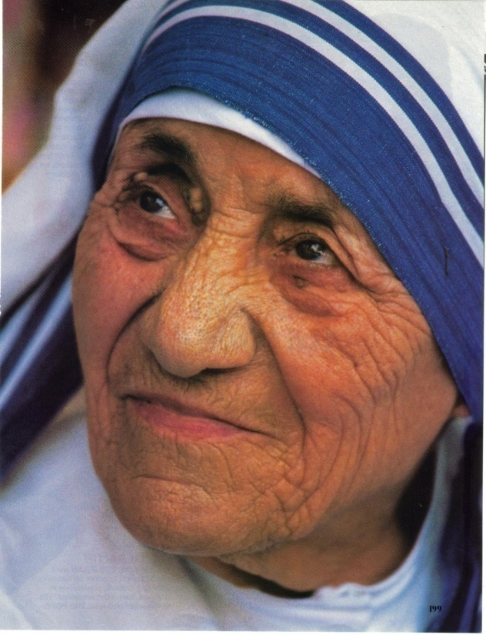
Compassion and Love
Mother Teresa

Slide 11
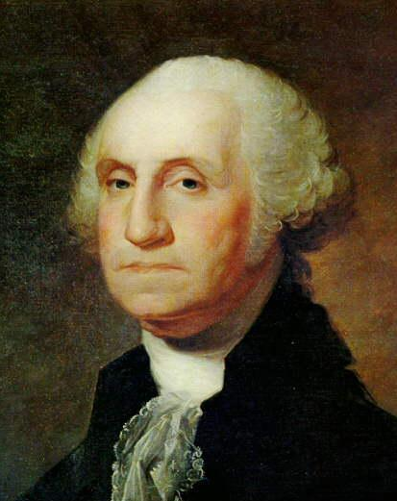
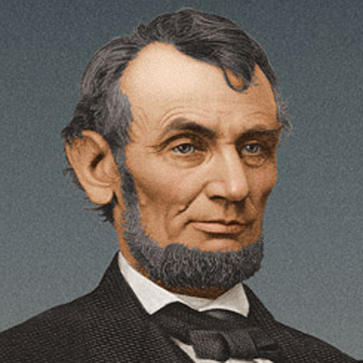
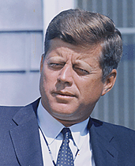
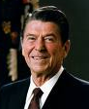
Honor, Leadership and Belief in America
George Abraham John Ronald
Washington Lincoln Kennedy Reagan

Slide 12
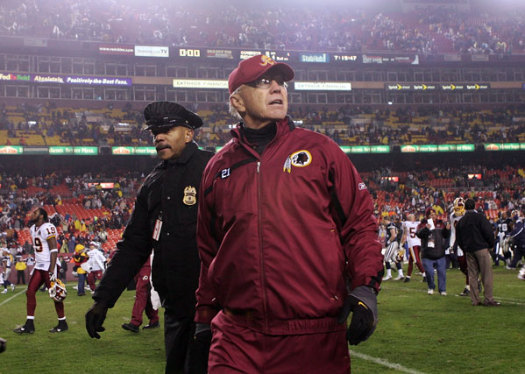
Tireless Effort, Class and Inspiration
Joe Gibbs

Slide 13
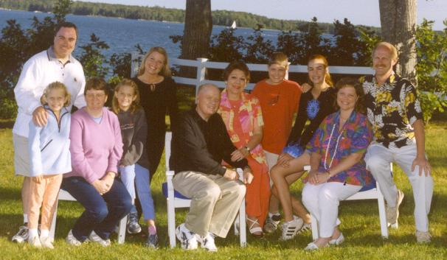
What Means The Very Most To Us
Family

Slide 14
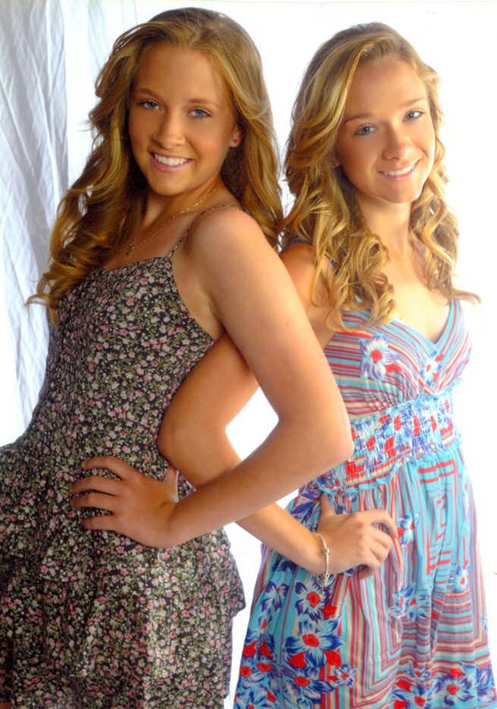
Enthusiasm and Understanding
Katie and Lizzie

Slide 15
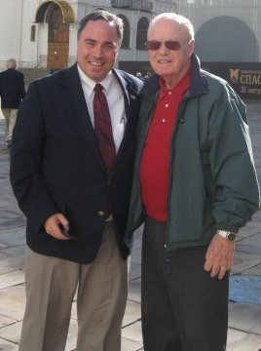
Kindness, Character and Strength
Dad

Slide 16
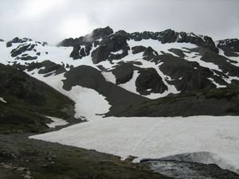
The Spirit of Adventure

Slide 17
End of Class Fourteen A
For next time – Review Assignments as follows on the Webpage:
Lecture Slides
Selected Readings
Cases and Exercises
We are a hot bench.
Questions?

