Slide 1

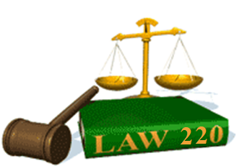
Slide Set One:
Introduction and Class Overview

Slide 2

Welcome !!!
We are about to set off together
on a grand adventure.
An Adventure of
  Intellectual Excitement, and
  Practical Usefulness.

Slide 3
Welcome !!!
This is a course in Law.
Law is an important, practical subject.
  You will use it your whole life
  Its study will transform how you look at the world
  It is not just a collection of facts, but also a way of thinking
“The law is reason free from passion.” Aristotle
“Where there is no common power, there is no
law: where no law, no injustice.” Hobbs

Slide 4
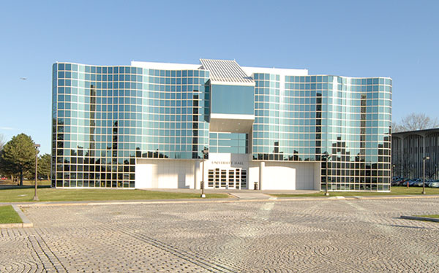
Class Administration

Slide 5
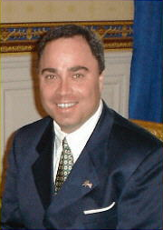

Every Adventure needs a Guide.
  Your Humble Professor, Mentor, and Intellectual Resource

Slide 6
What you need to know about me:
  Professional Background
    Attorney – Admitted to Practice Before State and Federal Courts
    Professor – Long Time Law Professor
    Senior Counsel – NYS Senate, Former NYS Deputy Attorney General
    My Biography is on our website at: http://www.bobfarley.us/0100aboutbob/aboutbob.htm
  Personal Background
    Wife: Marilyn – CPA Tax Attorney – Tax Managing Director - KPMG.
    Children: Katie (Lawyer) and Lizzie (Lawyer)
    My Personality – Sincere, Easy Going, Friendly and Approachable.
  Can be reached any time by appointment.
  E-Mail: bobfarley@bobfarley.us
  Telephone (Cell): 518-986-2037
  Website: http://www.bobfarley.us/0300lawclasses/

Slide 7
Statement of Teaching Philosophy
Teaching is among the noblest of human pursuits. Through its communication of knowledge and experience, our society is advanced, and our civilization is
offered the promise of a brighter tomorrow.
This high mantle of responsibility requires an effective teacher to possess a number of talents as well as expend a great deal of energy, enthusiasm and effort.
As a result, the measures of effective teaching include:
1. Knowledge;
2. Communication;
3. Retention; and
4. Understanding.
The threshold measure of effective teaching is knowledge. A Professor must exhibit, through education, study, background and experience, a fundamental
knowledge of the subject matter. Moreover, such knowledge must be kept timely, through regular research on recent developments, theories and advances.
Knowledge is not a static quality, but an ever growing and evolving virtue. Great teachers know their subject.
Knowledge alone, however, is not enough. Like some many other pursuits in life, high quality teaching also requires communication. A Professor must
demonstrate effective two way communication, to assure not only the delivery, but also the receipt, of the knowledge to be conveyed. Such effective
communication takes place when a teacher is always prepared, exudes a contagious enthusiasm for the subject discussed, offers concepts in an understandable,
focused and interesting manner, and shares a passion, relevance and real world application of the material presented. Great teachers motivate, fascinate and
educate.
Conveyance of knowledge through effective communication, however, is only the first step to first class teaching. Equally important is the retention of such
conveyed knowledge by the student. For if such knowledge is not retained, the conveyance was in vain. A Professor succeeds when their student succeeds,
and a professor should not only assure delivery, but also develop methods and measures that promote long term retention. Different students retain differently,
requiring the use of a variety of mediums and methods. Lectures, written materials, audio and visual presentations and practical interactions must all be selected
and presented in a complementary manner, to promote the repetition and reinforcement that leads to retention, without the dull redundancy that produces
boredom and disinterest. Creative Intellectual devices and responsive measurements further prove helpful in pursuit of this goal. In the end, retention is a
cornerstone to learning. Great teachers communicate knowledge in ways it will be retained.
The final measure of effective teaching is student understanding. A Professor has succeeded when their student understands the retained knowledge
communicated. Building understanding, the hardest task in all of teaching, requires a Professor to motivate students to develop their own intellectual talents,
and to apply their recently retained knowledge to new and different situations. Offered by way of the teacher’s enlightened path of perspective and insight,
understanding is attained by the student through their own thought and analysis. Through understanding, the future application and extension of communicated
knowledge can be achieved. Producing understanding is thus the essential element of education. It is the fundamental factor for which a teacher must effectively
test, and inspiring students to achieve it, is the ultimate hallmark of an effective teacher. Great teachers advance understanding.
It these four measures, knowledge, communication, retention and understanding, that I wish to employ as a professor at SUNYA. It is through their framework
that I wish to offer my time, talent, energy, enthusiasm and effort. It is upon their foundation, that I wish to combine my experience, to provide an added depth and
relevance in the education of our students. It is upon this philosophy, that I wish to develop into a great teacher.

Slide 8
Rules for Our Adventure:
For our Adventure to be Successful:
1. We Need to RESPECT each other.
I love my students!!!
They become like my family / children
I will do anything I can to help you succeed
2. Certain Things We DO NOT Tolerate in Class
Talking During Class (I am partially deaf)
Any use of electronics (including earphones)
3. We NEVER EVER Tolerate
Cheating of any kind

Slide 9

Rules for Our Adventure:
For our Adventure to be Successful:
4. We need to get to know each other.
You now know a bit about me, and so I need to know a bit about you.
Please Complete the Student Biography Form
It is worth 3 points toward your final grade and can be found at: http://www.bobfarley.us/0300lawclasses/bioform.pdf

Slide 10

Rules for Our Adventure:
For our Adventure to be Successful:
5. Please watch all lectures/cases/exercises.
The first step of any successful adventure is simply to be there.
The lectures, accompanying power point slides, and the
cases / class exercises, are the most important part of
this class. They form the foundation for your success.
Please watch and read them all, and pay attention.

Slide 11
Rules for Our Adventure:
For our Adventure to be Successful:
6. You Will Need:
A Thirst for Intellectual Excitement
A Hunger to be a Part of a Challenge
A Willingness to Explore and an Eagerness to Learn
THE TEXTBOOK IS COMPLETELY OPTIONAL
– If you wish to use such - it is Anderson’s Business Law
Access to a computer is necessary, to visit our website
http://www.bobfarley.us/0300lawclasses/
We do not use Blackboard, except for exams.
Our above listed Website is where you can find everything you need.

Slide 12


Slide 13
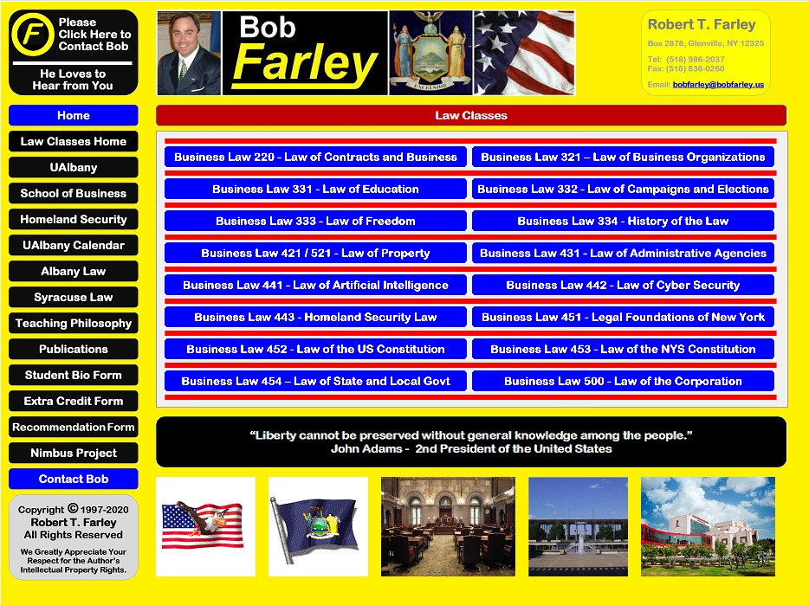

Slide 14
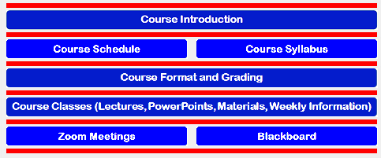

Slide 15
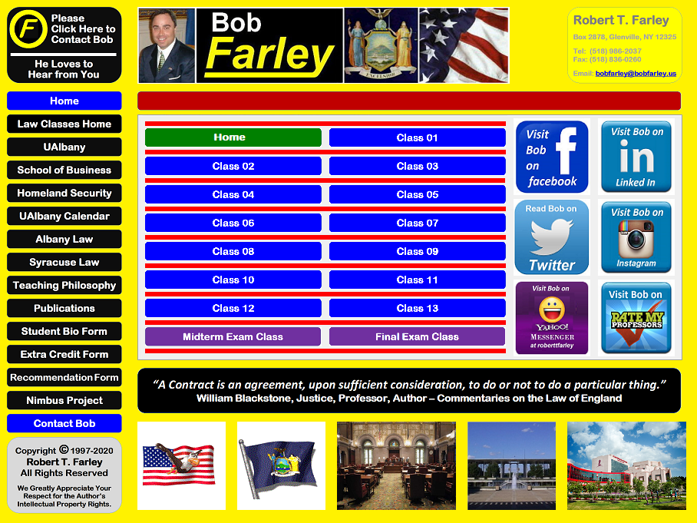

Slide 16
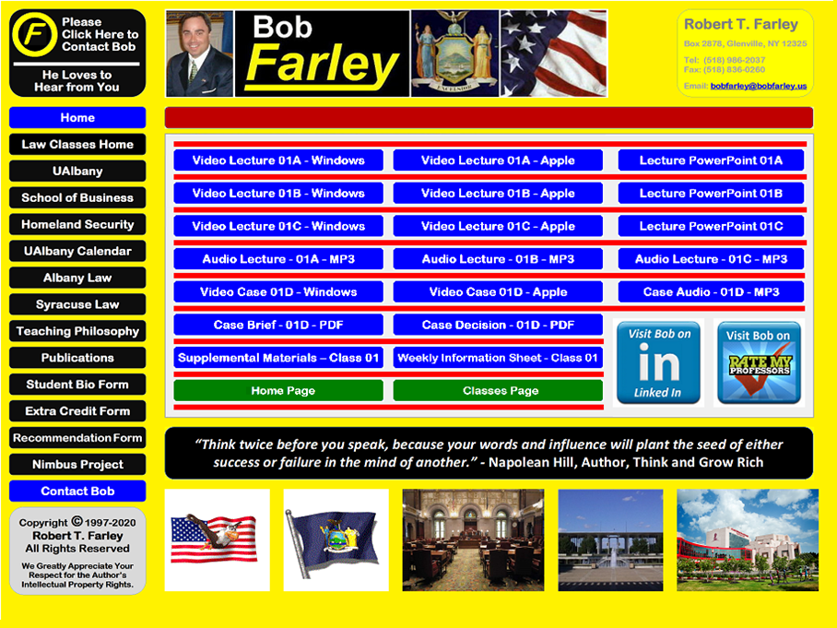

Slide 17
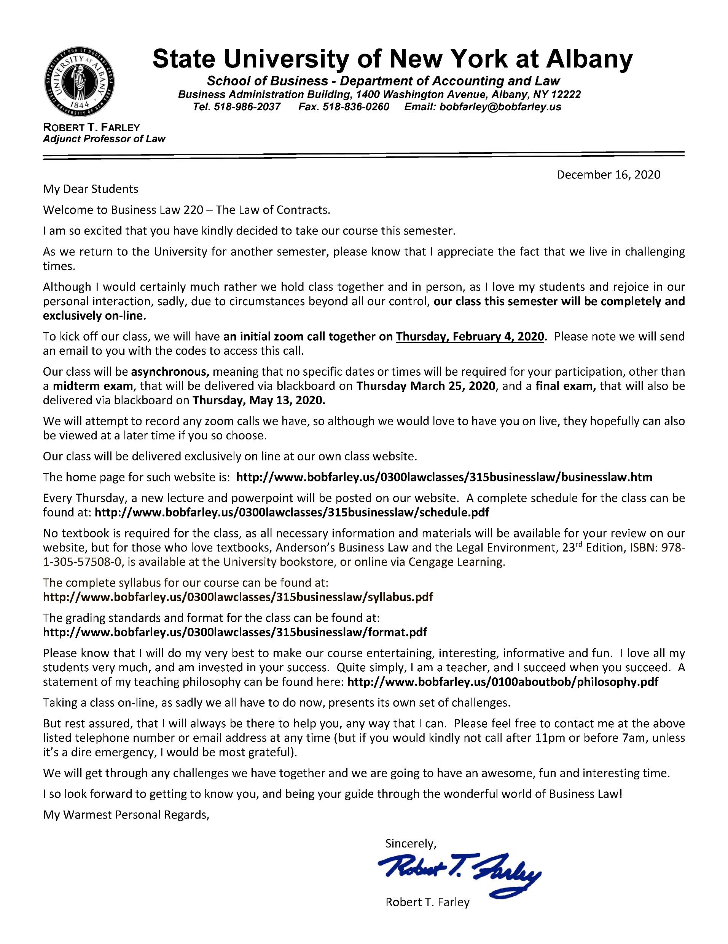

Slide 18
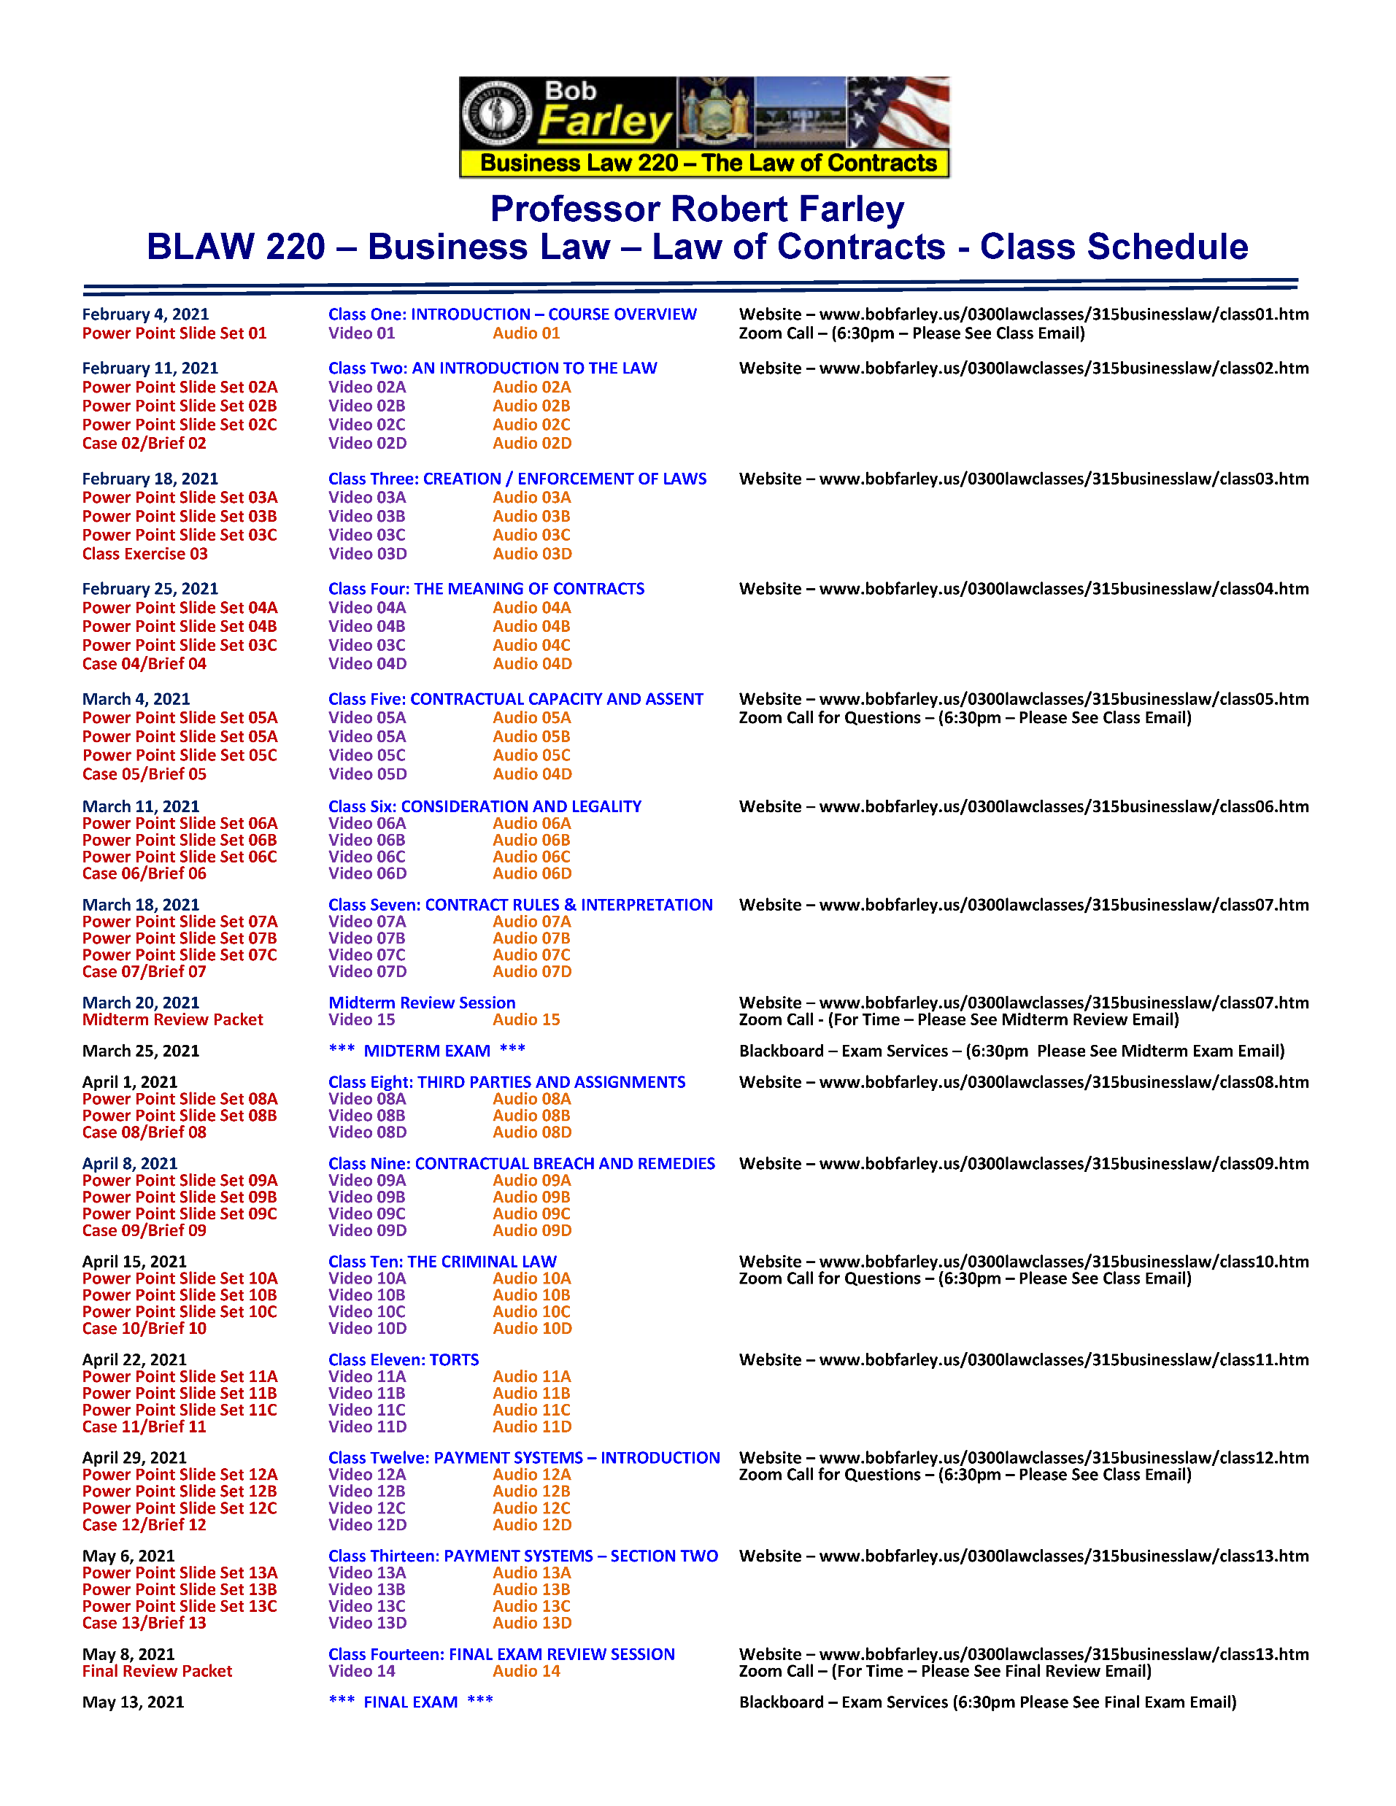

Slide 19
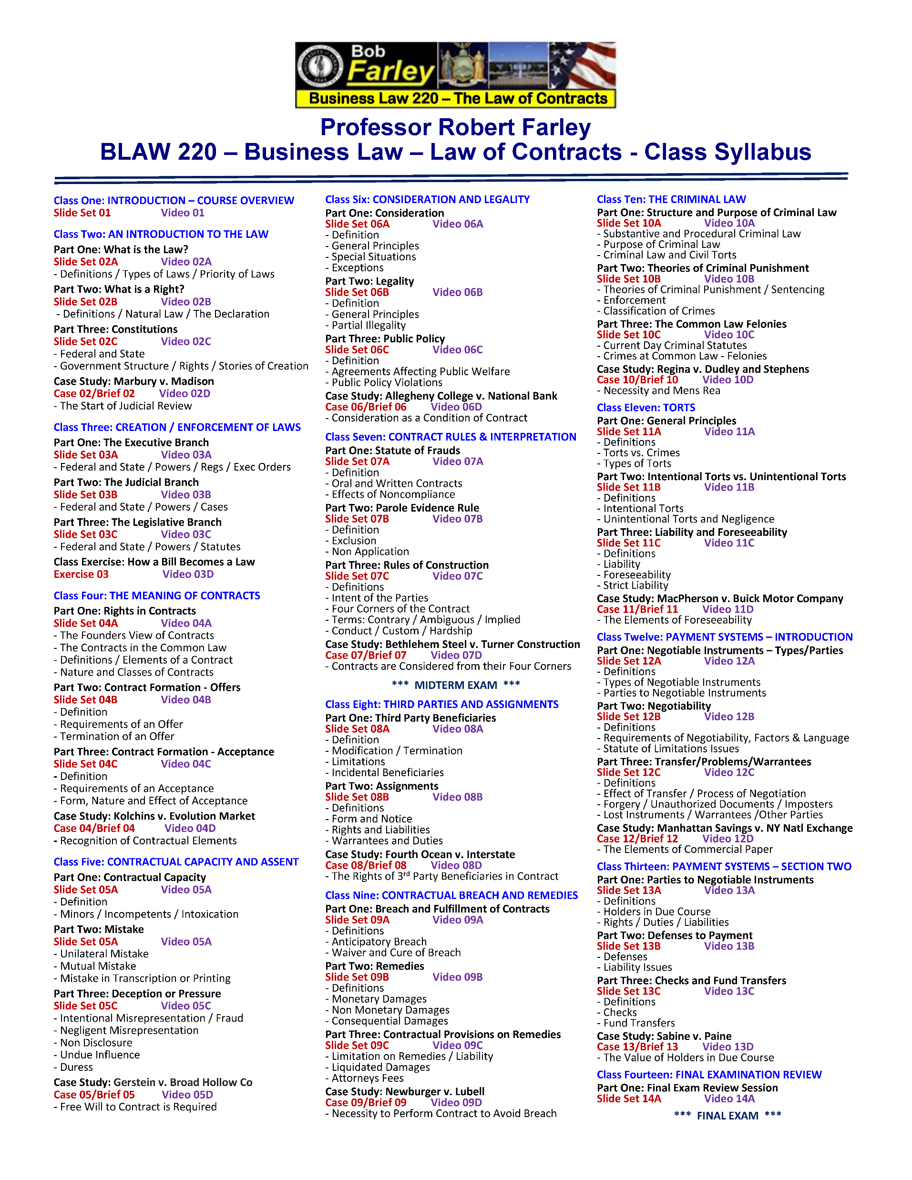

Slide 20
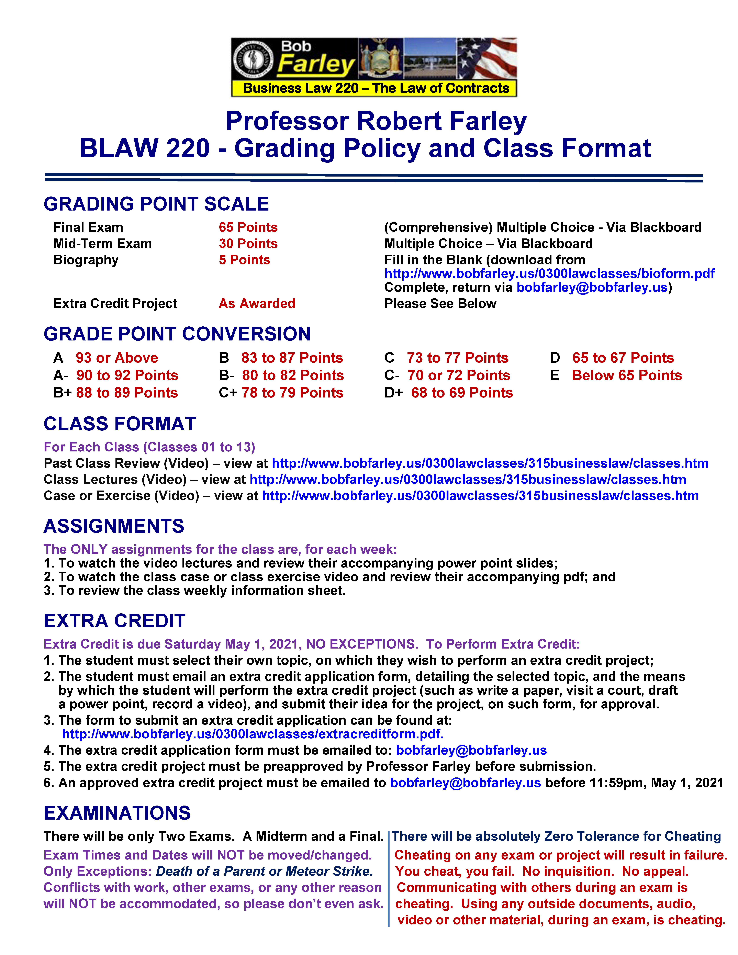

Slide 21
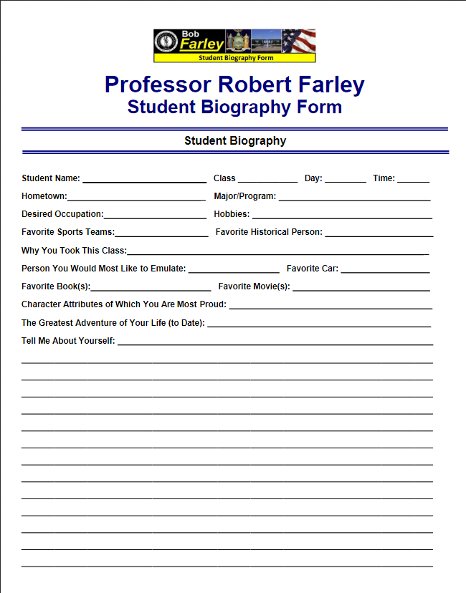

Slide 22

So, with that introduction…
Let’s Begin Our Grand Adventure

Slide 23
End of Class One A
Please don’t forget to hand in your bio form
For next time – Review Assignments as follows on the Webpage:
  Power Point Slides
  Class Lecture Video
  Cases and Class Exercise Video
Questions?
See you online for our next class

