Slide 1


Slide Set 02B:
Introduction to the Law
What is a Right

Slide 2

Last Time – We Spoke About:
Website: www.bobfarley.us
Your Biography: If you haven’t already, please hand it in.
Class Schedule:
http:/www.bobfarley.us/300lawclasses/315businesslaw/schedule.pdf
Class Syllabus:
http:/www.bobfarley.us/300lawclasses/315businesslaw/syllabus.pdf
Class Format and Grading Information:
http:/www.bobfarley.us/300lawclasses/315businesslaw/format.pdf
Contact Us:
Email – bobfarley@bobfarley.us
Phone/Text – (518) 986-2037
In Person – By Appointment

Slide 3
Tonight – We Will Speak About:
What is the Law?
Part One: Definitions / Types of Law / Priority of Laws
What is a Right:
Part Two: Definitions / Natural Law / The Declaration
Constitutions:
Part Three: Federal and State / Govt Structure / Rights / Creation
Case Study – Marbury v. Madison:
The Start of Judicial Review

Slide 4
What is a Right?
Rights and Freedom
Definition of Right
Evolution of Rights
The Meaning of Rights
The Development of Rights and Law

Slide 5
Rights and Freedom

Slide 6
Rights and Freedom
What is the Fundamental Pillar of the Law?
The Fundamental Pillar, upon which all American Law rests is:
Freedom
In the United States, our law is all designed to secure Freedom
Our rights, with which we are endowed, are protected by government, through our law, in order to facilitate freedom.
Freedom (or “liberty” as the founders often described it) derives from the fundamental respect for the individual.

Slide 7
Rights and Freedom
The Fundamental Pillar, upon which all American Law rests is:
Freedom
In the United States, our law is all designed to secure Freedom
In order to secure our Freedom, the law protects our rights.
These are individual rights, not community or collective rights.
Freedom can be a scary thing. For it is not the power to do what everyone thinks is a good idea, but rather what some think is a bad one.
The Law secures our Freedom, by protecting our individual rights, so long as we don’t use it to interfere with other people.

Slide 8
Rights and Freedom
The Pathway to Freedom
To understand Freedom, we must understand certain fundamental principles. These principles include:
Rights are Legal Instruments designed to protect Freedom.
The Law is the Means by which our Rights are protected.
RIGHTS + LAW = FREEDOM
This is the Pathway to Freedom
Notes:
8

Slide 9
The Definition of Right

Slide 10
The Definition of Right
When the legal concept of Right became recognized under English jurisprudence, what exactly did they mean by the term “right”?
How could this idea, this term, be defined?
According to William Blackstone, author of the famous Commentaries on the Law of England, a treatise often referred to as “the Bible of the Law”, the legal definition of the word “Right” represents the closest English translation of the Latin term “jus” (from which the term justice is derived), and essentially means:
“the abstract sense of law”
Notes:
10

Slide 11
The Definition of Right
For our purposes, however, perhaps the best
and most effective understanding of what the term “Right”
actually means, can be seen from the writings
of the Scottish philosopher and legal commentator, James Mill.
Mill saw “rights” in terms of a claim based upon a legally justified expectation.
(This explains how rights progressed from the Rules of Roman law, to the public expectations produced from Common law decisions and the pronouncement of the Magna Carta, and then through the individualist centered citizenship of the clerical-legal philosophers).
From Mill’s writings, a corresponding definition of the term “Right”, can accordingly be derived to be:
“The legally recognized ability to exercise power and control over an action or object”.
Notes:
11

Slide 12
The Definition of Right
But what exactly are our rights?
John Locke described them as Life, Liberty and the Pursuit of Property
Thomas Jefferson pronounced them as Life, Liberty and the Pursuit of Happiness
James Madison enumerated them in the Bill of Rights, which includes:
Freedom of religion, speech, press, assembly, and petition;
Right to keep and bear arms;
No quartering of soldiers;
Freedom from unreasonable searches and seizures;
Due process of law, freedom from self-incrimination, no double jeopardy;
Speedy and public trial;
Trial by jury;
No excessive bail, or cruel and unusual punishments;
All other recognized rights of the people (incorporation of Declaration); and
Limited Federal Government with non enumerated powers reserved to the states
Notes:
12

Slide 13
The Evolution of Rights

Slide 14
The Evolution of Rights
Rights + Law = Freedom
If you want to understand Freedom,
you need to understand just what Rights are.
For without the legal concept of Rights,
(and the just expectations upon which they are based)
together with the vehicle of the Law,
which protects these Rights,
Freedom simply would not exist.
And so we Examine how the legal concept of Rights
evolved into what we understand it to be today.
Notes:
14

Slide 15
The Evolution of Rights
A. The Concept of Right
The legal concept of “right” is a relatively recent one,
that was not fundamentally expressed
until after the rise of English jurisprudence.
Indeed, according to Susan Ford Wiltshire (Chair of the
Classical Studies Department of Vanderbilt University)
“Theories of rights assume a dignity of persons
and a status of individuals
that did not exist in the classical world”.
For Rights simply cannot exist without an inherent
respect for the individual person
Notes:
15

Slide 16
The Evolution of Rights
A. The Concept of Right Continued
Prior to the predominance of English jurisprudence,
the legal status of an individual person
was determined by their relationship with the state.
Under Roman law, any right enforceable by law,
were based upon the collective notion of a person’s family
and not upon an individual.
Notes:
16

Slide 17
The Evolution of Rights
A. The Concept of Right Continued
As English jurisprudence developed however,
events began to evolve toward a more individual
based concept of Right.
Beginning in 1066 when the Normans brought feudalism
with its reciprocal duties,
then with the establishment of the Common law,
and soon followed by the Magna Carta
English law began to see a “slow transition, from a
state defined, to an individual-defined, political identity”
This transformation was driven primarily
by a new belief in the concept of natural law.
Notes:
17

Slide 18
The Evolution of Rights
A. The Concept of Right - Evolution
Greece: Human beings are capable of governing themselves
Rome: The creation of a complex and sophisticated legal system
England: Development of feudalism, common law and natural law
The modern concept of Rights is based upon the inherent Value of the Individual.
Such concept is the foundation of Freedom
By 13th century, English jurisprudence became established. This was propelled by:
The common law court system,
Trial by jury,
The Magna Carta, and
The Rise of Political Philosophy – Culminating in the Enlightenment)
These developments began to evolve traditionally recognized State Based Rights into Individual Based Rights.
Notes:
18

Slide 19
The Evolution of Rights
A. The Concept of Right
An Age of Deep Thinkers – The Enlightenment
Along with these political and social events,
came the rise of a new clerical-legal philosophy.
Men like:
Thomas Aquinas;
William Ockham;
John Wycliffe;
Thomas Hobbes; and
John Locke
started to impart human beings as instruments of God,
with fundamental, divinely granted, individual natural rights.
This development proved earth shattering for the recognition of the
value of the individual person, and began to put mankind
on the legal path to “rights” through the concept of natural law.
Notes:
19

Slide 20
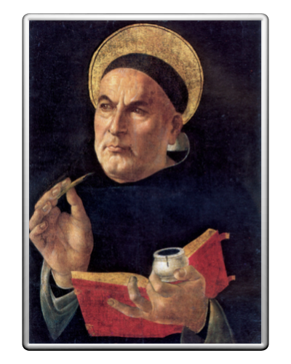
The Evolution of Rights
A. The Concept of Right - Continued
Enter St. Thomas Aquinas
Born in Sicily in 1225
Ordained as a Dominican in 1245
From 1265 to 1274 authored his landmark
Summa Theologica
which pioneered the concept of Grace
and held that every person had an Individual Relationship with God.
While the writings of Thomas Aquinas never expressly declared
the concept that men have abstract rights,
or that the autonomy of the individual is the source of all law,
his linking of the individual with the mission of seeking God’s Grace,
and his belief that the law, and its implementation of justice,
must respect that mission,
and the value of the individual person seeking it,
was a fundamental breakthrough
in the development of the legal concept of individual based, inviolate rights.
Notes:
20

Slide 21
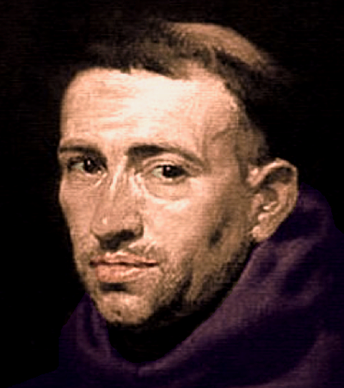
The Evolution of Rights
A. The Concept of Right - Continued
William Ockham
Born in Surrey England in 1285
Studied Theology at Oxford from 1309 to 1321
In 1323 authored his landmark
Summa Logicae
which declared the value of Logic
and held that every person had the talent and responsibility of Reason.
A Franciscan Friar, best known for the development of his maxim ‘Ockham’s Razor’(the simplest answer tends to be the best), he saw what would become known as natural law as a positive reflection of the Devine will.
A believer in the individual, Ockham created a volume of writing which established a “political theory not far removed from the classic theories of rights of the seventeenth century”.
He is said to have “inaugurated a ‘semantic revolution’ which transformed the traditional” ideas of natural law “into a new theory of subjective natural rights”, marking “a ‘Copernican moment ’in the history of the science of law”.
Notes:
21

Slide 22
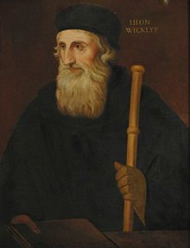
The Evolution of Rights
A. The Concept of Right - Continued
John Wycliffe
Born in Yorkshire, England in 1328
Priest and Professor at Oxford
In 1382 authored his landmark
Wycliffe Bible
Wycliffe was a legal and theological scholar, most famous for the first translation of the Bible into the English vernacular.
A protégé of Ockham, he has been credited with advancing the theme of the “individual as a fully fledged, autonomous, independent member of society who had inherent, inborn rights.”
This extension of Ockham’s views would lead to the evolution of individual right based liberties, and would create an entirely new way of thinking about human autonomy and individual rights.
It had a marked influence upon English jurisprudence. For once “individuals are considered autonomous human beings, endowed with natural human rights, they are no longer ‘subjects’ or mere ‘members’ of a higher power”.
Notes:
22

Slide 23
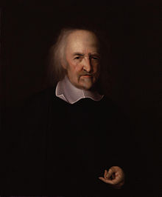
The Evolution of Rights
A. The Concept of Right - Continued
Thomas Hobbes
Born in Wiltshire, England in 1588
Teacher, Philosopher, Author
In 1651 authored his landmark
Leviathan
Hobbes was a legal Philosopher and Scholar, most famous for his famous work Leviathan.
In the Leviathan, Hobbes, expounds the “social contract theory” of government, which provides that individuals have consented, either explicitly or tacitly, to surrender some of their freedoms, and submit to the authority (of the ruler, or to the decision of a majority) in exchange for protection of their remaining rights and maintenance of the social order.
This theory, again recognizes not only individual rights, but equally importantly, that such rights must be protected by government.
He landmark work is further credited with launching the very concept of natural law, based upon principles originating in a state of nature.
Notes:
23

Slide 24
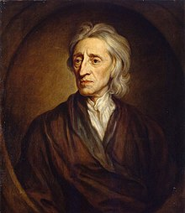
The Evolution of Rights
A. The Concept of Right - Continued
John Locke
Born in Somerset, England in 1632
Lawyer, Philosopher, Author
In 1689 authored his landmark
Two Treaties of Government
John Locke, was an intellectual giant of legal and political thought.
A scholar of languages, political systems, and science, Locke was adverse to innate ideas, scholastic philosophy, intellectual intolerance. Well traveled and well read, he commented extensively on issues facing his society.
Known for his practicality, sensibility and intellectual elegance, John Locke believed deeply in the rights of man, the value of every individual person, the importance of education, and the need to oversee government to insure that it serves the people and protects their natural rights.
A devotee of natural law, his commentaries have proven both timeless and enduring. He despised authoritarianism, and believed in the power reason to oppose it, through the use of empirical ideas. He advocated that the function of natural law, and the state itself, is to establish as inalienable, the rights of the individual.
Notes:
24

Slide 25
The Evolution of Rights
The Concept of Rights
Steps in the Evolution of Rights and Protection of Individual Freedom
1. Greek Democracy
2. Roman Law
3. The Development of English Common Law
4. The Magna Carta
5. Clerical Philosophy and the Recognition of Natural Law
- Magna Carta
- 4th Lateran Council
- Thomas Aquinas
- William Ockham
- John Wycliffe
6. Thomas Hobbes and the Social Contract Theory
7. John Locke and the Pronouncement of Rights
Notes:
25

Slide 26
The Meaning of Rights

Slide 27
The Meaning of Rights
Rights are foundational element of all law.
Rights are the very lynchpin of our liberty:
They form a fundamental element of our freedom.
Under our system of laws,
rights reside in the individual.
They are personal and unique.
Long recognized as inherent to our humanity,
our Rights are a quintessential component
that defines our freedom,
our modern society, and our quality of life.

Slide 28
The Meaning of Rights
Ours is a nation of laws, not a nation of men.
Think about freedom
and you ultimately get back to rights.
The unrestrained use, enjoyment and exercise of Rights
is ingrained in our very being as Americans.

Slide 29
The Meaning of Rights
Recognize rights, and you promote freedom.
Protect rights and you facilitate liberty.
Take away rights, and you take away,
an individual’s freedom.
Limit individual rights, and you limit an individual’s liberty.
Restrict or impair individual rights,
and you diminish a person’s quality of life.
This is how important rights are.
This is how connected they are
to our freedom and liberty.

Slide 30
The Development of
American Rights
and Law

Slide 31
The Development of American Rights and Law
Part A: The Legal Importance of America’s and New York’s
Legacy of Distrust of Power
Individual Rights = Freedom: The Founders understood that the
lynchpin of liberty was the proper management of power.
A Practical First Hand Experience: This was not just a philosophical
understanding, born from reasoned scholarship in the enlightenment.
It was produced from practical, first hand understanding as well.
America – A Freedom Laboratory: As witness to history, the founders
saw with their own eyes, as America was transformed.
From 1763 to 1776, the American Colonies transitioned
from a prosperous, free and growing land,
to that of a land facing the wrath of the most powerful nation on earth.

Slide 32
The Development of American Rights and Law
Part A: The Legal Importance of America’s and New York’s
Legacy of Distrust of Power – Protecting Rights
Founders Understood – Government’s Purpose is to Protect Rights:
From the very beginning it was all about rights and building
a legal system to protect those rights.
Rights are Key to Freedom: The protection of Rights, in the minds of
our founders, was always the pathway to freedom
and the pursuit of happiness.
Government of Law Not Men: The building of freedom and liberty,
and allowing the free exercise of those individual rights, meant a need for
a limited government of law, not men, that would respect and protect
individual rights, and that was limited with true checks and balances
and a separation of powers.

Slide 33
The Development of American Rights and Law
Part B: The Declaration of Independence – Spawning A Nation
It All Started with the Declaration of Independence:
The Declaration created a NATION OF IDEALS:
A nation of laws and not men.
A nation evolved from the principles of the enlightenment.
It outlined a concept of principles, not finalized government.
Unrealized until the Revolutionary War was won.
It would have never worked without the personalities involved.
It was a very special time in history.
Among its foremost declared rights were Individual Rights.
For the founders knew that behind the truest pathway to freedom,
was a foundational respect for every individual.

Slide 34
The Development of American Rights and Law
Part B: The Declaration of Independence – Spawning A Nation
What the Founders Understood:
From a time even before the Declaration of Independence,
the relationship between Rights and the Law
and the importance of these Rights
was intrinsically understood as the very foundation
of what we need to protect and believe as a free people.
This fact was expressed throughout the founding principles
which we hold dearest and most meaningful
in the establishment of our system
of law, government and society.

Slide 35
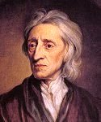
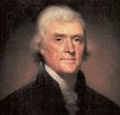
The Development of American Rights and Law
Part B: The Declaration of Independence
The Concept of Rights
Two Treatises of Government - John Locke, 1690:
The true concept of rights under Natural Law.
The Natural Rights of man - Life, Liberty and the Pursuit of Property
Declaration of Independence – Thomas Jefferson, 1776:
The artful lawyer – Liberty as property rights.
The Declaration was really a collaborative document
with John Adams, Lawyer and Ben Franklin, Scholar.
They all recognized the fundamental value of property rights
in our society as key to our freedom and liberty.
They restated Locke’s concept of Property Rights as a
cornerstone of Liberty and Freedom in a more artful way,
declaring our God given rights (under Natural Law) to be:
Life, Liberty and the Pursuit of Happiness

Slide 36
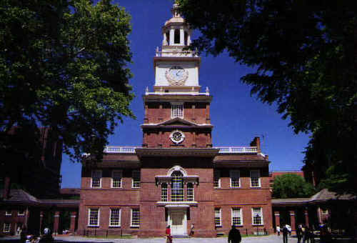
The Great Hall

Slide 37
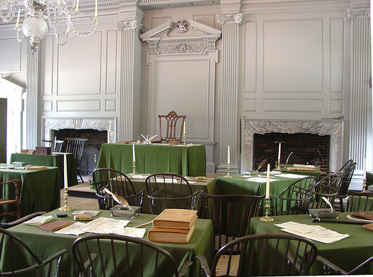
Inside The Great Hall

Slide 38
The Development of American Rights and Law
Part B: The Declaration of Independence
Declaration of Independence:
The first, real American pronunciation of Rights.
Written by a committee of Thomas Jefferson, John Adams, Ben Franklin, Robert Livingston (New York) and Roger Sherman (Connecticut)
Signed by 56 members of the continental congress
Contains five parts, 1458 words and 33 paragraphs.
The separate parts include:
The Preamble;
The Declaration of Natural Rights;
The List of Grievances;
The Reproach;
The Conclusion.

Slide 39
The Development of American Rights and Law
Part B: The Declaration of Independence
Declaration of Independence:
The Declaration states that:
“When in the Course of human events it becomes necessary for one people to dissolve the political bands which have connected them with another and to assume among the powers of the earth, the separate and equal station to which the Laws of Nature and of Nature's God entitle them, a decent respect to the opinions of mankind requires that they should declare the causes which impel them to the separation.
We hold these truths to be self-evident, that all men are created equal, that they are endowed by their Creator with certain unalienable Rights, that among these are Life, Liberty and the pursuit of Happiness. — That to secure these rights, Governments are instituted among Men, deriving their just powers from the consent of the governed, —
That whenever any Form of Government becomes destructive of these ends, it is the Right of the People to alter or to abolish it, and to institute new Government, laying its foundation on such principles and organizing its powers in such form, as to them shall seem most likely to effect their Safety and Happiness”
These are perhaps the most beautiful and personally empowering words in human history.

Slide 40
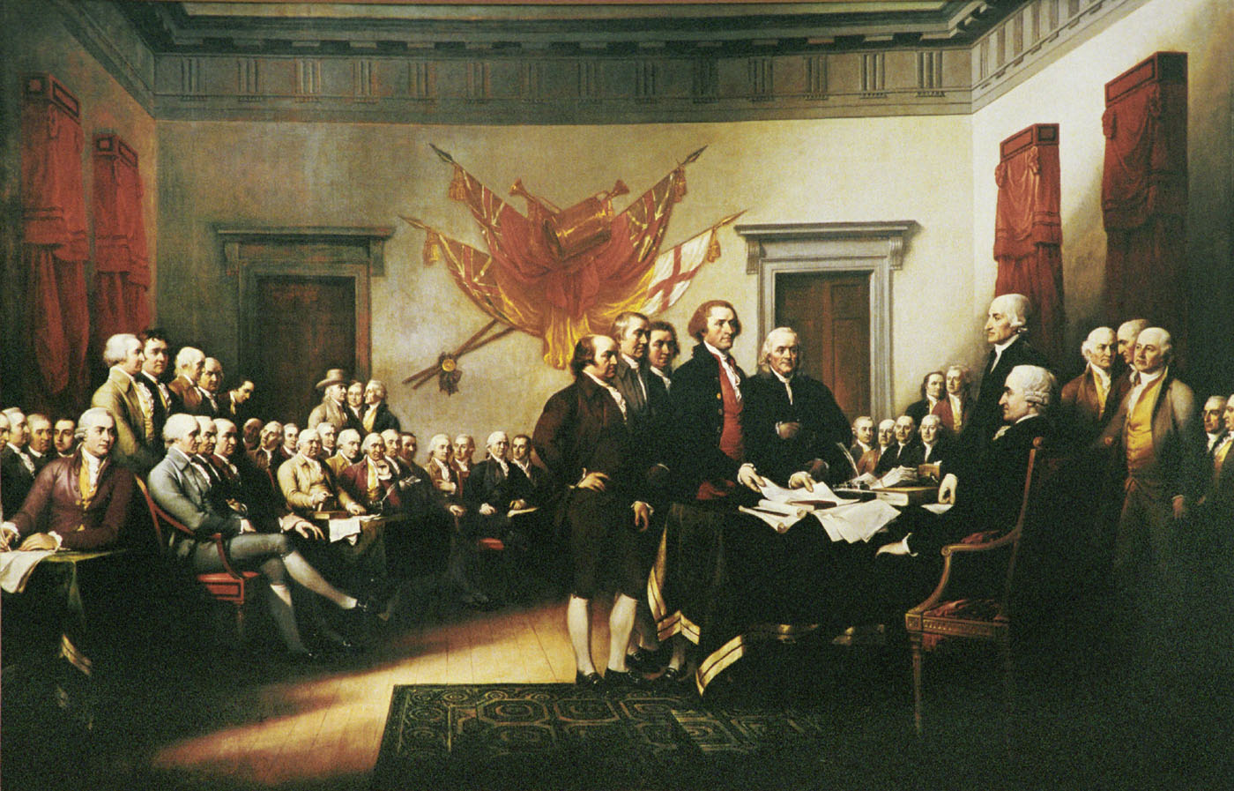
The Development of American Rights and Law
Part B: The Declaration of Independence
Our Declaration of Independence sets forth:
                “We hold these truths
                to be self evident,
                that all men are created equal,
                that they are endowed
                by their Creator
                with certain unalienable Rights,
                that among these are
                Life, Liberty and
                the pursuit of Happiness.”

Slide 41
The Development of American Rights and Law
Part B: The Declaration of Independence
The term “pursuit of happiness” of the declaration was lifted and was a direct reference from John Locke’s writings referencing the “pursuit of property”.
So just what were the founders saying:
That all people are endowed (possess from birth) certain inalienable (unbreakable and inherent) rights.
That these rights come NOT from Government but from God.
That among these rights include life, liberty and the pursuit of happiness (which Jefferson later explained was a more elegant way to say pursuit of property).
So we need to re-think of Government’s role in recognizing rights as protector, not as grantor.

Slide 42
The Development of American Rights and Law
The Federal Constitution’s Separation of Powers
The Key to Liberty: The founders also felt that freedom and liberty of the individual are best preserved by limited government, where sovereignty vests in the people not the government, and which is in a republican form, with three, independent, separate branches.
Such is why the first three words in the Constitution are:
“We The People”
The Key to Understanding Rights: To understand Right, it must be seen through a prism of freedom. Such requires an understanding of:
  what a right is,
  what the law is that protects property rights, and
  how protecting property rights an essential element to freedom.
Freedom + Protection of Rights: The founders understood, that if you want freedom, set up a system to protect individual rights. That system requires the power of government to be limited, and its express purpose must be to protect, and not infringe on, people’s individual rights.

Slide 43
Thank you for Coming
For next time – Review Assignments as follows on the Webpage:
  Lecture Slides
  Selected Readings
  Cases and Exercises
We are a hot bench.
Questions?

