Slide 1


Slide Set 03B:
Interpretation of the Law
The Judicial Branch

Slide 2

Last Time – We Spoke About:
What is the Law?
Part One: Definitions / Types of Law / Priority of Laws
What is a Right:
Part Two: Definitions / Natural Law / The Declaration
Constitutions:
Part Three: Creation/ Federal and State / Govt Structure / Rights
Case Study – Marbury v. Madison:
The Start of Judicial Review

Slide 3
Tonight – We Will Speak About:
The Executive Branch
Part One: Federal and State / Powers / Regs / Executive Orders
The Judicial Branch
Part Two: Federal and State / Jurisdiction / Powers / The Courts
The Legislative Branch
Part Three: Federal and State / Powers / Statutes / Oversight
Class Exercise – How A Bill Becomes A Law
And How to Run for Public Office

Slide 4
The Judicial Branch
Generally
  Definition / History / Purpose and Duties
  The Federal (National) Government
  Generally / Jurisdiction / Powers and Duties / The Courts
  The State Government
  Generally / Jurisdiction / Powers and Duties / The Courts

Slide 5
Generally

Slide 6
The Judicial Branch: Generally
Definition
Black’s Law Dictionary defines the term “Judicial Branch” as:
“The branch of government consisting of the courts, whose function is to interpret, apply and generally administer and enforce the laws.”
Notes:
6

Slide 7
The Executive Branch: Generally
History
The judicial branch of government is also among the oldest of governmental structures, dating back to the earliest of times, when kings appointed courts to decide cases in controversy. The body of law produced from the precedent of these cases, derived from England, and is known as the “common law” or “case law”.
Based upon the history of the deployment of judicial power, the Founders granted the following constitutional powers to the judiciary.
Decide Cases in Controversy by Means of Trials:
  The founders saw the importance of a having independent, trusted, impartial, government officials, who could take testimony and hear cases involving disputes between citizens.
  These disputes, known as cases in controversy, are decided by courts based upon the facts of the case, and the law applied to such facts.
  The judiciary is empowered to preside over the trials of these cases.
  Issues of Fact in a case are decided by empaneling a jury (a group of people who swear to hear the evidence and make an impartial determination based on the same) who will thereby decide questions of fact.
  Issues of Law in a case are decided by a judge in accordance with an interpretation of the Constitution, Statutes, and Precedent (a consideration of past case decisions) and applying such to the case being tried.
Decide Appeals:
  The founders also saw the importance of hearing appeals by having independent, trusted, impartial, government officials, who could review a previous case decision made by a lower court at the trial.
  These Appeals are decided by Appeals Courts based upon the law.
  The judiciary is empowered to preside over the Appeals, hearing from both sides of the controversy.
  After hearing from both sides, the Judge or Judges will write a decision interpreting the Constitution, Statutes, and Precedent (a consideration of past case decisions) and applying such to the case.
Notes:
7

Slide 8
The Federal Government

Slide 9
The Federal Government
The Judiciary - Generally

Slide 10
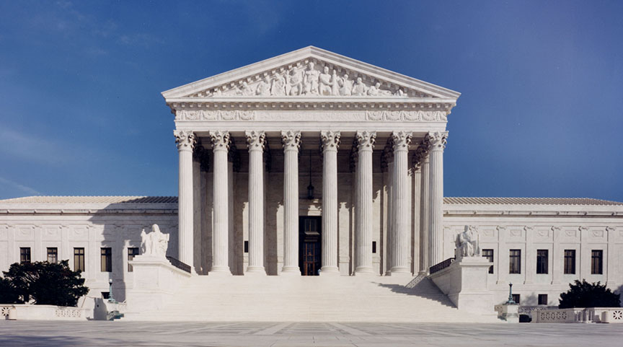
Federal Government – The Judiciary
Generally
Notes:
10

Slide 11
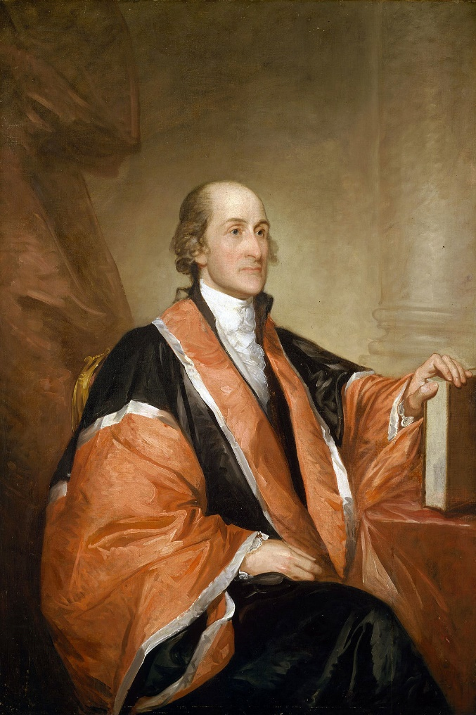
Federal Government – The Judiciary
Generally
The Judicial Power of United States is vested in one Supreme Court, and in such inferior Courts as the Congress may from time to time ordain and establish under the United States Constitution.
Created as an independent, co-equal branch of the federal (national) government, it has its substantial powers checked by the Executive Branch (through Appointment of Judges) and by the Legislative Branch (the Congress) through the establishing of jurisdiction and the inferior courts by Constitutionally authorized statute.
Designed to Hear Cases in Controversy and Appeals, involving the federal government, federal issues, and among citizens with federal jurisdiction, the federal courts are charged with providing impartial decisions to secure civil rights, interpret and apply federal law, and faithfully enforce federal laws made by the Congress.
The Article III Federal Courts consist of:
Supreme Court of the United States,
Federal Circuit Courts of Appeals,
Federal District Courts,
The US Court of International Trade,
Foreign Intelligence Surveillance Courts (FISA),
Federal Bankruptcy Courts, and
United States Court of Federal Claims.
Hon. John Jay
First Chief Justice
of the United States Supreme Court
Notes:
11

Slide 12
Federal Government – The Judiciary
Generally
The United States Constitution vests the Judicial Power of United States in one Supreme Court, and in such inferior Courts as the Congress may from time to time ordain and establish.
Article III of the United States Constitution expressly states the:
jurisdiction,
the qualifications, and
the duties, powers, and responsibilities
of the Judiciary of the United States.
Title 28 of the United States Code
(a Federal Statute that is proscribed by the Constitution)
also sets forth the Powers and Authority of the Judiciary.
Notes:
12

Slide 13
The Federal Government
The Judicial Branch

Slide 14
Federal Government – The Judiciary
Legal Authority
Section One of Article III of the United States Constitution expressly provides that:
“The judicial Power of the United States, shall be vested in one
supreme Court, and in such inferior Courts as the Congress
may from time to time ordain and establish. ”
Article III of the United States Constitution expressly states the:
jurisdiction,
the qualifications, and
the duties, powers, and responsibilities
of the Judiciary of the United States.
Title 28 of the United States Code
(a Federal Statute that is proscribed by the Constitution)
also sets forth the Powers and Authority of the Judiciary.
Section 1 of Chapter 1 of Title 28 sets the size of the United States Supreme Court at 9 justices, and requires a quorum of 6.
Notes:
14

Slide 15
Federal Government – The Judiciary
Manner of Selection
Section Two of Article II of the United States Constitution, and Title 28 of the United States Code, details that members of the Federal Judiciary shall be appointed by the President, for life, upon advice and consent of the Senate (confirmation).
More Specifically, Section Two of Article II of the United States Constitution specifies:
“[The President] shall have Power, … by and with the Advice and Consent of the Senate, [to] appoint … Judges of the supreme Court, and all other Officers of the United States, whose Appointments are not herein otherwise provided for”
Section 44 of Title 28 of the United States Code further specifies:
“The President shall appoint, by and with the advice and consent of the Senate, circuit judges for the several circuits”
Section 133 of Title 28 of the United States Code further specifies:
“The President shall appoint, by and with the advice and consent of the Senate, district judges for the several judicial districts”
Chapters 6, 7 and 11 of Title 28 of the United States Code additionally grant the President similar authority to appoint judges to the US Court of International Trade, the Federal Bankruptcy Courts, and the United States Court of Federal Claims.
Notes:
15

Slide 16
Federal Government – The Judiciary
Qualifications of the Judiciary
Article III of the United States Constitution also DOES NOT specify any specific qualifications for a person seeking to serve in the Judiciary of the United States, other than that such person shall hold their office “during good behavior”.
Such vague qualifications mean that unless the nomination is for a federal magistrate or a bankruptcy judge, the nominee need not even be a lawyer, or have attended law school.
In reviewing Judges for the Confirmation process however, the Department of Justice and the American Bar Association have developed a THREE PART STANDARD to recommend in its report to the Senate whether the nominee is “WELL QUALIFIED”, “QUALIFIED” or “NOT QUALIFIED”.
Such three part standard is based on the following criteria:
1. “INTEGRITY,” as a measure of the nominee’s character and general reputation in the legal community, as well as the nominee’s industry and diligence;
2. “PROFESSIONAL COMPETENCE” as a measure of such individual qualities as intellectual capacity, judgment, writing and analytical abilities, knowledge of the law, and breadth of professional experience (within this category they recommend at least 12 years of professional legal experience); and
3. “JUDICIAL TEMPERAMENT” as a measure of the nominee’s compassion, decisiveness, open-mindedness, courtesy, patience, freedom from bias, and commitment to equal justice under the law.
Notes:
16

Slide 17
Federal Government – The Judiciary
Removal and Compensation
Article II of the United States Constitution, together with Title 28 of the United States Code, provides for the removal of and the compensation for the Judiciary of the United States. Such Article and Title provides:
That the President, Vice President and all civil Officers of the United States, shall be removed from Office on Impeachment for, and Conviction of, Treason, Bribery, or other high Crimes and Misdemeanors (Section 4, Article II);
That the Judges, both of the supreme and inferior Courts, … shall, at stated Times, receive for their Services, a Compensation, which shall not be diminished during their Continuance in Office. (Sec. 1 Article III);
That in accordance with Title 28, the compensation of Federal Judges is as follows:
Chief Justice of the Supreme Court - $270,000
Associate Justice of the Supreme Court – 258, 900
Circuit Judge of the United States Court of Appeals - $223,700
Federal District Judge - $210,000
Notes:
17

Slide 18
Federal Government – The Judiciary
Jurisdiction
The Federal Courts are courts of LIMITED JURISDICTION. Section Two of Article III of the United States Constitution details the jurisdiction of the Federal Judiciary. Such section states that the judicial Power shall extend:
To all Cases, in Law and Equity, arising under this Constitution, the Laws of the United States, and Treaties made, or which shall be made, under their Authority;
To all Cases affecting Ambassadors, other public Ministers and Consuls;
To all Cases of admiralty and maritime Jurisdiction;
To Controversies to which the United States shall be a Party;
To Controversies between two or more States;
To Controversies between a State and Citizens of another State,
To Controversies between Citizens of different States, and
To Controversies between Citizens of the same State claiming Lands under Grants of different States, and between a State, or the Citizens thereof, and foreign States, Citizens or Subjects.
Such Section Two further provides:
That in all Cases affecting Ambassadors, other public Ministers and Consuls, and those in which a State shall be Party, the Supreme Court shall have original Jurisdiction;
That in all the other cases, the Supreme Court shall have appellate Jurisdiction, both as to Law and Fact, with such Exceptions, and under such Regulations as the Congress shall make; and
That the Trial of all Crimes, except in Cases of Impeachment, shall be by Jury; and such Trial shall be held in the State where the said Crimes shall have been committed; but when not committed within any State, the Trial shall be at such Place or Places as the Congress may by Law have directed.
Basic Rule – Federal Court Jurisdiction:
1. Federal Question or 2. Complete Diversity of Parties and Damages in excess of $75,000
Notes:
18

Slide 19
Federal Government – The Judiciary
Powers and Duties
Article III of the United States Constitution provides following the powers and duties onto the Judiciary of the United States. They are as follows:
To Hear and Try Cases in Controversy involving the federal government, federal issues, and among citizens with federal jurisdiction, and to prosecute any violation of federal law;
To Hear and Decide Appeals involving the federal government, federal issues, and among citizens with federal jurisdiction or violation of federal law;
In exercising their powers and performing their duties, the federal courts are charged with providing impartial decisions to secure civil rights, interpret and apply federal law, and faithfully enforce federal laws made by the Congress; and
Their power shall extend to all Cases, in Law and Equity, under their jurisdiction.
Notes:
19

Slide 20
Federal Government – The Judiciary
Constitutional Provisions
Article III of the United States Constitution creates the Federal Judiciary.
Text of Article III: Article III is broken up into three sections, and states as follows:
“Section. 1.
The judicial Power of the United States, shall be vested in one supreme Court, and in such inferior Courts as the Congress may from time to time ordain and establish. The Judges, both of the supreme and inferior Courts, shall hold their Offices during good Behaviour, and shall, at stated Times, receive for their Services, a Compensation, which shall not be diminished during their Continuance in Office.
Section. 2.
The judicial Power shall extend to all Cases, in Law and Equity, arising under this Constitution, the Laws of the United States, and Treaties made, or which shall be made, under their Authority;—to all Cases affecting Ambassadors, other public Ministers and Consuls;—to all Cases of admiralty and maritime Jurisdiction;—to Controversies to which the United States shall be a Party;—to Controversies between two or more States;— between a State and Citizens of another State,—between Citizens of different States,—between Citizens of the same State claiming Lands under Grants of different States, and between a State, or the Citizens thereof, and foreign States, Citizens or Subjects.
In all Cases affecting Ambassadors, other public Ministers and Consuls, and those in which a State shall be Party, the supreme Court shall have original Jurisdiction. In all the other Cases before mentioned, the supreme Court shall have appellate Jurisdiction, both as to Law and Fact, with such Exceptions, and under such Regulations as the Congress shall make.
The Trial of all Crimes, except in Cases of Impeachment, shall be by Jury; and such Trial shall be held in the State where the said Crimes shall have been committed; but when not committed within any State, the Trial shall be at such Place or Places as the Congress may by Law have directed.
Section. 3.
Treason against the United States, shall consist only in levying War against them, or in adhering to their Enemies, giving them Aid and Comfort. No Person shall be convicted of Treason unless on the Testimony of two Witnesses to the same overt Act, or on Confession in open Court.
The Congress shall have Power to declare the Punishment of Treason, but no Attainder of Treason shall work Corruption of Blood, or Forfeiture except during the Life of the Person attainted.”
Notes:
20

Slide 21
Federal Government – The Judiciary
Statutory Provisions
In addition to Article III, Title 28 of the United States Code also outlines the role of the Judiciary of the United States, as authorized under the Constitution.
Title 28 of the United States Code: Chapters 1 to 23 of this Federal Statute provide:
Chapter 1—Supreme Court (Sections 1 – 6)
Chapter 3—Courts of Appeals (Sections 41 – 49)
Chapter 5—District Courts (Sections 81 – 144)
Chapter 6—Bankruptcy Judges (Sections 151 – 159)
Chapter 7—United States Court Of Federal Claims (Sections 171 – 180)
[Chapter 9—Repealed] (§ 211)
Chapter 11—Court of International Trade (Sections 251 – 258)
Chapter 13—Assignment of Judges to other Courts (Sections 291 – 297)
Chapter 15—Conferences and Councils of Judges (Sections 331 – 335)
Chapter 16—Complaints against Judges and Judicial Discipline (Sections 351 – 364)
Chapter 17—Resignation and Retirement of Justices and Judges (Sections 371 – 377)
Chapter 19—Distribution of Reports and Digests (Sections 411 – 415)
Chapter 21—General Provisions applicable to Courts and Judges (Sections 451 – 463)
Chapter 23—Civil Justice Expense and Delay Reduction Plans (Sections 471 – 482)
Notes:
21

Slide 22

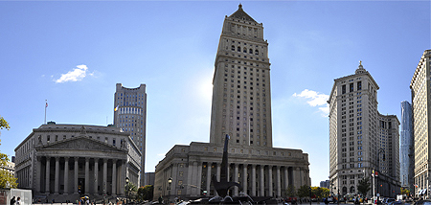
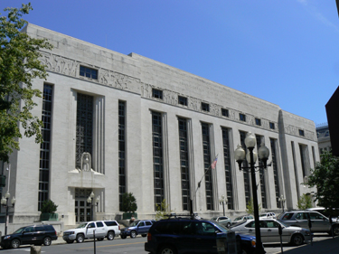
Federal Government – The Judiciary
The Courts
The principle Article III Federal Courts include:
Supreme Court of the United States (the Highest Court in the Land) – Washington D.C
Circuit Courts of Appeals (the 1st Level Federal Appeals Court) 2nd Circuit - NYC
Federal District Courts (The Trial Level Federal Court) – Northern District NY - Albany
Notes:
22

Slide 23
The State Government

Slide 24
The State Government
The Judiciary - Generally

Slide 25
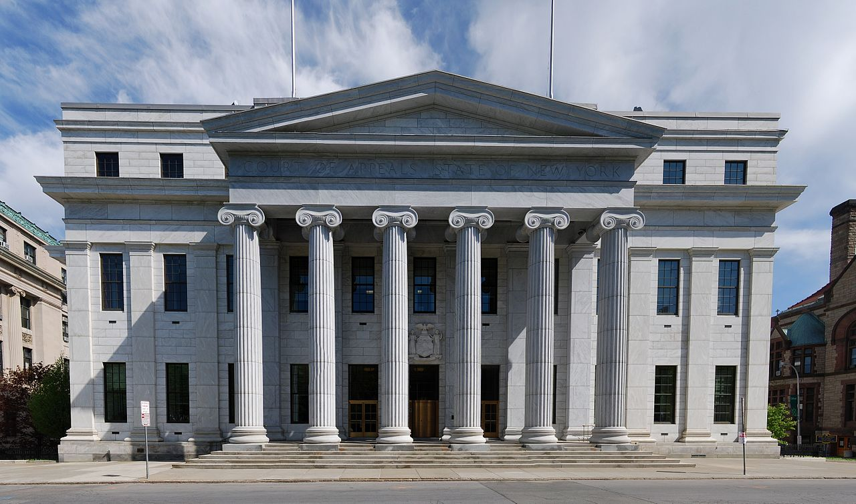
State Government – The Judiciary
Generally
Notes:
25

Slide 26
State Government – The Judiciary
Generally
The Judicial Power of the State of New York is vested the Unified Court System for the State, which shall consist of the Court of Appeals, the supreme court including the appellate divisions thereof, the court of claims, the county court, the surrogate's court and the family court.
Created as an independent, co-equal branch of the state government, it has its substantial powers checked by the Executive Branch (through Appointment of Appeals Judges), by the people (through the direct election of certain courts) and by the Legislative Branch (the Legislature) through the establishing of jurisdiction and the confirmation process in the Senate.
Designed to Hear Cases in Controversy and Appeals, it is a court system of broad jurisdiction, and is charged with providing impartial decisions to secure civil rights, interpret and apply state law, and faithfully enforce state laws made by the Legislature.
The State Courts consist of:
Court of Appeals of the State of New York,
Appellate Division of the Supreme Court,
Supreme Courts,
Court of Claims,
County Courts,
Surrogate’s Courts, and
Family Courts.
Hon. John Jay
First Chief Justice
of New York’s Highest Appellate Court
Notes:
26

Slide 27
Federal Government – The Judiciary
Generally
The New York State Constitution vests the Judicial Power of The State of New York in the Unified Court System which shall consist of the Court of Appeals, the supreme court including the appellate divisions thereof, the court of claims, the county court, the surrogate's court and the family court.
Article VI of the New York State Constitution expressly states the:
jurisdiction,
the qualifications, and
the duties, powers, and responsibilities
of the Judiciary of the State of New York.
The New York State Judiciary Law
(a State Statute that is proscribed by the Constitution)
also sets forth the Powers and Authority of the Judiciary.
Notes:
27

Slide 28
The State Government
The Judicial Branch

Slide 29
State Government – The Judiciary
Legal Authority
Section One of Article VI of the New York State Constitution expressly provides:
“There shall be a unified court system for the state. The state-wide courts shall consist of the court of appeals, the supreme court including the appellate divisions thereof, the court of claims, the county court, the surrogate's court and the family court, as hereinafter provided.
The legislature shall establish in and for the city of New York, as part of the unified court system for the state, a single, city-wide court of civil jurisdiction and a single, city-wide court of criminal jurisdiction, as hereinafter provided, and may upon the request of the mayor and the local legislative body of the city of New York, merge the two courts into one city-wide court of both civil and criminal jurisdiction. The unified court system for the state shall also include the district, town, city and village courts outside the city of New York, as hereinafter provided.
The court of appeals, the supreme court including the appellate divisions thereof, the court of claims, the county court, the surrogate's court, the family court, the courts or court of civil and criminal jurisdiction of the city of New York, and such other courts as the legislature may determine shall be courts of record.”
Article VI of the New York State Constitution expressly states the:
jurisdiction,
the qualifications, and
the duties, powers, and responsibilities
of the Judiciary of the State of New York.
The New York State Judiciary Law
(a State Statute that is proscribed by the Constitution)
also sets forth the Powers and Authority of the Judiciary.
Notes:
29

Slide 30
State Government – The Judiciary
Manner of Selection
Article VI of the New York State Constitution, provides for the manner of selection of Judges in New York State.
Court of Appeals: Judges are appointed by the Governor, upon advice and consent of the Senate, from a list of candidates offered by commission on judicial nomination who considers qualifications of candidates, for a term of 14 years (Article VI, Section 2);
Appellate Division: Judges are appointed by the Governor, upon advice and consent of the Senate, from the judges elected to the Supreme Court within the Division, for a term of five years (Article VI, Section 4);
Supreme Court: Upon Nomination from a judicial nominating convention, Judges are elected from their judicial district for a 14 year term (Article VI, Section 6);
Court of Claims: Judges are appointed by the Governor, upon advice and consent of the Senate, for a term of ten years (Article VI, Section 9);
County Courts: Judges are elected from their county of residence for a term of ten years (Article VI, Section 10);
Surrogate’s Courts: Judges are elected from their county of residence for a term of ten years (Article VI, Section 12); and
Family Courts: Judges are elected from their county of residence for a term of ten years (Article VI, Section 12).
Notes:
30

Slide 31
State Government – The Judiciary
Qualifications of the Judiciary
Article VI of the New York State Constitution sets forth the qualifications for a person seeking to serve in the Judiciary of the State of New York.
Judicial candidates for a judgeship in New York State must:
reside in New York State,
be admitted to practice law in New York for at least ten years, and
be attorneys in good standing
Judicial Candidates, even those seeking election, also are subject to a Bar Association screening committee, similar to the federal process. Such screening committees, make a public report on the candidate under the THREE PART STANDARD as to whether the nominee is “WELL QUALIFIED”, “QUALIFIED” or “NOT QUALIFIED”.
Such three part standard is based on the following criteria:
1. “INTEGRITY,” as a measure of the nominee’s character and general reputation in the legal community, as well as the nominee’s industry and diligence;
2. “PROFESSIONAL COMPETENCE” as a measure of such individual qualities as intellectual capacity, judgment, writing and analytical abilities, knowledge of the law, and breadth of professional experience (within this category they recommend at least 12 years of professional legal experience); and
3. “JUDICIAL TEMPERAMENT” as a measure of the nominee’s compassion, decisiveness, open-mindedness, courtesy, patience, freedom from bias, and commitment to equal justice under the law.
Notes:
31

Slide 32
State Government – The Judiciary
Removal and Compensation
Article VI of the New York State Constitution provides for the removal of and the compensation for the Judiciary of the State of New York. Such Article provides:
Judges of the court of appeals and justices of the supreme court may be removed by concurrent resolution of both houses of the legislature, if two-thirds of all the members elected to each house concur therein.
Judges of the court of claims, the county court, the surrogate's court, the family court, the courts for the city of New York, the district court and such other courts as the legislature may determine may be removed by the senate, on the recommendation of the governor, if two-thirds of all the members elected to the senate concur therein.
No judge or justice shall be removed by virtue of this section except for cause, which shall be entered on the journals, nor unless he or she shall have been served with a statement of the cause alleged, and shall have had an opportunity to be heard. On the question of removal, the yeas and nays shall be entered on the journal. (Section 23, Article VI);
The compensation of a judge of the court of appeals, a justice of the supreme court, a judge of the court of claims, a judge of the county court, a judge of the surrogate's court, a judge of the family court, a judge of a court for the city of New York, a judge of the district court or of a retired judge or justice shall be established by law and shall not be diminished during the term of office for which he or she was elected or appointed.
That in accordance with the judicial compensation committee authorized in accordance with Chapter 60 of the laws of 2015, State Judges are paid as follows:
Chief Judge of the Court of Appeals - $240,000
Associate Judge of the Court of Appeals – 232, 250
Appellate Division Justice - $221,250
Supreme Court Justice - $210,000
All other OCA Judges (County Court, Surrogate Court, Family Court) - $199,500
Notes:
32

Slide 33
State Government – The Judiciary
Jurisdiction
The State Courts are courts of BROAD JURISDICTION. Article VI of the New York States Constitution details the jurisdiction of the State Judiciary. Such section states:
Supreme Court: That the Supreme Court shall have general original jurisdiction with respect to all Cases, in Law and Equity, arising under the NYS Constitution, the Laws of the State of New York and its localities (Article VI, Section7);
Court of Appeals: That the NYS Court of Appeals shall be limited to the review of questions of law except where the judgment is of death, or where the appellate division, on reversing or modifying a final or interlocutory judgment in an action or a final or interlocutory order in a special proceeding, finds new facts and a final judgment or a final order pursuant thereto is entered; but the right to appeal shall not depend upon the amount involved (Article VI, Section3);
Court of Claims: That the court of claims shall have jurisdiction to hear and determine claims against the state or by the state against the claimant or between conflicting claimants as the legislature may provide (Article VI, Section9);
County Court: That the county court shall have jurisdiction over actions and proceedings which shall be originated in such county, including actions and proceedings for:
  the recovery of money and chattels,
  the foreclosure of liens where the amount sought to be recovered or the value of the property does not exceed $25,000 exclusive of interest and costs,
  the prosecution of all crimes and other violations of law,
  to recover possession of real property and to remove tenants therefrom; and
  actions and proceedings, not within the exclusive jurisdiction of the supreme court,
  It shall exercise such equity jurisdiction as may be provided by law and its jurisdiction to enter judgment upon a counterclaim for the recovery of money only shall be unlimited. It shall further have jurisdiction to hear and determine all appeals arising in the county (Article VI, Section11);
Surrogate Court: That the surrogate's court shall have jurisdiction over all actions and proceedings relating to the affairs of decedents, probate of wills, administration of estates and actions and proceedings arising thereunder or pertaining thereto, guardianship of the property of minors, and such other actions and proceedings, not within the exclusive jurisdiction of the supreme court, as may be provided by law.
Notes:
33

Slide 34
State Government – The Judiciary
Powers and Duties
Article VI of the New York State Constitution provides following the powers and duties onto the Judiciary of the State of New York. They are as follows:
To Hear and Try Cases in Controversy involving any issue of state or local law, among its citizens with broad, original jurisdiction, and to prosecute any violation of state law;
To Hear and Decide Appeals involving the Cases in Controversy heard and tried in other Courts of the Unified Court System, or any prosecution of a violation of state law;
In exercising their powers and performing their duties, the state courts are charged with providing impartial decisions to secure civil rights, interpret and apply federal law, and faithfully enforce state laws made by the Legislature; and
Their power shall extend to all Cases, in Law and Equity, under their jurisdiction.
Notes:
34

Slide 35
State Government – The Judiciary
Constitutional Provisions
Article VI of the New York State Constitution creates the New York State Judiciary.
Article VI: Article VI is broken up into 37 Sections. Sections 1 to 24 are as follows:
Section 1 Unified court system; organization; process.
Section 2. Court of appeals; organization; designations; vacancies, how filled; commission on judicial nomination
Section 3. Court of appeals; jurisdiction
Section 4. Judicial departments; appellate divisions, how constituted; governor to designate justices; temporary
assignments; jurisdiction
Section 5. Appeals from judgment or order; new trial
Section 6. Judicial districts; how constituted; supreme court
Section 7. Supreme court; jurisdiction
Section 8. Appellate terms; composition; jurisdiction
Section 9. Court of claims; jurisdiction
Section 10. County courts; judges
Section 11. County court; jurisdiction
Section 12. Surrogate's courts; judges; jurisdiction
Section 13. Family court; organization; jurisdiction
Section 14. Discharge of duties of more than one judicial office by same judicial officer
Section 15. New York city; city-wide courts; jurisdiction
Section 16. District courts; jurisdiction; judges
Section 17. Town, village and city courts; jurisdiction; judges
Section 18. Trial by jury; trial without jury; claims against state
Section 19. Transfer of actions and proceedings
Section 20. Judges and justices; qualifications; eligibility for other office or service; restrictions
Section 21. Vacancies; how filled
Section 22. Commission on judicial conduct; composition; organization and procedure; review by court of appeals; discipline
of judges or justices
Section 23. Removal of judges
Section 24. Court for trial of impeachments; judgment
Notes:
35

Slide 36
State Government – The Judiciary
Constitutional Provisions
Article VI of the New York State Constitution creates the New York State Judiciary.
Article VI: Article VI is broken up into 37 Sections. Sections 25 to 37 are as follows:
Section 25 Judges and Justices; compensation; retirement.
Section 26. Temporary Assignments of Judges and Justices
Section 27.Supreme Court; Extraordinary Terms
Section 28. Administrative supervision of court system
Section 29. Expenses of Courts
Section 30. Legislative power over judicial proceedings; delegation of power to regulate practice and procedure
Section 31. Inapplicability of article to certain courts
Section 32. Custodians of children to be of same religious persuasion
Section 33. Existing laws; duty of legislature to implement article
Section 34. Pending appeals, actions and proceedings; preservation of existing terms of office of judges and justices
Section 35. Certain courts abolished; transfer of judges, court personnel, and actions and proceedings to other courts
Section 36. Pending civil and criminal cases
Section 36-a Effective date of certain amendments to article VI and VII
Section 36-b No Section
Section 36-c Effective date of certain amendments to article VI, section 22
Section 37. Effective date of article
Notes:
36

Slide 37
State Government – The Judiciary
Statutory Provisions
In addition to Article VI, The New York State Judiciary Law also outlines the role of the Judiciary of the State of New York, as authorized under the Constitution.
NYS Judiciary Law: Articles 1 to 10-A of this Statute provide:
Article 1. Short Title (Sections 1 - 1-a)
Article 2. General Provisions Relating to Courts and Judges (Sections 2 - 39-b)
Article 2-a. State Commission on Judicial Conduct (Sections 40 - 48)
Article 3. Court of Appeals (Sections 51 - 60)
Article 3-a. Commission on Judicial Nomination (Sections 61 - 68)
Article 4. Appellate Division (Sections 70 - 109)
Article 4-a. Official Referees (Sections 114 - 125)
Article 5. Supreme Court (Sections140 - 174)
Article 5-a. The City Court of the City of New York (Sections 176 - 177)
Article 5-b. Special Narcotics Parts of The Supreme Court (Sections 177-a - 177-d)
Article 6. The Surrogates' Courts (Sections 179 - 181)
Article 6-a. County Judges, Surrogates and Certain District Attorneys (Sections 182 - 188)
Article 7. County Court (Sections 190 - 208)
Article 7-a. Judicial Administration (Sections 210 - 219-d)
Article 7-b. Compensation of Judges and Justices of the Unified Court System (Section 220 - 224)
Article 7-c. Of the Court for the Trial of Impeachments (Sections 240 - 248)
Article 7-d. Internal Control Responsibilities Of The Judiciary (Sections 249 - 249-c)
Article 8. Clerks (Sections 250 - 283)
Article 9. Stenographers (Sections 290 - 320)
Article 10-A. Grand Jury Stenographers (Sections 321 - 330)
Notes:
37

Slide 38
State Government – The Judiciary
Statutory Provisions
In addition to Article VI, The New York State Judiciary Law also outlines the role of the Judiciary of the State of New York, as authorized under the Constitution.
NYS Judiciary Law: Articles 10 to 23 of this Statute provide:
Article 10. Attendants, Officers and Messengers (Sections 340 - 352)
Article 11. Criers (Sections 360 - 364)
Article 12. Interpreters (Sections 380 - 391)
Article 13. Sheriffs And Constables (Sections 400 - 411-b)
Article 13-a. Judicial Proceedings to Remove Public Officers by Impeachment (Sections 415 - 428)
Article 14. Law Reporting (Sections 430 - 438)
Article 15. Attorneys and Counsellors (Sections 460 - 499)
Article 15-a. State Commission on Prosecutorial Conduct (Sections 499-a - 499-j)
Article 16. Selection of Jurors (Sections 500 - 528)
Article 17. Blank
Article 18. Blank
Article 19. Contempts (Sections 750 - 781)
Article 20. Collection of Fines (Sections 790 - 796)
Article 20-a. Remission of Fines and Forfeitures (Sections 798 - 799-a)
Article 21. Court Libraries (Sections 810 - 815)
Article 21-a. Community Dispute Resolution Centers Program (Sections 849-a - 849-g)
Article 21-b. Justice Court Assistance Program (Sections 849-h - 849-k)
Article 21-c. Court-appointed Special Advocates Program (Sections 849-l - 849-m)
Article 22. Judicial Hearing Officers (Sections 850 - 854)
Article 22-a. Judicial Wellness Or Assistance Committees (Section 857)
Article 23. Laws Repealed; When To Take Effect (Sections 860 - 861)
Notes:
38

Slide 39
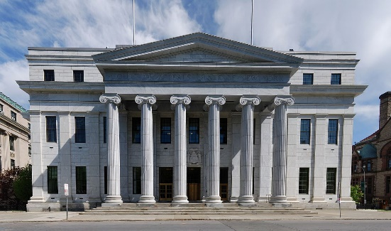
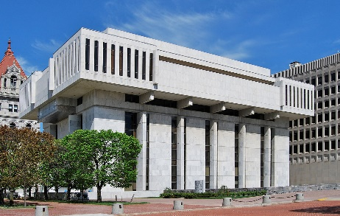
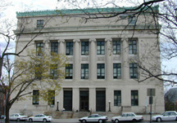
Federal Government – The Judiciary
The Courts
The principle Article VI State Courts include:
New York State Court of Appeals (the Highest Court in the State) – Albany, NY
Appellate Division of the Supreme Court (1st Level Appeals Court) 3rd Department – Albany, NY
Supreme Court (Trial Level State Court) – Albany County – Albany, NY
Notes:
39

Slide 40
Local Governments
The Judiciary – Generally

Slide 41
Local Governments – The Judiciary
Generally
In New York State Local Governments include: Counties, Cities, Towns and Villages. Each local government has courts within the Unified Court System.
Counties:
There are 62 Counties in New York State, and each has the following courts.
County Court: The County Court is established in each county outside New York City. It is authorized to handle the prosecution of all crimes committed within the County. The Court generally handles felony cases (in which a sentence of imprisonment in excess of one year may be imposed).The County Court also has limited jurisdiction in civil cases involving amounts up to $25,000. In addition, the County Court acts as an intermediate appellate court, hearing appeals from the City Courts and the Town and Village Courts.
Family Court: The Family Court hears matters involving children and families (The Family Court cannot grant a divorce; only Supreme Court can do that). Its jurisdiction includes: Adoption; Guardianship; Foster Care Approval and Review; Delinquency; Persons in Need of Supervision; Family Offense (domestic violence); Child Protective Proceedings (abuse and neglect); Termination of Parental Rights; Custody and Visitation; and Support.
Surrogate’s Court: The Surrogate's Court hears cases involving the affairs of decedents, including the probate of wills and the administration of estates. It also handles adoptions and Guardianships.
Cities:
There are also 62 Cities in New York State, and each has a city Court
City Court: City Courts handle criminal and civil matters. They have criminal jurisdiction over misdemeanors and lesser offenses (that carry a term of imprisonment of no more than one year) and handle civil matters where the amount of money in dispute is up to $15,000. City Court small claims jurisdiction is county wide. Unlike Town and Village Justices, City Court Judges are required to be lawyers
Towns and Villages:
There are 932 Towns and 551 Villages in New York State, and each has a Justice Court.
Town and Village Courts: Town and Village Courts are collectively known as the Justice Courts. These courts have jurisdiction over a broad range of matters, including vehicle and traffic matters, small claims, evictions, civil matters less than $3000 and misdemeanor and petty criminal offenses. Town and Village Justices, unlike City Court Judges, are not required to be lawyers
Notes:
41

Slide 42
Thank you for Coming
For next time – Review Assignments as follows on the Webpage:
  Lecture Slides
  Selected Readings
  Cases and Exercises
We are a hot bench.
Questions?

