Slide 1

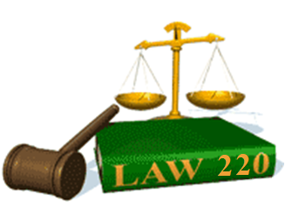
Slide Set Five B:
Mistake

Slide 2
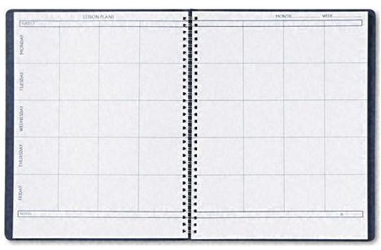
Last Time – We Spoke About:
The Rights in Contracts
Part One: Founders/Common Law/Definition/Elements/Nature
Contract Formation – Offer
Part Two: Definition/Requirements/Termination
Contract Formation - Acceptance
Part Three: Definition/Requirements/Form/Nature/Effect
Class Case – Kolchins v. Evolution Market
Recognition of Contractual Elements

Slide 3
Tonight – We Will Speak About:
Contractual Capacity
Part One: Definitions /Minors / Incompetents / Intoxication
Mistake
Part Two: Unilateral Mistake / Mutual Mistake / Transcriptions
Deception or Pressure
Part Three: Intentional Misrepresentation/Fraud/NonDisclosure
Class Case – Gerstein v. Broad Hollow Co.
Requirement of Free Will to Contract

Slide 4
Mistake
Definitions
Unilateral Mistake
  Mutual Mistake
  Mistake in Transcription or Printing

Slide 5
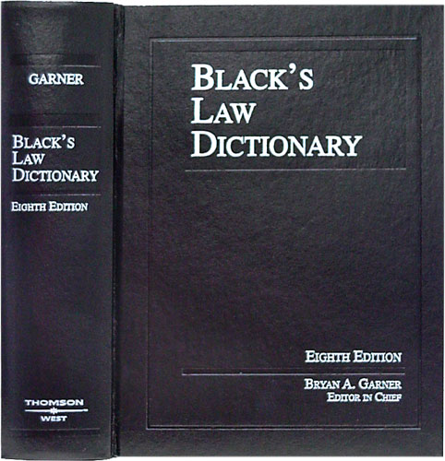
Contractual Mistakes
Definition
Black’s Law Dictionary defines the term “Contract” as:
“An agreement between
two or more parties
creating obligations
that are enforceable
or otherwise recognizable
at law.”
Notes:
5

Slide 6
Contractual Mistakes
Definition - Elements of a Contract
In Accordance with Common Law, the Elements of a Contract include:
Agreement,
Between Competent Parties,
Based on Genuine Assent,
Supported by Consideration,
for Lawful Purpose Subject Matter,
in Legal Form.
Notes:
6

Slide 7
Contractual Mistakes
Definition – Mistakes- Reasoning
The reason the law is concerned regarding Mistakes, is because in order to fully agree to a contract, the parties must have:
“Genuine Assent”
According to Black’s law dictionary, genuine assent is defined as:
“Agreement, approval or permission that is authentic, real and has the quality of what it is purported to be.”
When there is a Mistake in the contract, there can be no genuine assent, as ability of the parties to truly understand the terms, conditions, duties and responsibilities of the agreement to which they are entering is not what they believed it to be.
Notes:
7

Slide 8
Contractual Mistakes
Definition – Mistakes - Generally
With respect to contracts, a ”Mistake” has been defined as:
“An error, misconception, misunderstanding, or erroneous belief with respect to the terms, conditions, duties and/or responsibilities contained in a contract.”
Why Mistakes Matter: Because of the requirement of genuine assent, the validity of a contract may be affected by the fact that one or both of the parties made a mistake.
In some cases, the mistake may be caused by the misconduct of one of the parties.
In others, the mistake is the result of a non purposeful error.
Not Every Misunderstanding is a Mistake: It is important to understand that not every erroneous idea, is a “mistake” in a contractual context.
For purposes of rescinding contracts, a “mistake” refers only to a mistaken belief about an existing fact, NOT an erroneous belief about what will happen in the future.
Nor is a “mistake” a misunderstanding as to the “meaning” of the contract. For such is not an error as to some external fact, but rather an error as to the meaning of a manifestation of assent, which is ultimately resolved by the process of interpretation.
Three Types of Mistake: When it comes to mistakes in contracts, there are three types:
Unilateral Mistake;
Mutual Mistake; and
Mistake due to transcriptions or printing.
Notes:
8

Slide 9
Contractual Mistakes
Unilateral Mistakes
Defined: A unilateral mistake is a mistake made by only one of the parties.
It is a mistake as to a fact, that does not affect the contract, when the mistake is unknown to the other contracting party.
Not Always Obvious: A mistake is unilateral, not only in the obvious case where one party knows the true facts, and the other does not, but also where both parties may be unaware of the truth, yet the fact in issue affects the decision of only one of the parties.
In such case, although neither party realizes the error, the incorrect fact is a basic assumption of only one of the parties, because the other does not use it as a basis for deciding to enter the contract.
A Unilateral Mistake Can Be Where Both Parties are Misinformed: This means that the distinction between mutual and unilateral mistake is not necessarily merely a matter of deciding whether one or both parties had been misinformed.
When Can a Contract Be Rescinded for Unilateral Mistake: The bottom line with a unilateral mistake is, that a party making the mistake may avoid the contract, only if the other contracting party knew, or should have known, of the mistake.
This is because when there is a mistake known to the both contracting parties, it makes the mistake avoidable for the victim of the mistake.
Notes:
9

Slide 10
Contractual Mistakes
Mutual Mistakes
Defined: A mutual mistake is a mistake made by both of the contracting parties.
It is a mistake as to a fact, that does affect the contract, and such mistake is shared by both parties, it is often held that no contract was formed at all, or that the contract should be subject to either rescission (i.e., cancellation) or reformation (i.e., re-writing by the court).
When Can a Contract Be Rescinded or Reformed for Mutual Mistake: When both parties are mistaken about a basic, material fact of the contract, the adversely affected party may generally avoid the contract.
Three Requirements: Three requirements are generally must be satisfied before the adversely affected party may avoid the contract on account of mutual mistake:
The mistake must concern a basic assumption on which the contract was made;
The mistake must have a material effect on the “agreed exchange of performances”; and
The adversely-affected party (the one seeking avoidance) must not bear the risk of the mistake.
Meaning of “basic assumption”: The requirement that the mistake be a “basic assumption” on which the contract is based, is the assumption that is a central part of the bargain, is “basic,” but if the assumption, relates merely to a collateral or peripheral aspect of the contract, it is not.
Meaning of “material effect”: In addition to showing that the mistake was on a “basic assumption” shared by the parties, the person seeking to avoid the contract for mistake, must also show that the mistake has a “material effect on the agreed exchange of performances.”
This showing is not made merely by proof that the party would not have made the contract had it not been for the mistake. The party must show “that the resulting imbalance in the agreed exchange is so severe that he cannot fairly be required to carry it out.
Meaning of “not bear the risk”: The law requires that adversely-affected party of a mutual mistake must not bear the risk of the mistake. This allows such adversely effected party to avoid, rescind or reform the contract.
Notes:
10

Slide 11
Contractual Mistakes
Transcription or Printing Mistakes
Defined: A transcription or printing mistake is a mistake that is made in the typing or printing of a written contract.
This can happen when the parties make an oral agreement, and in the process of committing it to writing, or when printing it from a manuscript (a hand written document), a phrase, term, or segment is inadvertently left out of, or inadvertently altered in, the final, signed document.
When Can a Contract Be Rescinded or Reformed for Transcription or Printing Errors: When an error takes place as a result of a faulty transcription or printing, the aggrieved party may petition the court to rescind or reform the contract to reflect the actual agreement of the parties.
The burden of proof in such case, however, is heightened to clear and convincing evidence that such a transcription or printing mistake was made.
To obtain the relief of rescission or reform, the aggrieved party must show that the contract cannot be reformed (corrected to the original) or petition a judge to reform (rewrite) the contract to demonstrate the true intent of the parties.
Back to the Actual Intent of the Parties: A mistake in transcription is completely different in nature from a mistake of fact. For with transcription or printing errors, the “fact” that is wrong did not motivate the transaction, but is in the written record of the transaction. The problem is not that the manifestation is based on a faulty premise but that it incorrectly records the parties’ agreement.
When the mistake is in transcription, the desired relief is to have the writing changed to reflect what was actually agreed. It must be stressed that the goal of reformation in this situation is to correct the contract so that it reflects what was actually agreed, not to adjust or rewrite its terms.
Notes:
11

Slide 12
Thank you for Coming
For next time – Review Assignments as follows on the Webpage:
  Lecture Slides
  Selected Readings
  Cases and Exercises
We are a hot bench.
Questions?

