Slide 1

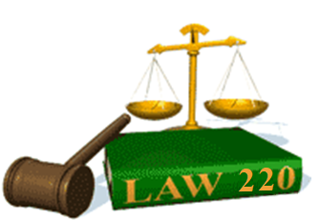
Slide Set Six A:
Consideration

Slide 2

Last Time: We Spoke About:
Contractual Capacity
Part One: Definitions /Minors / Incompetents / Intoxication
Mistake
Part Two: Unilateral Mistake / Mutual Mistake / Transcriptions
Deception or Pressure
Part Three: Intentional Misrepresentation/Fraud/NonDisclosure
Class Case – Gerstein v. Broad Hollow Co.
Requirement of Free Will to Contract

Slide 3
Tonight: We Will Speak About:
Consideration
Part One: Definitions / General Principals / Exceptions
Legality
Part Two: Definitions / General Principals
Public Policy
Part Three: Definitions / Public Welfare Agreements / Violations
Class Case – Allegheny College v. National
Chautauqua County Bank
Consideration as a Condition of Contract

Slide 4
Consideration
Definitions
General Principles
PURPOSE AND FUNCTION;
MEASURE AND ADEQUACY; AND
FORBEARANCE, ILLUSORY AND CONDITIONAL
  Exceptions

Slide 5
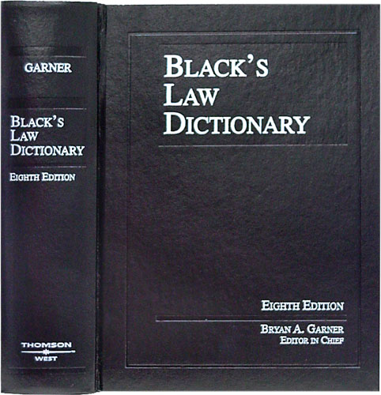
Consideration
Definition - Contract
Black’s Law Dictionary defines the term “Contract” as:
“An agreement between
two or more parties
creating obligations
that are enforceable
or otherwise recognizable
at law.”
Notes:
5

Slide 6
Consideration
Definition - Elements of a Contract
In Accordance with Common Law, the Elements of a Contract include:
Agreement,
Between Competent Parties,
Based on Genuine Assent,
Supported by Consideration,
for Lawful Purpose Subject Matter,
in Legal Form.
Notes:
6

Slide 7
Consideration
Definition – Consideration
To be a valid Contract, it must be supported by consideration.
According to Black’s law dictionary, consideration is defined as:
“Something (such as an act, a forbearance
or a return promise) bargained for and
received by a promisor from a promise,
that motivates a person to do something.”
  Bargained-for-Exchange: Consideration is what each party gives up (legal value) to the other in the making of the agreement.
  It is the “price” of the contract for each side.
  It is the value or promise given, and can be goods, services, property or forbearance of a legal right.
Mutuality of Consideration: Each party is required to furnish consideration to the other.
This is the called the requirement of “mutuality of consideration.”
Notes:
7

Slide 8
Consideration
Consideration – General Principles
PURPOSE AND FUNCTION OF CONSIDERATION:
Purpose of Consideration:
Generally: Not all promises are legally enforceable. The purpose of consideration is to distinguish between those promises that are enforceable, and those promises that are not. As a general rule, a court will not enforce a promise unless the promisee has given “consideration” for the promise.
Gifts: Promises to make a gift are unenforceable because they lack consideration. Charitable subscriptions are binding to the extent the donor reasonably should have known the charity was relying on the promise.
Function of Consideration: The requirement that a promise, to be binding, must be supported by consideration serves two primary functions:
Evidentiary Function: The existence of consideration helps to provide objective evidence that the parties intended to make a binding agreement. Such helps courts distinguish those agreements that were intended by the parties to be legally enforceable from promises which were intended merely as obligations of honor, promises of gifts which neither party expected to be enforceable in court, or any other arrangement as to which the parties did not contemplate legal consequences.
Cautionary Function: The requirement that promises must be supported by consideration also serves a cautionary function. If the parties are aware that the providing of consideration by one will make the other’s promise enforceable, the parties may act more carefully, and will be less likely to make thoughtless or bad bargains or mistakes. Conversely, parties may take fewer precautions during negotiations because they know that their statements will not be not enforceable in the absence of consideration; fewer precautions during the initial stages of the bargaining process will in turn reduce transaction costs.
Notes:
8

Slide 9
Consideration
Consideration – General Principles
MEASURE AND ADEQUACY OF CONSIDERATION:
Measure of Consideration: A promise is supported by consideration if two things are true :
Legal Detriment: The promisee gives up something of value, or circumscribes his liberty in some way. (If the promisee does either of these things, he’s said to suffer a “legal detriment”; and
Bargained Exchange: The promisor makes his promise as part of a “bargain”; that is, he makes his promise in exchange for the promisee’s legal detriment (i.e., in exchange for the promisee’s giving of value or circumscription of liberty).
Adequacy of Consideration: Ordinarily, courts do not consider the adequacy of the consideration given for a promise.
Amount of Consideration Considered Immaterial: The fact that the consideration supplied by one party is slight when compared with the burden undertaken by the other party is immaterial.
Sufficiency of Consideration Not Reviewable: It is a matter for the parties to decide when they make their contract whether each is getting a fair return. It is not a function of a court to review the amount of the consideration passed unless the amount is so grossly inadequate as to shock the conscience of the court.
Exceptions: There are two major exceptions as to adequacy of consideration. They are past consideration and sham or fraudulent consideration:
Past Consideration, Pre-existing Legal Obligations and Moral Obligations: “Past consideration” has been deemed by the courts as not sufficient consideration. In such cases, the court has found that the “bargain” is missing, in that the promise being made has already been suffered before by the promise, and as such, is obviously not being “bargained for” by the promisor. Additionally, pre-existing legal obligations and moral obligations are also held not to be consideration as they, like past consideration, impose no “bargained for” promise.
Sham, Incidental, Unconscionable or Fraudulent Consideration: While it is true that the law does not normally concern itself with the adequacy of consideration, provided that that consideration was truly bargained for, the recital of purely nominal or incidental consideration (such as $1) is usually an indication that there was no bargain at all, but rather, a gift. Additionally, where the consideration was based on fraud or is deemed unconscionable (under certain consumer statutes), such consideration can also be deemed as insufficient by the courts.
Notes:
9

Slide 10
Consideration
Consideration – General Principles
FORBEARANCE, ILLUSORY AND CONDITIONAL PROMISES AS CONSIDERATION:
Forbearance:
Positive Consideration: In most cases, consideration consists of the performance of an act, such as providing a service, or the making of a promise to provide a service or goods, or paying money.
Forbearance Consideration: Consideration may also consist of forbearance, which is refraining from doing an act that an individual has a legal right to do, or it may consist of a promise of forbearance. In such cases, the promisor may desire to buy the inaction, or a promise of inaction, of the other party.
The giving up of any legal right can also be consideration for the promise of the other party to a contract.
Illusory Promises: An illusory promise is a promise that appears on its face to be so insubstantial as to impose no obligation on the promisor. It is often an expression cloaked in promissory terms but actually containing no commitment by the promisor.
No Consideration with an Illusory Promise: As an illusory promise is not actually a promise, any contract based on such an illusory promise fails for lack of consideration.
Bilateral Contracts: In a bilateral contract, each party makes a promise to the other. For a bilateral contract to be enforceable, there must be mutuality of obligation.
That is, both parties must have created obligations to the other in their respective promises. If one party’s promise contains either no obligation or only an apparent obligation to the other, this promise is an illusory promise.
The party making such a promise is not bound because he or she has made no real promise. The effect is that the other party, who has made a real promise, is also not bound because he or she has received no consideration.
In such case, it is said that the contract fails for lack of mutuality.
Conditional Promises: A conditional promise is a promise that depends on the occurrence of a future specified condition in order for the promise to be binding. Such promises are enforceable.
Notes:
10

Slide 11
Consideration
Consideration – Exceptions
EXCEPTIONS TO CONSIDERATION:
Charitable Subscriptions: Where individuals made pledges to a charity, consideration is lacking according to technical standards applied in ordinary contract cases.
For public policy reasons, however, Courts have held that the reliance of the charity on the pledge, will be held as a substitute for consideration, and the pledge will be enforceable as a contract.
Uniform Commercial Code: In certain situations, the Uniform Commercial Code (UCC) abolishes the requirement of consideration. These situations include:
A merchant’s written, firm offer for goods stated to be irrevocable,
A written discharge of a claim for an alleged breach of a commercial contract, or
An agreement to modify a contract for the sale of goods.
Promissory Estoppel: Under the doctrine of promissory estoppel, a promisor may be prevented from asserting that his or her promise is unenforceable because the promisee gave no consideration for the promise.
This doctrine, sometimes called the doctrine of detrimental reliance, is applicable when:
The promisor makes a promise that lacks consideration;
The promisor intends, or should reasonably expect, that the promisee will rely on the promise;
The promisee in fact relies on the promise in some definite and substantial manner; and
Enforcement of the promise is the only way to avoid injustice.
Damages recoverable in a case of promissory estoppel are not the profits that the promisee expected, but only the amount necessary to restore the promisee to the position he or she would have been in had the promisee not relied on the promise.
In such cases, legal difficulties often arise because parties take certain things for granted. Frequently,
they believe that they have agreed to everything and that they have a valid contract. Sometimes, however, they do not. The courts are then faced with the problem of leaving them with their broken dreams or coming to their rescue when promissory estoppel can be established.
Notes:
11

Slide 12
Thank you for Coming
For next time – Review Assignments as follows on the Webpage:
  Lecture Slides
  Selected Readings
  Cases and Exercises
We are a hot bench.
Questions?

