Slide 1

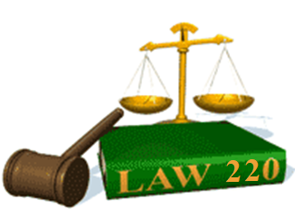
Slide Set Nine B:
Remedies

Slide 2

Last Time: We Spoke About:
Third Parties and Assignments
Third Party Beneficiaries
Part One: Definitions/Intentional/Incidental /Modification /Termination /Limitations
Assignments and Delegations
Part Two: Definitions / Notice / Rights / Liabilities / Warranties / Duties
Class Case – Fourth Ocean Putnam Co.
v. Interstate Wrecking Company
The Rights of 3rd Party Beneficiaries in Contract

Slide 3
Tonight: We Will Speak About:
Contractual Breach and Remedies
Breach and Fulfillment of Contracts
Part One: Definitions / Anticipatory Breach / Waiver and Cure of Breach / Discharge
Remedies
Part Two: Definitions /Monetary Damages /Non Monetary Damages/Consequential Damages
Contractual Provisions on Remedies
Part Three: Limitation on Remedies / Liability / Liquidated Damages / Attorneys Fees
Class Case – Newburger v. Lubell
Necessity to Perform Contract to Avoid Breach

Slide 4
Part One
Contractual Breach and Remedies
Generally - Definitions

Slide 5
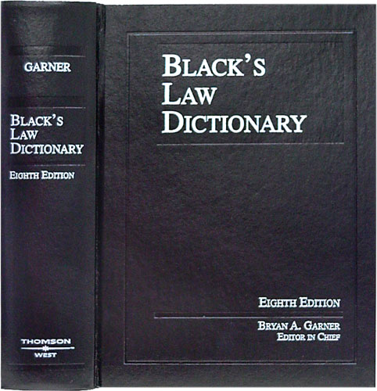
Contractual Breach and Remedies
Definition - Contract
Black’s Law Dictionary defines the term “Contract” as:
“An agreement between
two or more parties
creating obligations
that are enforceable
or otherwise recognizable
at law.”
Notes:
5

Slide 6
Contractual Breach and Remedies
Definition - Elements of a Contract
In Accordance with Common Law, the Elements of a Contract include:
Agreement,
Between Competent Parties,
Based on Genuine Assent,
Supported by Consideration,
for Lawful Purpose Subject Matter,
in Legal Form.
Notes:
6

Slide 7
Part Two
Contractual Breach and Remedies
Remedies – Definitions

Slide 8
Contractual Breach and Remedies
Remedies – Definitions
Remedies:
Defined: Blacks Law Dictionary defines a Remedy as:
“The means of enforcing a right or preventing or redressing a wrong, by means of providing legal or equitable relief.”
What Remedies are Available for a Breach of Contract: There are two principle remedies for a breach of contract. They are as follows:
Damages: The principle remedy for a breach of contract is monetary damages. These monetary damages are generally categorized into three separate areas.
Expectation Damages: These damages attempt to put the plaintiff in the position they would have been had the defendant performed, awarding the injured party their out-of-pocket costs incurred, together with whatever profit they would have made had the contract been completed;
Reliance Damages: These damages attempt to put the plaintiff in as good a position as they were in prior to the making of the contract, by allowing them to recover their out-of-pocket expenditures incurred in performing the contract; and
Restitution: These damages attempt to prevent the unjust enrichment of the defendant by returning to a plaintiff who has partially performed the value of the performance they have rendered to the defendant.
Equitable relief: Another possible remedy that a party who has been injured by a breach of contract may pursue is equitable relief. Equitable relief is awarded when a plaintiff can demonstrate that money damages would not prove an adequate remedy. This relief is generally categorized into two separate areas:
Rescission: This remedy is an order to effectively cancel the contract, so as to place the parties in the position as if the contract had never occurred.
Specific Performance: This remedy is an order to of the breaching party to actually render the promised performance of the contract;
Injunction: This remedy is an order to direct the breaching party to refrain from doing something relating to the contract provisions; or
Reformation: This remedy is where the court will actually re-write the contract or a provision that is inequitable.
Notes:
8

Slide 9
Part Three
Contractual Breach and Remedies
Remedies – Road Map

Slide 10
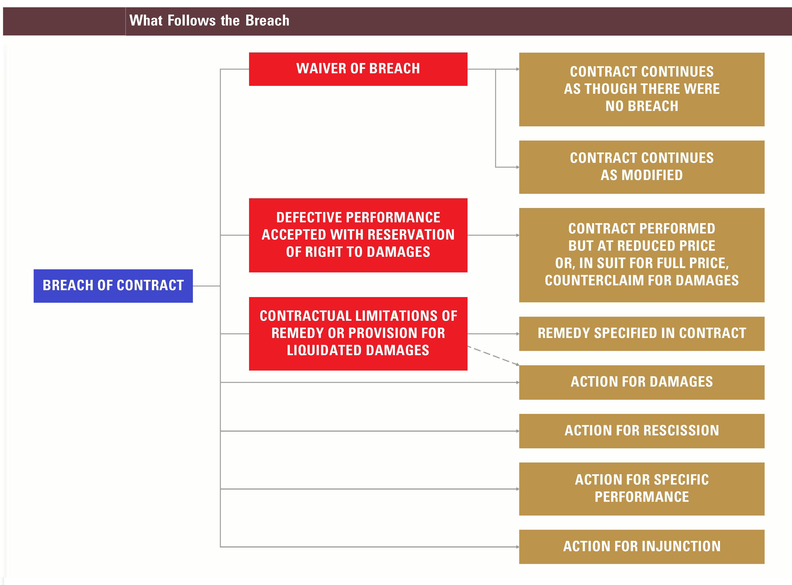
Contractual Breach and Remedies
Remedies – Road Map
Notes:
10

Slide 11
Part Four
Contractual Breach and Remedies
Remedies – Monetary Damages

Slide 12
Contractual Breach and Remedies
Remedies – Monetary Damages - Generally
Monetary Damages:
Generally: The principle remedy for a breach of contract is monetary damages. Monetary damages are commonly classified as compensatory damages, nominal damages, and punitive damages.
Compensatory Damages: The most prominent form of damages for breach of contract are compensatory damages. These damages compensate a plaintiff for the injury incurred as a result of the breach of contract. Compensatory damages have two classifications within their scope, as follows:
Direct Damages: These are monetary damages (sometimes called general damages), that the law presumes directly follow the type of wrong complained of, and which are awarded to compensate the plaintiff for a proven injury or loss, that directly flow from the breach of contract. These damages, as aforementioned, include expectation, reliance and restitution damages; and
Consequential Damages: These are monetary damages that do not flow directly and a immediately from the breach of contract, but rather flow as a “consequence” of the breach. Consequential damages may be recovered only if it was reasonably foreseeable to the defendant that the kind of loss in question could be sustained by the non breaching party if the contract were broken.
Nominal Damages: These are compensatory damages which represent a trifling or trivial sum (such as $1) which indicate an actual but extremely small amount of loss by the plaintiff; and
Punitive Damages: These are damages in excess of actual loss, imposed for the purpose of punishing or making an example of the defendant, are known as punitive damages or exemplary damages. These damages are very seldom awarded in contract actions.
Notes:
12

Slide 13
Contractual Breach and Remedies
Remedies – Monetary Damages - Mitigation
Monetary Damages Continued:
Mitigation of Damages: The injured party is under the duty to mitigate damages if reasonably possible. This means that the injured party is obligated under the law to take all reasonable efforts possible to prevent any increase possible in the amount of damages that occurs as a result of the other party’s breach of the contract.
Examples of Mitigation:
Cessation of Further Damages: The duty to mitigate applies so that the injured party must generally stop any performance under the contract which would avoid any further damages resulting from the breach;
Replacement of Items: The duty to mitigate damages may further require an injured party to buy or rent elsewhere the goods that the wrongdoer was obligated to deliver under the contract; or
Seeking Alternative Contract: In the case of breach of an employment contract by the employer, the employee is required to seek other similar employment, so that the wages earned from other employment must be deducted from the damages claimed, but the discharged employee, is not required to take employment of less-than-comparable work.
Effect of Failure to Mitigate Damages: The effect of the requirement of mitigating damages is to limit recovery by the non-breaching party to the damages that would have been sustained had this party mitigated the damages where it was possible to do so.
Notes:
13

Slide 14
Part Five
Contractual Breach and Remedies
Remedies – Non Monetary Damages

Slide 15
Contractual Breach and Remedies
Remedies – Monetary Damages - Generally
Non Monetary Damages:
Generally: Although the principle remedy for a breach of contract is monetary damages, there are certain instances when monetary damages will prove an inadequate or insufficient remedy. In such cases, equitable remedies can be employed, including recession, specific performance and injunction.
Rescission: When one party commits a material breach of the contract, and monetary damages prove insufficient, the injured party may seek rescission (cancellation) of the contract.
Purpose: The purpose of rescission is to restore the injured party to the position occupied before the contract was made.
Restitution: An injured party who rescinds a contract after having performed services may recover the reasonable value of the performance rendered, however, the party seeking such restitutionary damages must also return what this party has received from the party in default.
Materiality: A breach must be material (meaning that it is so substantial that it defeats the object of the parties in making the contract) in order to attain rescission.
Specific Performance: Under special circumstances, an injured party may obtain the equitable remedy of specific performance, which compels the other party to carry out the terms of a contract.
Limitation: Specific performance is, however, only granted if the subject matter of the contract is “unique,” thereby making an award of money damages an inadequate remedy. Contracts for the purchase and sale of land, for example, will be specifically enforced, whereas specific performance of a contract to sell personal property can be obtained only if the article is of unusual age, beauty, unique history, or other distinction.
Injunction: When a breach of contract results from a party performing an act prohibited by the contract, a possible remedy is an injunction by a court, ordering the breaching party from doing the act.
Reformation: At times, a written contract does not correctly state the agreement already made by the parties. When this occurs, either party may seek to have the court reform or correct the writing to state the agreement actually made.
Rare Action, Requiring High, Clear Burden of Proof: This is a rare action awarded by courts, and a party seeking reformation of a contract must clearly prove both the grounds for the reformation, and what the agreement actually was. This burden is particularly great when the contract to be reformed is written.
Unconscionability: This action is sometimes taken when the court finds the contract is unconscionable as written, thereby requiring the court to reform the contract.
Notes:
15

Slide 16
Class 09B - Thank you for Coming
For next time – Review Assignments as follows on the Webpage:
Lecture Slides
Selected Readings
Cases and Exercises
We are a hot bench.
Questions?

