Slide 1


Slide Set Nine C:
Limitation on Remedies

Slide 2

Last Time: We Spoke About:
Third Parties and Assignments
Third Party Beneficiaries
Part One: Definitions/Intentional/Incidental /Modification /Termination /Limitations
Assignments and Delegations
Part Two: Definitions / Notice / Rights / Liabilities / Warranties / Duties
Class Case – Fourth Ocean Putnam Co.
v. Interstate Wrecking Company
The Rights of 3rd Party Beneficiaries in Contract

Slide 3
Tonight: We Will Speak About:
Contractual Breach and Remedies
Breach and Fulfillment of Contracts
Part One: Definitions / Anticipatory Breach / Waiver and Cure of Breach / Discharge
Remedies
Part Two: Definitions /Monetary Damages /Non Monetary Damages/Consequential Damages
Contractual Provisions on Remedies
Part Three: Limitation on Remedies / Liability / Liquidated Damages / Attorneys Fees
Class Case – Newburger v. Lubell
Necessity to Perform Contract to Avoid Breach

Slide 4
Part One
Contractual Breach and Remedies
Generally - Definitions

Slide 5
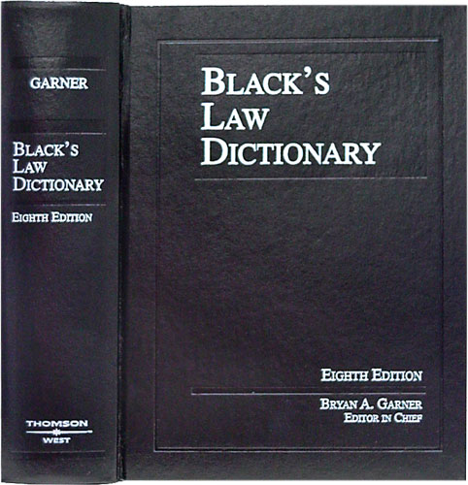
Contractual Breach and Remedies
Definition - Contract
Black’s Law Dictionary defines the term “Contract” as:
“An agreement between
two or more parties
creating obligations
that are enforceable
or otherwise recognizable
at law.”
Notes:
5

Slide 6
Contractual Breach and Remedies
Definition - Elements of a Contract
In Accordance with Common Law, the Elements of a Contract include:
Agreement,
Between Competent Parties,
Based on Genuine Assent,
Supported by Consideration,
for Lawful Purpose Subject Matter,
in Legal Form.
Notes:
6

Slide 7
Part Two
Contractual Breach and Remedies
Remedies – Definitions

Slide 8
Contractual Breach and Remedies
Remedies – Definitions
Remedies:
Defined: Blacks Law Dictionary defines a Remedy as:
“The means of enforcing a right or preventing or redressing a wrong, by means of providing legal or equitable relief.”
What Remedies are Available for a Breach of Contract: There are two principle remedies for a breach of contract. They are as follows:
Damages: The principle remedy for a breach of contract is monetary damages. These monetary damages are generally categorized into three separate areas.
Expectation Damages: These damages attempt to put the plaintiff in the position they would have been had the defendant performed, awarding the injured party their out-of-pocket costs incurred, together with whatever profit they would have made had the contract been completed;
Reliance Damages: These damages attempt to put the plaintiff in as good a position as they were in prior to the making of the contract, by allowing them to recover their out-of-pocket expenditures incurred in performing the contract; and
Restitution: These damages attempt to prevent the unjust enrichment of the defendant by returning to a plaintiff who has partially performed the value of the performance they have rendered to the defendant.
Equitable relief: Another possible remedy that a party who has been injured by a breach of contract may pursue is equitable relief. Equitable relief is awarded when a plaintiff can demonstrate that money damages would not prove an adequate remedy. This relief is generally categorized into two separate areas:
Rescission: This remedy is an order to effectively cancel the contract, so as to place the parties in the position as if the contract had never occurred.
Specific Performance: This remedy is an order to of the breaching party to actually render the promised performance of the contract;
Injunction: This remedy is an order to direct the breaching party to refrain from doing something relating to the contract provisions; or
Reformation: This remedy is where the court will actually re-write the contract or a provision that is inequitable.
Notes:
8

Slide 9
Part Three
Contractual Breach and Remedies
Remedies – Road Map

Slide 10
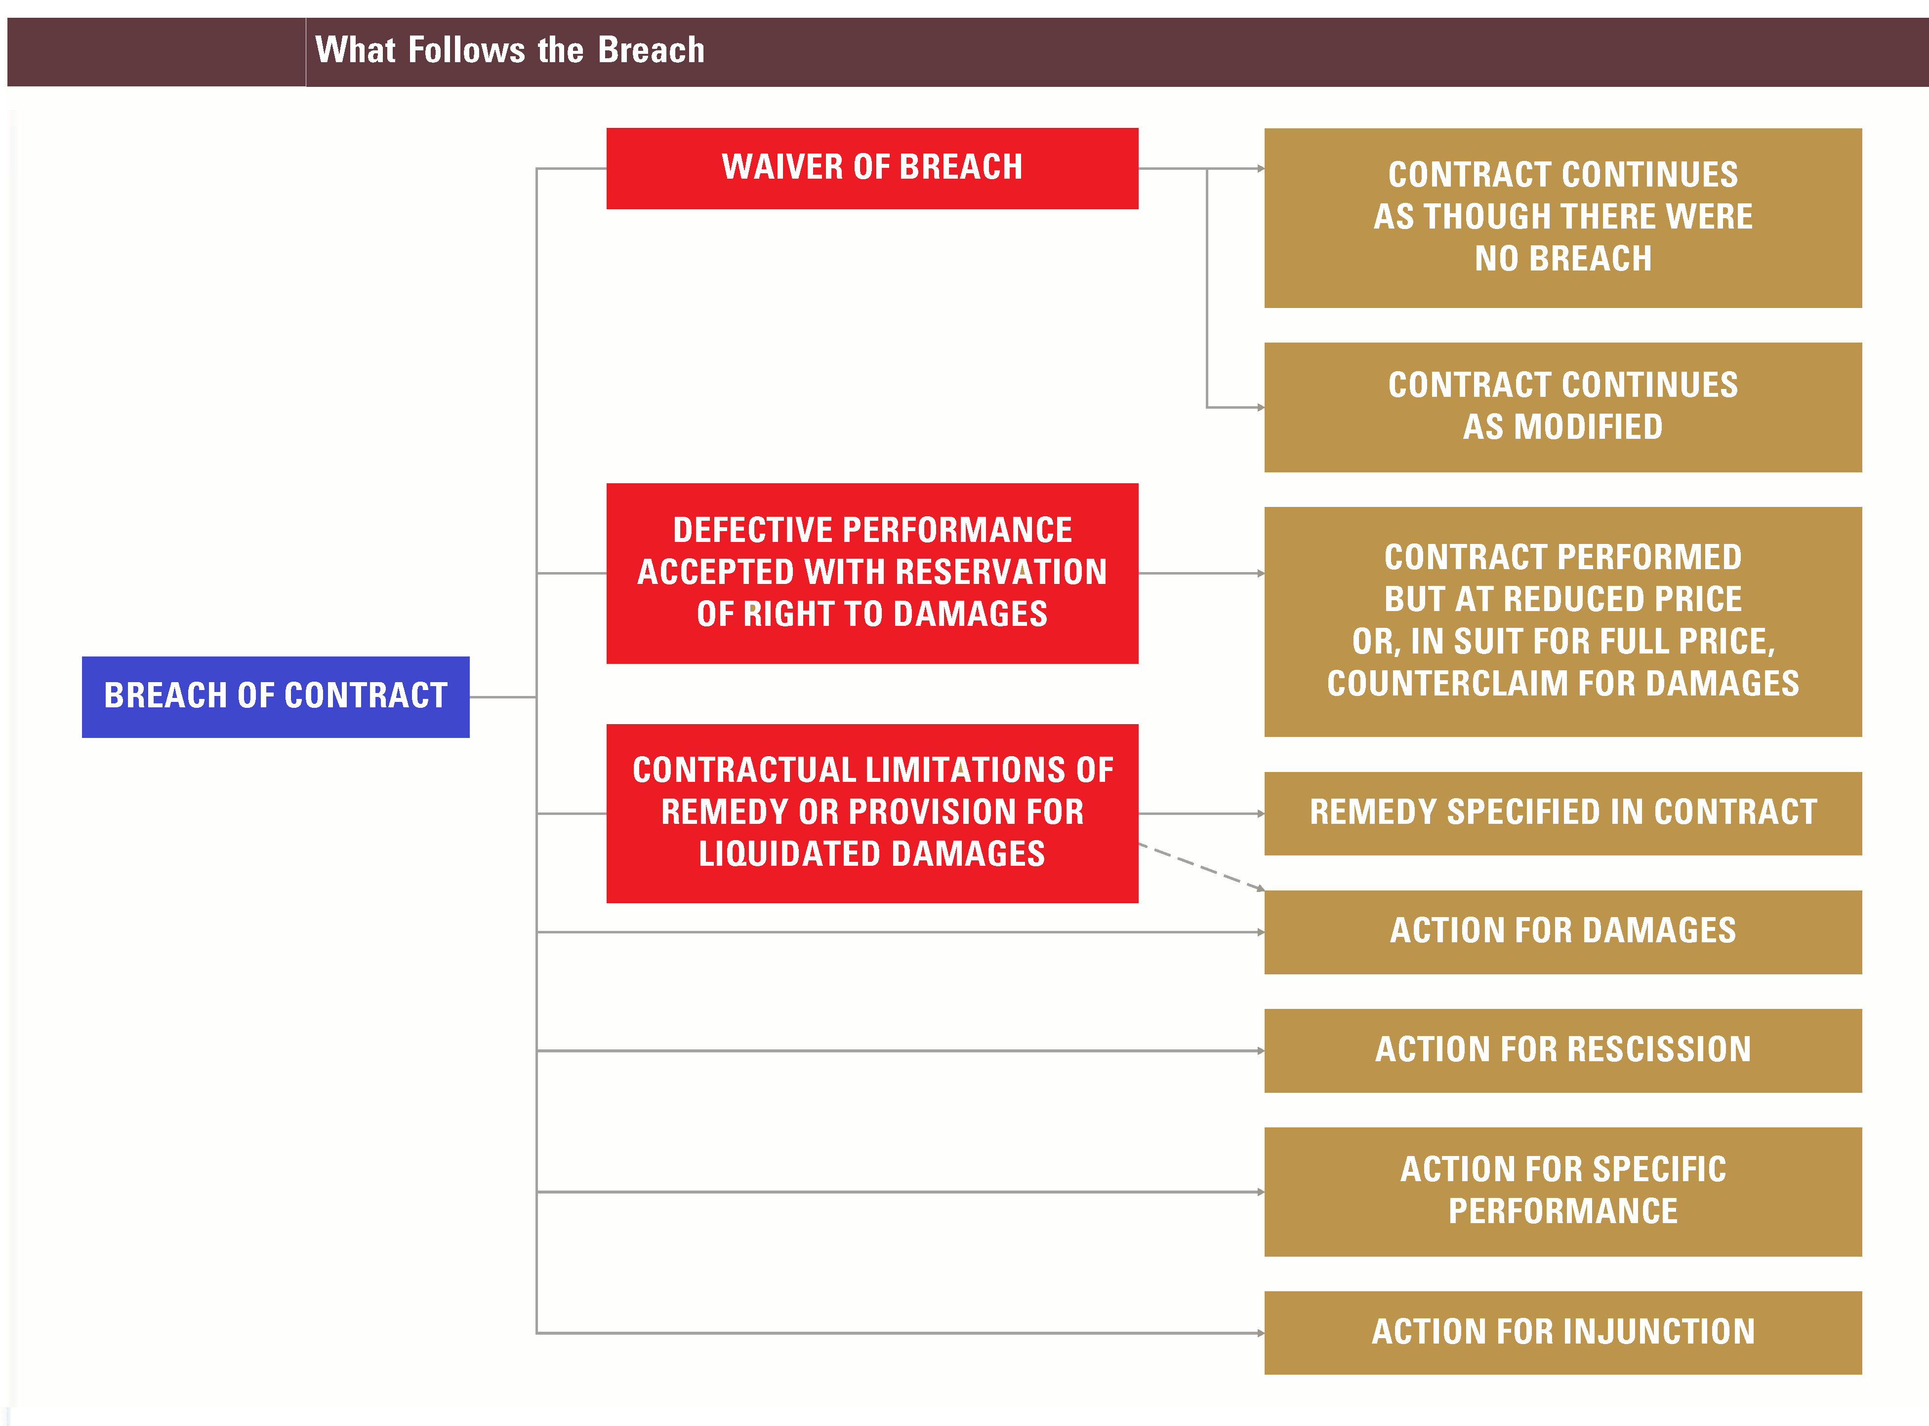
Contractual Breach and Remedies
Remedies – Road Map
Notes:
10

Slide 11
Part Four
Contractual Breach and Remedies
Limitation on Remedies – Liquidated Damages

Slide 12
Contractual Breach and Remedies
Limitation on Remedies – Liquidated Damages
Limitation on Remedies:
Generally: The contract itself may contain provisions that affect the remedies available to the parties or their recovery of damages.
Liquidated Damages: The parties may stipulate in their contract that a certain amount should be paid in case of a breach. This amount is known as liquidated damages and may be variously measured by the parties. When delay is possible, liquidated damages may be a fixed sum, such as $1,000 for each day of delay. When there is a total default, damages may be a percentage of the contract price or the amount of the down payment.
Validity: The validity of a liquidated damages clause is determined on the basis of the facts existing when the clause was agreed to. To be valid, a liquidated damages clause must satisfy two requirements:
The situation must be one in which it is difficult or impossible to determine the actual damages; and
The amount specified must not be excessive when compared with the probable damages that would be sustained.
Effect: When a liquidated damages clause is held valid, the injured party cannot collect more than the amount specified by the liquidated damages clause. The defaulting party is bound to pay such damages once the fact is established that there has been a default. The injured party is not required to make any proof as to damages sustained, and the defendant is not permitted to show that the damages were not as great as the liquidated sum.
Invalid Clauses: If the liquidated damages clause calls for the payment of a sum that is clearly unreasonably large and unrelated to the possible actual damages that might be sustained, the clause will be held to be void as a penalty. When a liquidated damages clause is held invalid, the effect is merely to erase the clause from the contract, and the injured party may proceed to recover damages for breach of the contract. Instead of recovering the liquidated damages amount, the injured party will recover whatever actual damages he can prove.
Notes:
12

Slide 13
Part Five
Contractual Breach and Remedies
Limitation on Remedies – Attorneys Fees

Slide 14
Contractual Breach and Remedies
Limitation on Remedies – Attorneys Fees
Limitation on Remedies:
Generally: In the United States, Attorney’s Fees are only recoverable from a defendant when expressly allowed in a contract or where specified by statute.
Attorney’s Fees: The American rule provide that each party is responsible to pay for their own attorneys’ fees in the absence of an express contractual or statutory provision to the contrary. Even in the event of a valid contractual provision for attorneys’ fees, a trial court has the discretion to exercise its equitable control to allow only such sum as is reasonable, or the court may properly disallow attorneys’ fees altogether on the basis that such recovery would be inequitable.
Contractual Exception: The parties may, by contractual provision, specify that the losing party shall be responsible to pay for the reasonable attorney’s fees of the prevailing party.
Statutory Exception: Certain statutes also provide that the prevailing party may make an application to the court to have the losing party pay for the reasonable attorney’s fees of the prevailing party. Federal and state civil rights statutes and many federal and state consumer protection statutes are examples of this exception.
Reasoning: The rationale for the American rule is that people should not be discouraged from seeking redress for perceived wrongs in court or from trying to extend coverage of the law. The rationale continues that society would suffer if a person was unwilling to pursue a meritorious claim merely because that person would have to pay the defendant's expenses if they lost.
Court Costs and Fees: Although Attorney’s Fees are not generally awarded without a contractual or statutory exception, court costs and fees (which are generally vastly less than attorney’s fees) are generally awarded to the prevailing party. These include items such as court filing and motion fees.
Notes:
14

Slide 15
Part Six
Contractual Breach and Remedies
Limitation on Remedies – Liability Limitation Clauses

Slide 16
Contractual Breach and Remedies
Limitation on Remedies – Liability Limitation Clauses
Limitation on Remedies:
Generally: A contract may contain a provision stating that one of the parties shall not be liable for damages in case of breach. Such a provision (sometimes called an exculpatory clause) applies when a breach of contract occurs, and is most often referred to as a limitation-of-liability clause.
Limitation of Liability Clause: While contracts that exculpate persons from liability are generally not favored by the courts, because they encourage lack of care, and are therefore strictly construed against the person or entity seeking to escape liability, nevertheless when the language of the contract and the intent of the parties are clearly exculpatory, the contract will be upheld. This principle arises out of the broad policy of the law, which accords to contracting parties’ freedom to bind themselves, as they themselves best see fit.
Releases: Release forms signed by participants in athletic and sporting events declaring that the sponsor, proprietor, or operator of the event shall not be liable for injuries sustained by participants because of its negligence are generally binding.
Notes:
16

Slide 17
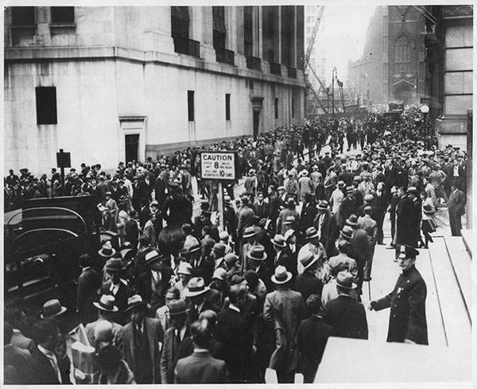
An Adventure into Case Law
The Case of Newburger v. Lubell
The Necessity to Perform the Contract
To Avoid a Breach

Slide 18
Class 0CB - Thank you for Coming
For next time – Review Assignments as follows on the Webpage:
  Lecture Slides
  Selected Readings
  Cases and Exercises
We are a hot bench.
Questions?

