Slide 1


Slide Set Ten A:
The Criminal Law – Structure / Purpose

Slide 2

Last Time We Spoke About:
Contractual Breach and Remedies
Breach and Fulfillment of Contracts
Part One: Definitions/Anticipatory Breach / Waiver and Cure of Breach
Remedies
Part Two: Definitions /Monetary Damages /Non Monetary Damages/Consequential Damages
Contractual Provisions on Remedies
Part Three: Limitation on Remedies / Liability / Liquidated Damages / Attorneys Fees
Class Case – Newburger v. Lubell
Necessity to Perform Contract to Avoid Breach

Slide 3
Tonight We Will Speak About:
The Criminal Law
Structure and Purpose of Criminal Law
Part One: Definitions / Substantive - Procedural / Purpose / Crimes / Torts
Theories of Criminal Punishment
Part Two: Punishment Theories / Sentencing / Classification
Common Law Felonies
Part Three: Common Law Felonies / Current Day Criminal Statutes
Class Case – Regina v. Dudley and Stephens
Necessity and Mens Rea

Slide 4
The Criminal Law
Generally
Definitions

Slide 5
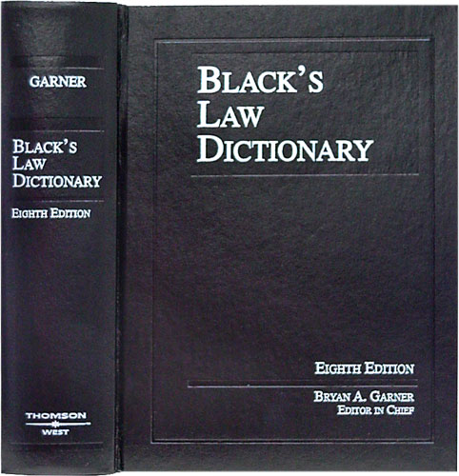
The Criminal Law
Generally - Definitions
The Criminal Law:
Defined: The body of law defining offenses
against the community at large, regulating
how suspects are investigated, charged and
tried, and establishing punishments for
convicted offenders.
The Criminal Justice System:
Defined: The collective institutions through
which an accused offender passes until the
accusations have been disposed of or the
assessed punishment concluded.

Slide 6
Criminal Law – What It Does
Criminal Law, is the branch of law that defines crimes, establishes punishments, and regulates the investigation and prosecution of people accused of committing crimes.
Criminal law includes both substantive law, and criminal procedure.
Substantive Law is the actual crime and its definition under the penal law, whereas criminal procedure is the process and rules by which the crime is prosecuted and justice is administered.
The Criminal Law
Generally - Definitions

Slide 7
The Criminal Law
Substantive Law and Procedure

Slide 8
The Criminal Law
Substantive Law and Procedure
Substantive Criminal Law:
Substantive criminal law defines crimes, the conduct that constitutes them, and the punishment that is proscribed for such conduct.
Substantive criminal law defines crime and punishment.
For example, what act constitutes murder or what punishment a murderer should receive.
In New York State, substantive criminal law is contained within the New York State Penal Law.
Criminal Procedure:
Criminal Procedure establishes the procedures for the implementation and enforcement of substantive criminal law.
Criminal procedure is concerned with the legal rules to be followed, and the steps taken, to investigate, apprehend, charge, prosecute, convict, and sentence to punishment individuals who violate substantive criminal law.
For example, criminal procedure describes how a murder trial must be conducted.
In New York State, procedural criminal law is contained within the New York Criminal Procedure Law.

Slide 9
The Criminal Law
Substantive Law and Procedure
The Criminal Law Is A Product of Common Law:
Criminal law should be seen in the context of the common law system, which is found in countries such as England, Canada, and the United States.
Common Law: In the common law system, judges decide cases by referring to principles set forth in previous judicial decisions under the doctrine of stare decisis.
Contrasted with Codified Law: Common law systems are typically contrasted with Code based systems, which are found in most Western European countries, much of Latin America, Africa, and parts of Asia.
In these code based countries, law is derived from written Roman laws, where judges decide cases by referring to written statutes, promulgated by kings or enacted by legislatures or councils, and compiled in comprehensive code books.
Civil Law: In legal systems based on common law, the criminal law is distinguished from what is known as civil law.
American Criminal Law Statutes Are Codifications of Common Law: In America, our criminal statutes are codified holdings of common law. Most of the crimes contained under state and federal law, were recognized long ago, as criminal conduct through case decision. So too are defenses and punishments.
The Criminal Law and Property Law: The criminal law, like property law, is a fundamental legal area with common justifications and antecedents.
The inherent nature of property rights, and its value to our society, has driven much of the criminal law.

Slide 10
The Criminal Law
Purpose of the Criminal Law

Slide 11
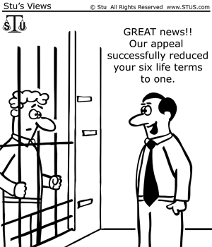
The Criminal Law
Generally - Definitions
Purpose of Criminal Law
The Criminal law seeks to protect the public from harm by:
1. Inflicting punishment on those who have already done harm and
2. Threatening with punishment those who are tempted to do harm.
The harm that criminal law aims to prevent varies. Such includes:
● Physical harm, death, or bodily injury to human beings;
● The loss of or damage to property;
● Immorality;
● Danger to the government or its institutions;
● Disturbance of the public peace and order; or
● Injury to the public health.
Conduct that threatens to cause, but has not yet caused, a harmful result, may also be enough to constitute a crime.
Thus, criminal law often strives to avoid harm by forbidding conduct that may lead to harmful results.

Slide 12
The Criminal Law
Crimes and Torts

Slide 13
The Criminal Law
Crimes and Torts
Criminal Law and Civil Law (Torts):
Both the criminal law and civil law in the common law system seek to respond to harmful acts committed by individuals.
Different Responses: Each type of law, however, provides different responses.
Civil Lawsuits: A person who is injured by the action of another may bring a civil lawsuit against the person who caused the harm.
If the victim prevails, the civil law generally provides that the person who caused the injury must pay money damages to compensate for the harm suffered.
Criminal Prosecutions: Under the criminal law, a person who acts in a way that is considered harmful to society in general may be prosecuted by the government in a criminal case.
If the individual is convicted (found guilty) of the crime, he or she will be punished under criminal law by either a fine, imprisonment, or death.
Many Crimes Are Also Torts: In many cases, a person’s wrongful and harmful act can invoke both criminal and civil law responses.
As a result, most crimes also contain a civil remedy, known as a tort.

Slide 14
End of Class Ten A
For next time – Review Assignments as follows on the Webpage:
  Lecture Slides
  Selected Readings
  Cases and Exercises
We are a hot bench.
Questions?

