Slide 1


Slide Set Thirteen A:
Payment Systems – Parties

Slide 2
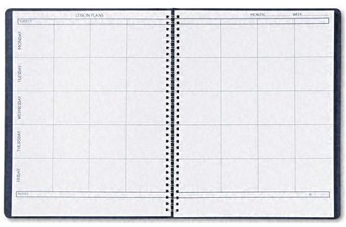
Last Time We Spoke About:
Payment Systems – Introduction
Negotiable Instruments – Types/Parties
Part One: Definitions / Types of Negotiable Instruments / Parties
Negotiability
Part Two: Definitions / Requirements of Negotiability / Factors
Language / Statute of Limitations Issues
Transfer/Problems/Warrantees
Part Three: Definitions / Effect of Transfer / Process of Negotiation
Forgery / Unauthorized Documents / Imposters / Lost Instruments Warrantees / Other Parties
Case Study: Manhattan Savings v. NY Natl Exchange
The Elements of Commercial Paper

Slide 3
Tonight We Will Speak About:
Payment Systems – Section Two:
Parties to Negotiable Instruments
Part One: Definitions / Holders / Holders in Due Course/ Assignees / Rights of Parties
Defenses to Payment
Part Two: Definitions / Defenses / Liability Issues
Checks and Fund Transfers
Part Three: Definitions / Checks / Fund Transfers
Case Study: Sabine v. Paine
The Value of Holders in Due Course

Slide 4
Negotiable Instruments
Parties to Negotiable Instruments
Definitions

Slide 5
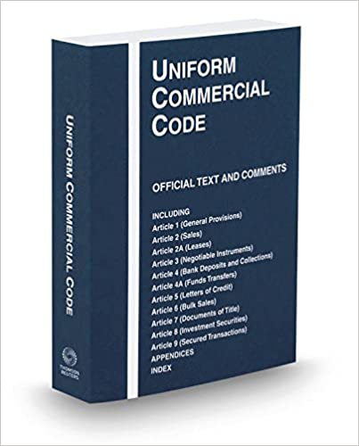
Negotiable Instruments
Parties to Negotiable Instruments
Definitions:
Defined: Article 3 of the UCC determines whether an instrument is
Negotiable. If an instrument is negotiable, it is governed by Article 3 of the
UCC, and it may be transferred by negotiation among parties.
UCC Section 3-103: This section of law defines "Negotiation" to mean “a
transfer of possession, whether voluntary or involuntary, of an instrument,
by a person, other than the issuer, to a person who thereby becomes its holder.”
Definitions:
Assignee: An Assignee of a negotiable instrument is a third party to whom contract benefits are transferred.
Holder: A Holder of a negotiable instrument is someone in possession of a negotiable instrument that runs to that person (i.e., the instrument is made payable to that person, is indorsed to that person, or is bearer paper).
Holder in Due Course: A Holder in Due Course is a holder who has:
given value for the instrument;
taken the instrument in good faith;
Has no knowledge that the instrument will be dishonored, or that it is overdue; and
Has no knowledge of any defenses to the instrument.
A holder in due course is accordingly afforded special rights and status.

Slide 6
Negotiable Instruments
Parties to Negotiable Instruments
Rights of Parties

Slide 7
Negotiable Instruments
Parties to Negotiable Instruments
Rights of Parties:
Ordinary Holders and Assignees:
Ordinary Holder of Commercial Paper: A holder is a party in possession of an instrument that runs to him. An instrument “runs” to a party if it is payable to his order, is bearer paper, or is indorsed to him.
Rights of the Ordinary Holder: Any holder has all the rights given through and under the negotiable instrument.
Right of Payment: The holder may demand payment or bring suit for collection on the instrument. A holder who seeks payment of the instrument is required only to produce the instrument and show that the signature of the maker, drawer, or indorser is genuine. If the party obligated to pay under the instrument has no valid defense (such as forgery) the holder is entitled to payment of the instrument.
Rights of Discharge, Release and Recovery: A holder can give a discharge or release from liability on the instrument. The holder can recover from any of the parties who are liable on the instrument, regardless of the order of the signatures on the instrument. A holder could recover from the first indorser on an instrument or from the last party to indorse the instrument.
Assignees: An Assignee of a negotiable instrument is a third party to whom contract benefits are transferred.
Rights of the Assignee: Any assignee has all of the rights given through and under the negotiable instrument. The rights of an assignee are no different from the rights of an ordinary holder. Accordingly, the assignee of is in the same position and has the same rights as an ordinary holder.
Example: If a carpenter who signed a note to pay for his tool has a warranty problem with the tools, he has a defense to payment on the note. Anyone who is assigned that note, as an assignee or holder, is also subject to the carpenter’s defense.

Slide 8
Negotiable Instruments
Parties to Negotiable Instruments
Rights of Parties:
Holders in Due Course:
Holders in Due Course of Commercial Paper: A Holder in Due Course is a holder who has:
given value for the instrument;
taken the instrument in good faith;
Has no knowledge that the instrument will be dishonored, or is overdue; and
Has no knowledge of any defenses or adverse claims to the instrument.
A holder in due course is afforded special rights and status.
Rights of the Holder in Due Course: Any holder in due course has all the rights given through and under the negotiable instrument. Additionally, the law gives these holders in due course of negotiable instruments special rights by protecting them from certain defenses. This protection makes negotiable instruments more attractive and allows greater ease of transfer.
Special Rights: To obtain the preferred status of a holder in due course, a person must first be a holder. The preferred status of Holder in Due Course also requires the additional standards set forth above. Unlike ordinary holders or assignees, holders in due course take free of contract assignment defenses, that are good against ordinary holders or assignees.

Slide 9
Negotiable Instruments
Parties to Negotiable Instruments
Rights of Parties:
Holders in Due Course:
Elements Required for a Holder in Due Course of Commercial Paper: Pursuant to UCC 3-302, there are four required elements to qualify as a Holder in Due Course. These include:
Must Give Value for the Instrument: The required element of Value is similar to consideration. As a result, a person who receives a negotiable note as a gift, does not give value, because gifts are not supported by consideration or value.
Value Defined: Value is defined as consideration, or antecedent debt, or security, given in exchange for the transfer of a negotiable instrument.
When Does the Holder Give Value: A holder takes an instrument for value when:
They have has promised to do something in exchange for receiving the negotiable instrument;
They take the instrument as security for a loan (such as when a debtor transfers a promissory note payable to the debtor to the holder); or
They receive the instrument as payment for a debt already due.
Amount of Value is Immaterial: As with consideration, the courts do not consider whether the value is enough, but merely must determine only whether some value has been given.
Bank Deposits: Under Article 3, the original payee of a note is not a Holder in Due Course unless that note is transferred to others and then back to the payee. As a result, a bank does not give value for a deposited check when it credits the depositor’s account with the amount of the deposit, but rather only gives value to the extent that the depositor is permitted to withdraw funds against that deposit.
Example: If Ted deposits a $300 check into his account, which already has $400 in it, Ted’s bank does not give value until Ted has written checks or withdrawn funds beyond the existing $400. The UCC follows FIFO (first in, first out) for drawing on funds. A bank that lets the customer draw on the funds immediately deposited gives value.

Slide 10
Negotiable Instruments
Parties to Negotiable Instruments
Rights of Parties:
Holders in Due Course:
Elements Required for a Holder in Due Course of Commercial Paper: Pursuant to UCC 3-302, there are four required elements to qualify as a Holder in Due Course. These include:
Must Take the Instrument in Good Faith: The required element of Good Faith for becoming a Holder in Due Course requires that a holder of a negotiable instrument act honestly in acquiring the instrument. In addition, the such holder must also follow reasonable standards of fair dealing.
Good Faith Defined: Good faith is defined as the absence of knowledge of any defects in, or problems with respect to, the negotiable instrument. It has been described as a “pure heart and an empty head.”
Bad Faith: Bad Faith, conversely, has is defined as dishonesty of belief or purpose. Bad faith can also be found to exist just when the holder takes the instrument under odd or questionable circumstances, such as when a holder buys a note made payable to an estate from an accountant in a bar at midnight. These questionable circumstances alone can prevent the creation of a Holder in Due Course status.
Close-Connection Doctrine: This doctrine arises when circumstantial evidence, such as an ongoing or a close relationship, offers notice of a problem with an instrument. The close-connection doctrine applies in circumstances that indicate a problem with the instrument.
Under the close-connection doctrine, the holder has taken so many instruments from its transferor or is so closely connected with the transferor that any knowledge the transferor has is deemed transferred to the holder, preventing holder-in-due-course status.
Examples include consumer transactions where the holder is a company that regularly does business with a company that has continual problems with consumer complaints.

Slide 11
Negotiable Instruments
Parties to Negotiable Instruments
Rights of Parties:
Holders in Due Course:
Elements Required for a Holder in Due Course of Commercial Paper: Pursuant to UCC 3-302, there are four required elements to qualify as a Holder in Due Course. These include:
Must Take the Instrument without Knowledge that it will be Dishonored, or is Overdue: The required element of Lack of Knowledge of Dishonorment for becoming a Holder in Due Course requires that a holder of a negotiable instrument must not be aware that the instrument will not be dishonered, or is overdue, for payment.
Dishonored Paper is Still Negotiable: An instrument can still be negotiated even though it has been dishonored, is overdue, or is demand paper, such as a check, that has been outstanding for more than a reasonable time. These instruments can still be transferred and the transferee is still a holder.
Dishonored Paper Will Negate Holder in Due Course Status: The fact that the instrument is circulating at a late date or after it has been dishonored is suspicious, and results in notice from the circumstances that there may be some adverse claim or defense. A person who acquires title to the instrument under such circumstances can be a holder but cannot be a holder in due course.
Example: Buying a discounted note after its due date is notice that something may be wrong with the instrument.

Slide 12
Negotiable Instruments
Parties to Negotiable Instruments
Rights of Parties:
Holders in Due Course:
Elements Required for a Holder in Due Course of Commercial Paper: Pursuant to UCC 3-302, there are four required elements to qualify as a Holder in Due Course. These include:
Must Take the Instrument without Knowledge of Defenses or Adverse Claims: The required element of Lack of Knowledge of Defenses or Adverse Claims for becoming a Holder in Due Course requires that a holder of a negotiable instrument must not be aware that the instrument is subject to any defenses or adverse claims that would prevent its payment.
Defenses and Adverse Claims: Prior parties on a negotiable instrument may have defenses that entitle them to withhold payment from a holder of an instrument.
Such a defense could include when the drawer of a check, upon demand for payment by the payee, asserts the defense to payment that the merchandise the payee delivered under the terms of their underlying contract was defective.
A person who acquires an instrument with notice or knowledge that there is such a defense, or that there are claims of ownership of the instrument from different parties, cannot be a Holder in Due Course.
Knowledge: In general, transferees who are aware of facts that would make a reasonable person ask questions are deemed to know what they would have learned if they had asked questions. Such knowledge and the failure to ask questions will cost them their special status of holder in due course, and they will simply remain holders.
When Knowledge is Acquired Matters: Knowledge acquired by a holder after the instrument was acquired does not prevent the holder from being a holder in due course. The fact that a holder, after acquiring the instrument, learns of a defense, also does not work retroactively to destroy the holder’s character as a Holder in Due Course.
C

Slide 13
End of Class Thirteen A
For next time – Review Assignments as follows on the Webpage:
  Lecture Slides
  Selected Readings
  Cases and Exercises
We are a hot bench.
Questions?

