Slide 1


Slide Set 02A:
Introduction to the Law
What is the Law

Slide 2

Last Time – We Spoke About:
Website: www.bobfarley.us
Your Biography: If you haven’t already, please hand it in.
Class Schedule:
http:/www.bobfarley.us/300lawclasses/375propertylaw/schedule.pdf
Class Syllabus:
http:/www.bobfarley.us/300lawclasses/375propertylaw/syllabus.pdf
Class Format and Grading Information:
http:/www.bobfarley.us/300lawclasses/375propertylaw/format.pdf
Contact Us:
Email – bobfarley@bobfarley.us
Phone/Text – (518) 986-2037
In Person – By Appointment

Slide 3
Tonight – We Will Speak About:
What is the Law?
Part One: Definitions / Types of Law / Priority of Laws
What is a Right:
Part Two: Definitions / Natural Law / The Declaration
Constitutions:
Part Three: Federal and State / Govt Structure / Rights / Creation
Case Study – Marbury v. Madison:
The Start of Judicial Review

Slide 4
Part One:
What is the Law?

Slide 5
Studying the Law of Property
as an Adventure in the Law
To start this Adventure we need to know:
What is the “Law”?
We need to find out, we need to discover this answer.
And just how do we do that?
Well, we need to learn that good law students,
like good adventures and explorers,
develop a well earned love for books.
For Books are the treasure trove of answers.

Slide 6
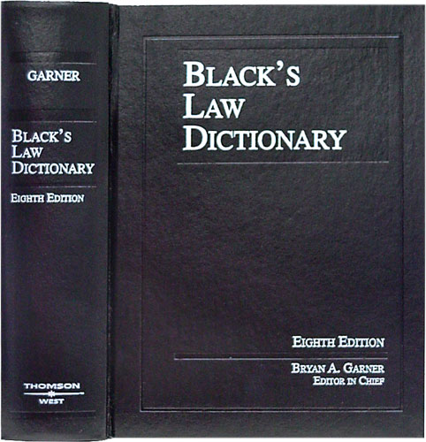
Adventures in Law – Just What is the Law ?
So Let’s Start with Black’s
Black’s Law Dictionary
is the Gold Standard
of Legal Definitions.
If we need to know a term
in the law, a legal definition,
we should start with Black’s.

Slide 7
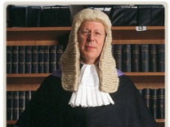
And so,
What is the “Law”?
The “Law” has been defined by Black’s Law Dictionary as follows:
  “That which is laid down, ordained, or established.
  A rule or method according to which a phenomena or actions co-exist or follow each other.
  Law, in its generic sense, is a body of rules of action or conduct proscribed by controlling authority, and having binding legal force. …
  Law is a solemn expression of the will of the supreme power of the state.”
Perhaps the simplest description of the Law, however, is that:
“Law is the Rules by which civilization is ordered.”

Slide 8
The Chief Elements / Components of the Law are:
Early laws were simply directives from a king or sovereign.
Modern Laws are Enacted by a Legislature
(In America that is Congress for the Federal Government
and State Legislatures for State Governments)
1. Rules
2. Pronounced, laid down and/or issued by a controlling authority;
3. That are consistent and lasting; and
4. That are enforceable and followed by the governed.

Slide 9
Components / Priority of Laws:
1. Constitutions: Established by Convention of Elected Delegates
to provide governmental framework and protections of individual rights,
they are supreme to all other laws as interpreted by the Courts
2. Statutes: Laws passed (enacted) by an elected legislative bodies
(Congress or State Legislature) and signed into law by the Executive
(President or Governor).
3. Regulation: Promulgated by government (Executive) agencies
to amplify or clarify their authority as provided in statute or constitution.
4. Executive Order: Issued by Executive (President or Governor)
as an instruction to their agencies on how to execute a procedure or law.
Case Law or Common Law -
Decisions issued by courts which provide legal rules by:
1. Interpretation of a Constitution, Statute, Regulation or Executive Order, or
2. Clarifying or creating law pursuant to past court decisions.

Slide 10
What are these Component/Elements?
Constitutions:
“The fundamental and organic law of a nation or state, that establishes the institutions and apparatus of government, defines he scope of governmental sovereign powers, and enumerates individual civil rights and liberties.”
Concrete: Constitutions are designed to be semi permanent, long lasting and difficult to amend. Most all are written and ratified.
Establishes Governmental Structure: Constitutions outline the structure and mechanisms of government and how it will operate.
Enumerates Rights: Constitutions also enumerate the individual civil rights that will be protected by the government.
Federal System: Under our Federal System, both states and the national government each have Constitutions.

Slide 11
What are these Component/Elements?
Statutes:
“A written law enacted by a legislative body, which declares, proscribes or commands a rule to be followed by the governed.”
Written Laws: Statutes are written laws, that set forth general propositions that courts can then apply to specific situations. A statute may forbid or direct a certain act, make a declaration, or set forth governmental policy.
Only Subordinate to Constitutions: Statutes are a product of the legislative branch. Aside from constitutions, statutes are the next highest laws to consult in determining the law which applies to a case.

Slide 12
What are these Component/Elements?
Regulations:
“A written rule or determination, promulgated by an administrative agency, that amplifies or clarifies a statute.”
Limited in Scope, Written Laws: Regulations are written rules or determinations, made by executive, administrative agencies, that only amplify or clarify the meaning or unspecified area of a statute.
Subordinate to both Constitutions and Statutes: As regulations are not made by elected legislatures, but instead are the product of the unelected, appointed executive employees, they are held to be limited and constrained to be within only the purview of their enabling statute. Aside from Executive Orders, Regulations are the lowest level of law to consult in determining what the law is.

Slide 13
What are these Component/Elements?
Executive Orders:
“A declaration from the head of the Executive Branch, directing his or her employees, how to handle a specific case or situation.”
Issue Determinative: Executive Orders are directions from the executive, to his or her employees, on how to handle or act with regard to specific case. They are limited in scope and must be in compliance with not only the constitution and statutes, but regulations as well.
Subordinate to Constitutions, Statutes and Regulations: As Executive Orders are not made by elected legislatures, but instead are merely the product of executive fiat, they are held to be extremely limited and constrained. Executive Orders are the lowest level of law to consult in determining what the law is.

Slide 14
What are these Component/Elements?
Case or “Common” Law:
“Case or ‘common’ law is where a court, of competent jurisdiction, issues a decision, ruling or determination, which specifies what the law is, with respect to the specific fact pattern, and issues of law, involving the case in controversy.”
Flexible: Case or ‘common’ law is designed to be case specific. By interpretation of statutes, and constitutional principles, and using precedent, in accordance with local custom and practice, its seeks to achieve just results, to resolve disputes between parties.
Unique and Limited: Case or ‘common’ law follows past decisions, as well as statutory and constitutional directives, through the limited scope of the case. It is not new law, it is law applied to the facts.

Slide 15
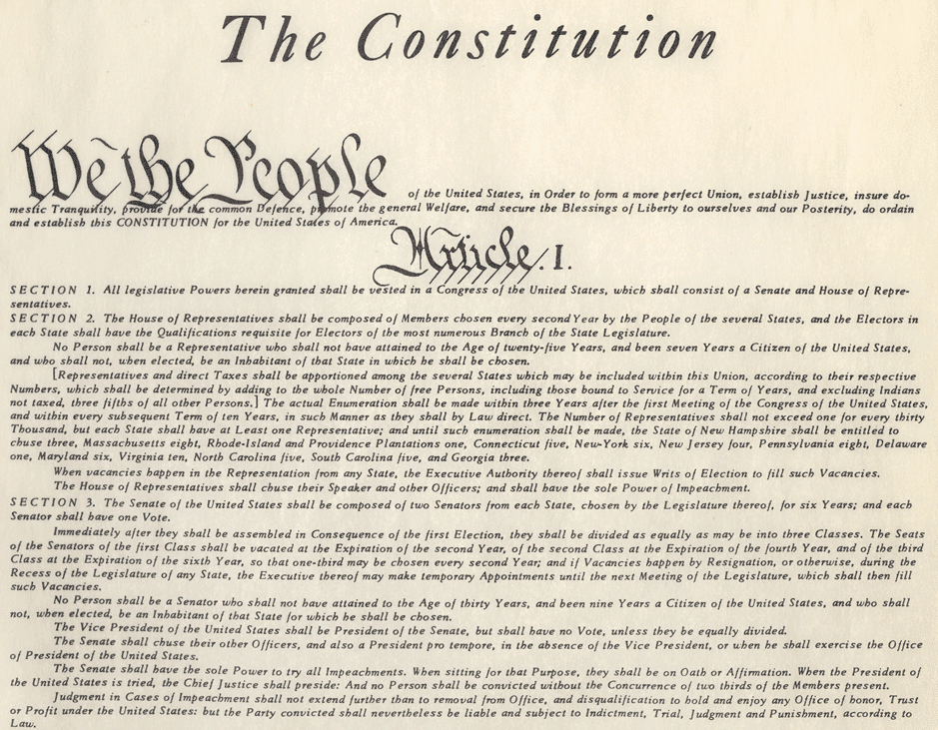

Laws as Rules:
So when we say that:
Laws are the rules by which civilization is ordered
What do we base their authority on?
Where does that the authority for that Rule Book come from?
It comes from America’s Ultimate Rule Book – Our Constitution

Slide 16

Our Founders set up our Nation
The United States of America
as a Representative, federal, Republic.
Pursuant to our United States Constitution,
our laws come from our government
and the sovereignty or power for our
government rests in the people.
This system is set up by our
United States Constitution
and it establishes the Rule Book
for our Government and its Laws.

Slide 17
The United States of America
A Representative, federal, Republic.
Articles IV and VI of the United States Constitution
expressly provide:
The United States shall guarantee to every State in this Union a Republican Form of Government … and
This Constitution, and the Laws of the United States, which shall be made in Pursuance thereof; and all Treaties made, or which shall be made, under the Authority of the United States, shall be the supreme Law of the Land; and the Judges in every State shall be bound thereby, any Thing in the Constitution or Laws of any state to the Contrary notwithstanding.

Slide 18
The History of Anglo American Law

Slide 19
What is the “Law”?
Remember our simple definition:
“Law is the Rules
by which civilization
is ordered.”

Slide 20
Part One : The History of Anglo American Law
So where do we begin our history?
Simple, at the beginning.
But before we start, like any great adventure,
we need a roadmap,
to tell us where we are going.

Slide 21
Roadmap to Legal History

Slide 22
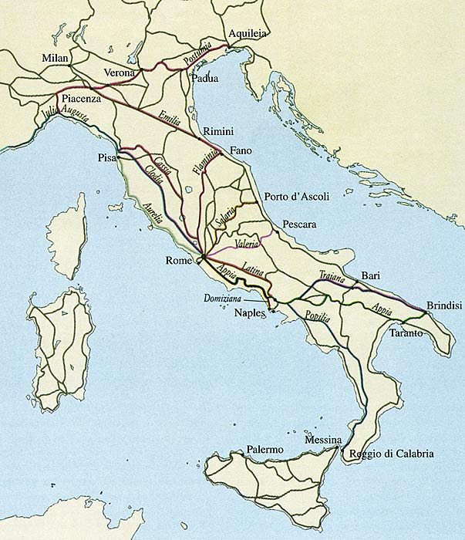
So Where Do We Start?
Where do we begin our adventure?
Where did the Law first begin, first start, first evolve?
Like the saying states: All Roads Lead to Rome

Slide 23
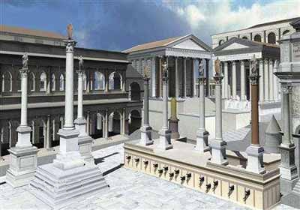
Rome
The concept of a body of law
(Rules by which civilization is ordered) first emerged in Rome.
For Rome was the first real society to embrace the idea of continuity.
They were the first civilization to openly recognize that the culture of Rome Itself was greater and more eternal than any one king or emperor.
Law became an extension of this view.
Roman Citizens were very well versed in the law.
They took it seriously and believed in its value and purpose.
Like so many other Roman institutions it was developed as a tool.
A tool to order their civilization and conquests.

Slide 24
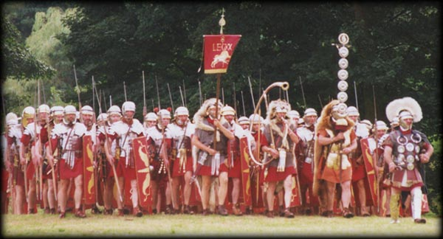
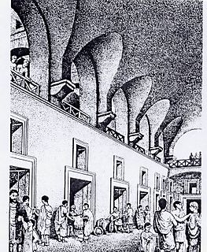
Rome Continued:
Rome was an empire
based upon trade and its military.
The law helped both these institutions
promote civilization
across the then known world by:
instilling both consumer and
merchant confidence , and
providing a consistent template
for the governance and operation
of conquered lands and peoples.
The Law of Rome,
often referred to as the Code due to its written history,
helped to make the Roman Empire the Greatest of its Time.

Slide 25
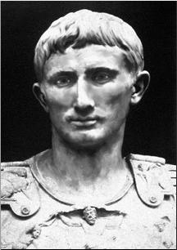
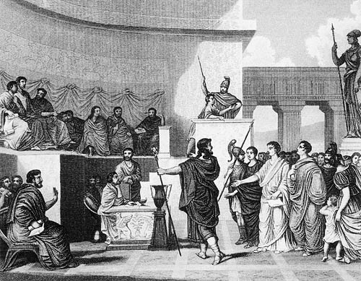
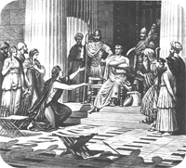
Just what were these Roman Legal Institutions?
(The First Three Branch Government)
Executive – The Emperor
2. Legislative – The Senate
3. Judicial – The Courts

Slide 26
Rome Continued
Rome developed a quasi legislative body
known as the Senate (Started as representatives of the 100 most prominent families to advise the Emperor)
They also established a system of Courts to arbitrate disputes. (Judges appointed by the Emperor)
The Roman concept of the Law, put down in Code, was still largely the edicts of the Emperor.
As such, any precedent was solely based upon the emperor’s respect for his predecessors.

Slide 27
Rome Continued
Through its law and the concept of continuity and respect for the legal principles established in the Empire, Rome became the center of civilization, wealth and Trade for the entire known world.
Roman Law and the Code it produced was centered upon property rights.
These legally protected property rights allowed the Roman economy to flourish, businesses to develop, and trade to dominate all other nations and peoples.
The Roman concept of the Law, invented corporations, established trade standards, punished those who did not respect property rights and recognized concepts such as ownership, possession, use, exclusion and transfer of private property.
Like the great architecture for which it is known, Rome developed a system of law that was timeless and has lasted throughout the ages.

Slide 28
So once again …
Why is this important to Property Law?
Because History Counts in Law –
To know where we are
We need to know where we’ve been

Slide 29

So on to Gaul (England)
So Let’s Go to the Time of King Arthur
Who was Arthur?
A Roman Soldier
King of Britain
Promoter of the Roman Code
Known for
- Equality,
- Rule of Law,
- Freedom and
- Military Strength

Slide 30
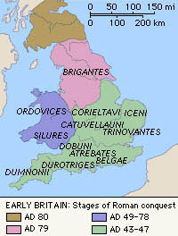
England: A Roman Heritage in the Law
The fact that England was conquered by the Romans instilled the philosophy of respect for the law.
By the time the Roman Empire fell and left England on its own to fend for itself, the tradition of respect for the law, had already taken hold for hundreds of years.
Arthur as King, the embodiment of English pride and values, was a Roman Soldier, whose respect for the law was embodied by his oath and character.

Slide 31
England: A Roman Heritage in the Law
Like many other former Roman colonies,
England began to develop its own system
for making and enforcing the Law.
Although largely rejecting the Roman Code itself,
the Roman template and idea
of the Law being the basis for civilization,
and of its need for respect,
was an unquestioned value of the English people.
Englishmen could disagree
over who should make the law,
or what laws should be made,
but always held dear the concept of the Law itself.

Slide 32
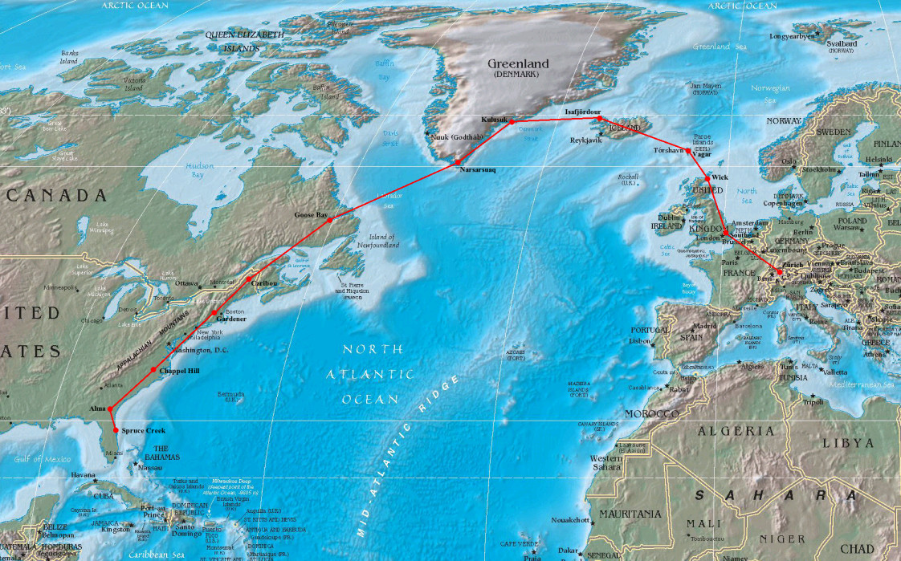
England and America – Bound by Heritage and Law

Slide 33
To Understand American Law We Need to Know English Law
The Law we know today as Americans is descended from England.
England, was a conquered colony of the Romans.
As a result, England had nearly a millennium
of history of respect for a system of Law,
before the modern country even came of age.
That concept, became engrained in the very nature and ideas of the English speaking peoples,
and carries itself down to this very day.
ROME ➔ ENGLAND ➔ UNITED STATES

Slide 34
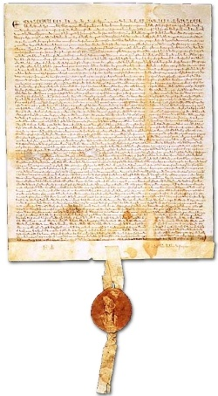
Understanding our Property Law
through the prism
of the Law of England
So to learn about the Law of Property, where do we start?
Well a good place to start is the first real battle for Rights.
The Rights fought for were Property Rights
And that Battle my dear students produced the Magna Carta.

Slide 35
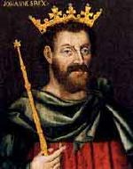
1215
The year is 1215 A.D.
John I is on the throne
It is the time of the Crusades and all the known World has been at War
800 years had passed since the fall of the Roman Empire and occupied England to the time of 1215.
And nearly 800 years have passed since that time until the present day.

Slide 36
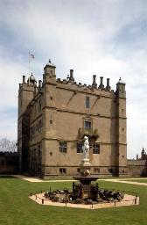
Medieval England
The times are tumultuous
England faces many challenges, both economic and security.
The country is really not yet a nation, but is struggling to gain an identity.
It’s the age of knights and kings, castles and swords.
To truly understand the times, however, lets review a bit of England’s history.

Slide 37
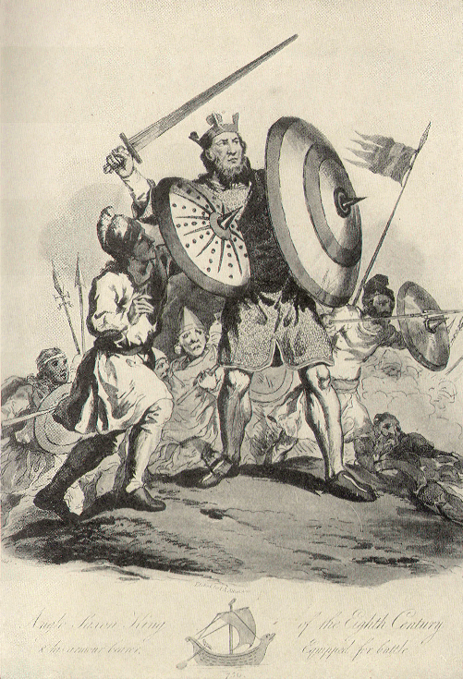
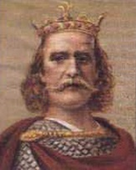
The Saxons Take Control
These English leaders, who were heavily
influenced by Roman tradition and culture,
only ruled, however, for a brief time.
Around 500 AD, Viking based Saxon tribes
invaded England and began to occupy
the country.
By 1066 these Anglo-Saxon tribes,
who by such date were residents of England
for 500 years, were led by King Harold.
Harold had loose control over the country
with his strongest hold over the region
now known as London.

Slide 38
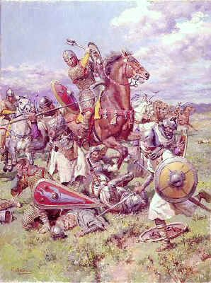
Enter William the Conqueror
In 1066, William the Conqueror, a man of Viking decedent, had just returned from the crusades as a knight.
The illegitimate son of a French Nobleman, with little prospects from a feudal farming society, he decided to leave his home in Normandy, France, to seek fame, riches and adventure.
An experienced soldier, he had an idea: To raid and conquer, the nearby Island of Brittan, across the English Channel.
A natural born leader, William raised a substantial army from towns nearby his Norman village and sailed across the Channel, seeking to recreate the glory of his Viking heritage.

Slide 39
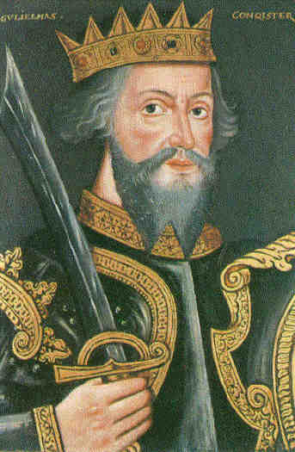
William Conquers
He did just that.
Confronting the ruling Anglo-Saxon armies at Hastings, England, William’s forces defeated the defenders, killing their King Harold with an arrow through his eye.
Organizing England, and consolidating his power throughout his new country, William proved to be a fine administrator, treating the people with a firm but fair hand.
During his reign he built the famed tower of London and began to transform his new capital into a true city.
Upon his death in 1087, he left the throne to
his nephew Stephen.

Slide 40
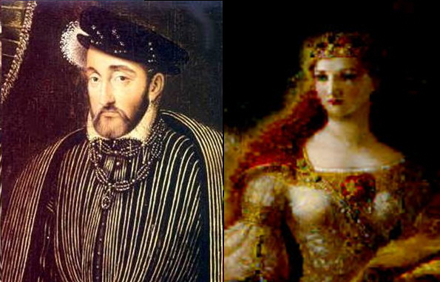
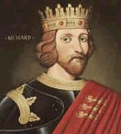
The Aftermath of William
After the reign of Stephen, in 1154
Henry the Second, and his Wife Eleanor of Aquitaine,
took over England, Normandy, and Aquitaine
(which belonged to Eleanor)
comprising not only England
but also half of modern France as well.
Henry was a strong king.
He also spent time organizing England,
as well as fighting against the French,
as well as against his Wife
who actually led a rebellion against him.
When Henry died, he left the throne to his son Richard.
Richard, known popularly as Richard the Lionhearted, was a handsome, noble and brave.
Leading English forces for the 3rd Crusade, Richard left his younger brother John in charge during his absence.

Slide 41
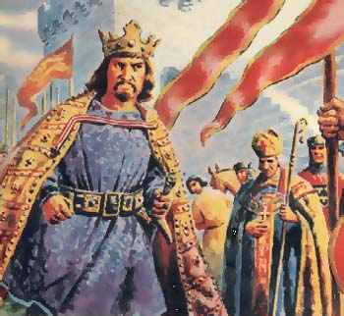
The Reign of John I
When times turn bad, leaders get vilified.
We may remember John from the stories of Robin Hood, whereby the bad John rules with corruption while the good Richard is away fighting for God and Country.
We may also remember his mother, Eleanor, as the evil Dark Haired Queen from the story of Snow White. Richard, of course, was Prince Charming.
While Richard was away, John was forced to levy heavy and oppressive taxes to pay for the Crusade as well as his brother’s ransom due to capture. A man with bad political instincts, his Court was filled with the corrupt and incapable.

Slide 42
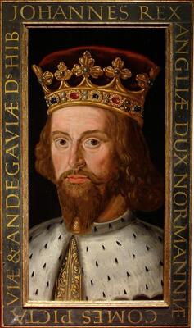
John’s Ineptitude and Bad Luck
In 1199, Richard, who had briefly returned to the throne, died.
Richard’s last few years had been blessed with good harvests and no war.
Upon Richard’s death John once again assumed the role of King.
Almost immediately, John once again presided over bad times.
The economy crashed, France repeatedly attacked, and war returned to the country.
Taxes were oppressive, corruption became rampant, and things fell into chaos.
Under the feudal system over which John ruled, the king was the unquestioned authority (The Devine Right of Kings). Landed Barons were vassals to the king, and their wealth was shared in tribute to him.
By 1215, John’s reign began to weigh to strongly upon the English people.
In addition to being a bad leader, John appears as a nasty, suspicious kind of person.
Worst of all John suffered by comparison. Compared to Philippe Augustus, who was king of France at the same time, John looked weak, corrupt and inept.

Slide 43
The Coming Storm of the Rebellion
In the constant battle between France and England, King Philippe of France chose to support the claims of Arthur, John’s nephew, to inherit the throne of Normandy.
John tried to solve this problem by capturing Arthur and having him killed, but this murder understandably upset the lords of Normandy and Anjou.
They decided they would rather be ruled by Philippe than by John, and so they agreed to fight on Philippe's side in a war with England.
By 1204 John’s forces lost most of his land in France.
It is interesting to note, that this loss really began to unite England as a people, but not behind John. For once the French land was lost, the English really began to think of themselves as different from the French people.
It was also about this time that English first started to really take shape as the language of England. (Before John, all the lords in England all spoke French.)
By 1215 the people of property, desperate to protect their interests, had had enough.

Slide 44
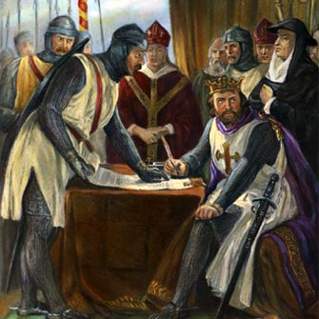
Enough is Enough
By 1215 the Barons (Lords) of England had endured enough.
Fearful that France would invade and impoverish them by seizing their lands and wealth, they raised an army to rebel against the King.
On June 15, 1215, their forces confronted King John at Runnymede, and forced him to put his seal on the Magna Carta (the Great Charter).

Slide 45
The Magna Carta is Signed
The Magna Carta established one of the foremost foundations of modern British law.
The US Constitution and its Amendments (the Bill of Rights) viewed it as a guiding document for the further expansion of the rights and liberties of the people and the limitation of the power of government.
Due to the nature of the feudal society, it did not abolish involuntary servitude.
Containing 63 clauses, this landmark document:
- Created a council to the King (a forerunner to parliament),
- Promised all freemen access to courts and a fair trial,
- Specified many property rights from infringement by the king and his agents,
- Eliminated unfair fines and punishments,
- Gave certain legal powers to the Catholic Church, and
- Addressed many lesser issues.

Slide 46
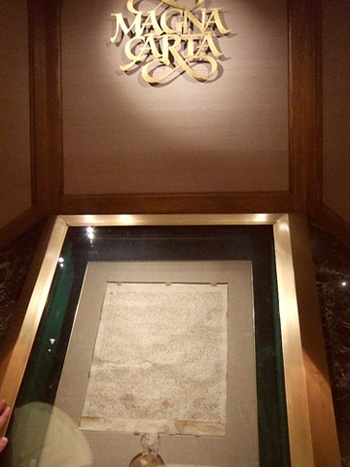
The Magna Carta Today
Today a copy of the Magna Carta can be seen on display in Washington D.C., due to a loan to the national archives
It is but another example of how property rights and the Law have an intertwined history.
If it were not for their fear of losing their property rights, the landed barons of England would never have rebelled against the King.
It was the protection of these property rights that led to the establishment of the first constitutional document of England, upon which our rights and laws are based.

Slide 47
The Effects of the Magna Carta
Since the time of the Magna Carta our system of modern Anglo-American Law has evolved to flow from three sources.
1. Constitutional Law
2. Statutes (Laws made by Elected Legislatures)
3. Case Law (Laws made by Judges).

Slide 48
Constitutions
Constitutions establish the framework of Government.
Under the British system they flow from the Magna Carta and then a Series of other similar King issued charters.
The United States Constitution, the first of its kind, arose out of our of representational government, through adoption by a convention of elected delegates and then ratification by elected state legislatures.

Slide 49
Statutes
Statutes in England came from Parliament, an elected national legislature, which evolved from the council established under the Magna Carta.
In the United States, Statutes came from (first colonial then state) legislatures, and after the ratification of the federal constitution, from Congress (our national legislature) as well.
In our country we have a federal system:
  Where Congress enacts statutes (of limited subject matter jurisdiction) for the entire nation, and
  Where state legislatures enact statutes (of more general jurisdiction) for the people of their state.

Slide 50
Case or Common Law
Case (or common) law in England came from the Royal Courts. Decisions of judges, reported and published with respect to specific cases.
In the United States we have Federal and State Courts.
  Federal: US Supreme Court, US Court of Appeals, and the Federal District Courts
  New York State: Court of Appeals, Appellate Division of the Supreme Court, and the Supreme Court (located in each County of the State).

Slide 51
1215: Fourth Lateran Counsel
In 1215 Pope Innocent III convened the Fourth Lateran Council to Determine Church Policy on a nunber of issues
This Council Recommended:
  Ending Trial by Combat – Where Parties would actually fight to determine guilt or liability
  Ending Trial by Ordeal – Where Defendants would be physically challenged to determine guilt or liability.
This Council thereby helped to lead the way to reform the judicial systems across the world.

Slide 52
Evolution of English Law
From 1215 until the English Civil War in 1642 and the Glorious Revolution in 1688, the English Common Law was the force that developed most of the law in England
With the challenges to the Monarchy in the English Civil War and the Glorious Revolution (conflicts basically arising out of religious controversies) the law of England began to transform away from the monarchy and toward Parliament.
The Rise of Parliament resulted in the rise of statutes, as this body began to codify rules and enact more and more English Law.
This rise in statutes would bring on conflict in the British Colonies, especially in America.

Slide 53
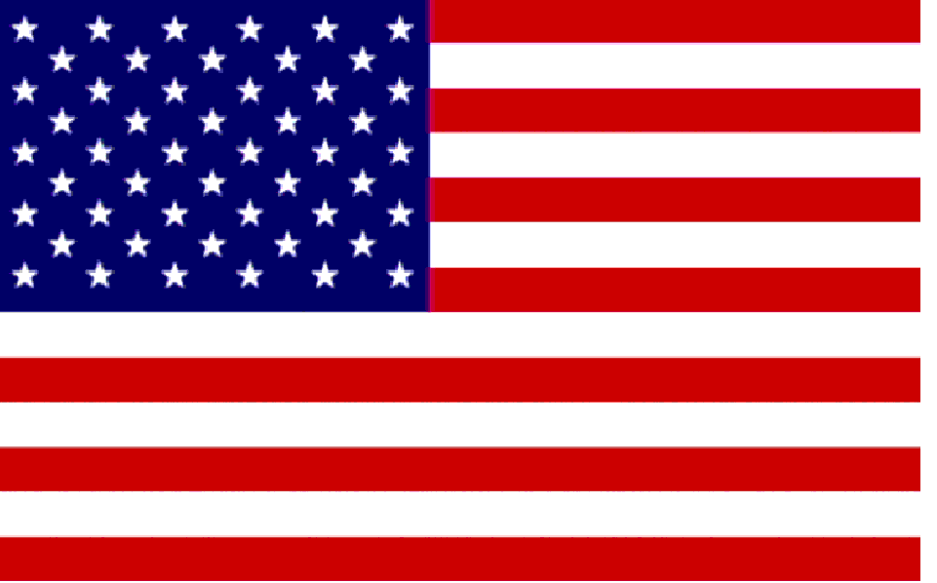

English Colonial America
The law of early America
was based largely upon the law of England.
We were, of course prior to the Revolution, English subjects.
Our founders initially spoke of redressing their grievances under a format of the “Rights of Englishmen”
In Colonial America, there was very little statutory law, and even after the US and State Constitutions, most law was still based upon English Court precedent. Indeed statutes were looked upon with a skeptical eye.
For it should be remembered that the Quartering Act, Stamp Act and the Townsend Acts were all statutes, and an igniting reason for the Revolution to occur in the first place.

Slide 54
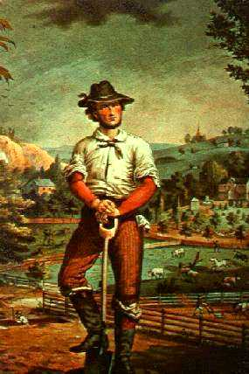
Don’t Tread on Me
Early Americans were practical sorts.
They wanted the Government to deliver the mail, defend the shores, PROTECT MY PROPERTY RIGHTS, and stay the heck out of my life.
That is why most of the early statutes, and the vast majority of case law decisions, were about property.
Property in England was power.
It was the property class that litigated, about their property rights, and it was these disputes that made the law.
So too in America. Although land was much more plentiful here than back in England (one of the main reasons for immigration) property (especially land) meant life. We were an agrarian society, where land translated into food and wealth.

Slide 55
The Development of American Law
1776 American Colonies declare Independence
1777 Articles of Confederation proposed
1783 British and Americans sign the Treaty of Paris, awarding America its Independence.
1787 Colonies convene a Constitutional Convention in Philadelphia
1788 New York is the last state to ratify the Constitution (NC and RI ratify in 1789 and 90)
1789 Newly Elected Federal Government Takes Office
1791 Bill of Rights Ratified
1803 Marbury v. Madison establishes the Doctrine of Judicial Review
1833 Certain States advance the Doctrine of Nullification
1857 Dred Scott v. Sanford declares slaves property
1865 13th Amendment Ratified
1913 16th Amendment (income taxes) and 17th Amendment (Senators Elected) Ratified 1913 Federal Reserve Established
1942 Supreme Court decides Ex Parte Quirin (Military Tribunals for Terrorists)
1942 Supreme Court decides Wickard v. Filburn (Feds can regulate interstate commerce)
1954 Supreme Court decides Brown v. Board of Education
1992 27th Amendment Ratified (Congress cannot effect their compensation in term)

Slide 56
Blackstone and the Common Law

Slide 57
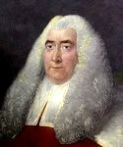
Mr. Blackstone
But with communication slow, with courts far apart and their decisions not available to the masses, what could be done?
Enter Blackstone and his Commentaries on the Law:

Slide 58
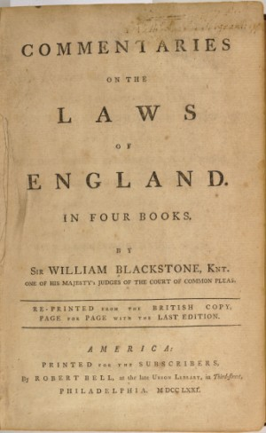
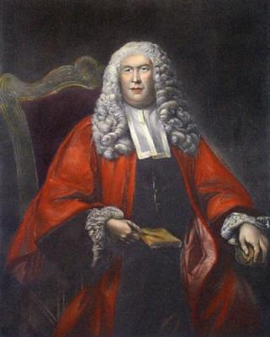
Blackstone’s Commentaries
Sir William Blackstone was an jurist and professor who produced the historical and analytic treatise on the law known as Commentaries on the Law of England.
First published in four volumes between 1765 and 1769. It had an extraordinary success.
A baseline “Bible of the law” of his time, these famous Commentaries still remain an important source on classical views of the common law and its principles.
It was used not only through out England but through out the United States as well.

Slide 59
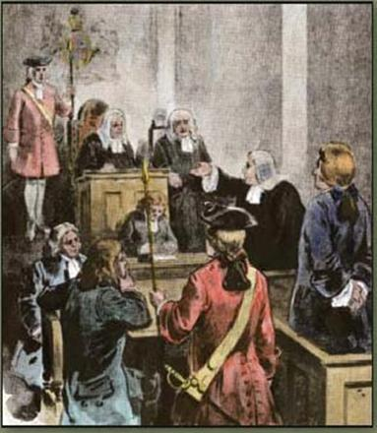

Common (Case) Law in the United States
Over time, the United States, through its State and Federal Courts, began to build a substantial body of law.
This law was reported and memorialized through published decisions of judges, following the concept of precedent, known as Stare Decisis (let the decision stand).
Using the Commentaries of Blackstone, as well as the previous case decisions of Judges, Courts found a bench mark to decide new ones.
Decisions of first impression sought to apply and adapt other legal principles, especially in the cases of equity.

Slide 60
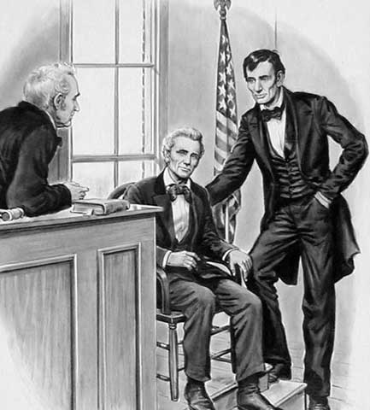
American Jurisprudence
Both British and American law
depended heavily upon custom
as well as precedent
to decide cases.
What was customary, necessary,
practical and popular
found its way into the law
by way of reported court decisions.
With elected judges and empanelled juries
this reflection of society
came to be placed in its law.

Slide 61
Law vs. Equity
In Early America, as in England, Courts were divided between law and equity.
Courts of Law had jurisdiction over money matters.
Equity Courts had jurisdiction over injunctive relief (non money matters)
Especially with equity cases, the social American norms of fundamental fairness crept into the cases to decide the outcomes.
By 1800, the Courts of Law and Equity were merged in most jurisdictions.

Slide 62
Most Lawsuits in Early America
Involved Property Rights
Regardless of the claim, until the later part of the 20th century, litigation was rare and utilized almost exclusively, by the wealthy over serious disputes.
Most often these issues were over property.
As a result, Property rights decided the law, shaped the law, and were shaped and formed by it.
Therefore it can therefore easily be seen
that most law involving property rights is state law, and that property and the law evolved together
and are intertwined.

Slide 63
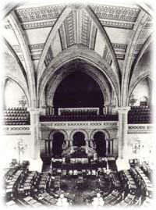
The Rise of Legislation
As America grew in its separation from England,
and its young state legislatures began to deliver
on the representational needs of their constituents,
our national aversion to statutes began to ease.
As a result, after the turn of the 19th century,
state legislatures began to become more active,
gradually enacting more laws through codification
(statutory enactment) then was developed through
case law by litigation.
Property rights as in court decisions, became a major concern
of state legislatures, and as such, incumbent with this growth in
statutory enactments, a significant body of statutes regarding
property rights joined that already in place under the common law

Slide 64
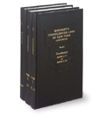
Use Both Belts and Suspenders
Today Rights are protected via two mechanisms in the law –
case (common law) and statutes
most often enacted by the state legislature.
In New York State, a line of case law dating back
from colonial times protects individual rights.
Additionally, a series of state statutes, enacted by
the New York State legislature, also provides a
wide array of property protections for all kinds of
personal rights.
Lastly, the New York State and United States Constitutions
also protect many individual rights
providing a three tier protection level for every citizen.
Accordingly nearly all contract law, property law and business organization law (such as corporation law) is state law.

Slide 65
End of Part One
Please don’t forget to hand in your bio form
For next time – Review Assignments as follows on the Webpage:
  Lecture Slides
  Selected Readings
  Cases and Exercises
We are a hot bench.
Questions?

