Slide 1


Slide Set Six C:
Industry Self Regulation Regulation

Slide 2

Last Time We Spoke About:
Shareholder’s Rights
Corporate Finance
Part One: Generally / Definitions / Shares / Bonds / Other Income
Shareholders
Part Two: Generally / Definitions / Rights / Liabilities / Voting
Class Case – Beaumont v. American Can Co.
Importance of Share Non-Diminishment

Slide 3
Tonight We Will Speak About:
Securities Regulation
State Regulation
Part One: Generally / Jurisdiction / Blue Sky Laws / The Martin Act
Federal Regulation
Part Two: Generally / Jurisdiction / Federal Regulatory Statutes
Industry Self Regulation
Part Three: Generally / Definitions / Effectiveness
Class Case – SEC v. W.J. Howey Company
The Scope of Federal Regulation

Slide 4
Part One:
Securities Regulation
Generally – Industry Self Regulation

Slide 5
Securities Regulation
Generally – Industry Self Regulation
Industry Self – Regulation- Generally:
FINRA: The Financial Industry Regulatory Authority (FINRA) is the largest independent, not for profit regulator for all securities firms doing business in the United States.
The National Association of Securities Dealers (NASD) and the New York Stock Exchange, merged their member regulation functions into this one self-regulatory organization, in 2007, in order to provide effective, dependable industry self-regulation of securities and their trading.
FINRA's mission is to protect investors by making sure the United States securities industry operates fairly and honestly. FINRA oversees 4,250 brokerage firms, 162,155 branch offices and 629,525 registered securities representatives.
Congressionally Authorized: FINRA is authorized by Congress to protect investors by ensuring that the securities industry is fair and honest. This organization:
Writes and enforces rules for securities firms and brokers;
Monitors compliance with its rules;
Fosters market transparency;
Educates investors;
Provides a BrokerCheck system, which allows investors to check out the professional and disciplinary backgrounds of firms and brokers online; and
Refers fraud and insider trading cases to the SEC for investigation.

Slide 6
Securities Regulation
Generally – Industry Self Regulation
Industry Self – Regulation- Generally:
FINRA Arbitration: The Financial Industry Regulatory Authority also administers the largest dispute resolution forum for investors and registered firms. This dispute resolution forum is done by means of an arbitration process.
Security Investment Firm Arbitration: Most agreements between investors and stockbrokers include mandatory arbitration agreements. Additionally, many securities investment firms have also adopted a code of arbitration, giving customers a contractual right to settle disputes through arbitration.
Arbitration Decisions Rarely Overturned: Courts rarely overturn the decisions of an arbitrator in security (or other) cases, as due process and an opportunity to be heard for both sides is afforded.
Who Arbitrators Are: Most Arbitrators are trained professionals and members of the American Arbitration Association. Arbitrators, who are generally part of a panel, are most often selected with one by each of the parties, with the third selected by the two Arbitrators selected by the parties. On occasion Arbitrators are also generally selected pursuant to contract.

Slide 7
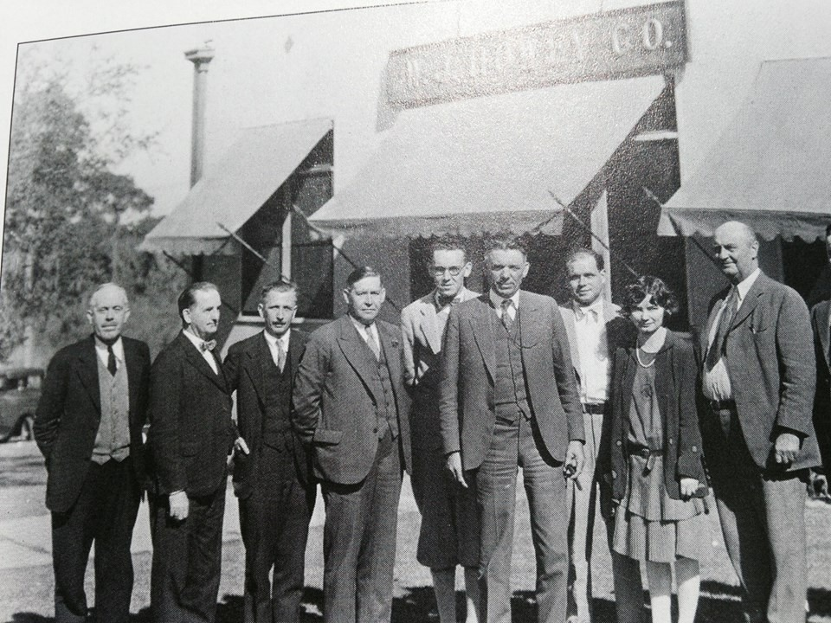
Case Study:
SEC v. W.J. Howey Company
The Scope of Federal Regulation
The case that arose from the pursuit of Orange Juice

Slide 8
End of Class Six C
For next time – Review Assignments as follows on the Webpage:
  Lecture Slides
  Selected Readings
  Cases and Exercises
We are a hot bench.
Questions?

