Slide 1


Slide Set Nine A:
Corporate Governance

Slide 2

Last Time We Spoke About:
Corporate Governance – Boards of Directors
Board Members
Part One: Definitions / Roles / Obligations and Duties / Liabilities
Board Member Powers
Part Two: Generally / Chairman / Board Members / Committees
Corporate Personhood
Part Three: Generally / Fiduciary Responsibilities / Personhood Interests
Class Case – Citizen United v. FEC
The Constitutional Rights of Corporations
Last Time We Spoke About:
Corporate Governance – Officers and Employees
Corporate Officers
Part One: Definitions / Roles / Obligations and Duties / Liabilities
Specific Officers
Part Two: CEO / President / Vice President / CFO / Treasurer / Secretary
Employees and Agents
Part Three: Definitions / Employees / Agents
Class Case – Miller v. McDonald
Compliance and Internal Control Enforcement

Slide 3
Tonight We Will Speak About:
Corporate Governance – Officers and Employees
Governing the Corporation
Part One: Board of Director Meetings / Board Actions / Business Judgment Rule/
Shareholder Derivative Lawsuits
Administration
Part Two: Running the Corporation / Enforcement of Policies / Employment Management
Loyalty
Part Three: Directors / Officers / Employees
Class Case – In Re Caremark International
Directors Duty of Oversight Care

Slide 4
Part One:
Corporate Governance
Corporate Governance – Running the Corporation

Slide 5
Corporate Governance
Corporate Governance – Running the Corporation
Running the Corporation:
Board of Directors: The New York Business Corporation Law, as well as the articles of incorporation and the by laws of the corporation, provide broad powers to the board of directors to manage and run the corporation. They are the policy making entity for the corporation and hire the corporate officers who provide the day to day management of corporate affairs.
Meetings of the Boards of Directors: The Board of Directors operates by means of meetings of the board. Agendas for such meetings are prepared by the Chair of the Board. Business of the board, and policy decisions made by the board, is accomplished by resolutions adopted by the board at their meetings.

Slide 6
Corporate Governance
Corporate Governance – Running the Corporation
Running the Corporation:
Size of the Board of Directors: The size of the board of directors is established in the articles of incorporation or the by-laws. Such size is a balancing test between the need for broad talent and diverse opinions and the need to have a manageable size so as to not make meetings unwieldy. Corporate Governance Expert Ira Milstein, has declared that seven persons is the perfect balance for board size. But due to regulatory requirements, corporate committee needs, and modern board duties, most boards are far larger than seven, so as to accommodate and more fairly such workloads and duties.
Officers: The board of directors appoints officers and other agents to act for the company, to do the day to day work of the corporation, in accordance with board directives and policies. To accomplish the work of the corporation, the board grants broad powers to its officers to do the work they are assigned. The Chief Executive Officer, is the primary corporate manager, and pursuant to board policy and directive, is the person responsible for carrying out the day to day responsibilities of the company, and assuring that the purposes and goals of the corporation are achieved.

Slide 7
Corporate Governance
Corporate Governance – Business Judgment
The Business Judgment Rule:
  The business judgment rule is a case law-derived concept in corporations law whereby the "directors of a corporation . . . are clothed with [the] presumption, which the law accords to them, of being [motivated] in their conduct by a bona fide regard for the interests of the corporation whose affairs the stockholders have committed to their charge" (See Gimbel v. Signal Cos., 316 A.2d 599, 608 (Del. Ch. 1974)
  To challenge the actions of a corporation's board of directors, or its officers, a plaintiff assumes "the burden of providing evidence that the directors, or the officers, in reaching their challenged decision, breached any one of the triads of their fiduciary duty good faith, loyalty, or due care".
  Failing to do so, a plaintiff "is not entitled to any remedy unless the transaction constitutes waste . . . [that is,] the exchange was so one-sided that no business person of ordinary, sound judgment could conclude that the corporation has received adequate consideration".
  The Business Judgment Rule has at its core, a responsibility of directors and officers to weigh risk against reward. This is an art, not a science.

Slide 8
Corporate Governance
Corporate Governance – Business Judgment
The Business Judgment Rule Continued:
  The business judgment rule protects corporate officers and directors from being sued when their business judgments turn out to be incorrect.
  The business judgment rule not only insulates officers and directors from lawsuits from shareholders, but it also keeps courts out of the business of monitoring business decisions.
  When corporate officers or directors exceed their authority, the business judgment rule no longer protects them.
  Such acts, which exceed authority, are deemed to be ultra vires (a Latin phrase meaning “beyond the powers” – meaning the board of directors has exceeded or gone beyond their legal authority).
  Only shareholders or others who have a direct interest in the corporation can raise a claim of ultra vires.

Slide 9
Corporate Governance
Corporate Governance – Shareholder Derivative Lawsuits
Shareholder Derivative Law Suits:
    Defined: A shareholder derivative suit is a lawsuit brought by a shareholder on behalf of a corporation against a third party. Often, the third party is an insider of the corporation, such as an executive officer or director.
    Shareholder derivative suits are unique because under traditional corporate law, management is responsible for bringing and defending the corporation against suit.
    Shareholder derivative suits permit a shareholder to initiate a suit when management has failed to do so.
    It should be noted, that if the shareholder wins the action, it is the corporation, and not the shareholder who is awarded the recovery.

Slide 10
Corporate Governance
Corporate Governance – Shareholder Derivative Lawsuits
Shareholder Derivative Law Suits:
    Reasons for Derivative Law Suits: Derivative shareholder lawsuits are frequently brought to redress the following types of wrongdoing by the Board of
    Directors and/or Officers of a company:
Breach of fiduciary duty
Fraud or other unlawful activity
Self-dealing or greed by insiders
Conflict of interest
Waste of corporate assets
Accounting wrongdoing
Inflated, false, or misleading financial statements
inflated executive compensation
Management or board decisions that expose the company
to harm, violate consumer protection or other laws.

Slide 11
Part Two:
Corporate Governance
Corporate Governance – Management of Corporation

Slide 12
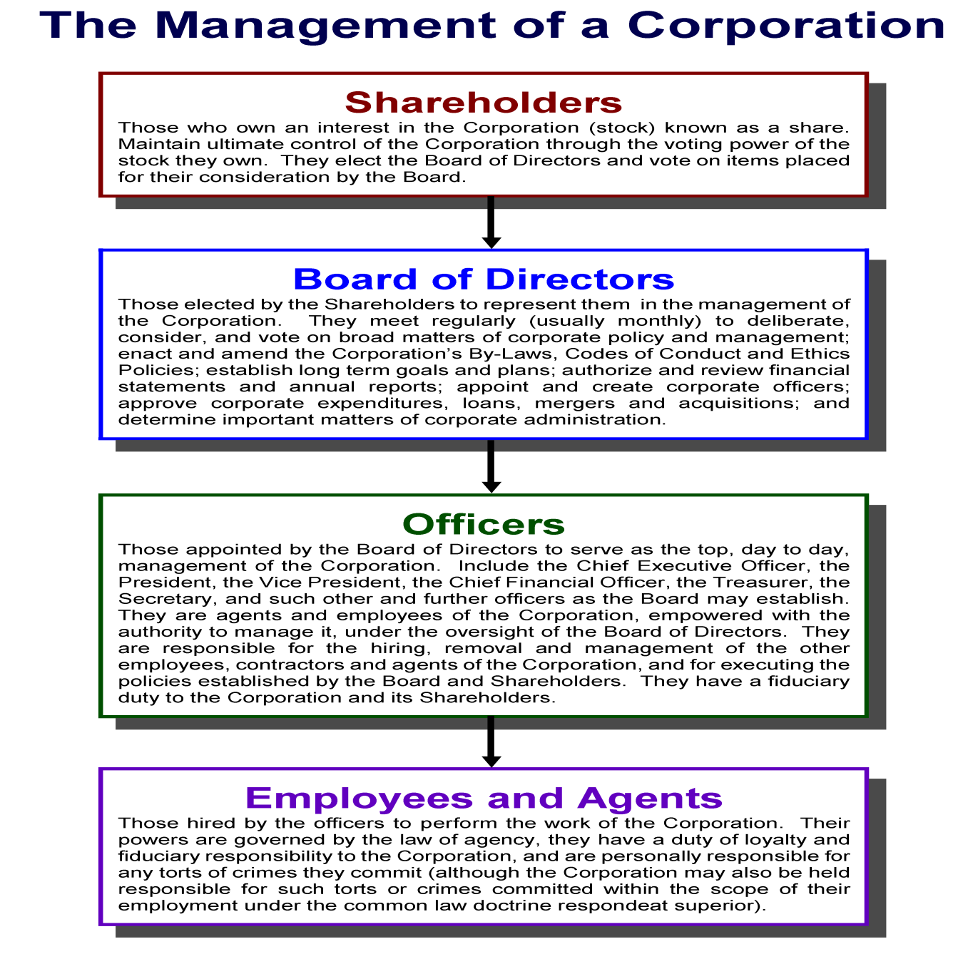

Slide 13
End of Class Nine A
For next time – Review Assignments as follows on the Webpage:
  Lecture Slides
  Selected Readings
  Cases and Exercises
We are a hot bench.
Questions?

