Slide 1


Slide Set Nine B:
Officer Administration

Slide 2
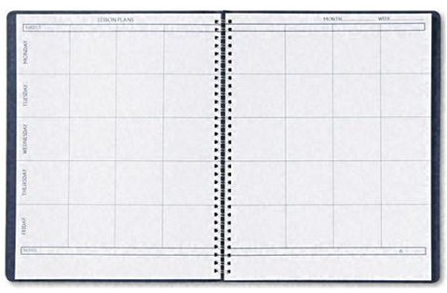
Last Time We Spoke About:
Corporate Governance – Boards of Directors
Board Members
Part One: Definitions / Roles / Obligations and Duties / Liabilities
Board Member Powers
Part Two: Generally / Chairman / Board Members / Committees
Corporate Personhood
Part Three: Generally / Fiduciary Responsibilities / Personhood Interests
Class Case – Citizen United v. FEC
The Constitutional Rights of Corporations
Last Time We Spoke About:
Corporate Governance – Officers and Employees
Corporate Officers
Part One: Definitions / Roles / Obligations and Duties / Liabilities
Specific Officers
Part Two: CEO / President / Vice President / CFO / Treasurer / Secretary
Employees and Agents
Part Three: Definitions / Employees / Agents
Class Case – Miller v. McDonald
Compliance and Internal Control Enforcement

Slide 3
Tonight We Will Speak About:
Corporate Governance – Officers and Employees
Governing the Corporation
Part One: Board of Director Meetings / Board Actions / Business Judgment Rule/
Shareholder Derivative Lawsuits
Administration
Part Two: Running the Corporation / Enforcement of Policies / Employment Management
Loyalty
Part Three: Directors / Officers / Employees
Class Case – In Re Caremark International
Directors Duty of Oversight Care

Slide 4
Part One:
Corporate Governance
Officer Administration

Slide 5
Corporate Governance
Corporate Governance – Running the Corporation
Running the Corporation:
Officers: The board of directors appoints officers and other agents to act for the company, to do the day to day work of the corporation, in accordance with board directives and policies.
To accomplish the work of the corporation, the board grants broad powers to its officers to do the work they are assigned.
The Chief Executive Officer, is the primary corporate manager, and pursuant to board policy and directive, is the person responsible for carrying out the day to day responsibilities of the company, and assuring that the purposes and goals of the corporation are achieved.

Slide 6
Corporate Governance
Corporate Governance – Board Policy Enforcement
Enforcement of Board Policies:
Board Policies: The Corporate Officers are the persons most generally responsible for the implementation and enforcement of policies adopted by the Corporation’s Board of Directors. As the day to day managers of the Corporation, the Officers are responsible for the board policies under their area of responsibility, and are overseen and held accountable by the board of directors for their performance
Execution of Board Action: If the Board of Directors decides to expand into a new product line or area, or discontinue a previously authorized corporate activity or mission, it is the officers of the corporation that must act to make this decision a reality, including the purchase or sale of materials and expansion or reduction of employees incumbent with such a directive. Officers are generally given broad discretion as to how to accomplish these board directives and policies.

Slide 7
Corporate Governance
Corporate Governance – Employee Management
Employee Management:
Oversight of Corporate Employees: The Corporate Officers are the persons responsible for the oversight and management of all the corporate employees. The officers hire, fire and manage the corporation’s employees so as to carry out the corporation’s purposes and accomplish the directive and policies of the board of directors.
Employee Administration: Corporate Officers, especially the Chief Executive Officer, provide employee administration, including tasking employees, defining employee roles, establishing and administering employee salaries, wages and benefits, granting employee raises, levying employee discipline, determining workforce strength, directing employee missions, and examining and reporting on employee productivity.

Slide 8
Part Two:
Corporate Governance
Corporate Governance – Structure

Slide 9
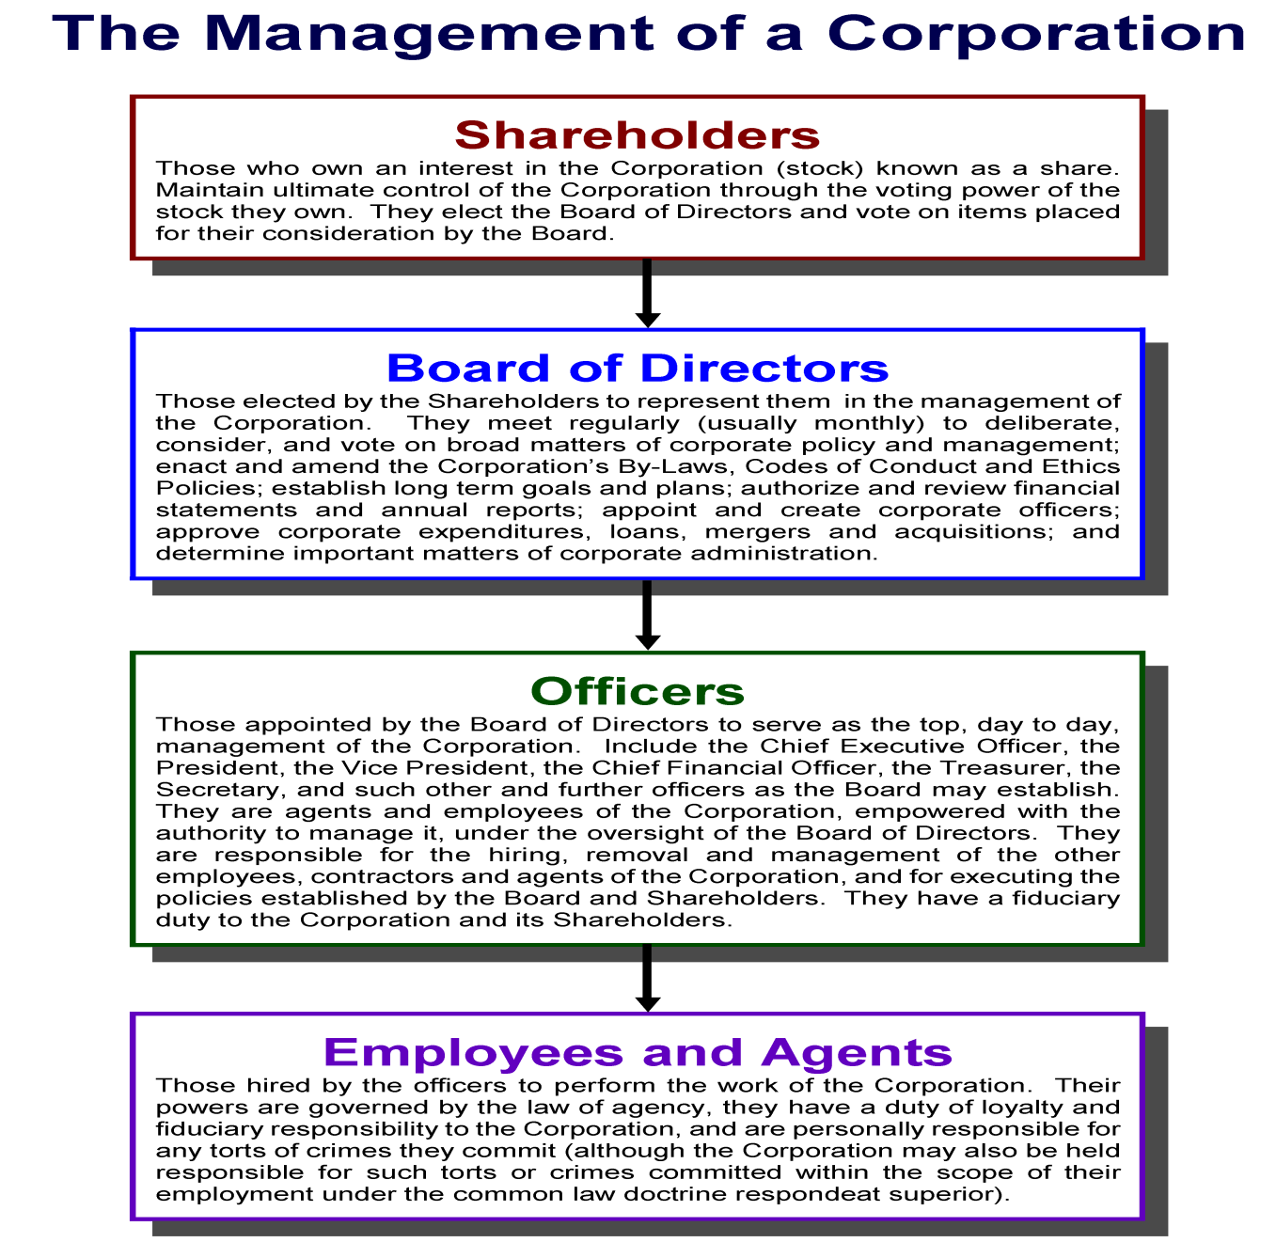

Slide 10
End of Class Nine B
For next time – Review Assignments as follows on the Webpage:
  Lecture Slides
  Selected Readings
  Cases and Exercises
We are a hot bench.
Questions?

