Slide 1


Slide Set Nine C:
Corporate Governance

Slide 2

Last Time We Spoke About:
Corporate Governance – Boards of Directors
Board Members
Part One: Definitions / Roles / Obligations and Duties / Liabilities
Board Member Powers
Part Two: Generally / Chairman / Board Members / Committees
Corporate Personhood
Part Three: Generally / Fiduciary Responsibilities / Personhood Interests
Class Case – Citizen United v. FEC
The Constitutional Rights of Corporations
Last Time We Spoke About:
Corporate Governance – Officers and Employees
Corporate Officers
Part One: Definitions / Roles / Obligations and Duties / Liabilities
Specific Officers
Part Two: CEO / President / Vice President / CFO / Treasurer / Secretary
Employees and Agents
Part Three: Definitions / Employees / Agents
Class Case – Miller v. McDonald
Compliance and Internal Control Enforcement

Slide 3
Tonight We Will Speak About:
Corporate Governance – Officers and Employees
Governing the Corporation
Part One: Board of Director Meetings / Board Actions / Business Judgment Rule/
Shareholder Derivative Lawsuits
Administration
Part Two: Running the Corporation / Enforcement of Policies / Employment Management
Loyalty
Part Three: Directors / Officers / Employees
Class Case – In Re Caremark International
Directors Duty of Oversight Care

Slide 4
Part One:
Corporate Governance
Loyalty

Slide 5
Corporate Governance
Loyalty– Fiduciary Responsibilities
Loyalty:
Fiduciary Duties and the Corporation:
Fiduciary Duty: The members of a corporation’s board directors and officers hold fiduciary duties to the corporation itself, as an artificial person under the law. These duties require board directors to place the best interests of the company ahead of their own. Directors must make decisions for the company and act in a manner that an ordinary, prudent person would. These fiduciary rules thus proceed from a theory of maximizing corporate financial well-being by focusing on shareholder wealth maximization.
Oversee a Financially Sound Corporation: Part of this fiduciary duty to the corporation is to assure that it is financially strong and will continue to grow and prosper. The board of directors has an explicit responsibility to form a short-term plan of one to two years to ensure sustainability of the corporation. In addition, the directors must also plan for long-term growth to promote continued security and prosperity.
Assure that the Corporation Operates Consistently With Policy Goals: Members of a corporation’s board of directors also have a responsibility to oversee all departments and aspects of the corporation. This responsibility includes making sure operations are running efficiently, company operations are in alignment with the organization’s purpose, that there are no incidences of fraud, that adequate communication takes place throughout the corporation, and that sufficient oversight is provided over all departments and operations of the company.

Slide 6
Corporate Governance
Loyalty– Fiduciary Responsibilities
Loyalty:
Duties of Care and Loyalty: According to traditional fiduciary analysis, corporate directors and officers owe two duties to the corporation: care and loyalty. Each duty describes standards for judicial review of corporate decision-making and fiduciary activities.
Duty of Care: The duty of care addresses the attentiveness and prudence of Directors in performing their decision-making and oversight functions. The famous “business judgment rule” presumes that directors carry out their functions in good faith, after sufficient investigation, and for acceptable reasons. Unless this presumption is overcome, courts abstain from second guessing well-meaning business decisions even when they are flops. This is a risk that shareholders take when they make a corporate investment. Thus, to encourage directors to take business risks without fear of personal liability, corporate law protects well-meaning Directors, through exculpation provisions in the corporation’s articles and Bylaws, as well as through directors’ and officers’ insurance.
Duty of Loyalty: The duty of loyalty addresses fiduciaries’ conflicts of interest. This duty requires fiduciaries to put the corporation’s interests ahead of their own. This means that fiduciaries cannot serve two masters. Corporate fiduciaries breach their duty of loyalty when they divert corporate assets, business opportunities, or proprietary information for personal gain. Accordingly, courts will not interfere with the board’s judgment in the absence of unusual conduct such as fraud, and a Director has a duty of loyalty, and is disqualified from taking part in corporate action, when they have a conflict of interest.

Slide 7
Part Two:
Corporate Governance
Corporate Governance – Management of Corporation

Slide 8
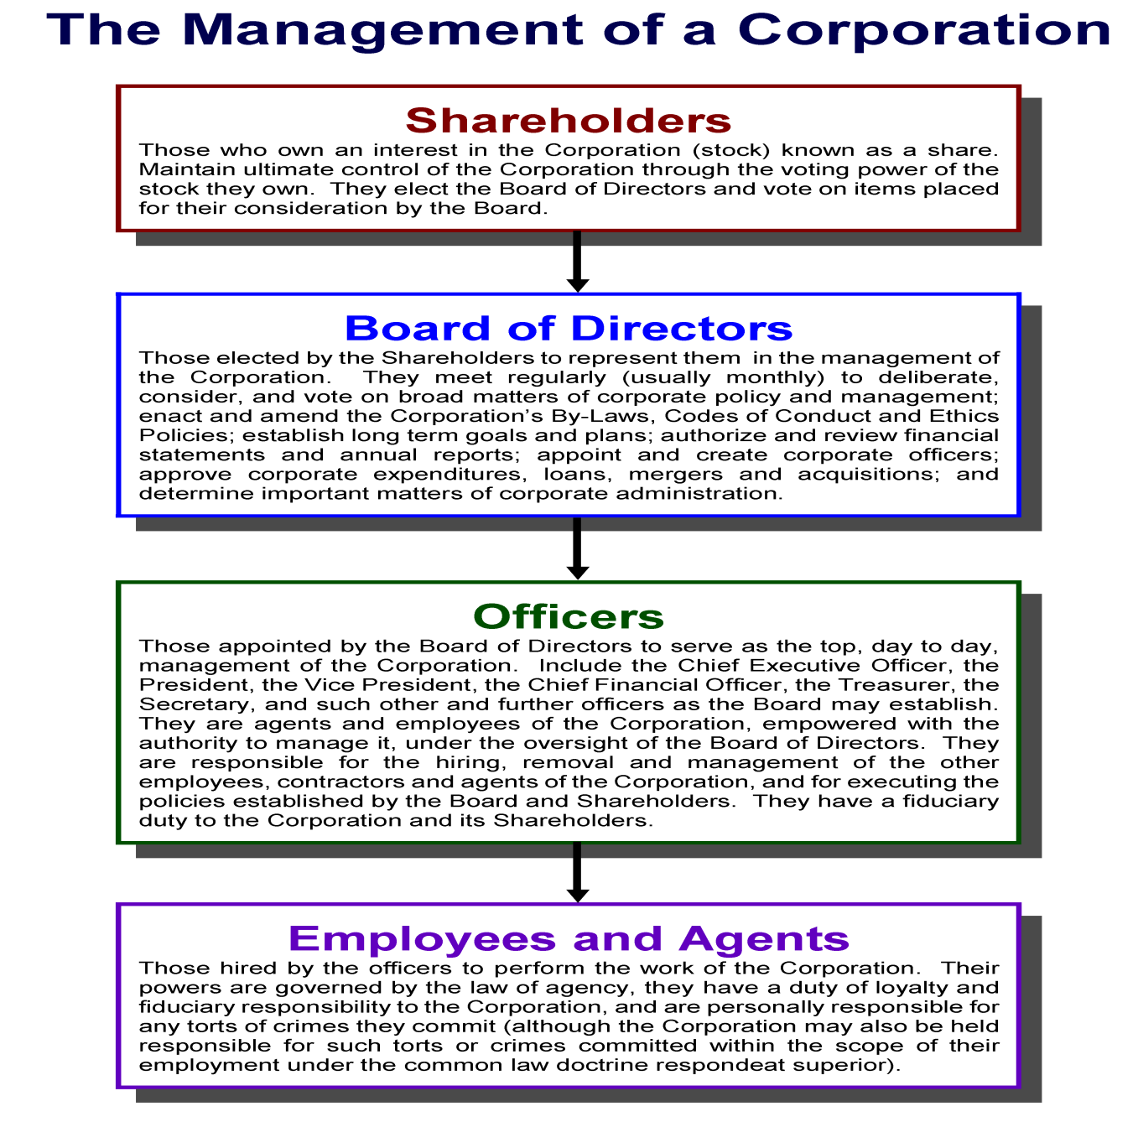

Slide 9

Case Study:
In Re: Caremark International
Director’s Duty of Oversight Care
The case that involved payoffs to doctors

Slide 10
End of Class Nine C
For next time – Review Assignments as follows on the Webpage:
  Lecture Slides
  Selected Readings
  Cases and Exercises
We are a hot bench.
Questions?

