Slide 1
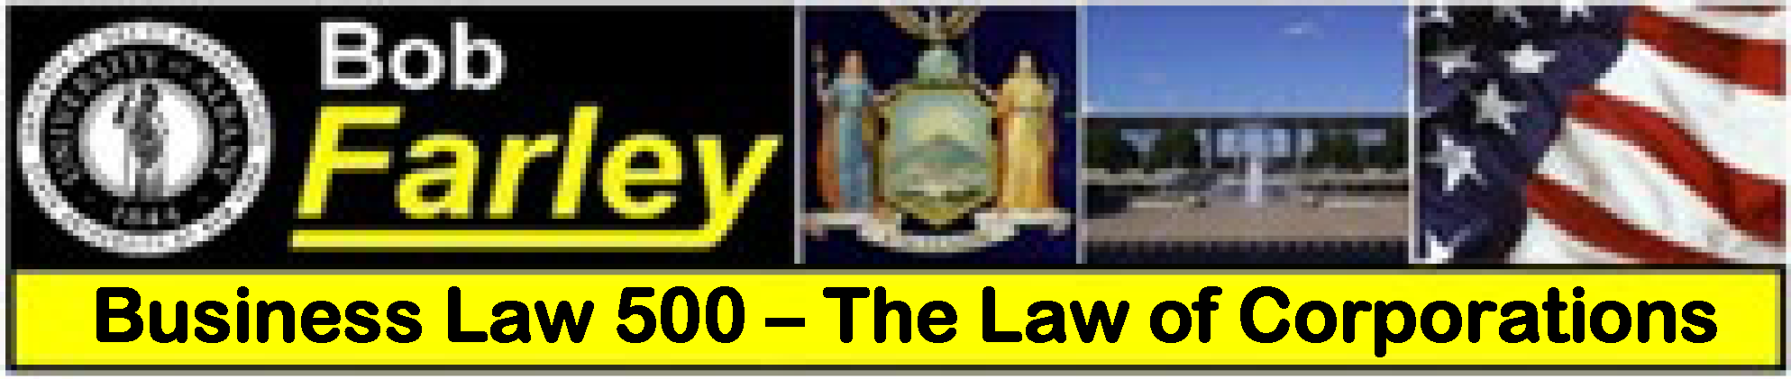

Slide Set Twelve A:
Public Authorities

Slide 2

Last Time We Spoke About:
Limited Liability Companies
LLC – History, Formation and Purpose
Part One: History
Formation
Purpose
Members and Agreements
Management
Benefits and Limitations
Class Case – Shapiro v. Ettenson
Member Responsibility in Operating Agreements

Slide 3
Tonight We Will Speak About:
Public Authorities
Public Benefit Corporations
Part One: Definitions
Incorporation
Roles and Duties
History / Purpose / Effectiveness

Slide 4
Public Benefit Corporations
Public Benefit Corporations and Public Authorities

Slide 5
    Public Benefit Corporations
  Public benefit corporations are entities that chartered by an act of the state legislature and are closely associated with governmental operations and public functions (such as public authorities).
  Public benefit corporations are designed to carry out a public purpose and therefore receive some benefit for this function.
  Public benefit corporations are usually not bound by the same set of rules and statutes as private corporations. They are formed for limited purposes, which are principally to build, finance and operate something for the public benefit.
  Public benefit corporations are often given special tax treatment and other benefits that private corporations do not receive.

Slide 6
    Public Authorities
  Public Authorities are Public benefit corporations chartered by an act of the state legislature.
  The first Public Authority was the Port of London Authority.
  The First Public Authority in New York (and in the United States) was the Port Authority of New York, which was chartered by Congress, and then codified in State Law. It is a bi-state authority, now known as the Port Authority of New York and New Jersey.
  Today there are hundreds of Public Authorities in New York. Some of the more famous include the Thruway Authority, the Dormitory Authority, the Metropolitan Transportation Authority, the Power Authority, and the Empire State Development Corporation (legally known as the Urban Development Corporation).
  The purpose of Public Authorities is to finance, build and operate things (principally infrastructure) for the benefit of the state and its citizens (i.e. the public).

Slide 7
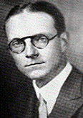
Public Authorities
The Story of Abbott Low Moffat
Born on May 12, 1901, on the upper east side of Manhattan, Abbott Low Moffat graduated from Harvard University in 1923, and from Columbia Law School in 1926. Admitted to the bar in 1927, and he practiced law in New York City and entered politics.
A member of the New York State Assembly from NY County’s 15th district, he served from 1929 to 1943. He was Chairman of the Committee on the Affairs of New York City in 1934; and Chairman of the Committee on Ways and Means from 1936 to 1943.
He was elected as a statewide delegate to the New York State Constitutional Convention in 1938, and was a champion of the idea to build a Superhighway across New York State from New York City to Buffalo.
A formidable adversary of Governors Roosevelt and Lehman, he resigned his seat on August 16, 1943, to accept an appointment by Roosevelt at the United States Department of State where he served as a diplomat in 12 countries, including Great Britain until 1961.
He died of cancer on April 17, 1996, in a retirement home in New Jersey.

Slide 8
End of Class Twelve A
For next time – Review Assignments as follows on the Webpage:
  Lecture Slides
  Selected Readings
  Cases and Exercises
We are a hot bench.
Questions?

