Slide 1


Slide Set Thirteen C:
Bankruptcy

Slide 2

Last Time We Spoke About:
Public Authorities
Public Benefit Corporations
Part One: Definitions
Incorporation
Roles and Duties
History / Purpose / Effectiveness

Slide 3
Tonight We Will Speak About:
Corporate Dissolution
Dissolution and Termination
Part One: Definitions / Process of Dissolution / Voluntary and Involuntary Dissolution
Corporate Property
Part Two: Distribution and Winding Up
Bankruptcy
Part Three: History / Article 7 / Article 11 / Article 13
Class Case – In Re Clothing Store Dissolution
Bankruptcy and Ramifications

Slide 4
Bankruptcy
Definitions, History, Administration, Types, Cases and Discharge

Slide 5
The Law of Bankruptcy
1. History of Bankruptcy
2. Administration, Actions and Parties
3. Types of Bankruptcies
4. The Bankruptcy Case
5. Discharge and Non Dischargable Items

Slide 6
Bankruptcy
  What is Bankruptcy?
Bankruptcy is an action brought under Federal Law (the United States Bankruptcy Code – Title 11 of the United States Code).
Federal Jurisdiction for Bankruptcy is conferred by the Constitution (Article 1, Section 8, Clause 4) which authorizes Congress to enact "uniform Laws on the subject of Bankruptcies throughout the
United States.“
The first federal bankruptcy law was enacted in 1801, and prior to that insolvency and debtors were dealt with pursuant to English Common Law.
There are two parties involved in bankruptcy. Each party can be a natural person or a corporation. Such parties are debtors and creditors. There is also the trustee and the federal government who will administer the bankruptcy proceeding.

Slide 7
Bankruptcy
  History of Bankruptcy
The term “Bankruptcy” is defined by Black’s Law dictionary to mean:
“A statutory procedure by which a (usually insolvent) debtor obtains financial relief and undergoes a judicially supervised reorganization or liquidation of the debtor’s assets for the benefit of creditors”
The word bankrupt is actually of ancient origin, and traces its roots to medieval Italy. There, as a symbol of your financial failure, and your inability to pay your debts, creditors were legally empowered to break the bench from which the merchant operated their business.
From the Italian “banka” – meaning “bench” and “rotta” – meaning ”break” derives the word “bankrupt”.
This was not only a means for the merchant to stop incurring more debt (due to an inability to conduct business), but also sent a clear message to the community that the merchant did not pay his debts.

Slide 8
Bankruptcy
  History of Bankruptcy - England
  Pursuant to English Law, no bench was broken, but failure to pay debts was deemed to be both immoral and illegal. (Hence another reason why the limited liability conveyed to corporate investors proved such an important tool).
  A person who refused or was unable to pay their debts could be sentenced to Debtor’s prison. Debtor’s prison conditions varied from apartment-style to filthy wards or dreary cells.
  In England, thousands of debtors were imprisoned, including 7,000 in London alone in 1829. Worse still, imprisonment actually made it harder for a debtor to ever make good on their debt.
  These early proceedings against insolvent individuals were a creditor’s remedy without recourse for the debtor.
    Civil – Take all of the Debtor’s Assets
    Criminal – Place Debtor in Jail
  These problems, and the squalid conditions, led to reform.

Slide 9
Bankruptcy
  History of Bankruptcy – England Continued
  1705: Parliament Enacts First Debt Reform Statute
    First law that gave any rights to the debtor
    Provides for a Right of Discharge – Thereby allowing a
    creditor to take all assets, but then must legally forgive the
    remainder of the existing debt
    Provides for Right of Exemptions – Debtor can keep some
    modest assets to live on
    Still allows for imprisonment in some instances.
  1849: Parliament Enacts Bankruptcy with Fault Based Discharge
    1st Class: Debtor is without fault
    2nd Class: Some fault (carelessness)
    3rd Class: At fault (dishonest)
  1869: Parliament Enacts Debtor’s Reform Act
    Abolished imprisonment for debt, although debtors who had the means to pay their debt, but did not do so, could still be incarcerated for up to six weeks (400 prisoners as of 1921).

Slide 10
Bankruptcy
  History of Bankruptcy – United States
  Colonies had debtors prisons
    60% owed $10 or less
    Not as common as in England
    3 major debtor prisons in Virginia
    (Accomac, Worsham and Tappahannock)
  Many prominent colonialists, including several signers of the Constitution had serious debt problems!
  Until 1833, when the United States abolished federal imprisonment for unpaid debts, and most states outlawed the practice around the same time, the use of debtors' prisons was in both Colonial America and the Early United States was not uncommon.
  All this said debt reform was a growing issue. The Constitution recognized a federal interest in bankruptcy in 1787 and the first federal bankruptcy law was passed by Congress in 1800.

Slide 11
Bankruptcy
  History of Bankruptcy – United States
  Signatories to the Declaration of Independence, including James Wilson and Robert Morris (known as the financier of the Revolution) were both later incarcerated.
  Over 2,000 New Yorkers annually were held in debtors prisons as late as 1816.
  Henry Lee III (also known as Light-Horse Harry Lee, a Revolutionary War general, former governor of Virginia, and father of Robert E. Lee), was imprisoned for debt between 1808 and 1809.
  Sometimes, imprisonment would result from less than sixty cents' worth of debt.
  Starting in the early 1850's most state constitutions, began including clauses that expressly prohibit the imprisonment of people for their debts.

Slide 12
Bankruptcy
  History of Bankruptcy – United States Cont.
  Starting in 1789, Article I, Section 8, Clause 4 of the Constitution gives Congress the power to enact uniform bankruptcy laws
  First bankruptcy law, was enacted in 1800
    Signed into law by President John Adams.
    Applied only to merchants
    Thomas Jefferson didn’t like the law, had it repealed in 1803.
    As a result, there was no federal bankruptcy law for 38 years.
    (States had debtor/creditor laws from English Common Law).
  Congress Passed the Second Bankruptcy Act in 1841
    Allowed the debtor to file bankruptcy (even a non-merchant)
    Allowed exemptions of clothing, furniture, and “necessaries”
    up to $300 in value
    Was repealed in 1843, then no federal law for 25 years
    (But this law served as a template for states who did enact
    laws with many similar provisions)

Slide 13
Bankruptcy
  History of Bankruptcy – United States Cont.
  Congress Passed the Third Bankruptcy Act in 1867
    After Civil War, an economic crisis resulted (a response)
    This Act designed to be permanent and to pre-empt states
    Began the legislative template for modern bankruptcies
    Allowed for voluntary and involuntary filings
  (Merchants, Individuals, and Corporations)
    Assignee elected by creditors replaced historical creditor
    administered estate distribution process
    Echoed sentiments of Lincoln’s second inaugural address
    Exemptions expanded to $500 for clothes for entire family
    Repealed in 1878, and then no federal law for 20 years
    Set the standard for future laws.

Slide 14
Bankruptcy
  History of Bankruptcy – United States Cont.
  Congress Passed the Fourth Bankruptcy Act in 1898
    This bill was again enacted in response to an economic crisis
    Revived the idea of voluntary and involuntary filings
    Eliminated earlier requirement of creditor discharge consent
    Allowed for states to set exemptions
    Created first bankruptcy courts, as part of District Courts
    Allowed for the appointment of referees by judges
    Created Trustees who would be paid from the estate.
    Remained in effect with only minor amendments until 1978
    Provided the framework for the law we use today.
    Saw significant Amendments in 1978 (transformed into the
    U.S. Bankruptcy Code), then amended again in 1984, 1986,
    1990, 1991, 1994 and 2005
  This law established a bankruptcy environment that had a focus of helping debtors seek a new start and businesses to rehabilitate.
  The 2005 law (The Bankruptcy Abuse Prevention and Consumer Protection Act of 2005) modernized the statute to place more requirements on both debtors and creditors to get a discharge.

Slide 15
Bankruptcy
  Administration, Actions and Parties
How Bankruptcy is Declared
  Jurisdiction over bankruptcy cases is in U.S. district courts, which may refer all cases and related proceedings to adjunct bankruptcy courts. These are federal cases pursuant to federal statute (Title 11 of the US Code – The Bankruptcy Code)
  An action is commenced by the filing of a petition, which can be voluntary (by the debtor – the corporation or person that owes the money) or involuntary (by not less than 3 creditors – the corporations or people to whom the money is owed).
  The debtor(s) and the creditor(s) are the parties in Bankruptcy.
  Five bankruptcy proceedings are available:
    Chapter 7 (Liquidation);
    Chapter 9 (Municipalities)
    Chapter 11 (Business reorganization);
    Chapter 12 (Family Farms and Fishermen); and
    Chapter 13 (Individual Consumer Debt Adjustment).

Slide 16
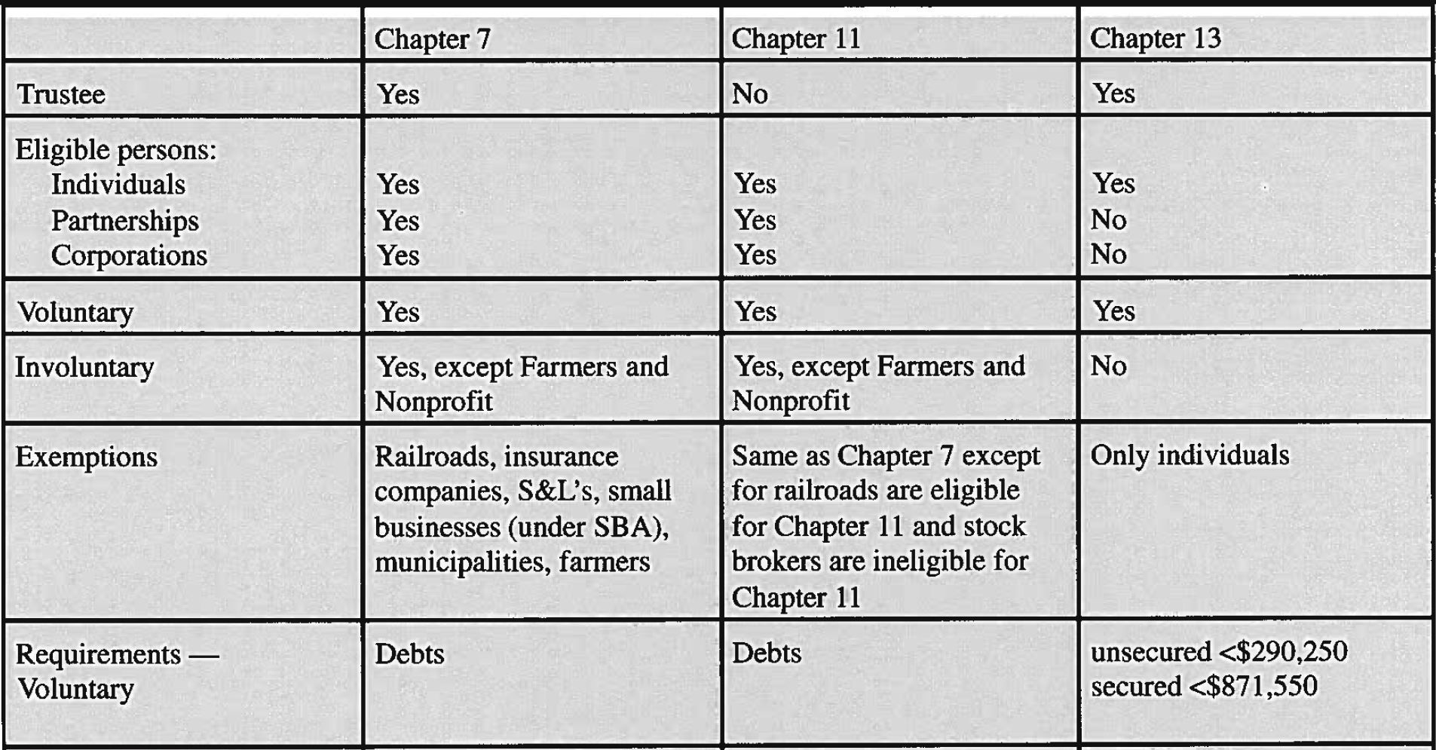
Bankruptcy
  Administration, Actions and Parties
How Bankruptcy is Declared

Slide 17
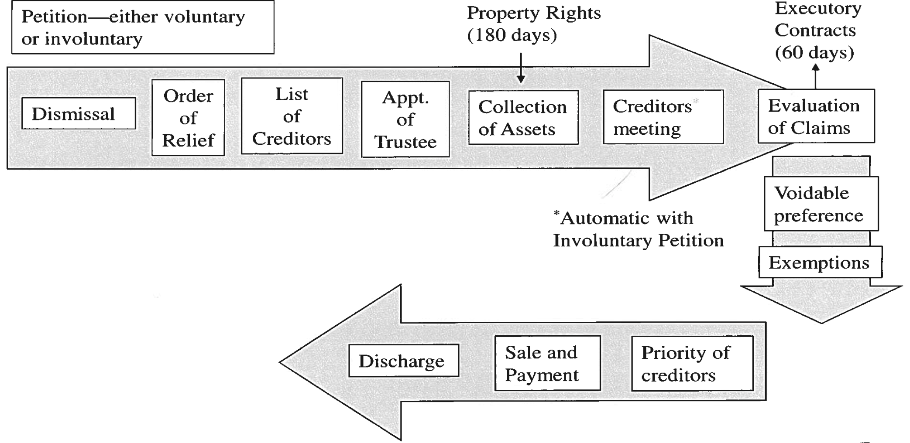
Bankruptcy
  Administration, Actions and Parties
The Administration of a Bankruptcy Case

Slide 18
Bankruptcy
  Administration, Actions and Parties
How Bankruptcy is Declared
  Bankruptcy Procedure
    Bankruptcy Court – Part of the Federal Court System;
    Governed by the Federal Rules of Bankruptcy Court;
    There are official forms; and
    Local Rules of Individual Bankruptcy Courts.
  Bankruptcy Cases
    State courts can rule on BR issues
    Mostly federal court cases however
    Bankruptcy reporters cite previous decisions for case law
    Various levels of appeal
    Each issue can have different law in different federal circuits

Slide 19
Bankruptcy
  Types of Bankruptcy Cases
The type of the Bankruptcy case, and the rules applied to its administration under the bankruptcy code, depend upon the debtor and the remedy they are seeking.
The Types of Bankruptcy are separated by Chapters in the code.
  Five bankruptcy proceedings are available:
    Chapter 7 (Liquidation);
    Chapter 9 (Municipalities)
    Chapter 11 (Business reorganization);
    Chapter 12 (Family Farms and Fishermen); and
    Chapter 13 (Individual Consumer Debt Adjustment).

Slide 20
Bankruptcy
  Types of Bankruptcy Cases
Chapter 7 - Liquidation
A liquidation proceeding under Chapter 7 may be either voluntary or involuntary.
A voluntary case is commenced by the debtor’s filing a petition with the
bankruptcy court.
An involuntary case is commenced by the creditors’ filing a petition with the court.
    If there are 12 or more creditors, at least 3 whose unsecured claims total $12,300 or more must sign the involuntary petition.
    If there are fewer than 12 creditors, any creditor whose unsecured claim is at least $12,300 may sign the petition.
Chapter 7 is:
    For personal bankruptcy
    Often referred to is liquidation bankruptcy
    When debtors turn over nonessential assets to bankruptcy trustee, who
    then sells them off and distributes proceeds to creditors eliminating debt
    completely
    This type of bankruptcy was most affected by the BAOCPA (The
    Bankruptcy Abuse Prevention and Consumer Protection Act of 2005)

Slide 21
Bankruptcy
  Types of Bankruptcy Cases
Chapter 7 – Liquidation (Administration)
Automatic stay prevents creditors from taking legal action against the debtor.
Order of relief granted by bankruptcy court.
List of creditors and notice given.
The trustee in bankruptcy is elected by the creditors.
Trustee acquires the rights and ownership of the debtor.

Slide 22
Bankruptcy
  Types of Bankruptcy Cases
Chapter 7 – Liquidation (Administration)
Voidable Preferences.
Voidable Transfers: Trustee can avoid (cancel)
transfers of property.
  Preferential Transfers to creditors.
  ‘Insider’ transfers.
Proof of Claim.
Priority of Claims.

Slide 23
Bankruptcy
  Types of Bankruptcy Cases
Chapter 7 – Liquidation (Claims and Creditors)
Bankruptcy law regulates the way creditors present their claims and the assets of the debtor are to be distributed in payment of the claims.
Certain property of the debtor is exempt from the claims of creditors.
Proof of Claim.
  Creditors object to discharge of debt and demand payment.
  Must be filed within 90 days of bankruptcy petition filing.
Priority of Claims.
  Creditors with security interests (such as a mortgage or lien)
  are not affected.

Slide 24
Bankruptcy
  Types of Bankruptcy Cases
Chapter 7 – Liquidation (Claims and Creditors)
Unsecured claims are paid in this order:
  (1) administrative expenses;
  (2) claims arising in the ordinary course of the debtor’s business;
  (3) wage claims, with limits;
  (4) contributions to employee benefit plans;
  (5) claims by consumer creditors;
  (6) certain taxes; and
  (7) general creditors.

Slide 25
Bankruptcy
  Types of Bankruptcy Cases
Chapter 7 – Liquidation
Debtor’s Duties and Exemptions:
  List of creditors, debts, and assets.
  List of exemptions (both federal and state laws).
  Debtor’s protection against discrimination.
Discharge in Bankruptcy:
  The decree terminating bankruptcy proceedings is generally a discharge that releases the debtor from most debts.
  Exemptions from Discharge:
    Income taxes, student loans, loans obtained by fraud, alimony, judgments based on willful and malicious injury.

Slide 26
Bankruptcy
  Types of Bankruptcy Cases
Chapter 11 – Reorganization
For Corporations that want to reorganize their finances and remain in business
Features a debt repayment plan
Under Chapter 11, Individuals, partnerships, and corporations in business may be reorganized so that the business may continue to operate.
A plan for reorganization must be approved by the court.

Slide 27
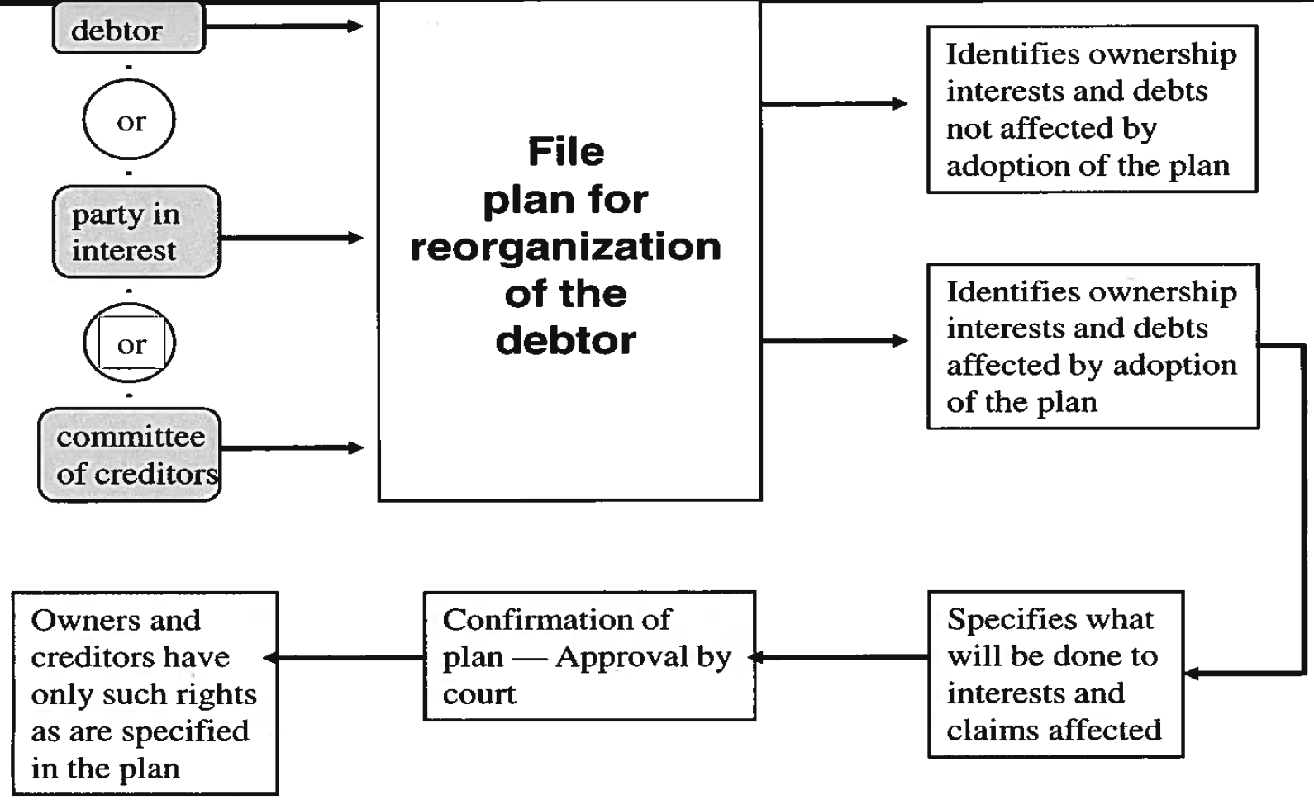
Bankruptcy
  Types of Bankruptcy Cases
Chapter 11 – Reorganization

Slide 28
Bankruptcy
  Types of Bankruptcy Cases
Chapter 13 – Individual Consumer Plans
Individual debtors with a regular income may adopt extended-time payment plans under Chapter 13 for the payment of debts.
A plan for extended-time payment must also be confirmed by the court.
More individuals who would have filed under chapter 7, now file under chapter 13. “Cram down” instead of liquidation.

Slide 29
Bankruptcy
  The Bankruptcy Case
What the Parties Want:
  Debtor
  Discharge debts
  Preserve assets
  Creditor & Trustee
  Maximize distribution to creditors
  Keep debtor “honest”
    Discharge only dischargeable debts
    Keep no non-exempt assets
What the Bankruptcy Court Wants:
  “Fresh start” for honest debtors
  Return to productivity
  Free from unmanageable debt
  Promote best interests of creditors
  Equitable distribution of estate, from debtor’s non-exempt assets

Slide 30
Bankruptcy
  Updates in Bankruptcy Law
Effective starting 2005, Congress enacted BAPCPA
Bankruptcy Abuse Prevention and Consumer Protection Act
BAPCPA
Requires credit counseling for all debtors before filing bankruptcy
Requires a personal financial management course after filing
Establishes thresholds for debtors to keep cars & homes after filing
Requires Debtors to wait 8 years (up from 7) to file again
Automatic stay can no longer be used to stop or delay:
  evictions,
  loss of driver's license,
  loss of professional license,
  divorce & domestic violence cases; and
Provides for a significantly increased paperwork burden

Slide 31
Bankruptcy
  Updates in Bankruptcy Law
BAPCPA Continued
Imposes a “means test” to see if debtors are poor enough to file a
Chapter 7 liquidation; if not, they must file a Chapter 13 payment
plan
Fewer debts can be discharged
Institutes a higher priority for child support & alimony
Requires lawyers to now certify the accuracy of debtor’s filings
(and they can be held liable if the information is wrong)
Requires attorneys to certify a debtor's ability to make payments
under a reaffirmation (debt payment) agreement
ALL lawyers who advise clients about bankruptcy (even business
lawyers) must now identify themselves as "debt relief agencies“

Slide 32

Case Study:
In Re: Matter of Clothing Store Dissolution
A Regrettable Case of Involuntary Bankruptcy
The case that involved deceit and tragedy

Slide 33
End of Class Thirteen C
For next time – Review the Final Exam Review Slides on the Webpage:
Thank you for Being a Wonderful Class!!!

