Slide 1
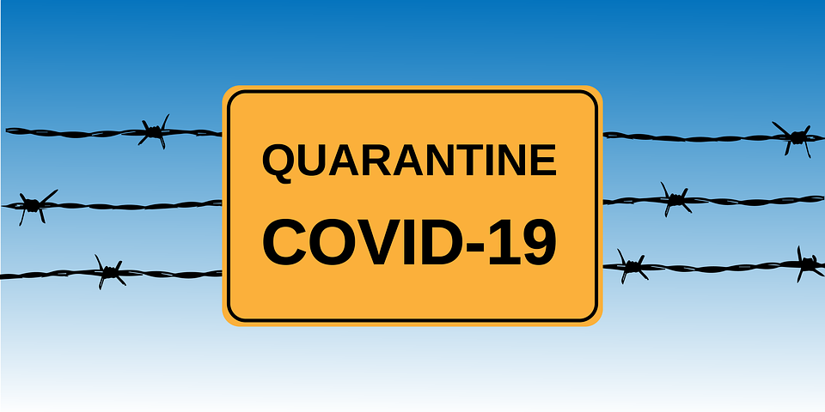
Government Response to Covid-19: Federal Responsibility or State Issue
Brooke Brewer
Professor Eric Lopez

Slide 2
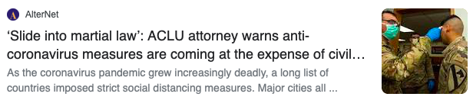
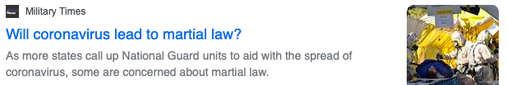
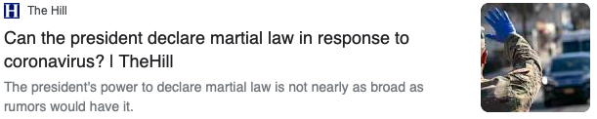
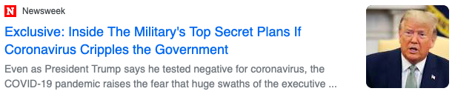
Introduction
Notes:
-In times of panic and crisis like we are in now, misinformation is abundant on social media, the internet, and some news sources, leading to the rise of conspiracy theories
-For example, many claim that the federal government will impose martial law as a way of enforcing a national shutdown

Slide 3
Introduction
What is martial law?
Is federal martial law applicable and reasonable to combat Covid-19?
If not, what can the federal government do to respond to a pandemic?
Notes:
-This leads to some interesting questions: what is martial law? Is it even applicable and reasonable to combat Covid-19? If not martial law, what can the federal government do to respond to a pandemic of this nature?

Slide 4
Research Question
Which level of government, under the Constitution and historical practice, can lawfully order isolation and quarantine?
Notes:
-These concepts bring about the central research question that this presentation answers: How does the federal government’s power co-exist with state police powers given under the foundations of federalism?
-This includes asking ourselves who is more appropriately able to do so, and leads us to examine the possibility of state or national shutdowns
-This is important for you to know so that, as an American, you know which level of government should and can be doing what
-In times of chaos like the current situation, it can be a source of relief and comfort to know that your mayor, governor, or president is doing what they can to protect you from Covid-19
-So, hopefully after this presentation you will be able to point out conspiracy theories regarding efforts to combat this virus

Slide 5
Review of the Legal History/Case Law
Justice Davis, Ex parte Milligan (1866)
“If, in foreign invasion or civil war, the courts are actually closed, and it is impossible to administer criminal justice according to law, then, on the theater of active military operations, where war really prevails, there is a necessity to furnish a substitute for the civil authority, thus overthrown, to preserve the safety of the army and society; and as no power is left but the military, it is allowed to govern by martial rule until the laws can have their free course. As necessity creates the rule, so it limits its duration; for, if this government is continued after the courts are reinstated, it is a gross usurpation of power. Martial rule can never exist where the courts are open, and in proper and unobstructed exercise of their jurisdiction. It is also confined to the locality of actual war.”
Notes:
-To begin, the best way to gain insight into how martial law is understood and applied is by looking at the judiciary’s analysis and explanation of the constitutional concepts at work
-In reviewing the case law relevant to martial law, I started by looking at Ex parte Milligan from 1866, which dealt with President Lincoln’s suspension of habeas corpus to suppress rebellion during the Civil War
-This opinion by Justice Davis gives an unclear, baseline understanding of martial law; not enough to set a constitutional definition

Slide 6
Review of the Legal History/Case Law
Justice Black, Duncan v. Kahanamoku (1946)
“The Constitution does not refer to "martial law" at all, and no Act of Congress has defined the term. It has been employed in various ways by different people and at different times. By some, it has been identified as "military law" limited to members of, and those connected with, the armed forces. Others have said that the term does not imply a system of established rules, but denotes simply some kind of day-to-day expression of a General's will dictated by what he considers the imperious necessity of the moment.”
Notes:
-So, we move forward to another case from 1946: Duncan v. Kahanamoku
-This case dealt with the military tribunals set up in Hawaii under martial law during World War II, following Pearl Harbor
-Here, Justice Black identifies that even the Supreme Court has no clear definition of martial law

Slide 7
Federal Martial Law
No clear definition, nor enough history to establish precedent
Understood to be the ability of the President to invoke the military to restore or preserve peace
  happens through the temporary replacement of civil authorities by the military
Notes:
-What is federal martial law then, since it has no clear definition, nor enough history to have established precedent?
-It is understood as the ability of the President, through his executive power as Commander in Chief and the power given to him by Congress, to invoke the military to restore or preserve peace, preventatively or amidst public chaos

Slide 8
History of Martial Law
Declared 7 times federally
President Washington during the Whiskey Rebellion
President Lincoln during the Civil War
President Roosevelt after Pearl Harbor
Notes:
President Lincoln declared martial law in response to rebellion and insurrection that could not be stopped by ordinary means in Kentucky, and in doing so suspended habeas corpus
After the attack on Pearl Harbor in 1941, the Governor of Hawaii declared state martial law (that essentially gave the local Army General command of the territory until it was secured) that was eventually approved by President Roosevelt.

Slide 9
History of Martial Law
Most recent declarations were for civil rights situations
1957: President Eisenhower in Arkansas
1962: President Kennedy in Mississippi
1964 & 1965: President Johnson in Alabama
Notes:
1957: sent federal troops to overcome the state National Guard that was dispatched to combat desegregation ordered by the courts
1962: federal troops were sent as an effort to suppress rioting following racial disagreements with a University admission decision
1964: sent troops to aid in court-ordered desegregation
1965: sent federal troops to protect civil rights activists, saying that there was a high risk of violence that was not being controlled by the state government

Slide 10
Is Martial Law Reasonable Now?
No
Not in a time of war
Not enough manpower
Civilian government is adapting
Courts are open (modified)
Notes:
-It is not reasonable to declare in this situation because we are not in a time of war (yes the times are crazy, but it is not wartime)
-Although it could be argued that America needs the strictness of the military to enforce quarantines (since we know some people will not stay home), we also do not have the manpower to set up the military in every state, airport, interstate highway, etc to stand outside and make sure this person doesn’t leave and that person doesn’t leave

Slide 11
Other Federal Powers
Commerce Clause
Quarantine and isolation at points of entry into the U.S.
Regulation of interstate and international commerce/travel
May assist states/local authorities
Notes:
-What can the federal government do?
-The federal government derives its authority for isolation and quarantine from the Commerce Clause of the United States Constitution
-This gives them the power to quarantine and isolate at points of entry into the US and regulate interstate and international commerce and travel, which could be seen in effect at airports and seaports
-they can assist states, probably financially, but they can NOT tell them what to do or force any one way of responding
-the most important form of power and responsibility the federal government can take in this situation is to provide assistance to states and local authorities

Slide 12
State Police Power
Tenth Amendment to the U.S. Constitution
“The powers not delegated to the United States by the Constitution, nor prohibited by it to the States, are reserved to the States respectively, or to the people.”
General police power as “first line of local defense” against a pandemic
Legally, this explains President Trump’s deferral to governors
Notes:
-So, you can see this really is a state issue
-States have an inherent power (one that the federal government doesn’t have) given to them through the 10th Amendment that allows them to order their citizens to do things. For example, it is the state government that has the power to require you to purchase car insurance, force you to go to school until you’re 18, and enforce quarantine and isolation
-Their general police power comes from the right of the state to take action affecting individuals for the benefit of society, making states the first line of local defense against a pandemic like Covid-19
-This is why President Trump has left deference to state governors, allowing them to take action as they see fit for the situation of their state and according to the presence of rural and exurban areas in their borders

Slide 13
State Police Power
Intrastate regulations
Isolation and quarantine
Close businesses, restaurants, churches, etc
Deployment of National Guard
Federally reimbursed by FEMA
Discretionary power that differs from state to state
43 states have stay-at-home orders
Notes:
-The state police power they have been afforded includes the ability to regulate intrastate affairs, which means they can enforce isolation and quarantine within their borders. This is why it is perfectly legal to close businesses, restaurants, churches, and more in this time where “essential businesses and services” are the only ones allowed to stay open
-States also have the power to deploy their National Guard, and as of March 22, President Trump directed the Secretary of Defense to permit full federal reimbursement by FEMA for the states’ use of their National Guard
-The police power given to states differs from state to state, and can be broadened or narrowed by provisions in a specific state’s constitution
-So we can see that state governments possess the power and tools to combat the virus, so they bare the responsibility to institute policies that make sense for their area
-For example, 43 states have stay-at-home orders in place as of now, but the other 7 states are not obligated to do that and can essentially respond how they please (obviously, those states have some sort of other measures taken, like county-by-county approaches seen in Florida, but the strictness of their Covid-19 measures are reliant upon the status of their state and the severity of spread/infection seen there)

Slide 14
Conclusions
Look to your state governors to take action in responding to this pandemic,
Constitution places immense police power with them
National lockdown through martial law is unlikely, as President Trump has shown a willingness to allow the states to craft their own solutions
Federalism
Allows states to use their inherent police power to combat the spread of the virus
Notes:
-After hearing the distribution of governmental power that allows for the coexistence of federal and state regulations, look to your state governors to take action in responding to this pandemic, since it is their responsibility first
-The federalist system that was established all those years ago at the Constitutional Convention leaves much of the appropriate authority for situations like this to the states
-In Smith County, County Judge Nathaniel Moran presides over the commissioners’ court and has numerous responsibilities that are related to public welfare, including acting as head of Emergency Management. This allows him to make decisions for Smith County, like his decision to extend the stay-at-home order until April 30
-The prospect of a national lockdown is unlikely, given the fact that President Trump is a big believer in allowing the states flexibility in their responses, and the imposition of martial law is not prudent nor legal in this situation
-The most important understanding of governmental power and its balance in this situation: federalism is controlling who has the most appropriate power to act

Slide 15
Looking Forward
Keep in mind what each level of government is actually responsible for
Be a critical consumer
Notes:
-by informing/researching martial law and the division of power, it is important to keep in mind what each level of government is actually responsible for
-If the National Guard is present in your area, that does not mean martial law is being imposed (in most states now, they are simply helping with food and medical supplies)
-Although we are all unqualified to answer who should take control for the public’s benefit, we can all be informed enough to know that the federal government can be giving assistance to the states, and the states have the power and tools to fight this virus on the frontlines

