Slide 1


Pandemics and Reactions
An Overview and Analysis

Slide 2
Pandemics and Reactions
What We Will Talk About:
Part One: What is a Pandemic?
Pandemic Defined
Why are Pandemics Scary?
What Causes Pandemics: Diseases, Transmission and Virulence
Defense Against Pandemics – Immunity
Forces to Fight Pandemics
Part Two: Pandemics in History
Pioneers in Medicine
Past Pandemics
Part Three: How to Address a Pandemic
Prevention
Response
Recovery
Entities Responsible for Addressing A Pandemic
Part Four: The Coronavirus Pandemic of 2019-20
Facts About the Coronavirus
Ground Zero Wuhan China
Coronavirus 2019-20 Pandemic Statistics
Coronavirus 2019-20 Pandemic Federal Action Team
Coronavirus 2019-20 Pandemic State Action Team
Coronavirus 2019-20 Pandemic Action Timeline
Coronavirus 2019-20 Pandemic Final Thoughts

Slide 3
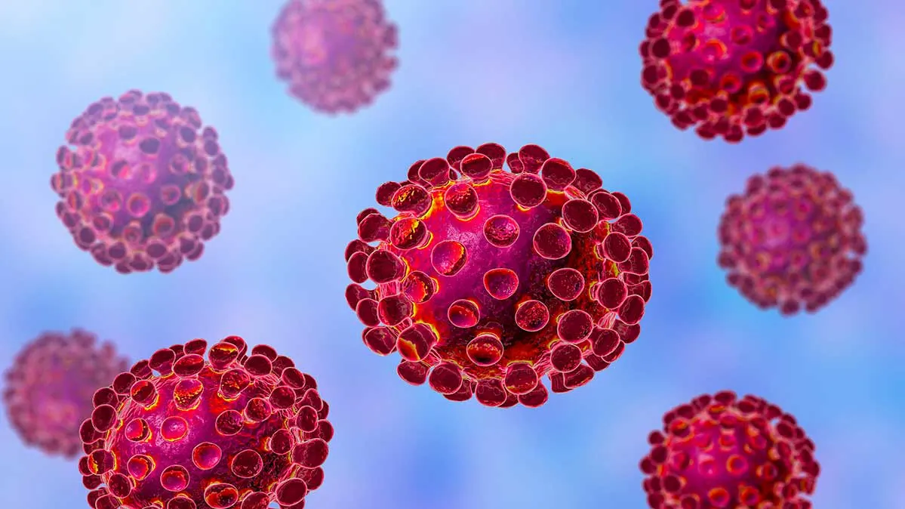
Part One - What is a Pandemic

Slide 4
Pandemic Defined
An Epidemic is the active spread of an infectious disease across a large geographic area, among a high proportion of the population, and has been characterized as “out of control”.
A Pandemic on the other hand, is the active spread of an epidemic, nationally or globally.
A disease is not a pandemic or epidemic merely because it kills or afflicts, a great number of people, or occurs in wide variety of places. It must be infectious and communicable as well.
Accordingly, cancer or diabetes are not a pandemic diseases, whereas AIDS, Influenza and Corona Viruses are.

Slide 5
Why are Pandemics Scary?
Pandemics are scary for multiple reasons.
Invisible – First, pandemics are caused by microscopic pathogens that human beings cannot see. An unseen threat is particularly scary.
Dangerous – Second, pandemics cause physical sickness, permanent disability and/or death. A threat that can make us sick, harm us forever, or kill us is again, particularly scary.
Dynamic – Third, pandemics are caused by complex, mutating, biological organisms that are hard to understand. A threat that frequently changes and is difficult to comprehend is very scary.
Helpless - Fourth, pandemics, until they are studied, and sometimes even afterward, are very difficult to treat, cure or prevent. When no effective treatment, cure or prevention exists, people feel helpless. A threat against which people are helpless, is again, particularly scary.

Slide 6
What Causes Pandemics?
A Pandemic, is caused by:
A Disease which is:
Communicable and
Virulent

Slide 7
What Causes Pandemics - Diseases
What Is A Disease?
A human Disease, is a particular abnormal condition, that negatively affects the structure or function of all or part of a human being’s body, and which is not caused by any immediate external injury.
Diseases are medical conditions that are associated with specific symptoms.
Diseases involved with pandemics are caused by a specific Pathogen. A Pathogen is anything that can cause a disease, and types of Pathogens include:
● Viruses; ● Bacteria; ● Prions;
● Fungi; ● Algae; and ● Parasites.

Slide 8
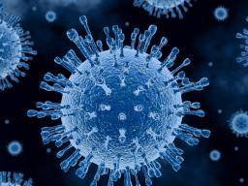
What Causes Pandemics - Diseases
Pathogens - Viruses
Viruses are submicroscopic infectious agents.
They are organisms typically 100 times smaller than bacteria.
Viruses are not plants, animals, or bacteria, and are not living
organisms in the strict sense of the word, because without a
host cell, they cannot carry out their life-sustaining functions
or reproduce.
They contain RNA or DNA, but they do require a host cell to replicate.
Found everywhere on earth, they are the most numerous type of biological entity.
They are classified into seven groups:
dsDNA viruses (e.g. Adenoviruses, Herpesviruses, Poxviruses);
ssDNA viruses (e.g. Parvoviruses);
dsRNA viruses (e.g. Reoviruses);
(+)ssRNA viruses (e.g. Coronaviruses, Picornaviruses, Togaviruses);
(−)ssRNA viruses (e.g. Orthomyxoviruses, Rhabdoviruses);
ssRNA-RT viruses (e.g. Retroviruses); and
dsDNA-RT viruses (e.g. Hepadnaviruses)

Slide 9
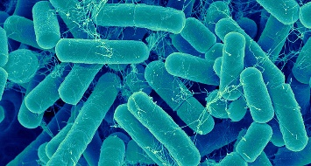
What Causes Pandemics - Diseases
Pathogens - Bacteria
Bacteria are microscopic infectious agents.
They are organisms typically 100 times larger than viruses, but are still so small they can not begin to be seen by the naked eye (typically a few micrometers – one millionth of a meter - in size).
Bacteria are Prokaryotes, which are cellular organisms that have no membrane bound organelles. (An organelle is a specialized subunit, within a cell, that has a specific function, and within bacteria, are spatially distinct functional units without a surrounding lipid bilayer).
The vast majority of bacteria are harmless or even beneficial to humans, however, certain pathogenic bacteria, can result in infectious diseases, by causing cellular damage to their host..
A type of biological cell, bacteria were among the first life forms to appear on Earth, and like viruses, are found everywhere on the planet.
Pathogenic bacteria are a major cause of human death and disease, and can cause infections such as tetanus, typhoid fever, diphtheria, syphilis, cholera, foodborne illness, leprosy and tuberculosis.
Bacterial infections may be treated with antibiotics, which are classified as bacteriocidal if they kill bacteria, or bacteriostatic if they just prevent bacterial growth.
Disinfectants, such as bleach, are also used to kill bacteria, or other pathogens, on surfaces, to prevent contamination and further reduce the risk of infection.

Slide 10
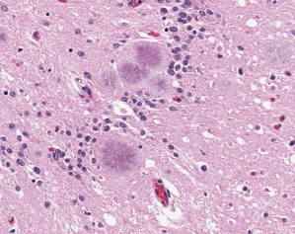
What Causes Pandemics – Diseases
Pathogens - Prions
Prions are misfolded proteins that can transfer their
misfolded state to normally folded proteins of the same type.
They do not contain any DNA or RNA and cannot replicate other
than to convert normal proteins to the misfolded state.
All known prion diseases affect the structure of the brain, or other neural tissue, are progressive and degenerative, have no known effective treatment, and are always fatal.
The most well known prion based disease is Creutzfeldt–Jakob disease (better known as mad cow disease).
Transmission of prions is believed to be caused by ingestion.
They are size of a single protein, and are 1/10th the size of a virus.
The word “prion”, coined in 1982 is derived from “protein” and “infection”, and is short for "proteinaceous infectious particle", in reference to its ability to self-propagate and transmit its conformation to other proteins.
Sadly, very little is known about prions or the diseases the cause, but research is ongoing.

Slide 11
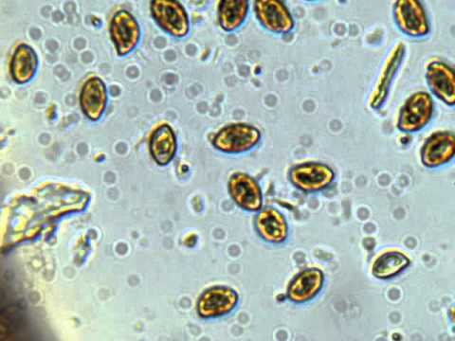
What Causes Pandemics - Diseases
Pathogens - Fungi
Fungi are eukaryotic, microscopic, spore based, organisms that
can function as pathogens. (Eukaryotes are organisms
whose cells have a nucleus enclosed within membranes)
Approximately 300 known fungi are pathogenic to humans.
Fungi spores are approximately the same size as a virus.
Fungi include yeasts and molds, as well as the more familiar mushrooms.
Abundant worldwide, most fungi are inconspicuous because of the small size of their structures, and their cryptic lifestyles in soil or on dead matter.
Certain fungi can cause serious diseases in humans, several of which may be fatal if untreated. These include aspergillosis, candidiasis, coccidioidomycosis, cryptococcosis, histoplasmosis, mycetomas, and paracoccidioidomycosis.
Persons with immuno-deficiencies are particularly susceptible to disease by fungi such as Aspergillus, Candida, Cryptoccocus, Histoplasma, and Pneumocystis.
Other fungi can attack eyes, nails, hair, and especially skin (the so-called dermatophytic and keratinophilic fungi) and can cause local infections such as ringworm or athlete's foot. Fungi can also cause allergies and other reactions.

Slide 12
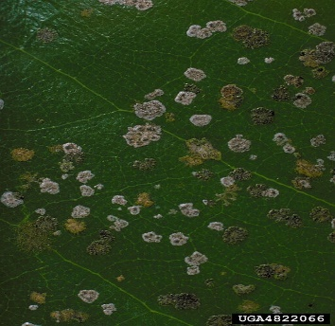
What Causes Pandemics - Diseases
Pathogens - Algae
Algae are single-celled microscopic plants.
Algae too are Eukaryotes, meaning organisms whose cells
have a nucleus enclosed within membranes.
They are generally non-pathogenic, but pathogenic varieties do exist.
They are 7 times the size of viruses.
Examples of algae acting as a pathogens are well known, causing such diseases as protothecosis and prototheca, which are parasitic conditions, causing infection, inflammation and cellular damage.
Algae can also become pathogenic as a part of harmful algal bloom (HAB), which is an algal bloom that causes negative impacts to other organisms via production of natural toxins, cellular damage, or by other means.
HABs are also often associated with large-scale marine mortality events, frequently causing shellfish poisonings, which can effect humans by ingestion.

Slide 13

What Causes Pandemics - Diseases
Pathogens - Parasites
Human parasites are organisms, that lives inside a human being,
and which depends upon that human host for its survival.
Without the human host the parasite cannot grow, live or multiply.
Parasites vary widely, with 70 percent not being visible to the human eye (such as the malarial parasite), but other parasites (such as some rapidly growing worms) can reach over 30 meters in length.
Human parasites include:
microscopic protozoa (more than 12 types);
worms (more than 8 types); and flukes
(more than 5 types).
Human parasites can infect humans and can cause parasitic diseases.
They are divided into:
endoparasites (which cause infection inside the body); and
ectoparasites (which cause infection superficially within the skin).

Slide 14
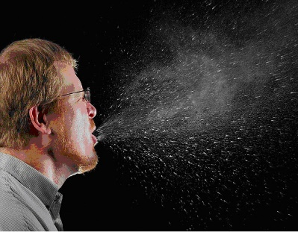
What Causes Pandemics - Transmission
Communicable Diseases – Means of Transmission
A pandemic requires that the disease which causes it
must be communicable.
This means that the subject disease must be able to be
transmitted to people.
The means of this transmission is the way the disease is transmitted
to a human being, as well as the manner in which another human
can catch it.
There are multiple means of transmission for pathogens, and they include:
● Airborne ● Droplet ● Foodborne ● Infectious ● Lifestyle ● Non-communicable

Slide 15
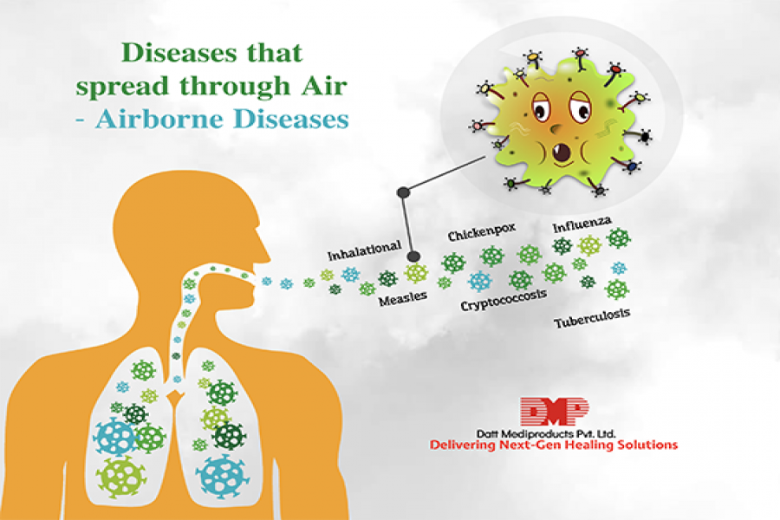
What Causes Pandemics - Transmission
Communicable Diseases – Means of Transmission
● Airborne:
An airborne disease
is any disease
that is caused
by pathogens
and is transmitted
through the air.

Slide 16
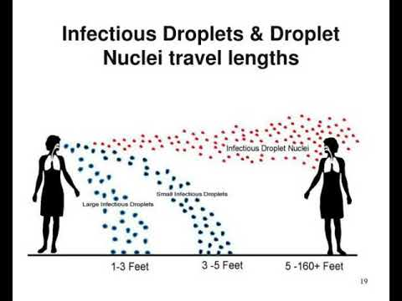
What Causes Pandemics - Transmission
Communicable Diseases – Means of Transmission
● Droplet:
Droplet transmission occurs
when pathogens travel
on relatively large respiratory
droplets that people sneeze,
cough, drip, or exhale.
These droplets travel short distances before
settling, usually less than 3 feet, and are loaded
with infectious particles.
They can be spread directly if people are close,
but more often, these droplets land on surfaces,
where they often remain infectious for hours or days.

Slide 17
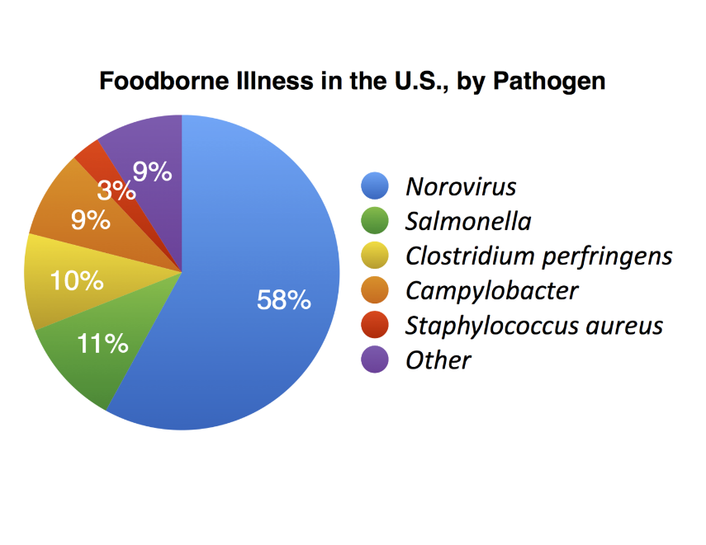
What Causes Pandemics - Transmission
Communicable Diseases – Means of Transmission
● Foodborne:
A foodborne illness
or food poisoning
is any disease
resulting from
the consumption
of food contaminated
with pathogenic bacteria, toxins, viruses,
prions or parasites.
In such cases the means of transmission
is ingestion

Slide 18
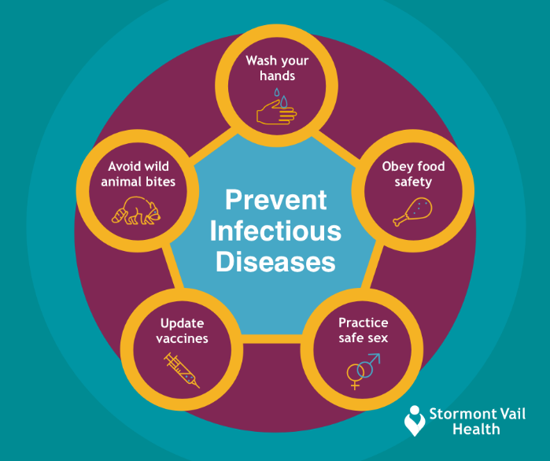
What Causes Pandemics - Transmission
Communicable Diseases – Means of Transmission
● Infectious:
An infectious disease,
also known as
a transmissible disease
or a communicable disease,
results from the infection,
presence and growth
of pathogenic, biological agents
in an individual host organism, and that can be transmitted from one person to another.
Such transmission occurs when the pathogen invades the human’s body, by means of physical contact with a person’s skin, mouth, nose, eyes, blood or other bodily canals or fluid exchange.

Slide 19
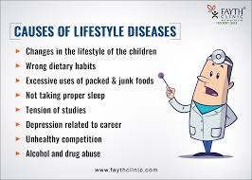
What Causes Pandemics - Transmission
Non Communicable Diseases:
Certain diseases are behavioral, and are not communicable. These diseases cannot cause a pandemic.
● Lifestyle:
A disease that is
non-transmissible,
with risk factors that
include behavioral choices,
such as a sedentary lifestyle,
substance abuse, smoking
or a diet high in unhealthful
foods.

Slide 20
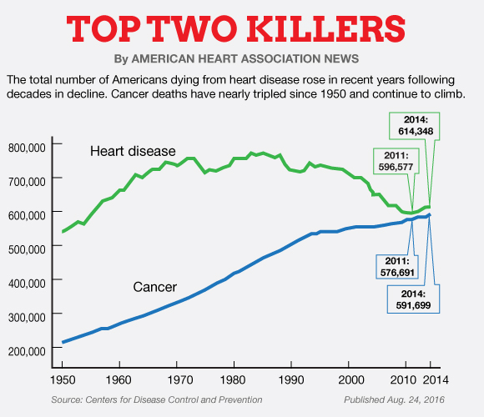
What Causes Pandemics - Transmission
Non Communicable Diseases:
Certain diseases cannot be transmitted, and are not communicable. These diseases cannot cause a pandemic.
● Non-communicable:
These diseases are a
medical condition or
disease that is
non-transmissible.
These diseases cannot be transmitted directly
from one person to another.
Heart disease and cancer are examples of
non-communicable diseases.

Slide 21
What Causes Pandemics - Transmission
Communicable Diseases: Ease of Transmission
A pandemic also requires that the disease which causes it, must be EASY to transmit and contract.
If a disease is not easily transmitted by an infected person, or not easily contracted by an uninfected person, it is unlikely to be widely spread.
Ease of transmission: How easily the disease is spread, from one person to another, depends on several factors.

Slide 22
What Causes Pandemics - Transmission
Communicable Diseases – Ease of Transmission
How easily the disease is spread, from one person to another, depends on:
● Means of Transmission:
Does the means of transmission
of the pathogen
afford easy transmissibility
(such as airborne or droplet transmission)
and can such a spread
occur simply by casual contact,
or through exposure to environments?

Slide 23
What Causes Pandemics - Transmission
Communicable Diseases – Ease of Transmission
How easily the disease is spread, from one person to another, depends on:
● Resiliency of the Pathogen:
How resilient the pathogen is
(i.e., can it survive on many kinds
of surfaces in the open air
for long periods of time,
or does it need moisture
or some special environment
to survive and spread)?

Slide 24
What Causes Pandemics - Transmission
Communicable Diseases – Ease of Transmission
How easily the disease is spread, from one person to another, depends on:
● Infectiousness of the Pathogen:
How infectious is the pathogen
(in how likely is any exposure
to the pathogen in an uninfected
person to cause an infection),
and how much of the pathogen
does it take to cause the infection
of another person?

Slide 25
What Causes Pandemics - Transmission
Communicable Diseases – Ease of Transmission
How easily the disease is spread, from one person to another, depends on:
● Control/Prevention of Transmission:
How abundant is the transmission
(how often can it occur) and
how difficult is it to prevent
the means of transmission?

Slide 26
What Causes Pandemics - Transmission
Communicable Diseases – Ease of Transmission
How easily the disease is spread, from one person to another, depends on:
● Virulence of the Disease:
Can the disease be present
in people without making them
so sick that they do not
have the opportunity
to transmit it to others?

Slide 27
What Causes Pandemics - Transmission
Communicable Diseases – Ease of Transmission
How easily the disease is spread, from one person to another, depends on:
● Incubation period:
How long does it take
for an infected person
to develop symptoms, and
how long does the infected person
remain contagious?

Slide 28
What Causes Pandemics - Transmission
Communicable Diseases – Ease of Transmission
How easily the disease is spread, from one person to another, depends on:
● Discoverability:
How easy is the disease
to diagnosis, treat, and prevent?

Slide 29
What Causes Pandemics - Virulence
Virulence
A pandemic requires that the disease which causes it must also be virulent.
● Virulence:
Relates to the level or degree
of harm that the subject disease
can cause to a human being
who contracts it.

Slide 30
What Causes Pandemics - Virulence
Virulence
A pandemic requires that the disease which causes it must also be virulent.
● Virulence and Pandemics:
Virulence is the prime factor of whether
a disease will rise to the level of a pandemic.
For if the disease which is spreading globally,
does not cause significant levels of death, or
serious disability, to human beings,
(such as the common cold or seasonal flu),
it is much more likely that the disease,
will merely be categorized as an annoyance,
rather than a serious, global health emergency.

Slide 31
What Causes Pandemics - Virulence
Virulence
A pandemic requires that the disease which causes it must also be virulent.
● Virulence and Infectiousness:
Virulence is also a factor related to both the lethality of the
disease (the likelihood that the disease will cause death or
serious, permanent injury to the person), as well as the
infectiousness of the disease (the ease of the disease’s
transmission and the likelihood that any single person can
catch such disease from exposure to any other person).
Because highly virulent diseases tend to kill or seriously
disable persons infected, they also often have a reduced
chance of transmissibility (since infected people die or
become disabled before they can transmit the disease).
This issue, however, is impacted by the length of time that
exists, before a person infected with the disease, becomes
symptomatic (as such a person can transmit the disease to
others before they succumb to the effects of its virulence).

Slide 32
Defense Against Pandemics - Immunity
The Immune System
The best defense against a pandemic is human beings themselves.
For when a disease attacks a human being, what ultimately allows that person to survive, is their immune system.
All treatments, vaccines and remedies that we develop to fight disease, have one thing in common, they buy time for our own immune system to kill the pathogen that invades us.

Slide 33
Defense Against Pandemics - Immunity
The Immune System – What is it?
What is the Immune System?
Our immune system is an intricate collection of specialized cells, tissues, and molecules, that work together to protect us from infectious diseases.
When our immune system is working well, we stay healthy, and when it’s not, we may become susceptible to deadly infections.
In this section we will discuss the components of the immune system, and how they work together to protect us.
Additionally, we will discuss what we can do to boost our immune systems to fight disease.

Slide 34
Defense Against Pandemics - Immunity
The Immune System - Components
● Components of the Immune System
There are four structural components of the immune system.
These include:
The Thymus;
Bone Marrow;
The Spleen; and
The Lymphatic System.
These components work together to keep us healthy and fend off pathogens that can cause disease.
To function properly, our immune system must detect these pathogens, and distinguish them from the organism's own healthy tissue.
As pathogens can rapidly evolve, adapt and mutate to avoid detection and neutralization by the immune system, it in turn, has developed multiple defense mechanisms, to recognize and neutralize diseases that have invaded a person’s body.

Slide 35
Defense Against Pandemics - Immunity
The Immune System – The Innate System
There are two divisions of the immune system we use to fight disease. They are the Innate System and the Adaptive System
The Innate System:
Human Beings have certain built-in, or innate, immune features that helps protect us from disease.
First, there are physical barriers to invasion from pathogens, including the skin, mucous membranes, tears, saliva, and stomach acid, which do not target specific germs, but are rather, all purpose defenses, to prevent infection from causing us harm.
Second, there are also internal innate immune responses, including:
White blood cells called neutrophils, produced in the bone marrow, and positioned along the circulatory system, and in the blood, to act as a reservoir of infection fighting cells.
Inflammation, which is a response to the entry of a pathogen that causes increased blood flow to the invaded area, bringing killer white blood cells to attack the disease.
Fever, raises the body temperature of the invaded person, to deploy the weapon of heat against the pathogen, which impairs them from replicating.

Slide 36
Defense Against Pandemics - Immunity
The Immune System – Adaptive System
There are two divisions of the immune system we use to fight disease. They are the Innate System and the Adaptive System
The Adaptive System:
Human Beings also have an adaptive immune system, composed of highly specialized cells that can adapt to, and learn from, prior encounters with a specific pathogen.
It remembers that you had a specific pathogen in the past, and will protect you from it again, thereby providing you “immunity.
The Adaptive Immune System works through the cell-mediated system and the antibody-mediated humoral system:
The Cell Mediated System uses cells to attack infection. These include Lymphocytes, which are B and T cells, which mount very specific antigen response and bind only one particular molecular structure, to impair or kill it, or to activate other cells to do so.
The Antibody Mediated System works through plasma cells, performing several functions, including neutralizing bacterial toxins, binding to viruses to prevent entry into cells, and opsonization, in which a coating of antibodies increases the effectiveness of neutrophils trying to engulf the pathogen. There are four main types of antibodies: immunoglobulins M, A, E, and G.

Slide 37
Defense Against Pandemics - Immunity
The Immune System – How to Boost It
How to Boost the Immune System?
It is difficult to boost the immune system precisely because it is a system made up of many different types of cells, and science is not exactly sure what kinds of cells, and/or how many of each, would make up a perfect system.
Presently, medical science looks for ways to best improve a person’s overall immune response, and make them healthy, thereby advising things like a healthy diet and exercise.
But when fighting a specific disease, there are some additional things that can be done to boost the immune system, including:
  Vaccination: Boosts a person’s adaptive immune system, by introducing a weakened version of a pathogen into a person’s body, so that the immune system can easily kill it and recognize it again in the future.
  Antibiotics and Antivirals: Medications that help the immune system attack and kill a pathogen, thereby providing it with an opportunity to defeat the disease, and allow the person to return to good overall health.
  Symptom Treatments: Medications or procedures that help a person deal with the negative symptoms of a pathogenic infection, and thereby prevent an overwhelming of the immune system, so as to give it sufficient time to kill, neutralize or address the disease.

Slide 38
Forces to Fight Pandemics
Modern Medicine
The principle force to help our own immune systems fight a pandemic is modern medicine.
Born from the scientific method of the 18th century, modern medicine helps us by developing cures, treatments and strategies to fight diseases.
It does this by research, experimentation, modeling and communication.

Slide 39
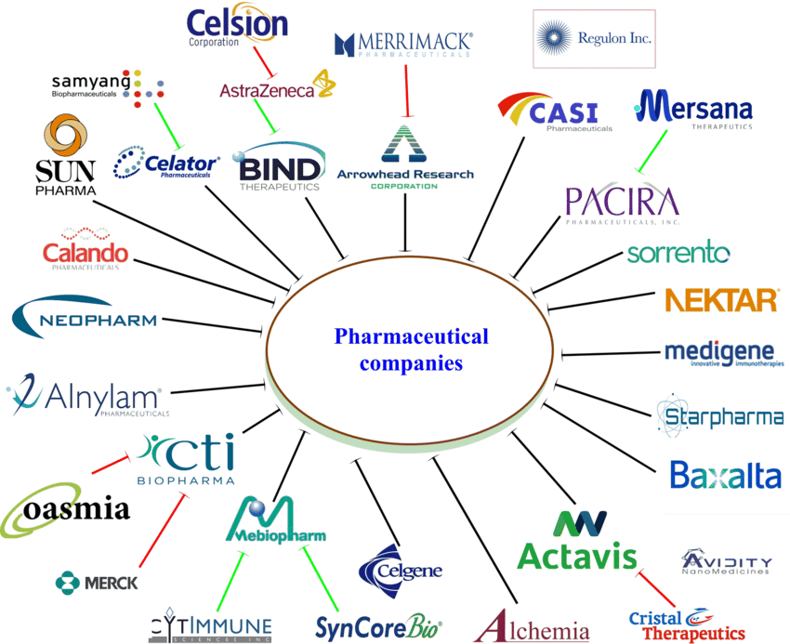

Forces to Fight Pandemics
Pharmaceutical Companies
One of the primary entities modern medicine uses to fight diseases is pharmaceutical companies.
These private sector companies use the power of profit to develop new treatments, medications (drugs) and vaccines to fight disease.
By pouring Billions of dollars annually into scientific research, clinical trials and testing, these companies produce countless treatments, medications and vaccines each year.
Located all across the globe, but principally in the United States, these companies lead the way against the fight against pandemics.

Slide 40
Forces to Fight Pandemics
Federal Research and Development Labs
Another critical entity that modern medicine uses to fight diseases is Federal Research and Development Laboratories.
Operated and funded by the federal government, these entities include:
USAMRID – The US Army Medical Research Institute of Infectious Disease;
Fort Detrick, Maryland
CDC – Center for Disease Control and Prevention;
Atlanta, Georgia
NIH - National Institutes of Health;
Bethesda, Maryland
NIAID - National Institute of Allergy and Infectious Diseases;
Bethesda, Maryland and Hamilton, Montana
FDA - Food and Drug Administration; and
Silver Spring, Maryland
HRSA - Health Resources and Service Administration.
Bethesda, Maryland

Slide 41
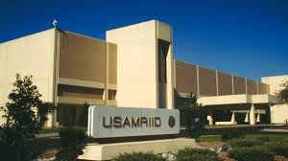
Forces to Fight Pandemics
Federal Research and Development Labs
Another critical entity that modern medicine uses to fight diseases is Federal Research and Development Laboratories.
Operated and funded by the federal government, these entities include:
USAMRID – The US Army Medical Research Institute of Infectious Disease;
Fort Detrick, Maryland

Slide 42
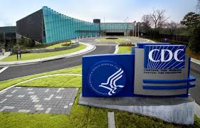
Forces to Fight Pandemics
Federal Research and Development Labs
Another critical entity that modern medicine uses to fight diseases is Federal Research and Development Laboratories.
Operated and funded by the federal government, these entities include:
CDC – Center for Disease Control and Prevention;
Atlanta, Georgia

Slide 43
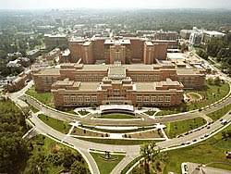
Forces to Fight Pandemics
Federal Research and Development Labs
Another critical entity that modern medicine uses to fight diseases is Federal Research and Development Laboratories.
Operated and funded by the federal government, these entities include:
NIH - National Institutes of Health;
Bethesda, Maryland

Slide 44
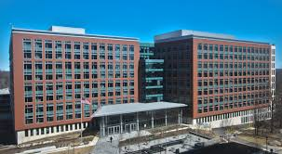

Forces to Fight Pandemics
Federal Research and Development Labs
Another critical entity that modern medicine uses to fight diseases is Federal Research and Development Laboratories.
Operated and funded by the federal government, these entities include:
NIAID - National Institute of Allergy and Infectious Diseases;
Bethesda, Maryland and Hamilton, Montana

Slide 45
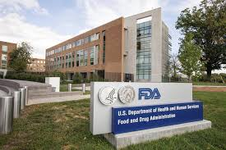
Forces to Fight Pandemics
Federal Research and Development Labs
Another critical entity that modern medicine uses to fight diseases is Federal Research and Development Laboratories.
Operated and funded by the federal government, these entities include:
FDA - Food and Drug Administration; and
Silver Spring, Maryland

Slide 46

Forces to Fight Pandemics
Federal Research and Development Labs
Another critical entity that modern medicine uses to fight diseases is Federal Research and Development Laboratories.
Operated and funded by the federal government, these entities include:
HRSA - Health Resources and Service Administration.
Bethesda, Maryland

Slide 47

Part Two - Pandemics in History

Slide 48
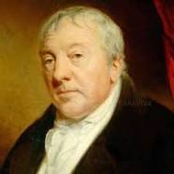
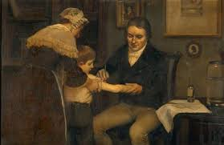
Pioneers of Modern Medicine
Edward Jenner
Edward Jenner (1749-1823): Vaccines
British surgeon and naturalist Edward Jenner developed the first vaccine, the smallpox vaccine, in 1796.
Jenner was inspired to develop the practice of vaccination after noticing that milkmaids who caught the disease cowpox never developed smallpox.
Jenner inoculated the son of his gardener with cowpox, and the boy failed to develop smallpox after being exposed repeatedly to infected smallpox material.
This first vaccine laid the foundations for the field of immunology.

Slide 49
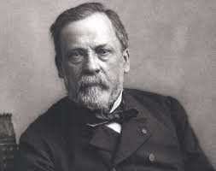
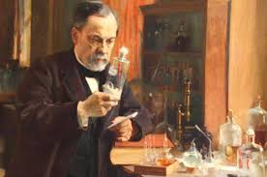
Pioneers of Modern Medicine
Louis Pasteur
Louis Pasteur (1822-1895): Germ Theory
Among his many claims to fame, French chemist and microbiologist Louis Pasteur was the first scientist to support the germ theory of disease, the idea that diseases are caused by microorganisms, with his research.
Pasteur expended a lot of effort investigating what agents caused beverages like milk and wine to spoil, inventing his eponymic process “pasteurization” in the process.
After discovering that microbes were responsible for sour wine and spoiled milk, Pasteur hypothesized that microbes also caused disease in the body.
He later supported this theory in the mid-1860s by showing that a malady attacking silkworms in Alais, France, was caused by microbes attacking silkworm eggs.

Slide 50
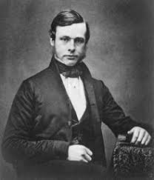
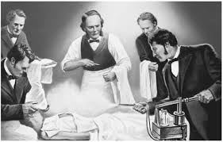
Pioneers of Modern Medicine
Joseph Lister
Joseph Lister (1827-1912): Antiseptic surgery
British surgeon Joseph Lister is best known for applying Louis Pasteur’s work in microbiology to pioneer antiseptic surgery.
At the University of Glasgow in the 1860s Dr. Lister experimented with wound treatment with carbolic acid, then used to treat sewage, using Pasteur’s studies of the germ theory of disease to guide his work.
After successfully proving that carbolic acid-based sterilization of wounds reduced gangrene, Dr. Lister went on to promote handwashing and surgical instrument sterilization as a means of reducing infection.
His legacy in sterilization is also evident in the naming of a bacteria genus, a slime mold genus and Listerine, all of which are his namesakes.

Slide 51
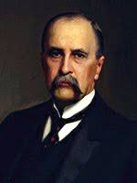
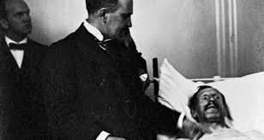
Pioneers of Modern Medicine
William Osler
William Osler (1849-1919): Specialty Residency and Medical Training
Canadian physician William Osler is known as the “father of modern medicine.”
One of the founders of Johns Hopkins Hospital in Baltimore, Md., Osler created the first specialty training residency program / medical school.
He was also the first to put medical students through formalized bedside clinical training.
In addition to his medical career, Osler was also a historian and an author.

Slide 52
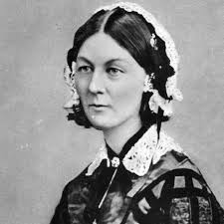
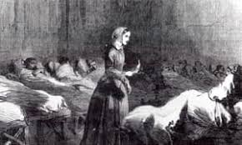
Pioneers of Modern Medicine
Florence Nightingale
Florence Nightingale (1820-1910): Nursing
Florence Nightingale, social reformer, statistician and healthcare pioneer, was the founder of modern nursing.
The British native’s claim to fame came during the Crimean War in 1854, when she and 38 other women were sent to minister to British soldiers.
Finding an unhygienic, short-staffed hectic camp, Nightingale and her team reduced the death rate by 42 percent to 2 percent.
A fund to train nurses for the war was established in her name in 1855.
Nightingale went on to found a nursing school, write several texts on nursing and contribute to modern statistical analysis of sanitary reform.

Slide 53
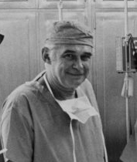
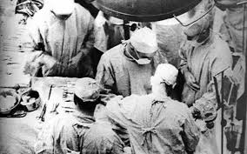
Pioneers of Modern Medicine
Richard Lawler
Richard Lawler (1896-1982): Organ transplants
Richard M. Lawler, MD, is best known for performing the first successful internal organ transplant, a kidney.
He performed the transplant in 1950 in Chicago at Little Company of Mary Hospital.
His patient was a 49-year-old Ruth Tucker, who suffered from polycystic kidney disease.
The transplant was successful, though Ms. Tucker died from other causes five years later.
While Dr. Lawler never performed another kidney transplant, his success paved the way for others to see the possibility of organ transplant as a viable treatment option.

Slide 54
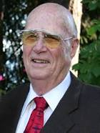
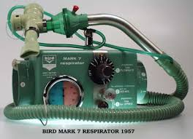
Pioneers of Modern Medicine
Forest Bird
8. Forrest M. Bird (b. 1921): Ventilator
Forrest M. Bird, MD, PhD, ScD, is an American pilot and inventor best known for creating the first reliable mechanical ventilators which are used in cardiopulmonary care.
Dr. Bird began his career as a pilot, making his first solo flight at the age of 14 and earning his first aviation license at 16.
By the time he enrolled in the Air Force at in 1941, he was qualified to be a technical air training officer.
This qualification allowed Dr. Bird to fly nearly every plane the Air Force had to offer, including several that exceeded comfortable breathing altitudes.
This experience prompted him to invent ventilation aids. In 1955 his work resulted in the release of the Bird Universal Medical Respirator, a pneumatic ventilator that is still in use around the world today.

Slide 55
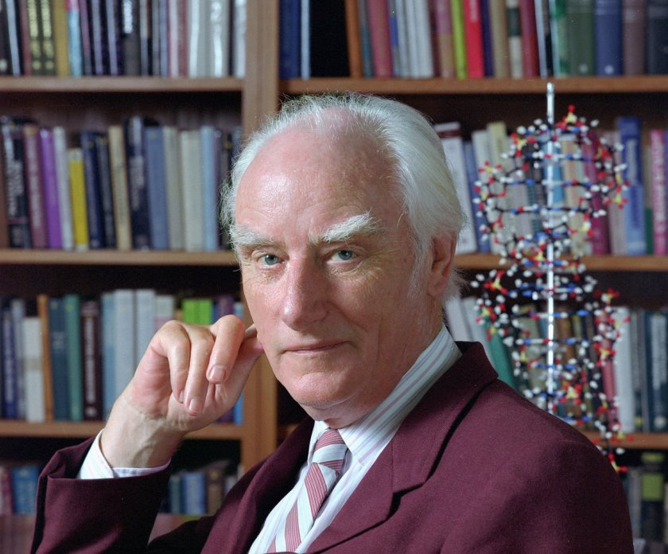

Pioneers of Modern Medicine
Francis Crick
Francis Crick (1916-2004): Molecular biology
Known most famously for being one of the four researchers who determined the double-helix structure of DNA, Francis Crick, PhD, is also a leader of the research team that discovered DNA is made of codons - amino acid triplets, that carry and encode genetic information.
As a result of this late-1950s discovery, another research team was able to decipher the genetic code.
This uncracking of the genetic code, had led to the birth of molecular biology and the understanding of the role genetics plays in human variation and health.

Slide 56
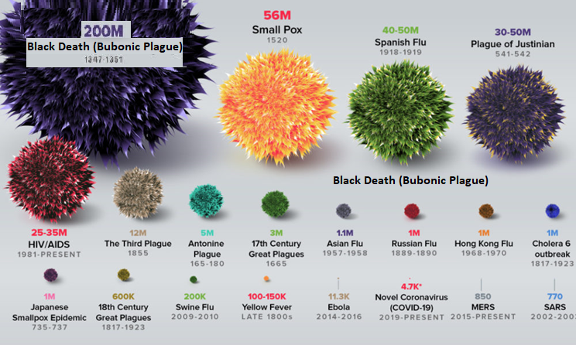
Terrible Pandemics in History

Slide 57
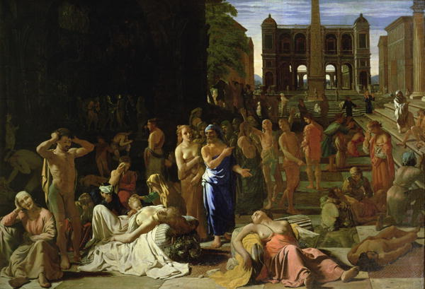
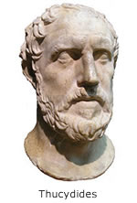

Plague of Athens (430 B.C.)
Typhoid
Occurred during the Peloponnesian War between Sparta and Athens.
First recorded pandemic in history.
Killed over a quarter of Athens troops and up to 2/3 of Athens population (estimated 100,000).
The cause was unknown until 2006, where university researchers analyzed teeth of the dead and found typhoid bacteria.

Slide 58
Plague of Athens (430 B.C.)
Typhoid
Cause:
An bacterial intestine/blood infection caused by Salmonella.
Symptoms:
Beginning 6 to 30 days after exposure;
High Fever;
Weakness/Fatigue;
Abdominal Pain/Constipation/Vomiting;
Headaches;
Skin rash.
Duration:
Without treatment, symptoms can last weeks or months.
Virulence:
Without treatment/antibotics – Fatality rate is 10 to 20 percent.
Asymptomatic carriers can spread the disease to others
Spread:
Eating or drinking food or water contaminated with the feces of an infected person.

Slide 59
Plague of Athens (430 B.C.)
Thucydides described the disease as such "People in good health were all of a sudden attacked by violent heats in the head, and redness and inflammation in the eyes, the inward parts, such as the throat or tongue, becoming bloody and emitting an unnatural and fetid breath. Next came coughing, diarrhea, spasms, and skin ulcers. A handful survived, but often without their fingers, sights, and even genitals!”
How we would treat it today:
Vaccinate against the toxin produced by the typhoid (salmonella) bacteria.
Fluid replacement.
Antibiotics like tetracycline.
These treatments would reduce the chance of death to close to zero.

Slide 60
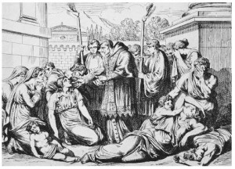
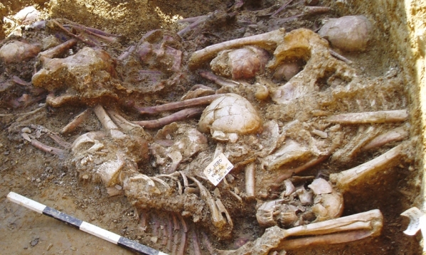
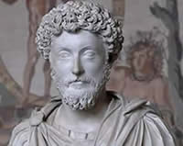
The Antonine Plague (165-180 A.D.)
Small Pox / Measles
Roman troops returning from battles in the middle east brought back with the spoils of war, smallpox and measles.
It decimated the population of Rome and is thought to be the single greatest cause of the weakening of the Roman Empire in Northern and Eastern Europe.
Killed the last great Roman Emperor, Marcus Aurelius Antoninius.
It killed one quarter of those infected. (estimated 5 million).

Slide 61
The Antonine Plague (165-180 A.D.)
Small Pox
Cause:
Highly contagious, viral variant infection caused by Variola Major/Minor.
Symptoms:
Beginning 10 to 14 days after infection;
Fever;
Vomiting;
Back Pain;
Fatigue;
Mouth Sores/Skin Rash;
Fluid-filled Bumps on the Skin, Which Scab, Fall Off, and Leave Scars.
Duration:
Days to Weeks
Virulence:
Fatality rate is typically 30%, with higher rates among babies.
Survivors often suffer extensive scarring, with a small number left blind.
Spread:
By Personal Contact or Contaminated Objects

Slide 62
The Antonine Plague (165-180 A.D.)
Measles
Cause:
A highly contagious, viral infection caused by the Measles Virus.
Symptoms:
Beginning 10–12 days after exposure to an infected person;
High Fever;
Cough;
Runny Nose/Congestion/Inflamed eyes;
Small, White Spots inside the Mouth;
Red, Flat Face Rash that Spreads to the Rest of the Body.
Duration:
7 to 10 Days
Virulence:
Without treatment – Fatality rate is 10 to 20 percent (mostly children)
Complications: diarrhea, ear infection or pneumonia.
Serious complications: seizures, blindness, or brain inflammation.
Most people do not get the disease more than once.
Spread:
Airborne/droplet transmission through coughs/sneezes of infected people, or through direct contact with mouth or nasal secretions, or surfaces on which the virus is residing.
Extremely contagious, 90% of non-immune people who share living space with an infected person, will also become infected.

Slide 63
The Antonine Plague (165-180 A.D.)
The famous Greek physician Galen described it as “a long, cruel disease that involved fever, diarrhea, and inflammation of the throat, as well as pustules on the skin”.
How we would treat it today:
Small Pox Vaccine.
Measles Vaccine.
Anti Viral Drugs such as Cidofovir.
Thankfully due to wide spread vaccination programs small pox has been eradicated all over the world since 1979.
The only remaining samples of the small pox virus exist today in high level medical research labs such as USAMRID (United States Army Medical Research Institute of Infectious Diseases.
Sadly measles does still exist, and outbreaks do still continue to happen, although it has been severely limited due to vaccines.

Slide 64
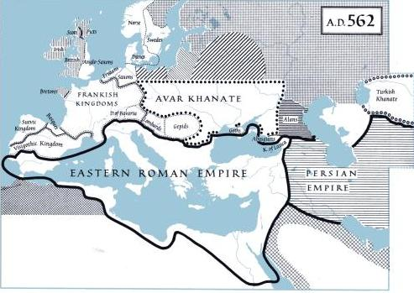

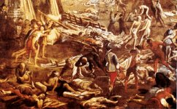
The Justinian Plague (541-542 A.D.)
Bubonic Plague
The Byzantine Empire, which imported most of its grain from Egypt, in order to feed its people, also imported with it, the Bubonic Plague (caused by the Bacteria Yserina pestis).
This plague killed between 5,000 to 10,000 people a day.
It eventually killed up to 40% of Constantinople’s population and by the year 700 A.D., killed up to 60% of Europe’s population (estimated 50 million).

Slide 65
The Justinian Plague (541-542 A.D.)
Bubonic Plague
Bubonic Plague:
A bacterial blood/lymph node infection caused by yserina pestis bacteria.
Symptoms:
Beginning 1 to 7 days after exposure;
Fever;
Headaches;
Vomiting;
Swollen and Painful Lymph Nodes, which may break open.
Duration:
10 Days
Virulence:
Without treatment/antibiotics – Fatality rate is 30 to 90 percent.
Spread:
By infected fleas whose bite transmits the bacteria, or
By exposure to the body fluids of a plague-infected animal or person.

Slide 66
The Justinian Plague (541-542 A.D.)
The Byzantine historian Procopius first reported the epidemic in 541, stating that at its peak the plague was killing 10,000 people in Constantinople daily. He further noted that because there was no room to bury the dead, bodies were left stacked in the open, with the entire city smelling like the dead. In his Secret History, he records the devastation, stating: “When pestilence swept through the whole known world and notably the Roman Empire, wiping out most of the farming community and of necessity leaving a trail of desolation in its wake, Justinian showed no mercy towards the ruined freeholders.”
How we would treat it today:
Antibiotics like streptomycin and tetracycline.
85% of today’s cases are curable.
Thankfully today, due to antibiotics, Bubonic Plague is not the deadly killer it was in the past

Slide 67
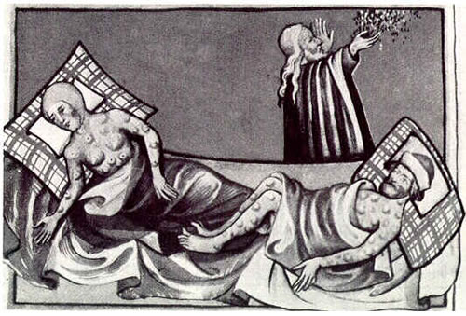
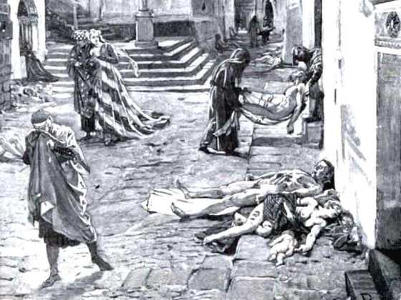
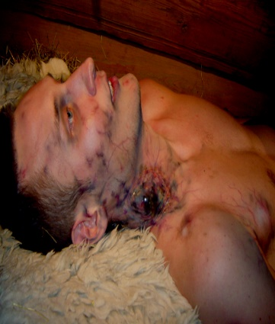
The Black Death (1347-1351 A.D.)
Bubonic Plague
This was the most famous and deadly pandemic in Earth’s history.
It killed between 30-60% of Europe’s population. (estimated 200 million).
Once arriving in western Europe via merchant ships, it spread rampantly from city to city creating widespread terror and panic.
Victims broke out in large, oozing pustules, vomited profusely, coughed up blood, and contracted other conditions such as necrosis and gangrene.
80 percent of victims died within eight days,

Slide 68
The Black Death (1347-1351 A.D.)
Bubonic Plague
Bubonic Plague:
A bacterial blood/lymph node infection caused by yserina pestis bacteria.
Symptoms:
Beginning 1 to 7 days after exposure;
Fever;
Headaches;
Vomiting;
Swollen and Painful Lymph Nodes, which may break open.
Duration:
10 Days
Virulence:
Without treatment/antibiotics – Fatality rate is 30 to 90 percent.
Spread:
By infected fleas whose bite transmits the bacteria, or
By exposure to the body fluids of a plague-infected animal or person.

Slide 69
The Black Death (1347-1351 A.D.)
According to medieval historian Philip Daileader, it is likely that over four years, 45–50% of the European population died of the plague. Italian chronicler Agnolo di Tura recorded his experience from Siena: “Father abandoned child, wife husband, one brother another; for this illness seemed to strike through the breath and sight. And so they died. And none could be found to bury the dead for money or friendship. Members of a household brought their dead to a ditch as best they could, without priest, without divine offices ... great pits were dug and piled deep with the multitude of dead. And they died by the hundreds both day and night ... And as soon as those ditches were filled more were dug ... And I, Agnolo di Tura ... buried my five children with my own hands.”
How we would treat it today:
Antibiotics like streptomycin and tetracycline.
85% of today’s cases are curable.
Thankfully today, due to antibiotics, Bubonic Plague is not the deadly killer it was in the past

Slide 70
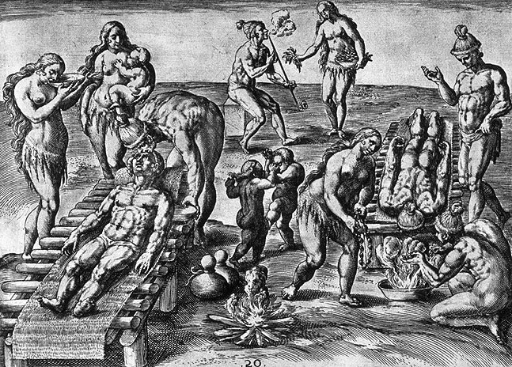
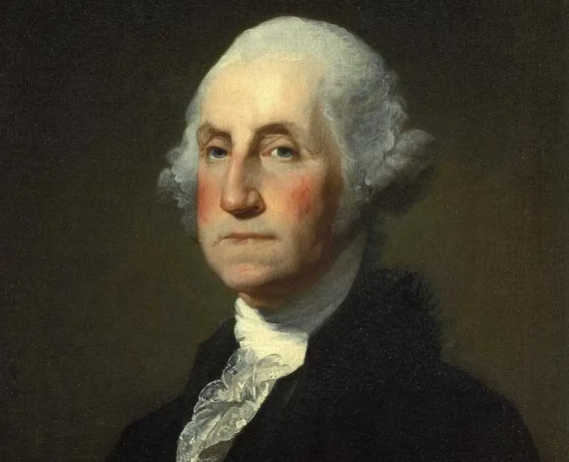

New World Small Pox (1633 - 1800 A.D.)
Small Pox
Small Pox became one of the deadliest killers in the New World.
Between Colonists and Native Americans, the small pox virus widely killed and disfigured (an estimated 56 Million).
By 1723, Boston alone, had seen four epidemics of smallpox alone.
Three out of every ten who contracted the disease died.
Starting in 1721 inoculation, the process of purposefully infecting a person with small pox by means of passing a needle with the pus of a victim and transferring it to a healthy individual became an accepted medical practice.

Slide 71
New World Small Pox (1633 - 1800 A.D.)
Small Pox
Cause:
Highly contagious, viral variant infection caused by Variola Major/Minor.
Symptoms:
Beginning 10 to 14 days after infection;
Fever;
Vomiting;
Back Pain;
Fatigue;
Mouth Sores/Skin Rash;
Fluid-filled Bumps on the Skin, Which Scab, Fall Off, and Leave Scars.
Duration:
Days to Weeks
Virulence:
Fatality rate is typically 30%, with higher rates among babies.
Survivors often suffer extensive scarring, with a small number left blind.
Spread:
By Personal Contact or Contaminated Objects

Slide 72
New World Small Pox (1633 - 1800 A.D.)
George Washington survived Small Pox as a teenager in Barbados, and he, as well as Ben Franklin, Alexander Hamilton and Thomas Jefferson were fierce advocates for inoculation.
During the Revolution small pox caused devastating losses to the Colonial Army, including stopping its invasion of Canada in 1775 and 1776, and in its winter encampment at Valley Forge during 1777.
How we would treat it today:
Small Pox Vaccine.
Anti Viral Drugs such as Cidofovir.
Thankfully due to wide spread vaccination programs small pox has been eradicated all over the world since 1979.
The only remaining samples of the small pox virus exist today in high level medical research labs such as USAMRID (United States Army Medical Research Institute of Infectious Diseases.

Slide 73
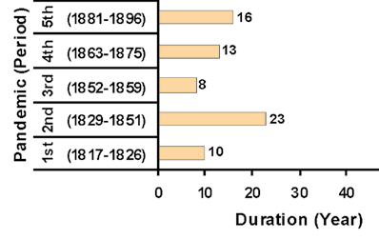
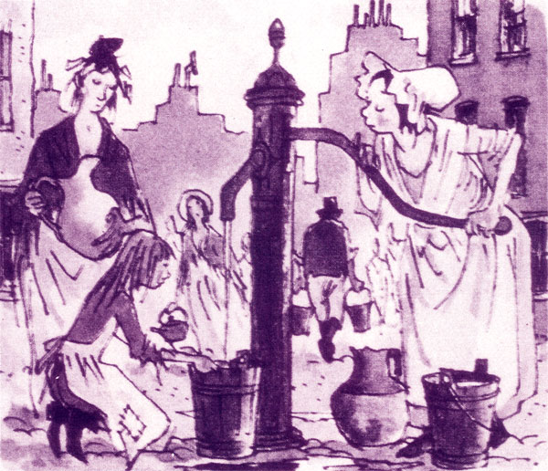
Cholera (1816 - 1896 A.D.)
Cholera
There were five major cholera pandemics, during the 19th century (killing an estimated 1 million people).
Untreated victims died within as little as 3 hours of the first symptoms, literally of fluid loss due to acute diarrhea, which was accompanied by vomiting, cramps and lowered blood pressure.
In Chicago in 1854, Cholera killed 5% of the city’s population.
The 1853 London outbreak was stopped when physician John Snow discovered its source to be a waterpump contaminated by the feces of other cholera victims.

Slide 74
Cholera (1816 - 1896 A.D.)
Cholera
Cause:
An bacterial intestine/blood infection caused by Vibrio Cholerae.
Symptoms:
Beginning 2 hours to 5 days after exposure;
Severe Diarrhea;
Muscle Cramps;
Vomiting;
Sunken Eyes;
Cold Skin.
Duration:
Three to Five Days.
Virulence:
Without treatment/antibotics – Fatality rate is 15% (mostly seniors).
Asymptomatic carriers and infected can spread the disease to others
Spread:
Eating or drinking food or water contaminated with the feces of an infected person.

Slide 75
.
Cholera (1816 - 1896 A.D.)
Cholera caused more deaths, more quickly, than any other epidemic disease in the 19th century. Cholera, an exclusively a human disease, is transmitted through fecal-contaminated waters and contaminated foods. Contemporary English doctors published the following description of the disease's symptoms and onset: “Giddiness, sick stomach, nervous agitation, intermittent, slow, or small pulse, cramps beginning at the tops of the fingers and toes, and rapidly approaching the trunk, give the first warning. Vomiting or purging, or both these evacuations of a liquid like rice-water or whey, or barley-water, come on; the features become sharp and contracted, the eye sinks, the look is expressive of terror and wildness; the lips, face, neck, hands, and feet, and soon after the thighs, arms, and whole surface assume a leaden, blue, purple, black, or deep brown tint according to the complexion of the individual, varying in shade with the intensity of the attack.”
How we would treat it today:
Antibiotics like streptomycin and tetracycline.
Fluid Replacement.
Thankfully today, when treated properly the death rate is now less than 1 percent of victims.

Slide 76
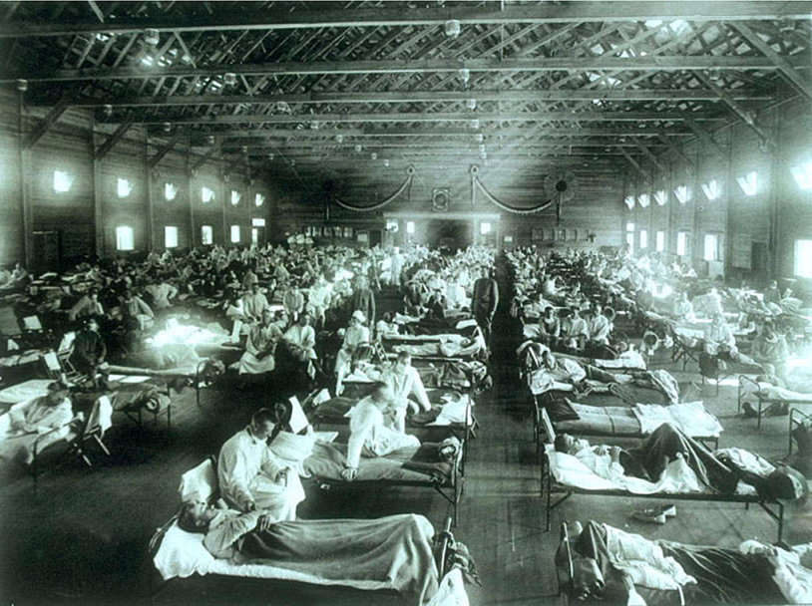


Spanish Flu (1918 - 1920 A.D.)
Influenza A (Spanish)
During the height of World War I, a shockingly virulent strain of Influenza-A swept the world, quickly spreading to all regions all across the globe (killing an estimated 50 million people).
Whereas most flu epidemics affect only weaker populations, such as infants or the elderly, the 1918 Flu involved a virus mutation that allowed it to overtake the immune system and turn it against the victim’s body.
This resulted in a much higher mortality rate among the otherwise young and healthy, whose immune systems were stronger, as well as a devastating toll on social productivity.

Slide 77
Spanish Flu (1918 - 1920 A.D.)
H1N1 - Influenza - A
Cause:
A highly contagious, viral infection caused the H1N1 Influenza A virus.
Symptoms:
Beginning 1 to 4 days after infection;
Headache;
Fatigue;
Dry, Hacking Cough;
Runny Nose/Congestion;
Stomach Ache, Loss of Appetite;
Respiratory Distress/Shortness of Breath.
Duration:
3 to 10 days
Virulence:
Fatality rate was typically 3%, with higher rates among young adults.
Known to trigger a Cytokine Storm (a hyper active immune response).
Spread:
Airborne/droplet transmission through coughs/sneezes of infected people, or through direct contact with mouth or nasal secretions, or surfaces on which the virus is residing.
Extremely contagious, nearly one third of the globe (an estimated 500 million people) became infected.

Slide 78
Spanish Flu (1918 - 1920 A.D.)
Everyday life stopped, schools and shops closed, and even gravediggers were too sick to bury the dead. In some cases, mass graves were dug using steam shovels, and bodies were buried without coffins.
This pandemic infected nearly one third of the world’s population (600, million people), and reportedly caused between 50 million and 100 million deaths – more than all the wars of the 20th century combined. World War One stopped in large part due to this pandemic.
With no vaccine to protect against influenza infection, and with no antibiotics to treat secondary bacterial infections, control efforts worldwide were limited to non pharmaceutical measures, such as isolation, quarantine, good personal hygiene, disinfectants, and limitations of public gatherings.
How we would treat it today:
Antivirals like Tamiflu and Relenza
Proper Hygiene.
This was the first Swine Flu (H1N1 virus) pandemic in recorded history and the first pandemic in the age of modern medicine.

Slide 79



Polio (1930 - 1955 A.D.)
Poliomyelitis
Throughout the first half of the 20th century, the polio virus arrived each summer, striking without warning. No one knew how it was transmitted or how it was caused.
In 1952, the number of polio cases in the U.S. peaked at 57,879, resulting in 3,145 deaths.
Those who survived this highly infectious disease, could end up with a form of paralysis, forcing them to use crutches, wheelchairs or to be put into an iron lung (a large tank respirator for breathing).
Ultimately, poliomyelitis was conquered in 1955. A vaccine was developed by Jonas Salk and his team at the University of Pittsburgh.

Slide 80
Polio (1930 - 1955 A.D.)
Polio
Cause:
A contagious, viral infection caused the poliomyelitis virus.
Symptoms:
Beginning 6 to 20 days after infection;
Fever;
Sore Throat;
Fatigue;
Stomach Pain/Vomiting;
Pain/Stiffness in Back, Neck, Limbs and/or Diaphragm.
Duration:
3 to 10 days
Virulence:
Fatality rate - 30 percent among adults, far less with children.
Asymptomatic carriers (nearly 70% of infected) can spread the disease to others.
Spread:
Present in saliva and intestines of infected individuals, it is spread from person to person, by food or water containing human feces, and less commonly from infected saliva.
Years after recovery, persons originally infected, can experience post-polio syndrome, with reoccurring symptoms similar to initial onset.

Slide 81
Polio (1930 - 1955 A.D.)
Polio became a cause celeb disease in the United States from the 1930’s to the 1950’s owing principally to the fact that President Franklin Roosevelt was a survivor, and in that it was so debilitating to children.
Although many people fully recover, in those with muscle weakness, up to 5% percent of children, and up to 30% of adults, die of the disease.
25% of people infected suffer only minor symptoms (fever / sore throat) and up to 5% experience a headache, and/or neck, leg and arm pains.
The cause to cure polio created the famous charity the March of Dimes in 1938. After funding the successful research that led to the development of a vaccine by Jonas Salk, the organization expanded its focus to fund research and treatments for childhood birth defects.
How we would treat it today:
Vaccine for Prevention
Treatment for relief of symptoms, speed recovery and prevent complications. Also antibiotics to prevent ancillary infections and analgesics for pain.

Slide 82


HIV - AIDS (1981 to Present A.D.)
Human Immunodeficiency Virus
Believed to have originated in Africa, (HIV/AIDS), first identified in 1981, is a spectrum of conditions caused by infection with the human immunodeficiency virus.
Initial infection is often asymptomatic, or accompanied by a brief period of influenza-like illness. If the infection progresses, it interferes with the immune system, manifesting in common opportunistic infections, and tumors which are otherwise rare in people who have normal immune function. Late symptoms of infection are referred to as Acquired Immunodeficiency Syndrome (AIDS), and are often associated with unintended weight loss. (Since discovery an estimated 35 million have died of AIDS worldwide).
HIV is spread primarily by unprotected sex, contaminated blood transfusions, hypodermic needles, and from mother to child during pregnancy, delivery, or breastfeeding. HIV is a member of the group of viruses known as retroviruses.

Slide 83
HIV - AIDS (1981 to Present A.D.)
HIV - AIDS
Cause:
A viral infection caused the human immunodeficiency (retro) virus, which over time can transform into acquired immunodeficiency syndrome.
Symptoms:
Beginning 2 to 4 weeks after infection;
Fever;
Lymph Node/Throat Inflammation;
Fatigue/Headache;
Rash/Genital and/or Mouth Sores;
Gastrointestinal Distress.
Duration:
Lifetime Disease, but if untreated into AIDS – Survival for 11 years.
Virulence:
Fatality rate – 100% if untreated into AIDS – Treated: Normal Lfespan.
Asymptomatic carriers (HIV had to detect if untested) can spread the disease to others.
Spread:
HIV is spread by three main ways:
Sexual contact;
Significant exposure to infected body fluids or tissues; and
From mother to child during pregnancy, delivery, or breastfeeding

Slide 84
HIV - AIDS (1981 to Present A.D.)
Since the start of the pandemic, an estimated 79 million people have been infected with HIV, world wide, and 35 million have died from the disease.
Presently, globally, about 38 million people are currently living with HIV, approximately 2 million people are annually infected, and about 770,000 people die every year of the disease.
In the United States it is estimated that 1.1 million people are living with the disease, with 37,000 new infections, and 16,000 deaths annually.
Starting in the early 21st century, the annual number of new infections began to decrease, and since 2005 the annual number of AIDS-related deaths globally has also begun to decline.
How we would treat it today:
Prevention strategies include use of condoms during sexual activity, avoidance of contaminated needles or blood transfer and HIV prevention medications such as as pre-exposure prophylaxis (PrEP) and post-exposure prophylaxis (PEP).
Treatment for HIV involves taking medicines that slow the progression of the virus in the body. Such involves the combination of drugs known as antiretroviral therapy (ART). These medications include Nucleoside and Nucleotide Reverse Transcriptase Inhibitors (NRTIs), Non-nucleoside Reverse Transcriptase Inhibitors (NNRTIs) and Protease Inhibitors (PIs)

Slide 85


Swine Flu (2009 - 2010 A.D.)
Influenza (H1N1)
In the spring of 2009, a novel influenza A (H1N1) virus emerged.
It was detected first in the United States and spread quickly across the world.
This new H1N1 virus contained a unique combination of influenza genes not previously identified in animals or people.
Few young people had any existing immunity the virus, but nearly 1/3 of people over 60 had antibodies against it (likely from exposure to an older H1N1 virus).
From April 12, 2009 to April 10, 2010, the Center for Disease Control estimated there were 60.8 million cases of infection, 274,304 hospitalizations, and 12,469 deaths in the United States due to the virus.

Slide 86
Swine Flu (2009 - 2010 A.D.)
H1N1 - Influenza - A
Cause:
A highly contagious, viral infection caused the H1N1 Influenza A virus.
Symptoms:
Beginning 1 to 4 days after infection;
Headache;
Fatigue;
Dry, Hacking Cough;
Runny Nose/Congestion;
Stomach Ache, Loss of Appetite;
Respiratory Distress/Shortness of Breath.
Duration:
3 to 10 days
Virulence:
Fatality rate is typically 3%, with higher rates among young adults.
Known to trigger a Cytokine Storm (a hyper active immune response).
Spread:
Airborne/droplet transmission through coughs/sneezes of infected people, or through direct contact with mouth or nasal secretions, or surfaces on which the virus is residing.
Extremely contagious.

Slide 87
Swine Flu (2009 - 2010 A.D.)
Analysis of the genetic divergence of the virus in samples from different cases indicated that the virus jumped to humans in 2008, probably after June, and not later than the end of November.
A report by researchers at the Mount Sinai School of Medicine found that the 2009 H1N1 virus likely originated from pigs in a very small region of central Mexico.
The initial response by the Federal Government proved less than effective. During the summer of 2009, the CDC attempted to reform the public health safety net before flu season started up again in early autumn.
Such reforms included planning a second influenza vaccination program, in addition to the one for seasonal flu, and improving coordination between federal, state, and local governments and private health providers. In October 2009, U.S. President Obama declared swine flu a national emergency.
How we would treat it today:
A new H1N1 vaccine was developed in October 2009, but previous flu vaccines proved ineffective.
Antivirals like Tamiflu and Relenza (although some mutated strains demonstrated resistance to Tamiflu)
Proper Hygiene.

Slide 88



Ebola (2014 - 2016 A.D.)
Ebola Virus Disease
Ebola, is a viral hemorrhagic fever, which originated from Africa. A recent outbreak in 2014 killed an estimated 11,000 people.
Control of outbreaks requires coordinated medical services and community engagement, including rapid detection, contact tracing of the exposed, quick access to laboratory services, care for those infected, and proper disposal of the dead through immediate cremation or burial. Some strains kill 90% of those who are infected.
Prevention includes limiting the spread of disease, wearing proper protective clothing and washing hands when around a person with the disease.
An Ebola vaccine was approved in the United States in December 2019.

Slide 89
Ebola (2014 - 2016 A.D.)
Ebola
Cause:
A highly contagious, viral, hemorrhagic fever, infection caused by the ebola virus.
Symptoms:
Beginning 2 to 21 days after infection;
Fever;
Sore Throat;
Muscular Pain, and Headaches;
Vomiting/Diarrhea;
Rash;
Decreased Liver and Kidney Function;
Internal and External Bleeding.
Duration:
6 to 16 days
Virulence:
Fatality rate is typically 25% to 90%, depending on the virus strain.
Causes extreme low blood pressure from fluid/blood loss.
Spread:
The virus spreads through direct contact with body fluids, such as blood from infected humans or other animals, or from contact with items recently contaminated with bodily fluids, or by means of semen or breast milk of a person who has suffered from ebola, even after recovery.
Extremely contagious.

Slide 90
Ebola (2014 - 2016 A.D.)
Eleven laboratory-confirmed cases of Ebola virus disease occurred in the United States in 2014. Two of these cases originated in the US and nine were contracted in other countries. Of the nine, two persons died, but of the two, both of whom were nurses treating the infected, each recovered.
Although hundreds of people were tested or monitored for potential Ebola virus infection, two nurses constituted the only confirmed cases of locally transmitted Ebola. A best selling book, the Hot Zone, details the challenges involved on combatting an Ebola outbreak.
Despite the lethality and virulence of the disease, both public health organizations and the Obama administration opposed instituting a travel ban on Ebola endemic areas, stating that it would be ineffective and would paradoxically worsen the situation.
How we would treat it today:
An Ebola vaccine was approved in the United States in December 2019. Fully effective after 10 days of being given, it was studied in Guinea between 2014, and 2016. More than 100,000 people have been vaccinated against Ebola.
Antivirals like regeneron (REGN-EB3) and mAb114
Providing fluids and electrolytes through intravenous infusion;
Oxygen therapy to maintain oxygen status;
Medication to support blood pressure, reduce vomiting, diarrhea, fever and pain.
Proper Hygiene.

Slide 91
Corona Virus (2019 - 2020 A.D.)
Corona Virus (COVID 19)
The coronavirus (COVID-19) is a severe acute respiratory syndrome coronavirus 2 (SARS-CoV-2).
First identified in Wuhan, China, in December 2019, as of May 2020, more than 3.6 million cases have been reported in 185 countries, resulting in more than 253,000 deaths.
The virus is primarily spread between people during close contact, often by small droplets produced by coughing, sneezing, or talking, or by touching a contaminated surface and then touching their eyes, nose, or mouth.

Slide 92
Corona Virus (2019 - 2020 A.D.)
COVID – 19 - Coronavirus
Cause:
A highly contagious, viral infection caused by caused by the severe acute respiratory syndrome coronavirus 2 (SARS-CoV-2).
Symptoms:
Beginning 2 to 14 days after infection;
Fever;
Sore Throat;
Cough;
Fatigue;
Shortness of Breath;
Loss of Taste and/or Smell;
Purple Marks on the soles of the foot or toes.
Duration:
2 to 6 weeks
Virulence:
Fatality rate is typically 2% to 5%, but higher with comorbidity factors such as diabetes, heart disease or respiratory issues (Asthma or COPD).
Known to trigger a Cytokine Storm (a hyper active immune response).
Spread:
The virus is spread between people during close contact, often by small droplets produced by coughing, sneezing, or talking, or by touching a contaminated surface and then touching the eyes, nose, or mouth.
Extremely contagious.

Slide 93
Corona Virus (2019 - 2020 A.D.)
The virus can survive on surfaces for up to 72 hours. It is most contagious during the first 3 days after the onset of symptoms, although spread may be possible before symptoms appear and in later stages.
Common symptoms include fever, cough and shortness of breath.
Complications may include pneumonia and acute respiratory distress syndrome.
The time from exposure to onset of symptoms is typically around 5 days, but may range from 2 to 14 days.
Authorities worldwide have responded by implementing travel restrictions, quarantines, stay-at-home orders, workplace hazard controls, and facility closures. The pandemic has led to serious societal and economic disruption, job loss and widespread shortages of supplies.
Treatments:
There is presently no approved vaccine, but several are in clinical trials.
Medications such as chloroquine, hydroxychloroquine, and antiviral remdesivir, have all shown promise at reducing virus symptoms and contraction of the disease.
Isolation, Decontamination, Quarantine, Cancellation and Postponement of Gatherings, Travel Limitations and Social Distancing Restrictions

Slide 94

Historical Pandemic Death Counts

Slide 95

Part Three - How to Address A Pandemic

Slide 96
How to Address A Pandemic
A Pandemic, like any other type of natural or man-made disaster emergency, is best addressed through the proven Homeland Security Strategy:
Prevention;
Response; and
Recovery

Slide 97
How to Address A Pandemic
Prevention is attained through a three part methodology:
Self Help Measures
Medical Measures
Community Measures

Slide 98
How to Address A Pandemic
Prevention is attained through a three part methodology:
Self Help Measures
Isolation - To Prevent Contracting Infection
Avoiding Contact with People Who Are Sick
Wearing Protective Clothing (Face Masks, Gloves, Outer Wear)
Decontamination
Washing Hands, Cleaning Surfaces, where Disease Might be Present
Supporting Immune System
Healthy Lifestyle to Keep Ready Natural Immune Defenses
Eating Correctly and Taking Vitamin Supplements

Slide 99
How to Address A Pandemic
Prevention is attained through a three part methodology:
Medical Measures
Vaccination – To Boost Natural Immune Response
Medications - To Prevent Transmission/Contraction of Disease
Technological Strategies – NanoTech/UV/Topical Disinfectant
Surgical Strategies – Physical Removal of Pathogen

Slide 100
How to Address A Pandemic
Prevention is attained through a three part methodology:
Community Measures
Quarantine
Cancellation, Postponement of Gatherings
Travel Limitations
Social Distancing Restrictions

Slide 101
How to Address A Pandemic
Response is attained through the following measures:
Medical Responses
Disease Research
Development and Distribution of Effective and Rapid Testing
Development and Distribution of Vaccine
Disease Treatment and Mitigation
Medication – Anti Biotics, Anti-Virals, Symptom Reducers
Hospitalization, Delivery of Care by Physicians, Nurses and Care Givers
Medical Technology – Respirators, Tenting, Treatment Dispensers

Slide 102
How to Address A Pandemic
Response is attained through the following measures:
Support Responses
Community/Government Information Services
Community/Government Support Services (to Enable Isolation and Assist Responders)
Food and Shelter Availability
Health Care Services
Financial Services
Sanitation Services
Public Protection Services
Burial and Funeral Services

Slide 103
How to Address A Pandemic
Recovery is attained through the following measures:
Medical Recovery
Continued Medical Research and Investigation
Continued Production and Distribution of:
Vaccines;
Testing; and
Treatments and Medications

Slide 104
How to Address A Pandemic
Recovery is attained through the following measures:
Medical Recovery
Continued Medical Research and Investigation
Continued Production and Distribution of Vaccines, Testing and Medications
Economic Recovery
Resurgence of Economy
Tax and Regulatory Relief
Support for Business Normalization and Opportunities
Support for Employment Normalization and Opportunities
Support for Financial Normalization and Opportunities
Societal Recovery
Resumption of Social Interactions and Events
Resumption of Travel
Resumption of Recreational Events
Resumption of Human Interaction

Slide 105
How to Address A Pandemic
Recovery is attained through the following measures:
Medical Recovery
Continued Medical Research and Investigation
Continued Production and Distribution of Vaccines, Testing and Medications
Economic Recovery
Resurgence of Economy
Tax and Regulatory Relief
Support for Business Normalization and Opportunities
Support for Employment Normalization and Opportunities
Support for Financial Normalization and Opportunities
Societal Recovery
Resumption of Social Interactions and Events
Resumption of Travel
Resumption of Recreational Events
Resumption of Human Interaction

Slide 106
How to Address A Pandemic
Entities Responsible for Addressing a Pandemic
United Nations
World Health Organization (WHO) - Tedros Adhanom, Director General
Federal Entities
Health and Human Services (HHS) – Alex Azar, Secretary, Adm Brett Giroir, Asst Secretary
Office of the Surgeon General – Vadm Jerome Adams – Surgeon General of the United States
National Institutes of Health (NIH) – Part of HHS – Dr. Francis Collins, Director
National Institute of Allergy and Infectious Diseases – Part of NIH – Dr. Anthony Fauci, Director
Centers for Disease Control and Prevention (CDC) – Part of HHS – Dr. Robert Redfield, Director
Food and Drug Administration – (FDA) Part of HHS – Dr. Stephen Hahn, Commissioner
Health Resources and Services Administration (HRSA) –Thomas Engels, Administrator
Centers for Medicare and Medicaid Services (CMS) – Seema Verma, Administrator
Department of Homeland Security – Chad Wolf, Acting Director, Ken Cuccinelli, Deputy Secretary.
President’s Coronavirus Task Force – Mike Pence, Vice President, Dr. Deborah Birx, Coordinator
State Entities
NYS Division of the Budget – Robert Mujica, Director
NYS Department of Health – Dr. Howard Zucher, Commissioner
NYS Division of Military and Naval Affairs – Gen. Raymond Shields, Jr., Adjutant General
NYS Div. of Homeland Security and Emergency Services – Gen Patrick Murphy, Commissioner
NYS Executive Chamber – Melissa DeRossa, Secretary, Dr. James Malatras, Special Advisor
Elizabeth Garvey, Counsel to the Governor

Slide 107

Part Four - The Corona Virus Pandemic COVID 19

Slide 108
The Corona Virus COVID 19 Pandemic
Facts About the Coronavirus
What It Is: The coronavirus (COVID-19) has been designated as a severe acute respiratory syndrome coronavirus (SARS-CoV-2). It is a novel virus, meaning that this virus has not been previously identified.
Other Related Viruses: SARS-CoV-2 is closely related to SARS-CoV (Severe acute respiratory syndrome coronavirus) which was a virus that had a substantial outbreak in 2002.
Origin: Thought to have originated in Wuhan, China, it is thought to have a zoonotic origin (meaning a virus that originated in animals and then was contracted by humans). Genetically clustered with other coronaviruses, it is genetically 96% genomically identical to other bat coronavirus samples and 92% genomically identical to pangolin coronavirus samples.
Transmission: Primarily spread between people during close contact, often by small droplets produced by coughing, sneezing, or talking, or by touching a contaminated surface and then touching their eyes, nose, or mouth. It survives on surfaces for up to 72 hours, and is most contagious during the first 3 days after the onset of symptoms, although spread may be possible before symptoms appear and in later stages.

Slide 109
The Corona Virus COVID 19 Pandemic
Facts About the Coronavirus
Symptoms: COVID19 symptoms include fever, headache, dry cough, fatigue, chills, nausea, diarrhea, loss of sense of smell, chest pain, chest pressure, sudden confusion, muscle pain, joint pain, decreased white blood cells, difficulty waking, sore throat, bluish face or lips and shortness of breath.
Time to Onset of Disease: The time from exposure to onset of symptoms is typically around 5 days, but may range from 2 to 14 days.
Complications: Pneumonia, acute respiratory distress syndrome (SARS), sepsis, septic shock, kidney failure, death.
Asymptomatic Carriers: Studies have indicated that between 25 to 44 percent of all those infected with COVID19 could be either asymptomatic or display very mild symptoms (such as headache or congestion). Such people, however, could still be carriers and spread the disease to others.
Testing: Two types of testing have been developed to detect COVID19.
Molecular Test: The first is a point of care molecular test that involves swabbing the nasal cavity and using a process known as reverse transcription polymerase chain reaction to determine results.
Serological Test: The second is a serological blood test that can not only determine the presence of the virus but the presence of antibodies as well.

Slide 110
The Corona Virus COVID 19 Pandemic
Ground Zero – Wuhan China
The COVID19 pandemic originated in the city of Wuhan, China.
● About Wuhan: Wuhan is a city of 11 million people, and is the sprawling capital of Central China’s Hubei province. Considered the political, economic, financial, commercial, cultural, and educational center of Central China, it is that region’s largest city. Divided by the Yangtze and Han rivers, it contains many lakes and parks, including the expansive, picturesque East Lake.
● A Manufacturing and Industrial Mecca: A traditional manufacturing hub for decades, it is also one of the areas promoting modern industrial changes in China. Wuhan consists of three national development zones, four scientific and technological development parks, over 350 research institutes, 1,656 high tech enterprises, numerous enterprise incubators, and investments from 230 Fortune Global 500 firms. It produced GDP of 22.4 billion dollars in 2018.
● The Lab: The Wuhan Institute of Virology, is a research institute on virology administered by the Chinese Academy of Sciences (CAS). Located in Wuhan, it opened mainland China's first biosafety level 4 (BSL–4) laboratory in 2015. In January 2020, reports circulated that the 2019-20 coronavirus pandemic originated from viruses studied by the WIV. These concerns emanated from reports of an accidental release of the COVID19 virus from the WIV. In 2018, the US State Department reported safety concerns regarding WIV's research on bat coronaviruses. In April 2020, U.S. intelligence officials announced the commencement of further examinations into a possible release of the COVID19 virus from the lab.

Slide 111

The Corona Virus COVID 19 Pandemic
Ground Zero – Wuhan China

Slide 112

The Corona Virus COVID 19 Pandemic
Ground Zero – Wuhan China

Slide 113

The Corona Virus COVID 19 Pandemic
Ground Zero – Wuhan China

Slide 114


The Corona Virus COVID 19 Pandemic
Ground Zero – Wuhan China
Concerns Over China
President Xi Jinping warned the public on the 7th day after top Communist Party leaders learned of the outbreak, on January 20, 2020.
In the meantime, the Chinese government arrested or silenced doctors, citizens, and even the Mayor of Wuhan who tried to speak out about the disturbing new virus.
Knowing of the virulence of the disease, the Chinese government imposed intra-China travel restrictions between Wuhan and other Chinese regions, but allowed for travel internationally between Wuhan and the rest of the world.
By the time Xi issued the public warning, more than 3,000 people had been infected.
The delay from January 14 to January 20 by the first country to face the new coronavirus came at a critical time - the beginning of the outbreak.
China's delay set the stage for a pandemic that has infected millions of people and that will likely kill more than 200,000 world wide.

Slide 115

Coronavirus COVID 19 Pandemic - Stats

Slide 116

Coronavirus COVID 19 Pandemic - Stats

Slide 117

Coronavirus COVID 19 Pandemic - Stats

Slide 118

Coronavirus COVID 19 Pandemic - Stats

Slide 119

Coronavirus COVID 19 Pandemic - Stats

Slide 120

Coronavirus COVID 19 Pandemic - Stats

Slide 121

Coronavirus COVID 19 Pandemic - Stats

Slide 122

Coronavirus COVID 19 Pandemic - Stats
Data as of May 9, 2020 at 9:00 pm Eastern Standard Time

Slide 123

Corona Virus – Federal Action Team

Slide 124

Corona Virus – State Action Team

Slide 125
Timeline of Corona Action
November 2019 - First Outbreak:
First COVID 19 outbreak suspected to have occurred in Wuhan, China
December 30, 2019 - First Reports of SARS-Like Illness:
Li Wenliang, an ophthalmologist at Wuhan Central Hospital, alerted physicians about the emergence of a SARS like illness. He was later detained by police on charges of spreading rumors.
December 31, 2019 - China Reports Disease to WHO:
China reports the discovery of the coronavirus to the World Health Organization (WHO). The Wuhan Municipal Health Commission reported 27 cases of viral pneumonia.
January 1 - Wuhan Market Shuts Down:
Wuhan officials closed down the Huanan seafood market, which is thought to be linked to the first group of cases.
January 3 – US Offers Help to Investigate Virus:
The Centers for Disease Control and Prevention (CDC) Director Robert Redfield emails director of the Chinese CDC to formally offer U.S. experts to China to investigate the coronavirus.
January 6 – CDC Issues First Travel Notice:
CDC issues a travel notice for Wuhan, China due to the spreading coronavirus.
January 7 – Chinese Internally Discus Outbreak, CDC Begins to Develop Response:
President Xi Jinping internally announces a viral pneumonia during a meeting of China's highest council. The CDC establishes an incident management system to share and respond to information about the coronavirus.
January 11 - China reported its first death due to Corona.
January 14 – Chinese Determine Corona Likely a Pandemic:
Top Chinese officials determined they likely were facing a pandemic, according to internal documents obtained by the Associated Press. Despite this internal knowledge, in the following Days, Wuhan is allowed to host a mass banquet for tens of thousands of people.
January 17 – Commencement of Airport Screenings:
The CDC began implementing public health entry screening at San Francisco, New York and Los Angeles airports. They later also add Atlanta and Chicago.
January 20 – Work Begins on a Vaccine:
Dr. Anthony Fauci, head of the National Institute of Allergy and Infectious Diseases, announces the National Institutes of Health (NIH) is working on the development of a vaccine for the coronavirus.
January 21 – 1st US Case, CDC Activates EOC:
The CDC confirms the first U.S. case of a new coronavirus, a Washington state man, in his 30s, who returned from Wuhan a week earlier. Nancy Messonnier, director of the National Center for Immunization and Respiratory Diseases, called the news "concerning," particularly in light of reports that the virus has begun to spread from person to person. The CDC activates its emergency operations center to provide support to the coronavirus response.
January 23 - Wuhan Locks Down, CDC Advances Testing:
Chinese authorities locked down at least 3 cities with a combined population of more than 18 million, in an effort to contain the virus. Despite this, the WHO declined to categorize the coronavirus as a global health emergency, saying there is no evidence of human-to-human infection outside China. On this day, however, the CDC sought a “special emergency authorization” from the FDA to allow states to use its newly developed coronavirus test.
January 24 - First Cases in Europe, Health Officials Uncertain About Risk:
French officials confirm the first three cases in Europe. In China, public transportation is halted for 36 million people in 13 cities. Wuhan Authorities announced the construction of a 1,000-bed hospital. Dr. Anthony Fauci, states. "We don't want the American public to be worried [but on] the other hand, we are taking this very seriously." Many health professionals also argue that the seasonal flu poses a greater threat than the coronavirus.
January 27 – Corona Virus Task Force Appointed and Starts Meeting, CDC Issues Level III Travel Notice:
President Trump offers Chinese President Xi Jinping to send experts to investigate the coronavirus outbreak, and the newly appointed White House Coronavirus Task Force begins meeting to help monitor and contain the spread of the virus and provide updates to the President. The CDC issues a level III travel health notice to urge Americans to avoid all nonessential travel to China due to the coronavirus.
January 28 – White House Announces it Has Been Monitoring Virus Outbreak Since December
Alex Azar, Secretary of Health and Human Services and Chairman of the Coronavirus Task Force, told reporters that the U.S. has "been monitoring this virus and preparing a response since back in December.“
January 30 - WHO Declares Global Health Emergency:
The WHO declares the coronavirus outbreak to be a "public health emergency of international concern." Dr. Tedros Adhanom Ghebreyesus, director-general of the WHO, praises China for its quick response to the crisis, The CDC reports the first case of person-to-person transmission in the U.S.
January 31 – US Declares Health Emergency, Establishes Quarantine Orders and China Travel Ban
The Trump administration declares the coronavirus outbreak to be a public health emergency in the United States, setting quarantines of Americans who have recently been to certain parts of China. CDC officials comment that it will be the first quarantine order issued by the federal government in over 50 years. Secretary Azar announces a temporary suspension of entry into the US of foreign nationals who had been in China in the previous 14 days. Officials begin funneling all flights from China to one of seven airports designated as controlled ports of entry: New York, San Francisco, Seattle, Honolulu, Los Angeles, Chicago and Atlanta. On this date, the outbreak had infected nearly 12,000 people, most of them in China, and killed more than 250 people, all in China.

Slide 126
Timeline of Corona Action - Continued
February 2 - Death Outside China, CDC expands Screening:
A 44-year-old Chinese man hospitalized in the Philippines became the first known fatality outside China from the new virus that has killed more than 300 people. The CDC expands enhanced entry screening to eight major airports across the nation
February 4 – President Vows All Necessary Steps To Protect Americans:
President Trump vows in his State of the Union Address to “take all necessary steps” to protect Americans from the coronavirus.
February 5 – Trump Administration Briefs Congress:
The Trump Administration and health officials brief lawmakers on the Federal Government's coronavirus response efforts.
February 6 - First Death in US, CDC Ships Test Kits:
Autopsies on the bodies of two people who died at home on February 6 and February17 showed they were positive for the coronavirus. Previously, the first U.S. death had been thought to occur February 29 outside Seattle. The CDC begins shipping CDC-Developed test kits for the 2019 Novel Coronavirus to U.S. and international labs.
February 7- Chinese Whistleblower Dies, US Donates Medical; Supplies to China:
The Chinese doctor reprimanded by security police for warning fellow doctors about the initial coronavirus outbreak died of the illness. In the U.S., Secretary of State Mike Pompeo announces the transportation of nearly 17.8 tons of donated medical supplies to the China, including "masks, gowns, gauze, respirators and other vital materials." A USA TODAY analysis later finds that American companies sold more than $17.5 million worth of face masks, more than $13.6 million in surgical garments and more than $27.2 million in ventilators to China during the first two months of the year, far exceeding that of any other similar period in the past decade.
February 9 – Task Force Briefs Governors:
The White House Coronavirus Task Force briefs governors at the National Governors’ Association Meeting in Washington.
February 11 - COVID-19 Named by WHO:
The WHO announced a formal name for the coronavirus - COVID-19. Meanwhile, China reported its highest daily coronavirus death toll, the 103 additional fatalities pushing the total past 1,100. "With 99% of cases in China, this remains very much an emergency for that country, but one that holds a very grave threat for the rest of the world," WHO's Dr. Tedros Adhanom Ghebreyesus said. At the same time, the CDC confirms the 13th U.S. coronavirus case, and about 800 Americans evacuated from Wuhan remained under quarantine. and to “expedite the development” of a coronavirus vaccine.
February 12 – Test Kits Shipped:
The U.S. ships test kits for the 2019 novel coronavirus to approximately 30 countries who lack the necessary reagents and other materials.
February 14 – CDC Conducts Virus Spread Surveillance:
The CDC begins working with five labs to conduct “community-based influenza surveillance” to study and detect the spread of coronavirus.
February 18 - HHS Expedites Development of a Vaccine:
The Department of Health and Human Services (HHS) expands a partnership with Janssen Research and Development and Sanofi Pasteur in an effort to quickly develop a coronavirus vaccine and to develop treatment for coronavirus infections.
February 21 - Pandemic Announced as Likely:
The CDC’s Dr. Nancy Messonnier tells reporters that U.S. health officials are preparing for the coronavirus to become a pandemic. "We're not seeing community spread here in the United States, yet, but it's very possible, even likely, that it may eventually happen.”
February 22 – WHO Arrives in China:
A WHO team of international experts arrives in Wuhan, China.
February 23 - Italy Locks Down:
Schools, businesses and restaurants were closed in a dozen northern Italian towns following reports of two deaths tied to an outbreak of the coronavirus in the region. After this date, the virus would begin to spread rapidly through Europe and Iran.
February 24 – Administration Asks Congress for Funding:
The Trump Administration sends a letter to Congress requesting at least $2.5 billion to help combat the spread of the coronavirus. On the same day the stock market begins an historic decline due to fears over the corona virus.
February 26 - CDC Reports Virus Spread; Pence to Lead Task Force:
The CDC confirms an infection in California that would represent the first U.S. person to contract the virus despite not visiting a foreign country recently or coming in contact with an infected patient. This brings the number of coronavirus cases detected in the U.S. to 15, with 12 of them related to travel and the other two to direct contact with a patient. Concurrently, President Trump announces that Vice President Mike Pence would lead the administration's coronavirus response.
February 28 - Flawed Test Kits Addressed:
Dr. Messonnier tells reporters that the CDC has taken steps to address problems with flawed test kits mailed to state and local labs. The agency also expands its criteria for coronavirus testing.
February 29 - FDA Opens Testing, Travel Bans Expanded:
In an effort to increase testing, the FDA announces it will open up its emergency authorization process to allow new testing technologies at hospitals and health care facilities nationwide. At the same time the Trump Administration announces a level 4 travel advisory to areas of Italy and South Korea, bars all travel to Iran, and bars the entry of foreign citizens who visited Iran in the last 14 days.

Slide 127
Timeline of Corona Action - Continued
March 2 – NYS Passes Corona Virus Bill Expanding Governor’s Powers:
In a late night session, the New York State Legislature enacts Chapter 23 of the Laws of 2020 (S7919) to authorize Governor Cuomo to suspend laws and issue directives, which have the force and effect of statute, in order to address the Corona Virus until April 30, 2021.
March 3 – US Surpasses 100 Case, CDC Lifts Testing Restrictions:
U.S. surpasses 100 cases, The CDC lifts federal restrictions on coronavirus testing to allow the testing of any American for coronavirus, “subject to doctor’s orders, and the White House announces that President Trump donated his fourth quarter salary to fight the coronavirus.
March 4 – Feds Buy Masks, HHS Provides Community Funding:
The Trump Administration purchases 500 million N95 masks (over the next 18 months) to respond to the outbreak, and Secretary Azar announces that HHS transferred $35 million to the CDC to help state and local communities impacted by the coronavirus.
March 6 – Federal Government Starts to Fund States and Localities:
President Trump signs an $8.3 billion bill to fight the coronavirus outbreak. The bill provides $7.76 billion to federal, state, & local agencies, to combat the coronavirus and authorizes an additional $500 million in waivers for Medicare telehealth restrictions.
March 7, 2020 – Governor Cuomo Issues First Executive Order:
Executive Order 202 declares a state disaster emergency until September 7, 2020, triggering his extraordinary powers authorized under Chapter 23, suspending and modifying laws, to expedite state contracts, to allow for the state purchase and procurement of goods and services outside of required procedures, to procure and distribute food, supplies, services and equipment, to permit unlicensed individuals to perform tasks necessary to respond to the virus, to allow the distribution of medication and treatment without delay, to direct the commissioner of health to promulgate emergency regulations, and to authorize the regulation of traffic and the movement of vehicles on roads, highways and streets in the state.
March 9 – President Asks for Payroll Tax Cut:
President Trump calls on Congress to pass a payroll tax cut over coronavirus.
March 10 – Co-Pays Waived on Corona Testing:
President Trump and Vice President Pence meet with top health insurance companies and secure a commitment to waive co-pays for coronavirus testing.
March 11- Travel ban on Europe; WHO declares pandemic:
President Trump addresses the nation on the coronavirus outbreak and outlined strict travel restrictions on passengers arriving in the United States from hard-hit portions of Europe. Three days later, he added the United Kingdom and Ireland to the ban. The WHO declared that the spread of COVID-19 had become a pandemic, which the organization has defined as "the worldwide spread of a new disease." Infections outside China have increased 13-fold in two weeks, WHO's director general said. In that same time, the number of countries hit by the outbreak has tripled.
March 12 - US Testing Program Not Successful; Cuomo Issues Second Executive Order:
Dr. Anthony Fauci, described US testing efforts as a "failing of the nation's health care system. Major League Baseball also announces that its remaining spring training games will cancelled, and that Opening Day, scheduled for March 26, was uncertain. MLB's decision came as the NBA (the day before), the NHL and MLS, also all suspended their seasons, which were already in progress.
Governor Cuomo issues his second Executive Order (202.1) to allow for expansion of services and temporary facilities for health and human service providers; to allow for flexibility for child care providers, to prevent delays in providing home delivered meals, to allow waiver of requirements necessary for apportionment of school aid, to allow emergency procurement, to adjust waiting periods for unemployment insurance, to allow the attendance of public meetings telephonically or by means other similar service, to allow residents of nursing homes to vote with modified visitor policies in place, to cancel any large gathering in excess of 500 persons and all Broadway Shows, and to require any place of business or gathering space with possible attendance of less than 500 people to operate at only 50 percent occupancy, except medical facilities and hospitals.
March 13 - President Trump Declares National Emergency:
President Trump declared the coronavirus pandemic to be a national emergency. The President said the move would free up nearly $50 billion in additional disaster funding, and would allow HHS to waive regulations and laws to deliver coronavirus testing more quickly. Additionally, the President also announced public-private partnerships to open up drive-through testing collection sites, a pause on interest payments on federal student loans, an order to the Department of Energy to purchase oil for the strategic petroleum reserve, the granting by the FDA of emergency approval for automated coronavirus testing kits and emergency approval for a coronavirus test, as well as the development of two new rapid diagnostic tests, which would be able to detect coronavirus in approximately 1 hour.

Slide 128
Timeline of Corona Action - Continued
March 15 – Communication With Stake Holders:
President Trump calls over two dozen grocery store executives to discuss on-going demand for food and other supplies, announces that HHS announces is projected to have 1.9 million COVID-19 tests available in 2,000 labs in a week, announces a partnership with Google to develop a website dedicated to coronavirus education, prevention, and local resources, and contacts all 50 states through FEMA to coordinate “federally-supported, state-led efforts” to end coronavirus.
March 16 – Multiple Measures to Slow the Spread; Governor Teleconference, Gov Cuomo issues Executive Orders:
President Trump issued guidelines that called for Americans to avoid social gatherings of more than 10 people for the next 15 days and to limit discretionary travel, among other guidelines. The President declares the country may be dealing with a number of restrictions through July or August as a result of the virus, and acknowledged the economy may be heading into a recession. The President also holds a teleconference with the nation’s governors and a conference call with G7 leaders, and announces that the first potential vaccine for coronavirus has entered a phase one trial in a record amount of time, At this time the Assistant Secretary for Health also confirms the availability of 1 million coronavirus tests, and projects that 2 million tests will be available next week and 5 million more the following week.
Governor Cuomo also issues two Executive Orders (202.3 and 202.4) to:
Cancel or postpone any large gathering or event (concert, conference, worship service, performance before a large audience, etc.) if more than 50 persons are expected in attendance, require all restaurants and bars to cease serving patrons food or beverage on-premises (allowing for take out and delivery);
Prohibit the operation of any gym, fitness centers or movie theaters;
Prohibit local governments from issuing any local emergency order or declaration of emergency or disaster inconsistent with, conflicting with or superseding state Executive Orders;
Allow local government non­essential personnel to work from home or take leave without charging accruals;
Close every school in the state no later than Wednesday, March 18, 2020, until April 1, 2020; and
Postpone all village elections to be held March 17, 2020.
March 17 - Defense Production Act Invoked, Virus Stable on Surfaces, All Ages at Risk:
President Trump invokes the Defense Production Act, a wartime authority that allows him to direct industry to produce critical equipment. He also announces that the Army Corps of Engineers is on ”standby” to assist federal and state governments and that DOD will make available up to 5 million respirator masks and 2,000 ventilators. The Treasury Department defers $300 billion in tax payments for 90 days without penalty. A NEJM study finds that viable virus could be detected up to 3 hours in the air, up to 4 hours on copper, up to 24 hours on cardboard, and up to 3 days on plastic and stainless steel. A CDC report finds that 1 in 5 COVID 19 cases were people ages 20 to 44. China reports no new domestic cases on the mainland
March 18 – Northern Border Closed, FEMA Activated, Governor Cuomo Issues Two More Executive Orders:
President Trump signed the Families First Coronavirus Response Act, providing free testing and paid sick leave for workers impacted by the coronavirus. He also announces the temporary closure of the U.S.-Canada border to non-essential traffic, that FEMA has been activated in every region, that the Navy will deploy USNS Comfort and USNS Mercy hospital ships, that all foreclosures and evictions will be suspended, that the Army Corps of Engineers is in New York to assist state officials, and that HHS temporarily suspended a regulation that prevents doctors from practicing across state lines.
Governor Cuomo issues two more Executive Orders (202.5 and 202.6) to:
Expand the number and ability of health care practitioners to effectively combat, treat and prevent the virus;
Waive waiting periods for unemployment insurance claimants whose claims arise due to closure of an employer because of COVID-19;
Permit business corporations to take any action with the electronic consent of the members of the board or committee;
Close all indoor common portions of retail shopping malls with in excess of 100,000 square feet of retail space available for lease,
Close all places of public amusement, whether indoors or outdoors, including but not limited to, locations with amusement rides, carnivals, amusement parks, water parks, aquariums, zoos, arcades, fairs, children's play centers, funplexes, theme parks, bowling alleys, family and children's attractions;
Order that no locality or political subdivision shall issue any local emergency order or executive order with respect to response of COVID-19 without the approval of the State Department of Health;
Permit the hiring of any individual who is deemed necessary to provide for an effective and efficient emergency response;
Permit any agency from receiving a donation in kind or otherwise, in any amount from any source, provided such donation is in furtherance of the response effort;
Provide that all businesses and not-for-profit entities in the state shall utilize, to the maximum extent possible, any telecommuting or work from home procedures that they can safely utilize, and that each employer shall reduce the in-person workforce at any work locations by 50% and that any essential business or entity providing essential services or functions shall not be subject to the in-person restrictions, with such essential services, which are defined as Health care operations including research and laboratory services; Infrastructure including utilities, telecommunication, airports and transportation infrastructure; Manufacturing, including food processing and pharmaceuticals; Retail including grocery stores and pharmacies; Trash collection, sanitation, mail, and shipping services; News media; Banks and related financial institutions; Providers of basic necessities to economically disadvantaged populations; Construction; Vendors of essential services necessary to maintain the safety, sanitation and essential operations of residences or other essential businesses; and any other business deemed essential after requesting an opinion from the Empire State Development Corporation..

Slide 129
Timeline of Corona Action - Continued
March 19 - U.S. Surpasses 10,000 Cases, Issues Level 4 Travel Advisory, Governor Cuomo Issues 8th Executive Order
President Trump announces very encouraging progress shown by anti-malaria drug Hydroxychloroquine for fighting coronavirus, and that Carnival Cruise Lines will make ships available, if necessary, for use as hospitals. The State Department issues a global level 4 health advisory, telling Americans to avoid all international travel due to coronavirus. Vice President Pence announces tens of thousands of ventilators have been identified that can be converted to treat patients, and President Trump directs FEMA to take the lead on the Federal Government’s coronavirus response and visits FEMA HQ with Vice President Pence for a video call with Governors.
Governor Cuomo issues his eight Executive Order (202.7) to:
Allow notarial acts to be performed utilizing audio-video technology;
Close all barbershops, hair salons, tattoo or piercing parlors and related personal care services;
Order all businesses and not-for-profit entities to utilize, to the maximum extent possible, any telecommuting or work from home procedures that they can, and that each such employers shall reduce the in-person workforce at any work locations by 75 percent;
March 20 – Southern Border Closed, Tax Day Moved and Governor Cuomo Issues 9th Executive Order:
President Trump announces that the U.S. and Mexico agree to restrict all nonessential cross-border traffic. He also addresses 12,000 small business owners to discuss relief efforts, and announces that the CDC provide border patrol with tools to secure the borders. Secretary Mnuchin announces that tax day will be moved from April 15 to July 15 for all taxpayers and businesses. The Department of Education announces it will cease the enforcement of standardized testing requirements and will allow federal student loan borrowers to stop payments without penalty. Additionally, Secretary Azar announces that FEMA is coordinating and assisting coronavirus testing at labs across the country, that the CDC is suspending all illegal entries to the country based on the public health threat, and sends a letter to all 50 Governors that the federal government is buying and making available 200,000 testing swabs.
Governor Cuomo issues his ninth Executive Order (202.8) to:
Limit court operations to essential matters during the COVID-19 crisis;
Extend the validity of driver's licenses, non-driver identification cards, motor vehicle registrations, as well as authorizing the issuance of temporary registrations by auto dealers;
Permit meetings of shareholders under the business corporation law by electronic notice and virtual location;
Order all businesses and not-for-profit entities to utilize, to the maximum extent possible, any telecommuting or work from home procedures that they can, and that such employers shall reduce the in-person workforce at any work locations by 100 percent, except for essential businesses or entities providing essential services or functions;
Prohibit the enforcement of either an eviction of any tenant residential or commercial, or a foreclosure of any residential or commercial property; and
Authorize the Commissioner of Taxation and Finance to abate late filing and payment penalties as well as authorize abatement of interest, for taxpayers who are required to file returns and remit sales and use taxes;
March 21 – 195,000 Infected, Hundreds of Millions of N95 Masks Ordered, and Governor Cuomo Issues 10th Executive Order:
Vice President Pence announces that over 195,000 Americans have been tested for coronavirus and have received their results, that HHS has placed an order for hundreds of millions of N95 masks through FEMA, and that the FDA has given emergency approval to a new coronavirus test that delivers results in hours, with an intended rollout of March 30. Also Admiral Brett Giroir confirms that 10 million testing kits had been put into the commercial market from March 2 to 14.
Governor Cuomo issues his tenth Executive Order (202.9) to:
Provide that the Superintendent of the Department of Financial Services (DFS) must ensure that any licensed or regulated entities provide to any consumer an opportunity for a forbearance of payments for a mortgage if they face a financial hardship due to the COVID-19 pandemic, and that they must promulgate emergency regulations to require such opportunity, and temporarily prohibit fees for the use of automated teller machines (ATMs), overdraft fees and credit card late fees.
March 22 – States to Continue as Command Authority:
President Trump announces that Governors will remain in command of National Guard forces and that the federal government will fund 100% of operations cost, directs the federal government to provide four large federal medical stations for California, New York and Washington State, approves major disaster declarations for Washington State and California, and announces that the USNS Mercy will be deployed to Los Angeles. Vice President Pence announces that the testing backlog will be resolved by midweek and that to date, over 254,000 Americans have been tested for coronavirus and received their results.

Slide 130
Timeline of Corona Action - Continued
March 23 – Hoarding Prohibited, Testing and Research Advanced, and Governor Cuomo Issues 11th Executive Order:
President Trump signs an executive order the Defense Production Act to prohibit the hoarding of vital medical supplies, announces that HHS is working to designate essential medical supplies as “scarce” to prohibit hoarding of these items, that FEMA has established a supply chain stabilization task force in order to assure that Americans get supplies they need, and that the Treasury Department is working with the Federal Reserve to lend up to $300 billion to businesses and local governments, and that the Department of Justice has held a National Task Force meeting on hoarding and price gouging, and that each of the 93 U.S. Attorney General offices is designating a lead prosecutor to prevent hoarding. Vice President Pence announces that 313,000 Americans were tested for the coronavirus & received results, that HHS has directed commercial labs to prioritize testing for hospitalized patients, and that the White House Office of Science and Technology Policy has formed a public-private consortium to advance coronavirus research and provide access to computing technology and resources for researchers.
Governor Cuomo issues his eleventh Executive Order (202.10) to:
Increase of the capacity of the healthcare system within the State;
Require the Commissioner of Health to direct all general hospitals, ambulatory surgery centers, office-based surgery practice and diagnostic and treatment centers to increase the number of beds available, including canceling all elective surgeries and procedures; Require all hospitals to submit COVID-19 Plans to the Department of Health;
Amend various scopes of practice to allow more flexibility among the healthcare workforce to respond to the outbreak;
Prohibit pharmacists from dispensing hydroxychloroquine or chloroquine except when written as prescribed for an FDA approved indication, or as part of the state approved clinical trial related to COVID-19 for a patient who has tested positive, and with the test result documented as part of the prescription, and to limit the prescription to one 14-day prescription with no refills; and
Cancel and postpone all on-essential gatherings of individuals of any size for any reason (e.g. parties, celebrations or other social events).
March 24: Tokyo Olympics Postponed, ACE Builds Hospitals, Help Sent to New York:
The International Olympic Committee and Japanese government agreed to postpone the 2020 Summer Olympics "to a date beyond 2020 but not later than summer 2021" due to the ongoing coronavirus pandemic. It is the first time in modern Olympic history that a global health issue has disrupted the Games. President Trump announces that the Army Corps of Engineers and the National Guard are constructing four hospitals and four medical centers in New York. Vice President Pence confirms that FEMA sent New York 2,000 ventilators, and announces that individuals who have recently been in New York should self-quarantine for 14 days. Dr. Deborah Birx announces that the U.S. has conducted more coronavirus tests in the last week than South Korea has over the prior eight weeks, and the U.S. Army issues orders for three army hospitals to deploy their health care professionals to New York and Washington state.
March 25 – Communication on Virus Issues:
President Trump approves major disaster declarations related to the coronavirus outbreak for Texas, Florida and North Carolina, holds a conference call with 140 non-profit organization leaders, including the Salvation Army and the Red Cross, to discuss coronavirus response efforts, and signs a bill reauthorizing The Older Americans Act, which supports senior citizens by providing meals, transportation, and other crucial services. Vice President Pence holds a conference call with equipment manufacturers to discuss on-going coronavirus response efforts, announces that 432,000 Americans have been tested for coronavirus and received results, confirms 4,000 ventilators were delivered to New York, and holds discussions with multiple governors, including the Governors of Indiana and Michigan.
March 26 - US Has Most Cases:
The U.S. reportedly past China and Italy to become the planet's most infected nation. More than 1,296 people are reported to have died in the U.S. President Trump approves major disaster declarations related to the coronavirus outbreak for Illinois, New Jersey, Maryland and Missouri, announces the USNS Comfort will depart for NYC on Saturday to assist in the coronavirus response, participates in a video conference with the leaders of the G20 to discuss the global coronavirus response and the need for countries to share information and data on the spread of the virus, and holds a phone call with Chinese President Xi Jinping to discuss the coronavirus. Vice President Pence announces 552,000 Americans have been tested for coronavirus and received their results, and Dr. Fauci announces the Federal Government is working with companies to speed up production of potential coronavirus vaccines while those drugs are still in the trial phase.

Slide 131
Timeline of Corona Action - Continued
March 27 - President Trump signs $2 Trillion Stimulus Package, Orders GM to Make Ventilators, Governor Cuomo Issues Executive Order:
President Donald Trump signed the largest stimulus package in U.S. history. The stimulus package (The Coronavirus Aid, Relief, and Economic Security (CARES) Act) was expected to provide $1,200 checks to many Americans - and more for families - while making available hundreds of billions of dollars for companies to maintain payroll through the crisis. He also ordered his administration to use its authority under the Defense Production Act to force General Motors to expedite government contracts to build ventilators, and directing the military to activate members of the Selected Reserve and Ready Reserve to active duty to assist with the Federal response to the coronavirus.
The President also approved major disaster declarations related to the coronavirus outbreak for South Carolina and Puerto Rico, appointed Office of Trade and Manufacturing policy director Peter Navarro to serve as the Defense Production Act Policy Coordinator, and announces that 100,000 ventilators are projected to be manufactured in the next 100 days, and that Boeing has offered the use of three "Dreamlifter" cargo aircrafts to transport medical supplies across the country.
Vice President Pence announced that 685,000 Americans have been tested for coronavirus and received test results, that the U.S. also surpassed 100,000 cases, that partnering with FEMA, the CDC, and the Coronavirus Task Force, Apple would be releasing a coronavirus app which allows users to screen for their symptoms, that Emory University has begun enrolling participants for a phase one clinical trial, sponsored by the NIH's National Institute of Allergy and Infectious Diseases (NIAID), of a new, potential coronavirus vaccine, and that the USNS Mercy has arrived in the port of Los Angeles to help relieve the strain on hospital facilities in Southern California.
Governor Cuomo also issues Executive Order 202.11 to:
Address several health related needs of the state regarding the treatment and prevention of transmission of the Corona Virus;
Restrict pharmacists from dispensing hydroxychloroquine or chloroquine, except as written, for FDA approved indication, for patients in inpatient settings and acute settings, or as part of a study approved by an Institutional Review Board;
Mandate that any guidance issued by the Department of Health related to prevention and infection control of COVID-19 shall be effective immediately and shall supersede any prior conflicting guidance issued by the Department;
Suspend the 30 day requirement for submission of certificates of residence to community colleges in New York State, and to allow for electronic mail and mail by post applications for certificates of residence in every county for the duration of the COVID-19 emergency;
Authorize the director of the Authorities Budget Office to disregard such deadlines due to a failure by a state or local authority to meet the requirements proscribed within the reporting sections of the Public Authorities Law;
Authorize the non-public opening of bids, but also providing that, where practical, public entities shall record or live stream bid openings so that the public has the opportunity to view such bid openings;
Extend the expiration dates of licenses and certifications issued by the Department of State, and to postpone continuing education requirements;
Authorize the Urban Development Corporation, upon the cancellation of a public hearing, to provide an alternative opportunity for the public to comment on proposed project and publish notice of that opportunity;
Waive deadlines under the General Business Law that require a response to co­op/condominium offering plans in 30 days;
Toll requirements of vehicle inspections, under the Vehicle and Traffic Law;
Disregard earning limitations in accordance with section 212 of the Retirement and Social Security Law, during the period of the emergency;
Authorize electronic signatures to be used by a person in lieu of a signature affixed by hand in executing documents and forms authorizing or accepting funeral services;
Provide that schools will remain closed for an additional two-week period until April 15, 2020;
Authorize deferrals for consumers experiencing financial hardship due to COVID-19 on the payment of life insurance, or property and casualty insurance, premiums, and that no late fees and no negative data would be reported for their failure to promptly pay; and
Direct the reopening of the NYS Health Marketplace for enrollment for health insurance, and if an employee lost coverage as a result of a layoff, they must apply within 60 days of loss of coverage.
March 28 - CDC issues travel advisory to New York Area, Governor Cuomo Issues Executive Order:
The CDC issues a request asking residents of New York, New Jersey and Connecticut to curtail nonessential travel for 14 days. President Trump visits Norfolk, VA to send off the USNS Comfort to New York City where it will help relieve the strain on local hospitals, approves major disaster declarations related to the coronavirus outbreak for Guam, Michigan, Massachusetts, Kentucky and Colorado, and speaks with New York Governor Andrew Cuomo and Florida Governor Ron DeSantis regarding the coronavirus response effort. Sadly, an infant younger than one year, who tested positive for the virus in Chicago, died.
Governor Cuomo issues his thirteenth Executive Order (202.12) to:
Modify and suspend provisions of the Election law to authorize the State Board of Elections to direct the time to mail the annual check of registrants and notice by mail, and postpone the presidential primary, and the special elections to be held in the 27th Congressional District, the 12th Assembly District, the 31st Assembly District, the 136th Assembly District, and the 50th Senate District until June 23, 2020;
Authorize the Tax Commissioner to disregard a period or more than 90 days, but not more than 100 days; and
Provide that any article twenty-eight facility (health care facility) licensed by the state, shall, as a condition of licensure permit the attendance of one support person who does not have a fever at the time of labor/delivery to be present as a support person for a patient who is giving birth.

Slide 132
Timeline of Corona Action - Continued
March 29 - White House Extends Social Distancing Guidelines, Governor Cuomo Issues Executive Order:
President Trump announced that the White House would be extending its social distancing guidelines through April 30. "The peak in death rate is likely to hit in two weeks," The President said. "Nothing would be worse than declaring victory before the victory is won." He continued. On this date President Trump also approves major disaster declarations related to the coronavirus outbreak for Connecticut, Oregon, Georgia and Washington DC, with supply chain distributors including FedEx, Cardinal Health, and UPS to discuss ways to get state and local governments necessary medical supplies to combat the coronavirus, congratulates the Army Corps of Engineers for having completed construction on a 2,900 bedroom temporary hospital at the Javits Center in New York, tweets his support for the FDA to expedite the approval process to approve mask sterilization equipment produced by Battelle, announces the study of 1,100 NYS patients being treated with Hydroxychloroquine for coronavirus an that Cigna and Humana are waving co-pays for coronavirus treatment, and directs the Treasury and Labor Departments to look at reinstating deductions of business expenses at restaurants, bars, and entertainment businesses to help the hospitality industry. Vice President Pence announces that the first "Project Airbridge" shipment of medical supplies from abroad, organized by FEMA, lands at JFK airport, carrying 80 tons of masks, face shields, and other vital medical supplies, that he has sent a letter to hospital administrators requesting that hospitals across the country report their coronavirus data to the Federal Government in addition to state authorities, and that HHS has accepted 30 million doses of Hydroxychloroquine, donated by Sandoz, and one million doses of Chloroquine, donated by Bayer Pharmaceuticals, for clinical trials and possible treatment of coronavirus patients. Additionally, Admiral Brett Giroir announces that 894,000 Americans have been tested for coronavirus and received their results.
Governor Cuomo issues his fourteenth Executive Order (202.13) to:
Authorize that workers supervised under the Mental Hygiene Law may temporarily forgo background checks and to allow the provision of certain health services at OPWDD facilities;
Extend the grace period under the Insurance Law for the payment of premiums and fees to 90 days for any life insurance policyholder or fraternal benefit society certificate holder, as those terms are used in such sections, facing a financial hardship as a result of the COVID-19 pandemic, and to allow a policy holder to exercise their rights and benefits during that time;
Impose a moratorium on an insurer cancelling, nonrenewing, or conditionally renewing any insurance policy issued to an individual or small business, or, in the case of a group insurance policy, insuring certificate holders that are individuals or small businesses, for a period of 60 days, for any policyholder, or in the case of a group insurance policy, group policyholder or certificate holder, facing financial hardship as a result of the COVID-19 pandemic;
Direct the Superintendent of Financial Services to promulgate an emergency regulation to concerning policy cancellations, to premium finance agencies, subject to the safety and soundness considerations of the premium finance agencies;
Wave the requirement that a proclamation must be separately issued by the Governor for an election to fill a vacancy;
Authorize school districts to pay for the cost of such child care services;
Allow electronic verification and acknowledgements for all instruments that are signed and delivered to the superintendent under the New York Banking Law, as well as authorize the transmission of such by fax or electronic means;
Postpone the special election in the City of New York to fill the vacancy in the Office of Borough President of Queens to June 23, 2020;
Provide that any special election which was previously scheduled to occur on April 28, 2020 and rescheduled for June 23, 2020, shall only contain the names of those individuals who had previously been qualified to appear on the ballot on April 28, 2020;
Postpone any school board, library board, or village election scheduled to take place in April or May of 2020, is hereby postponed until at least June 1, 2020, and shall be subject to further directive as to the timing, location or manner of voting for such elections;
Provide that any worker who is employed by the state of New York, shall, if deemed non-essential by their agency shall work from home or shall be able to stay home without charging their accruals until April 16, 2020;
Provide that only certain construction is considered exempt from the in-person restrictions of March 28, 2020, and the Empire State Development Corporation is authorized to determine which construction projects shall be essential and thereby exempt from the in-person workforce prohibition, and all continuing construction projects shall utilize best practices to avoid transmission of COVID-19;
Provide that Executive Orders 202.3, 202.4, 202.5, 202.6, 202.7, 202.8, 202.10, 202.11 which closed or otherwise restricted public or private businesses or places of public accommodation, shall be continued, until April 15, 2020, unless later extended by future Executive Orders; and
Provide that the directive of Executive Order 202.12 requiring a support person for a patient giving birth is modified insofar as to cover labor, delivery as well as the immediate postpartum period.

Slide 133
Timeline of Corona Action - Continued
March 30 – One Million Americans Tested for COVID 19, Feds to Deliver Large Number of Ventilators to States:
President Trump announces that one million Americans have been tested for coronavirus and received their results, that further private sector commitments to manufacture personal protective equipment by MyPillow, Honeywell, Jockey, Procter & Gamble, and United Technologies, that FEMA has dedicated $1.3 billion to assist NYS’s coronavirus response, and that “more than 14,000” National Guard service members have been activated to respond to the coronavirus outbreak, that the Federal Government will be delivering 400 ventilators to Michigan, 300 ventilators to New Jersey, 150 ventilators to Louisiana, 150 ventilators to Illinois, and 50 ventilators to Connecticut, that answering his call for the private sector to join the fight against the coronavirus, Ford Motor Company commits to producing 50,000 ventilators in the next 100 days, that the U.S. is currently testing nearly 100,000 samples per day, and that HHS has developed an accelerated clinical trial of a potential coronavirus vaccine developed by Janssen Research.
Also on this day, President Trump approves major disaster declarations related to the coronavirus outbreak for Alabama, Kansas, Pennsylvania and Rhode Island, addresses the nation’s governors about their need for medical supplies, and speaks to Prime Minister Giuseppe Conte of Italy and pledged to send $100 million of medical supplies to aid Italy’s battle against coronavirus. Additionally, Secretary Azar announces that the FDA has approved Battelle’s N95 mask sanitization process for use to decontaminate tens of thousands of masks per day, and CMS announces new regulatory changes to cut red tape and give flexibility to America’s health care workers by relaxing hospital workforce regulations, expanding child care, meal, and laundry services for health care workers, expanding tele-health reimbursement, and more. The Navy also announced that the USNS Comfort has arrived in New York Harbor, providing more than 1,000 more hospital beds for patients without coronavirus, to relieve pressure on local hospitals; and the USNS Mercy has begun treating patients in Los Angeles.
March 31 – 30 Days to Slow the Spread, Feds Offer Ventilators and Hospital Beds:
President Trump officially issues “30 Days To Slow The Spread” guidance to mitigate the outbreak of coronavirus, approves major disaster declarations related to the coronavirus outbreak for Ohio and Montana, participates in a conference call with executives of American Network Service Providers to promote connectivity amid social distancing, speaks to Michigan Governor Whitmer about the state’s need for ventilators and with Turkish President Recep Tayyip Erdogan about the international effort to defeat the coronavirus and support the global economy and their Majesties King Felipe VI and Queen Letizia of Spain about efforts to combat the coronavirus.
Also on this date President Trump announced that the federal government is stockpiling 10,000 ventilators to be urgently distributed as needed once the coronavirus pandemic hits its peak in the U.S., that the Treasury Department and SBA are rapidly mobilizing money from the CARES Act’s $349 billion paycheck protection program, with the program set to be “up and running” by April 3, and that the Army Corps of Engineers & FEMA will construct 8 facilities with 50,000 bed capacity in California, a field hospital with 250 bed capacity in Michigan, 2 field hospitals in Louisiana with 500 bed capacity, and an alternative care sight in New Orleans with a 3,000 bed capacity.
Meanwhile, Vice President Pence announces that 10 states now have access to federal funding for The National Guard to respond to the coronavirus outbreak, that 17,000 National Guard Servicemen have been activated across the country to assist in the coronavirus response, and that 1.1 million coronavirus tests have been completed, that Admiral Brett Giroir and Jerome Surgeon General Adams have issued an open letter to the U.S. health care community about how to optimize the use of ventilators, that the FDA has issued an emergency use authorization for a two-minute coronavirus antibody test developed by Bodysphere Inc, that the Treasury Department and IRS have launched the employee retention credit, created by the CARES Act to incentivize businesses to keep their employees on payroll, and said businesses can begin using it, and that the VA has expanded virtual services to veterans, continuing to provide care while limiting in-person interactions that could potentially harm vulnerable populations at VA facilities.
April 1 - The U.S. Surpasses 200,000 Cases, New York State Enacts Budget:
The United States reported over 100,000 confirmed cases of the COVID 19 Corona Virus, with over 83,000 in New York State. President Trump approves a major disaster declaration related to the coronavirus outbreak for North Dakota and Hawaii, speaks to Walmart CEO Doug McMillon about the need to procure gowns for hospitals, and to military families whose relocation or reunion with loved ones was impacted by the coronavirus, announces the consideration of the construction and refurbishing of two additional hospital ships like the USNS Mercy and USNS Comfort, that Social Security recipients, including senior citizens, disabled Americans, and low-income Americans, who do not file tax returns. will have their coronavirus relief payments directly deposited into their bank accounts, and efforts with Senator Rob Portman to acquire and authorize for use over two million gowns donated to the Strategic National Stockpile by Cardinal Health. Vice President Pence announces that 1.2 million coronavirus tests have been completed and Dr. Deborah Birx announces that the White House has issued a challenge to universities and states to develop ELISA, or Enzyme-Linked Immunosorbent Assays, tests to detect coronavirus antibodies in larger communities more quickly. In New York City, the USNS Comfort begins treating its first patients, and in East Orange, NJ, the VA medical center begins to serve non-veteran coronavirus patients to assist the state and FEMA in their response to coronavirus.
The New York State Legislature also enacts the 2021 Fiscal Year Budget. Due to the ongoing COVID-19 pandemic and its unprecedented negative impact on the global economy, the Enacted Budget maintains vital services and programs, while ensuring sustainability to weather this downtown, authorizes a reduction in spending by $10 billion and empowers the State Budget Director to develop a plan for across the board reductions and implement that plan as necessary over the course of the year. The budget also puts in place mechanisms to control spending through the year if revenues fall even further, and raise spending if either revenues come in higher than expected or the federal government delivers support that offsets the state’s revenue losses. All funds spending is estimated to total approximately $177 billion and state operating spending is authorized up to $105.8 billion, however in the absence of additional federal assistance or a faster than anticipated economic recovery, spending will initially total $95.8 billion.

Slide 134
Timeline of Corona Action - Continued
April 2 - More than 1 Million Confirmed Cases Worldwide, More Ventilators and Masks Produced, Distributed:
The world registered more than 1 million confirmed cases in less than five months. In reality, that mark was crossed much earlier because many more people have the virus but were not tested. In the U.S., a record 6.65 million Americans filed first-time jobless claims the previous week, the Labor Department said. That number would later be revised up by 219,000 to an all-time high of 6.86 million.
On this same day President Trump invokes the Defense Production Act to direct 3M to produce more N95 respirator masks, and to help 6 companies (General Electric, Hill-Rom Holdings, Medtronic, ResMed, eRoyal Philips, and Vyaire Medical) get the supplies they need to make ventilators. He also approved major disaster declarations related to the #coronavirus outbreak for Virginia, Tennessee and the U.S. Virgin Islands, and took an additional coronavirus test and tested negative.
President Trump also announced that The Javits Center temporary hospital will be converted into a coronavirus hospital, that the Department of Defense will be establishing 48 more ICU beds in New York, that the Federal Government will be establishing a coronavirus hospital in Louisiana and Texas, that the Federal Government will cover the costs of all National Guard operations in states with recently approved disaster declarations, that the Paycheck Protection Program, created by the CARES Act to provide $350 billion in loans to small businesses, will be launched on April 3rd, that the first relief payments will be dispersed within two weeks, that a letter has been sent to Senator Chuck Schumer a letter debunking false claims made against the Trump Administration’s coronavirus response, that the Federal Transit Administration (FTA) will provide $25 billion in federal funding to support public transportation systems in response to the coronavirus, that The Department of Justice and HHS distributed 192,000 N95 respirator masks confiscated from price gougers to health care workers in New York and New Jersey, that the FDA approved the first coronavirus antibody test, developed by Cellex and issued new guidance to increase the supply of blood donations, reducing the deferral period for gay men from 12 months to 3 months, that the Department of Education donated 5,760 N95 respirator masks discovered in storage to aid the fight against the coronavirus, that HHS will relax enforcement of HIPAA violations to encourage health care providers to share coronavirus data and information with federal and state health care officials, that the State Department has now brought home 30,000 Americans stranded overseas as a result of coronavirus-related travel restrictions, that the Energy Department would immediately make 30 million barrels of the strategic petroleum reserve’s (SPR’s) oil storage capacity available to struggling U.S. oil producers, that HUD would immediately make $3 billion of CARES Act funding available to help America’s low-income families and most vulnerable citizens across the nation, and that his administration issued recommendations to nursing homes to help mitigate the spread of coronavirus.
Vice President Pence also announced that 1.3 million coronavirus tests have been completed, and that all Blue Cross Blue Shield Members will be waiving out of pocket costs for coronavirus treatment. Rear Admiral Polowczyk announced FEMA’s Supply Chain Stabilization Task Force has delivered 27.1 million surgical masks, 19.5 N95 million respirator masks, 22.4 million surgical gloves, 5.2 million face shields and over 7,600 ventilators.
April 3 - CDC Recommends Use of Face Masks, CARES Act will Pay Uninsured Costs, PPP Launched:
President Trump announced that new voluntary CDC guidelines which provide that all Americans should wear non-medical, fabric or cloth face masks to prevent asymptomatic spread of coronavirus, that the DOJ and HHS have together secured 200,000 N95 masks, 130,000 surgical masks and 600,000 gloves from hoarders and have distributed the supplies to health care workers, that Anthem will waive co-pays for coronavirus treatment for 60 days, that uninsured Americans will have their coronavirus treatment covered, using funding from the CARES Act, that 9,000 retired Army medical personnel have volunteered and are assisting the federal response to the coronavirus, that the FDA would coordinate the national effort to develop blood-related therapies for COVID-19, that the SBA has launched the Paycheck Protection Program for small businesses impacted by the coronavirus pandemic and has issued more than 17,500 loans valued at $5.4 billion, that Secretary Azar will spearhead a public-private partnership with Oracle to collect crowd-sourced data on coronavirus therapeutic treatments, that the Army Corps of Engineers is working with states to assess 750 requests for temporary hospital facilities, having completed 673 already, that the Defense Department’s Joint Acquisition Task Force has launched a new portal giving the private sector the ability to submit information and solutions to the DoD, that the State Department has awarded contracts for 8 new medical facilities, totaling 9,693 new beds, that the Department of Labor has issued guidance to help employers reduce their use of N95 respirators which has freed up their supply for the coronavirus response, that HUD is making $200 million in Indian housing block grants for Indian Tribes under the CARES Act, and that EPA Administrator Wheeler has held a call with retailers and marketplace platforms to discuss ways to protect consumers from fake disinfectants.
President Trump also met with energy execs from Phillips 66, Devon Energy, Continental Resources, Hilcorp Energy, Occidental Petroleum, The American Petroleum Institute, The Energy Transfer Partners, Chevron, & Exxon Mobil to discuss coronavirus’ impact on the energy industry. He further approved major disaster declarations related to the coronavirus outbreak for New Hampshire, West Virginia, Indiana, Arkansas and Oregon, and signed a Presidential Memorandum blocking the export of N95 and other respirator masks, surgical masks, PPE gloves, and surgical gloves to ensure they are available in the U.S. – designating them as “scarce” under the Defense Production Act.
On this day, President Trump also spoke with French President Emmanuel Macron to discuss convening the five permanent members of the UN Security Council in an effort to defeat the coronavirus and discuss its impact on the world, and directed his Administration officials to speak to the directors of the two largest health care providers in Louisiana, Ochsner and LCMC Health, to discuss their need for medical supplies, as well as directing FEMA to send Ochsner Surgical Gowns.
Additionally, Vice President Pence announced that 1.4 million coronavirus tests have been completed to date, that 18,000 machines are already available across the country to administer Abbott 15 Minute Coronavirus Tests, with another 1,200 soon to be distributed to states, and that a Project Airbridge flight landed in Columbus, Ohio with medical supplies.

Slide 135
Timeline of Corona Action - Continued
April 4 – Military Medical Corps Deployed to New York, Medical Supplies Secured and Distributed :
President Trump announced that 1,000 members of the Defense Department’s Medical Corps will be deployed to New York to assist in the fight against coronavirus, that he was considering a second coronavirus task force focused on the economy, that the U.S. government has repatriated over 40,000 Americans from 75 countries, that FEMA and the Army Corps of Engineers have completed renovations at the McCormick Place Pavilion in Chicago, providing an additional 500 hospital beds for the city, and that FEMA has obligated $44 million to Iowa under the state’s major disaster declaration to combat the coronavirus.
President Trump also spoke to commissioners of major league sports organizations including the MLB, NFL, & NBA, recognizing what the leagues, teams, and players are doing in their communities to combat coronavirus, tweeted encouragement to American children unable to start their Little League baseball season on time due to coronavirus, approved major disaster declarations related to the coronavirus outbreak for Nebraska, Wisconsin, Maine and Nevada, and urged Prime Minister Modi of India to allow Hydroxychloroquine to be shipped to the United States. Vice President Pence also spoke to Governors of New York, New Jersey, Louisiana, Massachusetts, Michigan, and Maryland to advance combined efforts to address the corona virus outbreak.
April 5 – Military Medical Corps Further Deployed, More Medical Supplies Secured and Distributed :
President Trump announced that 3,000 military and medical personnel will have deployed to New York, New Jersey, and Connecticut to assist in the coronavirus response effort, that his Administration will be sending New York 600,000 N95 masks tomorrow, including 200,000 to Suffolk County alone, that his Administration will soon send 300 ventilators to Michigan, 200 ventilators to Louisiana, 600 ventilators to Illinois, 100 ventilators to Massachusetts and 500 ventilators to New Jersey, that Washington has returned 400 ventilators to the strategic national stockpile, that 1.67 million coronavirus tests have been completed, that a federal coronavirus medical station in Washington D.C. has been established and is up and operating, that FEMA and the Army Corps of Engineers have completed renovations at the McCormick Place Pavilion in Chicago, providing an additional 500 hospital beds for the city, and that the federal government has stockpiled 29 million doses of Hydroxychloroquine.
On this date, President Trump also approved major disaster declarations related to the coronavirus outbreak for South Dakota, New Mexico, Oklahoma and Mississippi. Dr. Birx also announced that testing in the New York metro area, New Jersey, Louisiana, and Washington has exceeded the testing rate of Spain and Italy. Admiral Polowczyk announced that three Project Airbridge
flights of medical supplies landed across the US today carrying 1 million gowns, 2.8 million surgical masks and 11.8 million gloves, and that he to spoke to top health officials from states severely impacted by the coronavirus to discuss the supply chain.
Vice President Pence also announced that he had spoken with governors from states severely impacted by the coronavirus, including Michigan, Louisiana, and Illinois, and that the VA is making 1,500 beds available at VA hospitals to help states and localities across the country.
April 6 – President Trump Speaks With Biden, USNS Comfort to Treat Corona Patients:
President Trump announced an agreement with 3M to produce and import 55.5 million N95 masks each month for the next three months, that 1.79 million coronavirus tests have been completed, that he has approved Governor Cuomo’s and Governor Murphy’s requests to allow New Jersey patients aboard the USNS Comfort, that CVS will open two new drive-thru coronavirus testing sites in Georgia and Rhode Island and both will use Abbott’s rapid coronavirus test, that the FDA has authorized Inovio’s potential coronavirus vaccine for a clinical trial, while 10 potential coronavirus therapeutic agents are in “active trials” with another 15 potential therapeutics in plans for clinical trials, that the Army Corps of Engineers is building 22 field hospitals and alternative care sites in 18 states, and that 8,450 hospital beds and 8,000 ventilators have been deployed across the country from federal stockpiles.
On this date, President Trump also held a call with CEOs from pharmaceutical and bio-tech companies to discuss potential coronavirus therapeutics and had a “very friendly” phone call with former Vice President Joe Biden to discuss the coronavirus. The President further praised the work of the private sector, including Apple and Salesforce, who have agreed to donate personal protective equipment to help defeat the coronavirus.
Vice President Pence also announced that to date $4.1 billion has been allocated to states under federal disaster declarations, that 21,000 National Guard Servicemen have been activated across the country to assist in the fight against coronavirus, that thanks to California’s donation of 500 ventilators, the federal government will send 200 ventilators to Maryland, 100 ventilators to Delaware,100 ventilators to Nevada, 50 ventilators to Washington DC, and 50 ventilators to Guam and the Northern Mariana Islands, that the CDC has begun publishing a new, data-centered coronavirus surveillance report on coronavirus.gov., that HHS will provide an additional $186 million in CDC funding for state and local jurisdictions combatting the coronavirus and will be purchasing 15 minute coronavirus tests from Abbott for state, territorial, and tribal labs and for the Strategic National Stockpile, and that the Department of Education will implement a streamlined process to make it easier for states to use federal education funding for distance learning during the coronavirus outbreak.

Slide 136
Timeline of Corona Action - Continued
April 7 – Request to Expand PPP, SBA processes more loans, Medical Supplies Continue to be Distributed, and Governor Cuomo Issues Another Executive Order:
President Trump announced his intent to ask Congress for an additional $250 billion for the Paycheck Protection Program to loan to small businesses, that the SBA has processed “more than $70 billion” in loans to help small businesses as part of the Paycheck Protection Program, that in addition to the 8,675 ventilators in the strategic national stockpile, the federal government will be acquiring 110,000 ventilators in the next three months to be distributed to states in need, that 1.87 million coronavirus tests have been completed, and that according to his State Department, an additional $225 million in health, humanitarian, and economic assistance to reduce the transmission of the coronavirus around the world.
President Trump further announced that according to the Centers for Medicare & Medicaid Services (CMS) Administrator Verma, CMS will make available an additional $30 billion in grants this week for health care organizations with increased operating costs due to the coronavirus, that as part of Project Airbridge, the United States Postal Service and FEMA has begun shipments of 25 flights with more than three million pounds of medical supplies, that the Department of Transportation has finalized a requirement that airlines who receive assistance under the CARES Act will continue flights to destinations they were serving before the outbreak, ensuring commercial flights remain available, and that the EPA has distributed over 1,100 N95 masks to the California Office of Emergency Services.
The President has also participated in a conference call with banking executives to discuss how to best deliver financial aid and technical assistance to small businesses, and approved a major disaster declaration for Minnesota related to the coronavirus outbreak. Additionally, Vice President Pence participated in a conference call with over 500 business owners to discuss their needs amid the coronavirus response effort.
Governor Cuomo issues his Fifteenth Executive Order (202.14) to:
Provide medical equipment (personal protective equipment (PPE), ventilators, respirators, bi-pap, anesthesia, or other necessary equipment or supplies as determined by the Commissioner of Health) that is held in inventory by any entity in the state, or otherwise located in the state shall be reported to DOH;
Direct DOH to shift any, such items not currently needed, or needed in the short term future by a health care facility, to be transferred to a facility in urgent need of such inventory, for purposes of ensuring New York hospitals, facilities and health care workers have the resources necessary to respond to the COVID-19 pandemic, and distribute them where there is an immediate need, and to further direct DOH to either return the inventory as soon as no longer urgently needed and/or, in consultation with the Division of the Budget, ensure compensation is paid for any goods or materials acquired at the rates prevailing in the market at the time of acquisition, and shall promulgate guidance for businesses and individuals seeking payment;
Extend Executive Orders 202.3, 202.4, 202.5, 202.6, 202,7, 202.8, 202.10, 202.11, and 202.13, which closed or otherwise restricted public or private businesses or places of public accommodation, and which required postponement or cancellation of all non-essential gatherings of individuals of any size for any reason, until April 29, 2020, unless later extended by a future Executive Order;
Provide enforcement of any violation of the foregoing directives on and after April 7, 2020, in addition to any other enforcement mechanism stated in any prior executive orders, shall be a violation punishable as a violation of public health law section 12-b(2) and the Commissioner of Health is directed and authorized to issue emergency regulations, and that the fine for any such violation by an individual who is participating in any gathering which violates the terms of the orders or is failing to abide by social distancing restrictions in effect in any place which is not their home shall not exceed $1,000;
Direct that all schools shall remain closed through April 29, 2020, at which time the continued closure shall be re­evaluated; and school districts must continue plans for alternative instructional options, distribution and availability of meals, and child care, with an emphasis on serving children of essential workers, and continue to first use any vacation or snow days remaining;
Direct the Superintendent of Financial Services to promulgate emergency regulations to extend the period for the payment of premiums to the later of the expiration of the applicable contractual grace period to June 1, 2020 for any small group or student blanket comprehensive health insurance policy or contract, or any child health insurance plan policy or contract, for any policyholder or contract holder who is facing financial hardship as a result of the COVID-19 pandemic, and such insurer shall be responsible for the payment of claims during such period and shall not retroactively terminate the insurance policy or contract for non-payment of premium during such period, as well as emergency regulations necessary to implement this executive order, the waiver of late fees and the prohibition on reporting negative data to credit bureaus; and
Provide that the act of witnessing that is required under the Estate Powers and Trust Law, the Public Health Law, the Real Property Law and the General Obligations Law may be performed utilizing audio­video technology.

Slide 137
Timeline of Corona Action - Continued
April 8 - Wuhan Lifts Lockdown, Trials of Corona Drugs Continue, Feds Obtain and Distribute PPE for Workers
The city of Wuhan was lit up after midnight to celebrate the lifting of a 76-day lockdown.
President Trump announced that a Project Airbridge shipment of protective gowns landed in Dallas, that 10 drugs to potentially be used against the coronavirus are currently in clinical trial, that under the Defense Production Act (DPA), HHS has issued a $646.7M contract with Philips to produce 2,500 ventilators for the Strategic National Stockpile by the end of May, and a total of 43,000 by December, that the CDC has issued guidance for how essential and critical workers who have been exposed to the coronavirus can return to work, with precautions, and that four additional flights as part of Project Airbridge landed across the country, delivering PPE and other medical supplies.
He further announced that Customs and Borders Protection, working with FEMA will detain shipments of Personal Protective Equipment (PPE) in order to keep critical medical supplies within the U.S. for domestic use, that according to Secretary Pompeo, since January, over 50,000 Americans have been repatriated by 90 countries in over 480 flights, that CMS has issued updated guidance based on CDC guidelines to protect patients and health care workers in hospitals from the coronavirus, that the USDA has approved Arizona's and California’s request for food stamp recipients to purchase food online, allowing these recipients to purchase groceries for delivery, and that the VA has begun using funding from the CARES Act to pay overtime, hire new staff, and purchase supplies including PPE, beds, and pharmaceuticals.
The President also spoke to over 10,000 faith leaders & more than 3,000 state, local, and tribal officials to discuss the coronavirus response effort, approved a major disaster declaration for Vermont related to the coronavirus outbreak, and thanked Indian PM Modi for allowing a shipment of the life-saving drug hydroxychloroquine to be released to the U.S.
Vice President Pence announced $98B in forgivable loans were disbursed through the Paycheck Protection Program, and that 27,000 National Guard service members were activated across the country to assist in the coronavirus response.
HHS Secretary Alexander Azar announced an agreement with DuPont and FedEx to rapidly manufacture and deliver 2.25M new Tyvek Protective Suits to the Strategic National Stockpile over the next five weeks, that HHS has expanded telehealth services for Native Americans through The Indian Health Service, and that it has also authorized pharmacists to order and administer coronavirus tests, further expanding the availability of testing, and has awarded $1.3 Billion from the CARES Act to 1,387 health centers in all 50 states, 8 territories, and the District of Columbia to fight coronavirus.
April 9 – Airbridge Flights and Corona Virus Therapy Tests Continue, Governor Cuomo Issues 16th Executive Order:
President Trump announced that 24 Project Airbridge flights have been completed to date, with an additional 49 flights scheduled, that there are currently 19 potential coronavirus therapies being tested and another 26 potential therapies in active planning for clinical trials, and that, to date, over 2 million coronavirus tests have been completed,
He further announced that his Treasury Department extended over 300 tax filing, payment, and administrative deadlines to give relief to taxpayers, that working with his Treasury Department, the Federal Reserve announced new lending programs providing up to $2.3 Trillion in loans to businesses and state and local governments, that CMS has temporarily suspended a number of regulations so that hospitals, clinics, and other health care providers can book the number of staff to confront the coronavirus, that according to the EPA more than 11,500 pieces of PPE have been transferred to FEMA, which will be later transferred to state and local agencies across New England combating the coronavirus,
President Trump also announced that the USDA has launched the Pandemic Electronic Benefit Transfer (EBT) Program in Michigan, which will help feed children eligible for USDA school lunch programs who are now home during the coronavirus outbreak, as well as a relief for farmers program, all across the country, to give borrowers 12 months to repay marketing assistance loans (MAL), so as to protect farmers from being forced to sell crops to make loan payments.
The President also spoke with mental health advocates from across the country to discuss their work amid the coronavirus, and approved major disaster declarations related to the coronavirus outbreak for Alaska and Idaho.
Meanwhile, Vice President Pence announced that $125B in Paycheck Protection Program forgivable loans has been approved to date,
that a total of 29,000 National Guard service members have been activated across the country to assist in the coronavirus response, and that, to date, 4,100 military medical personnel have been deployed to New York, New Jersey, and Connecticut.
HHS Secretary Azar announced that it would relax enforcement of HIPPAA for pharmacies and other organizations that are working at coronavirus testing sites, helping these groups focus on testing, and Secretary of Education DeVos announced that $6.3B in CARES Act funding will be immediately distributed to colleges and universities to provide cash grants to students affected by the coronavirus, as well as that $6.3B in CARES Act funding will be immediately distributed to colleges and universities to provide cash grants to students affected by the coronavirus.

Slide 138
Timeline of Corona Action - Continued
April 9 – Airbridge Flights and Corona Virus Therapy Tests Continue, Governor Cuomo Issues 16th Executive Order:
Governor Cuomo issues his Sixteenth Executive Order (202.15) to:
Provide a waiver of the assigned Department of Health number shown on certain bottled and bulk water products;
Authorize manufacturers, repackers, and wholesalers of prescription drugs or devices, physically located outside of New York and not registered in New York, but licensed and/or registered in any other state, to deliver into New York, prescription drugs or devices into New York;
Authorize New York-licensed pharmacies to receive drugs and medical supplies or devices from an unlicensed pharmacy, wholesaler, or third-party logistics provider located in another state to alleviate a temporary shortage of a drug or device that could result in the denial of health care under certain conditions;
Authorize individuals, who graduated from registered or accredited medical programs located in New York State in 2020, to practice medicine in New York State, without the need to obtain a license and without civil or criminal penalty related to lack of licensure, provided that the practice of medicine by such graduates shall in all cases be supervised by a physician licensed and registered to practice medicine in the State of New York;
Limit the Department of Health's review functions to essential matters during the pendency of the COVID-19 health crisis, and to toll any statutory time limits for transfer notices pertaining to operators of Article 28 and Article 36 licensed entities for the duration of this declaration of disaster emergency, and any subsequent continuation thereof;
Authorize Protestant Episcopal parishes to postpone any annual election and notice to the parish of such election during the state disaster emergency absent formal resolution and ratification by meeting;
Suspend the requirement that public hearings are required for certain public actions, provided that public comments shall still be accepted either electronically or by mail, or that any required appearances may be done so by teleconferencing or other electronic means, to satisfy public participation requirements;
Extend the expiration date of notices of proposed rulemakings until 90 calendar days after this Executive Order, as it may be continued, terminates;
Delay of the April 1st requirement that parents must file transportation requests with their school district in order to obtain transportation for their children for the following school year;
Authorize respiratory therapy technicians licensed and in current good standing in any state in the United States to practice in New York State without civil or criminal penalty related to lack of licensure;
Authorize mental health counselors, marriage and family therapists, creative arts therapists and psychanalysts licensed and in current good standing in any state in the United States to practice in New York State without civil or criminal penalty related to lack of licensure;
Authorize funeral directors licensed and in good standing in any state or territory of the United States to practice as a funeral director in New York State upon the approval of, and pursuant to such conditions as may be imposed by, the Commissioner of Health, without civil or criminal penalty related to lack of licensure in New York State, provided that such funeral director shall practice under the supervision of a funeral director licensed and registered in New York State, and to permit a funeral director licensed in New York State, but not registered in New York State, to practice in New York State upon the approval of, and pursuant to such conditions as may be imposed by, the Commissioner of Health, without civil or criminal penalty related to lack of registration in New York State, provided that such funeral director shall practice under the supervision of a funeral director licensed and registered in New York State;
Authorize persons deputized by the Commissioner of Health to be agents authorized by a funeral director or undertaker to be present and personally supervise and arrange for removal or transfer of each dead human body, and to be agents authorized by a funeral director or undertaker, or a county coroner, coroner physician and/or medical director for those deceased human bodies within their supervision, to personally supervise and arrange the delivery of a deceased person to the cemetery, crematory or a common carrier, with a copy of the filed death certificate;
Authorize the State Registrar to register death certificates and issue burial and removal permits, upon the request of a local registrar and upon approval of the Commissioner of Health;
Provide that any local official, state official or local government or school, which, by virtue of any law has a public hearing scheduled or otherwise required to take place in April or May of 2020, shall be postponed, until June 1, 2020, without prejudice, however such hearing may continue if the convening public body or official is able to hold the public hearing remotely, through use of telephone conference, video conference, and/or other similar service;
Authorize through May 9, 2020, the Department of Taxation and Finance to accept digital signatures in lieu of handwritten signatures on documents related to the determination or collection of tax liability, and the Commissioner of Taxation and Finance to determine which documents this directive shall apply to and to further define the requirements for accepted digital signatures;
Provide that Section 8-400 of the Election Law (the provision governing the application for an absentee ballot) is temporarily suspended and is modified to provide that an absentee ballot can be granted based on temporary illness and shall include the potential for contraction of the COVID-19 virus for any election held on or before June 23, 2020; and
Provide that solely for any election held on or before June 23, 2020, Section 8-400 of the Election Law is modified to allow for electronic application, with no requirement for in-person signature or appearance to be able to access an absentee ballot.

Slide 139
Timeline of Corona Action - Continued
April 10 - US Marks Deadliest Day to Date; Medical Supplies Continue to Be Distributed, Re-Opening to Be Examined:
More than 2,000 people in the U.S. died of coronavirus on Good Friday, a new daily high in the nation's fight against COVID-19.
President Trump announced that 60 mask sterilization systems, with the ability to clean over 80,000 masks approximately 20 times, will be sent to 10 cities, that a field hospital in Seattle will be leaving, as Washington State’s coronavirus outbreak becomes more manageable, that his administration is working to bring blood-based serology tests to market “as quickly as possible” so Americans can determine if they have had the coronavirus, that he will be establishing an “Opening Our Country Council” with more details coming early next week, and that HHS has begun to deliver $30B in relief funding to health care providers, part of the $100B allocated to health care providers by the CARES Act.
The president further announced that the FDA has approved an emergency authorization for a blood purification device to treat coronavirus patients, that according to Transportation Secretary Elaine Chao, Amtrak will receive $1Billion to continue rail service and respond to the spread of the coronavirus, that the Treasury Department has launched a web portal to help Americans who did not file tax returns receive their coronavirus relief payments under the CARES Act, and will launch a new “get my payment” app where Americans can enter their direct deposit information to get coronavirus relief payments more quickly, and that the VA has deployed medical staffers to New Orleans to help “surge” personnel in the area, which is currently being heavily impacted by the coronavirus.
The President also spoke with Russian President Vladimir Putin to discuss the global coronavirus response and the global energy market, and signed a Presidential Memorandum to facilitate the supply of medical equipment and other humanitarian relief to Italy.
Meanwhile, Vice President Pence, CDC Director Redfield, and Surgeon General Adams spoke to over 400 leaders of the African American community, including Jesse Jackson, NAACP representatives, & the National Black Nurses Association to discuss the impact of the coronavirus, the Vice President spoke to Colorado Governor Jared Polis about the specific needs of his state’s battle against the coronavirus, and announced that more than 2.1M coronavirus tests have been completed to date, that 29,600 National Guard Troops have been activated and 4,700 active duty medical personnel have been deployed to nine states, and that to date, 26 Project Airbridge flights have landed in the U.S. with PPE, with four flights scheduled to land today with 250,000 gowns and 25M pairs of gloves.
Dr. Deborah Birx, coordinator of the White House coronavirus task force, announced that the U.S. has not yet "reached the peak" of the pandemic but that there were "encouraging" signs that the curves were flattening or lowering, and Dr. Anthony Fauci spoke with Arkansas Governor Asa Hutchinson and Wyoming Governor Mark Gordon regarding coronavirus mitigation in those states.
April 11 - US Has Most Deaths, All 50 States Declare Disaster, More Testing Advanced:
The United States reportedly passed Italy to become the country with the most total coronavirus deaths. As a proportion of the total population in the U.S., however, corona virus deaths remain at about 1/6th of those in hard-hit Italy or Spain. More than 19,700 people in the U.S. had died due to complications from the coronavirus. Worldwide, the death count surpassed 104,000.
Also on this day, President Trump approved a major disaster declaration for Wyoming related to the coronavirus outbreak, marking the first time in U.S. history a President has declared that a major disaster exists in all 50 states. He also announced that the Department of Defense, using DPA, is working with the the private sector to produce 39 million N95 masks within 90 days, which is a $133 Million investment, that three Project Airbridge flights landed in Chicago, Illinois, delivering over 62 million gloves, that the Department of Justice is monitoring state and local social distancing regulations to ensure religious organizations are not unfairly targeted, that the USDA added Florida and Idaho to the food stamp online pilot program, allowing food stamp recipients to purchase food online, and that CMS has expanded the requirements that private health insurers provide free coronavirus testing, which will include anti-body testing and costs related to coronavirus testing, such as emergency room or urgent care visits.
April 12 – OPEC/Russia Oil Deal, Respirator Renewal Program, Governor Cuomo Issues New Executive Order:
President Trump announced a deal between OPEC, Russia, and the U.S. to cut production and stabilize the oil market amid dual disruptions from coronavirus and the price war between Saudi Arabia and Russia, that the FDA has issued an emergency authorization to devices from Advanced Sterilization Products, which can decontaminate approximately 4 million N95 respirators each day, and that the FBI has uncovered an international fraud scheme related to the attempted purchase of 39 million N95 masks by a Service Employees International Union Affiliate.
Governor Cuomo issues his Sixteenth Executive Order (202.15) to:
Direct testing for individuals suspected of suffering from COVID-19 infection;
Prevent displacement of persons due to COVID-19, from their housing;
Direct the NYC Dept of Housing and the NYC Dept of Finance to process and record condominium declarations for essential projects involving hospitals or health care facilities, affordable housing, and homeless shelters within 30 days of receipt of such filing;
Postpone all political party caucuses scheduled or otherwise required to take place in April or May of 2020, until June 1, 2020, unless such can take place remotely by electronic means, in which such are authorized; and
Directing that all essential businesses or entities must provide their employees present in the workplace with a face mask, and shall direct the wearing of such face coverings when in direct contact with customers or members of the public, with this provision being enforced by local governments or local law enforcement as if it were an order pursuant to section 12 or 12-b of the Public Health Law,

Slide 140
Timeline of Corona Action - Continued
April 13 – Progress on Infection Rates, Advancement on PPEs and Ventilators, Federal Government Responds:
President Trump announced that new coronavirus infection rates remained “flat” over the weekend across the country, that HHS is signing five new contracts for ventilators with GE, Hillrom, Medtronic, ResMed, & Vyaire, which will be added to the Strategic National Stockpile, that nearly 3 million coronavirus tests have been completed, with roughly 150,000 new tests each day, that multiple advisory committees, including a “faith leaders committee” will be formed to consult on the reopening of the country, that five flights landed across the country carrying shipments of PPE as part of Project Airbridge, and that 37 Project Airbridge flights have been completed, with another 43 have been scheduled.
The President further announced that the U.S. government now has 28 million doses of hydroxychloroquine stockpiled, that according to the Treasury Department 80 million Americans will receive economic impact payments in their bank accounts within the week and the Department has launched a new web portal which will quickly deliver CARES Act funding to state, local, and tribal governments, that the Defense Department will purchase 60 Battelle decontamination systems which can sanitize 80,000 N95 respirators per day, that the Department of Justice and the Federal Trade Commission will be enforcing antitrust laws against businesses that try to exploit the coronavirus outbreak to harm American workers, that HUD has issued new guidelines to clarify that borrowers of multifamily mortgages insured by HUD and FHA and renters have certain protections from eviction and foreclosure, and that the Department of Commerce and Census Bureau has made adjustments to the 2020 Census operational schedule to protect census workers and the American people during the coronavirus outbreak.
The VA also announced a “dramatic” increase in virtual and tele-mental health appointments, a sign that veterans are still able to access care remotely during the coronavirus. The USDA announced a “one-stop-shop” resource guide to help farmers, rural communities, and others know what resources and assistance are available to them as a response to the coronavirus, and that they approved Rhode Island’s request to join the Pandemic Electronic Benefit Transfer (EBT) Program, which will help feed children eligible for USDA school lunch programs who are now at home during the coronavirus outbreak. Additionally, DHS announced it had processed more than 271,000 travelers through enhanced screenings at airports as of April 12, referring nearly 1,500 to the CDC for further evaluation.
On this day, President Trump and Vice President Pence also met with representatives from Abbott to discuss increasing the production of cartridges for Abbott’s rapid coronavirus test machines. Vice President Pence also announced that there are currently just under 7,000 ventilators in the Strategic National Stockpile, and that no one has been denied a ventilator who needed one, and that he and members of the Coronavirus Task Force led a conference call with 48 governors. Meanwhile, Dr. Anthony Fauci participated in a meeting with members of the Congressional Black Caucus to discuss the impact of the coronavirus on the African American community.
April 14 – All 50 States Report Deaths, President Pulls WHO Funding, Continued Efforts on Ventilators and Delivering PPE, CARES Act Funds Distributed:
All 50 states reported at least one death, and more than 23,000 Americans died.
President Trump further announced a halt in funding to the WHO while a review is conducted to assess its mistakes and mismanagement of the coronavirus outbreak, that the Dynamic Ventilator Reserve, a public-private partnership will help hospitals with surplus loans, that members of the Great American Economic Revival Industry Groups, who will advise the President on how to re-open the economy, that HHS will distribute $3.5 billion in child care and development block grant funding included in the CARES act, that more than 30,000 National Guard troops have been activated to assist in the coronavirus response, that FEMA will send out 19.1 million doses of hydroxychloroquine to cities across the country, and that two flights landed carrying 16 million gloves, 698,590 gowns, and 690 thermometers as part of Project Airbridge.
The president also met with health care executives to discuss the supply of ventilators, and with coronavirus survivors at the White House to discuss their treatment and condition, spoke with French President Emmanuel Macron to discuss the global coronavirus response and the re-opening of the global economy, and extended an order for the federal government to cover the costs of all National Guard operations to states with recently approved disaster declarations.
On this date, the Treasury Department also announced that many of the nation’s major airlines, including American Airlines, Delta, JetBlue, and Southwest intend to participate in the Payroll Support Program, helping pay airline workers salaries and benefits. The Transportation Department announced $10 billion in relief for America’s airports from the Trump Administration’s newly created CARES Act airport grant program. The Department of Energy announced it is negotiating crude oil storage contracts totaling 23 million barrels to help US energy producers affected by lower demand.
The EPA also announced that it has temporarily waived certain approvals for manufacturers producing disinfectants for use against the coronavirus. The Department of Education announced $3 billion in education block grants for states to help schools, students, and educators at all levels. The VA announced it has made a total of 1,500 hospital beds around the country available to FEMA. GM announced that they have begun mass production on an order of 30,000 Ventec ventilators, 600 ventilators are expected to be shipped this month and the full order will be completed by August.

Slide 141
Timeline of Corona Action - Continued
April 15 - Protests Erupt Over Stay-at-Home Orders, Efforts Advance for Opening Up the Country, Feds Continue Supply Assistance, Governor Cuomo Issues 18th Executive Order:
Demonstrators drove thousands of vehicles to Michigan's state Capitol, protesting the state's stay-at-home order. Protests also erupted in Kentucky, Oklahoma and North Carolina.
President Trump announced that new guidelines for re-opening the country will be announced tomorrow, in consultation with governors and lawmakers, that more than 3.3 million coronavirus tests have been completed, and that 44 Project Airbridge flights have delivered supplies to date.
The president further announced that HHS has awarded $90 million to Ryan White HIV/AID Program recipients to combat coronavirus, and that the Treasury Department has launched the “Get My Payment” web app, allowing taxpayers to submit their direct deposit information online for their Coronavirus Economic Impact Payments.
The Treasury Department announced that supplemental security income recipients will receive their coronavirus relief payments as they would their SSI benefits, directly into their bank accounts or by debit cards or by check.
Meanwhile, CMS announced Medicare will nearly double payments for “high-throughput” coronavirus tests, incentivizing health care providers to increase the supply and speed of testing, and the Department of Labor announced that they have awarded more than $131 million in dislocated worker grants to help workers impacted by the coronavirus outbreak.
Governor Cuomo issues his Eighteenth Executive Order to:
Authorize and direct the Attorney General, along with the NYC Dept of Housing and the NYC Dept of Finance, to process and record condominium declarations for essential projects involving hospitals or health care facilities, affordable housing, and homeless shelters within 30 days of receipt of such filing to issue no-action or no-filing letters; and
Direct that any individual who is over age two and able to medically tolerate a face-covering, shall be required to cover their nose and mouth with a mask or cloth face-covering when in a public place and unable to maintain, or when not maintaining, social distance.
April 16 - White House Issues Guidance to Reopen America, President Trump Recognizes the Contribution of Truckers:
President Trump announced new, phased “opening up America again” guidelines to states aimed at easing social distancing restrictions and reopening parts of the country. Such announcement occurred in light of the fact that nearly 14% of the U.S. workforce has filed for unemployment in the past month.
The president further announced that he held a video conference with governors on opening up America again, that 3.5 million coronavirus tests have been completed to date, the most of any country worldwide, and that he participated in a video conference with leaders of the G7 to discuss a coordinated response to coronavirus, including pooling data and research, preparations to re-open their economies, and the WHO’s response to the coronavirus,
The president also announced that 4,000 community banks have participated in the paycheck protection program, and that he has reiterated his request for an additional $250 billion to replenish the paycheck protection program to help struggling small businesses.
President Trump also held a “Thank God For Truckers” ceremony on the South Lawn to thank truckers for moving goods and ensuring a stable supply of food, medical equipment, and other supplies during the pandemic, spoke with Republican and Democrat members of the Opening Up America Again Congressional Group on the coronavirus response and efforts to re-open the economy, and announced that under the DPA, HHS will issue a $336 million contract with GE for 50,000 ventilators to be produced by July 13; in total, HHS has signed contracts for 41,000 ventilators by May and over 187,000 ventilators by the end of the year.
​​​​​​​Secretary Mnuchin and Administrator Carranza urged Congress to provide additional funds to the paycheck protection program to help small businesses, while USAID announced that it committed nearly $508 million in emergency health, humanitarian, and economic aid around the world to help respond to the coronavirus pandemic, as the FDA encouraged Americans who have recovered from coronavirus to donate their plasma for the development of new treatments and therapies, and OSHA issued an alert listing safety tips employers can follow to help keep manufacturing workers safe during the coronavirus pandemic.

Slide 142
Timeline of Corona Action - Continued
April 16 - White House Issues Guidance to Reopen America, President Trump Recognizes the Contribution of Truckers, Governor Cuomo Issues 19th Executive Order:
Governor Cuomo Issues his Nineteenth Executive Order to:
Allow Canadian Health Care Workers (including physicians, nurses, social workers) to practice in New York during the Corona outbreak;
Allow unregistered Health Care Workers in good standing to practice in New York during the Corona outbreak without criminal penalty;
Permit graduates of registered, licensure qualifying nurse practitioner education programs, and clinical laboratory technology and clinical laboratory technician education programs, to be employed to practice;
Extend certain triennial registrations of pharmacy establishments;
Extend certain statements of domestic or foreign professional service corporations, design professional service corporations, registered professional limited liability partnerships, New York registered foreign professional limited liability;
Extend certain triennial renewal of certificates of authorizations of domestic or foreign professional service corporations, design professional service corporations, professional service limited liability companies, foreign professional service limited liability companies, registered professional limited liability partnerships, New York registered professional foreign limited liability partnerships, partnerships and joint enterprises which provide professional engineering, land surveying or professional geology services;
Extend the waivers for certain special education schools and early intervention programs providing certain professional services;
Permit pharmacy technicians and pharmacists to practice at an alternative location, including their home, as long as there is adequate security to prevent any Personal Health Information from being compromised;
Permit annual meetings of members of Not-For-Profit Corporations to be held remotely or by electronic means;
Make home-delivered meals available to persons age 60 or older who do not meet these listed eligibility requirements;
Allow client contacts be conducted in-home or in-person and to allow for all required client contacts to be conducted by telephone or otherwise remotely;
Allow an offering statement or prospectus under the General Business Law to become effective within 15 months from filing or from the date of issue of the letter of the attorney general stating that the offering statement or prospectus has been accepted for filing, and any such 15 month period, shall be tolled during the duration of this executive order, to the extent it requires certain filing fees be made at the time of submission and filing of each offering statement or prospectus, shall be exempted during the duration of this executive order, it being understood that such filing fees shall be remitted within 90 days from the expiration of this executive order;
Allow a sponsor to set forth a budget for the first year of condominium operation, the requirements with respect to any such projected first year of condominium operation are hereby tolled for the duration of this executive order, and that the sponsor must update the first year of operation, as necessary, within 30 days from the expiration of this executive order and shall not be required to offer rescission, to the extent such budget for the first year of operation does not increase by 25 percent or more during the pendency of the state of disaster emergency, and to the extent it requires sponsor to offer rescission if the first closing of a unit does not occur within the first year of operation projected in schedule B, is hereby tolled for the duration of the executive order and that the sponsor must further update the first year of operation, as necessary, within 30 days from the expiration of this executive order;
Allow clinical laboratory practitioners to perform testing in a clinical laboratory under remote supervision, provided a supervisor is on-site at least eight hours per week;
Waive the 15 day waiting period in which a service retirement application must be on file before it becomes effective, which suspension shall be deemed to have been in effect on and after the issuance of executive order 202, and shall enable any member who has died due to COVID-19 after March 7, 2020 while an application was on file, but not yet effective, shall be entitled to retirement benefits due to them pursuant to this suspension;
Require that any skilled nursing facility, nursing home, or adult care facility licensed and regulated by the Commissioner of Health shall notify family members or next of kin if any resident tests positive for COVID-19, or if any resident suffers a COVID-19 related death, within 24 hours of such positive test result or death;
Require that any person utilizing public or private transportation carriers or other for-hire vehicles, who is over age two and able to medically tolerate a face covering, shall wear a mask or face covering over the nose and mouth during any such trip, and that any person who is operating such public or private transport, shall likewise wear a face covering or mask while there are any passengers in such vehicle;
Provide that Executive Orders 202.14, and 202.13 which each closed or otherwise restricted public or private businesses or places of public accommodation, and which required postponement or cancellation of all non-essential gatherings of individuals of any size for any reason (e.g. parties, celebrations, games, meetings or other social events), shall be continued, until May 15, 2020,; and
Provide that Executive Order 202.14, related to the closure of schools statewide is hereby continued to provide that all schools shall remain closed through May 15, 2020, at which time the continued closure shall be re-evaluated, and that no school shall be subject to a diminution in school aid due to failure to meet the 180 day in session requirement as a result of the COVID-19 outbreak, provided their closure does not extend beyond the term set forth herein.

Slide 143
Timeline of Corona Action - Continued
April 17 – Federal Government to Help Farmers, Over 3 Million People Tested, Nearly 40,000 Military Activated, and Governor Cuomo Issues 20th Executive Order:
President Trump announced a $19 billion relief package for ranchers and farmers impacted by the coronavirus, that 3.7 million coronavirus tests have been completed to date, that the USDA has approved the Pandemic Electronic Benefit Transfer for North Carolina and Massachusetts, which will help feed children eligible for USDA school lunch programs who are now at home during the coronavirus outbreak, that USDA has also added Washington, DC and North Carolina to the SNAP online pilot program, allowing food stamp recipients to purchase food online and for delivery, and that the DOJ has filed an injunction to halt the online sale of a supposed “miracle” treatment for the coronavirus which is “unapproved, unproven, and potentially dangerous”.
The President also approved a major disaster declaration for American Samoa related to the coronavirus outbreak, meaning major disaster declarations have been approved in all 50 states and in all US territories for the first time in history, participated in a conversation with faith leaders to discuss the coronavirus response and “express his eagerness to get” houses of worship reopened as soon as possible, and spoke to President Andrés Manuel López Obrador of Mexico to discuss Mexico’s need for additional ventilators.
Vice President Pence announced that a total of 33,000 National Guard troops and 5,500 active duty servicemembers have been activated to date to assist in the coronavirus response, that Dr. Anthony Fauci participated in a call with the Senate Democrat Caucus to discuss the US coronavirus testing capacity, that CDC Director Redfield now has 500 CDC staff embedded in state, local, and tribal health agencies across the country, that the NIH has launched a new public-private partnership with over a dozen leading biopharmaceutical companies to speed up the development of coronavirus vaccines and therapies, that in cooperation with FEMA, GM has delivered the first GM-Ventec ventilators to Chicagoland hospitals, that to support Project Airbridge, UPS will add over 200 flights in April, that according to the Treasury Department and VA veterans who had not filed tax returns will now automatically receive economic impact payments without additional paperwork, that the Department of the Interior will continue to allow public access to parks.
Additionally, Dr. Deborah Birx announced that 47 states have the ability to perform at least 30 tests per month per 1,000 residents.
Governor Cuomo issued his 20th Executive Order (202.19) to:
Allow businesses that receive federal Paycheck Protection Program funding and subsequently rehire employees, to provide the notice required as soon as practicable but not necessarily within 90 days, provided that such business provides the notice required when it initially laid off employees;
Direct the Department of Health to establish a single, statewide coordinated testing prioritization process that requires all laboratories in the state, both public and private, that conduct COVID-19 diagnostic testing, to complete such COVID-19 diagnostic testing only in accordance with such process, and any such laboratories shall prioritize testing of entities or individuals as directed by this coordinated statewide process, and that any such laboratories may not, without an exemption from the Department of Health, enter into an agreement that would reserve testing capabilities for any private or public entity and therefore impede the Departments' ability to prioritize and coordinate COVID-19 testing in New York State, and that any violation of this directive may result in a civil penalty not to exceed $10,000 or three times the value of such testing provided in violation of this section, and provided :further that the Commissioner is hereby empowered and may revoke any operating certificate or license of such laboratory;
Provide that the directive contained in Executive Order 202.18 requiring any skilled nursing facility, nursing home, or adult care facility licensed and regulated by the Commissioner of Health, to notify a family member or next of kin if any resident tests positive for COVID-19, or suffers a COVID-19 related death, within 24 hours shall be subject to a penalty for non-compliance of S2,000 per violation per day; and
Provide that no local government or local department of health shall take any actions that could affect public health without consulting with the state department of health. No local government official shall take any action that could impede or conflict with any other local government actions, or state actions, with respect to managing the COVID-19 public health emergency.
April 18 – 4 Million Tests Completed, Governor Cuomo Issues His 21st Executive Order:
President Trump announced that over 4 million coronavirus tests have been completed to date, double the number of tests done by any other country, that 1.6 million small businesses have participated in the paycheck protection program and reiterated his request that Congress replenish funding for the program, that he offered to send ventilators to Iran, if the Iranian government accepted the assistance, that he consulted with FEMA and military officials about the coronavirus response, that he spoke to the leaders of Poland, South Korea, and Bahrain about the global response to the coronavirus, and that the USDA has added West Virginia to the SNAP online pilot program, allowing food stamp recipients to purchase food online and for delivery.
Governor Cuomo issued his 21st Executive Order (202.19) to:
Permit those persons to whom marriage licenses were issued but shall expire within the period of time that New York State residents are to maintain distance between each other, to waive the 60 days required to obtain a marriage license; and
Provide that any issuance of a marriage license application, marriage license, or witnessing or solemnizing of the marriage ceremony, that is required under New York State law is authorized to be performed utilizing audio-video technology.

Slide 144
Timeline of Corona Action - Continued
April 19 – Testing Efforts Advance, Millions of Swabs to Be Produced, More PPE Produced and Distributed, Governor Cuomo Issues His 22nd Executive Order:
President Trump announced that 4.18 million coronavirus tests have been completed to date – more tests than France, the U.K., South Korea, Japan, Singapore, India, Austria, Australia, Sweden, and Canada combined, that his administration is working on using the DPA to increase the production of testing swabs, that 64 Project Airbridge flights have been completed to date carrying over 600 million pieces of gloves, gowns, and other PPE, with 50 additional flights scheduled in the future, that CMS Administrator Verma has put in place new requirements for nursing homes to report outbreaks of coronavirus to patients, patients’ families, and the CDC, that he held a call with Republican senators on opening up America again, and with the head of the Eastern Orthodox Church Archbishop Bartholomew I, Turkish President Erdogan, and President of the Philippines Rodrigo Duterte about the response to the coronavirus pandemic​​​​​​​.
Governor Cuomo issued his 22nd Executive Order (202.21) to
Provide that his directive regarding solemnization of a marriage ceremony contained in Executive Order 202.20 shall be modified to expressly include any officiant, public or private, as able to perform or solemnize such marriage ceremony utilizing audio-video technology, as delineated in such directive.
April 20 - States Announce Plans to Reopen, Relief Flows from CARES Act, Mass Testing Ramps Up, Governor Cuomo Issues Another Executive Order:
The governors of Tennessee, South Carolina and Georgia announced various measures aimed at easing restrictions on some businesses in their states.
President Trump announced that HHS has distributed the $30 billion in relief funding to health care providers under the CARES act, that there are currently 72 active trials for coronavirus therapies, with 211 additional therapies in the planning stages for active trials, that his administration has pushed efforts to increase testing swab production by 30 Million per month - assisting an Ohio manufacturer to convert production lines to produce 10 Million swabs a month & using the DPA to help Puritan Medical Products produce 20 Million testing swabs a month, that according to CMS Deputy Administrator and CMMI Director Brad Smith, 650,000 infrared thermometers have been secured by the federal government in anticipation of future demand for these devices as states re-open, that according to the Chief of the Army Corps of Engineers (General Todd Semonite) his Corps has, to date, executed the construction of 32 facilities across the country, creating approximately 16,000 more beds, and that HHS has launched a partnership with Oracle and their donation of a therapeutic learning system, an online platform designed for collecting crowd-sourced data on potential coronavirus therapies.
The president further announced that the HHS’ substance abuse and mental health services administration (SAMHSA) will issue $110 million in emergency grants for those suffering from mental illness and substance abuse amid the coronavirus pandemic, that according to the Defense Department, the hospital ship the USNS Comfort has started admitting patients from New Jersey, and that the US will be providing humanitarian support and relief to Italy, including transportation, supplies, and telemedicine.
The president additionally annoubced that according to the EPA, it will make expanded research efforts into the coronavirus’ impact on the environment and human health, that the VA has acquired a 470,000 sq. ft. facility in Texas to help provide overflow bed capacity to treat coronavirus cases, which will eventually serve as an outpatients and specialty care clinic for veterans, that according to acting DHS Secretary Wolf, the US, Canada, and Mexico have all extended non-essential travel restrictions for an additional 30 days, that the Justice Department has cleared antitrust barriers which could have blocked the drug distribution company AmerisourceBergen from distributing medicine and supplies as part of the coronavirus response, including hydroxychloroquine, that the USDA has approved Arizona and Illinois to join the pandemic EBT program, which will help feed children eligible for USDA school lunch programs in these states who are now at home during the coronavirus outbreak, and that CMS is incentivizing Medicare health care providers to report more coronavirus data to help treat and fight the spread of the disease.
On this same date, Vice President Pence announced that he, and members of the coronavirus task force, spoke to all 50 state governors and provided each with a list of labs with additional testing capacity in their respective states, that he, and Dr. Deborah Birx, visited FEMA HQ and thanked FEMA staff for their tireless, hard work, that all DoD and federal labs will be made available for states to use in order to increase testing capacity, that current testing capacity means that all 50 states are “ready right now to enter phase one” if they meet other criteria of the President’s opening up America guidelines, and that the CDC is deploying teams of 10-12 experts to all 50 states to assist in contact tracing.
Governor Cuomo issued his 23rd Executive Order (202.22) to:
Allow the tentative and final assessment rolls to be filed, at local option, up to 30 days later than otherwise allowable;
Allow an assessing unit to set a date for hearing assessment complaints that is at least 21 days after the filing of the tentative roll,
Allow notice of the filing of the tentative roll to be published solely online;
Allow local Boards of Assessment Review to hear complaints remotely by conference call or similar service;
Allow the commissioner of taxation and finance to certify final state equalization rate, class ratios, and class equalization rates;
Allow the Westchester County Executive to negotiate with any town supervisor or mayor of any city, to accept a lesser percentage of taxes, special ad valorem levies or special assessments which are otherwise due on May 25;
Authorize town supervisors in Westchester County to waive payment of penalties for late payment of county and county district upon a determination of hardship due to COVID-19; p
Suspend any penalty provision of the tax code of a city within Westchester County to allow the mayor of that City to waive the payment of penalties for late payment of county and county district taxes and to further waive payment of penalties for late payment of city and city district taxes and assessments in the same manner, provided such city applies the County Executive's criteria for the determination of hardship due to COVID-19; and
Allow the Nassau County Executive to extend until June 1, 2020, the deadline to pay without interest or penalty the final one-half of school taxes upon real estate in such county.

Slide 145
Timeline of Corona Action - Continued
April 21 - FDA Approves Home-Testing Kit, Senate Passes PPP, Governor Cuomo and President Trump Discuss Testing:
LabCorp, a global life sciences company based in North Carolina, received FDA authorization for kits that enable people to collect nasal swab samples at home and mail them to a laboratory for testing.
President Trump announced that 20 states announced plans to enter phase one of the opening up America again guidelines, that he plans to suspend immigration, with certain exceptions, for 60 days, that met with Governor Cuomo at the White House to discuss coronavirus testing, that the FDA has now authorized more than 50 coronavirus diagnostic tests and four antibody tests, and that the Senate has passed the Paycheck Protection Program and Health Care Enhancement Act, which includes an additional $382B for the PPP, $75B for hospitals, and $25B for coronavirus testing efforts.
The president further announced that FEMA has approved nearly $5 million for BiPAP breathing machines for Pennsylvania, that HHS will deliver $995 million in CARES Act grants for older adults and the disabled, that the State Department is coordinating international humanitarian assistance with pacific nations including Australia, New Zealand, Japan, and Taiwan, that the USDA will add that states of Kentucky, Missouri, and Texas to the SNAP online program, allowing food stamp recipients to purchase food online, and that according to Education Secretary DeVos, an additional $6.2 billion in grants will be made available for universities to continue providing educational services during the outbreak, such as distance and remote learning programs.
April 22 – Treatments Advancing, Immigration Suspended, Governor Newsom and President Trump Speak on Testing
President Trump announced the Administration has, to date, directed more than $7 billion in funding towards coronavirus treatments, diagnostics, and therapies, that he signed a Presidential Proclamation suspending immigration in the U.S. for 60 days due to “the impact of foreign workers on the United States labor market, particularly in an environment of high domestic unemployment”, that he has urged the House of Representatives to pass the Senate-backed Paycheck Protection Program and Health Care Enhancement Act without delay, that he directed the Opportunity & Revitalization Council to focus on supporting underserved communities impacted by the coronavirus, including Black and Hispanic communities, that he spoke to Governor Newsom about increasing testing capacity, and that he held calls with Pakistan’s PM Imran Khan and Amir Sheikh Tamim Bin Hamad Al Thani of Qatar about the global coronavirus response.
On this same date, Vice President Pence announced that he held a call with over 340 state legislators from 43 states to discuss the response to coronavirus, that over 5,500 active duty military personnel are currently deployed to assist in the coronavirus response, including 964 medical personnel in 17 hospitals in 7 states, and that the VA has been deploying teams of VA personnel to assist nursing homes in some states.
The Justice Department announced, that through their federal law enforcement officials, has successfully disrupted hundreds of online coronavirus scam websites, and Education Secretary DeVos announced that she has called on wealthy universities to reject taxpayer coronavirus funds and on Congress to change the eligibility put forth by the CARES Act.
HHS also announced awarded nearly $165 million in funding to fight the coronavirus in rural communities, providing CARES Act funding to 1,779 small rural hospitals and 14 HRSA-Funded telehealth resource centers, and that they would be distributing an additional $20 billion in CARES Act funding for health care providers would be disbursed this week. FEMA also announced that they would distribute $36.5 million in expedited funding to the city and county of Denver, Colorado in response to the coronavirus, and that they have published a final rule defining certain PPE as ”scarce” to combat hoarding and price gouging of these materials. The USDA announced that it has successfully increased monthly SNAP benefits by 40% during the coronavirus outbreak, and that it has approved Alabama for the Pandemic EBT Program, which will help feed children eligible for USDA school lunch programs who are now at home during the coronavirus outbreak.
April 23 - Congress Approves PPP to Provide $320B For Small Businesses, PPE Distribution Continues, Virus Susceptible to UV Rays
The House approved $484 billion legislation that includes funding for hospitals that have been overwhelmed during the crisis and money for a coronavirus testing program. The bill would pump $320 billion into the Paycheck Protection Program, which is designed to keep small businesses from shuttering and their workers from going on unemployment during the coronavirus pandemic.
President Trump announced that, to date, 750 million pieces of PPE have been delivered to the US through Project Airbridge, that EPA has blocked the importation of “a significant number of shipments” of illegal and untested “virus shut out” products that were being shipped into California airports, that according to a study sponsored by DHS heat, humidity, and UV rays can slow and kill the coronavirus, that HHS will be distributing $631 million in CARES Act funding to public health departments across the country for testing, contact tracing, and containment of the coronavirus, that HHS has further awarded nearly $5 million to poison control centers across the country which are seeing increased calls during the coronavirus outbreak, and that he has held calls with United Arab Emirates Crown Prince Mohammed Bin Zayed, South Africa President Cyril Ramaphosa, Kenyan President Uhuru Kenyatta, and Colombian President Ivan Duque about the response to the coronavirus pandemic.
Vice President Pence announced that he participated in a conference call with Secretary Carson to discuss refocusing the White House Opportunity and Revitalization Council on the needs of Hispanic and Black communities impacted by the coronavirus, that since the release of the Trump Administration’s Opening Up America Again guidelines, 16 states have issued formal re-opening plans, that CMS has released a new telehealth toolkit to accelerate state us of telehealth in Medicaid and CHIP during the coronavirus pandemic, and that the USDA has approved Wisconsin for the Pandemic EBT Program, which will help feed children eligible for USDA school lunch programs who are now at home during the coronavirus outbreak.

Slide 146
Timeline of Corona Action - Continued
April 24: Georgia Reopens Some Businesses, President Signs PPP, Governor Cuomo Signs 24th Executive Order:
In Georgia, gyms, tattoo parlors, hair and nail salons, massage therapists, and other businesses were allowed to reopen. Some businesses filled up with clients, but other remained dark. The WHO also issued a statement saying there is still "no evidence" that people who have recovered from COVID-19 and have antibodies are protected from a second infection.
President Trump signed the Paycheck Protection Program and Health Care Enhancement Act into law, providing $321B in new funding for the PPP, $75B for health care providers, and $25B for coronavirus testing, that he held calls with the Indonesian President, Ecuadorian President, El Salvadorian President, and Honduran President about the response to the coronavirus pandemic, that according to FDA Administrator Dr. Hahn the FDA has granted emergency approvals to 63 coronavirus diagnostic and serological tests, that according to Administrator Carranza and Treasury Secretary Mnuchin the FBA will resume accepting PPP loans on Monday, April 27, and that Secretary of Labor Scalia participated in a virtual G20 Labor and Employment Ministers meeting to discuss the response to the coronavirus pandemic.
Also on this date, Vice President Pence announced that, to date, 5.1 million coronavirus tests have been completed, that over 35,000 National Guard troops and 5,000 active duty military personnel in 10 states remain active to assist in the coronavirus response, that he and members of the coronavirus task force held a conference call with Governors to discuss increasing testing capacity, that according to the VA, hiring has increased 37% during the first two weeks of April, as the agency surges staff to fight the coronavirus, that the DOJ has obtained an injunction prohibiting a Dallas health center from fraudulently promoting “ozone therapy” as a legitimate COVID-19 treatment, that the USDA approved California and Connecticut for the Pandemic EBT Program, which will help feed children eligible for USDA school lunch programs who are now at home during the coronavirus outbreak, and that the USDA also added Vermont to the SNAP online program, allowing food stamp recipients to purchase food online.
Governor Cuomo also issued his 24th Executive Order (202.23) to:
Provide that every voter eligible to vote in a primary or special election to be held on June 23, 2020 shall be sent an absentee ballot application form with a postage paid return envelope, and that any voter shall be able to request an absentee ballot via phone or internet or electronically;
Authorize the Commissioner of Health to suspend or revoke the operating certificate of any skilled nursing facility or adult care facility if it is determined that such facility has not adhered to any regulations or directives issued by the Commissioner of Health; and
Cancel the state assembly and state senate special elections, which were scheduled to be held on June 23, 2020, with such offices to be filled at the general election, and that the special election to be held for the office of Queens Borough President is also cancelled, and that such office shall be filled at the general election.
April 25 – 200,000 Deaths Worldwide, President Trump To Scale Back Briefings, Trouble With Meat Processing Plants, Governor Cuomo Issues 25th Executive Order:
The coronavirus has now killed over 200,698 people worldwide, according to the Johns Hopkins University tally. Over 2.8 million people around the world have tested positive for the virus and over 810,000 have recovered., but the actual numbers are believed to be much higher due to testing shortages, along with many unreported cases and suspicions that some governments are hiding the scope of their nations' outbreaks.
The United States has become the worst-affected country, with more than 939,000 diagnosed cases and at least 53,789 deaths. The WHO claims that there is “no evidence” that recovered coronavirus patients and former asymptomatic carriers who have coronavirus antibodies will have long-term COVID-19 immunity. On this date, however, total hospitalizations in New York, the global epicenter of the coronavirus, fell to their lowest level since early April, but at least 40 new cases of coronavirus have been detected in Milwaukee County, tied to the Wisconsin election on April 7, with the County presently having 2,612 confirmed cases of the virus, and 149 deaths.
President Donald Trump announced that he will be scaling back the daily coronavirus task force briefings. He questioned he purpose of having them "when the media asks nothing but hostile questions, and then refuses to report the truth or facts accurately." The president also called Ethiopian Prime Minister Abiy Ahmed Ali and offered assistance for Ethiopia’s COVID-19 response efforts.
States like Texas, Georgia, Oklahoma, while all taking a different approach, began to reopen businesses to jumpstart their economies. Georgia, despite criticism from President Donald Trump, will allow many businesses to reopen this week, including tattoo parlors, movie theaters, and bowling alleys, and the NBA announced that starting May 1, it would allow teams to open their practice facilities to players in locations that have eased stay-at-home orders..
According to the FDA, a number of meat processing plants have concerns over the coronavirus. Additionally, according to DHS, they warned officials in law enforcement and school systems of the security risks posed by cybercriminals and cyber-actors who might want to exploit what has become the new normal of online learning under COVID-19.
Governor Cuomo also issued his 25th Executive Order (202.24) to:
Authorize licensed pharmacists to order COVID- 19 tests, approved by the FDA to detect SARS-Co V-2 or its antibodies, and to administer COVID-19 tests subject to certificate of waiver requirements pursuant to the federal clinical laboratory improvement act in patients suspected of a COVID-19 infection, or suspected of having recovered from COVID- 19 infection, subject to completion of appropriate training developed by the Department of Health;
Permit licensed pharmacists to be designated as a qualified healthcare professional to test patients suspected of a COVID-19 infection or its antibodies provided that such test is FDA-approved and waived for use in a limited service laboratory; and
Provide that the special election to be held for the office of City Council in the 37th district is hereby cancelled, and such office shall be filled at the general election.

Slide 147
Timeline of Corona Action - Continued
April 26: More Coronavirus Symptoms, New York Improves
The CDC cautioned six symptoms that could be signs of the coronavirus: chills, repeated shaking muscle pain, headache, sore throat and a loss of taste or smell.
New York Governor Andrew Cuomo announced that today’s 367 deaths from the coronavirus were “horrific,” but such is less than half the nearly 800 deaths in a single day during the pandemic’s peak. He further stated that parts of the state could start reopening as early as May 15, and outlined a two-phase plan to begin, with phase one including construction and manufacturing with low risk.
Also on this date, Senator Lindsay Graham, announced that the U.S. needs to rely less on China and more domestically on critical infrastructure and medical products, as it is an issue of both medical proficiency as well as national security.
With coronavirus tests in limited supply, the Pentagon has devised a phased approach that focuses first on testing an elite slice of the military that includes counterterrorism and strategic nuclear forces.
Additionally, the number of business filings under Chapter 11 of the federal bankruptcy law has risen sharply in March, and owners are contemplating the possibility of bankruptcy, and according to Forbes Magazine, a flood of business bankruptcies appears to be likely in coming months, and meanwhile, Wall Street analysts say that Disney parks may not reopen until 2021.
After seven weeks in lockdown to contain one of the world’s worst outbreaks of COVID-19, Italy’s Prime Minister Giuseppe Conte announces that the country, which has Europe’s highest death toll, will ease more lockdown restrictions on May 4, 2020, meaning parks, construction sites and factories will reopen and allowing people to travel within regions.
China’s National Health Commission reported that the city of Wuhan, where the coronavirus began, has no more hospitalized coronavirus patients, and Canada's most populous province, Ontario, says all publicly-funded schools will remain closed until May 31 to keep students and staff safe amid the pandemic.
April 27 – Worldwide Cases Top 3 million, President Signs PPP, First In Home Testing Approved,:
As Worldwide cases of the corona virus topped 3 million, President Trump announced that there is evidence that the US strategy to combat the coronavirus is working at a very high level, that nationwide, the percent of tests that come back positive has declined very significantly, and that last week, roughly 38 percent of the tests in New York were positive, and that this week, that number is down to 28 percent, that new cases in New York are down 50 percent compared to a week ago, and that fatalities are down 40 percent over the same period.
The president further announced that in Louisiana, the rate of positive test results had declined from 25% down to 15% in the last week, that 18 states now show a decline in the number of positive tests from last week, that half of all Americans live in states that have now taken steps to open their economies, and that on April 26, Governors Newsom of California; Walz of Minnesota; and Lee of Tennessee all announced plans to start reopening. Despite all this positive news, the president and his task force also asked every American to continue to maintain vigilance, hygiene, social distancing and voluntary use of face masks.
President Trump further announced that he had spoken with Tim Cook, today, of Apple, and they predict a “V.” market which projects sharply upward after the American economy is fully back open.
The President also announced that he signed the Paycheck Protection Program, to provide $320 billion to keep American workers on the payroll, with $30 billion being reserved for small financial institutions that serve minority and distressed communities, and with $75 billion being reserved for hospitals and medical providers. He also announced that with NY’s agreement, the USS Comfort would return to its home port, and that he spoke with the leaders of numerous countries today, discussing health care assistance, including Mexico, Honduras, Indonesia, France, Spain, Italy and Germany.
President Trump also announced that the FDA has approved the first at-home COVID-19 test kit, and that the FDA is working with more than 400 test developers who are pursuing authorization for their diagnostics having over 220 labs beginning patient testing using validated tests, thereby allowing a significant increase of tests. Such announcement further indicated that the FDA is also seeking to advance serologic tests which are antibody tests that are used to detect natural immunity, as well as advance therapeutics to provide treatments for COVID-19, as well as vaccines to prevent infection in the first place., with 72 trials of therapeutics are underway in the US.
Additionally, the president also met with Industry Executives on the COVID-19 response, and praised their ingenuity and efforts to address this crisis on behalf of the nation. Among industry, JetBlue announced they will require all passengers to wear a mask or face covering during their flights.
Vice President Pence announced that from early in this effort, the U.S. has deployed a whole-of-government response to the coronavirus epidemic, providing a full partnership with state and local governments, and that today, in accordance with that approach, a conference call was held with governors all across America. speaking with them about their progress in expanding testing. On this call, Pete Gaynor of FEMA reported on testing advancements and that more than 35,000 National Guard have be activated, and 5,000 active-duty military have been deployed in 10 states, and that FEMA, HHS, and the private sector have coordinated the delivery of medical and testing supplies to the states, including 67 million N95 masks, 105 million surgical masks, surgical gowns, shields, gloves, more than 10,000 ventilators, and over 8,000 field medical station beds.
The Vice President continued that the Federal Government is advancing existing medical capacity to enable states to be able to reopen responsibly under the phased approach, and that as of April 27, 5.1 million Americans have been tested for the coronavirus. He continued that the United States is looking at very positive trends in hospitalization, in emergency room entrances, and that positive progress continues to be seen, not just on the West Coast, but even where the coronavirus epidemic has most deeply impacted in areas of the Greater New York City area, New Orleans, Detroit, and elsewhere.
On the call, Governor Cuomo recognized that testing is a partnership between the federal and state governments, and expressed that the federal government works with national manufacturing and the supply chain, and that the governors must deal with the labs to expand and implement testing at the state level, explaining that he’s using his licensing authority to engage more than 300 labs to do coronavirus testing. Tennessee Governor Lee reported that he’s deployed the National Guard to advance more than 20 drive-through test sites, and that they’re testing 10,000 people a day, and have already tested more than 130,000 people, New Jersey Governor Murphy reported that he has forged a partnership with Rutgers University, and Missouri Governor Parson reported that they are working with Google Marketplace to create an online portal for more than 200 companies who have repurposed their manufacturing lines.

Slide 148
Timeline of Corona Action - Continued
April 28: 1M cases in the US, President Uses DPA to Keep Meat Processing Plants Open, Discusses PPP
The United States topped 1 million confirmed cases – nearly a third of the world's cases. More than 57,000 people in the U.S. have died.
The American Medical Association urged the Trump administration to expand diagnostic testing and antibody testing for COVID-19, stating that "Federal guidance and leadership will be critical to the rapid identification and management of new cases as we work together to eliminate this global threat."
President Trump signed an executive order invoking the Defense Production Act to keep meat plants open as industry leaders sound the alarm about possible shortages, to ensure the continued supply of beef, pork, and poultry to the American people, while ensuring worker safety by the mandatory following of CDC and OSHA guidelines. This order is in addition to the several other measures the president has taken to make sure that Americans retain access to a variety of food and goods during the COVID-19 outbreak.
The president commented, that last month he asked Congress to pass the Paycheck Protection Program (PPP), in order to give small businesses emergency economic relief to keep workers on the payroll, and the Treasury Department and the Small Business Administration, in record-breaking time, processed more loans than the SBA has done in the past 14 years, providing more than 1.6 million small businesses with over $340 billion, and thereby saving an estimated 30 million American jobs. Then last week, Congress replenished the program that has proven so successful.
President Trump also met with Florida Governor Ronald DeSantis of Florida to talk about Florida’s plan for nursing homes, the innovations in testing, and federal support for fighting the coronavirus.
Meanwhile, a pug in North Carolina has tested positive for the coronavirus, in what may be the first instance the virus has been detected in a dog in the United States, and Dunkin' has announced an offer for free doughnuts and coffee for nurses and doctors.
Additionally, WHO director-general Ghebreyesus warned that the pandemic is "far from over" and said "the world should have listened" to the agency three months ago when it declared the novel coronavirus a global health emergency.
April 29 – LA to Perform Universal Testing, Remdesivir Potential Treatment, Business Roundtable Held, Governor Cuomo Issues His 26th Executive Order:
Los Angeles Mayor Eric Garcetti announced that all 4 million city residents, even those without symptoms, will be able to get a free coronavirus test, the most expansive testing effort of any major U.S. city since the outbreak began. At the same time, the stock market rallied with the Dow Jones industrial average up 500 points, after Gilead Sciences reported positive data on its Remdesivir drug as a potential treatment for coronavirus, and despite the fact that the U.S. economy shrunk at a 4.8% rate last quarter, due to coronavirus shut downs.
President Trump and Vice President Pence held a Roundtable with Industry Executives on the Plan for Opening Up America once again. Joining the president were Matt Maddox of Wynn Resorts, Chris Reynolds of Toyota, Chris Nassetta of Hilton, Josh Bolten of the Business Roundtable, Walt Ehmer of Waffle House, Vice President Mike Pence, Treasury Secretary Steve Mnuchin, Labor Secretary Eugene Scalia, and Director of the US National Economic Council Larry Kudlow..
The president also announced that due to the progress seen in fighting the coronavirus, the federal government will not be extending its social distancing guidelines when they expire Thursday at the end of the month.
On this same date, President Trump also with Governor Jon Bell Edwards of Louisiana to discuss the COVID19 pandemic, testing and reopening of the state.
Also on this date, SeaWorld and Busch Gardens announced that they will automatically be extending all active annual passes and membership products for the length of time in which the parks remain closed, and that starting May 4, Starbucks announced that its U.S. and Canada locations will gradually welcome customers back again by using its app and a variety of store formats.
Governor Cuomo issued his 26th Executive Order (202.25) to:
Allow for the approval and certification by the Commissioner of Health of temporary dedicated birthing sites operated by currently-licensed birthing hospitals and currently-licensed birthing centers;
Continue to require any article twenty-eight facility (hospitals and health care facilities), to allow any patient giving birth to have present with them: a support person, and/or a doula, who does not have symptoms of COVID-19, for the labor, delivery and also the remaining duration of the patient's stay; and
Authorize certain, select general hospitals to perform elective surgeries and procedures so long as certain criteria are met.

Slide 149
Timeline of Corona Action - Continued
April 30 – Vaccine by End of Year, 30 Million Seek Unemployment Benefits, President Acts to Protect Seniors:
Dr. Anthony Fauci, Director of the National Institute of Allergy and Infectious Diseases, and a member of the White House’s coronavirus task force, said he sees signs a coronavirus vaccine could be ready by January. 3.8 million more Americans filed for unemployment during the week, bringing 6-week total to 30 million, and US intel agencies report that they are studying if virus outbreak began from the Wuhan China lab. The CDC reports that 1 million people have now recovered from coronavirus around the world, that over 500 TSA employees have tested positive, and that the US death toll is approaching 61,000.
Meanwhile, President Donald Trump announced that he remains committed to caring for our nation’s seniors during the coronavirus pandemic and beyond, that in addition to the supplies already distributed by the Federal Government, FEMA will send supplemental shipments of personal protective equipment to all 15,400 Medicaid and Medicare-certified nursing homes all across America that CMS is now also providing States with $81 million from the CARES Act to increase their inspections of nursing homes at this crucial time, that a new rule for nursing homes is being finalized to require information about COVID-19 cases to be reported directly to the CDC, with testing data to be posted online, and that he is further establishing a Coronavirus Commission for Safety and Quality in Nursing Homes to protect seniors and residents.
The president also met with Governor Phil Murphy of New Jersey to discuss testing, reopening plans and federal assistance for the COVID 19 Virus, and he further sent a letter to the Speaker of the House of Representatives and the President of the Senate, notifying them that in accordance with the International Emergency Economic Powers Act, that he issued an Executive Order declaring a national emergency to deal with the threat posed by the unrestricted acquisition or use in the United States of bulk-power system electric equipment designed, developed, manufactured, or supplied by persons owned by, controlled by, or subject to the jurisdiction or direction of foreign adversaries, due to the fact that such foreign adversaries are increasingly creating and exploiting vulnerabilities in the United States bulk-power system, and that such systems provide the electricity that supports our national defense, our vital emergency services, our critical infrastructure, our economy, and our way of life.
New York Governor Andrew Cuomo further stated, on this date, that the state will hire thousands of contact tracers (who notify people who have been exposed to COVID-19) as part of the system being developed to help the state return to everyday life, as coronavirus hospitalizations and deaths continue to decline, and that New York City will begin the halting of subway service from 1 a.m. to 5 a.m. during virus outbreak, citing need to disinfect trains.
Meanwhile in Florida, starting Monday, businesses will be able to choose if they’d like to start serving customers at their restaurants again, and in California, Governor Newsom plans to order closure of all beaches, state parks. NASCAR also announced their season will resume May 17 with seven races in 10 days, including four in elite Cup Series, and this year’s Little League World Series and the championship tournaments in six other Little League divisions have been canceled because of the coronavirus pandemic.
For the first time since February 18, South Korea announced that had a day with no new local COVID-19 diagnoses, a result of an aggressive strategy for handling the outbreak which included mass rapid testing and comprehensive digitally-enabled contact tracing. South Korea is the only country with upwards of 10,000 cases to report a day with zero new local infections since coronavirus permeated its borders. Russia reports record spike in new cases, while China reports no new deaths, as South Korea reports no new local cases for 1st time since February.
May 1 – FDA approves EUA for Remdesivir, New Press Secretary Takes Over, HHS Starts Making Payments, President Recognizers Coronavirus Heroes, Governor Cuomo issues 27th Executive Order:
New White House Press Secretary Kayleigh McEnany held the White House’s first podium briefing in over 400 days, in which she discussed the Administration’s response efforts to the coronavirus Additionally, HHS announced that they have started processing payments to hospitals with a large number of COVID-19 admissions and to rural providers, distributing $12 billion to 395 hospitals, $2 billion for Medicare and Medicaid disproportionate share and uncompensated care payments, and $10 billion to rural providers, and the CDC announced that US coronavirus deaths have surpassed 63,000.
Shortly before departing for Camp David for a working weekend, President Trump commented on North Korea’s leader Kim Jong Un’s most recent public appearance and on Brazil President, Jair Bolsonaro’s response to the Coronavirus, China’s involvement in the Virus’ release, and the progress of the State of Georgia after reopening some of its businesses. Earlier in the day, the president held a recognition ceremony for the many heroes who have been battling the Coronavirus on behalf of the American people, including medical professionals, postal workers, community volunteers, military professionals, pilots, truckers, PPE manufacturers and distributors, Firefighters, Police and First Responders, and Public Health Professionals. He further announced that Remdesivir, an antiviral drug produced by Gilead, has been awarded an emergency use authorization (EUA) from the FDA, to provide once of the first promising therapeutic treatments for victims of the Coronavirus. Still earlier, the president approved an updated emergency declaration for South Carolina and issued a presidential message to the Class of 2020.
Several airlines have announced in recent days that face coverings will be required on flights during the spread of COVID-19, including Alaska Airlines, Delta, United, American and JetBlue, and the town of Huntington Beach, California announced that it will legally challenge Governor Newsom’s recently issued beach closure order.
A single New York City nursing home, the Isabella Geriatric Center, in Manhattan, a 705 bed facility, reported that 98 of its residents have died from confirmed or suspected cases of the coronavirus, and a Colorado paramedic who traveled to New York to help during pandemic, was pronounced by physicians as having died of COVID-19. Governor Cuomo further announced that the state’s schools would remain closed for the rest of the remaining academic school year.

Slide 150
Timeline of Corona Action - Continued
May 1 – FDA approves EUA for Remdesivir, New Press Secretary Takes Over, HHS Starts Making Payments, President Recognizers Coronavirus Heroes, Governor Cuomo issues 27th Executive Order:
Governor Cuomo issued his 27th Executive Order (202.26) to:
Allow a board of elections to procure and provide absentee ballot applications, absentee ballots, envelopes, or any other means of transmitting an absentee ballot application or absentee ballot, including postage, to voters without the usual advertising for bids and offers and compliance with existing procurement policies and procedures;
Reschedule the annual district meeting and election of every common, union free, central and central high school district and the annual meeting of every city school district until June 9, 2020, which shall be deemed the statewide uniform voting day;
Require voter notification for adjourned budget hearing and votes and school board elections;
Reschedule school district report cards until June 2, 2020;
Require school districts to mail every eligible voter an absentee ballot with a postage paid return envelope, to eliminate any minimum threshold of signatures required to obtain access to the ballot, to allow candidates be listed on ballots alphabetically, and to set ballots for the election;
Authorize public and school district libraries to re-notice elections and budget votes;
Allow school ballot funding propositions for public or association libraries to take place on the absentee ballot used to administer the school district's budget vote;
Provide for the conducting any village election to be held September 15, 2020 pursuant to this Executive Order;
Permit any absentee ballot submitted by a voter who requested such ballot for the prior date of an election canceled and then rescheduled due to the COVID-19 public health emergency, shall be cast and canvassed unless otherwise invalid;
Require boards of elections to provide and maintain a voting system that is accessible for voters wishing to mark their ballot privately and independently;
Permit any Justice of the Supreme Court appointed to hear election matters on election day may hear and determine such matters telephonically or by video conference;
Waive certain requirements regarding attendance at voting facilities and delivery of ballots to residents of nursing home or assisted living facilities for primaries or elections held on or prior to July 1, 2020;
Provide that meetings for local in person registration at poll sites shall not be held in 2020;
Restrict the circulation, filing, and collection of any independent nominating petitions;
Reschedule all village elections until September 15, 2020; and
Provide that any voter who requests an absentee ballot via telephone for the June 23 special or primary election, shall be sent an absentee ballot with a postage paid return envelope and shall not be required to complete an application either prior to or simultaneously to receiving the ballot.
May 2 – Governor Cuomo Changes 262 Laws, Buffett Records Nearly $50 Billion Loss, Congress Refuses Testing, Air Teams Honor Health Workers
With the State Legislature idle, Governor Cuomo has used Executive Orders to change 262 laws in 55 days. His Department of Environmental Conservation announced that enforcement of the state plastic bag ban, which went into effect on March 1, would now wait until June 15th. Meanwhile, businesses and filers alike launch complaints about New York’s broken unemployment insurance system, with astronomical costs, wrongfully denied benefits and seriously delayed checks the rule. New York continues effort to clean subways during night closures, and landlords are extremely alarmed at prospect to tenants, government, advancing rent cancellations.
Although the weather in Louisville, KY., on Saturday May 2nd, was perfect, partly sunny, 81 degrees and little chance of rain, with an ideal day for the 146th running of the Kentucky Derby, the contest was postponed on March 17, because of the coronavirus pandemic, with a new target date for America's most famous horse race of Saturday, Sept. 5.
In the latest sign of a struggling economy, Warren Buffett’s Berkshire Hathaway Inc. on Saturday recorded a $49.7 billion loss in the first quarter of the year.
In a rare joint statement, Speaker of the House Nancy Pelosi and Senate Majority Leader Mitch McConnell announced that they would “respectfully” decline the Trump administration’s offer to deploy rapid coronavirus testing capabilities on Capitol Hill, an offer that would have provided congress with 1,000 tests and three of the machines developed by Abbott Laboratories, which return results in 15 minutes, stating that although they were “grateful for the Administration’s generous offer,” they wanted “to keep directing resources to the front-line facilities where they can do the most good the most quickly.”
According to John Hopkins University, there have been more than 1.1 million confirmed cases of COVID-19 in the U.S., with more than 65,000 deaths, 164,000 recoveries, and 6.5 million conducted tests. Worldwide, over 3.4 million cases of COVID-19 have been confirmed, with a million recoveries, and 242,000 dead.
Meanwhile, fighter jets from the U.S. Navy Blue Angels and U.S. Air Force Thunderbirds brought people outside to watch them fly over Atlanta, Baltimore and Washington to honor the nation’s health care workers.
As reports of less outbreaks unfold, and less hospitalizations and deaths are recorded, more states are starting to ease lockdown measures imposed to slow the spread of COVID-19. Among them is Texas, which is allowing nonessential businesses to begin reopening, but other states, have yet to allow the easing of lockdowns, including California, where Governor Gavin Newsom announced beach closures in Orange County over concerns about crowds, and Michigan, where Governor Gretchen Whitmer has extended the state's emergency declaration.

Slide 151
Timeline of Corona Action - Continued
May 3 - President Trump Hopes For A Vaccine by the End of the Year, 67,000 Fatalities So Far, Treasury to Borrow $3 Trillion this Quarter:
Speaking during a virtual town hall on Fox News, President Donald Trump announced that he believes a COVID-19 vaccine will be developed by the end of 2020, stating that "we're pushing very hard, many companies are, I think, close, we are very confident that we'll have a vaccine by the end of this year."
The White House had announced last week a new initiative, dubbed “Operation Warp Speed,” to try to accelerate development of a vaccine, with the project's goal to deliver 100 million doses of a viable COVID-19 vaccine by January. Such would be a radical acceleration of the typical vaccine development timeline, which is typically described in years, not months, and Dr. Deborah Birx, coordinator of the White House coronavirus task force, announced that “it’s possible” that the accelerated deadline could be met, because the administration’s efforts are “not relying on a single vaccine platform”, but rather “relying on several different candidates that are made differently and act differently.”
During the town hall, with the Lincoln Memorial in the backdrop, the president also announced that America leads the world in testing, that America is safely getting back to work, that the best economy in history will soon be back, that relief is already here in that Treasury is steering $3 Trillion back into the American Economy, that America is investigating China’s involvement in the virus outbreak, that America is working to bring manufacturing and the supply chain back home, and that America is looking to get back to work and get back to church.
The president also announced that that the U.S. death count from the coronavirus pandemic could reach as high as 100,000 people, which is significantly lower than earlier feared estimates, but also higher than the 60,000 number forecast in March. According to John Hopkins University, American has experienced nearly 1.2 million confirmed cases of COVID-19, and has recorded over 67,000 deaths.
Meanwhile, a number of states have started to proceed with relaxing previously instituted lock down orders. Based on new data forecasts, the Trump administration is now assessing a model that predicts that fatalities will hit 3,000 a day by June, but that such new projections have not gone through the interagency vetting process.
President Trump also announced during the town hall that he supported allowing hospitals to resume elective surgeries, but noted that the decision is up to state governors.
Earlier in the day, the Treasury Department announced that it expects to borrow a record $3 trillion in the second quarter to pay for the coronavirus relief measures passed by Congress.
Governor DeSantis announced that the first phase of Florida’s reopening plan will start on May 4th, with restaurants and retail stores allowed to operate at a quarter of their normal occupancy levels, with schools, bars, gyms and salons will remaining closed. Governor Gavin Newsom announced that some California businesses could begin to open on May 8th.
May 4: Fauci to Testify Before Senate, NYS Announces Joint Legislative Hearings, Governor Cuomo Announces Reopening Requirements
The Trump Administration has agreed to allow Dr. Anthony Fauci to testify before a Senate hearing, but is refusing to allow such testimony before a committee of the House of Representative. The Department of Justice announced that Virginia acted above and beyond its rightful call of COVID-19 government duty by closing churches to more than 10 people while allowing some private businesses to host untold numbers of shoppers.
Meanwhile the Supreme Court of the United States holds its first series of arguments via teleconference, and allowing the public to listen in.
The New York State Senate and Assembly announced plans to hold joint hearings on the Coronavirus, with no specific date specified, with such hearings to be conducted via video conference technology.
Governor Andrew Cuomo also announced new details about the process that New York plans to follow for reopening the state, listing seven requirements for each of the state’s ten regions which must be met before restrictions can be eased, including:
A 14-day decline in hospitalizations, or fewer than 15 in a single day;
A 14-day decline in virus-related hospital deaths, or fewer than five in a single day;
A steady rate of new hospitalizations below 2 per 100,000 residents a day;
A hospital-bed vacancy rate of at least 30 percent;
An availability rate for intensive care unit beds of at least 30 percent;
At least 30 virus tests per 1,000 residents conducted a month; and
At least 30 working contact tracers per 100,000 residents.
The governor also commented that some parts of New York will probably meet the thresholds much sooner than others, and that some areas, including central New York and the sparsely populated North Country, are presently meeting five of the seven requirements, but none of the ten regions have satisfied all these criteria.
New York State has tested over 1 million people for the coronavirus, and the Cuomo administration, has further announced, in addition to the regional requirements, that individual businesses must also satisfy further measures in order to reopen, including:
The adjusting of hours and the making of design changes to cut density in the workplace;
The implementing of social distancing plans, the restricting of nonessential travel,
The requiring of all customers and employees to wear masks if they're in frequent contact with others;
The designing of strict cleaning and sanitation plans, the beginning of continuous health screening for everyone entering the workplace,
The tracking, tracing and reporting of cases; and
The development of liability processes.

Slide 152
Timeline of Corona Action - Continued
May 5 - President Visits Arizona Mask Factory, Taskforce to Transition to Reopening Economy, 1700 Dead in NY Nursing Homes, Governor Cuomo Issues 28th Executive Order:
President Trump announced that Dr. Anthony Fauci will testify before the United States Senate but will not testify before the House of Representatives, stating that the House is a setup, is a bunch of Trump haters, with every Trump hater on the committee, that they want our situation to be unsuccessful, which means death, and our situation is going to be very successful. President Trump continued that Dr. Fauci looks forward to testifying before the Senate.
The President visited Arizona, making a stop at a local Honeywell facility that has been enlisted to help in manufacturing much-needed N95 masks. At Honeywell, he highlighted the company's "investment in critical medical equipment production within the United States and the addition of 500 manufacturing jobs in Arizona."
President Trump also announced that the White House will phase out its coronavirus task force and likely replace it with a group focused on “reopening” the U.S. economy, with this phaseout of the group coming gradually, as states begin relaxing their strict social distancing.
Vice President Mike Pence, who oversees the coronavirus task force, confirmed in a meeting with reporters, that the administration is having conversations about transitioning its response to represent the current status of coronavirus response efforts and the activities of other federal agencies.
The president also commented on the issue of the provision of additional federal funding to help states recover from coronavirus, stating that such aid should be conditioned on adopting his policy priorities to return the country back to health and prosperity, and denoted that federal funding for states is a key fault line for Congress as it readies a fourth coronavirus aid package
On this same date, the Federal Communication Commission (FCC) issued an order waiving its requirement that certain broadcast stations engage in broad recruitment outreach for full-time job vacancies if they re-hire employees released due to COVID-19.
Meanwhile, HHS announced that its Office for Civil Rights has issued guidance reminding covered health care providers that the HIPAA Privacy Rule requires that they obtain patient consent before media is given access to PHI, and that HHS now has a tracking feature that allows public viewing of all COVID-19 HHS grant and cooperative agreement awards on its website. The grants were distributed through programs in the ACF, ACL, ASPR, CDC, DHHS/OS, HRSA, IHS, NIH, and SAMHSA. Contemporaneously, the CDC updated their interim guidelines for specimen collection, handling, and testing from persons for coronavirus disease, and the FDA announced a new webpage on EUA authorized serology test performance.
Also on this date, FEMA issued a fact sheet describing the federal support being provided to expand national testing capabilities, the Department of Justice announced the first enforcement action regarding alleged PPP fraud, the DOJ alleged that two defendants falsely claimed to have dozens of employees at several locations to get more than $500,000 in forgivable loans, and the DOL announced that states and territories can use Dislocated Worker Grant funding for contact tracing.
Additionally, Treasury and the Department of the Interior announced an agreement to begin making $4.8 billion in funds available to Tribal governments under the CARES Act, and the Federal Reserve announced that it was modifying its liquidity coverage ratio for banks participating in the Money Market Mutual Fund and Paycheck Protection Program Liquidity Facilities, and the Cybersecurity and Infrastructure Security Agency (CISA), and its counterpart in the United Kingdom, warned that they had exposed malicious cyber campaigns targeting organizations involved in the COVID-19 response, and also issued an advisory for health care and medical research organizations recommending staff to change passwords and implement two-factor authentication.
The Federal Housing Finance Agency (FHFA) also announced that it was extending loan processing flexibilities for Fannie Mae and Freddie Mac customers through June 30 to allow alternative appraisals, alternative methods of verifying employment, flexibility for documentation requirements to allow renovation disbursements, and expanding the use of power of attorney and online notarizations, and the Department of Transportation (DOT) announced exemptions under the CARES Act for Spirit Airlines and JetBlue Airlines to stop providing service at certain large hubs and focus city airports
In New York State, Governor Cuomo announced that the state is collaborating with Gates Foundation to develop a blueprint to “reimagine” education in the new normal following the COVID-19 outbreak, that the state will convene a group of education leaders to consider what education should look like in the new normal, and will bring together national and international experts to provide insight and guidance, as the state develops a plan to reopen K-12 schools and colleges. He also announced a new contest asking New Yorkers to create and share a video explaining why people should wear a mask in public.
The Governor further announced that total hospitalizations continued to decrease from 9,647 on May 4 to 9,600 on May , and that new hospitalizations per day decreased from 717 to 659 over the same period, while daily intubations decreased approximately by 102 patients from the previous day. The state death toll was 230 lives, with 203 in hospitals and 27 in nursing homes.
This information came at the same time that New York state is now reporting more than 1,700 previously undisclosed deaths at nursing homes and adult care facilities, as the state faces scrutiny over how it’s protected vulnerable residents during the coronavirus pandemic. Such means that at least 4,813 residents with confirmed or presumed cases of COVID-19, have now died at 351 of New York’s 613 nursing homes since March 1.
On this date, Governor Cuomo also issued his 28th Executive Order (202.27) to:
Continue to allow for the practice of a profession in the state of New York without a current New York State license, or registration, including but not limited to those individuals who are validly licensed in another state or Canada, for an additional period of 30 days, so as to allow those professionals the ability to continue to provide services necessary for the State's COVID-19 response.

Slide 153
Timeline of Corona Action - Continued
May 6, 2020 – President Focuses on Reopening Government, Meets With Iowa Governor, Honors Nurses:
President Trump announced his commitment to work toward reopening the nation for business, acknowledging that the move would cause more illness and death from the pandemic, but insisting it’s an unavoidable cost to get the economy back on track. As governors across the South and Midwest have begun returning people to work, the president said he’s starting to focus on “phase two” of the nation’s response to the pandemic, and publicly clarified that he has no imminent plan to disband the White House coronavirus task force, a group of public health experts that have advised the administration on how to confront the outbreak, and that the group will continue its work “indefinitely”.
The president also met with nurses at the White House as he honored their service by signing a proclamation for National Nurses Day. He also met with Iowa Governor Kim Reynolds to discuss coronavirus issues and the reopening of the economy.
A member of the U.S. Navy who works as a personal aide to President Trump, tested positive for coronavirus, according to the White House Medical Unit, but such Unit also confirmed that both the President and the Vice President have since been tested, and were negative for the virus, and that they remain in great health.
The Bureau of Economic Analysis announced that the good and services deficit was $44.4 billion in March, up from $38.9 billion in February, while the CDC provided updated COVID-19 laboratory reporting data for hospitals, issued guidance on pets and other animals, and quarantine and isolation, and updated its FAQs on clinical questions about COVID-19.
A&B Health Care Public Policy Practice provided a detailed summary of the CMS interim final rule, which was intended to provide additional flexibilities for individuals and entities that provide health care to Medicare, Medicaid, Basic Health Program, and Exchange beneficiaries, so as to assist in the response to COVID-19. These regulatory changes impact Coverage and payment rules, Hospitals, Rural health clinics, Physicians, Post-acute care providers, Durable Medical Equipment, Clinical laboratories, Medicare Shared Savings Programs, and Health care coverage and insurers. CMS also announced that it has updated its COVID-19 FAQs for Medicare Fee-for-Service billing.
The FDA announced that it has issued final guidance on manufacturer notifications to the FDA Center of Devices and Radiological Health of a permanent discontinuance or interruption of manufacturing of a device during the COVID-19 public health emergency, and Secretary of Agriculture Perdue issued letters to Governors directing meat processing plants to follow CDC and OSHA guidance on worker safety.
The SBA and Treasury announced that they have updated their FAQs on the Paycheck Protection Program, which clarify that employers will not be penalized if they are unable to rehire a worker despite good faith efforts, and such FAQs also extend the safe harbor to repay PPP loans until May 14, and confirm that foreign affiliate employees must be counted for size purposes, and the Treasury also announced plans to increase the amount of debt the Department will issue in quarterly refunding auctions to a record high of $96 billion, and this announcement noted that this borrowing has “increased substantially as a result of the federal government’s response to the COVID-19 outbreak.”
Governor Cuomo also announced that Eric Schmidt, former Google CEO, and Executive Chairman and founder of Schmidt Futures, will lead a 15-memember Blue Ribbon Commission to help integrate NYS practices and systems with the best available technology to build back a better NY. The Commission will look to what the state has learned during the pandemic and utilize new technologies to better improve telehealth and broadband access.
The Governor further discussed results of new hospitalization data, which seeks to understand where infections are coming from in NY. The state surveyed 113 hospitals over a three-day period and received 1,269 survey responses. The results found that most people being hospitalized are in the downstate region – NYC 21%; LI 18%; rest of the state 14%. Males are being hospitalized at a rate of 52% while females are hospitalized at a rate of 48%. Those with comorbidities account for 96% of the hospitalized population. Sources of admission are as follows: nursing home 18%; jail/prison <1%; homeless 2%; congregate 2%; assisted living facilities 4%; home 66%. Majority of patients being hospitalized are between 51 and 90 years of age. The survey found that 84% of patients were working from home and not utilizing public transportation. Looking at the employment status of those hospitalized, the survey found that 17% are employed, 37% are retired and 46% are unemployed.
Governor Cuomo additionally announced that JetBlue would be donating 100,000 pairs of round-trip flights for medical personnel and nurses to honor their work in fighting the pandemic, and will begin by giving 10,000 pairs of tickets for NY medical professionals. To highlight this effort, on May 7, three JetBlue planes will fly over NYC to honor New York’s frontline workers.
The Governor also announced that total daily hospitalizations continued to decrease from 9,600 to 9,179, that new daily hospitalizations also decreased from 659 to 601, and that daily intubations also decreased by 108 patients, and that yesterday’s death toll was 232, with 207 in hospitals and 25 in nursing homes.

Slide 154
Timeline of Corona Action - Continued
May 7, 2020 – Daily White House Coronavirus Tests, Possible Delay in Tax Date, Governor Cuomo Issues 29th Executive Order:
President Donald Trump announced that daily coronavirus tests will also be conducted for “everyone that comes into contact with the president,” after a personal aide to the president tested positive for Covid-19. He also announced, that in order to help bolster the economy, he is weighing a variety of measures, including the possibility of extending the tax-filing deadline, which was previously delayed until July 15, until September or even December.
The Small Business Administration (SBA) released its latest data on the Paycheck Protection Program, reflecting that the agency had processed 2.5 million applications from 5,425 lenders for loans totaling $185.4 billion, with the average loan a little greater than $74,000, with 53% of the loan amounts coming from banks with more than $50 billion in assets, 15% from mid-size banks, and 32% from lenders with less than $10 billion in assets.
Meanwhile HHS announced that HRSA has awarded $583 million in grants to community health centers in all 50 states, that a new website on community-based testing has been created, and that the US Surgeon General has released a video on telehealth that shares basic information about telehealth including the privacy protections and Medicare allowance of payments for visits.
HHS further announced an extension of the deadline for attestation and acceptance of the terms and conditions for Provider Relief Fund payments for 45 days, that it has released the terms and conditions for high impact and rural providers, with the distributions to begin on May 6, that it has also released provider level data for the general distribution of the Provider Relief Fund, with this this provider specific data being based on providers who attested as of May 4 and includes 142,419 providers and their cumulative payments.
On this date the CDC also announced that it has updated or issued new guidance regarding reopening and continued mitigation efforts for individuals, businesses, schools, health departments and community settings, as well as guidance on COVID-19 Infrastructure Sector Response planning and infrastructure worker preparedness, and the Assistant Secretary of Preparedness and Response (ASPR) has announced a new telehealth tipsheet that outlines what telehealth is, who is using it, its ongoing challenges and trends.
CMS also issued a memo and FAQs on the new requirements for notification of confirmed and suspected COVID-19 cases among nursing home residents and staff, released their Final Payment Notice for 2021 Coverage Year, and announced a one week extension of the Qualified Health Plans certification and rate review timelines while the FDA announced that it has posted FAQs for consumers on Remdesivir and COVID-19, that it has provided an update on the agency’s efforts to combat fraudulent actions by companies and individuals, and that it has released new guidance on reporting and mitigating animal drug shortages during the COVID-19 public health emergency.
The National Institutes of Health (NIH) announced a new research survey to examine the impact of COVID-19 on individuals with rare diseases, and the Health Resources and Services Administration (HRSA) announced nearly $583 million in awards to 1,385 HRSA-funded health centers, and issued a COVID-19-related FAQs.
The DHS Transportation Security Administration announced new security measures which include requiring its employees to wear masks while at screening checkpoints. Passengers are already encouraged to wear facial protection but may be asked to pull down the mask for identification purposes, and FEMA and HHS jointly announced a video on how the agencies collect critical data, analyze the data, and communicate the findings to appropriately distribute supplies.
The Federal Trade Commission (FTC) sent 45 more letters warning marketers nationwide to stop making unsubstantiated claims that their products and therapies can treat or prevent COVID-19, with this fourth round of letters targeting “treatments” including Chinese herbal medications, music therapy, homeopathic treatments, and even shields claimed to boost the immune system by protecting the wearer from electromagnetic field, as there is currently no scientific evidence that these or any services can treat or cure COVID-19.
Department of Labor (DOL) announced over $10 million in dislocated workers grant awards, while the Small Business Administration (SBA) released a Summary PPP of Round 2 data, and a list of PPP participating lenders.
Treasury Secretary Steven Mnuchin announced that he has communicated to Senator Grassley his decision to revise the employee retention tax credit rules to make the tax break available to companies who have furloughed workers but are still providing health insurance, and that the IRS has updated its FAQs to reflect this change, the Internal Revenue Service (IRS) announced that it has posted several FAQs on higher education financial aid relief under the CARES to clarify that emergency CARES Act aid is not taxable, and that it has recognized three new employer tax credits on employee retention, sick leave, and family leave, and the Department of Commerce announced it was accepting applications for grants from the Economic Development Administration to help communities prevent, prepare for, and respond to COVID-19.
Also on this date, Governor Cuomo announced the continuation of the moratorium on COVID-related residential and commercial evictions for another 60 days until August 20, 2020. The State will ban late payments or fees for missed rent payments during the eviction moratorium, and allow renters with COVID-19 related financial hardship to use their security deposit as payment and repay their deposit over time. These provisions are contained in Executive Order 202.28.
The Governor further discussed the actions of the Nourish New York Initiative, previously announced on April 27, 2020, which provides relief by purchasing food and other products from Upstate farms and connecting these items to areas with the greatest need through food banks, and that the State has purchased food from more than 2,100 New York farms, and provided these goods to approximately 50 food banks, soup kitchens and food pantries, that within the next week, approximately 20,000 households will receive Nourish New York products throughout the state, and that over the next six months, the Initiative will produce 2.8 million gallons of milk, 8.2 million units of yogurt and 10.1 million pounds of apples.

Slide 155
Timeline of Corona Action - Continued
May 7, 2020 – Daily White House Coronavirus Tests, Possible Delay in Tax Date, Governor Cuomo Issues 29th Executive Order:
Furthermore, the Governor also discussed the results of the state’s antibody testing survey of approximately 27,000 frontline health care workers from 27 downstate health care facilities (NYC, Westchester and Long Island), which found the infection rate among health care workers is about the same or lower than that of the general population.
Governor Cuomo additionally announced that total daily hospitalizations continue to decrease from 9,179 to 8,665, that new daily hospitalizations increased slightly from 601 to 607 today, that daily intubations decreased by 108 patients, and that the state’s daily death toll was 231, with 191 in hospitals and 40 in nursing homes.
On this date, Governor Cuomo also issued his 29th Executive Order (202.28) to:
End the suspension of certain statutes and regulations concerning the health care, in the Public Health Law, Mental Hygiene Law, and Education Law, as well as all codes related to construction, energy conservation, or other building code, regarding physical plant, bed capacities, and services provided for health care facilities;
Provide that landlords and tenants may, upon the consent of the tenant, enter into a written agreement by which the security deposit and any interest accrued thereof, shall be used to pay rent;
Require that landlords must provide such relief to tenants who so request it that are eligible for unemployment insurance or benefits under state or federal law or are otherwise facing financial hardship due to the COVID-19 pandemic;
Provide that it shall be at the tenant or licensee's option to enter into such an agreement, and that landlords shall not harass, threaten or engage in any harmful act to compel such agreement;
Provide that any security deposit used as a payment of rent shall be replenished by the tenant or licensee, and that such payments shall not become due and owing until not less than 90 days after the security deposit is used as rent;
Provide that the tenant may, at their sole option, retain insurance that provides relief for the landlord in lieu of the monthly security deposit replenishment, and that the landlord, must accept such as replenishment;
Provide that no landlord, lessor, sublessor or grantor shall demand or be entitled to any payment, fee or charge for late payment of rent occurring during the time period from March 20, 2020, through August 20, 2020;
Require that to the any absentee application mailed by a board of elections due to a temporary illness based on the COVID-19 public health emergency may be drafted and printed in such a way to limit the selection of elections to which the absentee ballot application is only applicable to any primary or special election occurring on June 23, 2020, and that all absentee ballot applications already mailed or completed that purported to select a ballot for the general election or to request a permanent absentee ballot shall in all cases shall only be valid to provide an absentee ballot for any primary or special election occurring on June 23, 2020, and that all Boards of Elections must provide instructions to voters and post prominently on the website, instructions for completing the application in conformity with this directive;
Allow the use of electronic appearances for certain pleas under the criminal procedure law;
Allow certain electronic hearing appearances under the criminal procedure law;
Allow defendants to continue to be held on certain felony complaints due to the inability to empanel a grand jury due to COVID-19;
Prohibit the initiation of a proceeding or enforcement of either an eviction of any residential or commercial tenant, for nonpayment of rent or a foreclosure of any residential or commercial mortgage, for nonpayment of such mortgage, owned or rented by someone that is eligible for unemployment insurance or benefits under state or federal law or otherwise facing financial hardship due to the COVID-19 pandemic for a period of 60 days beginning on June 20, 2020; and
Continue the closure of schools statewide, through the remainder of the school year, and that school districts must continue plans for alternative instructional options, distribution and availability of meals, and child care, with an emphasis on serving children of essential workers.

Slide 156
Timeline of Corona Action - Continued
May 8, 2020 – US Deaths Surpass 75,000, Nation Heals Through Prayer, President Vows to Rebuild Economy, Governor Cuomo Issues His 30th Executive Order:
U.S. COVID-19 cases exceed 1,250,538 and 75,254 U.S. deaths, but one day after proclaiming and celebrating a national day of prayer, President trump announced, “As our Nation heals, our Spirit has never been Stronger.” He further recognized our Nation’s first responders and the critically important work they do, by proclaiming National Police Week.
The president also issued a memorandum for the Secretary of Defense and the Secretary of the Department of Homeland Security to provide support for all the nation’s governors and to use the national guard to respond to the COVID-19 pandemic and facilitate economic recovery.
President Trump commented on the weekly unemployment report, showing that 3.2 million Americans applied for unemployment benefits last week, bringing the seven-week total to over 5 million, and the US unemployment rate to 14.7%, the highest since the Great Depression, stating that “it’s fully, expected, there’s no surprise”, continuing, “what I can do is bring it back”. The coronavirus-induced economic freeze has taken a historic toll, with new Labor Department figures showing 20.5 million workers were slashed from nonfarm payrolls in April. The president lamented that he was forced to virtually “close the country,” but added, that “if I didn’t, we would have lost 2 million, 2½ million [people], maybe more than that… “And we’ll be at 100,000, 110 [thousand deaths], the lower level of what was projected if we did the shutdown,” but still, the president stated, “you’re talking about two Yankee Stadiums of people. It’s unacceptable.”
The president also met with Republican members of Congress, denoting that “We’re rebuilding our economy…. We had to we had to close it down. It was an artificial closing…. We did the right thing. It’s horrible what’s happened. It should have been stopped…. But we’re going to build our country back, and we’re going to build it back fast. This group of people, we all did it before and we’ll do it again. We created something that has never been seen before…. So we are in a position where we have to start all over again. And we will start all over again, and we’ll build something that was even better than we had before.”
Despite the difficult jobs numbers, the U.S. stock market ended with the major U.S. benchmarks up for the day, with the Dow rising 211 points, the S&P up 32 points, and the Nasdaq gaining 125 points.
Meanwhile, the FDA announced that it has withdrawn its approvals for some Chinese mask makers, taking away approvals for more than 60 mask makers in China to export masks similar to N95 into the U.S., stating in a notice issued May 7, that certain filtering facepiece respirators from China may not provide adequate protection, and providing an updated list of authorized respirator imports from China which now only include 14 manufacturers.
The Urban Institute is collecting and tracking the impact of the coronavirus on state revenue reflecting the tough budget decisions ahead for state officials, and ICE, working with Health care and E-Commerce Companies, announced that it was making efforts to fight COVID-19 Scams, working with the Homeland Security Investigations unit, ICE is working with multiple health care and e-commerce companies to fight fraudsters that are trying to take advantage of the COVID-19 pandemic, with the partnership aiming to prevent the sale of counterfeit pharmaceuticals and medical equipment and illicit online sales and trade importation violations of products claiming to be treatment options.
On the insurance front, the National Association of Insurance Commissioners has issued a Business Interruption COVID-19 Data Call Letter to property and casualty insurers indicating that state insurance regulators in 50 states, the District of Columbia, and the U.S. territories “have agreed to participate in a data call to collect data related to business interruption insurance and COVID-19.” Insurers are “requested to complete both parts of the COVID-19 business interruption data call” and to submit a “Premiums Data Template” by May 22, and a “Claims Data Template” by June 15, with mid-monthly update filings thereafter. Relatedly, S&P Global Ratings have weighed in on state legislative efforts to retroactively alter insurance policy language to cover business income losses relating to the COVID-19 pandemic, opining that any “such efforts in any state would be largely unsuccessful” and would likely come up against “a host of constitutional and legal challenges.”
Meanwhile Governor announced that dozens of events would take place over the next week to kick off the Nourish New York Initiative, with the Initiative providing $25 million to food banks to purchase surplus agricultural products from upstate farms, in an effort to provide food to 20,000 households impacted by COVID-19.
Furthermore, the Governor also announced that the Department of Health (DOH) is investigating several cases of severe illness in children, and the death of a 5-year-old boy in NYC from COVID-related complications. There have been 73 reported cases in the state where children are experiencing symptoms similar to Kawasaki disease, and toxic shock-like syndrome, possibly linked to COVID, and DOH will be working with CDC to develop a case definition for this illness and evaluate the remaining cases.
NYSDOH has reported that 18,629 out of 20,828 (89.4%) deaths attributed to COVID-19, have at least one comorbidity, such as hypertension, diabetes, or hyperlipidemia.
The Governor further announced the members of the Reimagine Education Advisory Council, to be chaired by SUNY Empire State College President Jim Malatras, and will seek to help school districts reimagine schools while protecting the health and safety of the students and staff.
Governor Cuomo additionally announced that total daily hospitalizations continue to decrease from 8,665 to 8,196 today, that new daily hospitalizations also decreased slightly from 607 to 604, that daily intubations decreased by 130 patients from the previous day, and that the state’s daily death toll was 216 lives, with 171 in hospitals and 45 in nursing homes.
On this date, Governor Cuomo also issued his 30th Executive Order (202.29) to:
Extend his shutdown of government and the state’s economy, under the his NYS PAUSE declarations in Executive Orders 202.15 to 202.21 for 30 additional days, until June 7,2020; and
Extend the window for victims to file under the Child Victims Act, set to expire August 14, 2020, for an additional five months, until January 14, 2021, to continue to give individuals a window to file an expired or time-barred sexual abuse case.

Slide 157
The Corona Virus COVID 19 Pandemic
Final Thoughts and Issues:
Reopening:
The Federal Government and New York State have both issued guidance concerning the reopening of business and the relieving of governmental directives
Combatting the Infection:
The Federal Government is pulling out all stops to develop a vaccine, which President Trump predicted (and Dr. Anthony Fauci echoed) could be developed by as soon as the end of 2020 – a rate many times faster than usual.
The Federal Government and many states are also contracting with many health care and pharmaceutical companies to try to develop treatments (such as anti-virals) for the disease, which would make it much less severe, much less dangerous, and would make its symptoms and effects much less pronounced.
Rebuilding The Economy:
Every action does have a reaction and the many directives imposed by the federal and state governments to try to promote public health and safety during the peak of the coronavirus have had dramatic effects on the economy, with million of people losing their jobs, the stock market suffering significant losses, businesses filling for bankruptcy, and government spending and costs skyrocketing.

