Slide 1
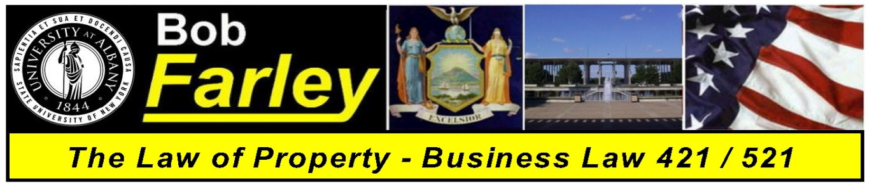

Slide Set Five:
The Law of Property
Introduction and Explanation of Terms

Slide 2

Tonight – We Will Speak About:
The Intertwinement of Property and Law
America’s Distrust of Power
The Legal Importance of America’s and
New York’s Legacy of Distrust of Power
New York’s Constitutional History
From Loyalist Roots to Independent Leader
The Importance of Separation of Powers
Making Property Rights Part of America
Federal Constitutional Perspectives

Slide 3
Tonight – We Will Speak About:
The Definition of Property
The Evolution of Property Rights in Law
How the Law and Property are Intertwined
The Constitution and Declaration:
How Property Rights Are A Part of America
The Four Postulates:
Property is a Collection of Rights NOT a collection of things;
Property Rights are those recognized by Law, and Property
Rights and the Law are intertwined and evolved from each other;
Property Rights are inherent to our humanity, and are legally
endowed to us by our Creator; and
Property Rights can be Summarized by EPUT:
The Rights to Exclude; Possess, Use and Transfer.

Slide 4
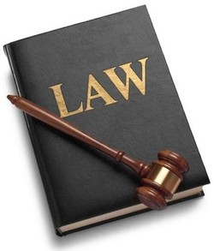
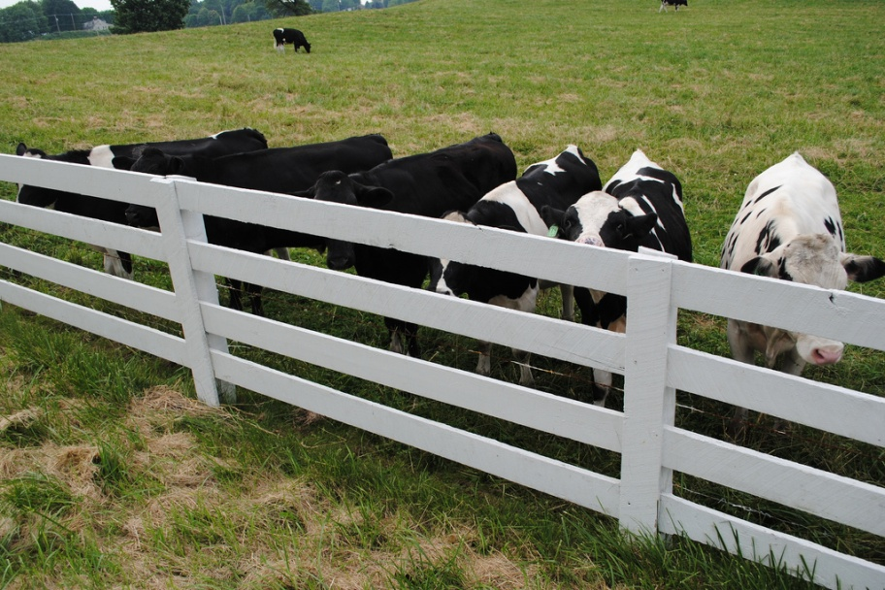
Let’s Begin our Adventure
With that perspective in mind, let us begin our adventure.
Let’s talk about how what property is
And just how important rights in property are to a free people

Slide 5
Let’s Begin our Adventure
So let’s begin our adventure with a discussion of
“What is Property”
How is it defined?
What does it mean?
What does it include?

Slide 6

So just what is Property?
Is it the Desk I sit at?

Slide 7

Is it the Pencil in my hand?

Slide 8
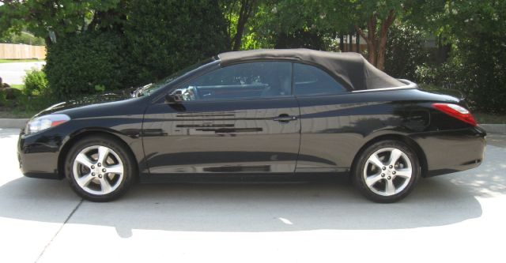
Is it the car that’s parked in the driveway?

Slide 9
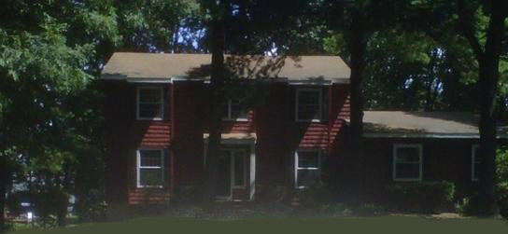
Is it our humble home?

Slide 10

Is it even my Puppy?

Slide 11
So What is Property?
Yes my dear friends
It is all these things and more!!!

Slide 12
And so before we begin our adventure
to discover just what property is …
We must think about the meaning of property
What it really is and means!!!

Slide 13
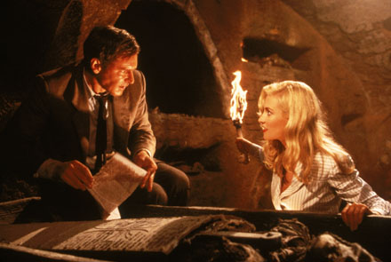
Remember: Every wonderful adventure
starts with a good book?

Slide 14
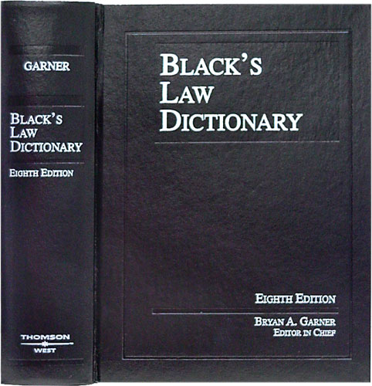
So Let’s Start again with Black’s
Black’s Law Dictionary
is the Gold Standard
of Legal Definitions.
If we need to know a term
in the law, a legal definition,
we should start with Black’s.

Slide 15
Black's Law Dictionary – 8th Edition (Thompson West 1999)
Defines the term Property as follows:
1. The right to possess, use and enjoy a determinate thing (either a tract of land or a chattel); the right of ownership. < the institution of private property is protected from undue governmental interference.>
2. Any external thing over which the rights of possession, use and enjoyment are exercised. <the airport is city property>.
In its widest sense, “PROPERTY includes all a person's legal rights of whatever description”. A man's property is all that is his in law.
Ok… What does this tell us?

Slide 16
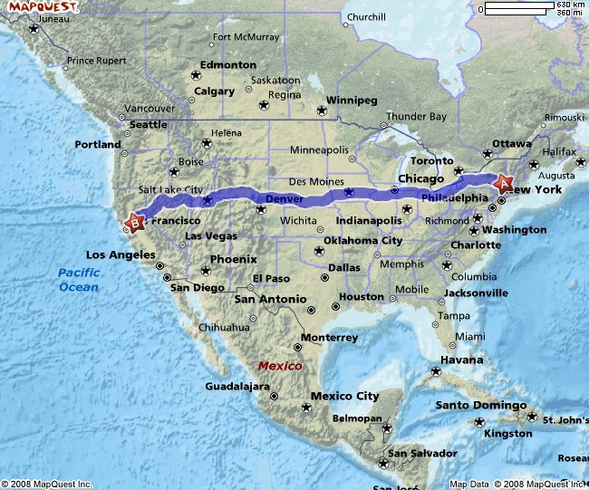
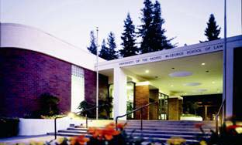
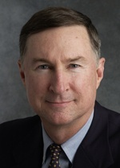
To find out, We need to take a little Road Trip
to find Professor John Sprankling
He’s a brilliant professor
who knows all things Property
and can be found after a journey
to McGeorge Law School

Slide 17
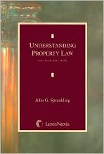
Who is Professor John Sprankling ??
Dr. John Sprankling, Distinguished Professor of Law at the University of the Pacific, McGeorge School of Law
The nationally recognized “expert” on Property Law
Author of numerous publications, including:
Understanding Property Law, selections of which are
on our website, and which is used by law students
across the nation.
His accomplishments include decades of classroom teaching experience, as well as practicing as managing partner at one of the nation's largest property law firms, Dr. Sprankling has served as Interim Dean and Associate Dean for Academic Affairs.

Slide 18
So what does Professor Sprankling say is … The True Meaning of Property?
To truly understand property – one must think in terms of one word:
Rights
Rights are the key to property law according to Dr. Sprankling
So let’s look at what these Rights are and what they mean.
With that we will gain ENLIGHTENMENT and UNDERSTANDING.
Notes:
18

Slide 19
What specifically does this mean in terms of Property??
… We need to Start at the Beginning
“From Black’s Law Dictionary, the treasure trove of American Legal thought, you have learned some general definitions.
What definition would Professor Sprankling use, and how can we summarize these definitions? Well, according to Dr. Sprankling:
Property is:
“Rights among People that Concern Things.”
Notes:
19

Slide 20
To decipher what this means we must ask
… What is a Right ???
Our old friend Black’s Law Dictionary defines the term “Right” as:
Powers of free action … a capacity residing in one man of controlling,
with the assent and assistance of the state, the actions of others.
2. A power, privilege or immunity guaranteed under a constitution,
statutes or decisional law, or claimed as a result of long usage.
Basically, it’s the legally recognized ability
to exercise Power and Control over the Property.
Notes:
20

Slide 21
The True Meaning of Property
Dr. Sprankling explains that we must think of Property
in terms of Rights.
So to begin our understanding into the true meaning of property law, we need to think of Property in terms of Rights, and Rights in terms of the legal ability to exercise Power and Control over it.
This will become our first Postulate of property law and will help us in our adventure of understanding.
Rights are based upon just Expectations that are enforced by Law.
Our first Postulate of property law is that:
Property is a collection of Rights,
NOT a collection of things.
Notes:
21

Slide 22
Why View Property as a Collection of Rights
and Not a Collection of Things?
Viewing property as a collection of rights rather than a collection of things serves a dual purpose.
- FIRST -
The essential element
which gives property its value,
is not the item itself,
but rather the ability to control the item.
The issue of control is reflected by an analysis of rights.
Notes:
22

Slide 23
Why View Property as a Collection of Rights
and Not a Collection of Things?
- SECOND -
It is only through a perspective of rights,
that we are able to broaden our concept of property,
to include many of the more abstract property
interests of great value to modern society.
Concepts such as intellectual property, future interests,
and non possessory interests, do not lend
themselves to be easily considered as “tangible items”,
and as such, are property interests best viewed
through the context of rights.
Accordingly, by employing this “rights” perspective, a more inclusive and accurate picture of what property actually is, and means, can truly be had.
Notes:
23

Slide 24
The Evolution of Rights
So it has become apparent – if you want to understand Property you need to understand Rights.
So lets begin our understanding into the true meaning of property law, by performing a review of the evolution of Rights. Where they came from and what they mean.
Last week we ventured into our journey of understanding to explore the History of the Law. Now we will examine that same history with respect to the concept of Rights.
For without the vehicle of the law
and the enforcement and protection its offers,
the legal concept of Rights
(and the just expectations upon which they are based) would not exist.
Notes:
24

Slide 25
The Evolution of Rights
A. The Concept of Right
In order to properly view property as a collection of rights, exactly what a right is, and where it came from,
needs to be understood.
The legal concept of “right” is a relatively recent one,
that was not fundamentally expressed
until after the rise of English jurisprudence.
Indeed, according to Susan Ford Wiltshire
(Chair of the Classical Studies Department of Vanderbilt University)
“Theories of rights assume a dignity of persons and a status of individuals
that did not exist in the classical world”.
Prior to the predominance of English jurisprudence,
the legal status of an individual was determined
by their relationship with the state.
As English jurisprudence developed however,
with both the events surrounding the Magna Carta
and the establishment of the Common law,
the law began to see a “slow transition from a state defined,
to an individual-defined, political identity”,
driven primarily by a new belief in the concept of natural law.
Notes:
25

Slide 26
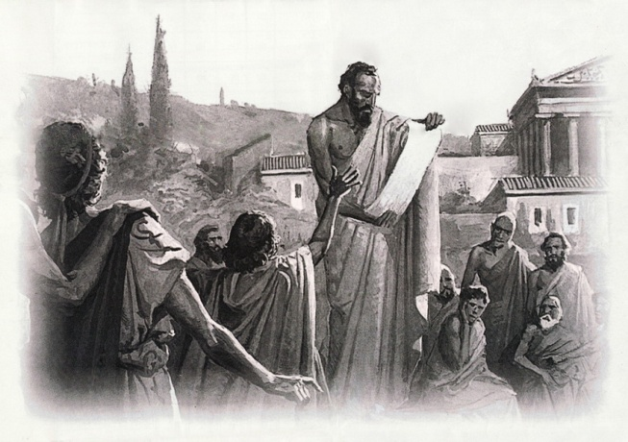
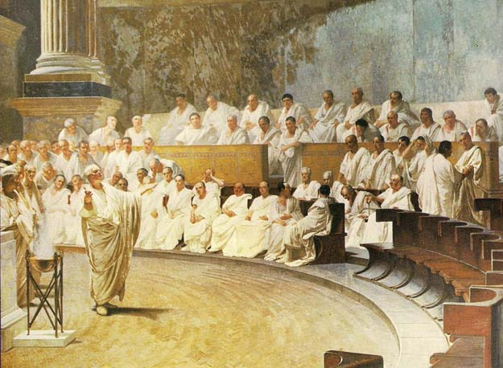
The Evolution of Rights
A. The Concept of Right - Continued
First Greece
The first step toward
the development of the concept of rights
can be traced back to ancient Athens,
when the Greeks “invented
the revolutionary idea that human beings
are capable of governing themselves
through laws of their own making”.
Then Rome
Thereafter, the development of the concept
of rights gained a significant boost,
through the Romans
and their creation of a complex
and sophisticated legal system.
Notes:
26

Slide 27
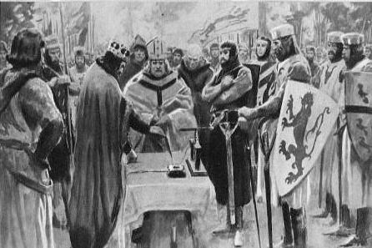
The Evolution of Rights
A. The Concept of Right - Continued
Then England
Despite this foundation, however,
the concept of “right” that we know today,
did not begin to truly emerge,
until after the establishment
of English jurisprudence,
and upon such time, as under its influence,
the unification of political thought
between clerics and legal scholars occurred,
to create the concept of natural law.
The Rise of Individual Rights
The 13th century was especially important
for the development of “rights” as we know them today.
The first transformation occurred during the early middle ages,
which saw the replacement of a person’s classical legal status
through the state
with a new similar bind with the Roman Catholic church
(thus continuing to leave no room
for the legal concept of non collective, individual “right”).
Notes:
27

Slide 28
The Evolution of Rights
A. The Concept of Right - Continued
The Rise of Individual Rights - Continued
By the time of the 13th century,
the establishment of English jurisprudence,
as influenced by the occurrence
of certain political and social events,
(such as the establishment of the common law court system,
trial by jury, and the signing of the Magna Carta)
began to change this perspective.
The Age of Deep Thinkers
Along with these political and social events,
came the rise of a new clerical-legal philosophy
(Men like Thomas Aquinas, William Ockham and John Wycliffe
that started to impart human beings as instruments of God
with fundamental, individual natural rights).
These developments proved earth shattering
and began to put mankind on the legal path to “rights”
Notes:
28

Slide 29
The Evolution of Rights
The Concept of Right
I. The Rise of English Jurisprudence
1. Roman Law
2. The Development of English Common Law
3. The Magna Carta
4. Clerical Philosophy and the Recognition of Natural Law
- Magna Carta
- 4th Lateran Council
- Thomas Aquinas
- William Ockham
- John Wycliffe
II. The Social Contract Theory
III. The Definition of Right
IV. John Locke and the Pronouncement of Property Rights
Notes:
29

Slide 30
The Evolution of Rights
B. The Definition of Right
When the legal concept of right became recognized under English jurisprudence, what exactly did they mean by the term “right”?
How could this idea, this term, be defined?
According to William Blackstone, author of the famous Commentaries on the Law of England, a treatise often referred to as “the Bible of the Law”, the legal definition of the word “Right” represents the closest English translation of the Latin term “jus” (from which the term justice is derived), and essentially means:
“the abstract sense of law”.
For our purposes, however, perhaps the best and most effective understanding
of what the term “Right” actually means,
can be seen from the writings of the Scottish philosopher and legal commentator, James Mill.
Mill saw “rights” in terms of a claim based upon a legally justified expectation
(which explains how rights progressed from the Rules of Roman law, to the public expectations produced from Common law decisions and the pronouncement of the Magna Carta, and then through the individualist centered citizenship of the clerical-legal philosophers).
From Mill’s writings, a corresponding definition of the term “Right”, can accordingly be derived to be:
“The legally recognized ability to exercise power and control over an action or object”.
Notes:
30

Slide 31
The Evolution of Rights
C. Types of Property Rights
Property as a “Right” - Types of Property
What types of Property can “Rights” be exercised over:
Real (Rights in Land);
Real Estate – Ownership/Leaseholds/Easements/Life Estates
Personal (Rights in Objects); and/or
Chattels – Tangible, visible “things”
Intellectual (Rights in Ideas)
Patents – Idea for Product or Process
Trademarks – Logo, Identification or Distinction
Copyrights – Written or Performed Works

Slide 32
The Evolution of Rights
C. Types of Property Rights
Property as a “Right” - Types of Property
Real (Rights in Land)
Real property consists of Rights in:
1. Land;
2. Anything attached to land (Buildings, buildings, signs, fences, or trees);
3. The land surface, subsurface (including minerals and groundwater), and the airspace above the surface.
Historically, Property Law was almost exclusively concerned with Real Property.

Slide 33
The Evolution of Rights
C. Types of Property Rights
Property as a “Right” - Types of Property
Personal (Rights in Things)
Personal Property consists of Rights:
Items of tangible, visible personal property, including:
Chattels: Cars, clothing, jewelry, livestock, airplanes, coins, rings, and books
Virtually all of the personal property in feudal England fell into this category.
Today, property rights can exist in almost any tangible, visible “thing.”
Almost every moveable thing around you now is a chattel, with property rights vested with someone.
Prominent exceptions to this general observation:
Human kidneys, fingers, ova, sperm, blood cells, and other body parts may well be characterized as “tangible, visible things,” but many courts and legislatures have proven reluctant to extend property rights to them.
Similarly, the law also deems deer, foxes, whales, and other wild animals, in their natural habitats, as unowned.

Slide 34
The Evolution of Rights
C. Types of Property Rights
Property as a “Right” - Types of Property
Intellectual (Rights in Ideas)
Intellectual Property Rights exist in:
Patents – (Property rights in conceptual products, designs and processes)
Trademarks – (Property rights in Logos, Identifications or Distinctions); and
Copyrights – (Property rights in writings, art or performances).
Property rights have been deemed to be vested in these types of ideas.
This type of property, known as intellectual property, provide for rights in items that are not tangible, nor visible, but which can have great worth, and which have been produced with great labor.

Slide 35
The Evolution of Rights
D. Why Have Property Rights?
The answer to this question is crucial because the justification for private property will necessarily affect the substance of property law.
We recognize Private Property Rights for a number of reasons, including:
1. First in Time First in Right (A way to allocate resources not yet owned)
2. Labor - People should be entitled to fruits of their labor
3. Utilitarianism – Private Property exists in order to maximize the overall happiness and utility of all citizens (People respond to incentives)
4. Economics – Private Property also exists to maximize the overall wealth of society (Society responds to incentives)
5. Liberty and Personhood – Private Property is essential to the development of a free society and individuals.

Slide 36
The First Postulate of The True Meaning of Property Law
Property needs to be seen as a
Collection of Rights,
NOT a Collection of Things.
These Rights are a bundle (Collection) and vest in these types of Property:
Real (Rights in Land);
Personal (Rights in Objects); and/or
Intellectual (Rights in Ideas).
Notes:
36

Slide 37
Adventures in Law - The Puzzle of Property
We turn the key on the Tablet of Knowledge and see:
Notes:
37

Slide 38
Understanding Property as a Collection of Rights
Property Rights:
Are fundamental
to our freedom and liberty
and are inherent elements
of our lives as a free people.

Slide 39
The First Postulate of The True Meaning of Property Law
Most people think of Property as a thing, an item to merely possess.
It is a foreign concept for most of us to think of our Property in terms of ”Rights”
But one’s Property is really an “idea”, a “concept”, and it extends far more than
just mere possession. It’s not the ownership of the “Thing” its your “Rights” over it.
To truly comprehend this idea, this concept, we use this this first postulate, to view
Property as a Collection of Rights, NOT a Collection of Things.
Remember it what it means
to have a “Right” in Property:
It is the legally recognized ability
to exercise power and control over it.
Notes:
39

Slide 40
The Second Postulate of The True Meaning of Property Law
And so we begin our quest for the second key, to unlock the second postulate of the true meaning of Property we need to explore the concepts of natural law and legal positivism.
John Locke was the father of natural law, believing that our rights in property as well as life and liberty are inherent to our humanity, and that they can never be taken away, only protected by Government.
Jeremy Bentham on the other hand is considered the father of legal positivism, believing that our rights in property as well as life and liberty, flow from the needs of society, and from a practical sense of the common good.
Notes:
40

Slide 41
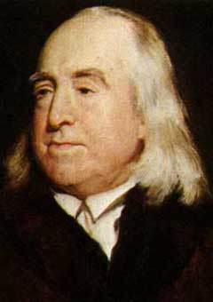
The Search for the Second Key
The Second Postulate of The True Meaning of Property Law
Just who was Jeremy Bentham?
Well a rather strange but brilliant man.
Legal Scholar and Jurist (1746-1842).
He was a child prodigy, found as a toddler
reading a multi-volume history of England.
Began his study of Latin at the age of three.
As requested in his will, his body was preserved and
stored in a wooden cabinet, termed an "Auto-icon".
It was acquired by University College London in 1850.
Notes:
41

Slide 42
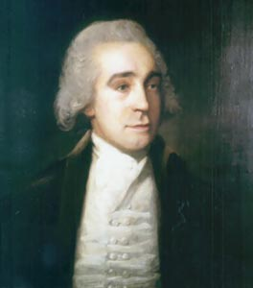
The Search for the Second Key
The Second Postulate of The True Meaning of Property Law
* Jeremy Bentham was well known for his
philosophy on the law, advocating strong
political views.
* Bentham's writings included arguments in favor of
individual and economic freedom, the separation of church and state, freedom of expression, equal
rights for women, the end of slavery, and the
abolition of all physical punishment (including that
of children).
* Offered philosophy on many areas of the law
including concerns with Property Rights.
Notes:
42

Slide 43

The Search for the Second Key
The Second Postulate of The True Meaning of Property Law
Jeremy Bentham opined:
“Property and Law are born together, and die together.
Before laws were made,
there was no property;
take away laws, and property ceases.”
Notes:
43

Slide 44
The Search for the Second Key
The Second Postulate of The True Meaning of Property Law
So it is becoming clear that the Second Postulate is focused on the relationship between Property and the Law.
Perhaps to understand what Jeremy Bentham meant,
we should visit England for some insight.
So let’s start off at his hometown of Spitalfields by London,
and visit University College London where it is rumored that
Mr. Bentham still resides.
Notes:
44

Slide 45
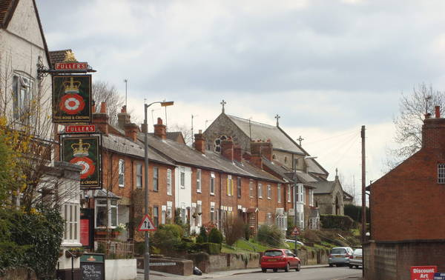
The Search for the Second Key
The Second Postulate of The True Meaning of Property Law
Our first stop is Jeremy Bentham’s Old Neighborhood on Red Lion Street just outside the City of London.
Here we learn that Jeremy Bentham
was born into a family of attorneys
(both his father and grandfather).
We also learn that despite never
practicing law, Jeremy Bentham
became a top flight legal scholar.
Notes:
45

Slide 46
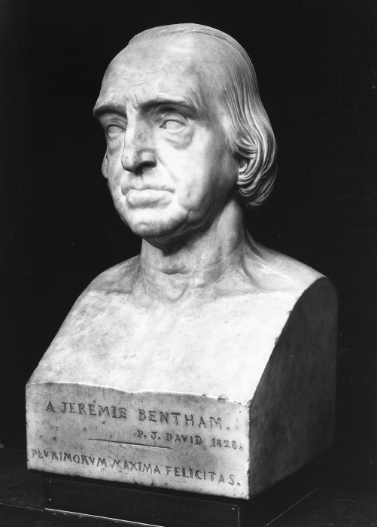
The Search for the Second Key
The Second Postulate of The True Meaning of Property Law
While eating lunch at the Jeremy Bentham Pub, we
receive a note from Dr. Sprankling saying:
Law is the foundation of Property Rights.
Property rights exist only if, and to the extent,
that they are recognized by our American legal system.
By the way – Preservation is the key to one’s will
So, we are on the right track, the second postulate
must deal with the relationship between property rights
and the law. So we head over to University College
Notes:
46

Slide 47
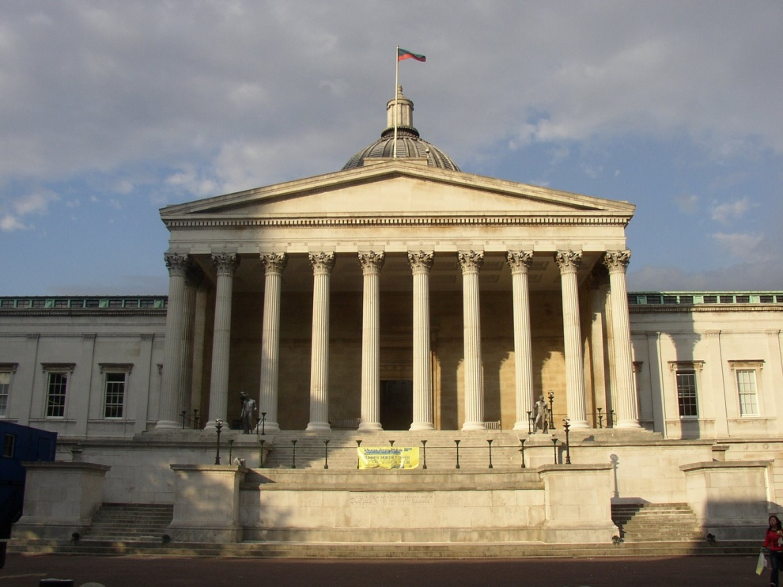
The Search for the Second Key
The Second Postulate of The True Meaning of Property Law
University College London
Notes:
47

Slide 48
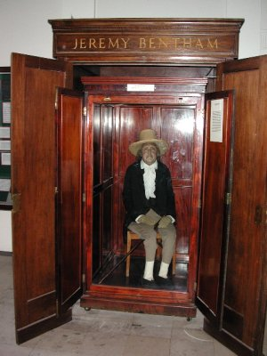
The Search for the Second Key
The Second Postulate of The True Meaning of Property Law
At University College London, we are directed down
the hallway toward a wooden cabinet.
Above its top in gold letters read the words:
Jeremy Bentham
Inside the doors, with great amazement, we find
a glass enclosed case with a man sitting atop a chair.
The man with the straw hat has a macabre appearance.
Could this actually be the man who’s legal
commentaries helped form our nation’s view
of property?
Notes:
48

Slide 49
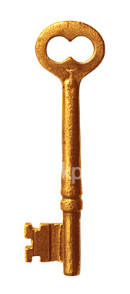
The Search for the Second Key
The Second Postulate of The True Meaning of Property Law
Looking next the Auto Icon we notice a book of Jeremy Bentham’s
commentaries, reflecting on how the law and property are
interrelated. Inside is his famous quote:
“Property and Law are born together and die together.
Before laws were made, there was no property;
take away laws, and property ceases.
Next to the book we find another key for our tablet.
Notes:
49

Slide 50
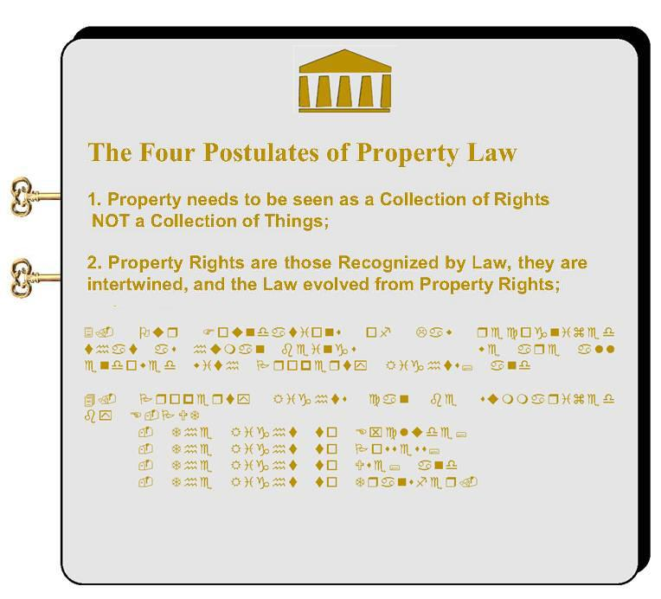
Adventures in Law - The Puzzle of Property
Notes:
50

Slide 51
The Second Postulate of The True Meaning of Property Law
As the tablet transforms to show the postulate, we unlock the second key to solving the Puzzle of Property.
2. Property Rights are those Recognized by Law, they are intertwined,
and the Law evolved from Property Rights;
This postulate tells us that to truly understand Property, we need to
know that Property and the Law are intertwined and evolved together.
This is fundamental to understanding the concept, the idea, of Property.
Notes:
51

Slide 52
The Search for the Third Key
The Second Postulate of The True Meaning of Property Law
And so with our understanding of the first two postulates,
1. Property needs to be seen as a Collection of Rights
NOT a Collection of Things
and
2. Property Rights are those Recognized by Law,
they are intertwined,
and the Law evolved from Property Rights;
we begin our quest to unlock the third postulate of the true meaning of Property.
Notes:
52

Slide 53
The Search for the Third Key
The Second Postulate of The True Meaning of Property Law
This circular relationship,
of Property Rights flowing from the law,
and the law evolving from Property Rights,
helps us understand the fact,
that we need to see Property in a new light,
in terms of its relationship to the law, and
in terms as its operation as a collection of rights.
These ideas were fully grasped by the founders of our nation.

Slide 54
The Search for the Third Key
The Third Postulate of The True Meaning of Property Law
What the Founders Understood:
From a time even before the Declaration of Independence,
the relationship between Property Rights and the Law
and the importance of these Rights
was intrinsically understood as the very foundation
of what we need to protect and believe as a free people.
This fact was expressed throughout the founding principles
which we hold dearest and most meaningful
in the establishment of our system
of law, government and society.

Slide 55
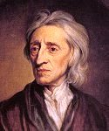
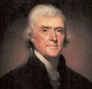
The Concept of Property Rights
Two Treatises of Government - John Locke, 1690:
The true concept of property rights.
The Natural Rights of man
Life, Liberty and the Pursuit of Property
Declaration of Independence – Thomas Jefferson, 1776:
The artful lawyer – Liberty as property rights.
The Declaration was really a collaborative document with John Adams, Lawyer and Ben Franklin, Scholar.
They all recognized the fundamental value of property rights
in our society as key to our freedom and liberty.
They restated Locke’s concept of Property Rights as a
cornerstone of Liberty and Freedom in a more artful way,
declaring our God given rights as:
Life, Liberty and the Pursuit of Happiness

Slide 56
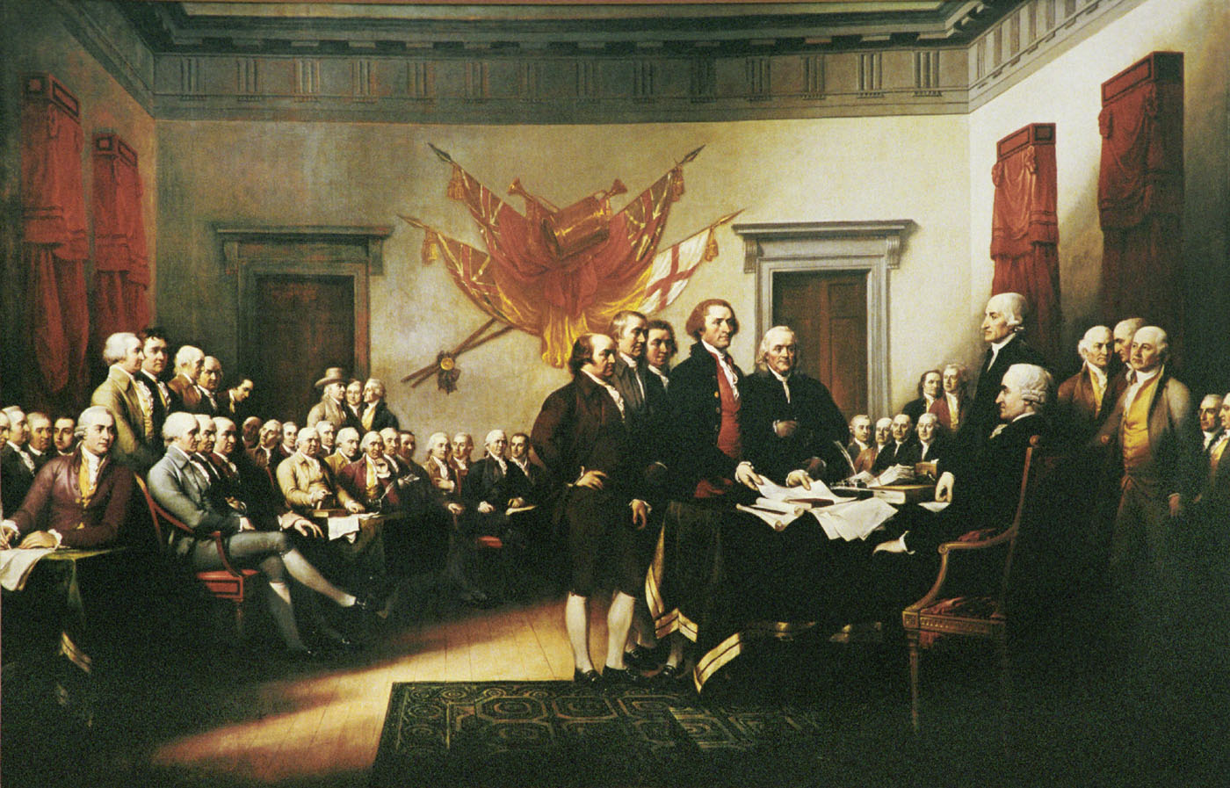
The Search for the Third Key
The Third Postulate of The True Meaning of Property Law
Our Declaration of Independence sets forth:
“We hold these truths
to be self evident,
that all men are created equal,
that they are endowed
by their Creator
with certain unalienable Rights,
that among these are
Life, Liberty and
the pursuit of Happiness.”

Slide 57
The Search for the Third Key
The Third Postulate of The True Meaning of Property Law
The term “pursuit of happiness” of the declaration was lifted and was a direct reference from John Locke’s writings referencing the “pursuit of property”.
So just what were the founders saying:
That all people are endowed (possess from birth) certain inalienable (unbreakable and inherent) rights.
That these rights come NOT from Government but from God.
That among these rights are property rights (as well as life and liberty).
So we need to re-think of Government’s role in recognizing property rights as protector, not as grantor.

Slide 58
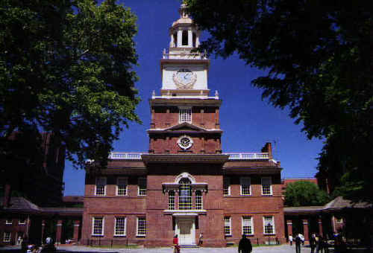
The Great Hall

Slide 59
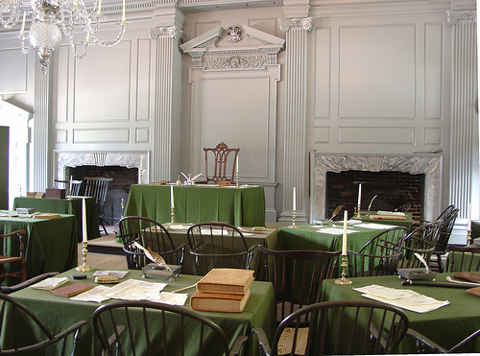
Inside The Great Hall

Slide 60
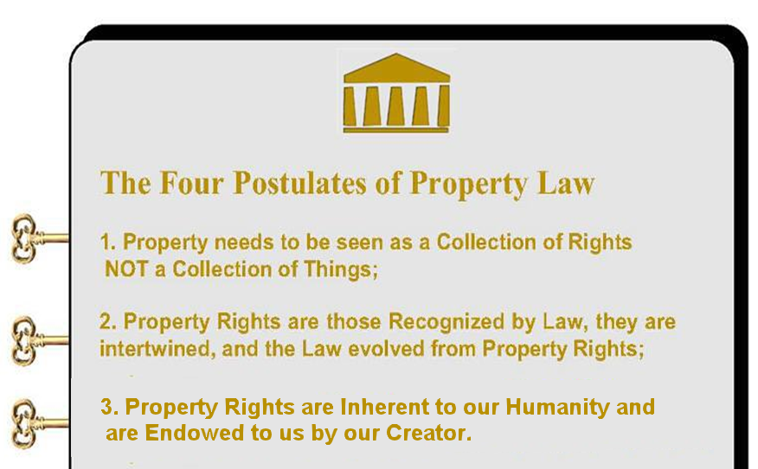
Adventures in Law - The Puzzle of Property

Slide 61
The Search for the Third Key
The Third Postulate of The True Meaning of Property Law
Property Rights Inherent to Our Humanity
When the Declaration expressed “that all men are created equal, that they are endowed by their Creator with certain unalienable Rights” our founders were stating that Property Rights are inherent to our humanity, and that they are to be protected by Government not granted by it.
As such, Property Rights are part of us as human beings.

Slide 62
The Search for the Third Key
The Third Postulate of The True Meaning of Property Law
Property Rights are Inherent to our Humanity and are Endowed to us by our Creator.
As such, Property Rights are part of us as human beings.
In our system of Representative Free Government,
these Rights are protected by Government
NOT granted by Government.

Slide 63
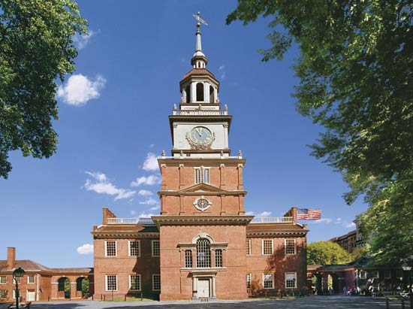
This concept contained within the Third Postulate was carried into our government through our
Constitution.
To see just how, lets return back in history to the City of Philadelphia during the Summer of 1787.

Slide 64
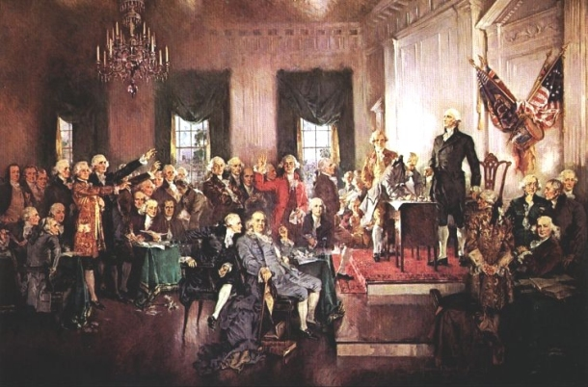
The Birth of Our Government
The Constitutional Convention was held in Philadelphia, on May 25 to September 17, 1787.
Many of the leading figures of the day were delegates:
George Washington
Ben Franklin
Alexander Hamilton
James Madison
George Mason

Slide 65
The Constitutional Convention
They came to revise.
What they created was one of the most inspired documents in the history of the world.
Months of deliberation, in secret, with great compromise.
The chief architect was a man that most would never have been thought of as a monumental figure, but he proved to them all what he could accomplish, amongst an assemblage of great men.
Enter Center stage …

Slide 66
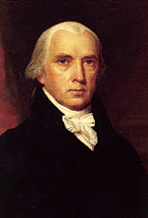
James Madison of Virginia
Brilliant Lawyer
Gifted Orator
Thoughtful
Soft Spoken
Disciple of Jefferson
Virginian to the Core
Willing to Compromise
Co-writer of Federalist Papers
Developed the Concept of
Sovereignty rests in the People
Sponsor of Bill of Rights

Slide 67
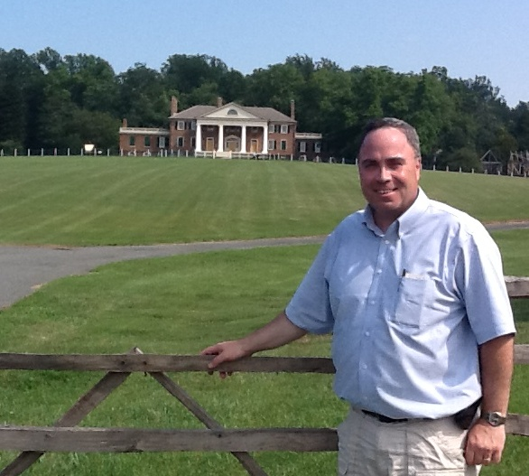

James Madison of Virginia
Student of Governments
Baltimore Convention
Constitutional Convention
Virginia Ratifying Convention
The Federalist Papers
Congressional Candidate
Congressman
Sponsor of Bill of Rights
Secretary of State
President of the United States

Slide 68
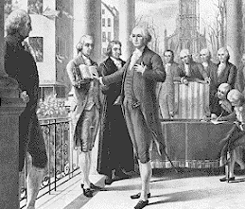
The Constitutional – The Foundation of Our Government
Ratification
Many States had Opposition
Bill of Rights was an Issue
Federalist Papers
Madison
Jay
Hamilton
On to New York (Our First Capital)
Bill of Rights
Firsts (well everything)

Slide 69
Property Rights in our Constitution
Indeed that concept was even retained in the Constitution
when our Federal system of Government was set up.
The 9th Amendment (the 9th of 10 Bill of Rights) to the
Constitution says”
Amendment IX
“The enumeration in the Constitution, of certain rights, shall not be construed to deny or disparage others retained by the people.”

Slide 70
Property Rights Inherent to Our Humanity
When the Declaration expressed:
“that all men are created equal, that they are endowed
by their Creator with certain unalienable Rights”
our founders were stating that Property Rights are inherent
to our humanity, and that they are to be protected by Government
not granted by it.
When the Constitution declared in the 9th Amendment that:
“The enumeration in the Constitution, of certain rights,
shall not be construed to deny or disparage others
retained by the people.”
our founders were stating that Property Rights are part of us
as human beings, and always retained can never be taken away.

Slide 71
¾ of the Fundamental Postulates of Property Law
Property is a collection of Rights NOT a collection of Things
Property and the Law are Intertwined and Evolved Together
Property Rights are Inherent to our Humanity and are Endowed to us by our Creator.
Now onto our search for the Fourth and Final Postulate!!!

Slide 72

The Search for the Fourth Key
The Fourth Postulate of The True Meaning of Property Law
And so we begin our search for the fourth and final postulate

Slide 73

The Search for the Fourth Key
The Fourth Postulate of The True Meaning of Property Law
Our Discovery of the Fourth Postulate
depends not on the brilliance of a
famous legal scholar, but rather on
the talents of a world famous golfer.
Morgan Pressel

Slide 74
The Search for the Fourth Key
The Fourth Postulate of The True Meaning of Property Law
So when it comes to Property, when we look at property in terms of a collection of Rights, just what are these Rights, and how can they be described, and more importantly how can we remember them?
The Answer:
Morgan Pressel E-PUT

Slide 75

The Search for the Fourth Key
The Fourth Postulate of The True Meaning of Property Law
E-PUT – Just like Morgan Pressel electronically
sinks a hole to win the championship in the
world of video golf, you can use this term to
remember the four principal means to exercise
exercise your Rights in the wonderful world
of Property.
E-PUT
1. The Right to Exclude;
2. The Right to Possess;
3. The Right to Use; and
4. The Right to Transfer.

Slide 76
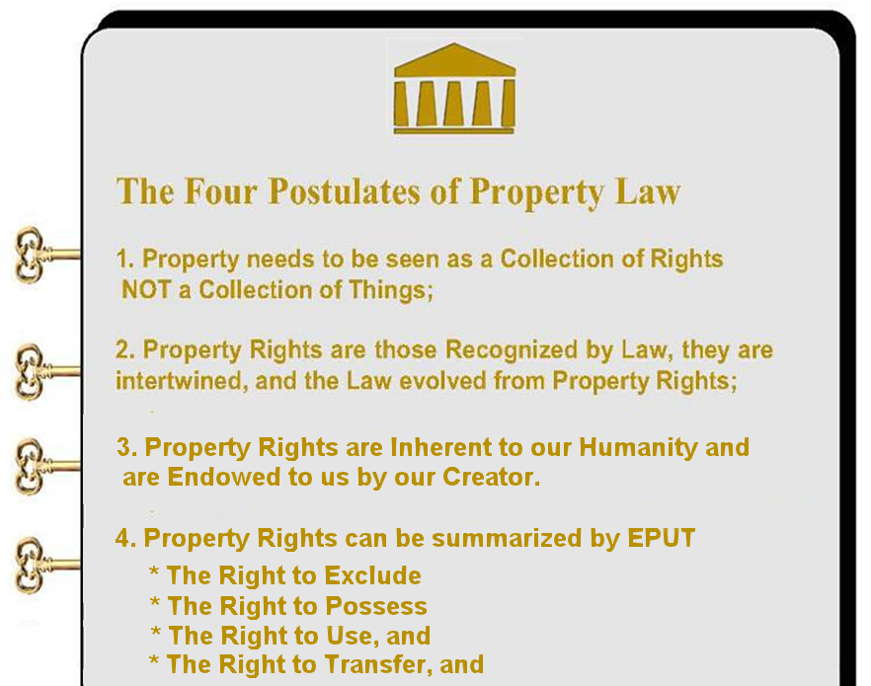
Adventures in Law - The Puzzle of Property

Slide 77
1. The Right to Exclude:
One stick in the metaphorical bundle of property rights is the right to exclude others from the use or occupancy of the particular “thing.”
If Morgan “owns” her beautiful 25 room mansion Golfland, she is generally entitled to prevent neighbors or strangers from trespassing.
In the same manner, if Morgan “owns” a beautiful Buick SUV, he can preclude others from driving it.
Of course, like many rights, the right to exclude is not absolute. For example, police officers may enter the in pursuit of fleeing criminals; and probably cannot bar entry to emergency medical staff who would treat an injured gardener residing at Golfland.

Slide 78
2. The Right to Possess:
The second stick in the metaphorical bundle of property rights is the right to possess the particular “thing.”
Simply put the right to possess is the right to hold, control or enjoy.
Black’s law dictionary defines “possession” as:
“The detention and control, or the manual or ideal custody, of anything which may be the subject of property, for one’s use and enjoyment, either as owner or as the proprietor of a qualified right in it, and either held personally or by another who exercises it in one’s place and name. That condition of facts under which one can exercise his power over a corporeal thing at his pleasure to the exclusion of all other persons.”

Slide 79
3. The Right to Use:
The third stick in the metaphorical bundle of property rights is the right to use a particular “thing.”
The law usually gives broad discretion to determine how someone will use “their” property.
With house, you can live in the house, plant a garden in the back yard, play tag on the front lawn, install a satellite dish on the roof, and host parties for your friends.
With an apple, you can eat it, bake it, place it in a bowl for decoration, or simply let it rot.
It must be remembered again, like all rights, this right is also not absolute, for it has long been held that a use may be limited when it interferes with the free use of another’s property (i.e. nuisance).

Slide 80
4. The Right to Transfer:
The fourth stick in the metaphorical bundle of property rights is the right to transfer the particular “thing.”
Through this right, the law recognizes broad power to transfer his rights either during lifetime or at death.
For example, Tiger might sell his rights in Golfland to a buyer, donate them to a charity, or devise them to his family upon his death. In our market economy, it is crucial that owners like can transfer their rights freely.
But the law does impose various restrictions on this right. For example, Tiger could not transfer title to Golfland for the purpose of avoiding creditors’ claims. or impose an unreasonable condition incident to the transfer; such as a conveyance “to my daughter on condition that she never sell the land”, (as society sees this as unacceptably restricting the title to this land). Also some types of property are market inalienable, essentially meaning that they cannot be sold at all (such as human body organs), while other types of property cannot be transferred after death, (such as a life estate).

Slide 81
So In Review:
The Four Fundamental Postulates of Property Law:
1. Property needs to be seen as a collection of “Rights” not a collection of “Things”;
2. Property Rights are those recognized by Law and the Law evolved from Property Rights;
3. Our Foundations of Law recognized that we are endowed with Property Rights; and
4. Property Rights can be summarized by E-PUT
The RIGHT to EXCLUDE
The RIGHT to POSSESS
The RIGHT to USE; and
The Right to TRANSFER.

Slide 82
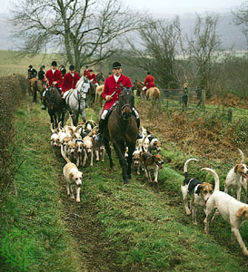
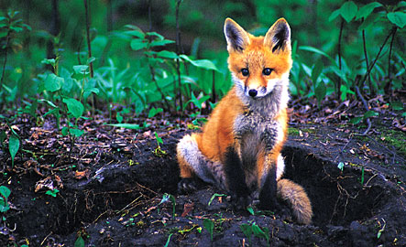
Our First Venture into Property Case Law
The Case of Pierson v. Post
Chase That Fox!

Slide 83
Thank you for Coming
Bonus Question of the Day
For next time – Review Assignments as follows on the Webpage:
Lecture Slide Set: Three, Four, Five and Six
Selected Readings: Two, Three, Four and Five
Selected Book Sets Two, Three and Four
Cases and Exercises Two, Three and Four
We are a hot bench.
Questions?

