Slide 1


Slide Set Nine:
Intellectual Property
Patents, Trademarks and Copyrights

Slide 2

Last Class – We Spoke About:
A Continuation of Rights, Ownership,
Possession and Transfers – Including:
- Liens,
- Bailments and
- Special Interests.
A Review of :
- Legal History
- Personal Property

Slide 3
Tonight’s Class:
We will discuss Intellectual Property Concepts
- Patents
- Trademarks and
- Copyrights; and

Slide 4
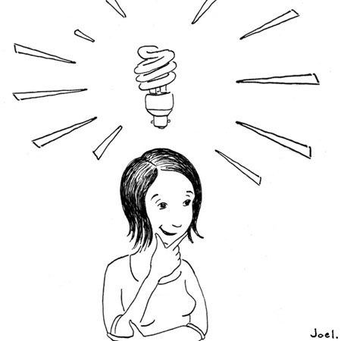
Intellectual Property
Not all property is tangible
This is why we need to think of property in terms of “rights” not “things”.
This concept becomes especially important for
intellectual property.

Slide 5
Intellectual Property
Although common law was reluctant to
invest property rights in an “idea”, modern
society and law have evolved property rights
to include certain unique intellectual
designs, processes or works.
Although most property law is state law,
virtually all intellectual property law
is based upon federal statutes.

Slide 6
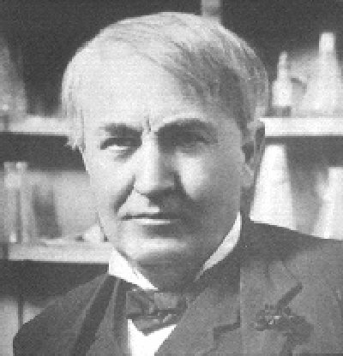
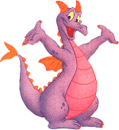

Intellectual Property
It all starts with an idea!

Slide 7

Intellectual Property
Copyrights – Rights in Writings, Art or Expression
Defined as “Original works of authorship fixed in any tangible medium of expression”.
Key Elements
1. Originality (Uniqueness)
2. Work of Authorship
    ● Literary,
    ● Music,
    ● Dramatic,
    ● Graphic or Architectural, or
● Movies or Audio Production
*Software is viewed as literary
3. Fixation (Any physical rendering)

Slide 8
Intellectual Property
Copyrights
Collection of Rights – Including the right to:
Prevent Reproduction
Create derivative works
Distribute Copies
Perform, display or transmit the Work Publicly
Duration of Rights:
If created after 1978 - Life of the author plus 70 years (No renewal)
If created before 1978 – 28 years plus a renewal for 47 years (75 years)
Work for Hire Exception – 95 years from publication or 120 from creation whichever is less.

Slide 9
Intellectual Property
Copyrights
To prove Infringement – A Plaintiff Must:
1. Hold a valid copyright
2. The defendant copied the work; and
3. The copy was inappropriate appropriation (Two works are substantially similar)
Defenses: Agreement or Fair Use – Protecting the Copyright and protecting the minimal use and free speech rights of the user.
Remedies: Injunction, Impoundment and Destruction, and Damages

Slide 10
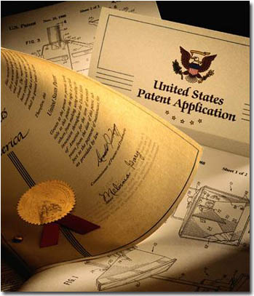
Intellectual Property
Patents
The intellectual property rights vested
in anyone who “invents or discovers
any new or useful process, machine,
manufacture, or any composition
of matter, or any new or useful
improvement thereof.”
Four Elements:
1. Patentable subject matter
2. Utility
3. Novelty; and
4. Non-obviousness

Slide 11
Intellectual Property
Patents
1. Patentable Subject Matter
● Process:
An act, or a series of acts or steps (such as a
mode of treatment of certain materials) to
produce a given result.
● Machine:
A concrete thing, consisting of parts, or of
certain devices and combination of devices.
● Manufacture
An article produced from raw or prepared materials by giving to these
materials new forms, qualities, properties, or combinations, whether by
hand labor or by machinery.
● Composition of matter
All compositions of two or more substances and all composite articles,
whether they be the results of chemical union, or of mechanical mixture, or
whether they be gases, fluids, powders or solids.

Slide 12
Intellectual Property
Patents
2. Utility
The Invention must be useful
and provide actual benefit
3. Novelty
The Invention must new, novel
and unique.
4. Non-obviousness
The Invention must not be obvious
to a person of ordinary skill in the
subject area.

Slide 13
Intellectual Property
Patents
Collection of Rights
- The Right to prevent others from
making, using or selling the invention.
- A patent is federal right with no rights
directly transferable outside the US.
- Must file the patent in every nation
in which they wish to protect.
2. Duration of Rights
- 20 years from the date the patent is filed
- Nonrenewable and require a maintenance fee to the PTO.

Slide 14

Intellectual Property
Trademarks
A trademark is any “word, name, symbol or devise used by a person to identify and distinguish their goods from those sold by others”
Requirements:
Distinctiveness
Non-functionality
First use in trade
Duration – Good for 10 years with infinite renewals

Slide 15

Registration and Recording
Where, When and How
● US Patent and Trademark Office
Washington DC
● Practice before it and the Federal
Courts requires admission to a
separate bar
● Can clerk at the office and
don’t have to even be a lawyer.

Slide 16
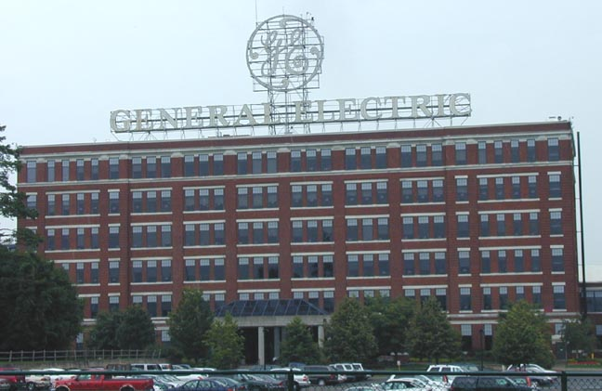
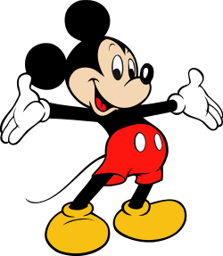

Modern Trends
The World of Intellectual Property
Concerns over China – Reverse Engineering
Especially big issues with items uniquely
Intellectual – music, software, processes
Big players
General Electric
Disney
Motion Picture Companies

Slide 17
Bonus Questions of the Day
For next time – Read Assignments
on the Website for the Midtem
We have our Midterm Next Time
Questions???

