Slide 1


Slide Set Ten:
Midterm Review
Legal History and Personal Property

Slide 2

Tonight – We Will Speak About:
Part One: A Brief Review
Part Two: A Continuation of Rights, Ownership,
Possession and Transfers – Including:
- Liens,
- Bailments and
- Special Interests.
So here we go.

Slide 3

Review – Looking back – Looking forward

Slide 4
In Review:
The Four Postulates of Property Law:
1. Property needs to be seen as a collection of “Rights” not a collection of “Things”;
2. Property Rights are those recognized by Law and the Law evolved from Property Rights;
3. Our Foundations of Law recognized that we are endowed with Property Rights; and
4. Property Rights can be summarized by E-PUT
The right to EXCLUDE;
The right to POSSESS;
The right to USE; and
The right to TRANSFER

Slide 5
How our Property Rights are Exercised:
E-PUT
1. The Right to Exclude;
2. The Right to Possess;
3. The Right to Use; and
4. The Right to Transfer.

Slide 6
Types of Property
Property can be:
Real (Rights in Land);
Real Estate – Ownership/Leaseholds/Easements/Life Estates
Personal (Rights in Objects); and/or
Chattels – Tangible, visible “things”
Intellectual (Rights in Ideas)
Patents – Idea for Product or Process
Trademarks – Logo, Identification or Distinction
Copyrights – Written or Performed Works

Slide 7
GIFTS
Types of Gifts
Gifts Inter Vivos (Gifts During Lifetime)
Gifts Causa Mortis (Gifts in Contemplation of Death)
The Three Factors that make a Gift (IDA)
a. Donor's Intent
b. Delivery
c. Acceptance

Slide 8
Common Law Felonies: Remember - Mr & Mrs Lamb Murder Rape Manslaughter Robbery Sodomy Larceny Arson Mayhem Burglary

Slide 9
And so, just what is the “Law”?
The “Law” has been defined by Black’s Law Dictionary as follows:
“That which is laid down, ordained, or established.
A rule or method according to which a phenomena or actions co-exist or follow each other.
Law, in its generic sense, is a body of rules of action or conduct proscribed by controlling authority, and having binding legal force. …
Law is a solemn expression of the will of the supreme power of the state.”
Perhaps the simplest description of the Law, however, is that:
“Law is the Rules by which civilization is ordered.”

Slide 10
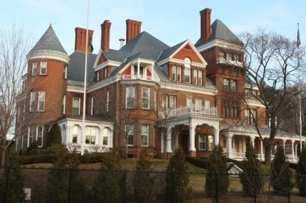

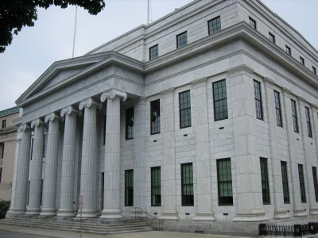


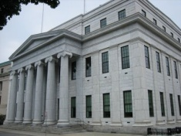
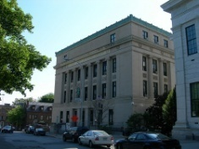
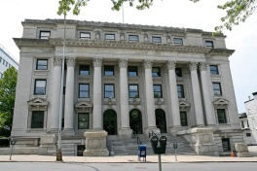
State Government (Pursuant to State Constitution – Similar Checks and Balances)
Governor (Executive) State Legislature (Legislative) State Courts (Judicial)
NYS Court of Appeals
NYS Senate NYS Assembly
Appellate Division of NYS Supreme Court
NYS Supreme Court

Slide 11


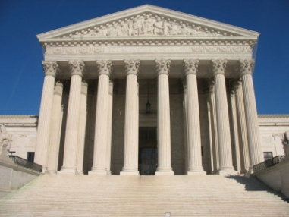
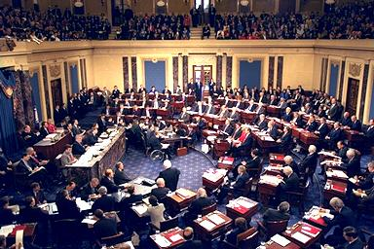




Federal Government (Separation of Powers and Checks and Balances)
President (Executive) Congress (Legislative) Federal Courts (Judicial)
Supreme Court
US Senate US House of Representatives
US Court of Appeals
US District Court

Slide 12
Priority of Laws:
1. Constitution: Established by Convention of Elected Delegates
to provide governmental framework and protections of individual rights,
they are supreme to all other laws as interpreted by the Courts
2. Statute: Laws passed (enacted) by an elected legislative body
(Congress or State Legislature) and signed into law by the Executive
(President or Governor).
3. Regulation: Promulgated by government (Executive) agencies
to amplify or clarify their authority as provided in statute or constitution.
4. Executive Order: Issued by Executive (President or Governor)
as an instruction to their agencies on how to execute a procedure or law.
Case Law or Common Law -
Decisions issued by courts which provide legal rules by:
1. Interpretation of a Constitution, Statute, Regulation or Executive Order, or
2. Clarifying or creating law pursuant to past court decisions.

Slide 13
Rome and Our Law
The concept of a body of law first emerged in Rome.
Although Rome developed a quasi legislative body known as the Senate as well as a system of Courts to arbitrate disputes, their concept of the Law, put down in Code, was largely the edicts of the emperor.
Rome was an empire based upon trade and its military. The law helped both these institutions promote civilization across the then known world by instilling both consumer and merchant confidence and providing a consistent template for the governance and operation of conquered lands and peoples.
The Law of Rome, often referred to as the Code due to its written history, helped to make the Empire the greatest of its time.

Slide 14

England and America – Bound by Heritage and Law

Slide 15
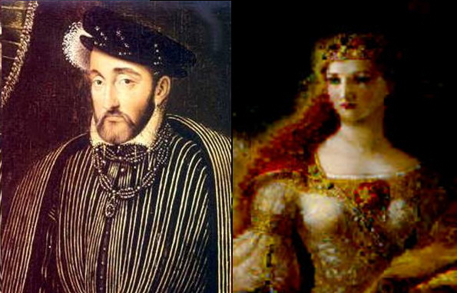
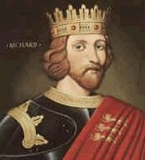
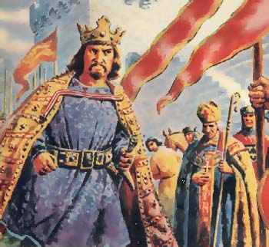
Henry, Eleanor, Richard and John
After the reign of Stephen, in 1154 Henry the Second, and his Wife Eleanor of Aquitaine took over England, Normandy, and Aquitaine (which belonged to Eleanor) thereby comprising not only England but also half of modern France as well.
When Henry died, he left the throne to his son Richard. Richard, known popularly as Richard the Lionhearted, was a handsome, noble and brave.
Leading English forces for the 3rd Crusade, King Richard left his younger brother John in charge during his absence.

Slide 16
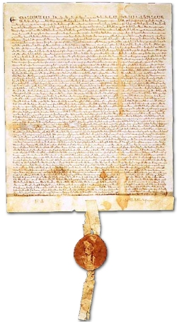
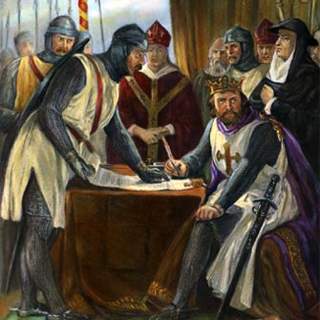
The First Real Battle for Property Rights
On June 15, 1215, their forces confronted King John at Runnymede, and forced him to put his seal on the Magna Carta. (the Great Charter).

Slide 17
The Magna Carta is Signed
The Magna Carta was one of the forerunners of modern British law, the US Constitution and its Amendments (the Bill of Rights) and the guiding documents of many other countries that have further expanded the rights and liberties of the people and limited the power of the government.
Containing 63 clauses, this landmark document:
- Created a council to the King (a forerunner to parliament), - Promised all freemen access to courts and a fair trial, - Specified many property rights from infringement by the king and his agents, - Eliminated unfair fines and punishments, - Gave certain legal powers to the Catholic Church, and - Addressed many lesser issues.
It did not abolish serfdom or slavery

Slide 18
Since the time of the Magna Carta the system of modern Anglo-American Law evolved to flow from three sources.
1. Constitutional Law
2. Statutes
3. Case (or Common) Law (Laws made by Judges).

Slide 19
The law of early America was based largely upon
the law of England.
We were, of course prior to the Revolution, English subjects.
Our founders initially spoke of redressing their grievances under a format of the “Rights of Englishmen”
There was very little statutory law, and even after the US and State Constitutions, most law was still based upon English Court precedent. This is best stated under the Doctrine of Stare Decisis – Latin for “Let the Decision Stand”.
Indeed statutes were looked upon with a skeptical eye.
- For it should be remembered that the Quartering Act, Stamp Act and the Townsend Acts were all statutes that ignited the Revolution to occur in the first place.

Slide 20
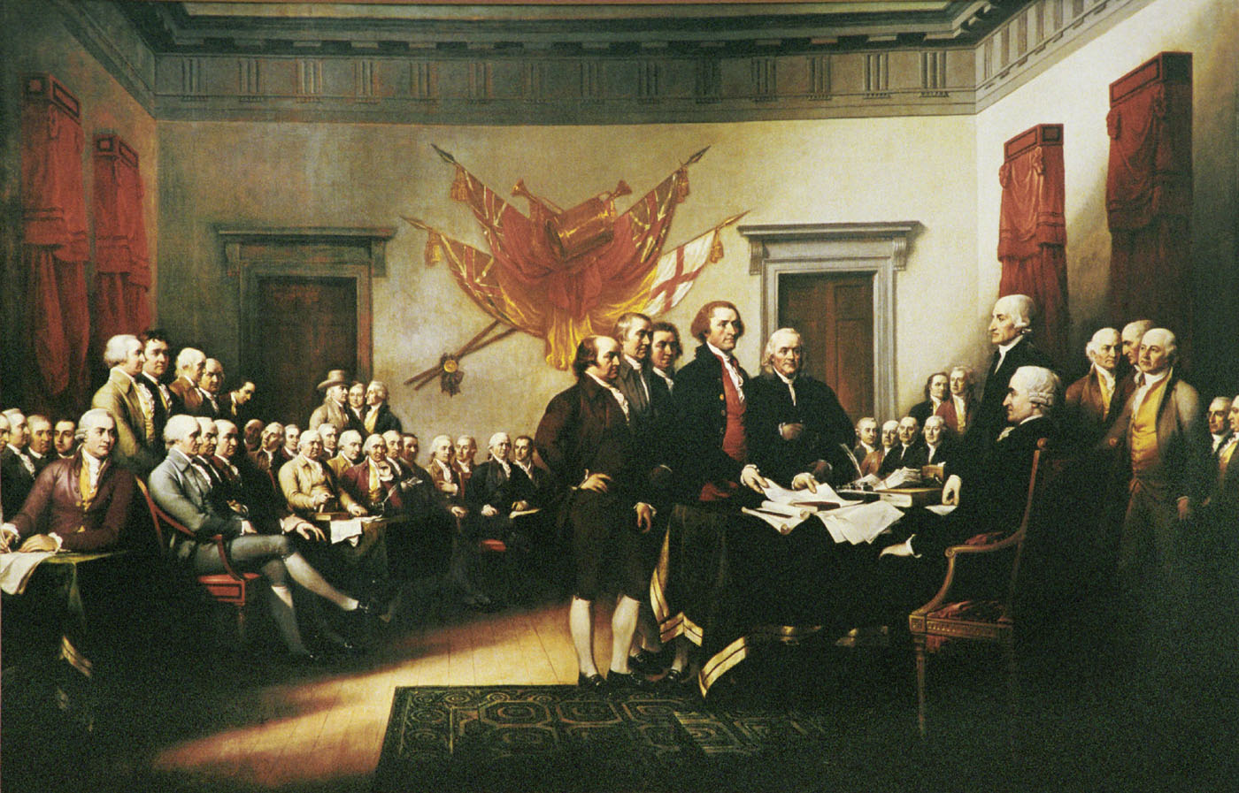
Our Declaration of Independence sets forth:
“We hold these truths
to be self evident,
that all men are created equal,
that they are endowed
by their Creator
with certain unalienable Rights,
that among these are
Life, Liberty and
the pursuit of Happiness.”

Slide 21
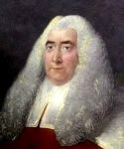
Sir William Blackstone was an jurist and professor who produced the historical and analytic treatise on the law known as Commentaries on the Law of England.
First published in four volumes over 1765–1769. It had an extraordinary success.
A baseline “Bible of the law” of his time, these famous Commentaries still remain an important source on classical views of the common law and its principles.
It was used not only through out England but through out the United States as well.

Slide 22
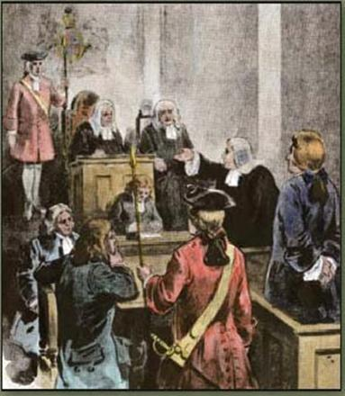
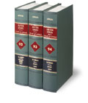
Common (Case) Law in the United States
Over time, the United States, through its State and Federal Courts, began to build a substantial body of law.
This law was reported and memorialized through published decisions of judges, following the concept of precedent, known as Stare Decisis (let the decision stand).
Using the Commentaries of Blackstone, as well as the previous case decisions of Judges, Courts found a bench mark to decide new ones.
Decisions of first impression sought to apply and adapt other legal principles, especially in the cases of equity.

Slide 23
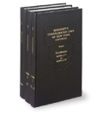
Use Both Belts and Suspenders
Today Property Rights are protected via two
mechanisms in the law – case (common law) and
statutes enacted by the state legislature.
In New York State, a line of case law dating back
from colonial times protects private property rights.
Additionally, a series of state statutes, enacted by
the New York State legislature, also provides a
wide array of property protections for personal
property rights.
Lastly, the New York State and United States Constitutions
also protect many private and public property rights
providing a three tier protection level for every citizen.
Accordingly nearly all property law is state law.

Slide 24

The Search for the Second Key
The Second Postulate of The True Meaning of Property Law
Jeremy Bentham opined:
“Property and Law are born together, and die together.
Before laws were made,
there was no property;
take away laws, and property ceases.”
Notes:
24

Slide 25
Law vs. Equity
In Early America, as in England, Courts were divided between law and equity.
Courts of Law had jurisdiction over money matters.
Equity Courts had jurisdiction over injunctive relief (non money matters)
Especially with equity cases, the social American norms of fundamental fairness crept into the cases to decide the outcomes.
By 1800, the Courts of Law and Equity were merged in most jurisdictions.

Slide 26
To decipher what this means we must ask
… What is a Right ???
Our old friend Black’s Law Dictionary defines the term “Right” as:
Powers of free action … a capacity residing in one man of controlling,
with the assent and assistance of the state, the actions of others.
2. A power, privilege or immunity guaranteed under a constitution,
statutes or decisional law, or claimed as a result of long usage.
Basically, it’s the legally recognized ability
to exercise Power and Control over the Property.
Notes:
26

Slide 27
Part Three: The Exercise of Property Rights
A. The Acquisition and Loss of Right or Title to Personal Property
Its all about the PROOF:
Since the exercise of property rights is the legal ability
to exercise dominion and control over the property
in question, the legal recognition of such right has led
to elements of proof.
Such elements are proven by means of demonstrating the methods of acquisition or loss of the item of property
itself.

Slide 28
Part Three: The Exercise of Property Rights
A. The Acquisition and Loss of Right or Title to Personal Property
1. Occupancy/Possession
- Generally:
Remember property rights are the legally recognized ability to exercise power and control over the property.
The law seeks to have property to be owned by someone.
As such, the law recognizes that a thing capable of ownership, but not yet owned, will belong to the person who acquires actual or constructive dominion or control over it, and who has the intent to assert ownership over it. (i.e. possession).
Occupancy/Possession is this actual or constructive dominion or control.
Hence the well known adage: Possession is 9/10ths of the law.

Slide 29
Part Three: The Exercise of Property Rights
A. The Acquisition and Loss of Right or Title to Personal Property
1. Occupancy/Possession (Continued)
- Special Rules: Wild Animals
Wild animals (ferae naturae) in their natural state are unowned.
They become private property upon being reduced to possession.
Acquisition of Title and Possession
An animal in its natural state is unowned.
The first person to exercise dominion and control over such animal becomes, with possession, the owner of it.
To become the owner, the claimant must establish that they have exercised dominion and control over the animal. (Pierson v Post)
Acquisition of Title - Constructive Possession
Animals caught in a trap or net belong to the one who owns and has set the trap or net. By setting such a trap, one is said to constructively possess those animals snared.

Slide 30


Pierson v. Post
Queens NY Case about Possession
Remember – chase that fox – get nothing!
Shoot that fox – and carry it away- get the prize for possession.
Mere pursuit is not possession!

Slide 31
Types of Property
Property can be:
Real (Rights in Land);
Real Estate – Ownership/Leaseholds/Easements/Life Estates
Personal (Rights in Objects); and/or
Chattels – Tangible, visible “things”
Intellectual (Rights in Ideas)
Patents – Idea for Product or Process
Trademarks – Logo, Identification or Distinction
Copyrights – Written or Performed Works

Slide 32
Common Law
Real property means land, things fixed to land. and things incidental or appurtenant to land (basically immovable property).
Personal property is movable property, but includes virtually every kind of physical property that is not real property.
Real property may be converted to personal property by severance.
Personal property may be converted to real property by an annexation intended to be permanent.

Slide 33
REAL AND PERSONAL PROPERTY DISTINCTIONS
Leases
Under the common law, a lease of land for a term of years constituted personal property.
This was because the lease did not fall within the common law definition of land, tenements, or hereditaments.
A lease was considered an interest in land less than a freehold and therefore a real chattel.
Modern statutes changed the common law rule for leases, defining them as real property.

Slide 34
REAL AND PERSONAL PROPERTY DISTINCTIONS
Crops
a. Fructus Naturales
Crops that grow spontaneously on land, e.g., trees, bushes, and grass, are described as fructus naturales and are considered to be a part of the land, and therefore real property.
Title to the land includes such crops.
b. Fructus Industriales
Crops that are the result of annual planting, labor, and cultivation, e.g., grains, vegetables, and other crops, are described as fructus industriales.
These crops are, as a general rule, regarded as personalty.

Slide 35
REAL AND PERSONAL PROPERTY DISTINCTIONS
Fixtures
Under the concept of fixtures, a chattel that has been annexed to real property is converted from personalty to realty. The former chattel becomes an accessory to the land (i.e., a fixture) and passes with ownership of the land. (See Real Property outline.)

Slide 36
ACQUISITION AND LOSS OF RIGHT OR TITLE TO PERSONAL PROPERTY
Rights and title to personal property are acquired or lost by
1. Transfer - Sale
2. Occupancy,
3. Adverse possession,
4. Accession,
5. Confusion,
6. Judgment,
7. When the chattel is lost, mislaid, or abandoned, or
8. Gift

Slide 37

Part Three: The Exercise of Property Rights
A. The Acquisition and Loss of Right or Title to Personal Property
7. Lost, Mislaid or Abandoned Property
- Rules: Lost, Mislaid or Abandoned Property
The fact that the owner has either lost or mislaid
their property does NOT lead to the divestiture of
their title.
As such, title to such property persists despite the fact
that it has been lost or mislaid.
However, the owner DOES relinquish title when and if
they abandon it.
So what is the difference between lost, mislaid and
abandoned property, and what are the rules for the
same?

Slide 38
Part Three: The Exercise of Property Rights
A. The Acquisition and Loss of Right or Title to Personal Property
7. Lost, Mislaid or Abandoned Property
- Rules: Lost, Mislaid or Abandoned Property
a. Lost Property
Although New York DOES NOT distinguish between lost and mislaid property there is technically a difference between the two.
Property is "lost" when the owner has accidentally and involuntarily parted with possession of the property and does not know where to find it.
In determining if property is deemed as lost, the key factor is the place where it is found.
The test is: Judging from the place where found:
“Would a reasonable person judge that the owner had accidentally and involuntarily parted with the possession of it and does not know where to find it?”
Example:
A wristwatch found on the floor in a public place will likely be regarded as lost property. Judging from the place where found, it is reasonable to conclude that one would not intentionally place a wristwatch on the floor, and, therefore, it would be categorized as lost.

Slide 39
Part Three: The Exercise of Property Rights
A. The Acquisition and Loss of Right or Title to Personal Property
7. Lost, Mislaid or Abandoned Property
- Rules: Lost, Mislaid or Abandoned Property
b. Mislaid Property
Property is deemed "mislaid" when, judging from the place where found, it can reasonably be determined that it was intentionally placed there and thereafter forgotten.
Example:
A briefcase found on a desk, table, or counter will likely be regarded as mislaid property. Judging from the place where found, it is reasonable to conclude that the item was intentionally placed there and thereafter forgotten.
New York Distinctions:
Although at common law, there was a distinction between lost and mislaid property, New York no longer recognizes such distinctions and treats all property that is lost or mislaid as lost property.

Slide 40
ACQUISITION AND LOSS OF RIGHT OR TITLE TO PERSONAL PROPERTY
The Finder of “Lost Property”
Property with Value Under Twenty Dollars
A finder of lost property of less than $20 in value must make a reasonable effort to find the owner and restore the property to them; if unable to do so after a reasonable effort, title vests in the finder one year after the finding. [N.Y. Pers. Prop. Law §252( I )]
Property with Value of Twenty Dollars or More and Instruments
A finder of lost property with a value of $20 or more, or an instrument as defined for purposes of the statute, who knows the property was lost, must within 10 days of finding it either return it to the owner or report such a finding and deposit the property with the local police. [N.Y. Pers. Prop. Law §252(l)]
Abandoned Property
Abandoned property is that which the owner has voluntarily relinquished all ownership of without reference to any particular person or purpose.
The owner must intend to give up both title and possession.

Slide 41
ACQUISITION AND LOSS OF RIGHT OR TITLE TO PERSONAL PROPERTY
Escheat
Where abandoned property is held by an intermediary with no property interest in the property (e.g., unclaimed funds held by banks or other depositories), the state may assume title to the property through a process called escheat.
Property may be escheated only by the state in which the property is located.
Intangible property is considered to be located at the domicile of the property owner.
Accession
Accession is the addition of value to property by the expenditure of labor or the addition of new material.
If the added article can be detached from the principal chattel, this will be ordered and each party will be put in status quo ante.
If the added expenditure or thing cannot be detached from the principal chattel, the question arises as to who is the owner of the chattel in its enhanced state.
The answer depends upon whether the trespasser acted in good faith or is a willful trespasser.

Slide 42
ACQUISITION AND LOSS OF RIGHT OR TITLE TO PERSONAL PROPERTY
Title by Judgment
Election of Remedies
One who destroys, misuses, misdelivers, or otherwise wrongfully deprives the owner of chattel of his possessory rights, may be liable to the owner under various theories of recovery.
1) Replevin - Replevin is an action to recover the chattel itself.
2) Trespass - The action in trespass is to recover money damages incurred by reason of the dispossession.
3) Trover - The action in trover is to recover the value of the chattel along with damages for dispossession.

Slide 43
GIFTS
Types of Gifts
Gifts Inter Vivos (Gifts During Lifetime)
Gifts Causa Mortis (Gifts in Contemplation of Death)
The Three Factors that make a Gift (IDA)
a. Donor's Intent
b. Delivery
c. Acceptance

Slide 44
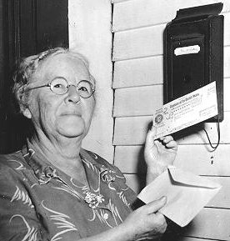
GIFTS
When it comes to gifts
remember your dear Aunt IDA
The Three Factors that make a Gift
a. Donor's Intent
b. Delivery
c. Acceptance

Slide 45
GIFTS
Inter Vivos Gifts
Gifts in Contemplation of Marriage
Engagement gifts (e.g., a diamond engagement ring) are made in contemplation of marriage and are conditioned upon the subsequent ceremonial marriage taking place.
If the marriage does not occur, engagement gifts must be returned regardless of who is at fault for breaking off the engagement.
The donor may recover gift even if donor is at fault.

Slide 46
GIFTS
Gifts Causa Mortis
a. Gifts of Personal Property Only
Only personal property may be transferred as a gift causa mortis.
b. Delivery and Acceptance
Delivery and acceptance must be sufficient to vest control and dominion in the donee.
Delivery to an agent does not complete the gift, since death is an event that terminates the agency.
c. Connection Between the Gift and the Donor's Fear of Death
At the time of the gift, the donor must have an immediate and present fear of death.
However, the actual cause of the death need not necessarily be the specific one the donor feared (i.e.• donor hospitalized for cancer, but dies of stroke).
A gift causa mortis is revocable and is automatically revoked by the donor's recovery or by the donee's death.

Slide 47
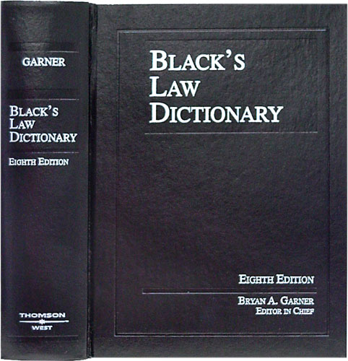
Part One: Liens
So just what is a Lien?
Well lets go to Blacks Law Dictionary,
and remember we need to think of
property as a collection of “Rights”
and not a collection of “Things”;
Blacks defines a “LIEN” as:
A charge or security or encumbrance upon property
A claim or charge on property for payment of some debt, obligation or duty
A right to retain property for payment of debt or demand
A simple definition of Lien is:
“The Right to encumber certain property for security on a debt”

Slide 48
Liens
A lien is a security device to enforce payment
Types of Liens
A. Common Law Lien
A Common Law Lien is a common law, customary right to possess or retain personal property which has been improved or enhanced in value by the person who claims the lien until the person claiming the property pays in full all charges attaching to the property for such improvement. Every lien requires that:
1. A debt has arisen from services performed on the thing;
2. Title to the thing is in the debtor; and
3. Possession of the thing is in the creditor.
B. Statutory Lien
A Statutory Lien is an express right to enforce a lien pursuant to statute.

Slide 49
Liens
Classes of Liens
A. General Lien
A general lien is the right to retain ALL OF THE PROPERTY of another person as security for a general balance due from such other person. Certain creditors and universal agents can have a general lien.
B. Special Lien
A special lien is the right to retain SPECIFIC PROPERTY of another to secure some particular claim or charge which has attached to the property retained. A common or private carrier, a warehouser or ordinary bailee, a trustee, attorney, arbitrator, and a general or special agent may have a special lien.
Consequence of Classification
The question as to whether a lien is general or special becomes important only when the lienholder releases a portion of the chattels held as security. Where a doubt exists as to whether the lienholder has a general or special lien, the law presumes the lien to be special rather than general.
General Lien
If the lienholder has a general lien and releases part of the chattels, he releases no portion of the lien and he may hold the unreleased portion until the entire lien charge is paid.
Special Lien
If the lien is a special lien and the lienholder releases a portion of the chattels held, he thereby waives the lien to the extent of the chattels released.

Slide 50
BAILMENTS
DEFINITION
General Definition
A bailment is the relationship created by the transfer
of possession of an item of personal property
by one called the bailor
to another called the bailee
for the accomplishment of a certain purpose.
Blacks defines Bailment as: “A delivery of goods or personal property, by one person to another, in trust for the execution of a special object upon or in relation to such goods, beneficial to the bailor or the bailee or both, and upon a contract, express or implied, to perform the trust and carry out such object, and thereupon redeliver the goods to the bailor or otherwise dispose of the same in conformity with the purpose of the trust.”
A simple definition of a Bailment is:
“A contractual relationship created by the transfer of possession
of personal property for a purpose”

Slide 51
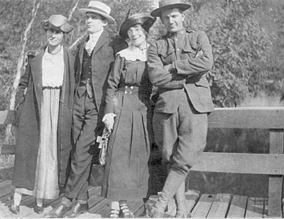
BAILMENTS
Elements of a Bailment
DAPPER
Delivery
Agreement
Personal Property
Purpose
Entered into for the Benefit of one or both parties; and
ended with Redelivery

Slide 52
BAILMENTS
BAILEE'S DUTY WITH RESPECT TO THE BAILED GOODS
4. Bailee's Duty of Care
The traditional view is that the standard of care applicable to a bailee depends on the type of bailment involved.
A bailee is not an insurer of the safety of the goods bailed, but will be liable only for failure to adhere to the standard of care imposed on them by virtue of the type of bailment.
a. Sole Benefit of the Bailor (Gratuitous)
Generally, where the bailment is for the sole benefit of the bailor (e.g., where the bailee is uncompensated), the bailee must exercise only slight care with respect to the goods bailed.
He is liable only for gross negligence with respect to the bailed goods.
Examples:
1) A gratuitous bailee of furniture could be held liable for failure to insure the furniture after making a promise to insure it
2) A gratuitous bailee of storage trunks may be liable for an unexplained failure to return the property. [Dalton v. Hamilton Hotel Operating Co., 242 N.Y. 481 (1926)]
Note: A three-year statute of limitations applies to actions in which a bailor seeks a recovery because of loss of or damage to goods held under a gratuitous bailment.

Slide 53
BAILMENTS
BAILEE'S DUTY WITH RESPECT TO THE BAILED GOODS
4. Bailee's Duty of Care (Continued)
b. Sole Benefit of the Bailee (Gratuitous)
When the bailment is for the sole benefit of the bailee (e.g., the bailor gratuitously loans his property), great diligence is required. The bailee will be liable for even slight negligence.
1. Limitation
No liability is imposed on a bailee for loss caused by an independent agency where the bailee exercised at least ordinary care. [Hobbie v. Ryan, 130 Misc. 221 (1927)]
Note: A bailee's promise of freedom from "risk from all hazards“ makes them liable for robbery. [Eckel v. Trencher Furs, Inc., 191 Misc. 14 (1947); Balice v. Erie Railroad, 208 A.D. 427 (1924)]
2. Bailor's Duty
A bailor has a duty to warn a gratuitous bailee user of known defects. [Hood v. State, 48 Misc. 2d 43 (1965), aff’d: 28 A.D.2d 1034 (1967)]

Slide 54
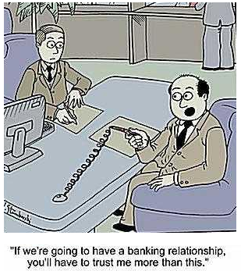
BAILMENTS
BAILEE'S DUTY WITH RESPECT TO THE BAILED GOODS
4. Bailee's Duty of Care
c. Mutual Benefit Bailment (Commercial)
Bailments for hire and pledges are for the mutual benefit
of the bailor and bailee. In such instances, the bailee must
exercise a duty of ordinary care. The bailee will be liable
for their ordinary negligence.
d. Modern Approach to Duties
Modern courts tend to reject this three-step standard and
simply hold the bailee to a duty of ordinary care in light of
the circumstances. New York decisions appear to be moving
toward this trend.

Slide 55
Bonus Question of the Day
For next time – Read Assignments for the Midterm
Questions???
Have a Wonderful Week

