Slide 1


Slide Set Fourteen:
Real Property – Property Taxes and Shared Land Interests

Slide 2

Last Class:
We began to discuss Real Property Concepts
- Real Property – The Basics
- Definitions of Real Property
- The Importance of Real Property
- Nature of Interests in Real Property
- Possessory Estates vs. Non Possessory
- Estates in Time – Duration of Rights
- Collection of Rights

Slide 3
Tonight’s Class:
We will begin to discuss Real Property Concepts
- Shared Rights in Land
- Tenant in the Entirety
- Joint Tenants
- Tenants in Common
- Real Property Taxes

Slide 4

Shared Rights in Land

Slide 5
Joint Interests/Concurrent Estates
- Tenancy in the Entirety
By Marital Right – only between husband and wife
Right of Survivorship – by operation of law
Severance Limited (Death, divorce, agreement, joint creditor execution)
- Joint Tenancy
Created by unity of time, title, interest and possession
Right of Survivorship – by operation of law
Severance Less Limited (Inter vivos conveyance or contract to convey, death, agreement, foreclosure on lien)
- Tenants in Common
No Right of Survivorship.
Freely alienable.
Joint ownership based upon percentage.
Share and responsible proportionally in all gains and liabilities.

Slide 6
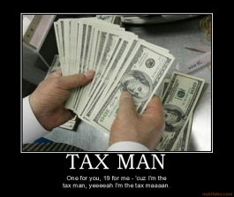
Real Property Taxes
The Tax Man Cometh

Slide 7
Real Property Taxes
- Real Property Taxes and Estate (Death) Taxes
are the only two type of taxes
that tax you on what you own or have,
not on what you earn or acquire.
- Very Repressive and Regressive,
especially on the poor and elderly.
- Imposed by and used to finance:
Local governments, Special districts and Schools.
- Very stable source of government revenue.
- Many movements to shift funding from Real Property Tax
(STAR Program – Tax Cap).

Slide 8
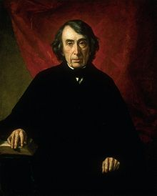
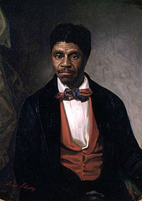
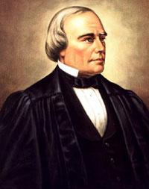
Case Study:
Dred Scott v. Sanford
The case that caused a
Civil War
Roger Tauney Dred Scott Benjamin Robbins Curtis

Slide 9
Bonus Questions of the Day
For next time – Read Assignments
for Class One to Nine
Question of the Day
Questions???

