Slide 1
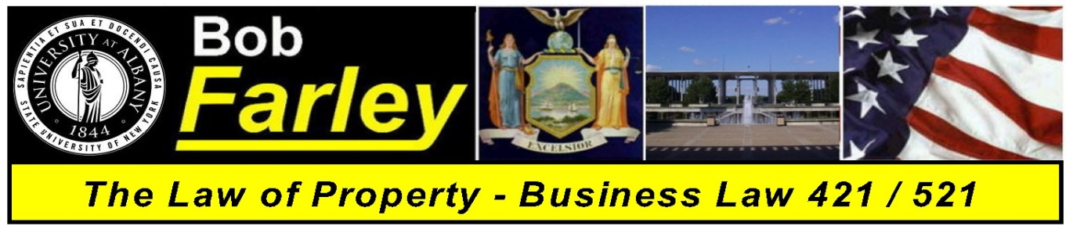

Slide Set Seventeen:
Real Property
Modern Challenges in Property Law

Slide 2
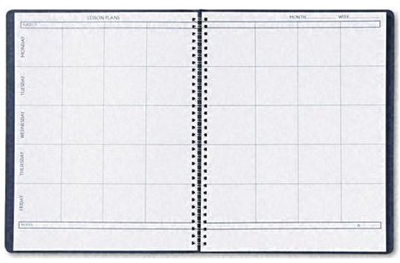
Last Time We Spoke About:
- Conveyances
- CMDR
1. Contract,
2. Mortgage,
3. Deed, and
` 4. Recording
- Who Wants to Be a Homeowner

Slide 3
Tonight We Will Speak About:
- The Value of Title Searches
- A Review of Real Property
- The wonderful world of Land Use
- The Law of Nuisance and Trespass
- The Law of Zoning; and
- The Law of Eminent Domain and Takings
- Urban Renewal vs. Personal Property Rights

Slide 4
Real Property – Issue of Title
The Value of Title Searches
A purchaser can only get the property rights of the seller
Title searches identify the property rights the seller has
Title searches prevent mistakes like the Creamery Bldg.
Title searches make the buyer eligible for title insurance
Title insurance guarantees rights found in title searches
Title searches help the buyer know what they purchase

Slide 5
The Law of Land Use
Nuisance
Trespass
Zoning and Planning
Governmental Taking (Eminent domain)

Slide 6
Nuisance
The law has long recognized the concept that one must not use one’s property to injure another’s property. When this type of conduct occurs it can legally be classified as Nuisance.
Private Nuisance – A private nuisance is the substantial interference with private rights to use and enjoy land, produced by either intentional and unreasonable conduct, or by unintentional conduct that is either negligent, reckless, or so inherently dangerous that strict liability is applied.
Public Nuisance – A Nuisance that affects the rights held in common by many landowners, i.e. the public, rather than the specific rights of an individual, targeted landowner can be classified as a public nuisance.

Slide 7
Nuisance
Unlike Trespass which involves a physical invasion of a person’s land, i.e. an interference with a person’s exclusive right of possession, Nuisance involves an interference, usually by instrumentality, with a person’s right to use and enjoy their land.
Examples:
Private Nuisance – An adjoining land owner decides to open a vehicle repair shop next to an organic gardener. Each day, due to numerous oil changes, oil spills from the repair shop property onto the garden, leaching into the garden’s soil. The owner of the garden would have an action in private nuisance against the owner of the repair shop.
Public Nuisance – A cement plant lawfully discharges chemicals from its smokestacks, which causes cement particles to land all over the homes and yards of an adjacent town. Because the town’s residents’ health and safety might be seen as being adversely affected, the town could maintain an action in public nuisance against the owner of the cement factory.

Slide 8
Nuisance
Remedies for nuisance include remedies at law and equity or both. As a result, a party who has suffered a nuisance can bring an action for:
* Money Damages;
* Injunction (to have the person creating the nuisance cease creating it); or
* Both

Slide 9
Trespass
Generally
The law has also long recognized the concept that a property owner is entitled to use one’s property with out interference from others, and that property owners have an inherent right to exclude those who may so wish to so interfere.
When this type of physical interference occurs, it can legally be classified as Trespass.
Trespass Defined – At common law, any intentional and unprivileged entry onto land owned or occupied by another constituted a trespass. Although recent developments in the law have focused on carving out special exceptions to liability, the basic liability standards have not changed.

Slide 10
Trespass
Generally
Intent - The element of intent has a special meaning in trespass law. A trespasser is strictly liable; good faith, knowledge, and fault are irrelevant. A person commits trespass, even if they merely walk across a property owner’s land, mistakenly believing it to be their own. The trespass doctrine requires only that the trespasser intended to enter onto the land as a matter of free choice, not that he had a subjective intent to trespass or even knew he was trespassing.
Entry - Although trespass always involves a physical invasion, a trespass may occur without any personal entry by the trespasser. For a trespasser will also be liable in trespass, if they cause a thing or a third person to enter the property owner’s land. This doctrine also applies to entries below the land surface (e.g., through tunnels or caves) as well as-at least partially to entries in the air space over the land.
Remedies - A trespasser is liable even if the entry causes no actual damage. A court can hold a trespasser liable for nominal damages and, upon the property owner’s request, can enjoin any further trespass.

Slide 11
Trespass
General Exceptions to Trespass Liability
An entry under a legally recognized privilege does not constitute a trespass.
A privileged entry is one made with the landowner's consent.
If an owner invites a repairman onto their land to fix a leaky pipe, then the workman’s entry is privileged.
Privilege may also be found of necessity.
A firefighter may enter private property to save an adjacent house from fire.
A police officer may enter to arrest a suspect.
Private persons can also be found to have a privilege to enter another's land in an emergency situation (e.g., while fleeing from an attacking bear).

Slide 12
Trespass
Remedies for trespass also include remedies at law and equity or both. As a result, a party who has suffered a nuisance can bring an action for:
* Money Damages; (can be nominal)
* Injunction (called ejectment, to have the trespasser removed from the property and/or enjoined from re-entering it); or
* Both

Slide 13
Zoning
Zoning is the use of governmental power to regulate land use.
Zoning laws divide a political jurisdiction into specific separate geographic areas and impose limits on the permissible uses of land within each area.
Zoning has several legitimate objectives:
(1) To prevent incompatible uses from occurring (thus reducing the need for nuisance law),
(2) to increase property values generally by minimizing use conflicts (thus increasing the property tax base). and
(3) to channel development into patterns that may serve larger social goals (e.g., reduce urban sprawl to conserve resources and reduce air pollution from automobiles).
Zoning is the use of public power to impose uniform results that might otherwise be accomplished in more piecemeal and selective fashion by private bargains.

Slide 14
Zoning
Zoning limits the use that may be made of property. Usually an area is zoned for a particular use (such as commercial, industrial, agricultural, residential.
Zoning is usually done at the local level, pursuant to authority conferred by a state enabling act.
Zoning must comply with the enabling act. the state and federal constitutions. and all other state or federal laws that limit zoning power.
Some zoning laws are cumulative, meaning that in an area zoned for the least favored use all other uses are permitted, but in an area zoned for the most favored use only that use is permitted. Other zoning laws are mutually exclusive.
Zoning laws may address many specific land uses such as density. aesthetics, or household composition.
Zoning laws. when enacted, restrict or prohibit some prior lawful uses. To avoid challenges to the validity of the newly imposed regulation, zoning laws typically permit nonconforming uses to continue for a limited period of time. If an owner discontinues the use, however, it generally may not be renewed.
Zoning laws typically confer some discretion on a zoning board. When abuses of discretion occur, such rulings are deemed invalid.

Slide 15
Zoning
Variances from zoning can permit otherwise prohibited uses or deviations from density or area controls. Zoning variances are granted only to alleviate undue hardships not of the applicant's creation.
Exceptional uses are permitted by the zoning law under flexible criteria specified in the law.
Zoning amendments present the problem of spot zoning, an amendment that confers benefits on a discrete parcel without any public benefit, and often in disregard of the comprehensive use plan that zoning is supposed to implement.
Floating zones are uses that are not tethered to a specific area - the zoning board decides when the use becomes relevant where it should be located.
Contract or conditional zoning involves a change in zoning conditioned upon imposition of a
servitude restricting use that is designed to produce public benefits.
Constitutional and statutory law impose limits on the zoning power. Zoning for aesthetic purposes is generally permitted, particularly when it upholds property values.
When zoning restricts free speech it is presumed void and the government has a heavy burden of justification.
Zoning that restricts the ability of people related by blood or marriage to live together is presumed void, while zoning that restricts the ability of unrelated people to live together is presumptively valid.

Slide 16
Eminent Domain
TAKINGS: THE POWER OF EMINENT DOMAIN AND REGULATORY TAKINGS
The power of eminent domain is the power of a governmental body to take private property for public purposes.
The law places the particular focus upon the regulator. Eminent domain takings, pursuant to the United States Constitution, requires just compensation. These constitutional requirements apply to all governments and protects all forms of property.
The public use requirement is satisfied so long as there is a conceivable public purpose fur the taking.
A taking occurs whenever a regulation permanently dispossesses an owner or prevents their use and enjoyment of the property.
Compensation for the taking must be the market value of the property.
The amount of compensation is the current market value not the value that will occur due to the public improvement. Compensation is required for regulations that constitute takings, no matter how long or short the regulation may endure.

Slide 17
Eminent Domain
The Takings Clause
All governments in the United States have the power to take private property for public purposes, but that power (the eminent domain power) is limited by the U.S. Constitution, state constitutions, state statutes and judicial decisions.
The U.S. Constitution's Fifth Amendment specifically provides that "private property [shall not] be taken for public use without just compensation.“ This is called the "takings clause" or the “eminent domain" clause.
These requirements protect all property and applies to all governments.
The takings clause serves two important and related purposes.
1. Prevent forcible redistribution of property
2. Takings permitted only for public benefit

Slide 18
Eminent Domain
The meaning of public use
A literal reading of the Constitution's text
would limit governmental power
to take private property to instances
where the property will actually be used
by the public (e.g., as a park. school. road,
or military base).
The question becomes pronounced
when seizures are designed to produce
some collateral public benefit.

Slide 19
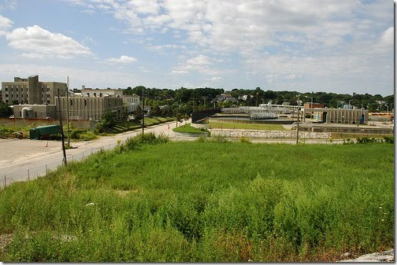
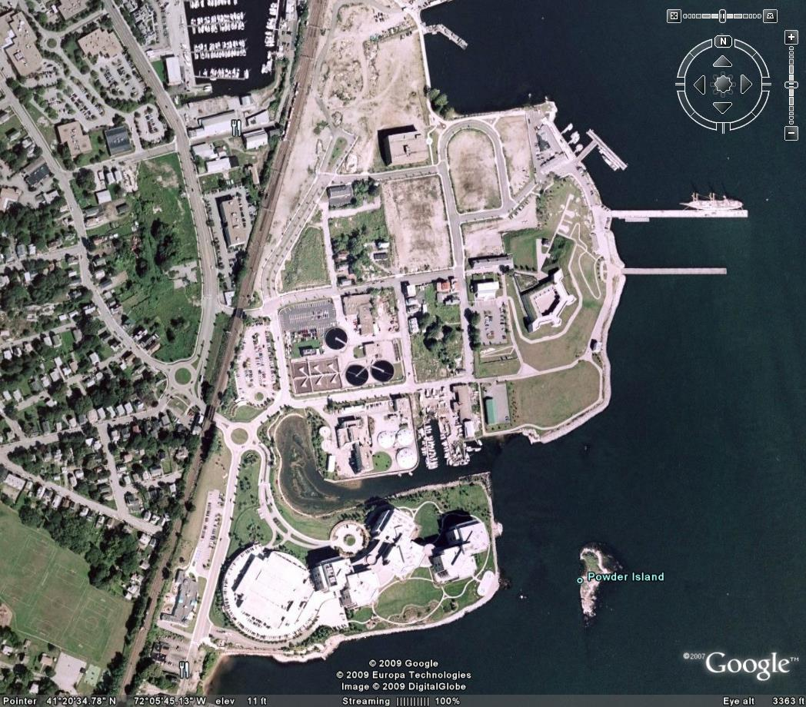

The Case of Economic Development and Urban Renewal
-v-
Individual Property Rights
The Famous Kelo Decision

Slide 20
Bonus Questions of the Day
For next time – Read Assignments for Classes One to Twelve on the Webpage.
Questions???

