Slide 1
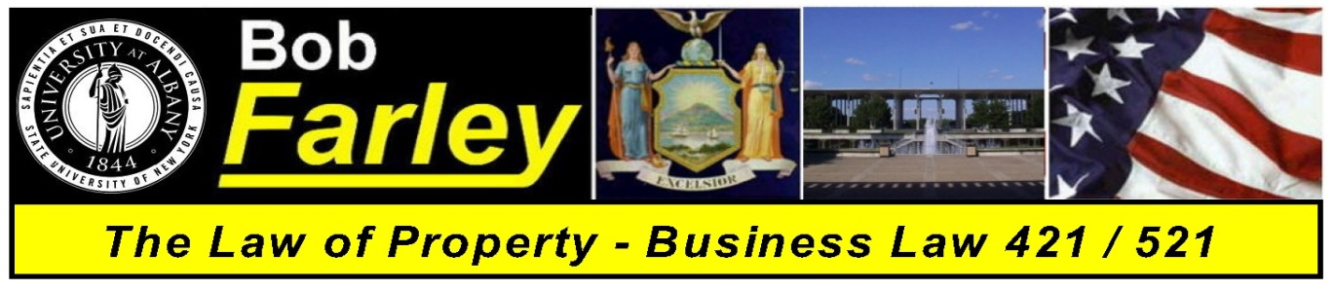

Slide Set Thirteen:
Real Property – Property Taxes

Slide 2
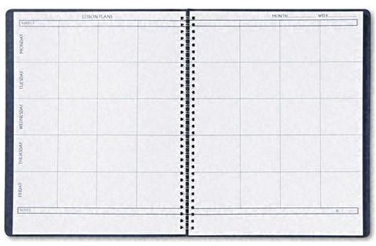
Tonight’s Class:
We will begin to discuss Real Property Concepts
- Shared Rights in Land
- Tenant in the Entirety
- Joint Tenants
- Tenants in Common

Slide 3
Tonight’s Class:
We will begin to discuss Real Property Concepts
- Property Taxes
- Very Repressive and Regressive,
- Used to finance local governments and Schools.
- Very stable source of government revenue.
- Movements to shift such funding.

Slide 4
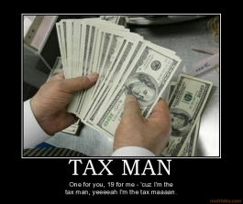
Real Property Taxes
The Tax Man Cometh

Slide 5
Real Property Taxes
- Real Property Taxes and Estate (Death) Taxes
are the only two type of taxes
that tax you on what you own or have,
not on what you earn or acquire.
- Very Repressive and Regressive,
especially on the poor and elderly.
- Imposed by and used to finance:
Local governments, Special districts and Schools.
- Very stable source of government revenue.
- Many movements to shift funding from Real Property Tax
(STAR Program and the Tax Cap).

Slide 6
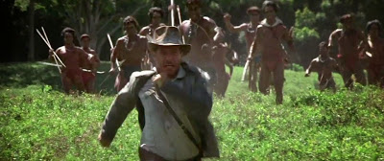
Case – Charrier v. Bell
- The Archeologist, the Indians and the Land Owner

Slide 7
Bonus Questions of the Day
For next time – Read Assignments and Cases
Question of the Day
Questions???

