Slide 1


Slide Set Two:
The History of American Law
and Property Rights

Slide 2

Last Time – We Spoke About:
Website: www.bobfarley.org
Your Biography: If you haven’t already, please hand it in.
Property: Is a collection of Rights, not a collection of things
What is a Right: The legally recognized ability to exercise power and control over an action or an object
What is the Law: Rules by which civilization in ordered.
Laws: Constitution, Statutes, Case Law Regulations and Executive Orders
Sovereignty: In the United States it vest in the People themselves.
Structure of Government:
Adams: Pre-Declaration “Thoughts on Government”
Federal: President, Congress (Senate/House), Judiciary (Supreme Court)
State: Governor, Legislature (Senate/Assembly), Judiciary (Court of Appeals)
Founders: Devoted to Property Rights
Exercise: How A Bill Becomes A Law

Slide 3
Tonight – We Will Speak About:
The Importance of Property
The Evolution of Property Rights in Law
How the Law and Property are Intertwined
Anglo-American Legal History
How Property Rights Became a Fabric of Law
Blackstone and Colonial Perspective:
Making Property Rights Part of America
Property Rights in American Law:
Life, Liberty and the Pursuit of … Property!

Slide 4
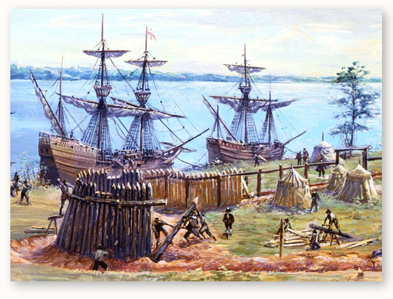
It Was Always About Property

Slide 5
The Evolution of Property Rights and the Law
This is a survey of the History of Anglo American Law
But this as this is a course in the law of property, you may have questioned:
Why should we learn about:
Roman Codes,
The British Monarchy and Common Law,
Colonial Legislatures, and
The formation of Constitutions and State Legislatures?
Is this not a course on land transactions, mortgages, bailments, gifts and real and rental property relationships?
What does the heck does the first have to do with the second?

Slide 6
The Evolution of Property Rights and the Law
This is a concept not for the intellectually lazy.
Indeed from first blush, you may not grasp the reason why we must learn about the history of Anglo American Law to understand property.
The simple answer is that to truly understand the law of property,
we must understand the law itself,
for property and the law are intertwined,
with each developing from the other.
So if we want to understand property, we need to understand the law.
If we want to understand the law, we need to know how it developed. Thus a understanding of property, requires a review of legal history.
Once we grasp the legal history, the difficult concepts of property law,
all start to make sense and fall into place.

Slide 7
What do Rights, Law and Constitutions have to do with Property?
Our next two classes might seem like they have nothing to do with property, but let me assure you dear students, they have absolutely everything to do with property.
To truly understand property, it is necessary to think of it in terms of a collection of rights, not a collection of things.
To truly understand rights, one must understand the law that protects those rights.
To truly understand the law, one must understand the constitutions under which the law maintains its framework.
Accordingly Rights, Law and Constitutions are the three pillars upon which property is supported.

Slide 8


Are you a sailboat or are you a submarine?
Well my dear students, let me address
your burning curiosity
as any good professor of law would do,
by asking a question of my own.

Slide 9
Sailboat Students
A sailboat student simply skims the tides of knowledge.
Merely reacting to the waves of information before them, they fail to truly comprehend the conditions the sea of learning presented during their trip.
Sailboat students are mere passengers on the adventure, never bothering to ask what causes such conditions below the surface upon which they travel.
Consequently, the sailboat student leaves their vessel at the end of the journey without ever asking what lies beneath the surface of the water. They sadly lose the opportunity to make the deep discoveries that their adventure offers.

Slide 10
Submarine Students
Conversely, the Submarine student longs to not only enjoy the beauty of cruising the surface, but also dares to venture into watery depths of understanding.
By permitting themselves to at times be immersed in the knowledge of the subject waters before them, they choose the journey of full perspective learning, weathering the storms of uncertainty, by diving into the information of the deep.
Those brave students, dedicated enough to wear the dolphin insignia upon their lapel of learning, are rewarded with the exhilaration of understanding and knowledge, grasping the opportunity of discovery and enrichment.

Slide 11
Which are You?
For those of you courageous and dedicated enough to become submariners, I urge you to thoroughly complete our reading assignments posted to our website.
There you can take the plunge into the full depths of understanding.
For those of you more inclined to a sailboat adventure, however, please know that we will do our best here in class
to serve as an effective tour guide
for our adventure into the Law of Property.
As a lawyer, however, I must advise you all of a caveat. It is my experience, that reading is indeed the gateway to learning. It can, like few other mediums, transport our minds to the wonderful world of understanding and comprehension.
You show me a gifted, educated person, I’ll show you a reader.

Slide 14
So What is Property?
And so before we begin our adventure
to discover just what property is …
We must think about the meaning of property
What it really is and means!!!

Slide 15
Let’s Continue on our Adventure in the Law
As we spoke briefly the last time, any true understanding of the law of property requires at least a basic understanding of the concept of the law.
For as Professor Friedman so accurately points out in his landmark work “A History of the American Law”, the law. and our conception of property rights, evolved together.
The Law and Property Rights are integrated and intertwined.
In so many ways, they formed the basis for each other.
In their early days they were virtually inseparable.

Slide 16
Studying the Law of Property
as an Adventure in the Law
To start this Adventure we need to know:
What is the “Law”?
We need to find out, we need to discover this answer.
And just how do we do that?
Well, we need to learn that good law students,
like good adventures and explorers,
develop a well earned love for books.
For Books are the treasure trove of answers.

Slide 17
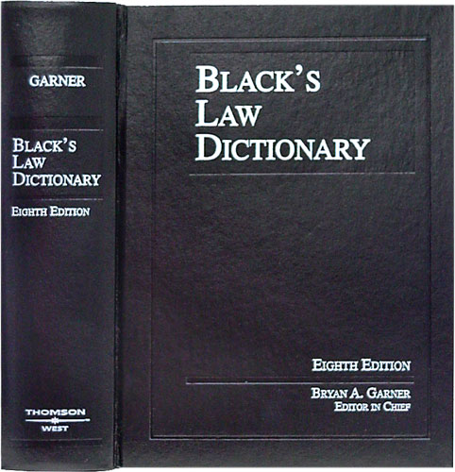
Adventures in Law – Just What is the Law ?
So Let’s Start with Black’s
Black’s Law Dictionary
is the Gold Standard
of Legal Definitions.
If we need to know a term
in the law, a legal definition,
we should start with Black’s.

Slide 18
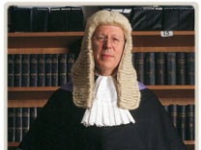
And so,
What is the “Law”?
The “Law” has been defined by Black’s Law Dictionary as follows:
“That which is laid down, ordained, or established.
A rule or method according to which a phenomena or actions co-exist or follow each other.
Law, in its generic sense, is a body of rules of action or conduct proscribed by controlling authority, and having binding legal force. …
Law is a solemn expression of the will of the supreme power of the state.”
Perhaps the simplest description of the Law, however, is that:
“Law is the Rules by which civilization is ordered.”

Slide 19
The Chief Elements / Components of the Law are:
Early laws were simply directives from a king or sovereign.
Modern Laws are Enacted by a Legislature
(In America that is Congress for the Federal Government
and State Legislatures for State Governments)
1. Rules
2. Pronounced, laid down and/or issued by a controlling authority;
3. That are consistent and lasting; and
4. That are enforceable and followed by the governed.

Slide 20
Priority of Laws:
1. Constitution: Established by Convention of Elected Delegates
to provide governmental framework and protections of individual rights,
they are supreme to all other laws as interpreted by the Courts
2. Statute: Laws passed (enacted) by an elected legislative body
(Congress or State Legislature) and signed into law by the Executive
(President or Governor).
3. Regulation: Promulgated by government (Executive) agencies
to amplify or clarify their authority as provided in statute or constitution.
4. Executive Order: Issued by Executive (President or Governor)
as an instruction to their agencies on how to execute a procedure or law.
Case Law or Common Law -
Decisions issued by courts which provide legal rules by:
1. Interpretation of a Constitution, Statute, Regulation or Executive Order, or
2. Clarifying or creating law pursuant to past court decisions.

Slide 21
Part One : The Evolution of Rights

Slide 22
The Evolution of Rights
So it has become apparent – if you want to understand Property you need to understand Rights.
So lets begin our understanding into the true meaning of property law, by performing a review of the evolution of Rights. Where they came from and what they mean.
As we venture into our journey of understanding to explore the History of the Law. Now we will examine that same history with respect to the concept of Rights.
For without the vehicle of the law
and the enforcement and protection its offers,
the legal concept of Rights
(and the just expectations upon which they are based) would not exist.
Notes:
22

Slide 23
The Evolution of Rights
A. The Concept of Right
In order to properly view property as a collection of rights, exactly what a right is, and where it came from,
needs to be understood.
The legal concept of “right” is a relatively recent one, that was
not fundamentally expressed until after the rise of English jurisprudence.
Indeed, according to Susan Ford Wiltshire
(Chair of the Classical Studies Department of Vanderbilt University)
“Theories of rights assume a dignity of persons and a status of individuals
that did not exist in the classical world”.
Prior to the predominance of English jurisprudence, the legal status of an individual was determined by their relationship with the state.
As English jurisprudence developed however, with both the events surrounding the Magna Carta and the establishment of the Common law, the law began to see a “slow transition from a state defined, to an individual-defined, political identity”,
driven primarily by a new belief in the concept of natural law.
Notes:
23

Slide 24
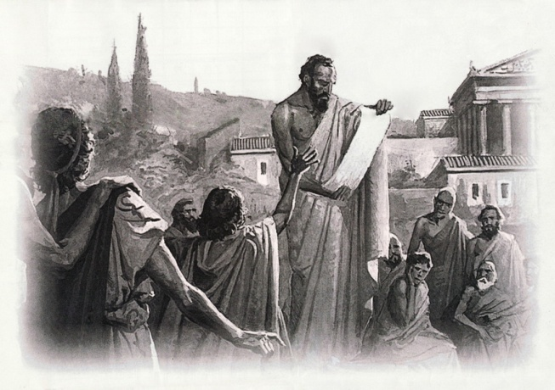
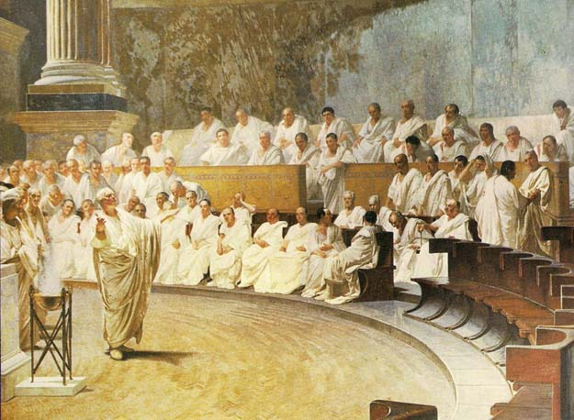
The Evolution of Rights
A. The Concept of Right - Continued
First Greece
The first step toward
the development of the concept of rights
can be traced back to ancient Athens,
when the Greeks “invented
the revolutionary idea that human beings
are capable of governing themselves
through laws of their own making”.
Then Rome
Thereafter, the development of the concept
of rights gained a significant boost,
through the Romans and their creation
of a complex and sophisticated legal system.
Notes:
24

Slide 25
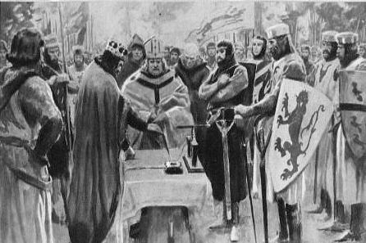
The Evolution of Rights
A. The Concept of Right - Continued
Then England
Despite this foundation, however,
the concept of “right” that we know today,
did not begin to truly emerge,
until after the establishment
of English jurisprudence,
and upon such time, as under its influence,
the unification of political thought
between clerics and legal scholars occurred,
to create the concept of natural law.
The Rise of Individual Rights
The 13th century was especially important
for the development of “rights” as we know them today.
The first transformation occurred during the early middle ages,
which saw the replacement of a person’s classical legal status
through the state with a new similar bind with the Roman Catholic
church.
Notes:
25

Slide 26
The Evolution of Rights
A. The Concept of Right - Continued
The Rise of Individual Rights - Continued
By the time of the 13th century,
the establishment of English jurisprudence,
as influenced by the occurrence
of certain political and social events,
(such as the establishment of the common law court system,
trial by jury, and the signing of the Magna Carta)
began to change this perspective.
The Age of Deep Thinkers
Along with these political and social events,
came the rise of a new clerical-legal philosophy
(Men like Thomas Aquinas, William Ockham and John Wycliffe
that started to impart human beings as instruments of God
with fundamental, individual natural rights).
These developments proved earth shattering
and began to put mankind on the legal path to “rights”
Notes:
26

Slide 27
The Evolution of Rights
The Concept of Right
I. The Rise of English Jurisprudence
1. Roman Law
2. The Development of English Common Law
3. The Magna Carta
4. Clerical Philosophy and the Recognition of Natural Law
- Magna Carta
- 4th Lateran Council
- Thomas Aquinas
- William Ockham
- John Wycliffe
II. The Social Contract Theory
III. The Definition of Right
IV. John Locke and the Pronouncement of Property Rights
Notes:
27

Slide 28
The Evolution of Rights
B. The Definition of Right
When the legal concept of right became recognized under English jurisprudence, what exactly did they mean by the term “right”?
How could this idea, this term, be defined?
According to William Blackstone, author of the famous Commentaries on the Law of England, a treatise often referred to as “the Bible of the Law”, the legal definition of the word “Right” represents the closest English translation of the Latin term “jus” (from which the term justice is derived), and essentially means:
“the abstract sense of law”.
For our purposes, however, perhaps the best and most effective understanding
of what the term “Right” actually means,
can be seen from the writings of the Scottish philosopher and legal commentator, James Mill.
Mill saw “rights” in terms of a claim based upon a legally justified expectation
(which explains how rights progressed from the Rules of Roman law, to the public expectations produced from Common law decisions and the pronouncement of the Magna Carta, and then through the individualist centered citizenship of the clerical-legal philosophers).
From Mill’s writings, a corresponding definition of the term “Right”, can accordingly be derived to be:
“The legally recognized ability to exercise power and control over an action or object”.
Notes:
28

Slide 29
Part Two : The History of Anglo American Law

Slide 30
What is the “Law”?
Remember our simple definition:
“Law is the Rules
by which civilization
is ordered.”

Slide 31
Part One : The History of Anglo American Law
So where do we begin our history?
Simple, at the beginning.
But before we start, like any great adventure,
we need a roadmap,
to tell us where we are going.

Slide 32
Roadmap to Legal History

Slide 33
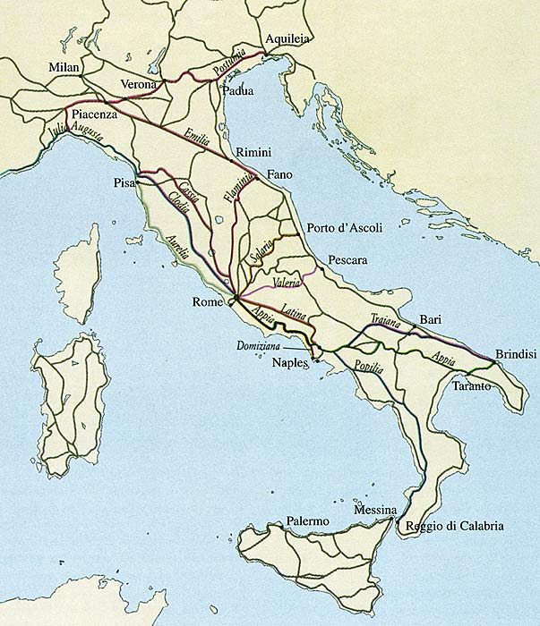
So Where Do We Start?
Where do we begin our adventure?
Where did the Law first begin, first start, first evolve?
Like the saying states: All Roads Lead to Rome

Slide 34
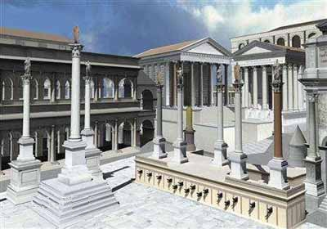
Rome
The concept of a body of law
(Rules by which civilization is ordered) first emerged in Rome.
For Rome was the first real society to embrace the idea of continuity.
They were the first civilization to openly recognize that the culture of Rome Itself was greater and more eternal than any one king or emperor.
Law became an extension of this view.
Roman Citizens were very well versed in the law.
They took it seriously and believed in its value and purpose.
Like so many other Roman institutions it was developed as a tool.
A tool to order their civilization and conquests.

Slide 35
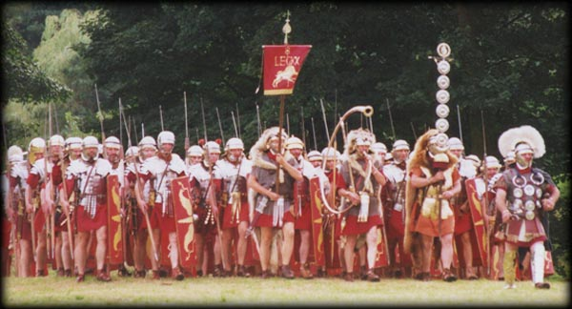
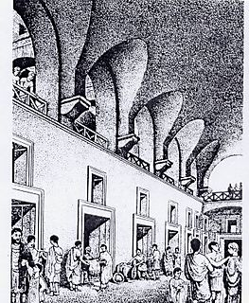
Rome Continued:
Rome was an empire
based upon trade and its military.
The law helped both these institutions
promote civilization
across the then known world by:
instilling both consumer and
merchant confidence , and
providing a consistent template
for the governance and operation
of conquered lands and peoples.
The Law of Rome,
often referred to as the Code due to its written history,
helped to make the Roman Empire the Greatest of its Time.

Slide 36
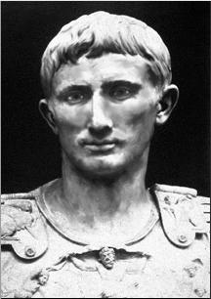
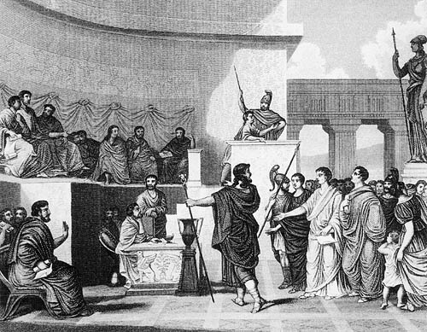
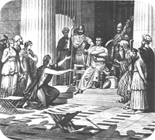
Just what were these Roman Legal Institutions?
(The First Three Branch Government)
Executive – The Emperor
2. Legislative – The Senate
3. Judicial – The Courts

Slide 37
Rome Continued
Rome developed a quasi legislative body
known as the Senate (Started as representatives of the 100 most prominent families to advise the Emperor)
They also established a system of Courts to arbitrate disputes. (Judges appointed by the Emperor)
The Roman concept of the Law, put down in Code, was still largely the edicts of the Emperor.
As such, any precedent was solely based upon the emperor’s respect for his predecessors.

Slide 38
Rome Continued
Through its law and the concept of continuity and respect for the legal principles established in the Empire, Rome became the center of civilization, wealth and Trade for the entire known world.
Roman Law and the Code it produced was centered upon property rights.
These legally protected property rights allowed the Roman economy to flourish, businesses to develop, and trade to dominate all other nations and peoples.
The Roman concept of the Law, invented corporations, established trade standards, punished those who did not respect property rights and recognized concepts such as ownership, possession, use, exclusion and transfer of private property.
Like the great architecture for which it is known, Rome developed a system of law that was timeless and has lasted throughout the ages.

Slide 39
So once again …
Why is this important to Property Law?
Because History Counts in Law –
To know where we are
We need to know where we’ve been

Slide 40

So on to Gaul (England)
So Let’s Go to the Time of King Arthur
Who was Arthur?
A Roman Soldier
King of Britain
Promoter of the Roman Code
Known for
- Equality,
- Rule of Law,
- Freedom and
- Military Strength

Slide 41
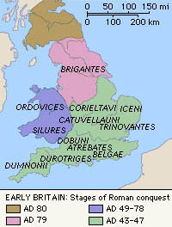
England: A Roman Heritage in the Law
The fact that England was conquered by the Romans instilled the philosophy of respect for the law.
By the time the Roman Empire fell and left England on its own to fend for itself, the tradition of respect for the law, had already taken hold for hundreds of years.
Arthur as King, the embodiment of English pride and values, was a Roman Soldier, whose respect for the law was embodied by his oath and character.

Slide 42
England: A Roman Heritage in the Law
Like many other former Roman colonies,
England began to develop its own system
for making and enforcing the Law.
Although largely rejecting the Roman Code itself,
the Roman template and idea
of the Law being the basis for civilization,
and of its need for respect,
was an unquestioned value of the English people.
Englishmen could disagree
over who should make the law,
or what laws should be made,
but always held dear the concept of the Law itself.

Slide 43
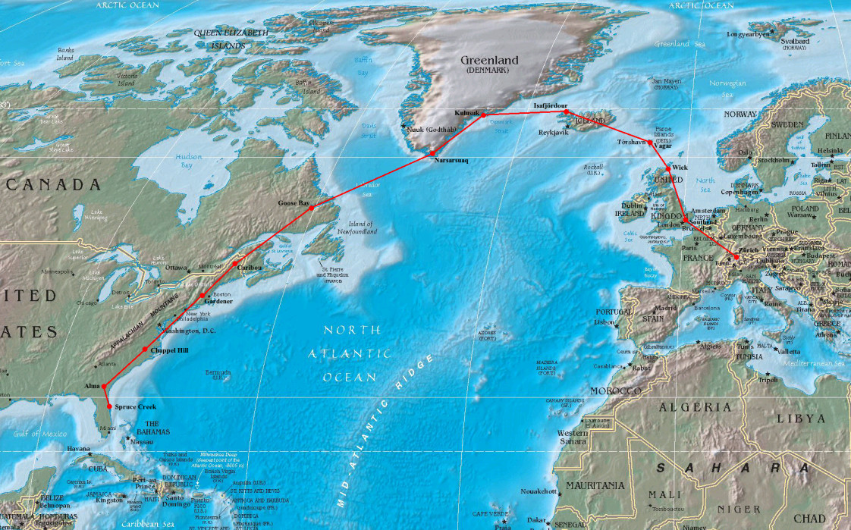
England and America – Bound by Heritage and Law

Slide 44
To Understand American Law We Need to Know English Law
As Professor Friedman opines, the Law we know today as Americans is descended from England.
England, was a conquered colony of the Romans.
As a result, England had nearly a millennium
of history of respect for a system of Law,
before the modern country even came of age.
That concept, became engrained in the very nature and ideas of the English speaking peoples,
and carries itself down to this very day.

Slide 45
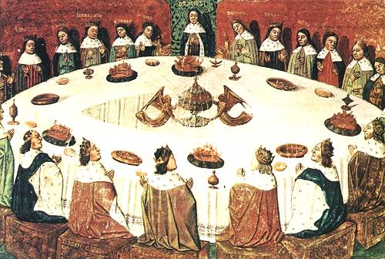
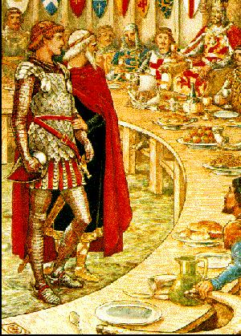
Early English Legal History
Remember, in the early years of its civilization, England was a part of the Roman Empire (43 AD to 410 AD).
After the Romans left, native Englishmen, who had been affiliated with Rome, such as soldiers, magistrates, or local governors, took power.
These men honored the Roman tradition of the Rule of Law.
One such man was Arthur, a former Roman Soldier, upon whom the King Arthur legends are based.

Slide 46
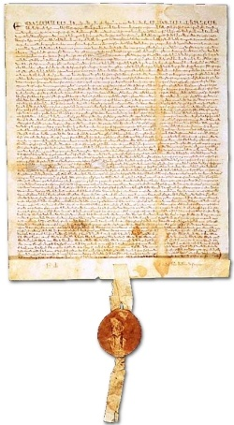
Understanding our Law
through the prism
of the Law of England
So to learn about the Law of Property, where do we start?.
Well a good place to start as Americans, is the first real battle for Property Rights in England.
And that my dear students was the Magna Carta.

Slide 47
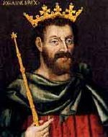
1215
The year is 1215 A.D.
John I is on the throne
It is the time of the Crusades and all the known World has been at War
800 years had passed since the fall of the Roman Empire and occupied England to the time of 1215.
And nearly 800 years have passed since that time until the present day.

Slide 48
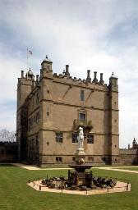
Medieval England
The times are tumultuous
England faces many challenges, both economic and security.
The country is really not yet a nation, but is struggling to gain an identity.
It’s the age of knights and kings, castles and swords.
To truly understand the times, however, lets review a bit of England’s history.

Slide 49
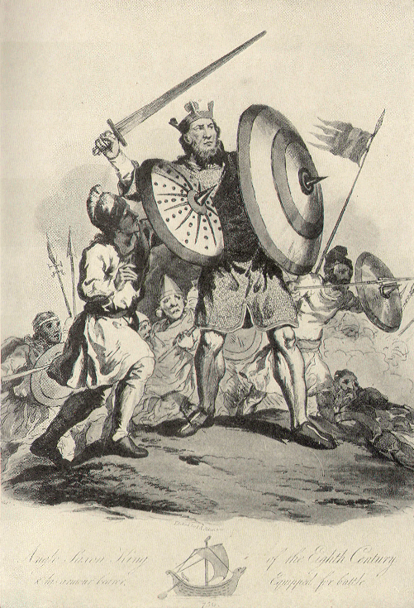
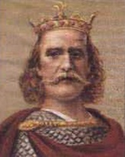
The Saxons Take Control
These English leaders, who were heavily
influenced by Roman tradition and culture,
only ruled, however, for a brief time.
Around 500 AD, Viking based Saxon tribes
invaded England and began to occupy
the country.
By 1066 these Anglo-Saxon tribes,
who by such date were residents of England
for 500 years, were led by King Harold.
Harold had loose control over the country
with his strongest hold over the region
now known as London.

Slide 50
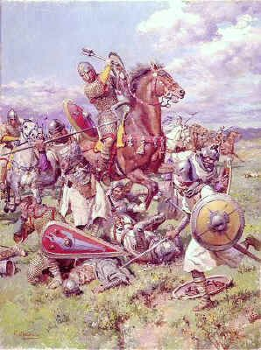
Enter William the Conqueror
In 1066, William the Conqueror, a man of Viking decedent, had just returned from the crusades as a knight.
The illegitimate son of a French Nobleman, with little prospects from a feudal farming society, he decided to leave his home in Normandy, France, to seek fame, riches and adventure.
An experienced soldier, he had an idea: To raid and conquer, the nearby Island of Brittan, across the English Channel.
A natural born leader, William raised a substantial army from towns nearby his Norman village and sailed across the Channel, seeking to recreate the glory of his Viking heritage.

Slide 51
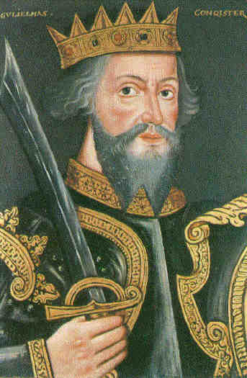
William Conquers
He did just that.
Confronting the ruling Anglo-Saxon armies at Hastings, England, William’s forces defeated the defenders, killing their King Harold with an arrow through his eye.
Organizing England, and consolidating his power throughout his new country, William proved to be a fine administrator, treating the people with a firm but fair hand.
During his reign he built the famed tower of London and began to transform his new capital into a true city.
Upon his death in 1087, he left the throne to
his nephew Stephen.

Slide 52
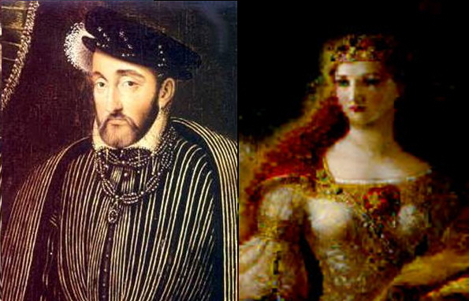
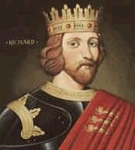
The Aftermath of William
After the reign of Stephen, in 1154
Henry the Second, and his Wife Eleanor of Aquitaine,
took over England, Normandy, and Aquitaine
(which belonged to Eleanor)
comprising not only England
but also half of modern France as well.
Henry was a strong king.
He also spent time organizing England,
as well as fighting against the French,
as well as against his Wife
who actually led a rebellion against him.
When Henry died, he left the throne to his son Richard.
Richard, known popularly as Richard the Lionhearted, was a handsome, noble and brave.
Leading English forces for the 3rd Crusade, Richard left his younger brother John in charge during his absence.

Slide 53
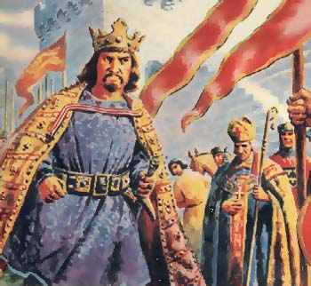
The Reign of John I
When times turn bad, leaders get vilified.
We may remember John from the stories of Robin Hood, whereby the bad John rules with corruption while the good Richard is away fighting for God and Country.
We may also remember his mother, Eleanor, as the evil Dark Haired Queen from the story of Snow White. Richard, of course, was Prince Charming.
While Richard was away, John was forced to levy heavy and oppressive taxes to pay for the Crusade as well as his brother’s ransom due to capture. A man with bad political instincts, his Court was filled with the corrupt and incapable.

Slide 54
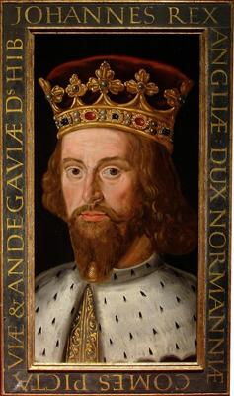
John’s Ineptitude and Bad Luck
In 1199, Richard, who had briefly returned to the throne, died.
Richard’s last few years had been blessed with good harvests and no war.
Upon Richard’s death John once again assumed the role of King.
Almost immediately, John once again presided over bad times.
The economy crashed, France repeatedly attacked, and war returned to the country.
Taxes were oppressive, corruption became rampant, and things fell into chaos.
Under the feudal system over which John ruled, the king was the unquestioned authority (The Devine Right of Kings). Landed Barons were vassals to the king, and their wealth was shared in tribute to him.
By 1215, John’s reign began to weigh to strongly upon the English people.
In addition to being a bad leader, John appears as a nasty, suspicious kind of person.
Worst of all John suffered by comparison. Compared to Philippe Augustus, who was king of France at the same time, John looked weak, corrupt and inept.

Slide 55
The Coming Storm of the Rebellion
In the constant battle between France and England, King Philippe of France chose to support the claims of Arthur, John’s nephew, to inherit the throne of Normandy.
John tried to solve this problem by capturing Arthur and having him killed, but this murder understandably upset the lords of Normandy and Anjou.
They decided they would rather be ruled by Philippe than by John, and so they agreed to fight on Philippe's side in a war with England.
By 1204 John’s forces lost most of his land in France.
It is interesting to note, that this loss really began to unite England as a people, but not behind John. For once the French land was lost, the English really began to think of themselves as different from the French people.
It was also about this time that English first started to really take shape as the language of England. (Before John, all the lords in England all spoke French.)
By 1215 the people of property, desperate to protect their interests, had had enough.

Slide 56
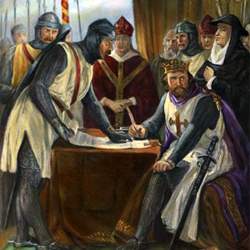
Enough is Enough
By 1215 the Barons (Lords) of England had endured enough.
Fearful that France would invade and impoverish them by seizing their lands and wealth, they raised an army to rebel against the King.
On June 15, 1215, their forces confronted King John at Runnymede, and forced him to put his seal on the Magna Carta (the Great Charter).

Slide 57
The Magna Carta is Signed
The Magna Carta established one of the foremost foundations of modern British law.
The US Constitution and its Amendments (the Bill of Rights) viewed it as a guiding document for the further expansion of the rights and liberties of the people and the limitation of the power of government.
Due to the nature of the feudal society, it did not abolish involuntary servitude.
Containing 63 clauses, this landmark document:
- Created a council to the King (a forerunner to parliament),
- Promised all freemen access to courts and a fair trial,
- Specified many property rights from infringement by the king and his agents,
- Eliminated unfair fines and punishments,
- Gave certain legal powers to the Catholic Church, and
- Addressed many lesser issues.

Slide 58
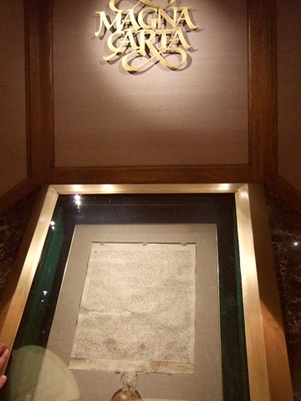
The Magna Carta Today
Today a copy of the Magna Carta can be seen on display in Washington D.C., due to a loan to the national archives
It is but another example of how property rights and the Law have an intertwined history.
If it were not for their fear of losing their property rights, the landed barons of England would never have rebelled against the King.
It was the protection of these property rights that led to the establishment of the first constitutional document of England, upon which our rights and laws are based.

Slide 59
The Effects of the Magna Carta
Since the time of the Magna Carta our system of modern Anglo-American Law has evolved to flow from three sources.
1. Constitutional Law
2. Statutes (Laws made by Elected Legislatures)
3. Case Law (Laws made by Judges).

Slide 60
Constitutions
Constitutions establish the framework of Government.
Under the British system they flow from the Magna Carta and then a Series of other similar King issued charters.
The United States Constitution, the first of its kind, arose out of our of representational government, through adoption by a convention of elected delegates and then ratification by elected state legislatures.

Slide 61
Statutes
Statutes in England came from Parliament, an elected national legislature, which evolved from the council established under the Magna Carta.
In the United States, Statutes came from (first colonial then state) legislatures, and after the ratification of the federal constitution, from Congress (our national legislature) as well.
In our country we have a federal system:
Where Congress enacts statutes (of limited subject matter jurisdiction) for the entire nation, and
Where state legislatures enact statutes (of more general jurisdiction) for the people of their state.

Slide 62
Case or Common Law
Case (or common) law in England came from the Royal Courts. Decisions of judges, reported and published with respect to specific cases.
In the United States we have Federal and State Courts.
Federal: US Supreme Court, US Court of Appeals, and the Federal District Courts
New York State: Court of Appeals, Appellate Division of the Supreme Court, and the Supreme Court (located in each County of the State).

Slide 63
1215: Fourth Lateran Counsel
In 1215 Pope Innocent III convened the Fourth Lateran Council to Determine Church Policy on a nunber of issues
This Council Recommended:
Ending Trial by Combat – Where Parties would actually fight to determine guilt or liability
Ending Trial by Ordeal – Where Defendants would be physically challenged to determine guilt or liability.
This Council thereby helped to lead the way to reform the judicial systems across the world.

Slide 64
Evolution of English Law
From 1215 until the English Civil War in 1642 and the Glorious Revolution in 1688, the English Common Law was the force that developed most of the law in England
With the challenges to the Monarchy in the English Civil War and the Glorious Revolution (conflicts basically arising out of religious controversies) the law of England began to transform away from the monarchy and toward Parliament.
The Rise of Parliament resulted in the rise of statutes, as this body began to codify rules and enact more and more English Law.
This rise in statutes would bring on conflict in the British Colonies, especially in America.

Slide 65


English Colonial America
The law of early America
was based largely upon the law of England.
We were, of course prior to the Revolution, English subjects.
Our founders initially spoke of redressing their grievances under a format of the “Rights of Englishmen”
In Colonial America, there was very little statutory law, and even after the US and State Constitutions, most law was still based upon English Court precedent. Indeed statutes were looked upon with a skeptical eye.
For it should be remembered that the Quartering Act, Stamp Act and the Townsend Acts were all statutes, and an igniting reason for the Revolution to occur in the first place.

Slide 66
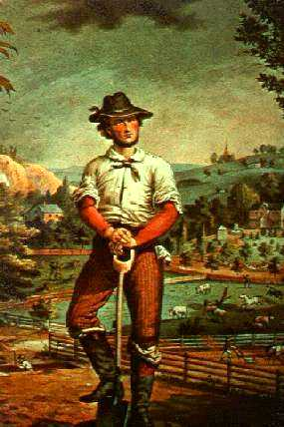
Don’t Tread on Me
Early Americans were practical sorts.
They wanted the Government to deliver the mail, defend the shores, PROTECT MY PROPERTY RIGHTS, and stay the heck out of my life.
That is why most of the early statutes, and the vast majority of case law decisions, were about property.
Property in England was power.
It was the property class that litigated, about their property rights, and it was these disputes that made the law.
So too in America. Although land was much more plentiful here than back in England (one of the main reasons for immigration) property (especially land) meant life. We were an agrarian society, where land translated into food and wealth.

Slide 67
The Development of American Law
1776 American Colonies declare Independence
1777 Articles of Confederation proposed
1783 British and Americans sign the Treaty of Paris, awarding America its Independence.
1787 Colonies convene a Constitutional Convention in Philadelphia
1788 New York is the last state to ratify the Constitution (NC and RI ratify in 1789 and 90)
1789 Newly Elected Federal Government Takes Office
1791 Bill of Rights Ratified
1803 Marbury v. Madison establishes the Doctrine of Judicial Review
1833 Certain States advance the Doctrine of Nullification
1857 Dred Scott v. Sanford declares slaves property
1865 13th Amendment Ratified
1913 16th and 17th Amendments Ratified, and Federal Reserve Established
1942 Supreme Court decides Ex Parte Quirin
1942 Supreme Court decides Wickard v. Filburn
1954 Supreme Court decides Brown v. Board of Education
1992 27th Amendment Ratified

Slide 68
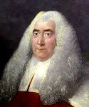
Mr. Blackstone
But with communication slow, with courts far apart and their decisions not available to the masses, what could be done?
Enter Blackstone and his Commentaries on the Law:

Slide 69
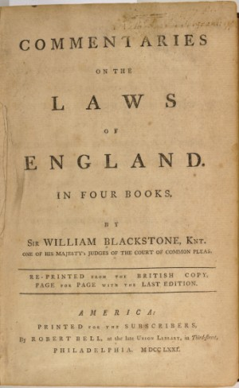
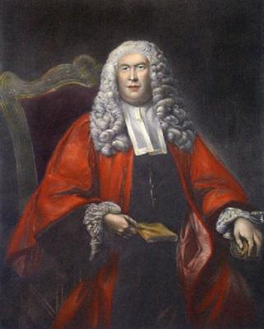
Blackstone’s Commentaries
Sir William Blackstone was an jurist and professor who produced the historical and analytic treatise on the law known as Commentaries on the Law of England.
First published in four volumes between 1765 and 1769. It had an extraordinary success.
A baseline “Bible of the law” of his time, these famous Commentaries still remain an important source on classical views of the common law and its principles.
It was used not only through out England but through out the United States as well.

Slide 70
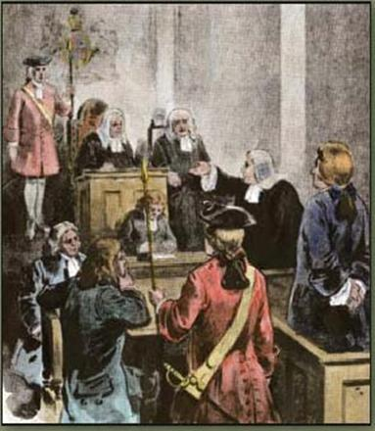
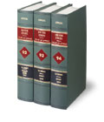
Common (Case) Law in the United States
Over time, the United States, through its State and Federal Courts, began to build a substantial body of law.
This law was reported and memorialized through published decisions of judges, following the concept of precedent, known as Stare Decisis (let the decision stand).
Using the Commentaries of Blackstone, as well as the previous case decisions of Judges, Courts found a bench mark to decide new ones.
Decisions of first impression sought to apply and adapt other legal principles, especially in the cases of equity.

Slide 71
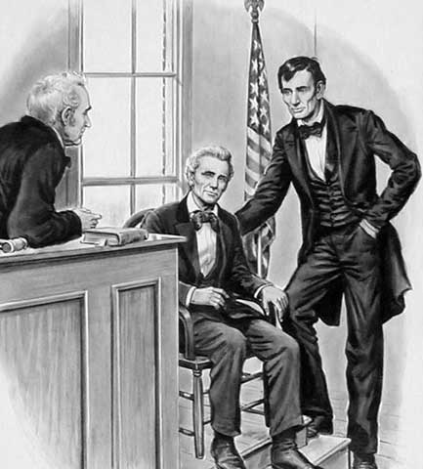
American Jurisprudence
Both British and American law
depended heavily upon custom
as well as precedent
to decide cases.
What was customary, necessary,
practical and popular
found its way into the law
by way of reported court decisions.
With elected judges and empanelled juries
this reflection of society
came to be placed in its law.

Slide 72
Law vs. Equity
In Early America, as in England, Courts were divided between law and equity.
Courts of Law had jurisdiction over money matters.
Equity Courts had jurisdiction over injunctive relief (non money matters)
Especially with equity cases, the social American norms of fundamental fairness crept into the cases to decide the outcomes.
By 1800, the Courts of Law and Equity were merged in most jurisdictions.

Slide 73
Most Lawsuits in Early America
Involved Property Rights
Regardless of the claim, until the later part of the 20th century, litigation was rare and utilized almost exclusively, by the wealthy over serious disputes.
Most often these issues were over property.
As a result, Property rights decided the law, shaped the law, and were shaped and formed by it.
Therefore it can therefore easily be seen
that most law involving property rights is state law, and that property and the law evolved together
and are intertwined.

Slide 74
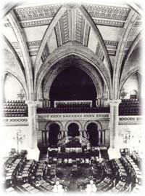
The Rise of Legislation
As America grew in its separation from England,
and its young state legislatures began to deliver
on the representational needs of their constituents,
our national aversion to statutes began to ease.
As a result, after the turn of the 19th century,
state legislatures began to become more active,
gradually enacting more laws through codification
(statutory enactment) then was developed through
case law by litigation.
Property rights as in court decisions, became a major concern
of state legislatures, and as such, incumbent with this growth in
statutory enactments, a significant body of statutes regarding
property rights joined that already in place under the common law

Slide 75
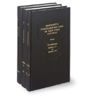
Use Both Belts and Suspenders
Today Property Rights are protected via two
mechanisms in the law – case (common law) and
statutes enacted by the state legislature.
In New York State, a line of case law dating back
from colonial times protects private property rights.
Additionally, a series of state statutes, enacted by
the New York State legislature, also provides a
wide array of property protections for personal
property rights.
Lastly, the New York State and United States Constitutions
also protect many private and public property rights
providing a three tier protection level for every citizen.
Accordingly nearly all property law is state law.

Slide 76
Property is a Fundamental Right
Property is a foundational element of all law.
To truly understand property, it is necessary to think of it in terms of a collection of rights, not a collection of things.
Property rights are the very lynchpin of our liberty: They form a fundamental element of our freedom.
Under our system of laws, property rights reside in the individual: They are personal and unique.
Long recognized as inherent to our humanity,
our right to exclude, possess, use and transfer private property,
is a quintessential component that defines our modern society
and its quality of life.

Slide 77
Property is a Fundamental Right Protected by Law
Ours is a nation of laws, not a nation of men.
Think about freedom and you ultimately get back to property rights.
The unrestrained use and enjoyment of property is ingrained in our very being as Americans.
Recognize property rights, and you promote freedom.
Protect property rights and you facilitate liberty.
Take away property rights, and you take away an individual’s freedom.
Limit property rights, and you limit an individual’s liberty.
Restrict or impair property rights, and you diminish a person’s quality of life.

Slide 78
The Intertwinement of Property Rights and the Law
Last time we spoke of the evolution of Rights – how they came to develop into what we see today.
Our Simple Definition of Right:
The Legally recognized ability to exercise power and control
We then discussed, how to protect those rights, such as property, governments were instituted amongst men, to develop laws.
Our Simple Definition of Law:
Rules by which civilization is ordered
Our legal history then evolved laws to protect our rights, that in the Anglo-American system, focused on the rights of the individual.

Slide 79
The Intertwinement of Property Rights and the Law
Earlier we saw how our Anglo-American law developed from:
Rome: A concept of continuity – the legal system built the empire
Early England: A Roman colony governed by respect for the law
Norman England: Feudalism where reciprocal oaths became rights
Medieval England: Rights & liberties were embodied by the Magna Carta
Enlightenment England: The rise of the Common law and English rights
Colonial America: The rights of Englishmen transformed to Americans
The Early United States: Constitutional rights & transported Common law
The Mature United States: Constitution, Common law & the rise of statutes

Slide 80
The Development of American Property Rights and Law
Part A: The Legal Importance of America’s and New York’s
Legacy of Distrust of Power
Property Rights = Freedom: The Founders understood that the lynchpin of liberty was the proper management of power.
A Practical First Hand Experience: This was not just a philosophical understanding, born from reasoned scholarship in the enlightenment. It was a practical, first hand understanding as well.
America – A Freedom Laboratory: As witness to history, the founders saw with their own eyes, as America was transformed. From 1763 to 1776, the American Colonies transitioned from a prosperous, free and growing land, to that of a jurisdiction facing the wrath of the most powerful nation on earth.

Slide 81
The Development of American Property Rights and Law
Part A: The Legal Importance of America’s and New York’s
Legacy of Distrust of Power – Protecting Rights
Founders Understood – Government’s Purpose is to Protect Rights: From the very beginning it was all about rights and building a legal system to protect those rights.
Property Rights are Key to Freedom: The first of all those rights in the minds of our founders, was always property.
The Meaning of Property: For as we know by now, property is a collection of rights, not a collection of things.
Government of Law Not Men: The building of freedom and liberty, and allowing the free exercise of those property rights, meant a need for a government of law, not men, that would respect and protect rights, and was limited with true checks and balances and separation of powers.

Slide 82
The Development of American Property Rights and Law
Part 7: The Declaration of Independence – Spawning A Nation
Declaration of Independence:
The Declaration created a nation of ideals:
A nation of laws and not men.
A nation evolved from the principles of the enlightenment.
It outlined a concept of principles, not finalized government.
Unrealized until the War was Won.
Would have never worked without the personalities involved.
A special time in history.

Slide 83
The Development of American Property Rights and Law
Part 7: The Declaration of Independence – Continued
Declaration of Independence:
The Declaration states that:
“When in the Course of human events it becomes necessary for one people to dissolve the political bands which have connected them with another and to assume among the powers of the earth, the separate and equal station to which the Laws of Nature and of Nature's God entitle them, a decent respect to the opinions of mankind requires that they should declare the causes which impel them to the separation.
We hold these truths to be self-evident, that all men are created equal, that they are endowed by their Creator with certain unalienable Rights, that among these are Life, Liberty and the pursuit of Happiness. — That to secure these rights, Governments are instituted among Men, deriving their just powers from the consent of the governed, — That whenever any Form of Government becomes destructive of these ends, it is the Right of the People to alter or to abolish it, and to institute new Government, laying its foundation on such principles and organizing its powers in such form, as to them shall seem most likely to effect their Safety and Happiness”
These are perhaps the most beautiful and personally empowering words in human history.

Slide 84
The Development of American Property Rights and Law
The Federal Constitution’s Separation of Powers
The Key to Liberty: The founders felt that freedom and liberty of the individual are best preserved by limited government, where sovereignty vests in the people not the government, and which is in a republican form, with three, independent, separate branches.
The Key to Understanding Property: To understand property, it must be seen through a prism of rights. Such requires an understanding of:
what a right is,
what the law is that protects property rights, and
how protecting property rights an essential element to freedom.
Freedom + Protection of Property Rights: The founders understood, that if you want freedom, set up a system to protect property rights. That system requires the power of government to be limited, and it express purpose to be to protect and not infringe on people’s rights.
“A government big enough to give you everything you want, is also big enough to take from you everything you have.” Gerald R. Ford – Address to Congress – August 12, 1974.

Slide 85
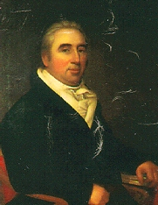
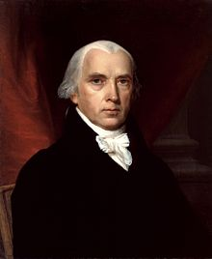
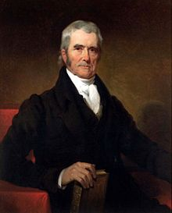
A Venture into Critical Case Law
The Case of Marbury v. Madison
William Marbury James Madison John Marshall
The Decision that Changed the Legal World!

Slide 86
Thank you for Coming
Bonus Question of the Day
For next time – Review Assignments on the Webpage
We are a hot bench.
Questions?

